Slide 1
ATMOSPHERIC PHYSICS AND WEATHER
EART23001
Week 3 — Physics of the Atmosphere
Professor Paul Connolly
p.connolly@manchester.ac.uk • Simon Building 3.08

Slide 2
Today's Session
Physics of the Atmosphere • approx. 110 minutes
0:00
The ideal gas law for air, the constants we'll use, and where R_{d} comes from
0:15
Quick checks: density from p and T, and checking the units
0:21
Dalton's law and partial pressures
0:29
The first law of thermodynamics, and what “adiabatic” means
0:42
Adiabatic cooling in the real world, then a rising parcel does work and cools
0:56
IN-CLASS DISCUSSION 1 — a rising parcel expands and cools adiabatically
9 min
1:05
Latent heat: a much bigger energy reservoir
1:12
Comparing temperatures fairly: potential temperature, and reading stability from θ
1:22
IN-CLASS DISCUSSION 2 — potential temperature and atmospheric stability
9 min
1:31
What this means for pollution and weather ↔ EART22001
1:37
Why stability matters beyond today
1:41
A quick look ahead: Wien's law
1:46
Wrap-up and looking ahead to Week 4
EART23001 Atmospheric Physics & Weather | Week 3

Slide 3
The Ideal Gas Law for Air
PART 1 OF 3
From a universal constant to the number we use every week
⏱ 0:04 – 0:29
EART23001 Atmospheric Physics & Weather | Week 3

Slide 4
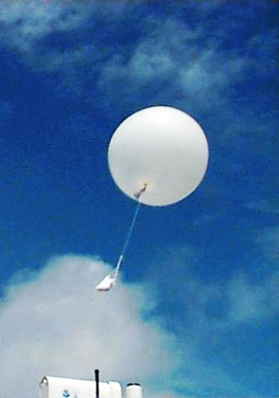
The Ideal Gas Law, Written for Air
Ideal gas law
• For dry air, the ideal gas law is usually written as:
  – p = ρR_{d}T
• p is pressure (Pa), ρ is density (kg m⁻³), T is temperature (K), and R_{d} is the specific gas constant for dry air.
  – R_{d} = 287 J kg⁻¹ K⁻¹ — worth committing to memory, since we'll use it constantly from here on.
• This links the three quantities you can most easily measure or estimate for a parcel of air — exactly the three we've been discussing since Week 1.
EART23001 Atmospheric Physics & Weather | Week 3

Slide 5
The Constants We'll Use All Course
Reference
• R_{d} = 287 J kg⁻¹ K⁻¹ — specific gas constant, dry air.
• c_{p} = 1004 J kg⁻¹ K⁻¹ — specific heat capacity of dry air at constant pressure.
• L_{v} ≈ 2.5 × 10⁶ J kg⁻¹ — latent heat of vaporisation.
• b = 2.898 × 10⁻³ m K — Wien's constant.
  – These four numbers will reappear constantly for the rest of the course — today's lecture is where all four first earn their place.
EART23001 Atmospheric Physics & Weather | Week 3

Slide 6
Two Ways to Write the Ideal Gas Law
Ideal gas law — where R_{d} comes from
• Chemists usually write the ideal gas law in molar form:
  – pV = nR*T, R* = 8.314 J mol⁻¹ K⁻¹ (the universal gas constant)
• n is the number of moles. For a fixed gas of molar mass M_{d}, n = m/M_{d}, so:
  – pV = (m/M_{d}) R*T
• Dividing through by V and using ρ = m/V turns this into the form we actually use for air.
EART23001 Atmospheric Physics & Weather | Week 3

Slide 7
Where Does R_{d} Come From?
Ideal gas law — the derivation
• Rearranging the previous slide's result:
  – p = ρ (R*/M_{d}) T ⟹ R_{d} ≡ R*/M_{d}
• Dry air's molar mass is M_{d} ≈ 28.97 × 10⁻³ kg mol⁻¹, so:
  – R_{d} = 8.314 / (28.97 × 10⁻³) = 287.0 J kg⁻¹ K⁻¹
• So R_{d} isn't an independent fact to memorise blindly — it's the universal gas constant, repackaged for one specific gas mixture.
EART23001 Atmospheric Physics & Weather | Week 3

Slide 8
The Molecular Origin: Kinetic Theory
Ideal gas law — why it holds at all
• Zoom in far enough, and pressure is just the constant hail of molecular collisions on a surface — kinetic theory derives p directly from that picture:
– p = (1/3)(N/V) m⟨v²⟩ for N molecules of mass m in volume V, mean-square speed ⟨v²⟩
• Comparing this with the ideal gas law, pV = NkT, shows the mean kinetic energy per molecule is set only by temperature:
– (1/2)m⟨v²⟩ = (3/2)kT
• k = 1.381×10⁻²³ J K⁻¹ is Boltzmann's constant — literally the universal gas constant per molecule: k = R*/N_{A} (N_{A} = Avogadro's number).
• So R_{d}, R*, and k are the same physical constant, just repackaged for one gas (R_{d}), one mole (R*), or one molecule (k) — temperature is, at bottom, a measure of average molecular kinetic energy.
EART23001 Atmospheric Physics & Weather | Week 3

Slide 9
Quick Check: Density From p and T
Ideal gas law — worked example
• Air has pressure 985 hPa and temperature 288 K. What's its density?
  – ρ = p/(R_{d}T) = 98500/(287 × 288) = 1.19 kg m⁻³
• Compare that with the value we've been using since Week 2 (ρ₀ = 1.20 kg m⁻³ at sea level) — a useful sanity check that the number is the right order of magnitude for near-surface air.
EART23001 Atmospheric Physics & Weather | Week 3

Slide 10
Checking Units: Does R_{d}'s Value Make Sense?
Ideal gas law
• It's worth pausing on units, not just numbers: R_{d} carries units of J kg⁻¹ K⁻¹ — energy per unit mass per unit temperature.
• Rearranged as R_{d} = p/(ρT), the units check out directly: Pa / (kg m⁻³ × K) = J kg⁻¹ K⁻¹.
  – This is a habit worth keeping for the rest of the course: whenever a formula's result looks surprising, check the units before you check the arithmetic.
EART23001 Atmospheric Physics & Weather | Week 3

Slide 11
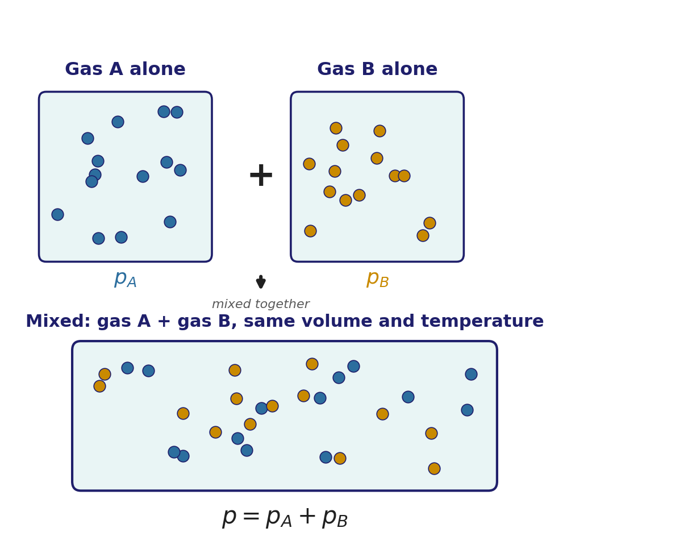
Dalton's Law: Sharing the Pressure
Dalton's law
• For a mixture of ideal gases, the total pressure is the sum of each gas's own partial pressure:
  – p = Σᵢ pᵢ, pᵢ = xᵢ p
• xᵢ is the mole fraction of gas i. Each gas behaves as if it alone filled the container — the mixture doesn't change how any one constituent behaves.
• This might look abstract, but you've already used it implicitly: Week 2's “78.08% N₂, 20.95% O₂” compositions are mole fractions, and this is the law that lets us convert them into pressures.
EART23001 Atmospheric Physics & Weather | Week 3

Slide 12
Quick Check: Partial Pressures of N₂ and O₂
Dalton's law — worked example
• At total pressure 1000 hPa, with 78.08% N₂ and 20.95% O₂ by mole fraction:
  – p_{N2} = 0.7808 × 1000 = 780.8 hPa
  – p_{O2} = 0.2095 × 1000 = 209.5 hPa
• Together: 780.8 + 209.5 = 990.3 hPa — about 99.0% of the total. The remaining ~1% is mainly argon, with smaller contributions from everything else.
EART23001 Atmospheric Physics & Weather | Week 3

Slide 13
Why Dalton's Law Matters for Moist Air
Dalton's law — looking ahead
• Dalton's law is what lets us treat dry air and water vapour separately, even when they're mixed together in the same parcel:
  – p = p_{d} + e
• e is the water-vapour partial pressure — the quantity behind everything we'll do with humidity from Week 7 onwards.
  – Keep p_{d} and e in mind: they're the same two symbols we'll build relative humidity, mixing ratio and the whole of Week 7 out of.
EART23001 Atmospheric Physics & Weather | Week 3

Slide 14
Adiabatic Processes and the First Law
PART 2 OF 3
Where last week's cooling formula actually comes from
⏱ 0:29 – 1:12
EART23001 Atmospheric Physics & Weather | Week 3

Slide 15
The First Law of Thermodynamics
First law
• Using the sign convention where pdV is work done by the parcel on its surroundings:
  – dU = δQ − p dV
• dU — change in internal energy. δQ — heat added to the parcel. p dV — work the parcel does by expanding.
• For an ideal gas, internal energy depends only on temperature — so anything that changes U changes T.
EART23001 Atmospheric Physics & Weather | Week 3

Slide 16
Sign Convention Cheat-Sheet
First law — quick reference
• δQ > 0 : heat flows into the parcel. δQ = 0 : no heat exchange (adiabatic).
• dV > 0 : the parcel expands, and does positive work on its surroundings (p dV > 0).
• dV < 0 : the parcel is compressed; its surroundings do work on it instead.
  – Rising air is always the dV > 0 case in this course — keep that one fixed in mind and the rest follows.
EART23001 Atmospheric Physics & Weather | Week 3

Slide 17
Heat Capacities: C_{v} and C_{p}
First law — two useful special cases
• At constant volume (dV = 0), the first law hands all the heat straight to internal energy:
– C_{v} ≡ (δQ/dT)_{V} = dU/dT
• At constant pressure, some of the heat also does expansion work, so more heat is needed for the same temperature rise — Mayer's relation:
– C_{p} = C_{v} + R* (per unit mass: c_{p} = c_{v} + R_{d})
• For dry air: c_{v} ≈ 717 J kg⁻¹ K⁻¹, so c_{p} = 717 + 287 = 1004 J kg⁻¹ K⁻¹ — exactly the c_{p} constant from earlier in this lecture, not a separate number to memorise.
• This is exactly why the dry-adiabatic exponent uses c_{p} specifically (n = R_{d}/c_{p}): a rising parcel expands against a changing environmental pressure, so it's the constant-pressure heat capacity that sets how much it cools per unit of work done.
EART23001 Atmospheric Physics & Weather | Week 3

Slide 18
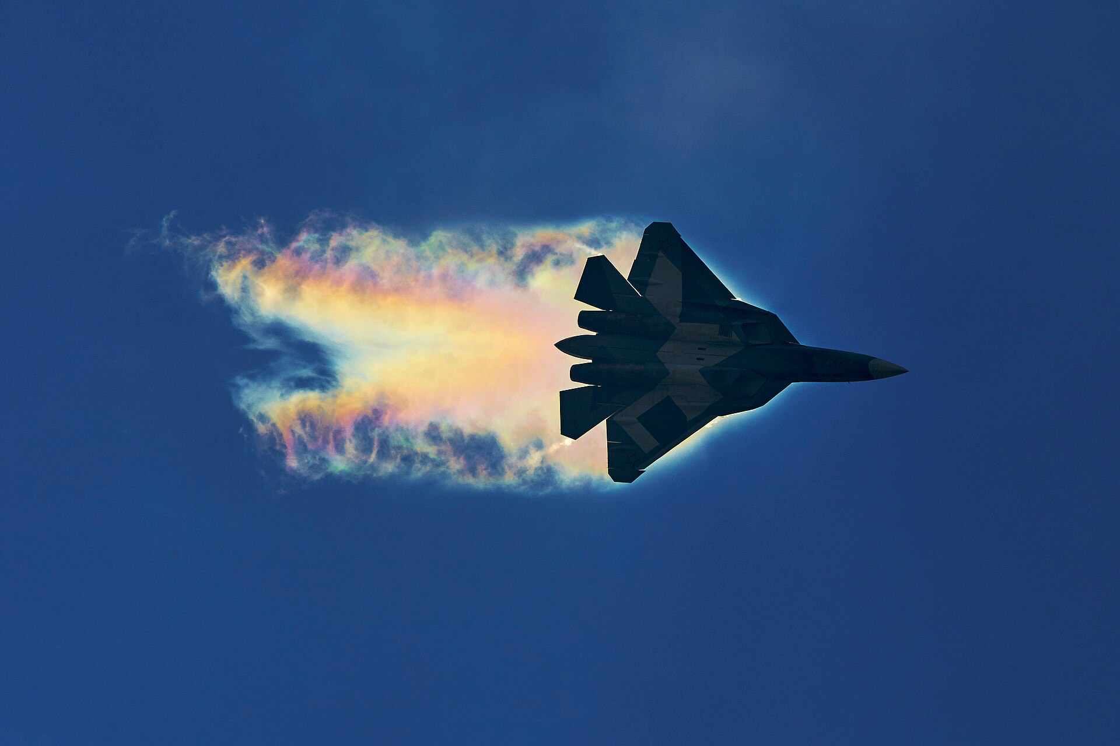
What Does “Adiabatic” Mean?
First law
• Adiabatic means negligible heat transfer between the parcel and its environment: δQ = 0.
• It does not mean the parcel is thermally isolated forever — it's an approximation for one process, not a permanent property of the air.
• Air is, after all, a fairly good insulator — conduction between a parcel and its surroundings is slow compared with many atmospheric motions.
EART23001 Atmospheric Physics & Weather | Week 3

Slide 19
Why Adiabatic Is a Good Approximation
First law — a timescale argument
• The approximation holds whenever vertical motion happens faster than conductive or radiative heat exchange can equalise temperatures.
• A convective updraught can cross a kilometre in a couple of minutes; conducting a meaningful amount of heat across even a few centimetres of still air takes far longer than that.
  – So the fast-moving parcel simply doesn't have time to exchange much heat with its surroundings before it has already risen, expanded, and cooled — which is exactly why treating δQ ≈ 0 works so well for weather-scale motion.
EART23001 Atmospheric Physics & Weather | Week 3

Slide 20
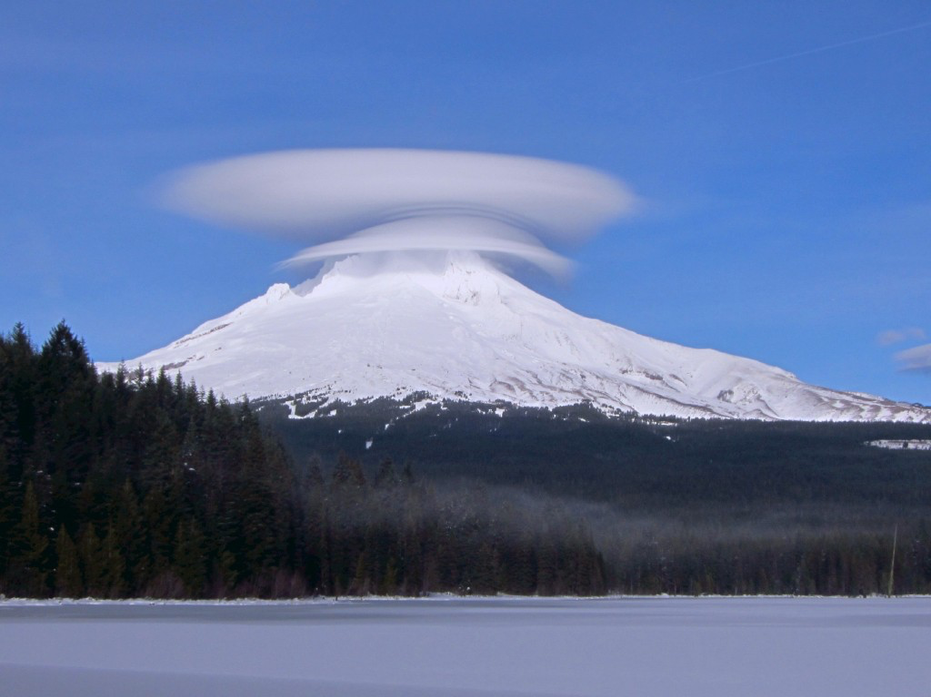
Adiabatic Cooling, Made Visible
First law — a real-world example
Air forced up and over a peak expands and cools adiabatically until it condenses into a lens-shaped cloud — the same p, V, T relationship as a rising parcel, just forced by terrain instead of buoyancy.
EART23001 Atmospheric Physics & Weather | Week 3

Slide 21
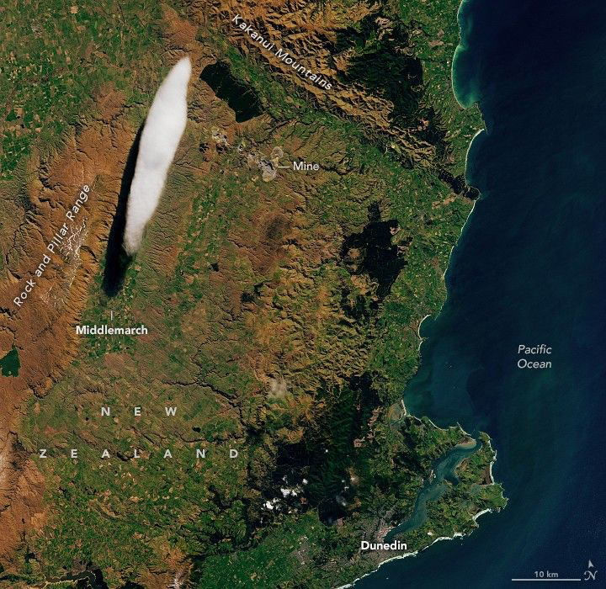
The Same Physics, Seen From Orbit
First law — the same physics from space
A wave cloud over the Rock and Pillar Range, New Zealand, imaged by Landsat — orographic waves like the one on the previous slide are large enough to show up from space. (NASA Earth Observatory)
EART23001 Atmospheric Physics & Weather | Week 3

Slide 22
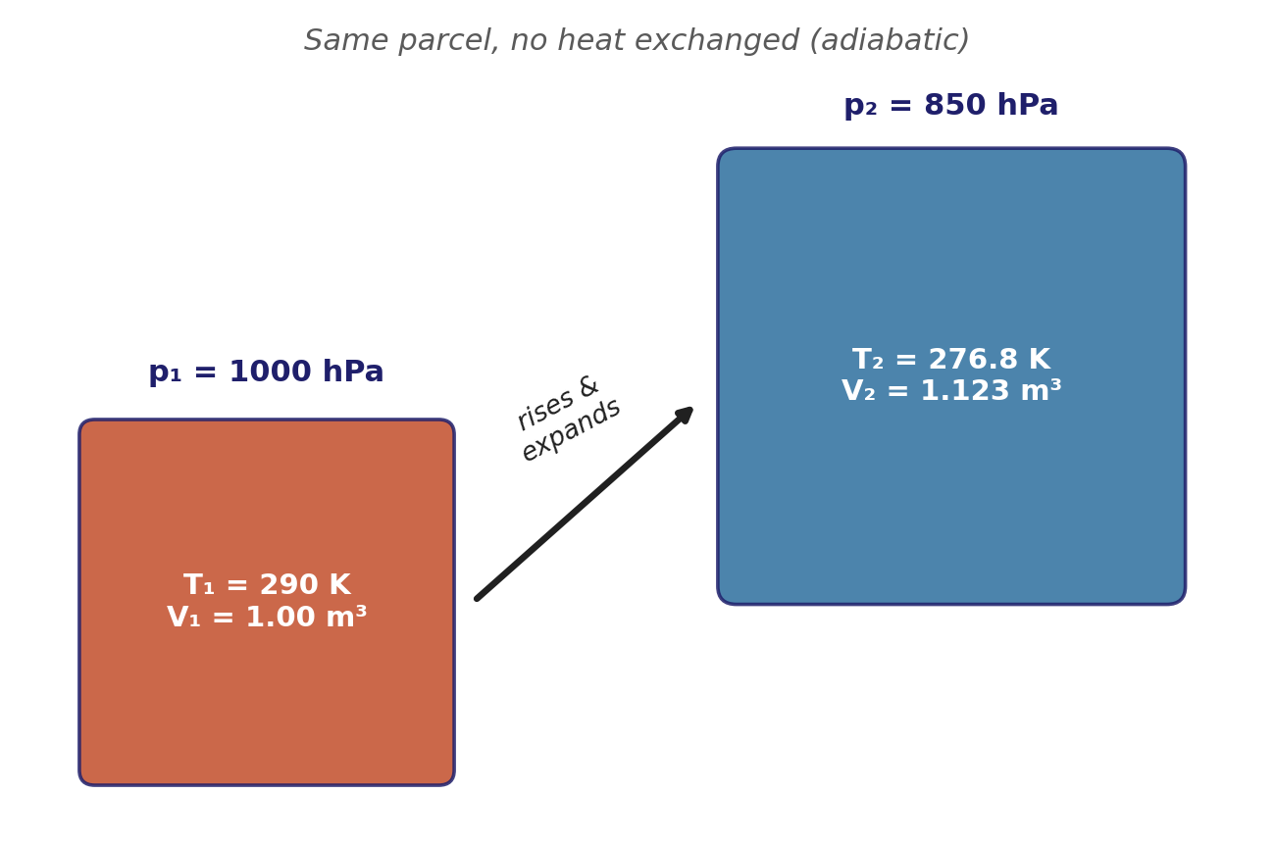
A Rising Parcel Does Work — and Cools
First law
• Put the pieces together for a rising parcel: it moves into lower-pressure surroundings, so it expands — dV > 0.
  – With δQ = 0: dU = −p dV < 0
• Internal energy falls — and since U depends only on T for an ideal gas, temperature falls too.
• Physically: the parcel spends energy doing work on its surroundings as it pushes outward, and that energy has to come from somewhere — its own internal (thermal) energy.
EART23001 Atmospheric Physics & Weather | Week 3

Slide 23
From the First Law to a Formula
First law — the equation you used last week
• Solving the first law for an ideal gas undergoing a dry adiabatic process gives a clean power-law relationship between temperature and pressure:
  – T₂ = T₁ (p₂/p₁)^{n}, n = R_{d}/c_{p} = 287/1004 ≈ 0.286
• This is exactly the formula Week 2 handed you as a preview, with no explanation of where it came from — now you have it: it's the first law, rewritten for a dry, adiabatic parcel.
↔ EART22001 If you're taking EART22001, you're solving this exact parcel-in-a-container problem this same week — with a Köhler-equation aerosol term added on top.
EART23001 Atmospheric Physics & Weather | Week 3

Slide 24
A rising parcel expands and cools adiabatically
IN-CLASS DISCUSSION 1
• A sealed, flexible dry-air parcel starts at V₁ = 1.00 m³, p₁ = 1000 hPa, T₁ = 290 K. It rises to p₂ = 850 hPa. Assume dry adiabatic motion, T₂ = T₁(p₂/p₁)^{0.286}.
• 1. Calculate the parcel temperature T₂.
• 2. Using pV/T = constant for a fixed amount of gas, calculate V₂.
• 3. Calculate the parcel density at the start and at the upper level.
• 4. Explain physically why the parcel both expands and cools as it rises.
✍ Discuss in pairs, then we'll take answers
Worked-answers sheet, Week 3 — IN CLASS Question

Slide 25
A rising parcel expands and cools — worked answer
WORKED ANSWER — DISCUSSION 1
• T₂ = 290 × (850/1000)^{0.286} = 276.8 K.
• V₂ = V₁ × (p₁/p₂) × (T₂/T₁) = 1.00 × (1000/850) × (276.8/290) = 1.123 m³.
• ρ₁ = 100000/(287 × 290) = 1.20 kg m⁻³. ρ₂ = 85000/(287 × 276.8) = 1.07 kg m⁻³.
  – The environmental pressure falls with height, so the flexible parcel expands until its own pressure matches its surroundings. Expanding means doing work on the environment; with no heat coming in to pay for that work, the energy is drawn from the parcel's internal energy, so its temperature falls.
EART23001 Atmospheric Physics & Weather | Week 3

Slide 26
Latent Heat: A Much Bigger Reservoir
First law — why moisture changes everything
• Warming 1000 kg of dry air by 5.0 K at constant pressure needs:
  – Q = mc_{p}ΔT = 1000 × 1004 × 5.0 = 5.02 × 10⁶ J ≈ 5.0 MJ
• Condensing just 10 kg of water vapour releases:
  – Q = mL_{v} = 10 × 2.5 × 10⁶ = 2.5 × 10⁷ J = 25 MJ
  – That's about five times more energy, from a tiny fraction of the parcel's mass. This is why phase changes of water can dominate atmospheric energetics even though water vapour is only ever a minor constituent by mass — a theme that returns with real force in Weeks 8 and 9.
EART23001 Atmospheric Physics & Weather | Week 3

Slide 27
Beyond the First Law
First law — the other laws, briefly
• The First Law only says energy is conserved — it doesn't say which direction a process actually runs, or which processes are even possible.
• The Second Law supplies that direction: for an isolated system, entropy S can never decrease. Heat flows spontaneously hot → cold, never the reverse; a truly reversible process is the idealised limit where dS = 0.
– A dry-adiabatic, reversible process is exactly this idealised case — which is precisely why the potential temperature θ in Part 3 is conserved along it: for an ideal gas, dS = c_{p} d(ln θ), so “isentropic” and “θ = constant” mean the same thing.
• The Third Law fixes an absolute zero-point for entropy: S → a well-defined minimum as T → 0 K. Not used directly in this course, but it's what makes entropy an absolute quantity rather than only ever a difference.
• (For completeness) The Zeroth Law is what makes “temperature” itself well-defined: two systems each in equilibrium with a third are in equilibrium with each other.
EART23001 Atmospheric Physics & Weather | Week 3

Slide 28
Potential Temperature and Stability
PART 3 OF 3
A fair way to compare temperatures at different heights
⏱ 1:12 – 1:46
EART23001 Atmospheric Physics & Weather | Week 3

Slide 29
Comparing Temperatures Fairly
Potential temperature — why height isn't enough
• Temperature normally falls with height — but we already know a rising, unsaturated parcel cools adiabatically even with no heat exchanged at all.
• So a simple temperature comparison between two heights conflates two different effects: the environment's real thermal structure, and the purely mechanical cooling any parcel would show just from being at lower pressure.
• We need a variable that removes the second effect, so what's left over reflects only genuine thermal structure.
EART23001 Atmospheric Physics & Weather | Week 3

Slide 30
Potential Temperature, θ
Potential temperature
• Potential temperature is the temperature a parcel would have if brought dry-adiabatically to a reference pressure of 1000 hPa:
  – θ = T (1000 hPa / p)^{0.286}
• Notice the exponent: it's the same R_{d}/c_{p} ≈ 0.286 from Part 2 — θ is built directly out of the dry adiabatic relationship, just anchored to a fixed reference level instead of comparing two arbitrary heights.
• Crucially, θ is conserved for a parcel moving dry-adiabatically — it doesn't change just because the parcel rises or sinks.
EART23001 Atmospheric Physics & Weather | Week 3

Slide 31
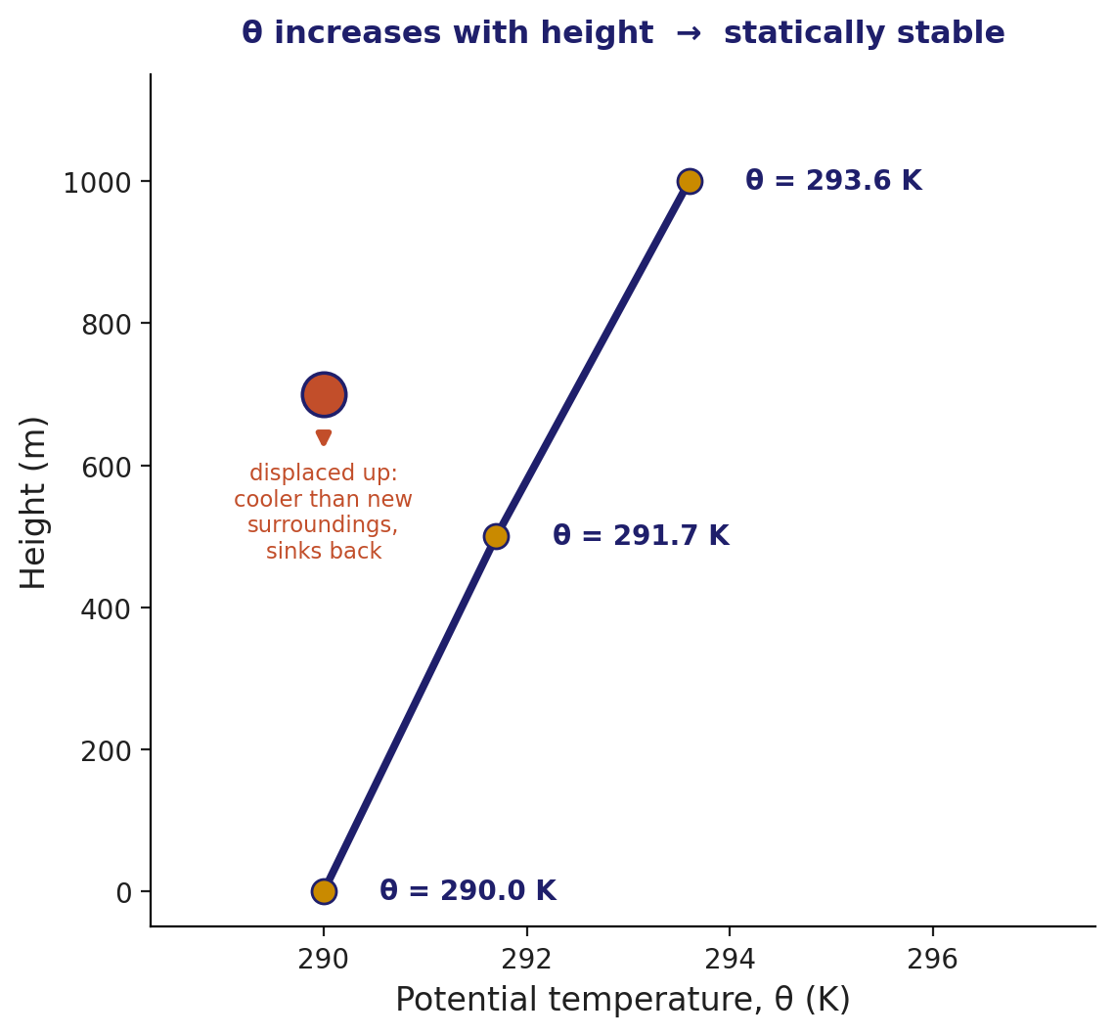
Reading Stability From θ
Potential temperature — the rule
• Because θ strips out the adiabatic effect, comparing θ at different heights tells us about the environment's real stability:
  – θ increasing with height → statically stable — a displaced parcel returns to where it started.
  – θ constant with height → neutral — a displaced parcel has no restoring force either way.
  – θ decreasing with height → statically unstable — a displaced parcel keeps moving further from where it started.
• The physical reason: a parcel conserves its own θ as it moves, so if the environment's θ rises faster with height than the parcel's, the parcel ends up colder — and denser — than its new surroundings, and sinks back.
EART23001 Atmospheric Physics & Weather | Week 3

Slide 32
Quick Check: A Simple Case
Potential temperature — worked example
• Suppose a layer has T = 300 K at p = 1000 hPa, and T = 300 K again at p = 900 hPa — the same temperature at both levels.
  – θ at 1000 hPa = 300 K. θ at 900 hPa = 300 × (1000/900)^{0.286} ≈ 308.7 K.
• Even though the raw temperature didn't change at all, θ increased with height — this layer is statically stable. That's the whole point of using θ rather than T.
EART23001 Atmospheric Physics & Weather | Week 3

Slide 33
Potential temperature and atmospheric stability
IN-CLASS DISCUSSION 2
• Height (m): 0 500 1000
• p (hPa): 1000 945 890
• T (K): 290 287 284
• Calculate θ = T(1000 hPa/p)^{0.286} at each level.
• Classify the layer as statically stable, neutral or unstable.
• Explain what this implies qualitatively for the vertical spread of a passive pollutant plume.
✍ Discuss in pairs, then we'll take answers
Worked-answers sheet, Week 3 — IN CLASS Question

Slide 34
Potential temperature and stability — worked answer
WORKED ANSWER — DISCUSSION 2
• θ₀ = 290.0 K.
• θ₅₀₀ = 287 × (1000/945)^{0.286} = 291.7 K.
• θ₁₀₀₀ = 284 × (1000/890)^{0.286} = 293.6 K.
  – θ increases with height, so the layer is statically stable. A vertically displaced dry parcel keeps approximately its own θ, so it tends to become negatively buoyant if pushed up and positively buoyant if pushed down — resisting vertical motion either way.
  – For a passive plume, that means reduced vertical dispersion compared with a neutral or unstable boundary layer: the plume stays flatter and more layered, rather than mixing rapidly through a deep column.
EART23001 Atmospheric Physics & Weather | Week 3

Slide 35
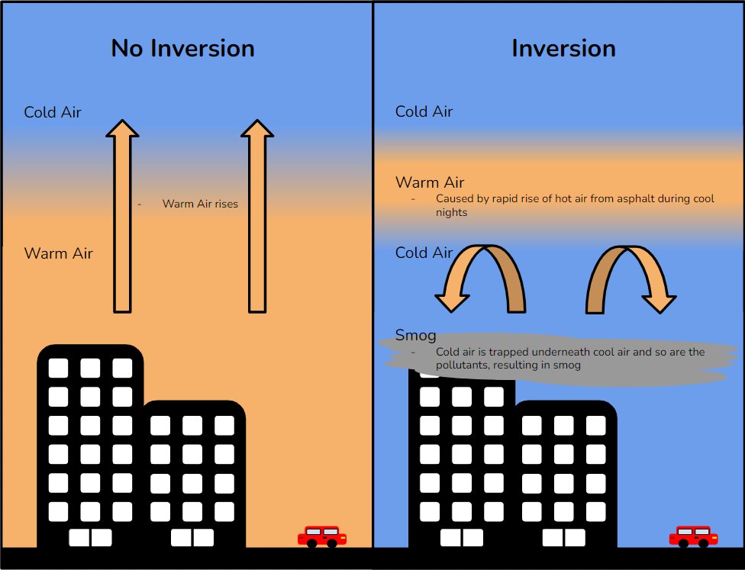
What This Means for Pollution and Weather
Potential temperature — why it matters
• The stability classification you just made is exactly the input a pollution-dispersion model needs before it can say anything about ground-level concentrations downwind of a source.
• A stable layer traps a plume close to its release height; an unstable layer mixes it through a much deeper column, diluting it faster but potentially bringing it to the surface sooner too.
• The same reasoning, one layer at a time, is also what a forecaster uses to anticipate fog (very stable near the surface) or vigorous convection (unstable through a deep layer).
↔ EART22001 EART22001's Gaussian-plume model, coming up in their course next week, uses this exact environmental-vs-parcel comparison to set its stability class — you've just derived the physics behind an input they'll take as given.
EART23001 Atmospheric Physics & Weather | Week 3

Slide 36
Why Stability Matters Beyond Today
Potential temperature — looking ahead
• Today's table was small and clean, hand-picked to make the arithmetic manageable — real soundings have many more levels and messier numbers.
• Week 4 develops the fuller stability framework properly, comparing environmental lapse rates directly against the dry (and later saturated) adiabatic rate.
• Week 8 builds on exactly this idea again for convection: the same θ-based reasoning decides whether a rising parcel keeps accelerating upward or gets pulled back — the difference between a clear afternoon and a thunderstorm.
EART23001 Atmospheric Physics & Weather | Week 3

Slide 37
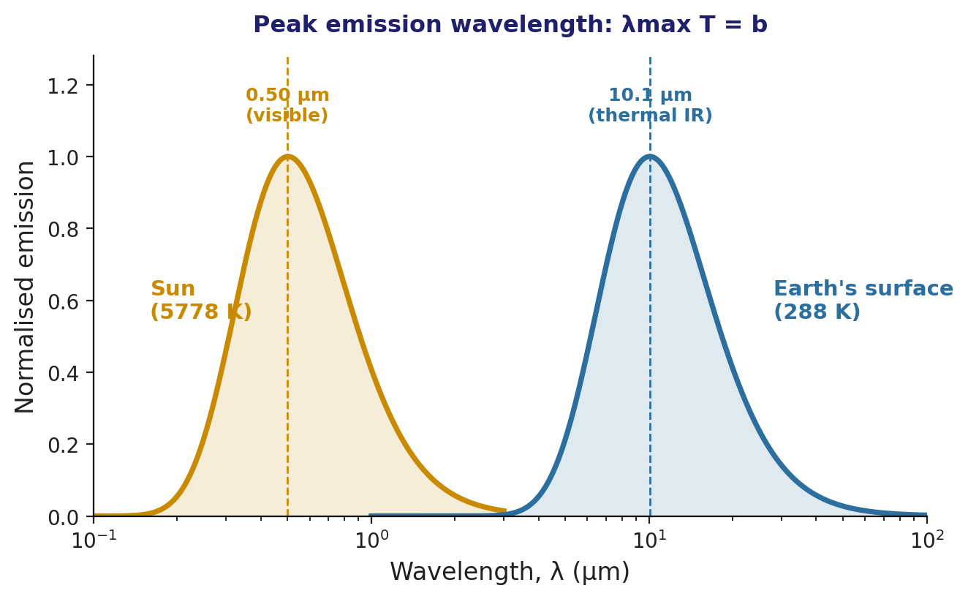
A Quick Look Ahead: Wien's Law
Radiation — a teaser for Week 12
• One more relationship worth planting now: every warm object emits radiation across a spread of wavelengths, peaking at a wavelength set by its temperature:
  – λ_{max} T = b, b = 2.898 × 10⁻³ m K
• For the Sun (T ≈ 5778 K): λ_{max} = 2.898×10⁻³/5778 ≈ 0.50 µm — visible light.
• For Earth's surface (T ≈ 288 K): λ_{max} = 2.898×10⁻³/288 ≈ 10.1 µm — thermal infrared.
  – That huge separation is why we can talk about incoming solar “shortwave” and outgoing terrestrial “longwave” radiation as two nearly non-overlapping bands — the whole framework Week 12's energy balance is built on.
EART23001 Atmospheric Physics & Weather | Week 3

Slide 38
What to Take Away From Today
WRAP-UP
• The ideal gas law for air, p = ρR_{d}T, and R_{d} itself are both just the universal gas constant, repackaged — not facts to memorise blindly.
• Adiabatic motion (δQ = 0) plus the first law explains exactly why rising air cools — the formula you used last week, now derived from physics.
• Latent heat is a far larger energy reservoir than sensible heat for realistic atmospheric masses.
• Potential temperature, θ, lets us compare thermal structure fairly across height, and its slope with height tells us whether a layer is stable, neutral or unstable — a tool we'll reuse constantly.
Next week: Vertical Profiles — hydrostatic balance, and the fuller stability framework.
EART23001 Atmospheric Physics & Weather | Week 3

