Slide 1
Radiosondes
EART23001 ATMOSPHERIC PHYSICS AND WEATHER | WEEK 10
Guest lecture: Dr Hugo Ricketts, National Centre for Atmospheric Science (NCAS)
• Part 1 — Dr Ricketts's own guest lecture: measuring the atmosphere, radiosonde types, and a real 3-day balloon field campaign on Anglesey (8–10 April 2025), unchanged from how he delivers it.
• Part 2 — Reading tephigrams for the exam: taking the real soundings you've just seen and using them to practise the graphical technique (finding the LCL, testing parcel buoyancy) that the exam asks you to do.
EART23001 Atmospheric Physics & Weather | Week 10

Slide 2
SEAtS QR code

Slide 3
Radiosondes
Dr Hugo Ricketts
National Centre for Atmospheric Science
University of Manchester

Slide 4
Overview
Measuring vertical profiles of the atmosphere
Radiosonde types
Launching
Balloon data from Anglesey, 8-10 April 2025
Discussion
Notes:
No launching today, but will show videos.

Slide 5
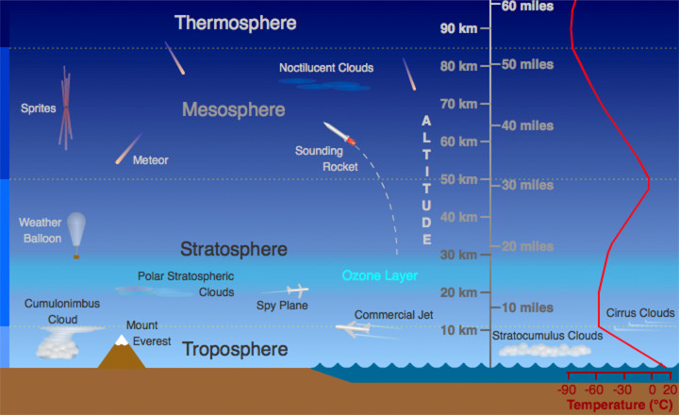
Motivation
Why do we want to measure vertical profiles of the atmosphere?
  To initialise weather forecasting models
    They need to know what the weather is doing now to forecast accurately.
  Observe long-term changes in the atmosphere
    Is the atmosphere warming? Is it becoming moister?
  Research
    E.g. How do clouds form?
https://scied.ucar.edu/image/atmosphere-layers-diagram
Notes:
Lots of measurements at the surface.

Slide 6

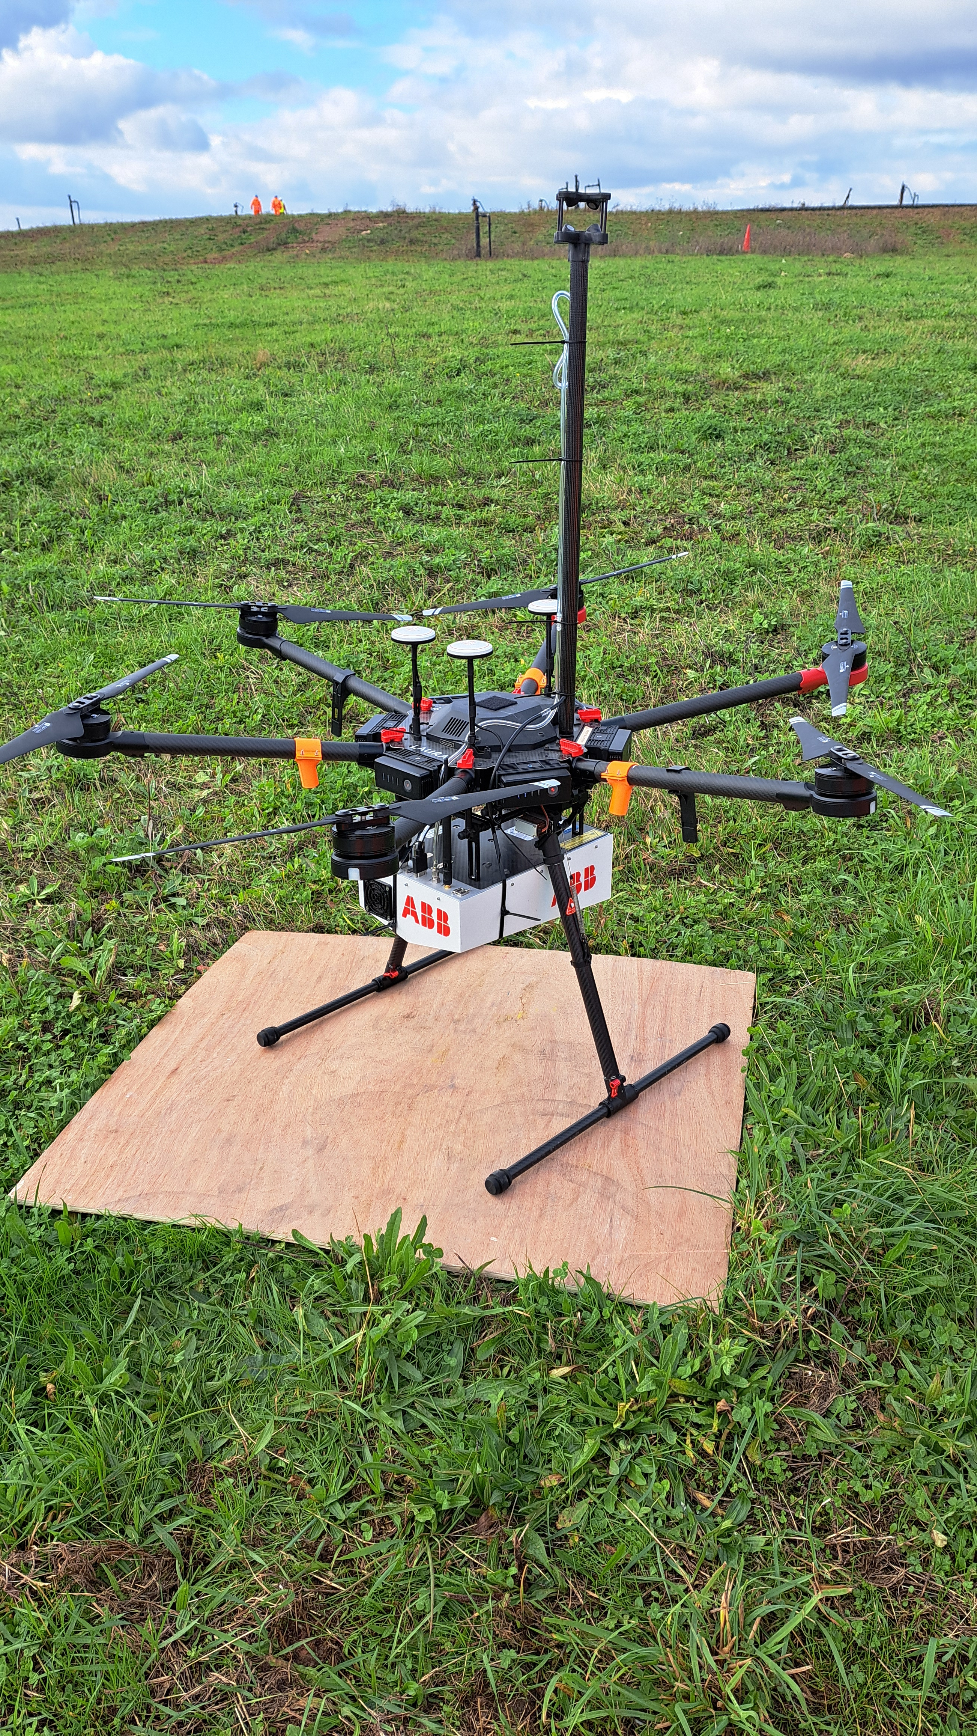
Vertical atmospheric profiles
By Maarten Visser from Capelle aan den IJssel, Nederland - A6-EDY
A380 Emirates 31 jan 2013 jfk, CC BY-SA 2.0,
https://commons.wikimedia.org/w/index.php?curid=56233674
Aircraft
  Commercial airliners broadcast air speed, ground speed, Mach number (ADS-B)
    Used to calculate wind and temperature, but generally only at cruise altitude
  IAGOS fleet: 10 airplanes collecting gas and air quality data - https://www.iagos.org/
    High quality data
  UAVs/drones
    Very versatile, but difficult to fly to high altitude due to regulation and aerodynamics
    (generally max. 6 km, although this is changing…)
Satellites
  Low-orbit limb sounders: detects microwaves to measure water vapour and other gases
    Great spatial coverage. Can cover the whole globe at least once a day.
Photo credit: Kieran Wood

Slide 7
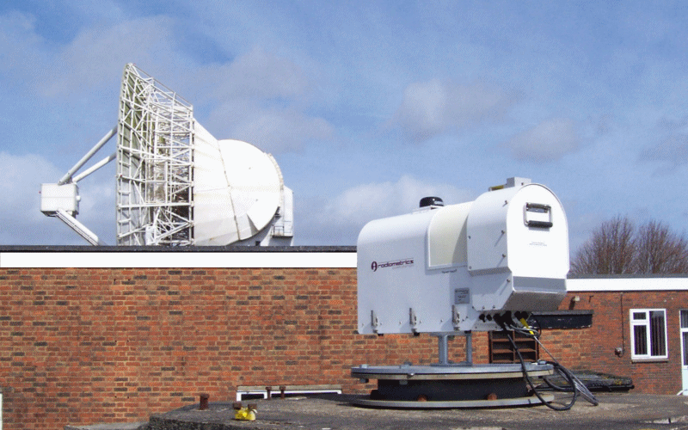
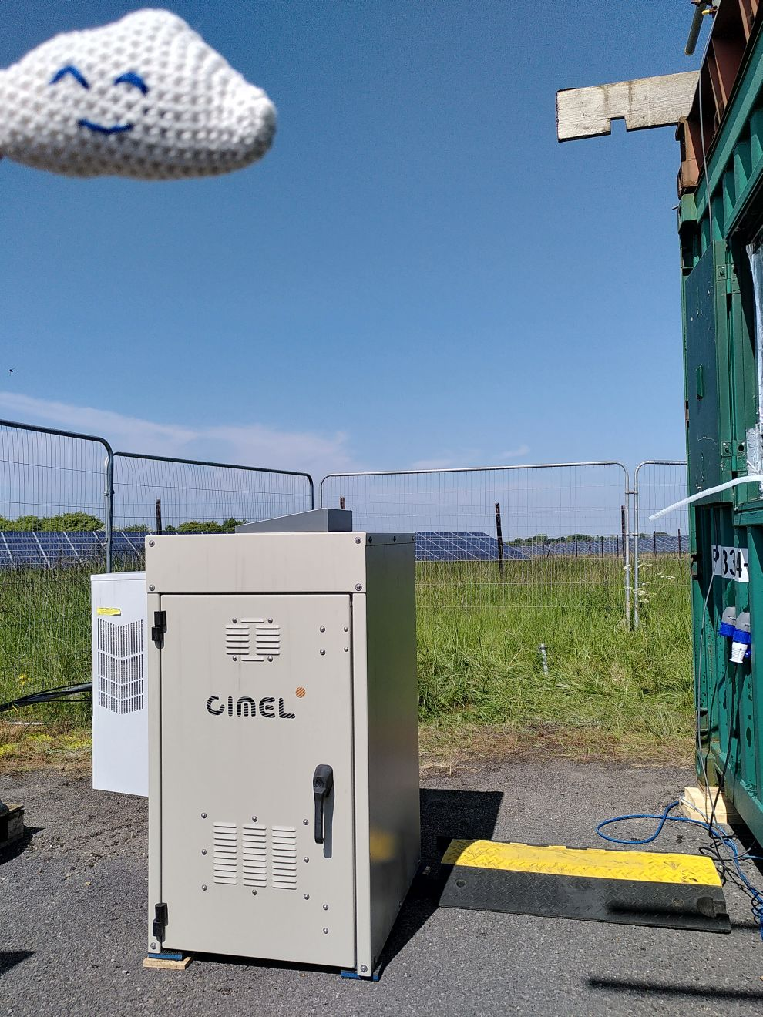
Vertical atmospheric profiles
Chilbolton Observatory webpage
https://www.chilbolton.stfc.ac.uk/Pages/Profiling-Microwave-Radiometer.aspx
Ground-based instruments
  Microwave radiometer: also detects microwaves to measure temperature and humidity
  Lidar: Uses a laser beam. Mostly used to detect cloud and aerosol, but can also be used to measure temperature and humidity.
Radiosondes
  Gives a high resolution profile of temperature, humidity, pressure and wind
Let’s take a look!

Slide 8
Radiosonde types
Windsond
Vaisala RS92 (old)
Vaisala RS41 (new)
Ozonesonde

Slide 9
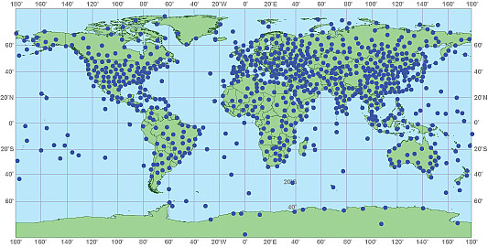
Weather balloons/radiosondes
Where are they launched from?
  Approximately 1,300 locations
When are they launched?
  Once or twice a day
How are they launched?
  (video)
Why are they launched?
Image credit: https://www.noaa.gov/jetstream/upperair/radiosondes

Slide 10
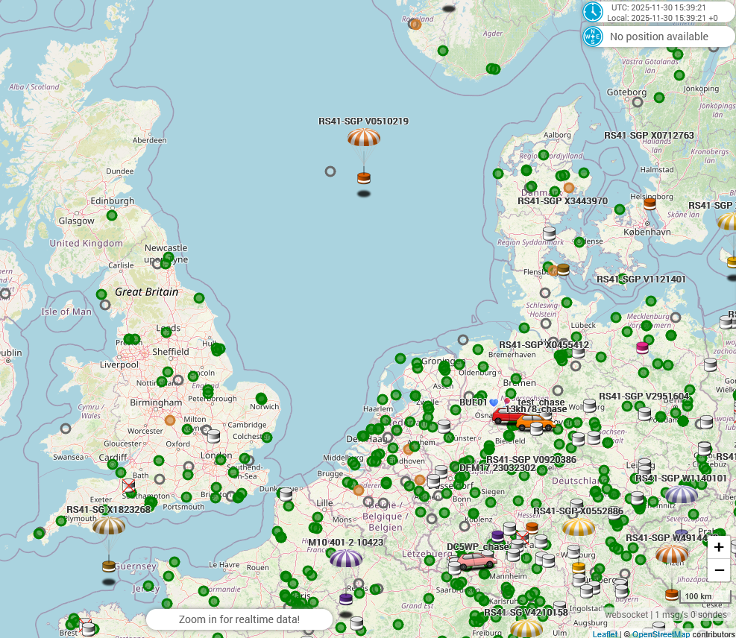
Sondehub
Live sonde tracking by the community
  https://sondehub.org/

Slide 11
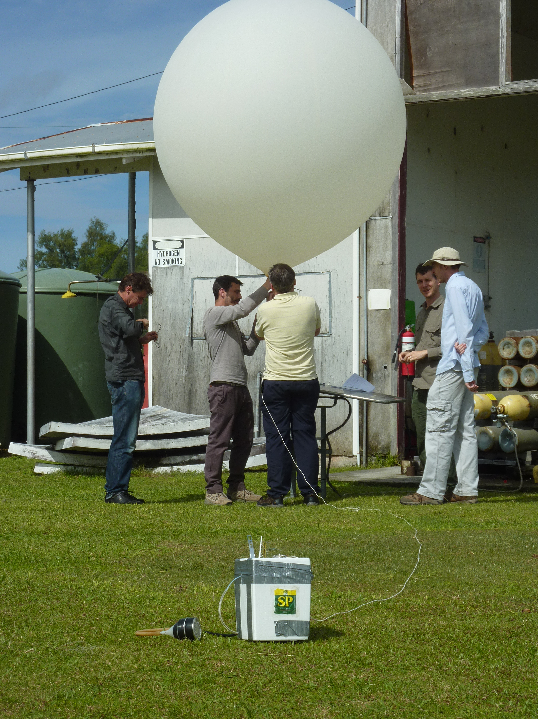
Videos
UMIST launch
Capel Dewi launch
School launch
Manus launch
Ozonesonde photo
Shipsonde - https://www.youtube.com/watch?v=M51ZX3GNalY
Dropsonde - https://www.youtube.com/watch?v=NZZhIfbBHtE

Slide 12
Anglesey - Sonde launches
8th
9th
10th
1
2
3
4
5
6
No. | Date | Time | Max altitude
1 | Tues 8 April | 07:40 | 1260
2 | Wed 9 April | 07:41 | 1040
3 |  | 07:47 | 480
4 |  | 16:39 | 1520
5 |  | 23:12 | 6880
6 | Thu 10 April | 19:13 | 2060

Slide 13
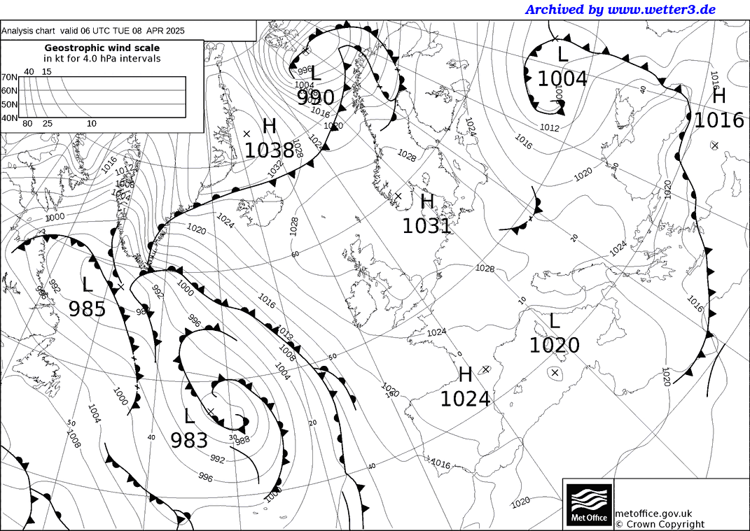
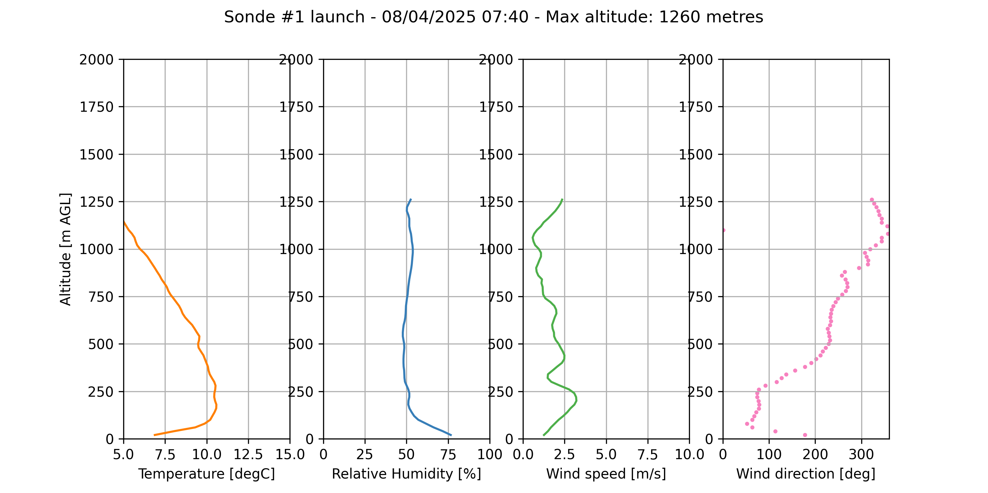
8th
9th
10th
1
2
3
4
5
6
Let’s look at the flight path.
Which way is the sonde going to go?

Slide 14
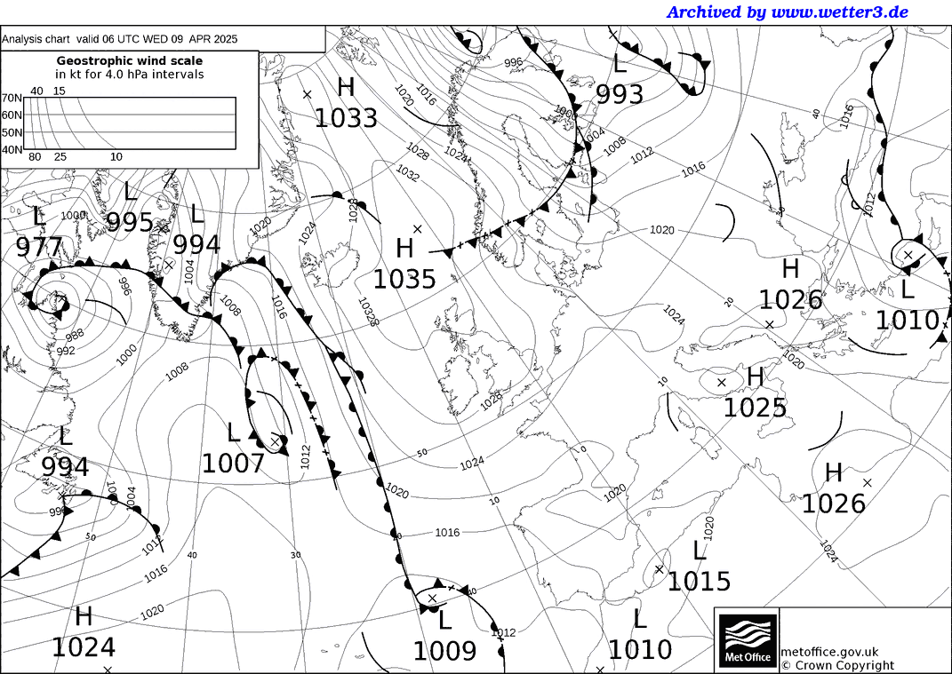
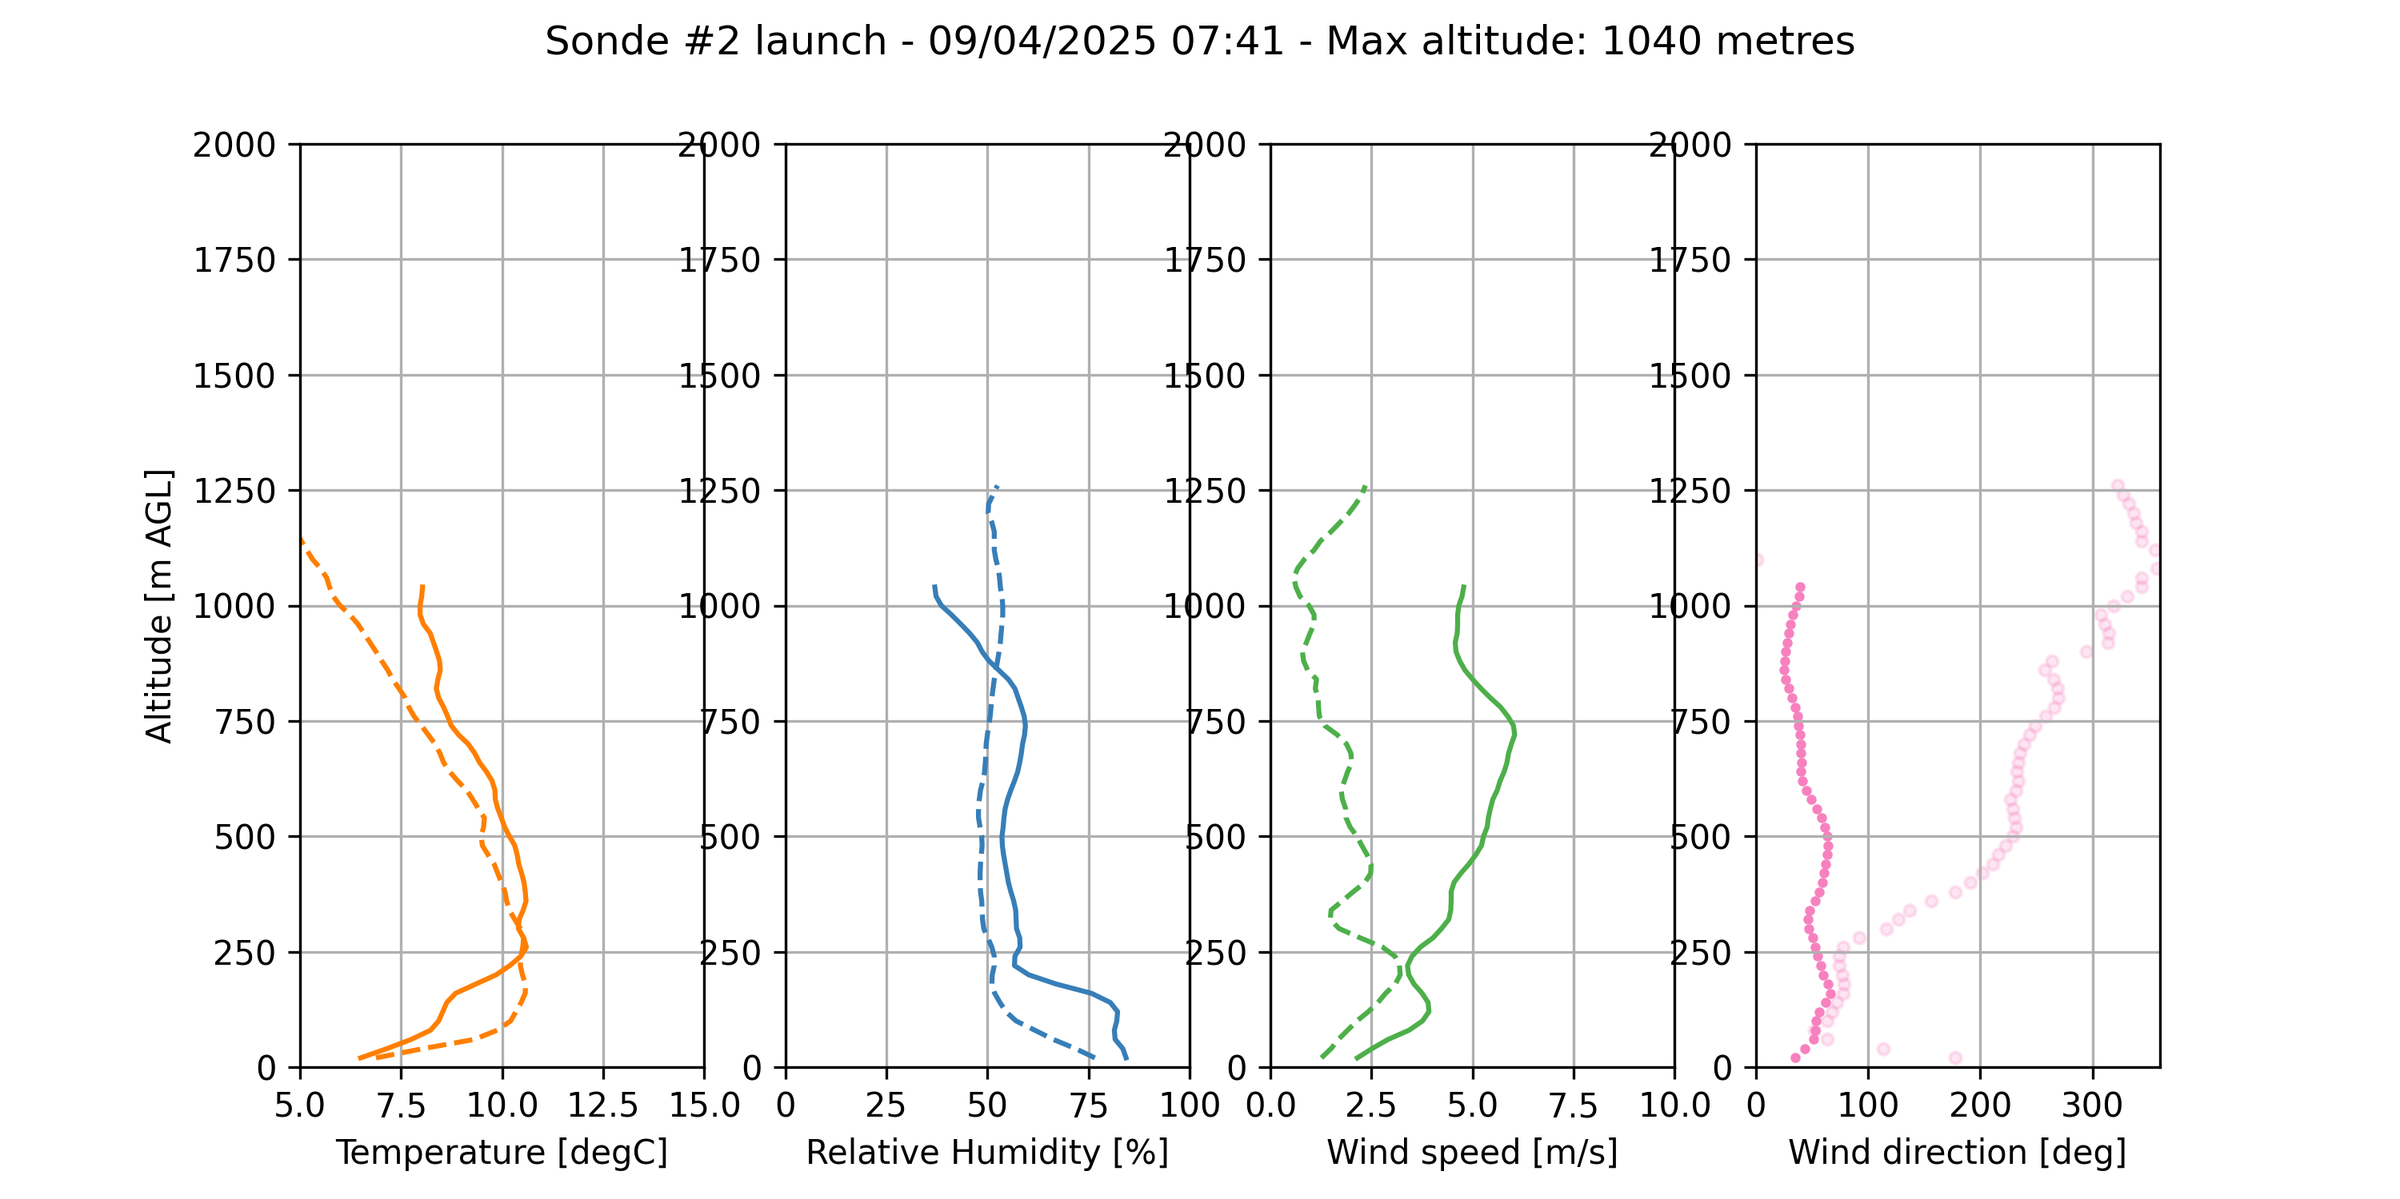
8th
9th
10th
1
2
3
4
5
6
Which way is this sonde going to go?

Slide 15
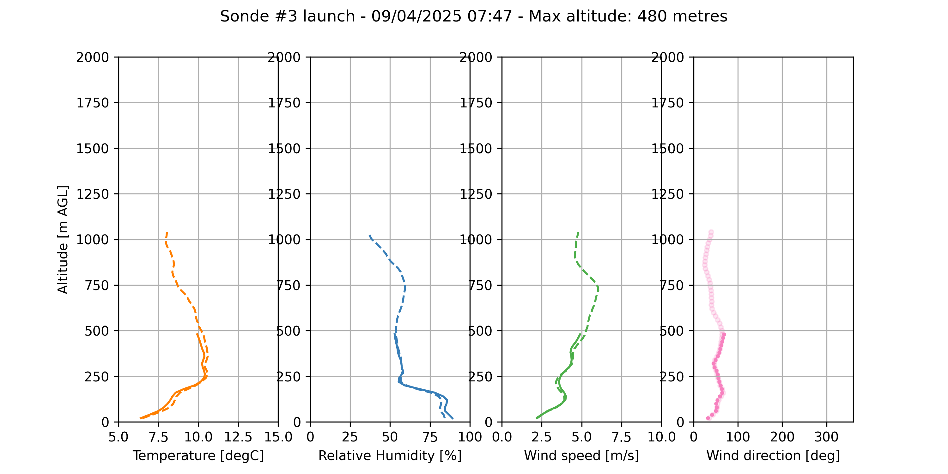
8th
9th
10th
1
2
3
4
5
6
Launched 6 minutes later. What’s changed?

Slide 16
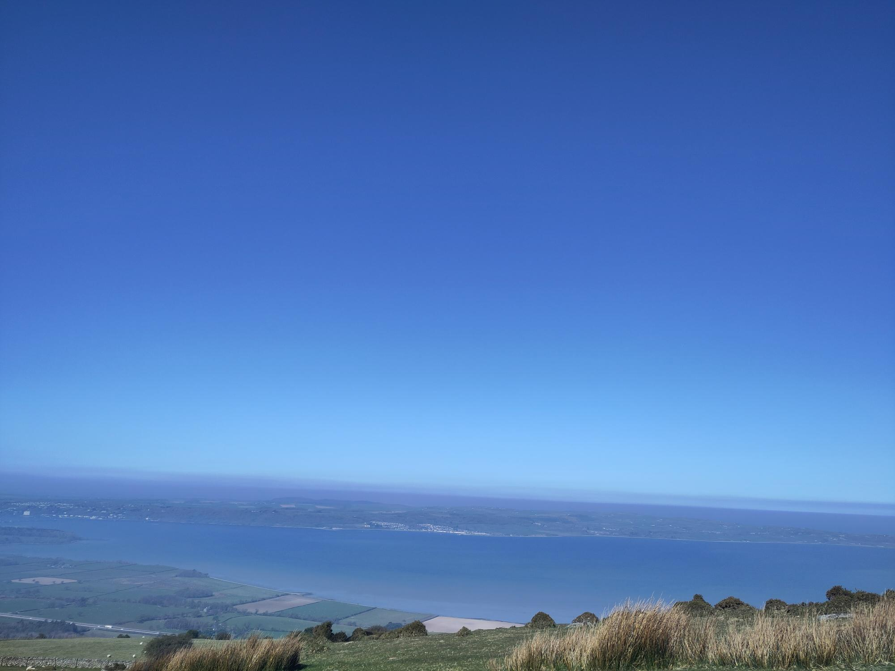
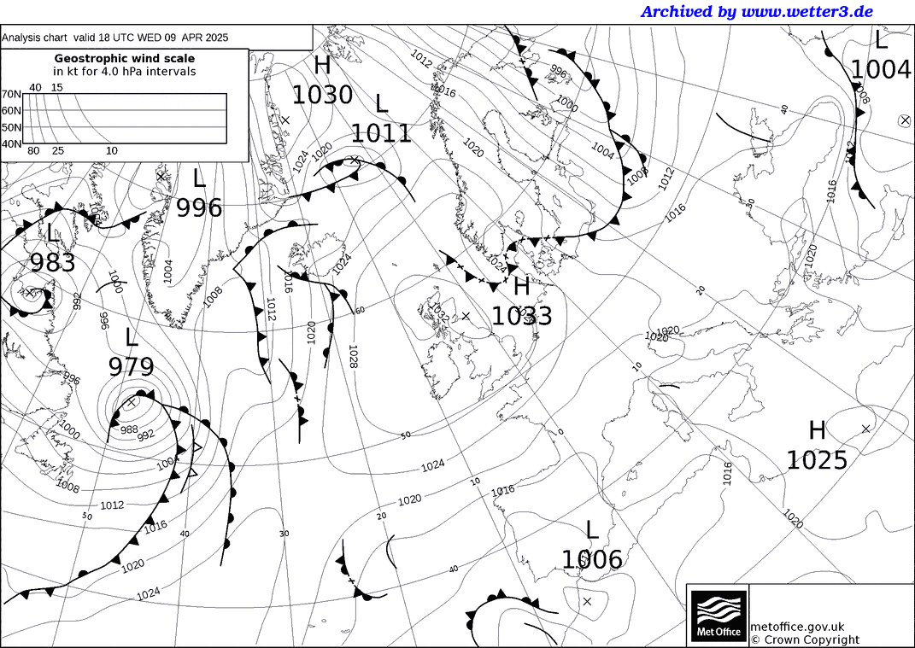
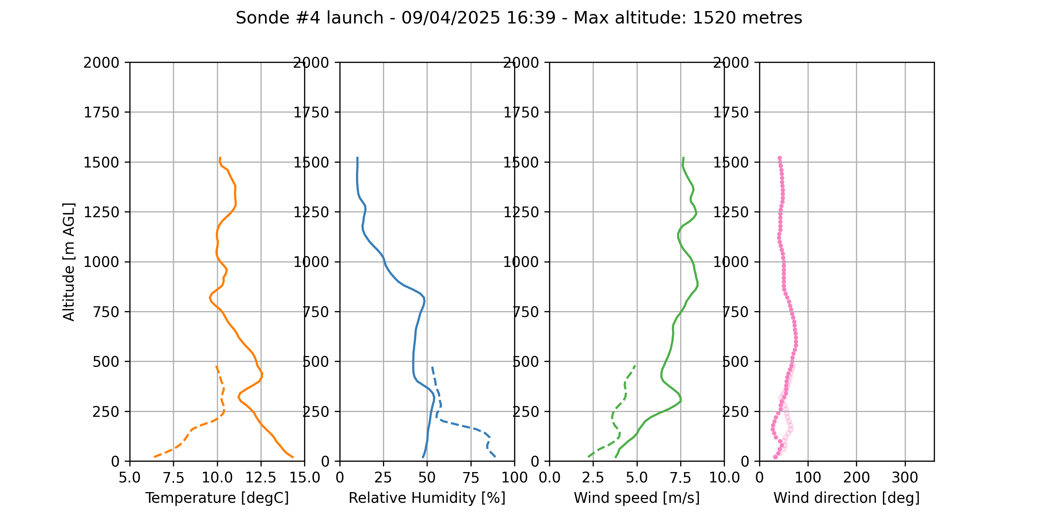
8th
9th
10th
1
2
3
4
5
6
Photo credit: Jessica Girdwood
Late afternoon:
Warmer
Drier
Windier
Inversion at 350 metres

Slide 17
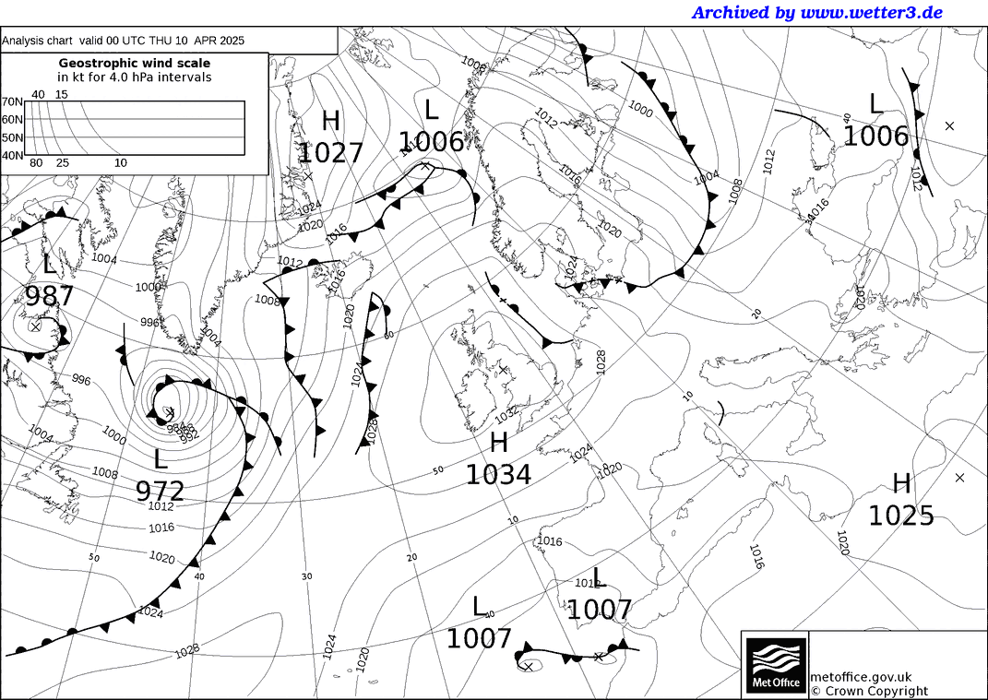
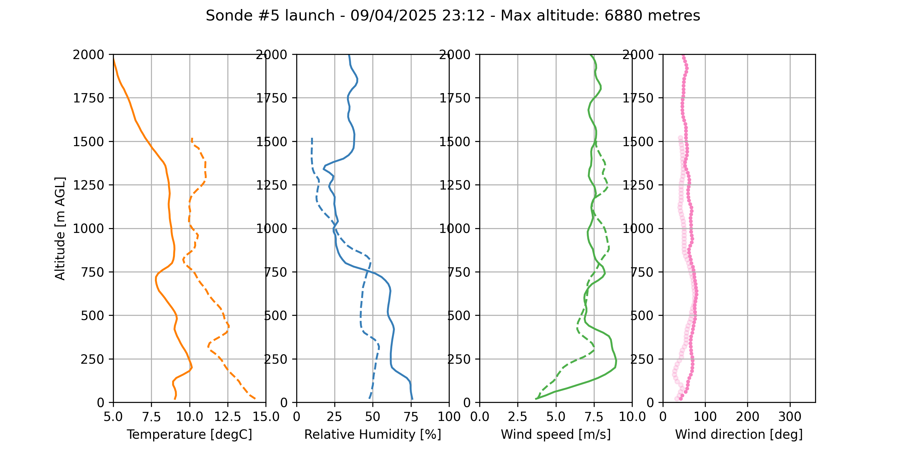
8th
9th
10th
1
Midnight:
Cooler again
Windier
Low-level jet
2
3
4
5
6

Slide 18
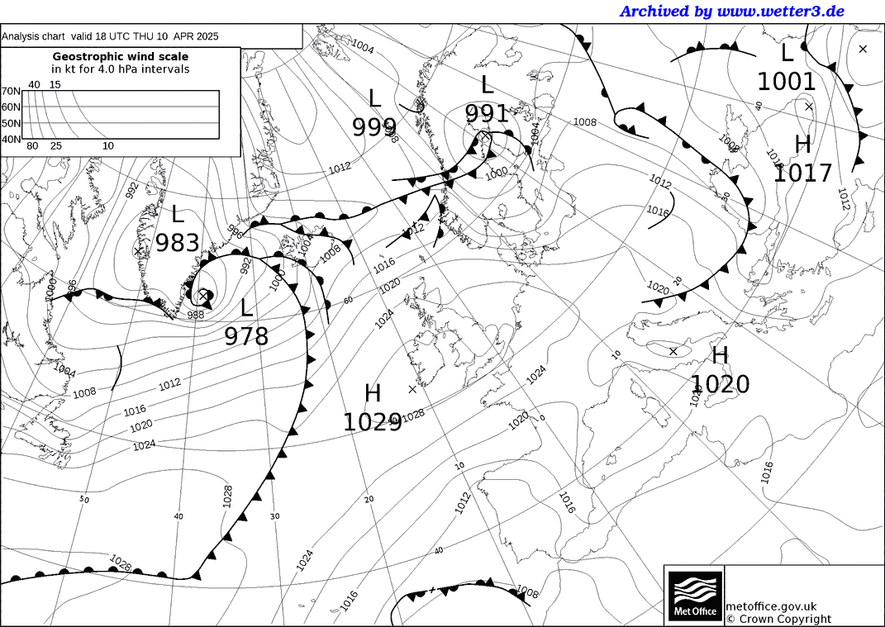
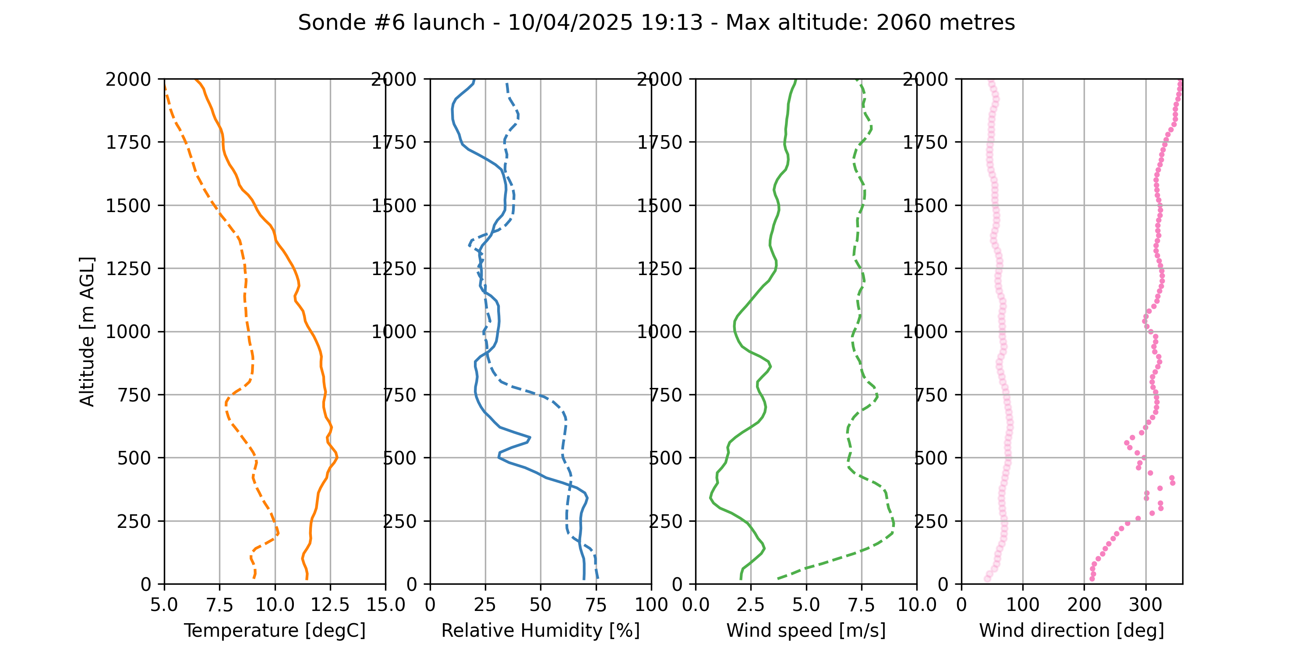
8th
9th
10th
1
2
3
4
5
6
One day later (evening):
Wind drops
Wind has flipped 180°
High pressure has moved

Slide 19
Summary of observations
No. | Date | Time | Notes
1 | Tues 8 April | 07:40 | Landed almost where it started
2 | Wed 9 April | 07:41 | Cold and moist at the surface (fog?)
3 |  | 07:47 | Compares well to previous ascent
4 |  | 16:39 | Much warmer. Inversion. DALR.
5 |  | 23:12 | Low-level jet
6 | Thu 10 April | 19:13 | Wind direction flips. High pressure moved.
#1
#2
#3
#4
#5
#6

Slide 20
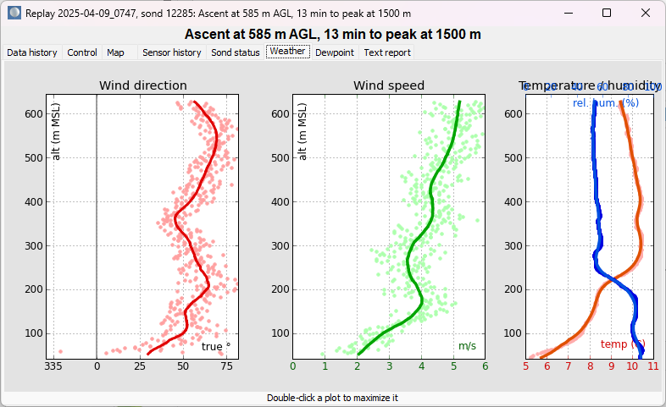
Data accuracy (sonde #3)
Data needs to be averaged as the raw data is noisy

Slide 21
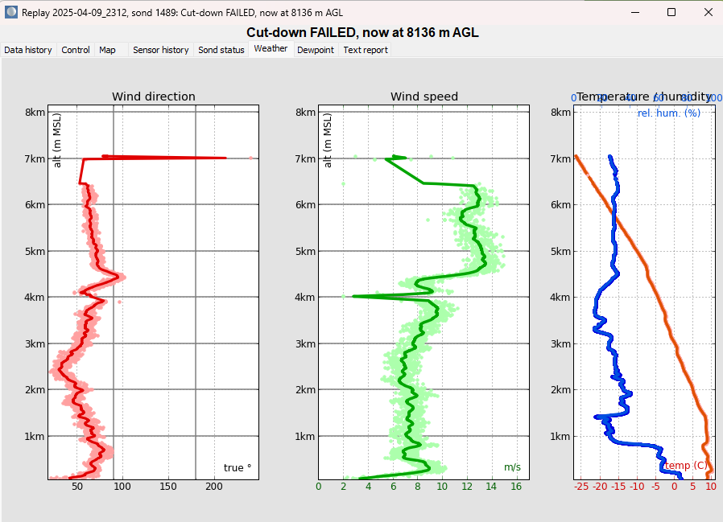
Cut-down failure (sonde #5)
Was meant to cut down at 3900 metres, but it just kept going until the battery ran out.

Slide 22
Conclusions
Radiosondes can be used to study the evolution of the atmosphere
They can be launched from land, sea and air
Great at measuring height and thickness of cloud (or lack thereof)
Data is routinely used to initialise weather forecasting models
Sometimes raw data needs to be averaged

Slide 23
Short break (5 minutes)

Slide 24
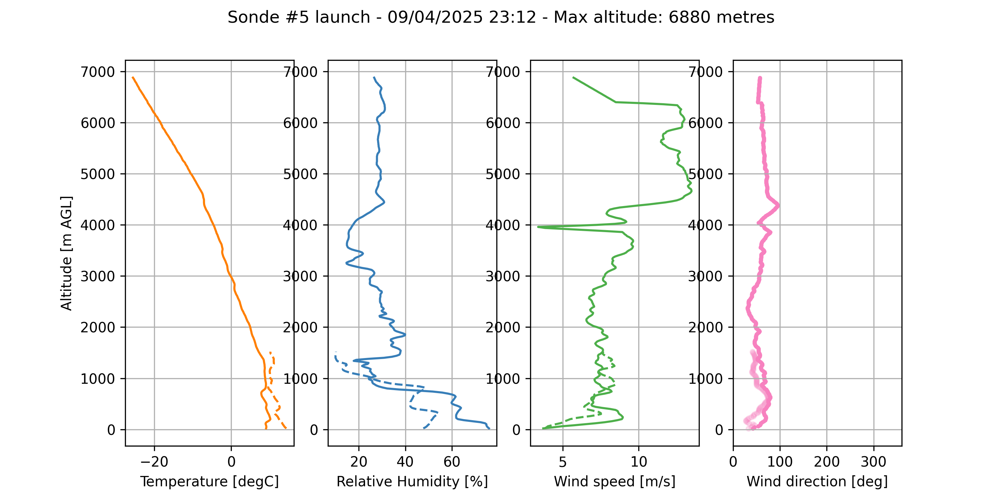
Group Discussion Questions
Group 1 – Balloon Design
What determines the altitude at which a weather balloon bursts?
Group 2 – Launch Strategy
Why was a detach mechanism considered at 3900 m and what happened when it failed?
Group 3 – Burst Altitude
What factors determine where and when the balloon eventually bursts?
Group 4 – Humidity Observations
How does relative humidity change with height, and how do we detect when the balloon is inside a cloud?
Group 5 – Temperature Profile
What was the minimum temperature observed, and what does it tell us
about atmospheric layers?
Group 6 – Dry Layers
Why are very dry atmospheric layers important for weather and climate processes?
Group 7 – Retrieval Decisions
What are the pros and cons of retrieving sondes after flight?
Group 8 – Applications of Radiosonde Data
How do meteorologists use radiosonde data for forecasting and research?

Slide 25
Bonus questions
Where is the inversion?
How much does the temperature increase by at the inversion?
What is the lapse rate below and above the inversion?
If the surface heated up more, would you expect clouds to form?

Slide 26
Reading Tephigrams for the Exam
AFTER THE GUEST LECTURE
Same real atmosphere you just saw from Hugo's balloons — now on the diagram you'll use in the exam
⏱ ~20 min
EART23001 Atmospheric Physics & Weather | Week 10

Slide 27
Read a Plotted Sounding
IN-CLASS DISCUSSION 1
• Identify the likely cloud layer from the separation between temperature and dew point.
• Estimate the freezing level and the tropopause height.
• Where is the driest lower/mid-tropospheric air evident?
• What's one advantage of seeing the profile graphically rather than only as a table of numbers?
✍ Discuss in pairs, then we'll take answers
Worked-answers sheet, Week 10 — IN CLASS Question (Q7)

Slide 28
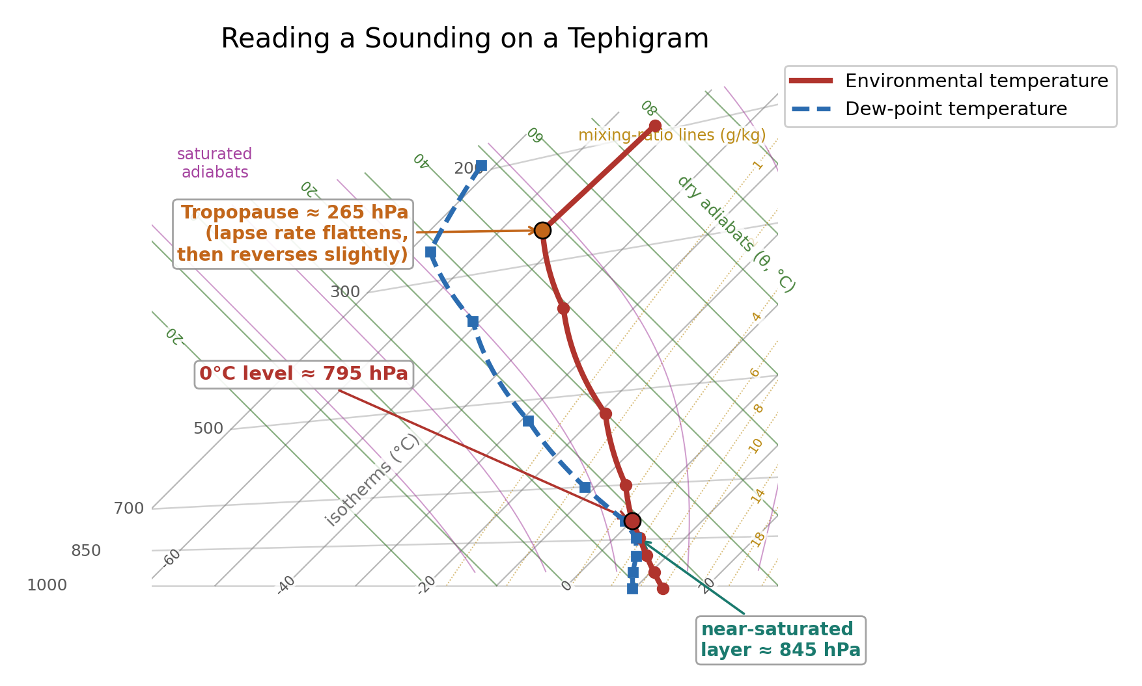
The Same Sounding, Read Graphically
WORKED ANSWER — DISCUSSION 1
• Temperature and dew point sit closest together roughly 1–2 km — near-saturation, likely cloud.
• The 0°C level is close to 2 km, where the temperature curve crosses freezing.
• The lapse rate flattens and reverses near 10–12 km — the tropopause transition, now visible directly on the curve since the diagram is plotted all the way up to it.
• The wide T–dew-point gap above ~3 km marks a pronounced dry layer.
• A plotted sounding makes vertical structure (cloud layers, inversions, freezing levels, dry layers, the tropopause) visible by PATTERN, rather than by repeatedly comparing individual table entries — and it gives coordinates that let you compare an environmental profile with a parcel's own path.
EART23001 Atmospheric Physics & Weather | Week 10

Slide 29
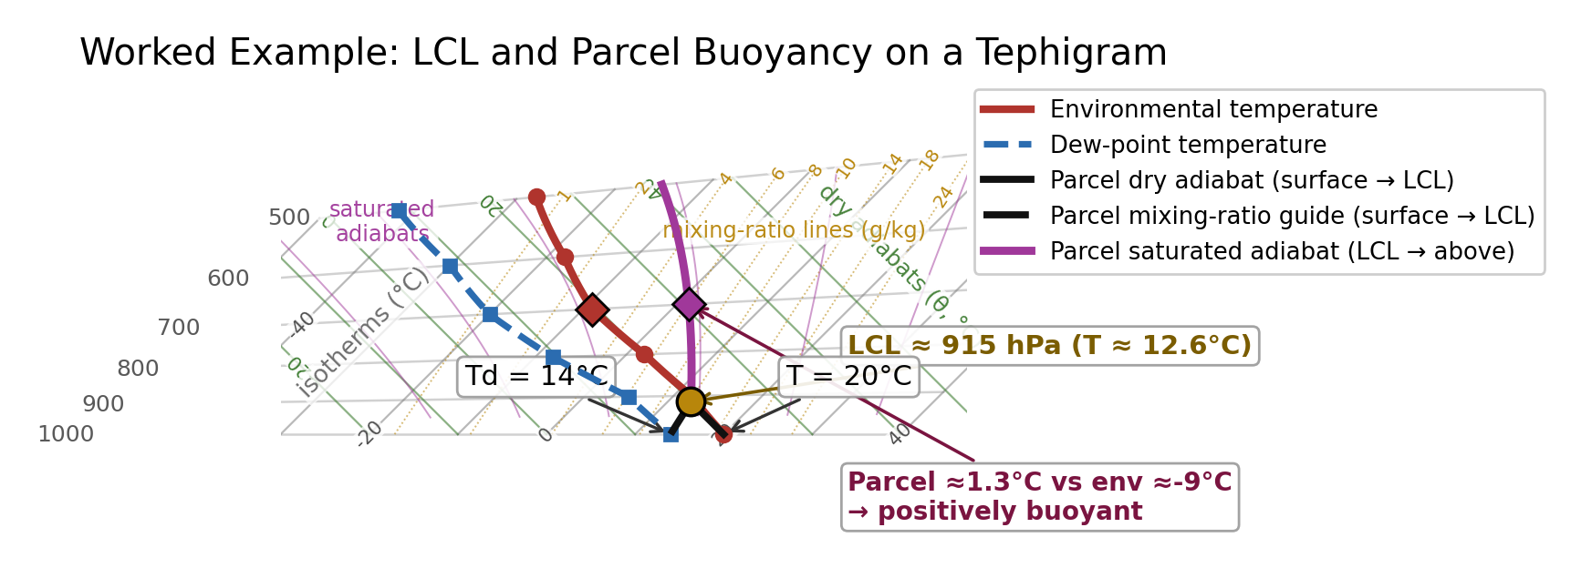
From Reading a Sounding to Tracing a Parcel
Worked example — the exact technique the exam asks you to use
Surface parcel T=20°C, Td=14°C. LCL ≈915 hPa; the saturated ascent to 700 hPa comes out warmer than the environment there (≈1.3°C vs ≈-9°C) — positively buoyant. Try it yourself, next.
EART23001 Atmospheric Physics & Weather | Week 10

Slide 30
Practice: Trace a Parcel's Ascent
IN-CLASS DISCUSSION 2
• A surface parcel has T=15°C and Td=9°C at 1000 hPa. Its dry adiabat and mixing-ratio guide are drawn from the surface, exactly as in the worked example.
• 1. By eye, estimate the pressure at which this parcel reaches its LCL.
• 2. From the LCL, follow a saturated adiabat. Estimate the parcel's temperature at 700 hPa.
• 3. The environmental temperature at 700 hPa is -8°C. Is the parcel positively or negatively buoyant there?
• 4. Why does the parcel's path follow a different family of guide lines above the LCL than below it?
✍ Discuss in pairs, then we'll take answers
Worked-answers sheet, Week 10 — YOU SHOULD TRY (Q8)

Slide 31
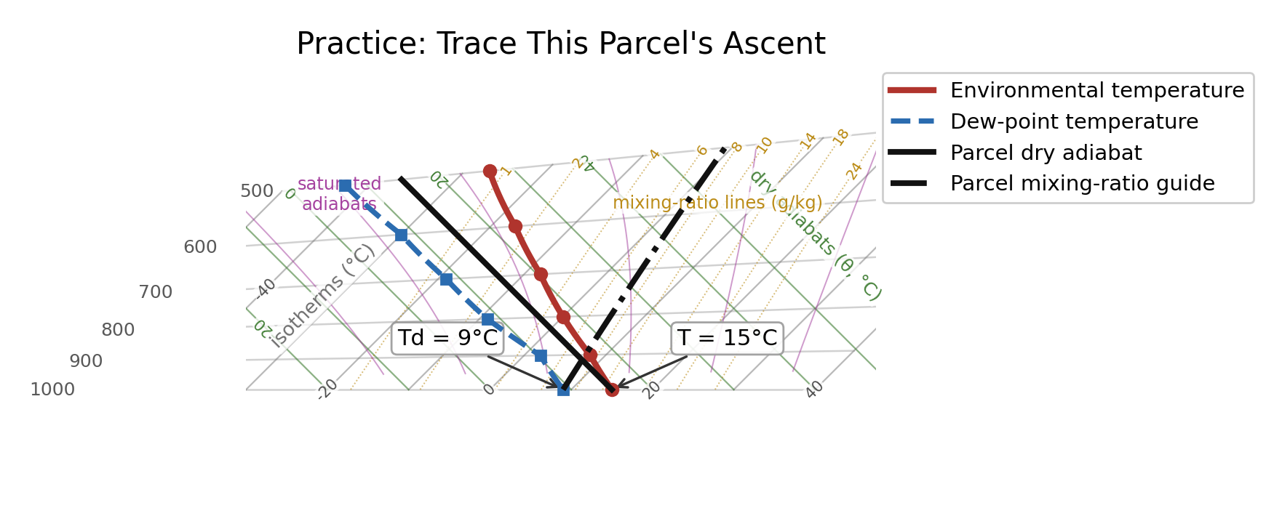
Q8 Worked Answer
WORKED ANSWER — DISCUSSION 2
• The dry adiabat and mixing-ratio guide cross at approximately 910–915 hPa — this is the LCL (allow a reasonable graphical range, e.g. 895–930 hPa).
• Following a saturated adiabat from the LCL to 700 hPa gives a parcel temperature of roughly -4 to -5°C.
• The environment at 700 hPa is -8°C, so the parcel (around -4 to -5°C) is warmer than its surroundings — positively buoyant.
• Below the LCL the parcel is unsaturated: it cools at the dry adiabatic lapse rate (a dry adiabat) while its mixing ratio rv stays fixed, so its dew point falls along a mixing-ratio guide. Once T and Td meet at the LCL the parcel saturates — continuous condensation releases latent heat and slows the cooling rate, so it follows a saturated adiabat instead.
EART23001 Atmospheric Physics & Weather | Week 10

Slide 32
Tephigrams: What to Remember for the Exam
A quick recap before you revise
• A tephigram's temperature and potential-temperature axes are genuinely at 90° to each other (T-φ-gram) — that's what makes it a tephigram rather than a skew-T diagram.
• Reading the environment: plot T and Td against pressure. Where they converge = near-saturation/cloud; where they diverge = dry layers; where the lapse rate flattens or reverses = the tropopause.
• Finding the LCL: from a surface parcel's T and Td, follow its dry adiabat and its mixing-ratio guide upward — they cross at the LCL, where the parcel first saturates.
• Testing buoyancy: above the LCL, follow a saturated adiabat and compare the parcel's temperature to the environment at that pressure level. Warmer than the environment = positively buoyant.
• This LCL-then-buoyancy sequence is exactly what the exam's own tephigram question asks you to do — practise it with Q8, and with fresh numbers of your own.
EART23001 Atmospheric Physics & Weather | Week 10

