Slide 1
ATMOSPHERIC PHYSICS AND WEATHER
EART23001
Week 4 — Vertical Profiles
Professor Paul Connolly
p.connolly@manchester.ac.uk • Simon Building 3.08

Slide 2
Today's Session
Vertical Profiles • approx. 87 minutes
0:00
Hydrostatic balance: forces on a slab of air
0:05
IN-CLASS DISCUSSION 1 — deriving dp/dz = −ρg
9 min
0:14
What the balance means, and integrating it to p(z) and ρ(z)
0:21
Where the pressure goes: mass fractions, the 500 hPa level, and density with height
0:30
Real-world pressure: aircraft altimetry and a hill-station reduction to sea level
0:37
Aside: scale height on Earth and Mars
0:41
Lapse rate: the environment against the dry adiabatic rate
0:48
IN-CLASS DISCUSSION 2 — lapse rate and dry static stability
9 min
0:57
A more realistic pressure profile ↔ EART22001
1:02
Potential temperature, revisited: why conserve it at all?
1:08
IN-CLASS DISCUSSION 3 — why potential temperature is conserved
9 min
1:17
The EART22001 single-column model, and a first look at rain ↔ EART22001
1:23
Wrap-up and looking ahead to Week 5
EART23001 Atmospheric Physics & Weather | Week 4

Slide 3
Hydrostatic Balance and Pressure With Height
PART 1 OF 3
Why the atmosphere thins out the way it does
⏱ 0:04 – 0:41
EART23001 Atmospheric Physics & Weather | Week 4

Slide 4
A Slab of Air, Held Up by Its Own Pressure
Hydrostatic balance — setting up the problem
• Picture a thin horizontal slab of air: area A, thickness dz, density ρ, sitting at height z.
• Two vertical forces act on it from the air around it: pressure pushing up on its lower face, p(z)A, and pressure pushing down on its upper face, p(z+dz)A.
• A third force acts on the slab regardless of the air around it: its own weight, ρA dz g, downward.
• Unless the atmosphere is doing something violent, the slab isn't accelerating vertically — these forces must very nearly balance.
EART23001 Atmospheric Physics & Weather | Week 4

Slide 5
Deriving the hydrostatic equation
IN-CLASS DISCUSSION 1
• Consider a horizontal slab of air of area A, thickness dz and density ρ.
• 1. Draw and label the vertical pressure forces and the weight of the slab.
• 2. Derive the hydrostatic equation dp/dz = −ρg.
• 3. State clearly what physical balance the equation represents.
✍ Discuss in pairs, then we'll take answers
Worked-answers sheet, Week 4 — IN CLASS Question

Slide 6
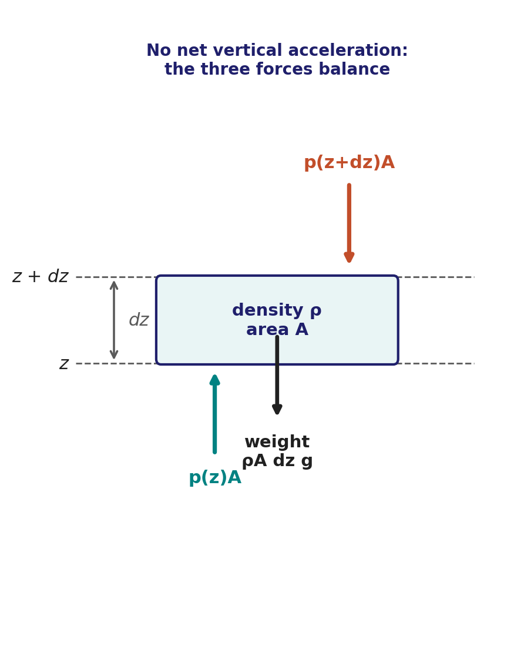
Deriving the hydrostatic equation — worked answer
WORKED ANSWER — DISCUSSION 1
• Force balance, taking upward as positive (shown alongside): p(z)A − p(z+dz)A − ρA dz g = 0 — no net vertical acceleration.
• Rearrange and divide by A dz: −[p(z+dz) − p(z)] / dz = ρg.
• Take the limit dz → 0: dp/dz = −ρg.
  – The upward pressure-gradient force balances the downward weight of the air. “Hydrostatic” doesn't mean the atmosphere is motionless — just that vertical accelerations are small enough for this balance to be an excellent approximation almost everywhere.
EART23001 Atmospheric Physics & Weather | Week 4

Slide 7
Reading the Equation
Hydrostatic balance — interpretation
• dp/dz = −ρg says pressure falls with height, and it falls faster wherever the air is denser.
• That's why pressure drops quickly near the ground (dense air) and much more slowly high in the stratosphere (thin air) — the same equation, just evaluated with a different ρ.
• It also explains something you may have taken for granted: pressure is largest at the surface, because that's the level with the most atmosphere still stacked above it.
  – In fact, at hydrostatic balance the pressure at any level is exactly the weight of the air column above it, per unit area — p(z) = (mass above z per unit area) × g.
EART23001 Atmospheric Physics & Weather | Week 4

Slide 8
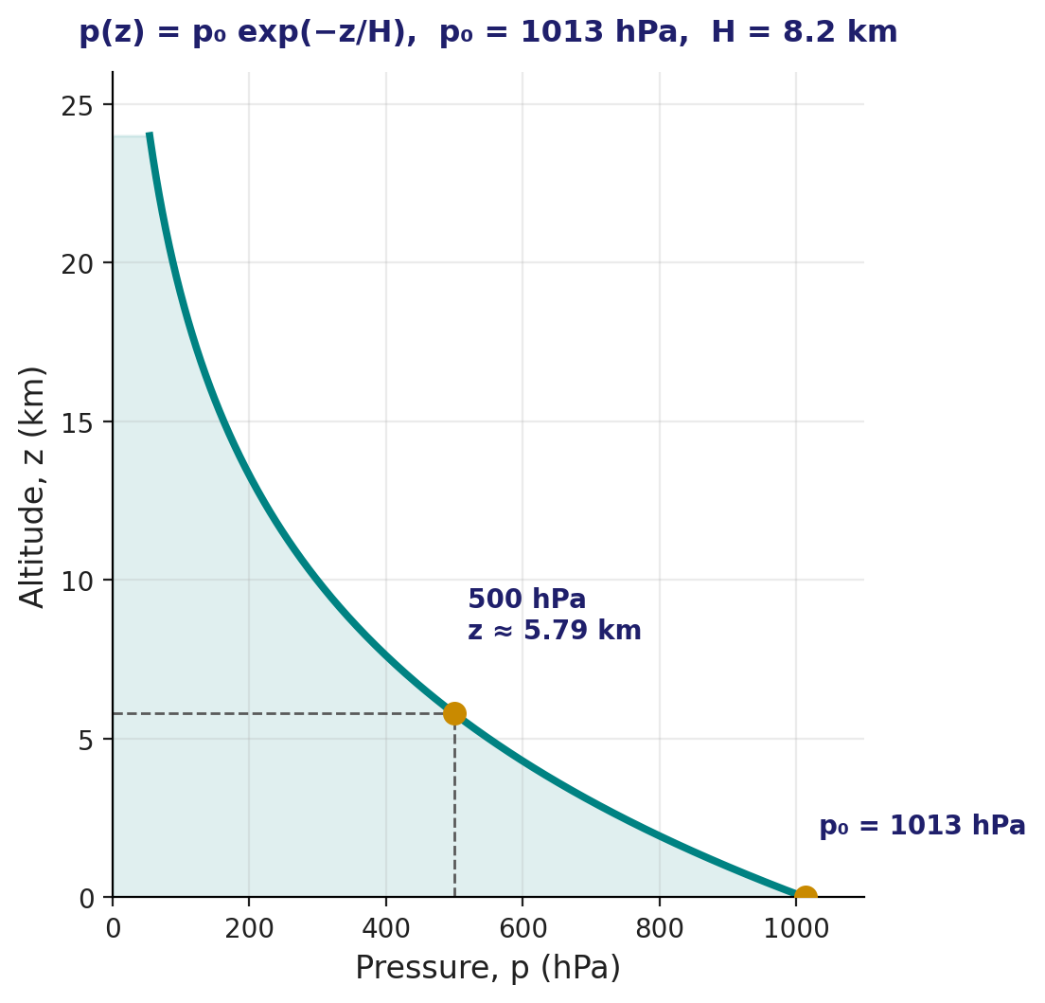
Integrating to an Exponential Profile
Hydrostatic balance — from a slab to the whole atmosphere
• Combine dp/dz = −ρg with the ideal gas law, ρ = p/(R_{d}T), and assume an isothermal atmosphere at temperature T:
  – dp/p = −(g/R_{d}T) dz ⟹ p(z) = p₀ exp(−z/H), H = R_{d}T/g
• H is the scale height — the height over which pressure falls by a factor of e ≈ 2.72. Using T ≈ 240 K gives the representative value we'll use all course, H ≈ 8.2 km.
• Density obeys exactly the same exponential form, ρ(z) = ρ₀ exp(−z/H) — density and pressure fall together because temperature is being held fixed.
EART23001 Atmospheric Physics & Weather | Week 4

Slide 9
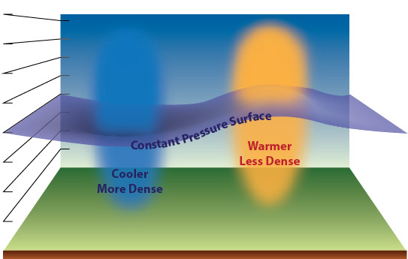
Where Does the Pressure Go? Mass Fractions
Hydrostatic balance — pressure as stacked mass
• Because p(z) is just the weight of atmosphere above z per unit area, the ratio p/p_{s} tells you directly what fraction of the whole atmosphere's mass lies above that level.
  – At 850 hPa: 850/1013 = 0.839 — about 84% of the atmosphere is still above you.
  – At 350 hPa: 350/1013 = 0.346 — about 35% remains above.
  – At 10 hPa (in the stratosphere): 10/1013 ≈ 0.99% — you've left behind essentially all of the atmosphere's mass.
• This is exactly why meteorologists are happy to use pressure itself as a vertical coordinate: it already tells you how much atmosphere is above you, with no extra conversion needed.
Source: NOAA JetStream, “Common Features of Constant Pressure Charts.”
EART23001 Atmospheric Physics & Weather | Week 4

Slide 10
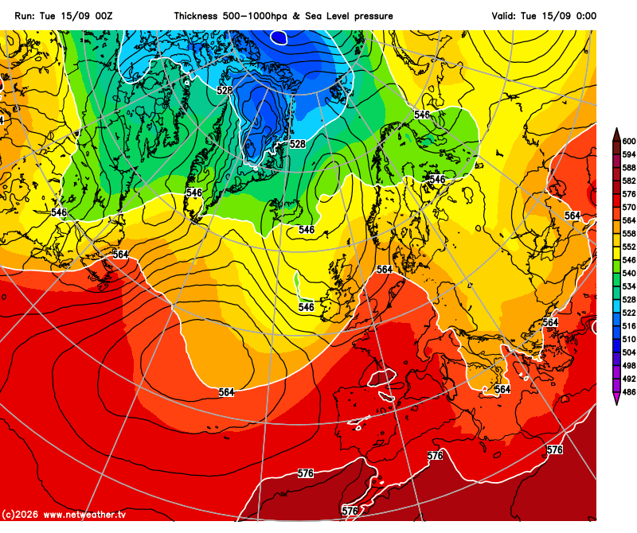
Quick Check: How High Is the 500 hPa Level?
Hydrostatic balance — worked example
• Using p = p₀ exp(−z/H) with p₀ = 1013 hPa and H = 8.2 km, rearrange for height:
  – z = −H ln(p/p₀) = −8.2 × ln(500/1013) = 5.79 km
• The 500 hPa surface — a level forecasters watch constantly — sits at roughly 5.8 km in this simple, isothermal atmosphere. Its real height varies from day to day with the temperature of the column beneath it.
• The '546', '564' etc. contours on the forecast chart alongside are 1000–500 hPa thickness in decametres — literally the depth of that layer — which the hypsometric equation (today's own p = p₀exp(−z/H) relation, applied between two pressure surfaces) converts directly from the mean temperature of the layer.
1000-500 hPa thickness (dam) and MSLP forecast. Source: netweather.tv.
EART23001 Atmospheric Physics & Weather | Week 4

Slide 11

Quick Check: Density Falls the Same Way
Hydrostatic balance — worked example
• Using ρ = ρ₀ exp(−z/H) with ρ₀ = 1.225 kg m⁻³ and H = 8.2 km:
  – At 5 km: ρ = 1.225 × exp(−5/8.2) = 0.666 kg m⁻³ — about 54% of the sea-level value.
  – At 10 km: ρ = 1.225 × exp(−10/8.2) = 0.362 kg m⁻³ — about 30% of the sea-level value.
• That's a big reduction over a fairly short climb — with real consequences for aircraft lift, human physiology at altitude, and how we interpret any instrument reading taken high up.
Source: Wikimedia Commons, “FedEx DC10 in the air.”
EART23001 Atmospheric Physics & Weather | Week 4

Slide 12
Real World: Aircraft Altimetry
Hydrostatic balance — why pressure calibration matters
• An aircraft is actually at 9.0 km, with p₀ = 1013 hPa and H = 8.2 km: p = 1013 × exp(−9/8.2) = 338 hPa.
• At 9.3 km — just 300 m higher — the pressure has fallen only to 338 × exp(−0.3/8.2) = 325.9 hPa.
  – That whole 300 m of vertical separation corresponds to a pressure difference of only 338.0 − 325.9 ≈ 12.1 hPa.
• A pressure-reading error of just ~10 hPa at cruising altitude can translate into hundreds of metres of altitude error — exactly why aviation altimetry relies on standardised calibration procedures rather than a single barometer reading taken at face value.
EART23001 Atmospheric Physics & Weather | Week 4

Slide 13
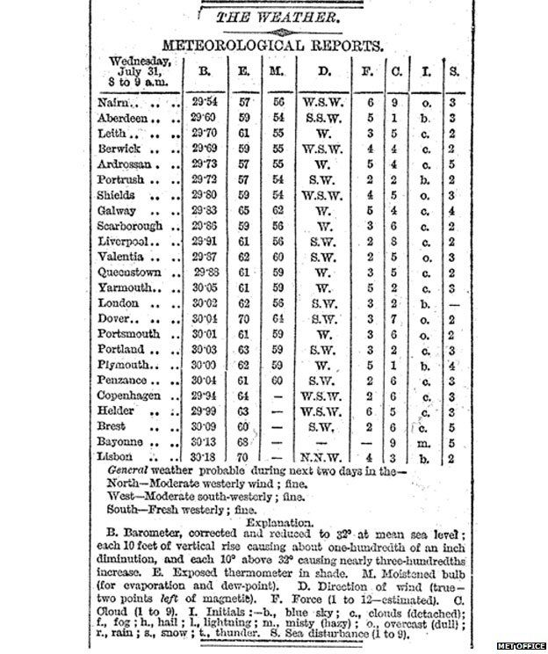
A Hill-Station Pressure Reduction
Hydrostatic balance — real-world example, reduced to sea level
• A barometer reads 950 hPa at a station 500 m above sea level; assume an isothermal layer at 273 K.
  – Scale height: H = R_{d}T/g = (287 × 273)/9.81 = 7.99 km.
  – Sea-level equivalent: p₀ = p(z) exp(z/H) = 950 × exp(0.5/7.99) = 1011 hPa.
• A properly representative reduction should use the actual mean temperature of the column between the station and sea level, not just a single assumed value.
• The historical clipping alongside shows an even cruder pre-calculator shortcut: a linear rule (about 0.01 inch per 10 ft of elevation), corrected to a standard 32°F reference with a small extra adjustment for how far the local temperature sits from that reference — simpler than our exponential model, not more careful.
Historical newspaper weather report (19th/early 20th century).
EART23001 Atmospheric Physics & Weather | Week 4

Slide 14
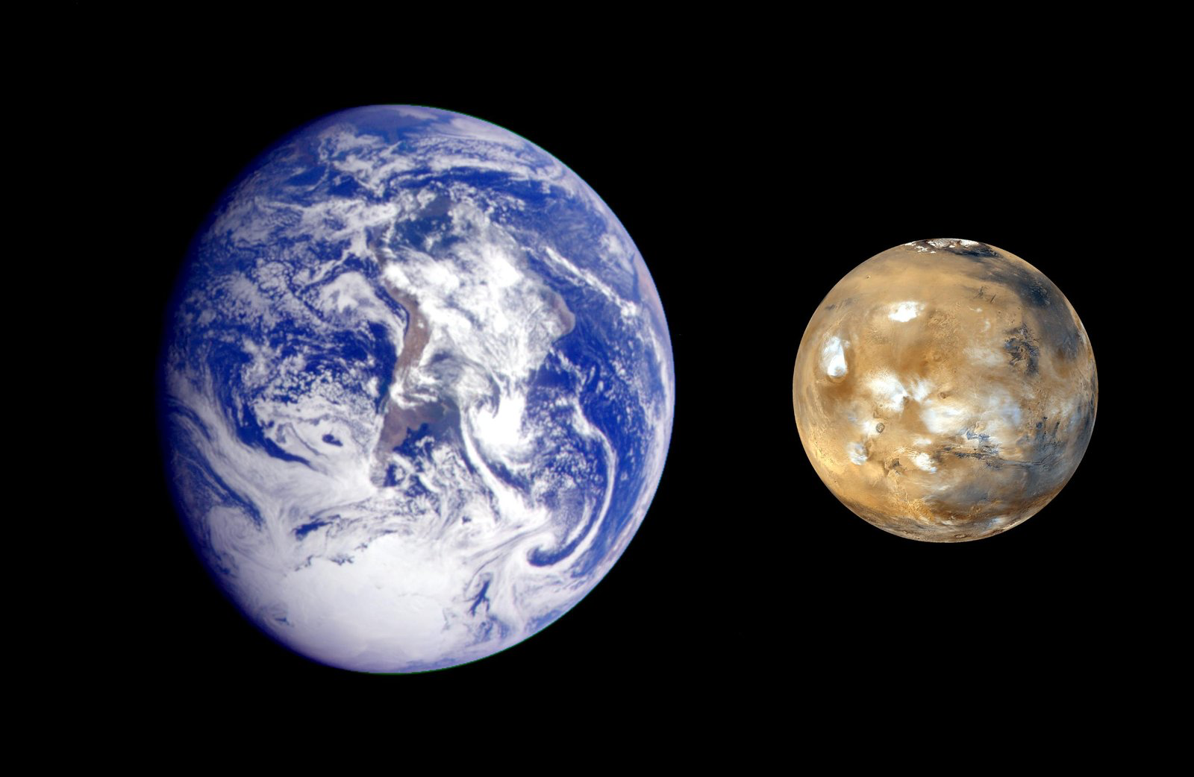
Aside: Scale Height on Earth and Mars
Hydrostatic balance — a planetary comparison
• The scale height derivation generalises to any planet: H = R*T/(Mg), with R* = 8.314 J mol⁻¹ K⁻¹ the universal gas constant.
  – Earth (T = 288 K, M = 28.97×10⁻³ kg mol⁻¹, g = 9.81 m s⁻²): H_{E} = 8.43 km.
  – Mars (T = 210 K, M = 44.01×10⁻³ kg mol⁻¹, g = 3.71 m s⁻²): H_{M} = 10.7 km.
• Mars is colder and its CO₂ atmosphere is heavier — both of which should shrink H — but its much weaker gravity wins out, giving Mars the larger scale height despite the colder, heavier air.
Source: NASA/JPL, Earth–Mars Comparison (PIA02570).
EART23001 Atmospheric Physics & Weather | Week 4

Slide 15
Lapse Rate and Atmospheric Stability
PART 2 OF 3
Comparing what the environment actually does with what a parcel would do
⏱ 0:41 – 1:02
EART23001 Atmospheric Physics & Weather | Week 4

Slide 16
Lapse Rate: How Fast Does the Environment Cool?
Lapse rate
• The environmental lapse rate is simply how fast the measured (environmental) temperature falls with height — not to be confused with the dry adiabatic rate from Week 3, which describes a rising parcel, not the air sitting still around it.
• The two rates answer different questions: the dry adiabatic rate, Γ_{d} ≈ 9.8 K km⁻¹, is a property of the gas law and the first law alone — it doesn't care what the environment is doing.
• The environmental lapse rate, by contrast, is whatever the atmosphere happens to be doing on a given day — set by radiation, mixing, and weather, and it can be smaller than, equal to, or even larger than Γ_{d}.
• Comparing the two is precisely how we'll decide whether a layer is stable or unstable.
EART23001 Atmospheric Physics & Weather | Week 4

Slide 17
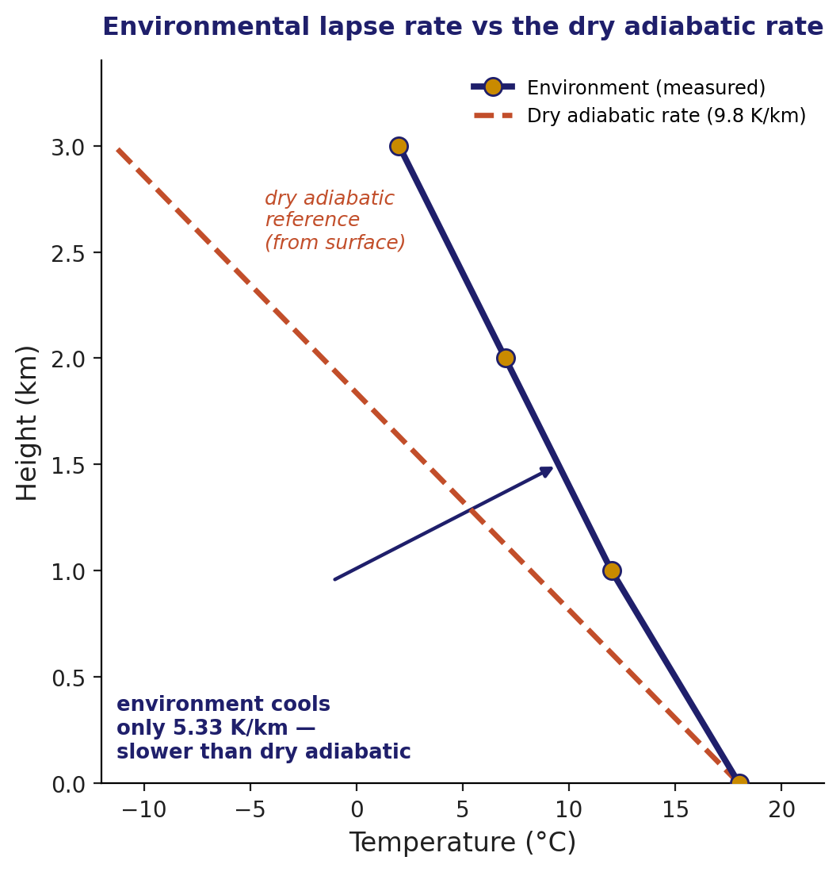
Environment vs. Dry Adiabatic Rate
Lapse rate — the comparison that matters
• A sounding through the lowest 3 km cools from 18°C at the surface to 2°C at 3 km — a fall of 16 K over 3 km, or Γ_{env} = 16/3 = 5.33 K km⁻¹.
• Plotted against the dry adiabatic reference line (the rate a rising parcel would cool at, starting from the same surface temperature), the environment is clearly cooling more slowly.
  – That gap is the whole story: a rising unsaturated parcel cools faster than its surroundings, so it arrives at any given height colder — and denser — than the air already there, and sinks back.
EART23001 Atmospheric Physics & Weather | Week 4

Slide 18
Lapse rate and dry stability
IN-CLASS DISCUSSION 2
• A sounding gives these temperatures in the lowest 3 km:
• Height (km): 0 1.0 2.0 3.0
• T (°C): 18 12 7 2
• 1. Calculate the mean environmental lapse rate over 0–3 km.
• 2. Compare it with the dry adiabatic lapse rate, Γ_{d} ≈ 9.8 K km⁻¹.
• 3. Would an unsaturated parcel displaced upward tend to become warmer or colder than its environment? What does that imply for dry static stability?
✍ Discuss in pairs, then we'll take answers
Worked-answers sheet, Week 4 — IN CLASS Question

Slide 19
Lapse rate and dry stability — worked answer
WORKED ANSWER — DISCUSSION 2
• The environmental temperature falls 16 K over 3 km, so Γ_{env} = 16/3 = 5.33 K km⁻¹.
• That's substantially smaller than the dry adiabatic lapse rate of 9.8 K km⁻¹ — the environment cools much more gently than a rising parcel would.
  – An unsaturated rising parcel therefore cools faster than the environment: after an upward displacement it is colder — and so denser — than its new surroundings. It tends to sink back.
  – The layer is stable to dry convection: a displaced parcel is pushed back toward where it started, exactly the θ-based stability criterion from Week 3, now expressed as a comparison of lapse rates instead of a comparison of θ at two heights.
EART23001 Atmospheric Physics & Weather | Week 4

Slide 20
A More Realistic Pressure Profile
Lapse rate — beyond the isothermal assumption
• Real air isn't isothermal — it cools with height. Combine dp/dz = −ρg, p = ρR_{d}T and T(z) = T₀ − Γz, and integrating gives:
  – p(z) = p₀ (T(z)/T₀)^{g/(RdΓ)}
• With T₀ = 288 K, Γ = 6.5 K km⁻¹, g/(R_{d}Γ) = 5.26: at 5 km, T = 255.5 K and p ≈ 540 hPa.
• Compare that with the isothermal, constant-H estimate from Part 1: p = 1013 exp(−5/8.2) ≈ 551 hPa — close, but the lapse-rate version is the more physically realistic of the two, since real air really does cool with height.
↔ EART22001 EART22001's Gaussian-plume model this week draws the same environment-vs-parcel distinction — just with rounded lapse rates (10 K km⁻¹ dry, 6 K km⁻¹ saturated) versus our 9.8.
EART23001 Atmospheric Physics & Weather | Week 4

Slide 21
A Conserved Variable, and a Preview of Rain
PART 3 OF 3
Why models track θ instead of temperature, and how raindrops actually start
⏱ 1:02 – 1:23
EART23001 Atmospheric Physics & Weather | Week 4

Slide 22
Potential Temperature, Recap
Potential temperature — from Week 3
• Recall from Week 3: θ = T (1000 hPa/p)^{0.286} — the temperature a parcel would have if brought dry-adiabatically to 1000 hPa.
• The key property we used it for was diagnosing stability: θ increasing with height meant a stable layer, because a displaced parcel conserves its own θ while the environment's θ changes with height around it.
• Today we push that same conservation property one step further — from a diagnostic you read off a plot, to a variable a model can actually track through time.
EART23001 Atmospheric Physics & Weather | Week 4

Slide 23
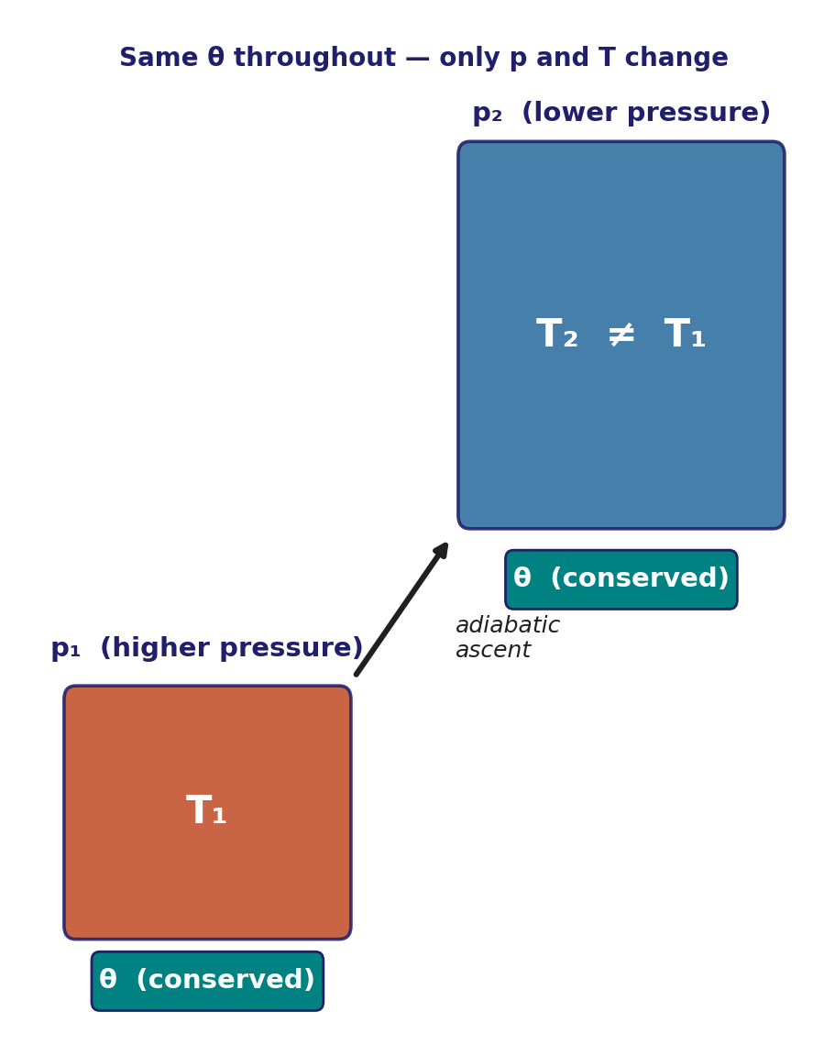
Why Conserve θ Rather Than T?
Potential temperature — the modelling motivation
• A parcel's raw temperature changes for two different reasons: real heating or cooling, and the purely mechanical effect of pressure changing as it moves up or down.
• For dry adiabatic motion, θ is built to cancel out exactly the second effect — so if nothing is heating or cooling the parcel, θ simply doesn't change, no matter how far it rises or sinks.
  – That makes θ a natural state variable for a numerical model: it only changes when something physical — radiation, latent heat release, mixing — actually acts on the parcel, not just because the parcel changed height.
EART23001 Atmospheric Physics & Weather | Week 4

Slide 24
Why potential temperature is a useful conserved variable
IN-CLASS DISCUSSION 3
• A dry parcel begins at p₁ = 950 hPa and T₁ = 285 K. It is displaced adiabatically to p₂ = 800 hPa.
• 1. Calculate its initial potential temperature using θ = T(1000/p)^{0.286}.
• 2. Assuming θ is conserved, calculate the parcel temperature at 800 hPa.
• 3. Explain why a numerical atmospheric model may predict or conserve θ rather than temperature directly for dry adiabatic motion.
✍ Discuss in pairs, then we'll take answers
Worked-answers sheet, Week 4 — IN CLASS Question

Slide 25
Why potential temperature is conserved — worked answer
WORKED ANSWER — DISCUSSION 3
• θ = 285 × (1000/950)^{0.286} = 289.2 K.
• Conserving θ: T₂ = θ (800/1000)^{0.286} = 289.2 × (0.8)^{0.286} = 271.3 K.
  – Temperature changes simply because pressure changes during adiabatic expansion or compression, whereas θ is constructed to remove exactly that pressure dependence.
  – θ is therefore the natural thermodynamic state variable for diagnosing — and modelling — dry adiabatic atmospheric motion: a model can update θ only when real physics (heating, mixing) acts, rather than recomputing spurious temperature changes every time a parcel simply moves.
EART23001 Atmospheric Physics & Weather | Week 4

Slide 26
EART22001's Single-Column Model
Potential temperature — a shared modelling idea
• Conserving θ during adiabatic motion is exactly the trick a numerical single-column model relies on: predict θ level by level, and ordinary temperature falls out afterwards from p and θ together.
• You don't need any EART22001-specific background to have just derived the physics behind it — the conservation principle from the previous two slides is the whole idea, however it's dressed up in model code.
• The same principle resurfaces with real force in Week 9, when cloud microphysics needs to track parcels rising and falling through a whole column without losing track of their thermodynamic history.
↔ EART22001 Students taking EART22001 will meet related ideas built into a single-column model — but as the course notes say, no knowledge of that model is assumed here; today's derivation stands on its own.
EART23001 Atmospheric Physics & Weather | Week 4

Slide 27
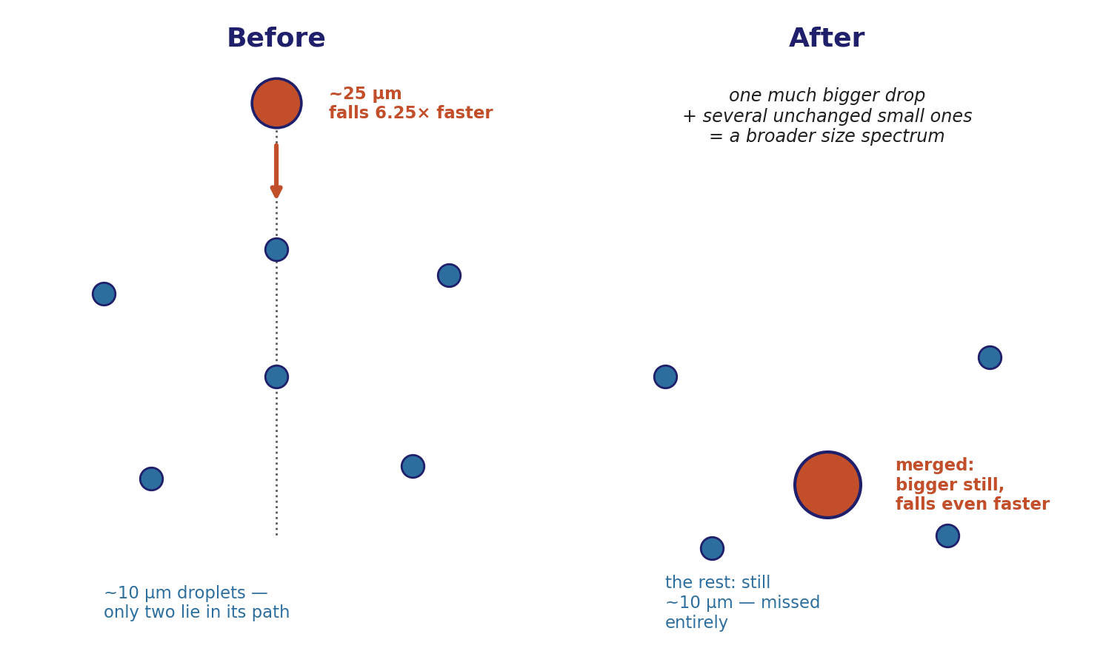
A First Look at Rain: Collision–Coalescence
Looking ahead to Week 9
• One more piece worth planting now: in the Stokes regime, a cloud droplet's terminal fall speed scales as v_{t} ∝ r².
  – For radii 10 µm and 25 µm: v₂₅/v₁₀ = (25/10)² = 6.25 — the larger droplet falls more than six times faster.
• That speed difference lets a bigger drop overtake and collide with smaller ones directly in its path — but not every small droplet lies in that path. There are always more small droplets than the falling path can sweep up, so plenty are simply missed and carry on unchanged.
• The result isn't a uniform shift to a slightly bigger size — it's a mix of one much-bigger merged drop and several untouched small ones. That's exactly why collision–coalescence broadens a droplet-size distribution rather than narrowing it, and it's the process that ultimately turns a cloud into rain — the detailed microphysics returns in full in Week 9.
EART23001 Atmospheric Physics & Weather | Week 4

Slide 28
What to Take Away From Today
WRAP-UP
• Hydrostatic balance, dp/dz = −ρg, is just Newton's second law applied to a thin slab of air with no net vertical acceleration — and it integrates to the exponential pressure and density profiles we've been using since Week 2.
• Pressure at any level is the weight of the atmosphere still above it — which is exactly why pressure itself makes a natural, physically meaningful vertical coordinate.
• Comparing the environmental lapse rate against the dry adiabatic rate tells you directly whether a layer is stable or unstable to dry convection — the same physics as Week 3's θ argument, from a different angle.
• Potential temperature isn't just a diagnostic: its conservation under dry adiabatic motion is precisely why models track θ rather than raw temperature — and the same conservation logic carries straight into how droplets grow toward rain.
Next week: building on today's stability framework for real, moist atmospheres.
EART23001 Atmospheric Physics & Weather | Week 4

