Slide 1
ATMOSPHERIC PHYSICS AND WEATHER
EART23001
Week 11 — Weather Systems and Forecasting
Professor Paul Connolly
p.connolly@manchester.ac.uk • Simon Building 3.08
With real Met Office charts and infographics illustrating today's syllabus

Slide 2
Today's Session
Weather systems and forecasting • approx. 109 minutes
0:00
Air masses: what they are, source regions, and classification
0:07
Air masses affecting Great Britain
0:10
Q1 — identifying an air mass from its trajectory
0:15
What a front is, and the types of front
0:17
Q2 — identifying a front from the observed change
0:22
What starts cyclogenesis?
0:24
The polar front model: wave to occlusion and decay
0:28
Upper-level waves: why the jet stream matters
0:31
Q3 — tracking a cyclone through its pressure evolution
0:36
IN-CLASS DISCUSSION 1 — diagnosing a frontal passage from station data
12 min
0:48
Anticyclones in summer and winter, with a real forecast
0:53
Q8 — diagnosing a blocking-high scenario
0:57
Isobars and the geostrophic wind
0:59
Q5 — isobar spacing and the geostrophic wind
1:03
The cloud sequence as a depression passes
1:08
From observations to a synoptic chart
1:11
Synoptic forecasting, NWP, and its basic principles
1:13
Q6 — ordering the NWP forecast cycle
1:18
Why forecasts are uncertain
1:23
Q7 — interpreting an ensemble forecast probabilistically
1:27
Other forecasting methods, and long-range limits
1:31
Q9 — AI versus physics-based forecasting
1:35
IN-CLASS DISCUSSION 2 — integrative UK weather case
12 min
1:47
Wrap-up
EART23001 Atmospheric Physics & Weather | Week 11

Slide 3
Air Masses and Fronts
PART 1 OF 3
What air masses are, how fronts form between them, and how a cyclone develops
⏱ 0:00 – 0:48
EART23001 Atmospheric Physics & Weather | Week 11

Slide 4
What Is an Air Mass, and How Does It Change?
Formed by its source region, then modified by everywhere it travels
• An air mass is a very large body of air (tens of thousands of km²) within which horizontal temperature and humidity gradients are small — everywhere within it feels roughly the same.
• It forms by sitting over a source region for many days, long enough for the air near the surface to take on that surface's temperature and moisture through a deep layer, then carries that character with it once it starts moving.
• Once it moves away from its source region, its lower layers are modified by whatever surface it crosses: warmed or cooled from below (making the lowest layers more or less stable), and it can pick up moisture crossing a large body of water even if it started out dry.
• The weather an air mass brings therefore depends on BOTH its original source-region character AND how much it's been modified en route — why the same air-mass label can still bring slightly different weather on different occasions, and exactly why classifying air masses is useful for forecasting in the first place.
EART23001 Atmospheric Physics & Weather | Week 11

Slide 5
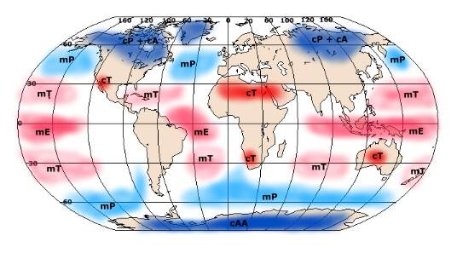
Source Regions
Where an air mass gets its character from
• A source region must be large, homogeneous, and settled for days at a time, letting air take on a uniform temperature and moisture through a deep layer.
• The main regions are the subtropical high-pressure belts (Tropical, T) and the polar regions (Polar, P); Arctic (A) regions, right at the pole, give the most extreme cold of all.
• The map below shows all six global source regions and the two-letter codes used for each one.
EART23001 Atmospheric Physics & Weather | Week 11

Slide 6
Classifying Air Masses
Two independent labels combine to give six distinct kinds of weather
• Temperature label — where it formed: Tropical (T, warm/hot, low latitudes), Polar (P, cool, higher latitudes), Arctic (A, extremely cold, polar regions).
• Humidity label — what surface it formed over: continental (c, formed over land, so dry) or maritime (m, formed over water, so moist).
• The two labels are independent, so they combine into six types: continental Polar (cP, cool/dry), maritime Polar (mP, cool/moist), continental Tropical (cT, warm/dry), maritime Tropical (mT, warm/moist), continental Arctic (cA, very cold/dry), maritime Arctic (mA, very cold/moist).
• Knowing both labels lets you predict the weather before the air mass even arrives — cold-and-dry behaves very differently from cold-and-moist.
EART23001 Atmospheric Physics & Weather | Week 11

Slide 7
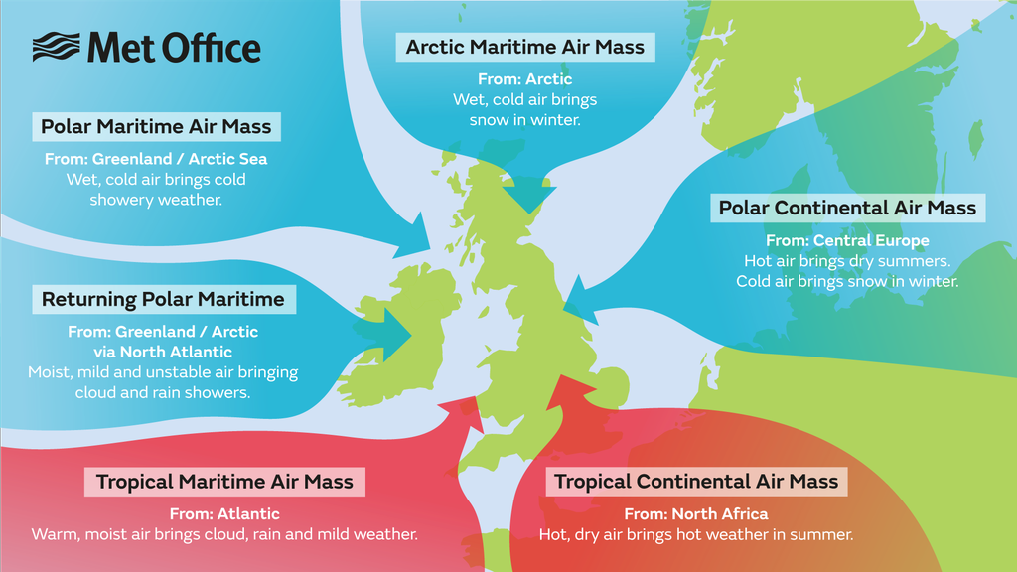
Air Masses Affecting Great Britain
Six air masses reach Britain, each bringing its own recognisable weather
• Tropical continental (cT): from North Africa — hot, dry, hazy air; mostly June–August.
• Polar continental (cP): from central Europe — hot/dry in summer, cold with snow showers in winter.
• Tropical maritime (mT): from the Atlantic near the Azores — warm, moist air; low cloud, drizzle, hill fog in the SW.
• Polar maritime (mP): Britain's commonest air mass — from Greenland/the Arctic Sea, warmed and moistened crossing the Atlantic; frequent showers.
• Arctic maritime (mA) and returning polar maritime: both from the Arctic/Greenland — mA brings hail/snow to northern coasts in winter; returning mP loops south via the Atlantic first, giving showers with good visibility.
Source: Met Office, Crown Copyright.
EART23001 Atmospheric Physics & Weather | Week 11

Slide 8
Q1 — Identify the Air Mass from Its Trajectory
For each trajectory, identify the air mass and predict one weather feature
• 1. Air travels NE from the subtropical North Atlantic near the Azores, remaining over ocean for several days.
• 2. Air arrives from Greenland and the high-latitude North Atlantic after a long ocean crossing.
• 3. Air moves north from North Africa across France during summer.
• 4. In winter, very cold continental air moves west from central/eastern Europe, then crosses the North Sea before reaching eastern Britain.
EART23001 Atmospheric Physics & Weather | Week 11

Slide 9
Four Trajectories, Four Air Masses
WORKED ANSWER — Q1
• 1. Tropical maritime — mild/warm and moist; often low cloud, drizzle and hill fog in exposed western areas.
• 2. Polar maritime — cool, moist and often unstable after ocean modification; showers with good visibility between showers are common.
• 3. Tropical continental — hot/warm and relatively dry, often hazy from dust/aerosol; thunderstorms can occur if moisture/instability increase.
• 4. Polar continental — cold and initially dry, but the North Sea crossing adds heat and moisture; eastern Britain can therefore receive snow showers in winter.
EART23001 Atmospheric Physics & Weather | Week 11

Slide 10
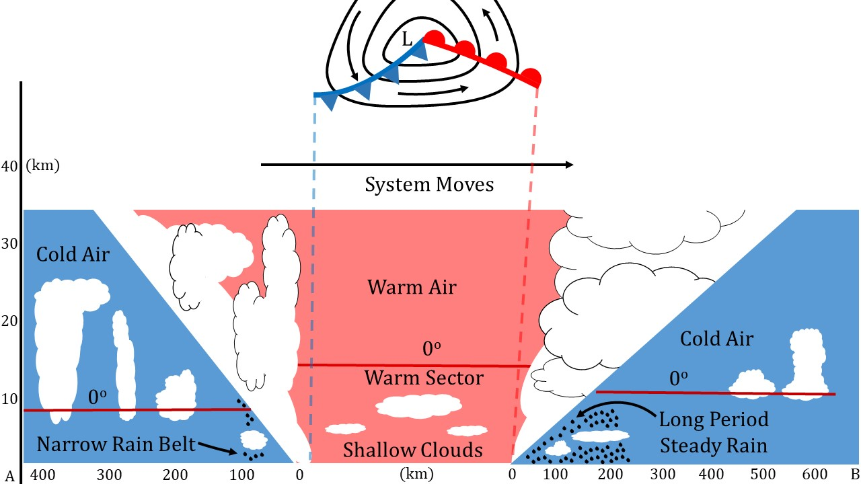
Fronts: Where They Form, and Their Types
A narrow zone where travelling air masses collide, named by which side is winning
• Air masses form in the tropics and polar regions, then get pushed into the mid-latitudes by large-scale pressure gradients. Where warm air moving north meets cold air moving south, the narrow zone between them (15–200 km, much narrower than the air masses themselves) is a front — the warm air slides up and over the cold air rather than mixing in, so crossing feels like a sudden change, not a gradual one.
• Warm front: warm air is replacing cold air at the surface. Cold front: cold air is replacing warm air. Stationary front: neither side is winning, so the boundary sits over the same region for an extended period, still bringing persistent cloud and rain.
• One air mass is usually moving faster than the other — the faster one 'pushes into' the slower one, which is what keeps the frontal zone active and stormy rather than calm.
EART23001 Atmospheric Physics & Weather | Week 11

Slide 11
Q2 — Identify the Front from the Observed Change
Name the frontal type; for cases 1–2, say which air is replacing which
• 1. Surface air changes from 5°C to 11°C as a broad zone of layered cloud and steady rain passes.
• 2. Surface air changes from 12°C to 6°C as a narrow band of heavy showers and gusty winds passes.
• 3. A strong temperature contrast stays almost stationary over the same region for 18 hours, with persistent cloud and rain.
• 4. A faster cold front catches a warm front so that the warm sector is lifted away from the surface.
EART23001 Atmospheric Physics & Weather | Week 11

Slide 12
Warm, Cold, Stationary, Occluded
WORKED ANSWER — Q2
• 1. Warm front — warmer air is replacing colder surface air.
• 2. Cold front — colder air is replacing warmer surface air.
• 3. Stationary front.
• 4. Occluded front.
• The cloud/precipitation character fits each case: gentler ascent ahead of a warm front gives the broad, layered cloud and steady rain of case 1; the steeper, more concentrated ascent along many cold fronts gives the narrower, heavier showers of case 2.
EART23001 Atmospheric Physics & Weather | Week 11

Slide 13
What Starts Cyclogenesis?
Air masses meeting is the setting — something still has to trigger the wave
• The polar-front model (next slide) describes the shape a cyclone takes once it gets going, but not what actually starts the wave growing along the front in the first place.
• Surface features can trigger it: mountains, land/sea temperature contrasts, and ocean-current effects can all perturb the front enough for a wave to begin.
• The jet stream is closely tied to it too: cyclones are almost always centred beneath the jet-stream axis, and tend to form downwind of upper-level troughs — they rarely develop where the upper-level flow runs nearly straight (zonal).
• The next-but-one slide looks at exactly why the jet stream's shape matters so much for what happens at the surface below it.
EART23001 Atmospheric Physics & Weather | Week 11

Slide 14
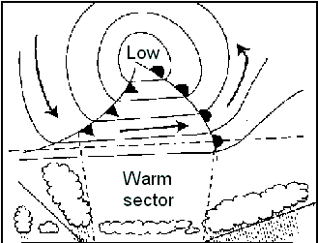
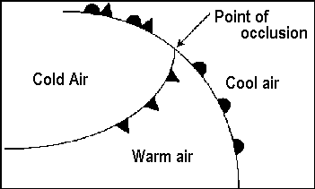
The Polar Front Model
From a wave on the polar front, to a mature low, to occlusion and decay
• It starts when warm and cold air masses meet along the polar front, moving in opposite directions; a small wave grows into a full cyclonic circulation with closed isobars and a clear warm sector between the fronts (left).
• The cold front usually moves faster than the warm front. As it catches up, warm air is lifted clean off the surface at the point of occlusion (right), and the surface warm sector shrinks and eventually disappears.
• Whether the result is a warm or cold occlusion depends on which of the two cold air masses — ahead of the old warm front, or behind the old cold front — is relatively colder.
• Once cold air completely surrounds the low, the temperature contrast that powered the system is gone: surface friction slows the circulation, and the depression fills and decays as it tracks east with the jet stream.
Mature open wave, with a clear warm sector.
The point of occlusion, where the cold front lifts the warm air off the surface.
EART23001 Atmospheric Physics & Weather | Week 11

Slide 15
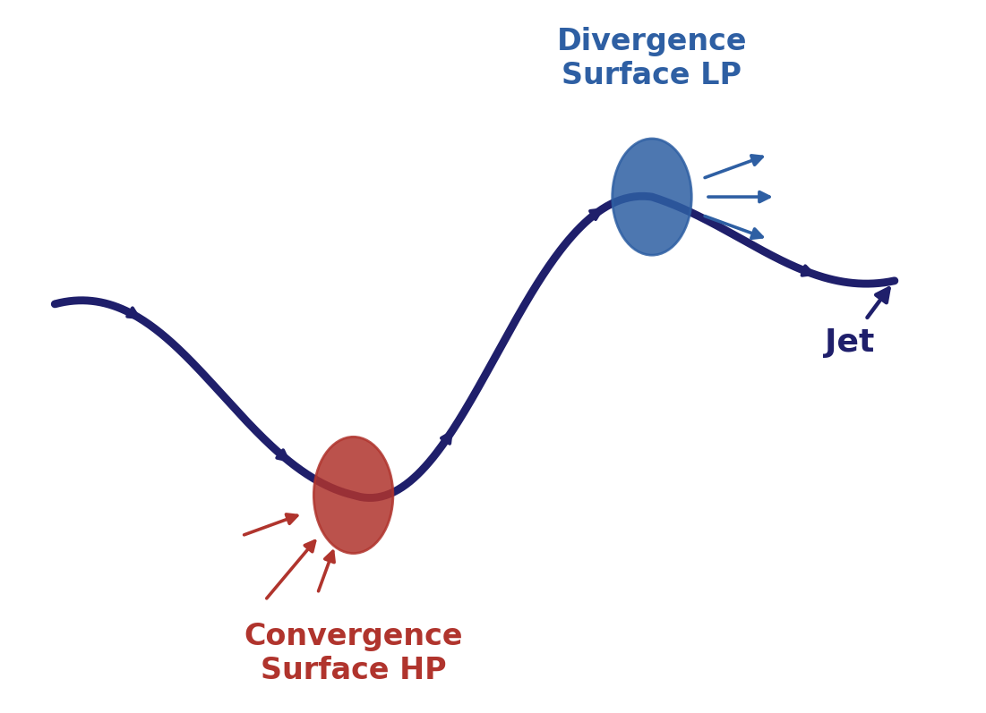
Upper-Level Waves: Why the Jet Stream Matters
Convergence and divergence aloft build the surface highs and lows beneath them
• As air moves through a bend in the jet stream, its speed changes: moving through a trough it slows down and piles up (converges); moving out of a trough towards the next ridge it speeds up and spreads out (diverges).
• Convergence aloft forces air to sink beneath it, building a surface high; divergence aloft draws air up from below, building or deepening a surface low.
• This is exactly why cyclones form downwind of upper-level troughs — the diverging, low-favouring side of the wave — while anticyclones tend to sit downwind of upper-level ridges, the converging, high-favouring side.
• Speed change isn't the whole story: directional divergence and vorticity (the rotation of the moving air) also contribute to the total divergence aloft, and hence to the strength of the surface system beneath it.
EART23001 Atmospheric Physics & Weather | Week 11

Slide 16
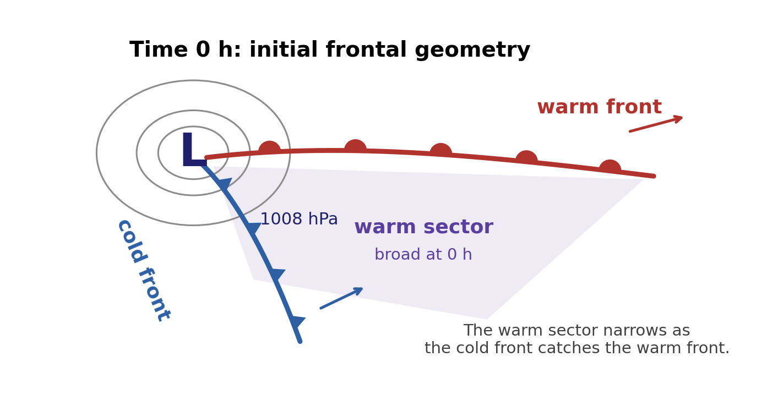
Q3 — Track a Cyclone from Its Pressure Evolution
An idealised mid-latitude cyclone's central pressure and warm-sector width
• Time (h) | 0 | 12 | 24 | 36 | 48
• Central pressure (hPa) | 1008 | 996 | 984 | 988 | 997
• Warm-sector width (km) | 600 | 450 | 250 | 0 | 0
• When is the cyclone deepening most clearly? When is it strongest? When has surface occlusion clearly occurred? What shows it filling afterwards?
EART23001 Atmospheric Physics & Weather | Week 11

Slide 17
Deepening, Mature, Occluding, Filling
WORKED ANSWER — Q3
• The cyclone deepens from 0–24 h as central pressure falls from 1008 to 984 hPa — its most clearly deepening interval.
• It is strongest at about 24 h, when central pressure is lowest.
• By 36 h the surface warm sector has disappeared (0 km) — surface occlusion has clearly occurred by this time.
• After 24 h, central pressure rises again (984 → 988 → 997 hPa) while the warm sector stays absent: the low is filling and weakening.
EART23001 Atmospheric Physics & Weather | Week 11

Slide 18
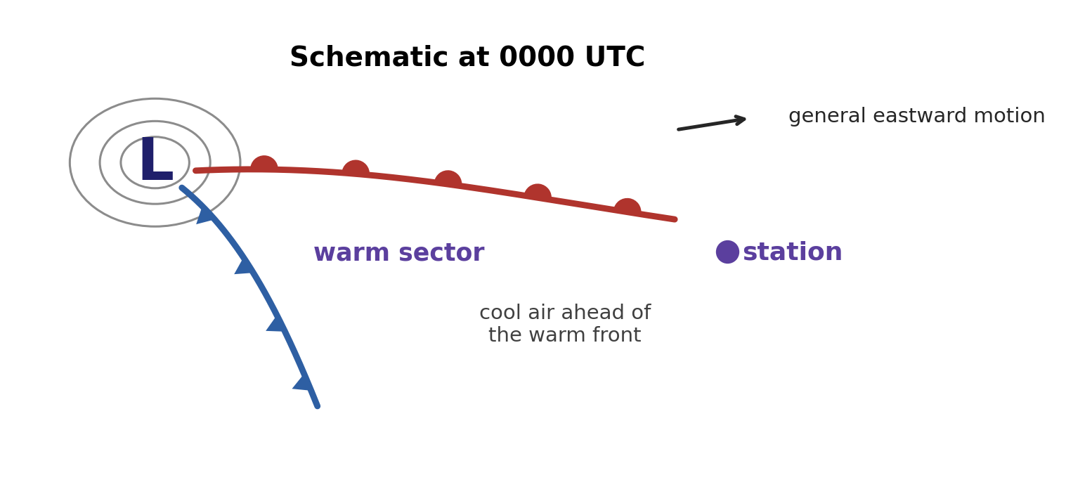
Diagnose a Frontal Passage from Station Observations
IN-CLASS DISCUSSION 1
• A station records this sequence through the day. The schematic below shows the broad synoptic setting at 0000 UTC — it is NOT intended to give the passage times directly; use the observations to diagnose those.
• 0000 | 1008 hPa | 5°C | ESE | high cloud increasing 0300 | 1004 hPa | 6°C | SE | cloud thickening
• 0600 | 999 hPa | 8°C | S | steady rain 0900 | 996 hPa | 11°C | SW | rain easing, low cloud
• 1200 | 994 hPa | 12°C | SW | mild, cloudy, drizzle 1500 | 997 hPa | 8°C | W | brief heavy showers, gusty
• 1800 | 1003 hPa | 6°C | NW | showers clearing
• Discuss: when did each front pass? Quote 3+ pieces of evidence per front, and say when the station was most clearly in the warm sector.
✍ Discuss in pairs, then we'll take answers
Worked-answers sheet, Week 11 — IN CLASS Question (Q4)

Slide 19
Warm Front ~0900, Cold Front ~1500
WORKED ANSWER — DISCUSSION 1
• The warm front most likely passes around 0900 UTC: preceding steady rain and falling pressure, a marked temperature rise, a wind veer to southwesterly, and rain easing as the station enters the warm sector.
• The cold front most likely passes around 1500 UTC: temperature falls from 12 to 8°C, wind veers from southwest to west, pressure begins rising, and there is a short period of heavy/gusty showers. By 1800 the wind is northwesterly and showers are clearing.
• The station is most clearly in the warm sector from roughly 0900 to just before 1500 UTC — mild, cloudy, with drizzle, and comparatively steady pressure and wind direction throughout.
EART23001 Atmospheric Physics & Weather | Week 11

Slide 20
Weather and Pressure Systems
PART 2 OF 3
Anticyclones, blocking highs, isobar spacing, and the passage of a depression
⏱ 0:48 – 1:08
EART23001 Atmospheric Physics & Weather | Week 11

Slide 21
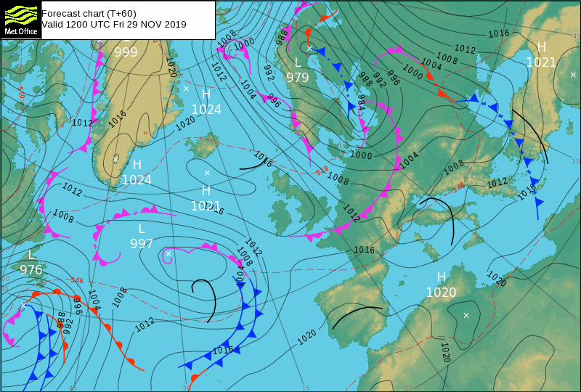
Anticyclones: Summer and Winter
The same subsiding air gives very different weather each season
• An anticyclone is a large area of high pressure where air is gently sinking (subsiding) over a wide region.
• In summer: clear skies plus strong daytime heating give sunny, warm conditions; warm, moist air can still rise locally after strong heating, so thunderstorms can develop even under a broad high; at night, clear skies let the ground radiate heat away efficiently, sometimes enough to form mist by early morning.
• In winter: skies can stay just as cloudless, but with far less solar heating, nights turn very cold with frost and fog. If the next day's sun can't burn off the fog it can persist for days, and the descending air traps pollutants near the surface instead of letting them disperse, so visibility keeps declining the longer the high sits there. Snow can even fall in eastern Britain if the flow around the high draws in cold continental air.
• A real example, from a Manchester forecast under exactly this kind of high: “Clear, sunny, possible overnight mist and frost, light winds, turning colder (3–4°C day, below 0°C night).”
Source: Met Office, Crown Copyright.
EART23001 Atmospheric Physics & Weather | Week 11

Slide 22
Q8 — Diagnose a Blocking-High Scenario
A 1035 hPa anticyclone sits almost stationary over western Europe for four days
• Atlantic cyclones that would normally move east are instead diverted north around it.
• Why is this described as a blocking high?
• What broad surface-wind and vertical-motion pattern is expected near its centre?
• Give one likely summer consequence beneath the block and one possible winter consequence.
• Why can regions around the edge of a block see persistent wet weather even while the centre stays dry?
EART23001 Atmospheric Physics & Weather | Week 11

Slide 23
A Stubborn High that Diverts the Storm Track
WORKED ANSWER — Q8
• It's a block because the large, persistent high disrupts the normal eastward progression of mid-latitude cyclones.
• Near its centre: weak, divergent surface flow with broad subsidence aloft.
• Summer: prolonged dry, sunny, potentially hot conditions. Winter: weak winds and subsidence inversions favouring frost, fog and poor air quality.
• Cyclones and their fronts are slowed or steered repeatedly around the block's flanks, so a neighbouring region can sit under a persistent storm track and receive repeated precipitation while the block's centre stays dry.
EART23001 Atmospheric Physics & Weather | Week 11

Slide 24
Isobars and the Geostrophic Wind
Why the spacing between isobars tells you the wind speed
• Above the friction layer, the wind blows (almost) parallel to the isobars, not across them — this is the geostrophic wind: a balance between the pressure-gradient force pushing air from high to low pressure, and the Coriolis force deflecting it.
• The pressure-gradient force is stronger wherever isobars are packed closer together — the same pressure change is happening over a shorter distance.
• Since the geostrophic wind is a balance against that force, closely spaced isobars mean a strong geostrophic wind, and widely spaced isobars mean a weak one — you can read approximate wind speed straight off a chart just from isobar spacing.
• This is exactly the reasoning behind Q5, next — an isobar-spacing calculation.
EART23001 Atmospheric Physics & Weather | Week 11

Slide 25
Q5 — Isobar Spacing and the Geostrophic Wind
A surface analysis has 4 hPa isobar intervals
• Near Region A, adjacent isobars are typically 80 km apart; near Region B they are 200 km apart. Assume similar latitude and air density.
• Which region has the larger horizontal pressure gradient, and by what factor?
• If the upper-air geostrophic wind in Region B is about 12 m/s, estimate the corresponding value in Region A under the same assumptions.
• Why shouldn't a forecaster expect the observed 10-m wind to match this geostrophic estimate exactly?
EART23001 Atmospheric Physics & Weather | Week 11

Slide 26
Closer Isobars, Stronger Geostrophic Wind
WORKED ANSWER — Q5
• Region A has the larger pressure gradient because the same pressure change occurs across a shorter distance: |∇p|_A / |∇p|_B = 200/80 = 2.5.
• At similar latitude and density, geostrophic wind is proportional to the pressure gradient, so v_g,A ≈ 2.5 × 12 = 30 m/s.
• Near the surface, friction slows the wind and turns it to cross isobars toward lower pressure. Terrain, buildings, stability and curvature also make the real 10-m wind depart from the ideal geostrophic value.
EART23001 Atmospheric Physics & Weather | Week 11

Slide 27
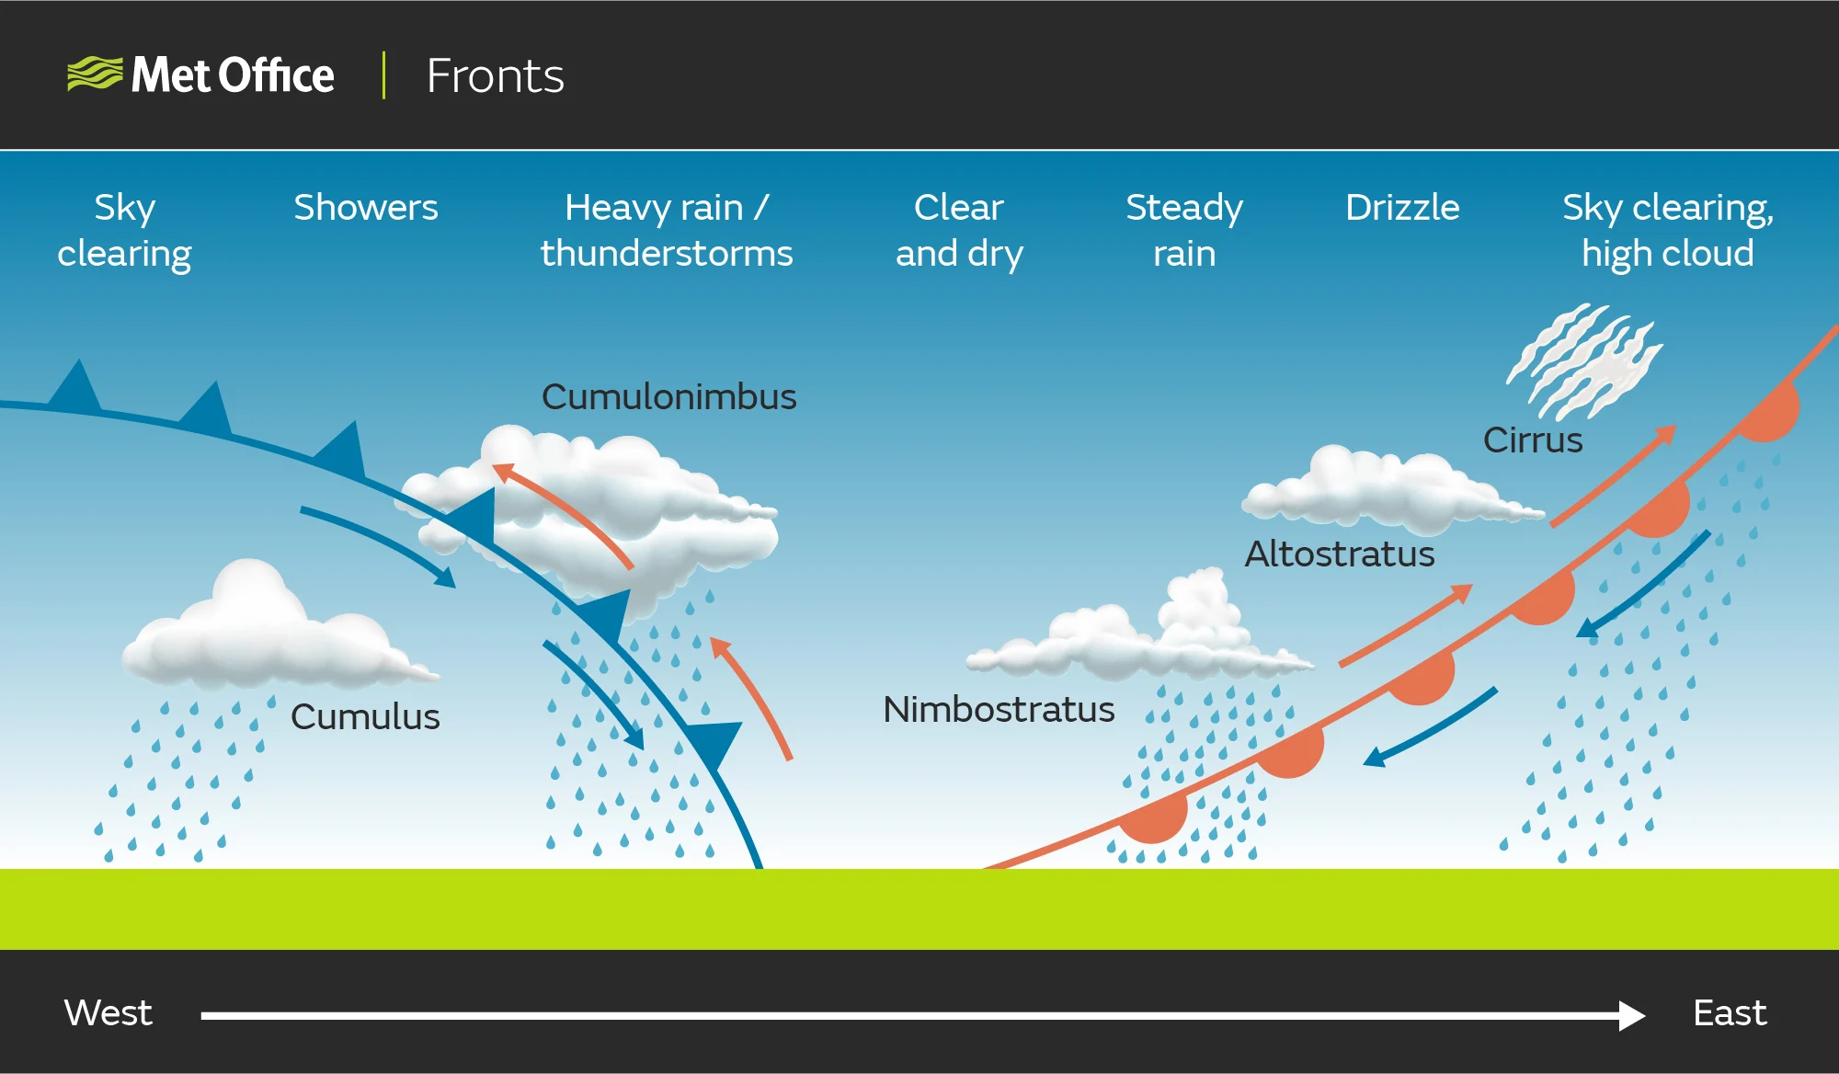
The Cloud Sequence as a Depression Passes
From the first high cirrus to clearing skies behind the cold front
• First sign: high cirrus, up to 900 km ahead of the warm front. Cloud thickens and lowers (altostratus, then nimbostratus) as it nears, with rising temperature, falling pressure, and drizzle turning to rain.
• In the warm sector, pressure stabilises and cloud decreases — warmer, drier, rain having stopped.
• At the cold front: pressure rises and temperature falls again; cumulonimbus bring heavy rain, squalls, hail or thunder — a steeper, more concentrated ascent than at the warm front.
• Behind the cold front, pressure keeps rising; scattered showers may continue, but conditions turn cool, clearer and increasingly fine.
Source: Met Office, Crown Copyright.
EART23001 Atmospheric Physics & Weather | Week 11

Slide 28
Weather Forecasting
PART 3 OF 3
From synoptic charts to numerical weather prediction, and its uncertainties
⏱ 1:08 – 1:49
EART23001 Atmospheric Physics & Weather | Week 11

Slide 29
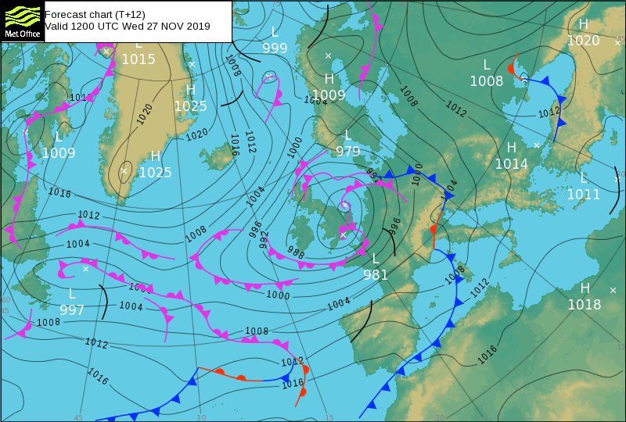
From Observations to a Synoptic Chart
Turning a snapshot of raw data into a picture of the whole atmosphere
• Forecasting begins with observations of the atmosphere's current state right through its depth (surface stations, radiosondes, aircraft, radar, satellites), collected worldwide and compiled at three WMO centres — Washington DC, Moscow and Melbourne — using an international plotting code so a forecaster anywhere can read any station's plot.
• An analyst (or, increasingly, a computer with a human check) adds isobars, high/low-pressure centres and fronts on top of the plotted data, turning raw observations into a synoptic chart. Surface charts are produced 4 times a day; upper-air charts only twice, at standard levels (850, 700, 500, 300, 200 hPa) — mapped by height contours of a pressure level rather than pressure at a fixed height.
• Other tools add more localised detail — a tephigram, for instance, shows a single radiosonde's full vertical profile (see Week 10).
• Question to keep in mind reading a chart like this one: how would you actually identify a front just from the isobars and station data?
Source: Met Office, Crown Copyright.
EART23001 Atmospheric Physics & Weather | Week 11

Slide 30
From Synoptic Forecasting to NWP
From extrapolating today's chart, to computing tomorrow's atmosphere from physics
• Synoptic forecasting extrapolates the current chart forward in time — the analogue method (what happened last time we saw a similar setup), persistence, trend forecasting, plus a forecaster's own experience and judgement. Still widely used for short-term forecasts (1–2 days) and for specific, localised events such as thunderstorms.
• As more data became available (especially upper-level winds) and computing power grew, forecasting shifted towards numerical weather prediction (NWP) — applying physics directly, rather than reasoning by analogy with the past. NWP is now the backbone of modern forecasting, with synoptic-chart reasoning still layered on top by human forecasters.
• In essence: take the basic physical principles governing gases, apply them to the atmosphere's current observed state, and calculate forward to its future state — feeding observations into the equations of motion (pressure-gradient force, Coriolis, friction — Week 5), the hydrostatic equation (Week 4), the first law of thermodynamics and ideal gas law (Week 3), and conservation of mass and water.
• NWP isn't new physics — it's the same physics you've been building all course, applied simultaneously everywhere, and stepped forward automatically by computer.
EART23001 Atmospheric Physics & Weather | Week 11

Slide 31
Q6 — Put the NWP Forecast Cycle in Order
Six stages, deliberately scrambled
• Compare the forecast with later observations • Collect surface, radiosonde, aircraft, radar and satellite observations
• Numerically integrate the atmospheric governing equations forward in time • Combine observations with a previous forecast using data assimilation
• Produce the best estimate of the 3-D initial atmospheric state • Represent unresolved processes (cloud/turbulence/surface exchange) using parameterisations
• Put the stages into a sensible forecast-cycle order, then identify two distinct sources of forecast error.
EART23001 Atmospheric Physics & Weather | Week 11

Slide 32
Observe → Assimilate → Initialise → Integrate → Compare
WORKED ANSWER — Q6
• 1. Collect observations. 2. Combine with a previous forecast via data assimilation. 3. Produce the best 3-D initial-state estimate. 4. Integrate the governing equations forward in time. 5. Represent unresolved processes via parameterisations. 6. Compare the forecast with later observations.
• In an operational model, step 5's parameterisations are applied during step 4's integration — they're listed separately here only so the stages map directly onto this scrambled question.
• Two important error sources: uncertainty/incompleteness in the initial atmospheric state, and imperfections in the model itself (finite resolution, parameterised unresolved processes). Numerical approximation and chaotic growth of small errors also contribute.
EART23001 Atmospheric Physics & Weather | Week 11

Slide 33
Why Forecasts Are Uncertain
NWP isn't always right — understanding why is part of forecasting well
• Small variations in the initial conditions fed into the model can produce very different results later on — NWP is sensitive to missing or slightly inaccurate input data.
• Limited spatial resolution is also a problem: anything smaller than a model's grid spacing can't be represented directly.
• The underlying physics is sound, but some processes (small-scale turbulence, cloud formation, surface heat/moisture exchange) have to be simplified, or 'parameterised', rather than calculated exactly.
• Forecasters combine several models, satellite and radar observations, and their own experience — and increasingly run many slightly different versions of the same forecast together, an ensemble, to see how much those small initial differences actually matter.
EART23001 Atmospheric Physics & Weather | Week 11

Slide 34
Q7 — Interpret an Ensemble Forecast
A 20-member ensemble forecast for Manchester, tomorrow afternoon
• 14 members produce measurable rain. 6 members produce more than 10 mm. 4 members remain completely dry.
• Estimate the ensemble probability of measurable rain, of more than 10 mm, and of a completely dry outcome.
• A single deterministic run predicts 12 mm. Explain why reporting “12 mm will fall” without the ensemble information would be misleading.
EART23001 Atmospheric Physics & Weather | Week 11

Slide 35
70% Rain, 30% Heavy, 20% Dry
WORKED ANSWER — Q7
• P(rain) = 14/20 = 70%. P(>10 mm) = 6/20 = 30%. P(dry) = 4/20 = 20%.
• The deterministic 12 mm solution is only one plausible trajectory. The ensemble shows substantial uncertainty — some members are dry, and only 30% exceed 10 mm.
• A forecast should communicate probability/range rather than presenting a single run as certain.
EART23001 Atmospheric Physics & Weather | Week 11

Slide 36
Other Methods, and Long-Range Limits
NWP isn't used alone, and no forecast stays accurate forever
• Statistical methods use known patterns — e.g. the typical relationship between season, wind direction, humidity and cloud, and the resulting maximum temperature.
• Analogue and persistence methods are still used alongside NWP, especially for long-range forecasting, where 'similar to now' or 'similar to last time this happened' can be a useful starting point.
• Nowcasting spots situations occurring or about to occur right now, relying heavily on satellite and radar — used especially for severe-weather warnings, where there's no time to wait for a full NWP run.
• Forecast accuracy diminishes the further ahead you look. Long-range forecasts (a month or season ahead) rely heavily on climatic data, giving broad hotter/colder/wetter/drier-than-usual guidance: the general atmospheric progression is modelled, then adjusted against statistical/seasonal patterns and compared to the climatic norm.
EART23001 Atmospheric Physics & Weather | Week 11

Slide 37
Q9 — AI and Physics-Based Forecasting
A conventional NWP model and a data-driven ML model both produce a 5-day forecast
• The ML model runs much faster; the NWP model explicitly evolves conservation laws and parameterised physical processes.
• Give one scientific or operational advantage of the ML approach.
• Give one advantage of retaining physics-based NWP.
• Why might a forecasting centre use both, rather than treating them as mutually exclusive replacements?
EART23001 Atmospheric Physics & Weather | Week 11

Slide 38
Complementary Strengths, Used Together
WORKED ANSWER — Q9
• ML: can generate forecasts very rapidly and learns useful high-dimensional relationships from large reanalysis/observation datasets.
• Physics-based NWP: retains an explicit dynamical/thermodynamic structure, supports process diagnosis, and stays closely integrated with data assimilation.
• Using both exploits complementary strengths — fast ML forecasts can add ensemble members or guidance, while physics-based models provide physically interpretable predictions for conditions poorly represented in training data. Operational systems compare, blend and verify both.
EART23001 Atmospheric Physics & Weather | Week 11

Slide 39
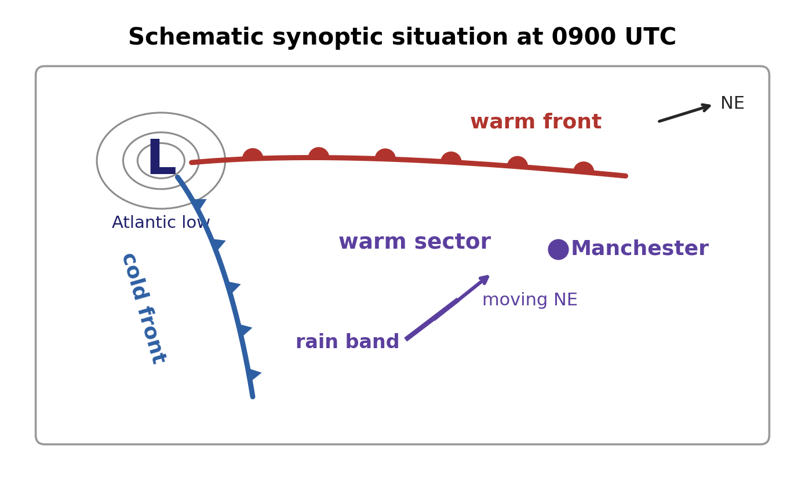
Integrative UK Weather Case: Chart, Sounding and Radar
IN-CLASS DISCUSSION 2
• At 0900 UTC a deep Atlantic low lies west of Ireland; a warm front moves NE across Wales and a cold front approaches SW England. Manchester is in the warm sector: T=11°C, dew point 9°C, pressure 995 hPa falling 2 hPa/3h, wind 210° at 12 m/s.
• A nearby sounding shows a near-saturated layer 1–3 km, a freezing level near 2.2 km, and winds increasing to 30 m/s by 5 km. Radar shows a narrow band of heavier precipitation 120 km SW, moving NE at 50 km/h.
• Discuss: when will the rain band arrive? Is cloud likely before frontal passage? Why are falling pressure and strengthening upper winds consistent with an approaching cyclone? What precipitation phase, and why? What changes as the cold front passes? What uncertainty can't be removed from the data given?
✍ Discuss in pairs, then we'll take answers
Worked-answers sheet, Week 11 — IN CLASS Question (Q10)

Slide 40
2.4 Hours, Rain, and a Classic Frontal Passage
WORKED ANSWER — DISCUSSION 2
• At 50 km/h, a band 120 km away arrives in t = 120/50 = 2.4 h — roughly 2–3 hours later if motion and structure are maintained.
• The dew-point depression is only 2 K, and the sounding is nearly saturated through 1–3 km: low/mid-level cloud is very likely before frontal passage. Falling pressure and stronger winds aloft are both typical of an approaching/deepening cyclone and its frontal zone.
• The freezing level (~2.2 km) leaves ice hydrometeors a substantial above-freezing layer to melt in, so rain is the most likely surface precipitation phase.
• As the cold front passes: wind veers, temperature falls, pressure stops falling then rises, and a short period of heavier rain/showers is likely, with cooler, more broken/showery conditions behind it.
• Remaining uncertainty: the exact frontal/radar-band speed and intensity, small-scale convective enhancement, and how the cyclone itself evolves — a diagnosis, not a guarantee of the next six hours.
EART23001 Atmospheric Physics & Weather | Week 11

Slide 41
Wrap-Up
• Air masses take their character from a source region; fronts are where contrasting air masses meet, and the polar front model explains how a mid-latitude cyclone forms, occludes and decays along one.
• Surface pressure systems (anticyclones, blocking highs) and isobar spacing (via the geostrophic wind) both shape day-to-day British weather.
• Forecasting moves from observations → synoptic charts → NWP, applying the same physics from earlier in this course, with ensembles and — increasingly — machine learning helping quantify and communicate uncertainty.
• Next week: Week 12 — the global energy balance, closing the course's dynamics and physics threads.
EART23001 Atmospheric Physics & Weather | Week 11

