Slide 1
Latency–Fairness vs. Throughput in Non-Preemptive Shared GPU Scheduling
Yayen Lin
Xuechun Jin
Jianing Ou
Matthew Kearney
CS/ECE 757
Spring 2026

Slide 2
Motivation
Shared GPUs + Non-Preemptive Execution = Hard Scheduling Problem
Kernels cannot be interrupted
Scheduling decisions directly impact:
Latency
Throughput
Fairness
We explore how different scheduling policies and execution modes shift this tradeoff
1
THROUGHPUT
Non-Preemptive
GPU Scheduler
LATENCY
2
3
FAIRNESS

Slide 3
Problem Statement
FIFO
When multiple workloads share a GPU, jobs can get stuck waiting behind others.
Two forces compete:
Scheduling Policy → Who runs next? (FIFO, Priority, Dependency-aware)
Execution Mechanism → How do we launch work? (Small batches vs large batches vs levels)
Levelized DAG
Level 1
A
Level 2
B
C
Level 3
D
E
time
Notes:
Policy makes decisions within the space allowed by the execution mechanism

Slide 4
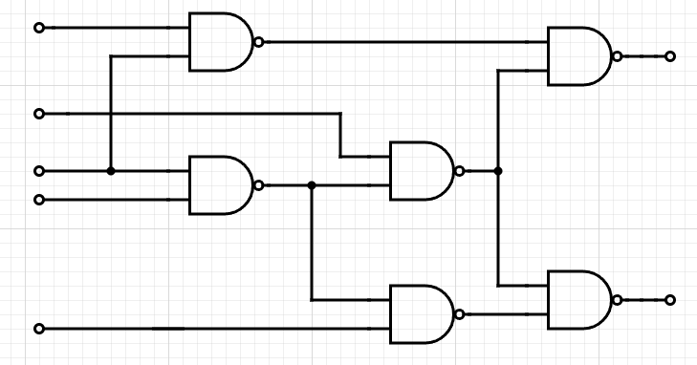
Approach Ⅰ: Workload Modeling
in1
ISCAS-85 Circuit Benchmarks
We use circuit logic benchmarks to create complex, realistic task graphs
Nodes: Every gate maps to a synthetic CUDA kernel
Edges: Data dependencies between gates
LSIM Framework: Executes these task DAGs on physical NVIDIA GPUs
in2
in3
in4
in5
in1
in2
in3
in4
in5
C17 (ISCAS-85 Smoke Test)

Slide 5
Scheduling Policies:
Fan-in Priority
1
3
4
5
FIFO
Priority = fan-in, higher fan-in runs first
Smallest Job First (SJF)
5
4
3
1
Fan-in: number of input edges (predecessors)
Priority = fan-in, lower fan-in runs first
Notes:
Cool looks nice

Slide 6
Scheduling Policies:
Dependency Aware
1
3
4
5
Priority = fan-out, higher fan-out runs first
Fan-out: number of output edges (successors )

Slide 7
Execution Modes
Execution Mode
Blocking: The CPU launches a batch of N gates and waits for all of them to finish before moving on.
Non-blocking: The CPU continuously checks for completed gates and immediately launches newly-ready ones, keeping the GPU busy without waiting for a full batch to finish.

Slide 8
Evaluation Metrics
Primary Timing (Speed)
Makespan: Total wall-clock time from start to finish.
Average Wait Time: How long gates sit in the queue before being launched.
Throughput: Total tasks completed per second.
Responsiveness (Efficiency)
Average Slowdown: Turnaround time relative to execution time; measures the "delay" felt by each gate.
Weighted Slowdown: Penalizes the starvation of high-priority gates (low fan-in) more heavily.
GPU Utilization: The percentage of time the GPU was actually busy during the stream.
Fairness (Equity)
Jain’s Fairness Index: A score (0 to 1) measuring if resources were shared fairly across different circuit workloads.
Completion Variance: Measures the consistency of finish times within a single workload to identify "jitter."

Slide 9
Key Observation 1

Slide 10
Key Observation 2

Slide 11
Key Observation 3

Slide 12
Results

Slide 13
Limitations

Slide 14
Future Work

Slide 15
Conclusion

Slide 16
Q&A
Thank you for your attention

