Slide 1
链表反转

Slide 2
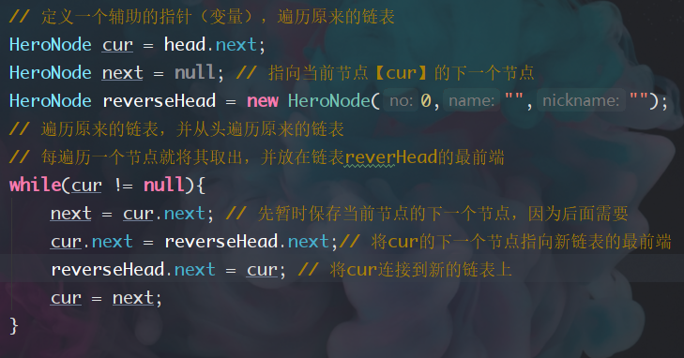
cur
next
cur=head.next
next=null
new reverseHead
head
1
2
3
4
5
6
reverseHead
next
head
2
3
4
5
6
1
1
reverseHead
reverseHead
cur
next
head
3
4
5
6
2
1
reverseHead

Slide 3
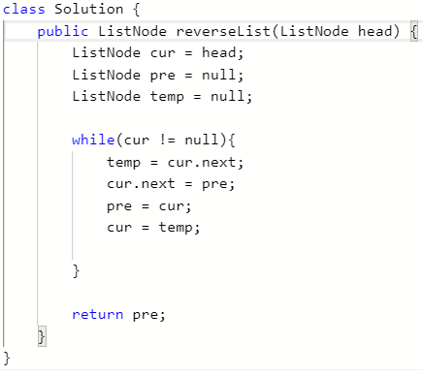
pre=null
pre
cur
cur=head
1
2
3
4
5
6
temp
temp=null
cur
temp
pre
1
2
3
4
5
6
cur
pre
temp
1
2
3
4
5
6
cur
pre
temp
1
2
3
4
5
6

