Slide 1
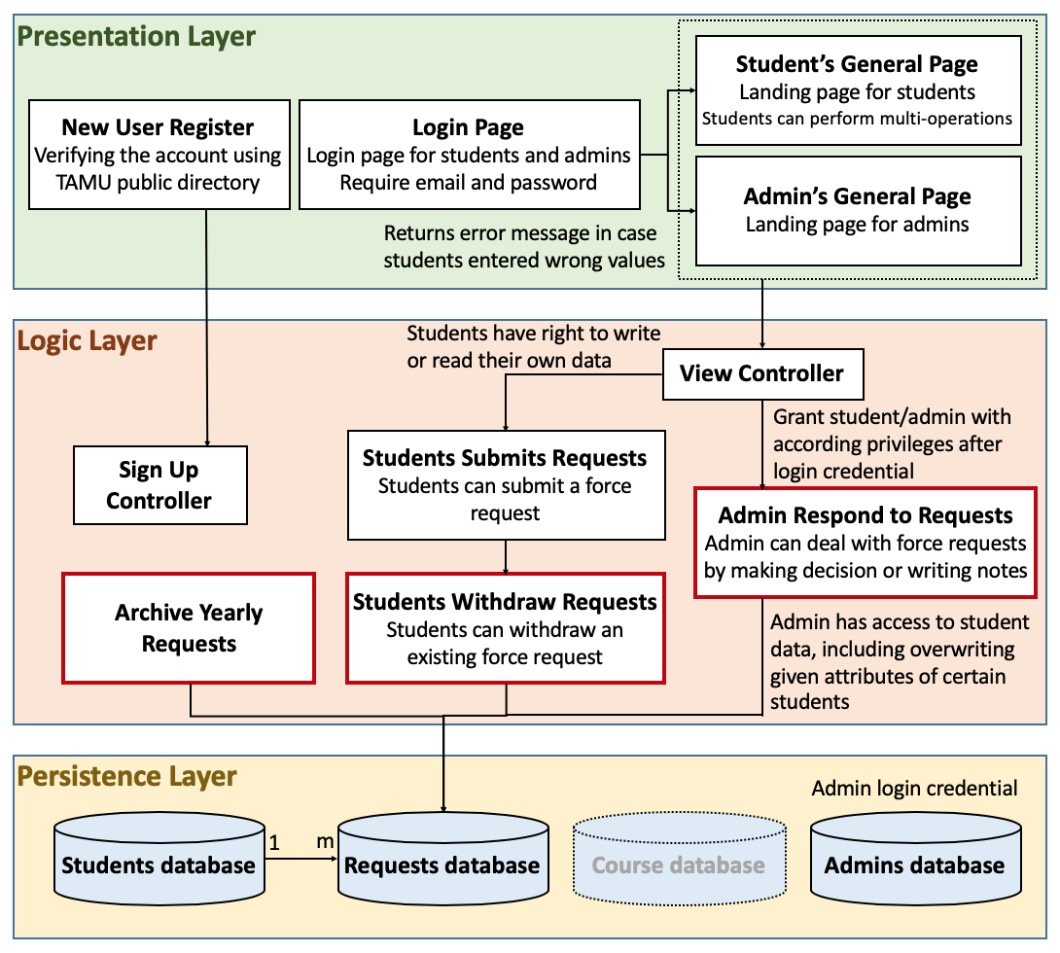
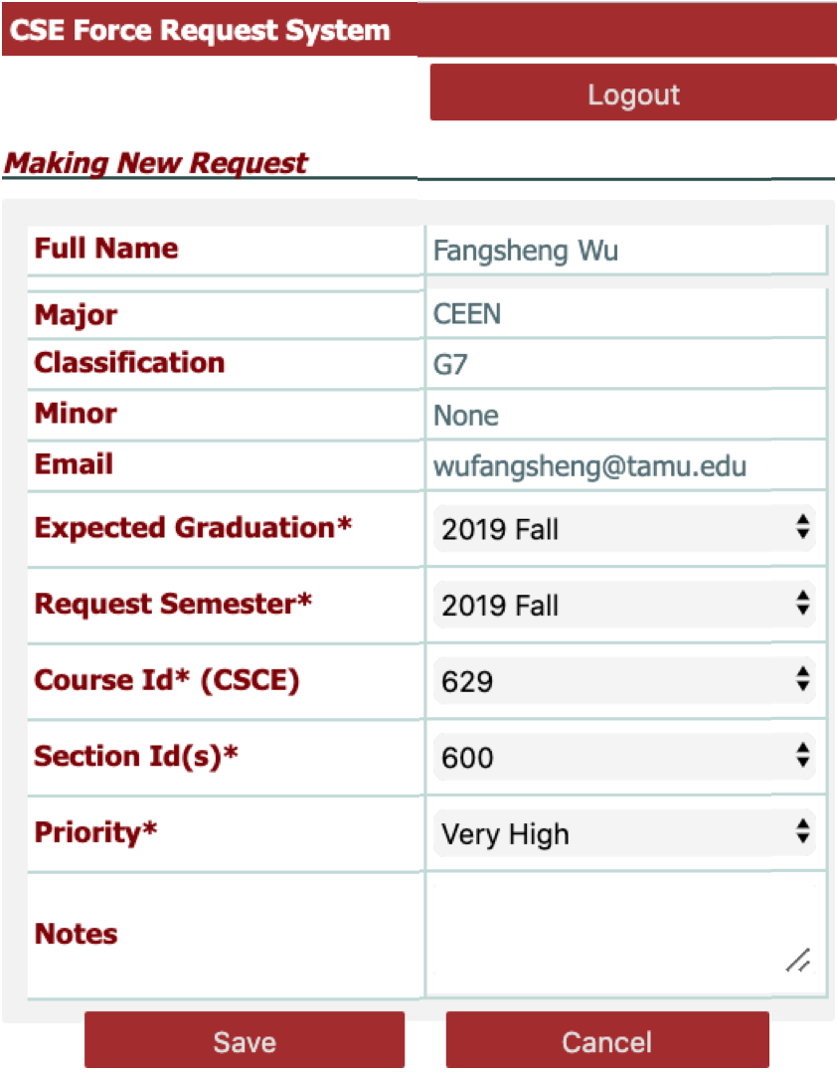
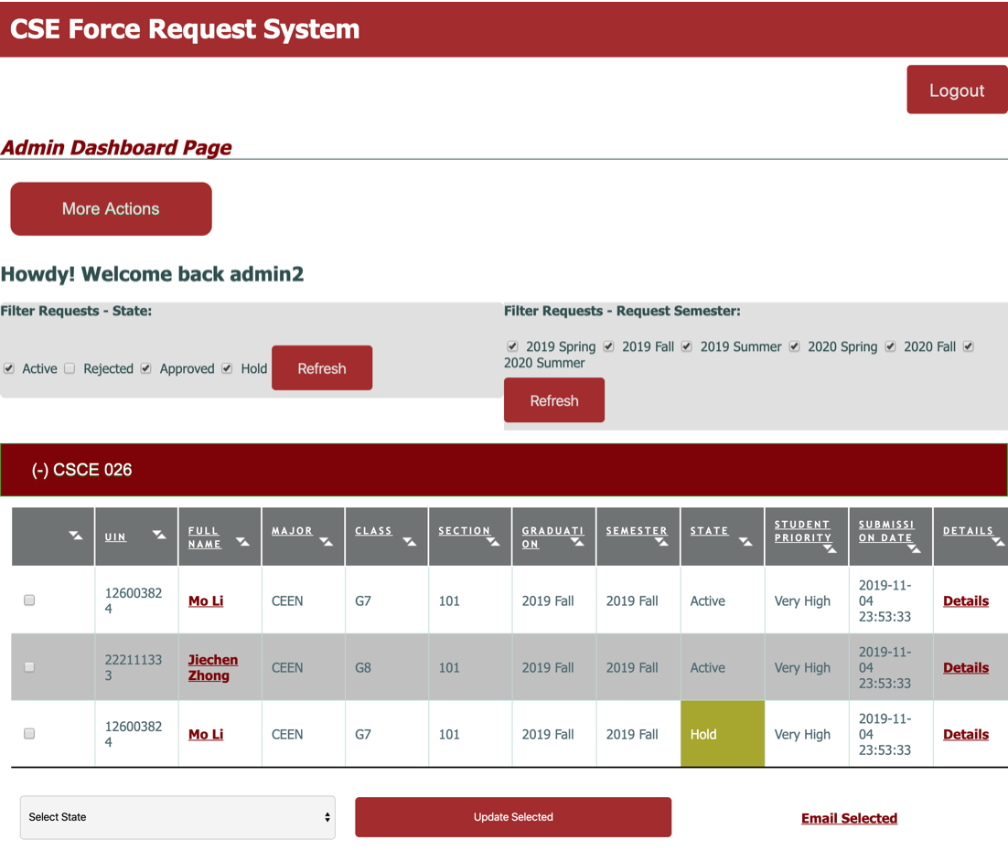
Force Request System For CSE Department
Dongwei Qi(SCRUM master), Lianghao Zou(Product Owner), Jing Jiang, Fangsheng Wu, Cheng Chen, Jianghao Shen
Team TitaniumSouth| CSCE 606: Software Engineering | Fall 2019 Semester | Texas A&M University | Customers: Dr. Hank Walker
The Force Request System
is a legacy project developed to replace the existing Force Request system on CSNet. This is a legacy project our team inherited to improve the functionalites and add additional features for administrators.
Customer Expectation
Application Structure
The detail links should be click-able
Add force request for the admins
Students should get access to the priorities
Customers need the admin login ID to see the 606 and 629 force requests, and start processing them for Spring 2020.
Students need the ability to *WITHDRAW* a force request. One student said they submitted a request, now want to withdraw it, and there is no way to do that.
Customers need to be able to archive the requests for each year, that is, dump them into an Excel spreadsheet. We use past force requests to estimate future class demand.
Admin should be able to wipe the database, with a confirmation dialog.
As we discussed the admin needs a way to load all the courses and sections for a semester in a batch load from a file of some format. The admin also needs the interface to add individual courses and sections.
The admin needs a way to delete courses and sections, e.g. when the course is canceled. That way students don’t try to submit force requests for a course that is “0 0 0” in Howdy, that is, no seats allocated, which means canceled.
User Stories
Iteration 1
Deployed the system on Heroku:
https://peaceful-fjord-63136.herokuapp.com/
Found a legacy code bug:
Users did not receive confirmation email during signup
Iteration 2
Made the detail links clickable:
We implemented this function such that the “Details” link of each request instance should have the attribute of “clickable” making it more indicative.
Added force request for the admins:
We implemented this function such that administrators can add new force requests through the “More Actions” operation.
Iteration 3
Created admin test accounts:
We created the admin login ID so that the professor can see the 606 and 629 force requests, and start processing them for Spring 2020.
Rejected duplicated force requests for the same section:
We implemented a function such that any students cannot duplicate request for one section of one same course.
Iteration 4
Withdrew an existing force request:
When a student submitted a force request, he or she can click “delete” so that the request could be withdrawn.
Archived requests log into excel:
We implemented a function to archive the requests for each year, and dump them into an excel spreadsheet. Professors can use past force requests to estimate future class demand.
Future Works and Challenges
User & Admin Interface
Future Works:
Notes for admin should be editable:
Former students’ info should be editable rather than written in code.
Get rid of the level classifications:
Students should have no privilege of determining the class (grade).
Upload all course information from excel:
The admin needs a way to upload all the courses information for a certain semester from a file like csv.
Admin can wipe the database:
Admin should have the privilege of empty last semesters’ requests.
Challenges:
Development Environment Establishment Problem
Hard Coded Courses
Clear Force Requests Efficiently

