Slide 1

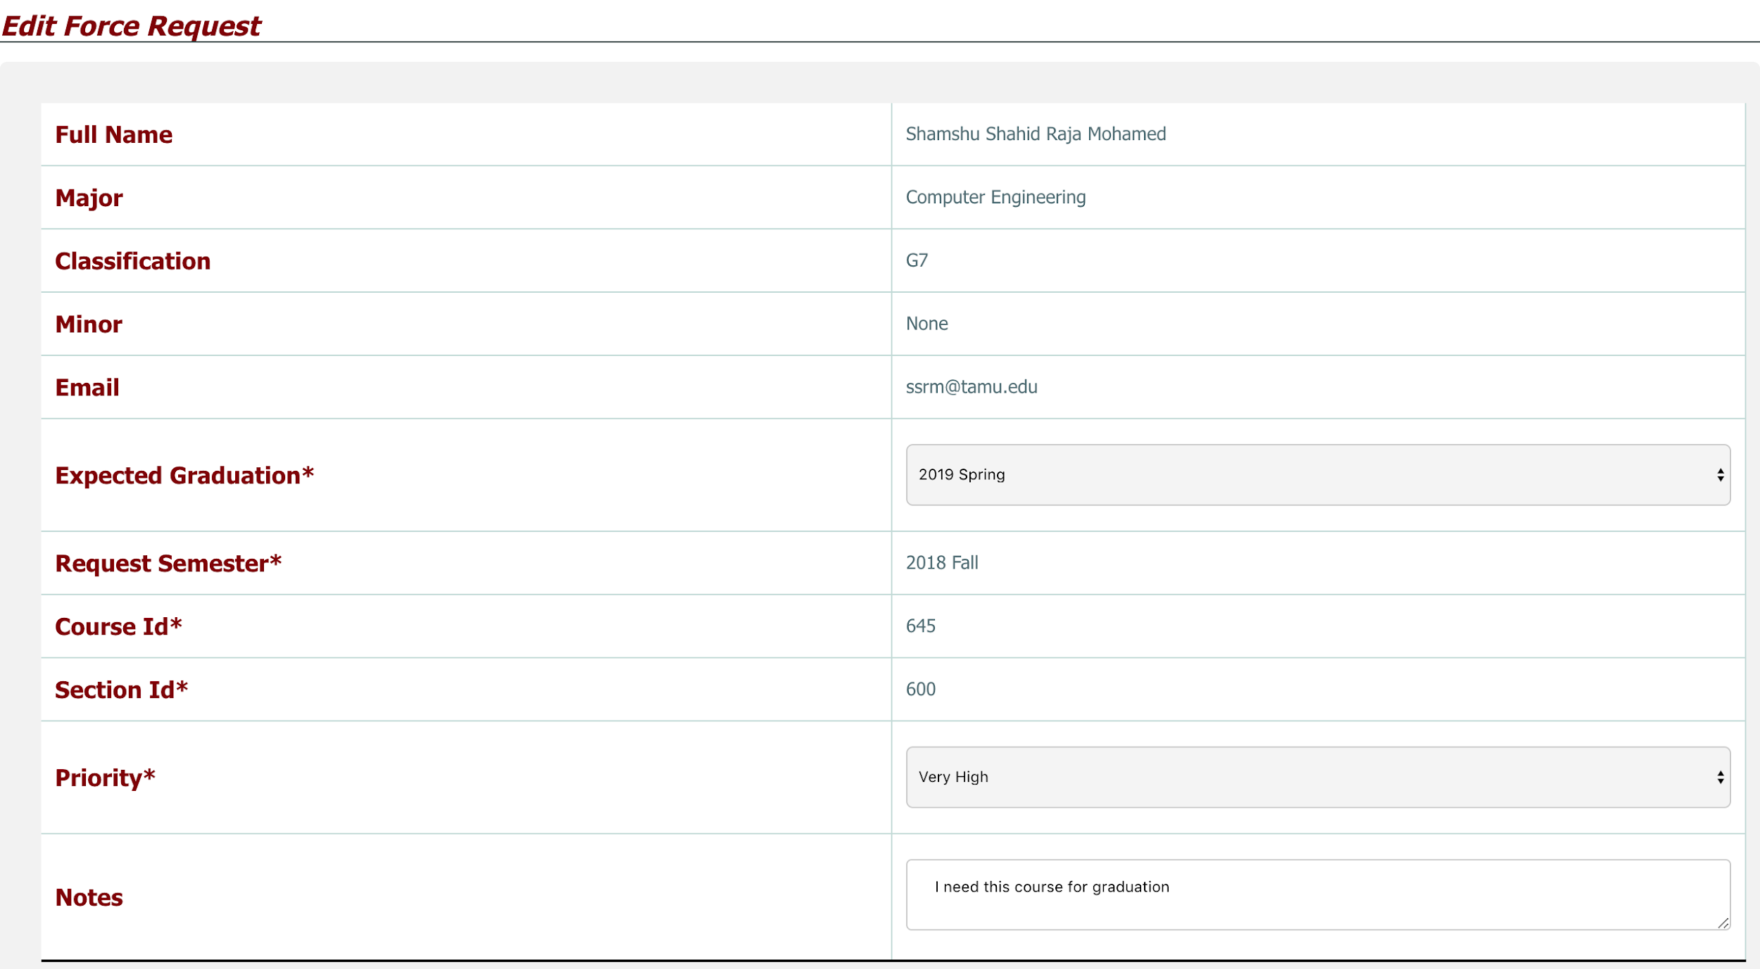
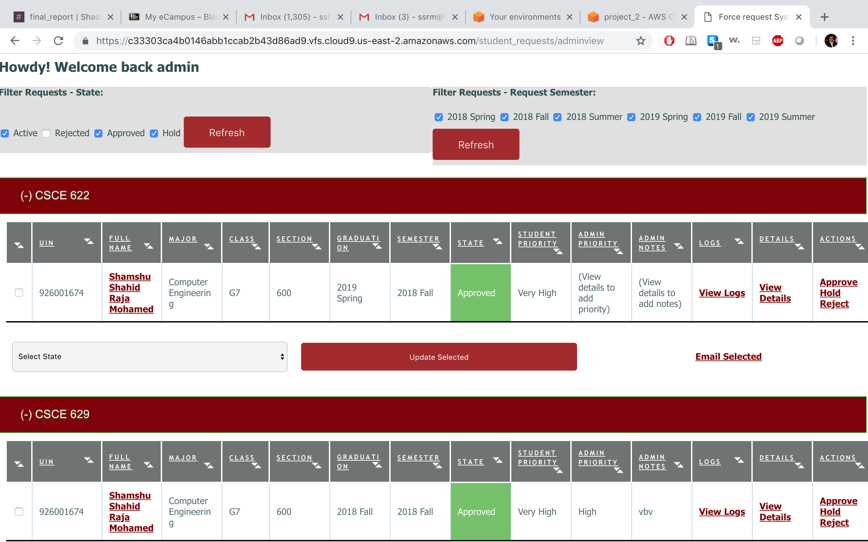
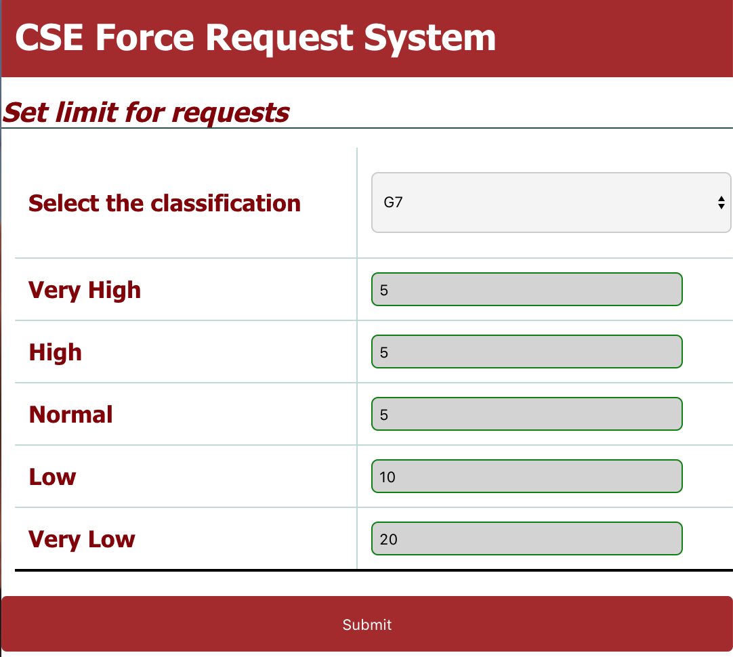
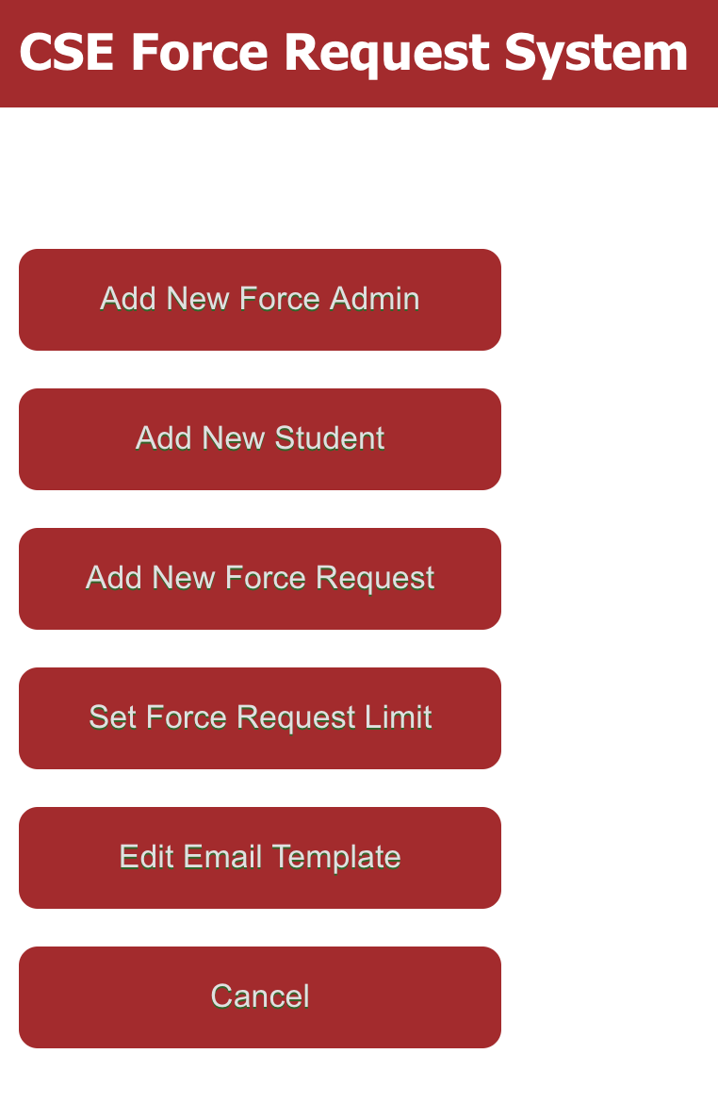
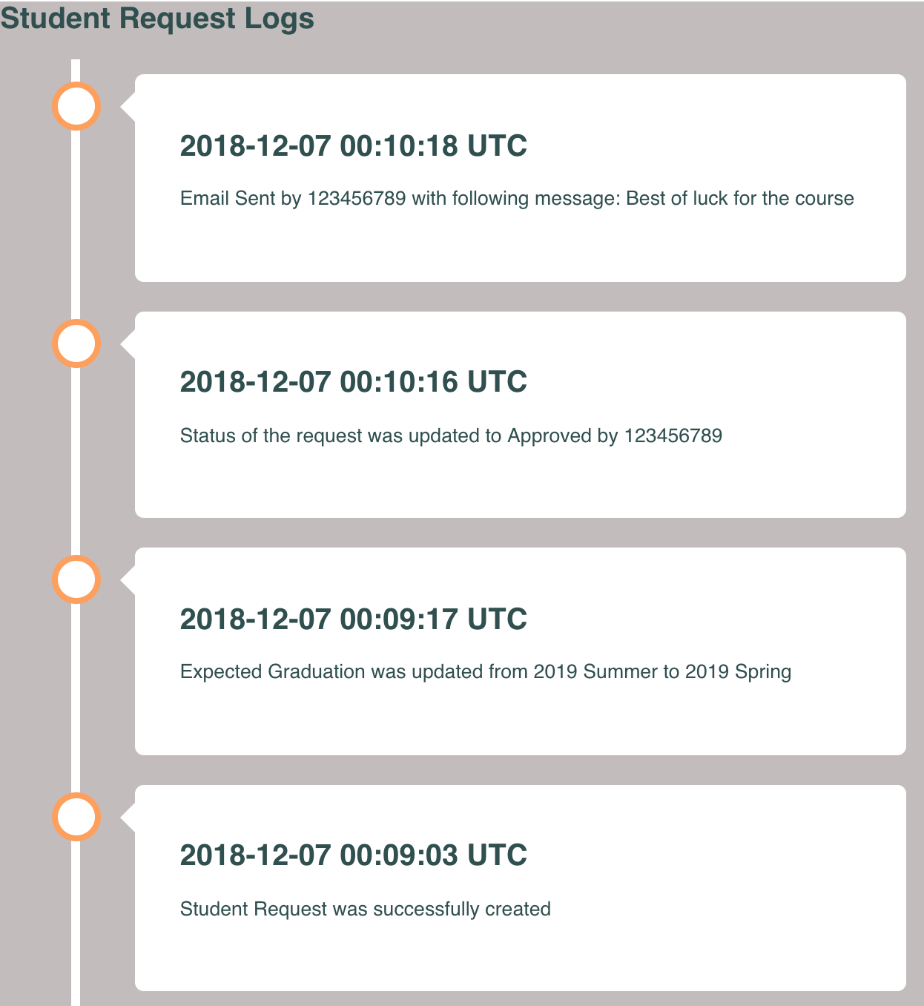
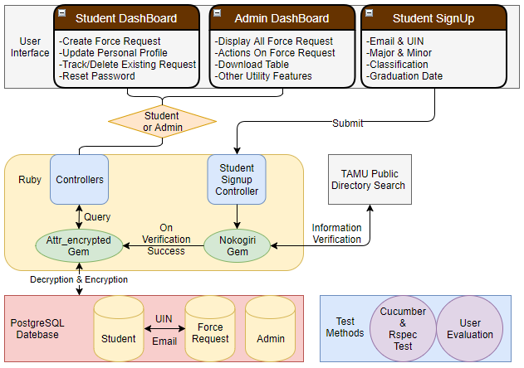
CSCE FORCE REQUEST SYSTEM
Team Shadow Coders: Abdullah Abdul Kader, K. Abhishek Das, Nishant Aditya, Niti Jain, Ramesh Ghimire, Shamshu Shahid Raja Mohamed, Sulav Adhikari
Project Advisors: Dr. James Raley Marek, Dr. Richard Furuta, Dr. Scott Schaefer and Dr. Vivek Sarin
OVERVIEW
APPLICATION FEATURES (ADMINISTRATOR)
APPLICATION FEATURES (STUDENT)
The Force Request System is a legacy project developed to replace the existing Force Request system on CSNet. This is a legacy project our team inherited to improve the funtionalites and add additional features for administrators.
Added a feature for admins to prioritize the requests
Admins are given the ability to add a priority level to a particular request
Admins can set a limit to the number of requests
Admins can set a maximum limit to number of requests per priority level
Added a customized email template that admins can edit
Admins are given the ability to edit the default template of the email
Admins can also personalize each message when taking an action
Added a logging feature
Admins can select a request and see a log of actions on that request
Date of creation
Date modified/ updated
Admin actions along with Admin name and time
Allow students to prioritize their requests
Students can prioritize their requests across 5 priority levels
Allow students to modify their requests
Students are given the option of going back and changing the following features of their request:
OUR ASSIGNMENT
Request Priority
Notes
Expected Graduation
Inherit legacy system codebase and run it in production
Refactor the code and fix bugs if any
Enhance student experience with the system
In the legacy system the students couldn’t do so much beyond submitting requests. There was a need for a more interactive experience for the students with the system
Enhance Admin Experience with the system
Develop key additional features for the admins which provide them more control over the system
Improve ability of the system to report and log actions of users
Student View for Editing Requests
Admin Dashboard View
Admin Features
CHALLENGES
Encryption
App level encryption in heroku.
Bugs in Legacy code
When we received the legacy code, we found a few bugs that we had to fix initially
SOFTWARE DESIGN AND IMPLEMENTATION
WHAT WE LEARNED
Test Early and Often: Without frequently testing, making small feature changes could have potentially widespread bad consequences.
Test Locally and on Heroku: Features that work locally often do not work once deployed.
Customer Communication is Key: With a project of this scale, picking the most important features to implement was dependent on consistent customer communication.

