Slide 1



X
Perfomance Analytics
Business Year 2020-2023
Kimia Farma - Big Data Analytics
Presented by
SUYANTO

Slide 2

About Me 3
Table of Contents
Tabel Analisa 9
BigQuery Syntax 12
About Company 4
Dashboard 14
Project Portfolio 5
Recommendations 17
Links 18
Importing Dataset 6
2

Slide 3




About Me
SUYANTO
Data Analytics & Engineering Professional with 4+ years in FMCG sales, specializing in data visualization, SQL, Python, and data engineering. Achieved "Distinction" in Tetris Data Analyst Fast Track and MySkill Data Bootcamp.
Completed internships at Bio Farma Group, developing Power BI dashboards and using Google BigQuery, and graduated from Digital Skola Fast Track Data Engineer and AWS re/Start programs. Certified as an AWS Cloud Practitioner with hands-on cloud experience.
Skilled in delivering actionable insights through data-driven solutions.
Pontianak, West Kalimantan
suyanto.zhang31@gmail.com
linkedin.com/in/suyanto-zhang/
3

Slide 4
About Company
Founded in 1817 by the Dutch East Indies government, Kimia Farma is Indonesia's first pharmaceutical company. Initially named NV Chemicalien Handle Rathkamp & Co, it was nationalized in 1958 and renamed PNF Bhinneka Kimia Farma. The company transitioned to PT Kimia Farma (Persero) in 1971 and became a publicly listed company in 2001, establishing itself as an integrated healthcare provider contributing significantly to Indonesia's health sector.
In 2020, 90.025% of Kimia Farma's shares were transferred to PT Bio Farma (Persero), forming the State-Owned Pharmaceutical Holding. Along with this restructuring, the company’s name changed to PT Kimia Farma Tbk. With decades of experience, Kimia Farma continues to play a vital role in national health development.
website : kimiafarma.co.id/
4

Slide 5
Background : Big Data Analytics Internship at Kimia Farma: Evaluating business performance from 2020 to 2023 using data-driven insights. Dataset : - kf_final_transaction.csv = customer transaction details - kf_inventory.csv = product inventory stocks - kf_kantor_cabang.csv = branch store details - kf_product.csv = product details Problem : - Create analysis tables by aggregating data from the four previously imported tables using Google BigQuery. - Develop a performance analysis dashboard for Kimia Farma (2020-2023) using Google Looker Studio.
Project Portfolio
5

Slide 6
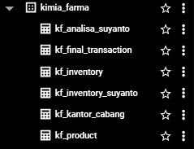
Importing Dataset to BigQuery
Task
Import the provided datasets into BigQuery as tables. Use the dataset names as table names, excluding the ".csv" extension
kf_final_transaction.csv → kf_final_transaction
kf_inventory.csv → kf_inventory
kf_kantor_cabang.csv → kf_kantor_cabang
kf_product.csv → kf_product
Data Preparation
Check the data for :
Missing values
Duplicates
Inconsistent formats
The data is already in good shape with no issues detected.
6

Slide 7
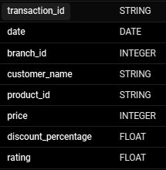
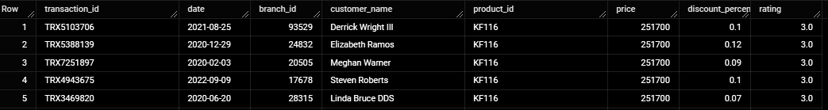
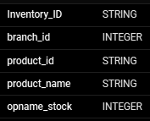
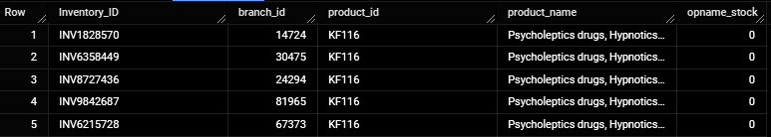
kf_final_transaction (8 Columns and 672,458 Rows)
Importing Dataset to BigQuery
kf_inventory (5 Columns and 1,035,000 Rows)
7

Slide 8
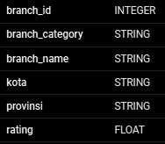
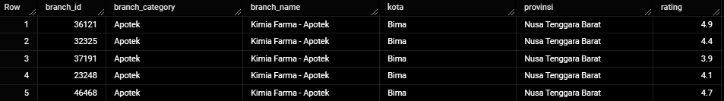
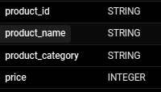
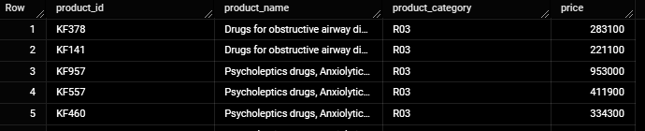
Importing Dataset to BigQuery
kf_kantor_cabang (6 Columns and 1,725 Rows)
kf_product (4 Columns and 150 Rows)
8

Slide 9
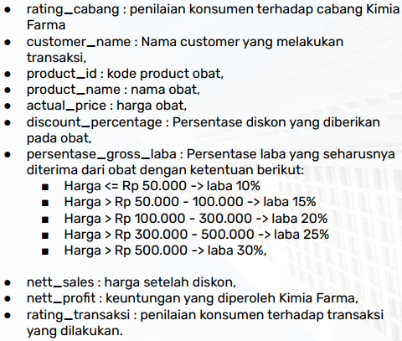
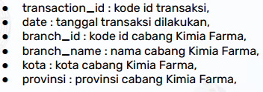
Tabel Analisa
Create a table with the following conditions. Total 16 Columns
9

Slide 10
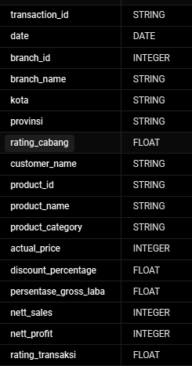
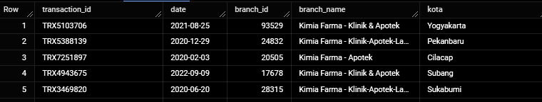
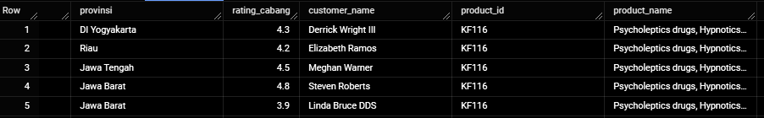
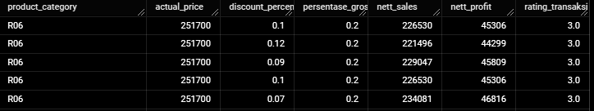
Tabel Analisa
The query result table has a total of 17 columns (including an additional column for product_category) and 672,458 rows.
10

Slide 11
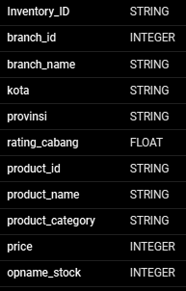
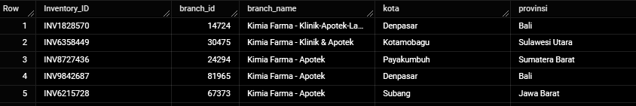
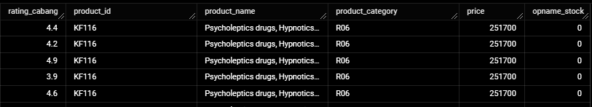
Tabel Analisa
An additional table will be used for stock opname visualization, containing 11 columns and 1,035,000 rows.
11

Slide 12
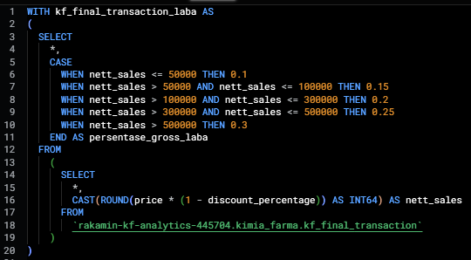
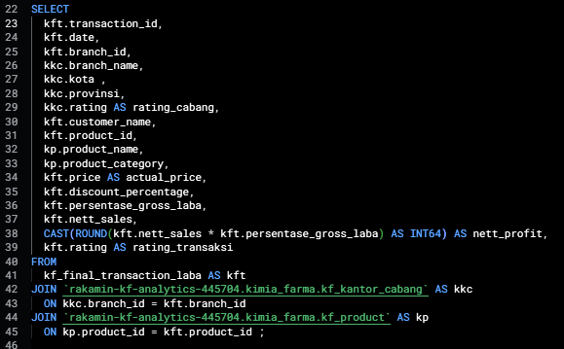
BigQuery Syntax
Table Analisa :
Using CTEs and subqueries to reduce redundancy in the use of CASE WHEN statements and applying CAST to INT64 to ensure the results are in whole numbers.
Table :
kf_final_transaction, kf_kantor_cabang, kf_product
12

Slide 13
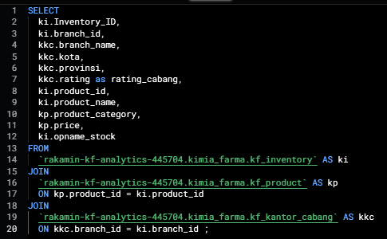
BigQuery Syntax
Table Inventory Stocks :
Direct query by joining several tables
Table :
kf_inventory, kf_kantor_cabang, kf_product
13

Slide 14
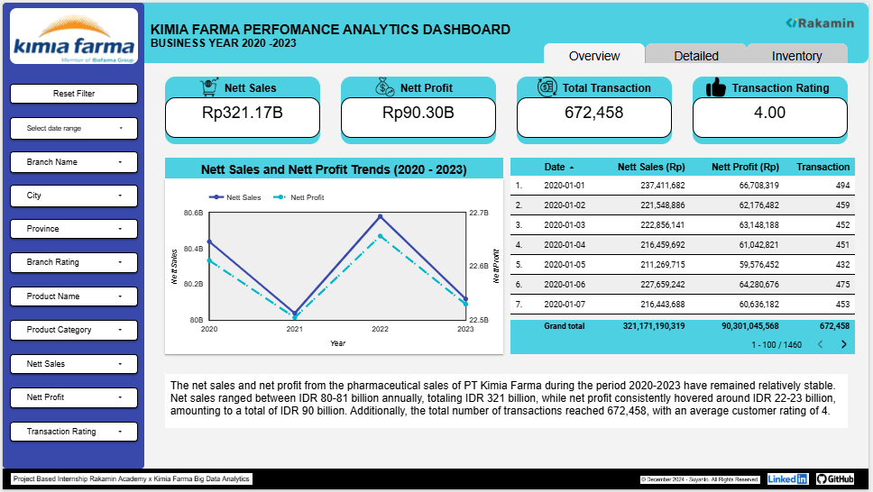
Dashboard Title
Dashboard Performance Analytics
Rakamin Logo
Kimia Farma Logo
Page Navigation
Dashboard Summary
Filter Control
Data Snapshot
Sales and Profit Chart
14

Slide 15
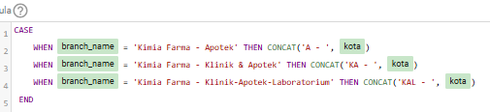
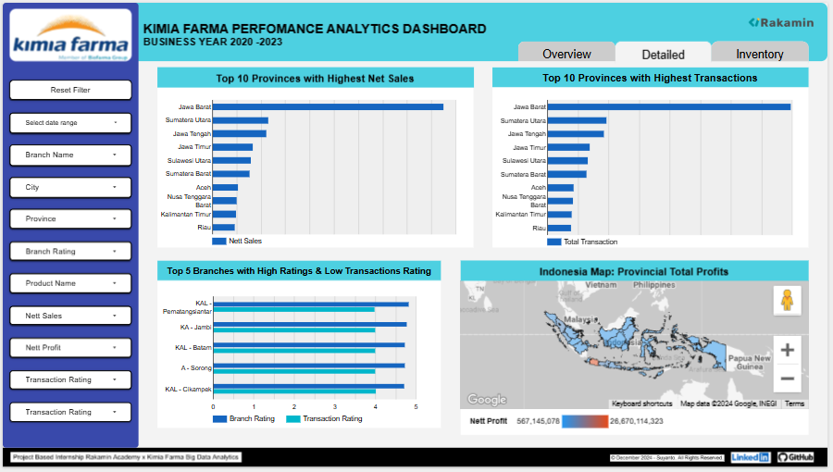
Dashboard Performance Analytics
A calculated field has been added to the table to make it easier to display the chart of branches with high ratings and low transaction ratings.
On this page, there are 4 charts:
- Highest Net Sales
- Highest Transaction Count
- Branch with High Rating and Low Transaction Rating
- Geo Map of Provincial Total Profit.
15

Slide 16
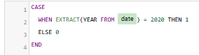
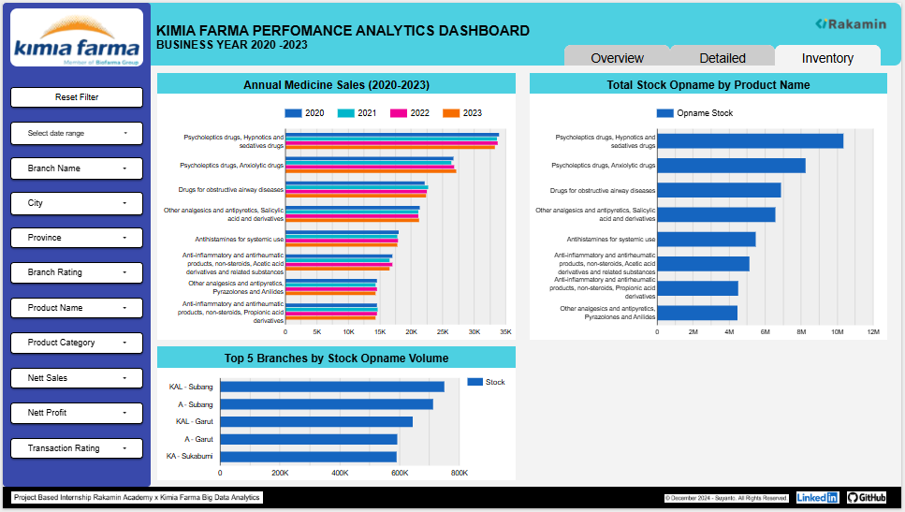
Dashboard Performance Analytics
Four calculated fields have been added to the table to make it easier to display the Annual Medicine Sales chart
On this page, there are 3 charts:
Annual Medicine Sales
Total Stock Opname
Top Branch with Highest Stock
16

Slide 17
Recommendations
Profit Margin: The average profit margin is 25% of sales, which is considered a healthy performance indicator.
Sales Distribution: The highest sales were recorded in West Java, totaling 94.8 billion during the 2020-2023 period, followed by North Sumatra with 22.9 billion in second place. This highlights a significant potential for expanding sales outside of West Java.
Stock Management: The total stock on hand amounts to 51 million units, compared to a total of 672,000 units sold during the 2020-2023 period. This indicates an excess stock level, which needs to be addressed to prevent expiry issues. It is recommended to either accelerate sales efforts or reduce production volumes to better align stock levels with demand.
17

Slide 18
Looker Studio Dashboard : https://lookerstudio.google.com/s/olRkAzr-_Es Presentation Video (Youtube) : https://youtu.be/RxbwlvBtqCg Github Repository : https://github.com/Yuandro/PBI-Kimia-Farma-Dec-2024.git
Links
18

Slide 19
Thank You
X

