Slide 1
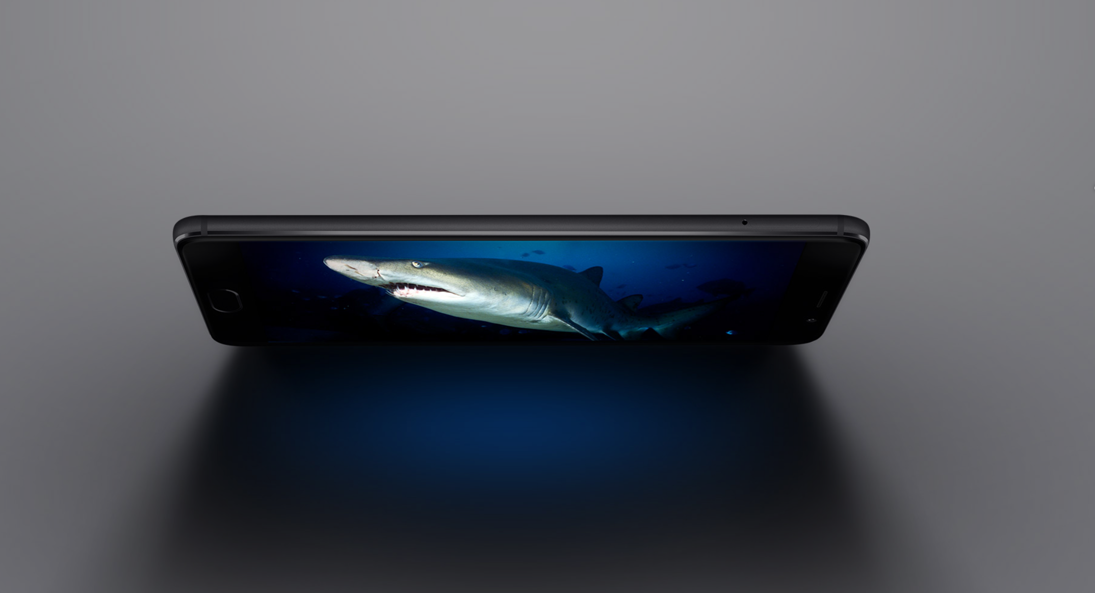


Slide 2

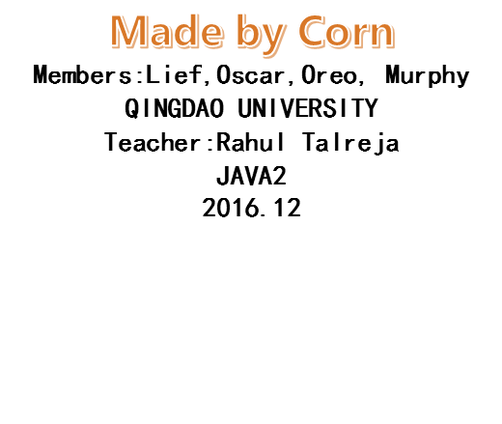

Slide 3

Design a calculator application which has the scientific capabilities as well.
a. Portrait Mode (normal calculator)
i. Provide the essential functions of calculator
b. Landscape Mode (Scientific calculator)
i. It should show a different interface which has the scientific functionalities as well.

Slide 4
DEVELOPMENT
Lief
Oreo
Framework Interaction，
Some functions，Precedence
Calculate Functions
Oscar
Murphy
Layout and UI Maker，
Some functions
UI Design And Make The Power Point

Slide 5
Problem Faced during the Development
1.How to make the layout both beautiful and functional.
2.How to change the two views and Activity by gravity
3.How to make many difficult calculations comes ture[like “(”and “)”, “MC”]
4.How to make the function:continuous plus comes true
5.How to make the reminder work
6.Our App always shut down,and we debuged it many times
7.How to make the function :when I click ,the button tells me it is been clicked
comes true
8.How to make the function:exit the app comes ture
*9.Some very difficult bugs
* Means that problems has not been fixed now

Slide 6
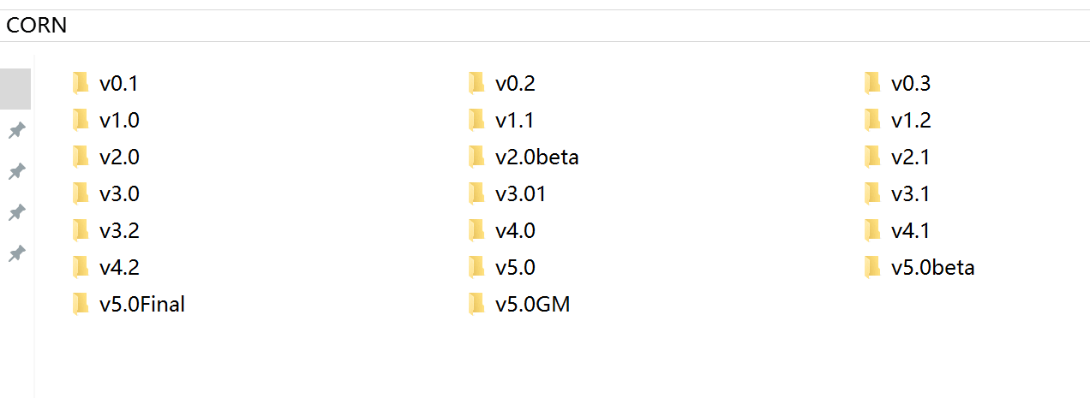
History Versions:
To solve those problems,we........

Slide 7

Finally，We got this

Slide 8
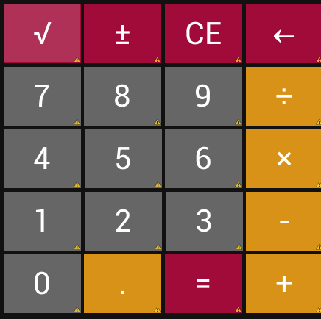
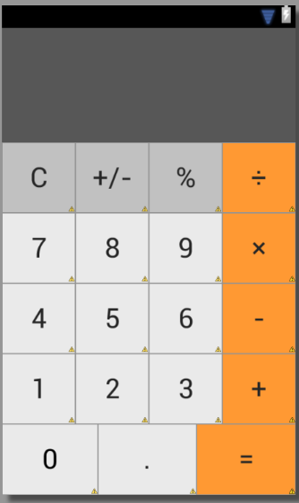
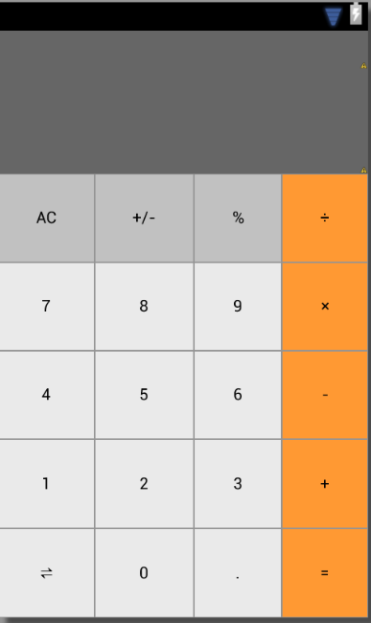
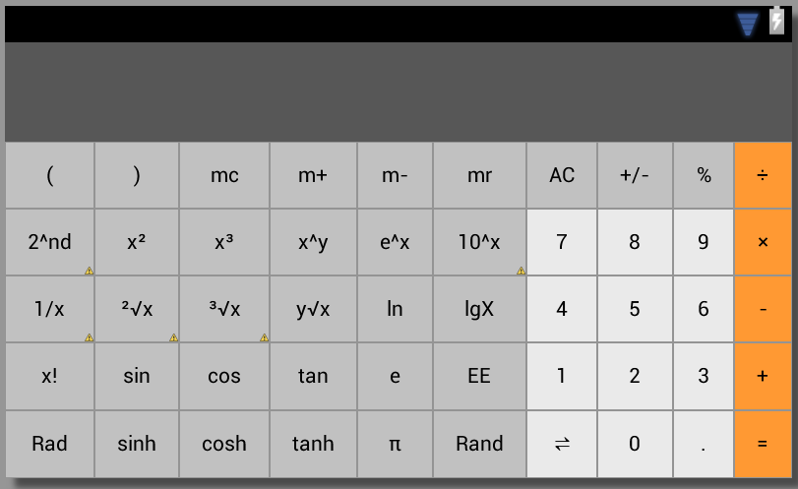
At fist:
V0.1
V2.0
V3.0
And a lot of different UI………………

Slide 9
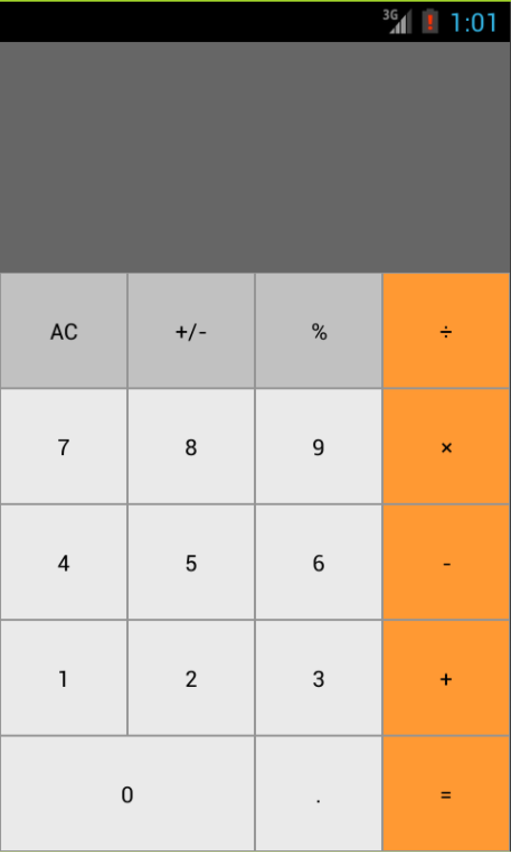
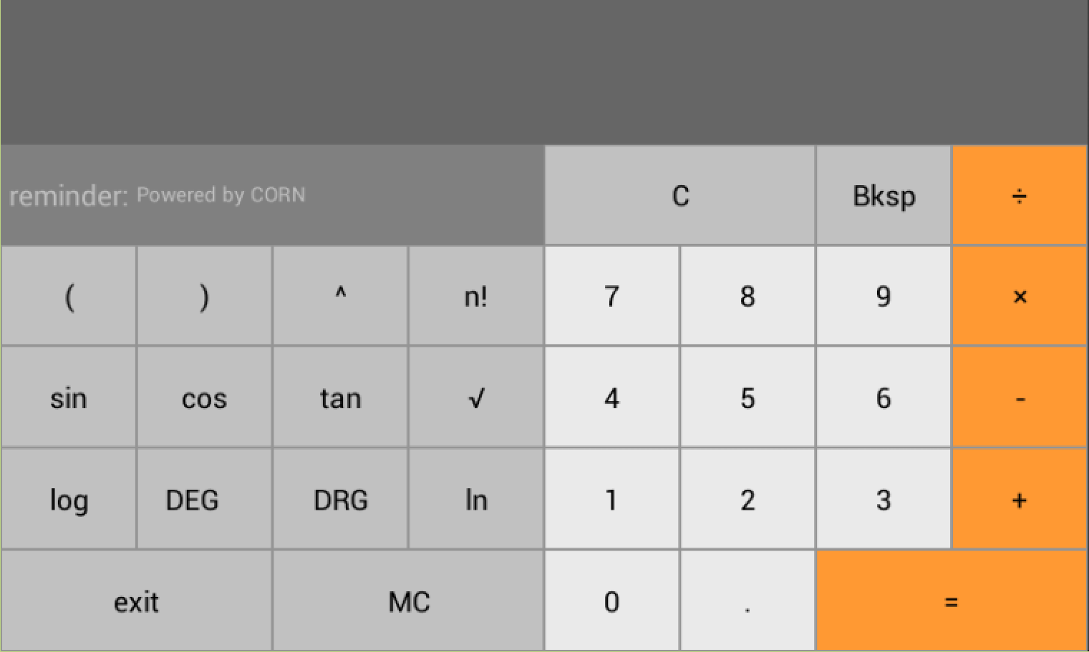
Finally ，in version 5.0
We decide to cut some parts ,
And redesigned UI like this
Beautiful!!!!!!!!!!!!!!

Slide 12
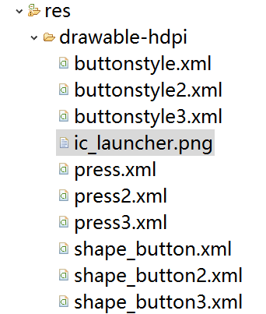
To make the buttons more beautiful, we made many XMLs to make it come true
When I click the button, different buttons also have different colors.

Slide 13
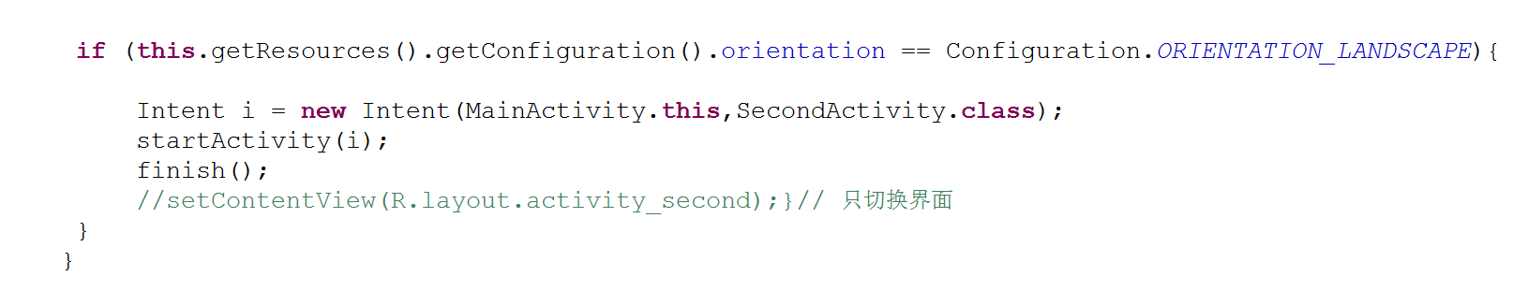
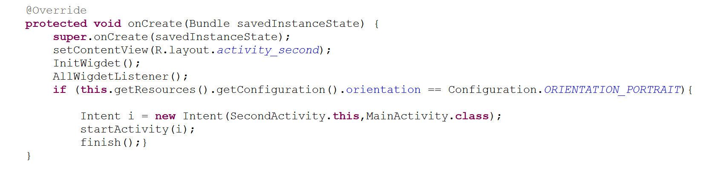
To change the view:

Slide 14
Future Vision/idea on the Project
Our calculator’s functions is not rich enough.
We can also make functions just like conversion(money,longth,gravity).
We can make some special themes for users to choose.
Fix the other bugs and make it greater.

Slide 15

Let’s see the Application

Slide 16



Slide 17


