Slide 1

Predicting Kidney Allograft Outcomes for Clinicians
Blood and Biopsy
Biomed Group 22: Celine, Boyi, Minh, Rishi, Yuanfeng, Zhiyuan

Slide 2




Why Kidney allograft rejection?
Damaged
"25% of patients receiving an organ transplant will experience rejection in the first-year post-transplant" (Higdon et al., 2023 )
Replace
Donor

Slide 3



Aim
Formulate a model that allows the prediction of successful or rejected kidney allografts for clinicians, that can be used on both biopsy and blood data, depending on the availability.
Invasive
Biopsy data (Al-Awwa et al., 1998)
Notes:
Formulate a model that allows the prediction of successful or rejected kidney allografts for clinicians, that can be used on both biopsy and blood data, depending on the availability.
Biopsy data is considered the “gold standard” for diagnosis (Al-Awwa et al., 1998)
We acknowledge that collection of biopsy data is invasive and not as accessible while blood data, although not as accurate, is more accessible, therefore include the option to choose which data to input for results.
Our target audience for the shiny application is the clinician
To pin-point patients to monitor closely
Have the option to forward the result to patients with own advice on management depending on whether they are likely to get an allograft rejection or not.

Slide 4
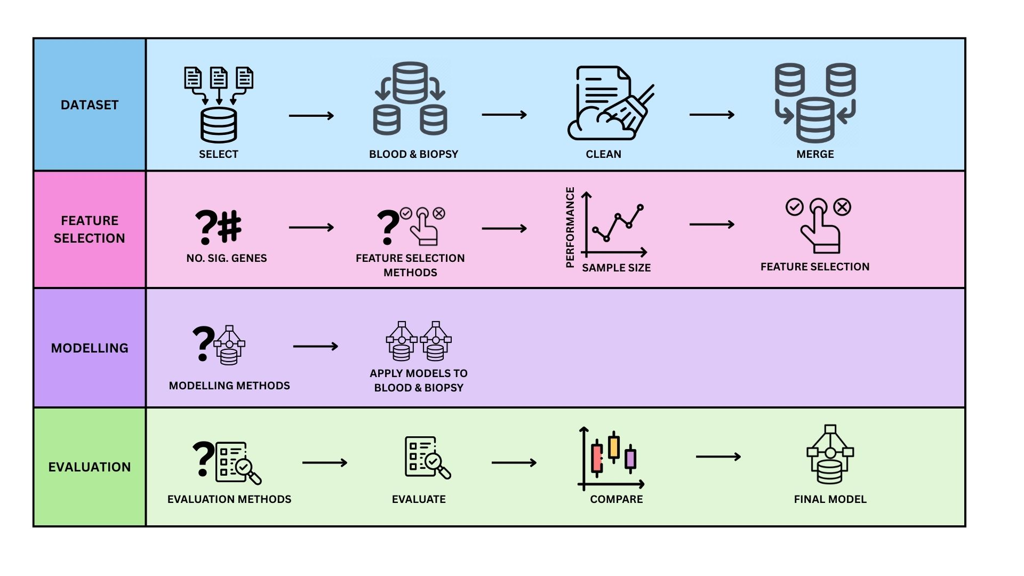
Methods - Workflow
Notes:
Multidisciplinary aspect: Acknowledge that different individuals in the group have different strengths. For example, we decided to use feature selection by networking as an innovation method because Rishi had strengths in that field. Two members of our group had an extra major in the medical field of science, therefore applied that knowledge to the project.

Slide 5

Methods - Workflow
COMBAT
LIMMA
Microarray
+
Binary outcome
Notes:
Multidisciplinary aspect: Acknowledge that different individuals in the group have different strengths. For example, we decided to use feature selection by networking as an innovation method because Rishi had strengths in that field. Two members of our group had an extra major in the medical field of science, therefore applied that knowledge to the project.

Slide 6
Methods - Workflow
Notes:
Multidisciplinary aspect: Acknowledge that different individuals in the group have different strengths. For example, we decided to use feature selection by networking as an innovation method because Rishi had strengths in that field. Two members of our group had an extra major in the medical field of science, therefore applied that knowledge to the project.

Slide 7
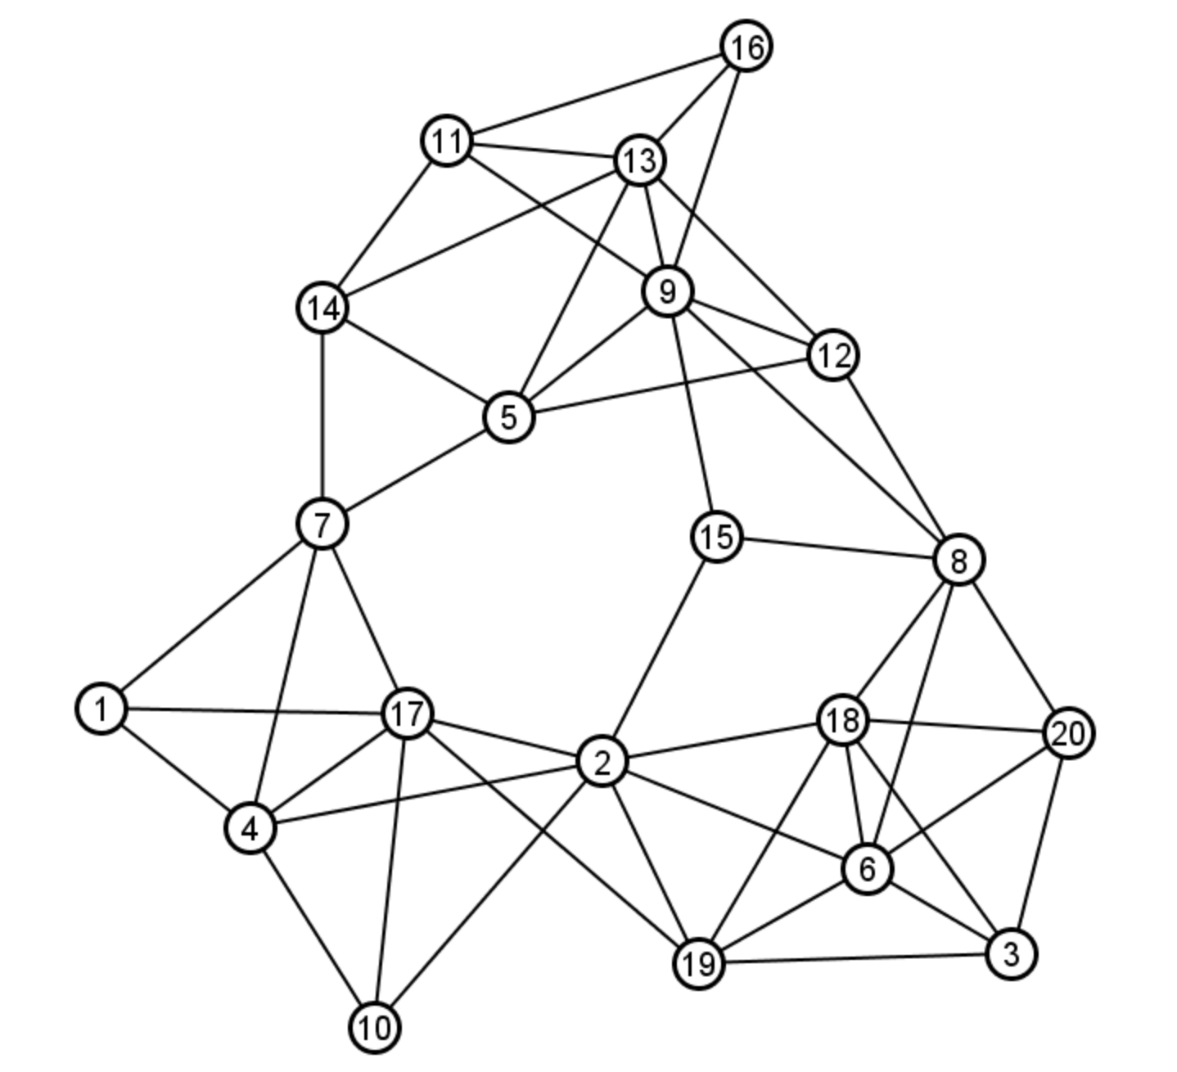
Innovation – Network Theory
Centrality Measure | Description | Formula
Degree | # of direct connections | deg(v) = ∑ aᵢⱼ
Betweenness | importance in shortest paths | C_B(v) = ∑ (σᵢⱼ(v) / σᵢⱼ)
PageRank | recursive node importance | PR(i) = (1 - d)/N + d * ∑ [PR(j)/L(j)], for j ∈ M(i)
Eigenvector | influence via connected nodes | Ax = λx
K-Core | depth of embedding in dense subgraphs | v ∈ k-core ⇔ deg(v) ≥ k
(Wu et al., 2014)

Slide 8
Methods - Workflow
Notes:
Multidisciplinary aspect: Acknowledge that different individuals in the group have different strengths. For example, we decided to use feature selection by networking as an innovation method because Rishi had strengths in that field. Two members of our group had an extra major in the medical field of science, therefore applied that knowledge to the project.

Slide 9
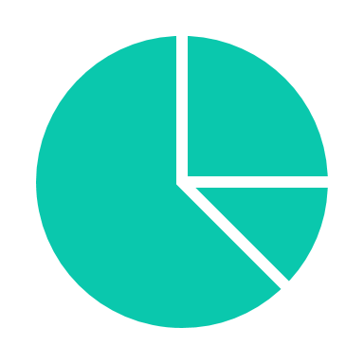

Methods - Workflow
{
SENSITIVITY
False positives
Notes:
Multidisciplinary aspect: Acknowledge that different individuals in the group have different strengths. For example, we decided to use feature selection by networking as an innovation method because Rishi had strengths in that field. Two members of our group had an extra major in the medical field of science, therefore applied that knowledge to the project.

Slide 10
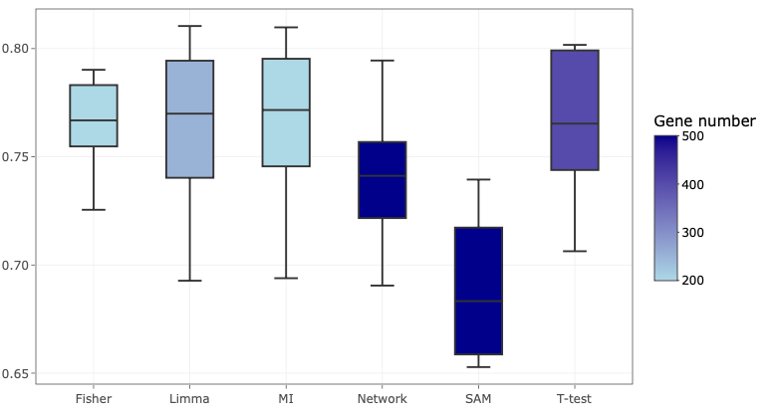
Results – Biopsy feature selection
Area under curve (AUC)
Feature selection methods

Slide 11
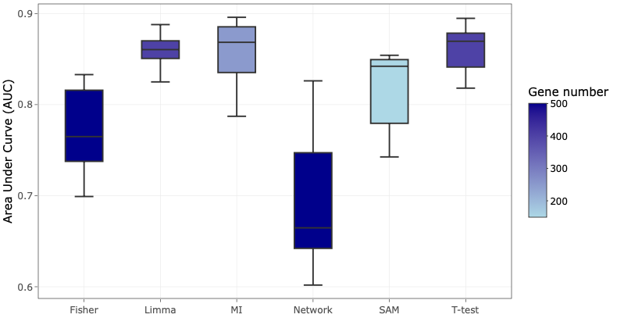
Results – Blood feature selection
Area under curve (AUC)
Feature selection methods

Slide 12
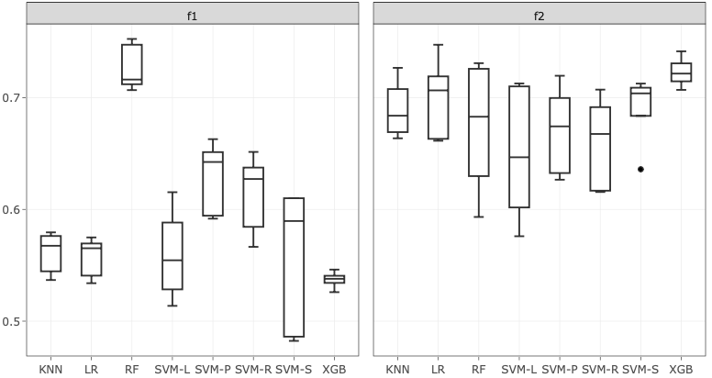
Results – Biopsy model selection
Performance
Model​

Slide 13
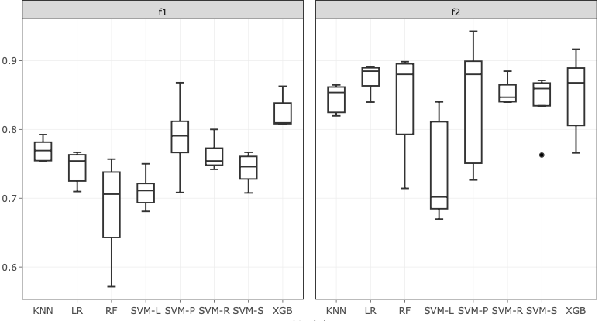
Results – Blood model selection
Performance
Model

Slide 14

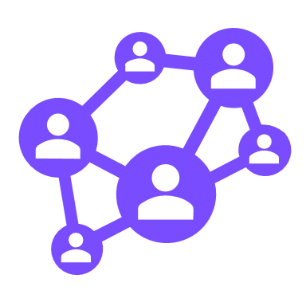
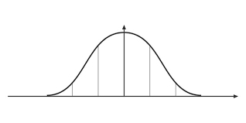





Discussion – limitations
Normalisation
Duplicate gene symbols
Network theory
Remove patterns
Not generalisable
Biological significance

Slide 15
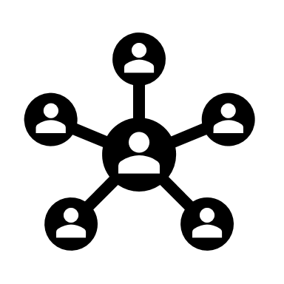
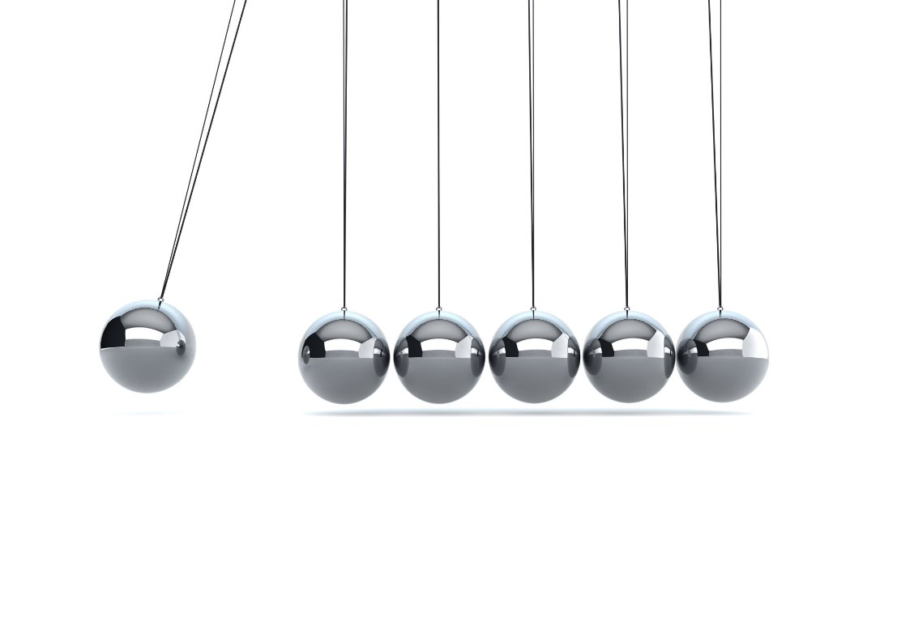



Discussion – validity
Data Handling
Network Validity
Evaluation Integrity
Clear training-testing split
WGCNA meets scale-free criteria
Metrics from untouched test set

Slide 16

Conclusion
SIGNIFICANCE
Increasing prominence of Digital Health Interventions (DHI) - reduce cost, access wider populations (Briggs et al., 2024)
Tailored, patient-centric interventions (Faleval & Hassandoust, 2025)
Our application – identify patients that require intervention
Our application – target preoperative period (prehabilitation) (Briggs et al., 2024)
FUTURE WORK
Find better feature selection methods, specifically networking (choosing significant genes)
1,300 × 750

Slide 17

Shiny Application Demonstration

Slide 18
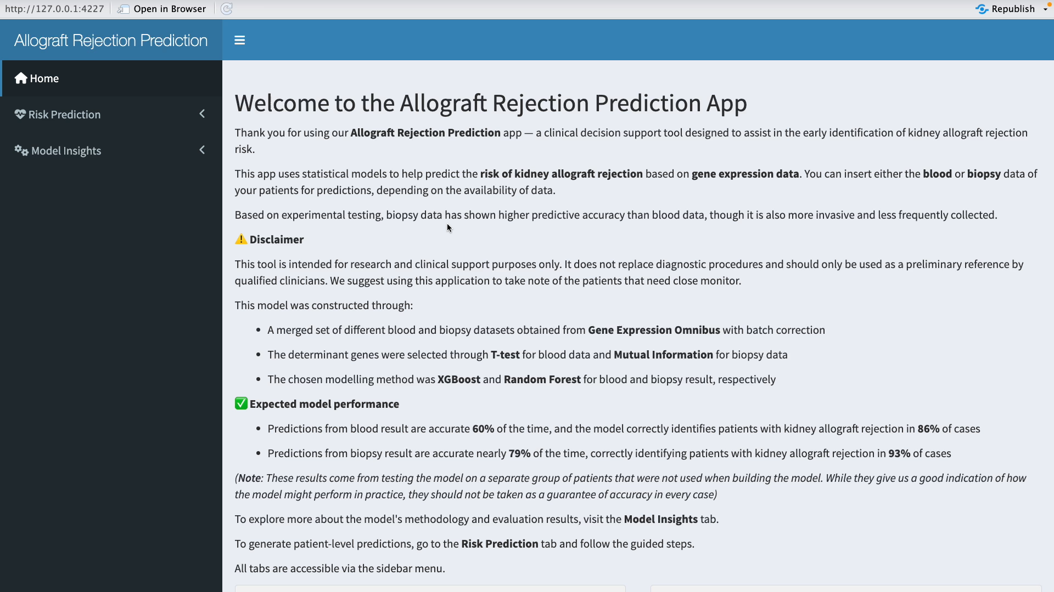
Shiny Application Demonstration

Slide 19
References
Briggs, J., Chilcot, J., & Greenwood, S. A. (2024). The use of digital health interventions to deliver prehabilitation in solid organ transplant recipients: are we there yet?. Current opinion in organ transplantation, 29(5), 357–362. https://doi.org/10.1097/MOT.0000000000001164
Falevai, I., & Hassandoust, F. (2025). Enhancing Transplantation Care with eHealth: Benefits, Challenges, and Key Considerations for the Future. Future Internet, 17(4), 177. https://doi.org/10.3390/fi17040177
Higdon, L. E., Tan, J. C., & Maltzman, J. S. (2023). Infection, Rejection, and the Connection. Transplantation, 107(3), 584–595. https://doi.org/10.1097/TP.0000000000004297
Naik RH, Shawar SH. Renal Transplantation Rejection. [Updated 2023 Feb 9]. In: StatPearls [Internet]. Treasure Island (FL): StatPearls Publishing; 2025 Jan-. Available from: https://www.ncbi.nlm.nih.gov/books/NBK553074/
Wu, D., Liu, X., Liu, C., Liu, Z., Xu, M., Rong, R., Qian, M., Chen, L. and Zhu, T. (2014). Network analysis reveals roles of inflammatory factors in different phenotypes of kidney transplant patients. Journal of Theoretical Biology, 362, pp.62–68. https://doi.org/10.1016/j.jtbi.2014.03.006

Slide 20
Marking Criteria
3.1. Provides appropriate context and motivational background. 3.2. Underlying multidisciplinary concepts explained well in appropriate language. 3.3. Succinct overview of the method including data collection and model development. 3.4. Results - clear description of the deployment process. 3.5. Engaging and clear illustration of the product with discussion of multidisciplinary concepts. 3.6. Conclusion adequately summarises the project and identification of future work. 3.7. Appropriate referencing and acknowledgment.

