Slide 1
Do Markets Know Inflation First?
Evaluating Kalshi's KXCPI prediction markets as real-time forecasts of U.S. CPI
MQE QuantLab Summer Project · Final Presentation · August 2026
Notes:
Presenter 1 opens. ~20s. One line: we test whether a real-money prediction market forecasts U.S. CPI as well as the professionals, using the market's full price history. Then hand into Section 1.

Slide 2
1
THE QUESTION
Can a betting market
forecast inflation?
Notes:
— Presenter 1 — Sets up the motivation and the market. ~2:15 total for Section 1 (this divider + next two slides).

Slide 3
Every month, real money bets on the CPI print
1
Prices, not opinions
57
Traders buy and sell contracts on where CPI will land. Prices move continuously and encode a probability-weighted consensus — updated by anyone with money on the line.
monthly CPI releases
Nov 2021 – Jul 2026
2
The efficient-market bet
3,484
If markets aggregate information efficiently, those prices could rival professional forecasters — with no econometric model, just incentives to be right.
contract-days of
live market quotes
3
What we tested
$0
We put that to the test on Kalshi's KXCPI threshold contracts across every monthly release since the market opened.
cost of the forecast —
the market is free
Notes:
~1:00. The pitch in three beats: prices encode a live consensus; if markets are efficient they could match the pros; we test it on Kalshi KXCPI. The rail: 57 releases, 3,484 contract-days, and the forecast is free — no model, no analysts.

Slide 4
How the market works: CPI threshold contracts
Contract | Price = P(above) | Implies outcome | Prob.
CPI > 0.0% | 95¢ | ≤ 0.0% | 5%
CPI > 0.1% | 78¢ | = 0.1% | 17%
CPI > 0.2% | 35¢ | = 0.2% | 43%
CPI > 0.3% | 8¢ | = 0.3% | 27%
 |  | > 0.3% | 8%
THE MARKET'S POINT FORECAST
Implied mean = Σ (probability × outcome)
.05(0.0) + .17(0.1) + .43(0.2) + .27(0.3) + .08(0.4)
= 0.22%
Differencing adjacent threshold prices turns a stack of yes/no contracts into a full probability distribution over the CPI print.
one number the market is willing to back
Notes:
~1:00. Walk the table once: each contract's price is the probability CPI comes in above that threshold. Difference neighbors and you get the odds of each exact outcome. The weighted average — 0.22% here — is the market's point forecast. The mechanics of the differencing are in the appendix.

Slide 5
2
THE APPROACH
From prices to a
fair comparison
Notes:
— Nathan (methodology) — ~2:30 for Section 2. Keep the three rules to one line each; the worked examples are in the appendix if asked.

Slide 6
Methodology: handling the raw data from Kalshi
Three handling rules — each demonstrated on real KXCPI data in the appendix
Price = live bid/ask midpoint
53%
1
A last-trade price often does not exist, but live quotes always do. We price every contract at the bid/ask midpoint: bid 25¢, ask 35¢ → a 30% probability.
of quoted contract-days
have zero trades
Distribution sums to one by construction
1.000
2
Subtracting each threshold price from the one below slices the whole 100% into outcomes — the total is exact by construction, nothing to rescale.
probability total on
all 3,484 event-days
Monotonicity: measure, fix, report
12%
3
P(CPI > 0.2%) can never exceed P(CPI > 0.1%); thin quotes sometimes break this rule. A running-minimum cap repairs it, and every fix is logged.
of days need a fix —
median under 1¢
Notes:
~1:15. Three rules, one line each. (1) Use the quote midpoint — half of days never trade. (2) The distribution sums to one automatically, so we can't lean on that as a coherence check. (3) We cap out-of-order prices with a running minimum and log the size of every fix. Worked examples on real days are in the appendix — good Q&A material.

Slide 7
Benchmarking: Kalshi vs. the Cleveland Fed nowcast
1
The benchmark: a professional model
57
The Cleveland Fed inflation nowcast: a statistical model that predicts CPI, published every business day. We match it to all 57 settled Kalshi months.
Kalshi months matched
to the daily nowcast
2
A fair comparison
4
Both are graded against the same answer key — the first-release CPI print — read on the same date: 1, 7, 14, and 30 days before each release. No one sees the future.
checkpoints per month:
1, 7, 14, 30 days out
3
A statistical test, not eyeballing
56
The Diebold–Mariano test asks: is one forecaster genuinely more accurate, or just luckier month to month? The verdict comes in the results section.
shared months in the
significance test
Notes:
~1:10. The design that makes the comparison fair: same opponent (Cleveland Fed nowcast), same truth (first-release CPI for both), same information set (matched by calendar date at four horizons), and a significance test so we don't over-read a noisy gap. Hand into Section 3.

Slide 8
3
KEY FINDINGS
The market beats
the model
Notes:
— Presenter 3 — ~3:25, the heart of the talk. Slow down here.

Slide 9
The market beats the model at every horizon
Mean absolute error vs. the Cleveland Fed nowcast · 57 settled releases, real-time vintages
READING IT
Kalshi is lower — more accurate — at all four horizons.
Its edge widens as the release nears: 0.090 vs 0.128 pp one day out.
Holds under RMSE too — 0.125 vs 0.166 one day out — which weights the big-surprise months most.
Snapshot horizon before release
Notes:
~1:50. The headline. Navy is Kalshi, amber is the nowcast — Kalshi's bar is lower at every horizon, and the gap grows toward release: 0.090 vs 0.128 one day out. The nowcast plateaus from 14 days in while the market keeps sharpening. RMSE tells the same story (0.125 vs 0.166), so it isn't just a few easy months.

Slide 10
Is the gap real? The Diebold–Mariano test
Paired test of equal accuracy on |error| loss · n = 56 common events
Horizon | Mean loss diff | t-stat | p-value | Verdict
1 day | −0.037 | −3.26 | 0.001 | significant
7 days | −0.024 | −2.06 | 0.040 | significant
14 days | −0.020 | −1.62 | 0.104 | suggestive
30 days | −0.010 | −0.61 | 0.542 | inconclusive
VERDICT
Kalshi's advantage is statistically significant in the final week
p = 0.001 at one day, 0.04 at seven. The direction favors Kalshi at every horizon; 56 events limit the test's power further out.
Negative loss difference → Kalshi's errors are smaller. p < 0.05 → the gap is unlikely to be luck.
Notes:
~1:30. Could the gap be luck? Each month, subtract the nowcast's absolute error from Kalshi's; negative means Kalshi was closer. DM is a t-test on that average. Significant in the final week (p=0.001), suggestive at two weeks, direction consistent everywhere. Showing the two non-significant rows is what makes the significant ones credible. Hand into Section 4.

Slide 11
4
TAKEAWAYS
What it means,
and what's next
Notes:
— Presenter 4 — ~2:05. Close confidently: state the limitation honestly, then the takeaway.

Slide 12
What holds it back — stated honestly
Short sample
57 months, dominated by the 2021–23 inflation spike. Planning a pre/post-2023 split to check the edge holds in calmer regimes.
1
Thin liquidity
Many zero-volume days and wide spreads. The implied mean occasionally leaves the [0,1] range — a symptom we measure and flag.
2
A missing month
October 2025 CPI was never released (government shutdown). We skip it explicitly rather than impute a value.
3
Notes:
~1:00. Credibility comes from naming the weak spots: a short sample over the spike, thin liquidity that occasionally pushes the implied mean out of range, and the shutdown month we drop rather than fake. Each has a planned or implemented response.

Slide 13
What we learned — and what comes next
The market beats the model
33 of 57
1
One day before release the market misses by 0.090pp on average vs 0.128 for the Fed nowcast — closer in 33 of 57 months, and too consistent to be luck (p = 0.001).
months the market was
closer to the print
The edge grows as data arrives
−34%
2
Kalshi improves from a 0.137pp miss 30 days out to 0.090 the day before; the nowcast plateaus near 0.13. Both are unbiased — the win is tighter misses, not direction.
error shrinkage from
30 days out to release eve
What comes next
3
Add the economist consensus median as a second benchmark, stress-test the liquidity filter and tail assumptions, and extend to year-over-year CPI (KXCPIYOY).
Notes:
~1:00. Land it: a free, model-free market matches a professional nowcast and beats it near release; the win is precision, both are unbiased; next steps are consensus + naive baselines, with detail in the written deliverable. Thank the panel and take questions.

Slide 14
Appendix
Technical backup — worked examples on real KXCPI days, for Q&A
Notes:
Not shown in the 10 minutes. Jump here if asked how a specific rule works.

Slide 15
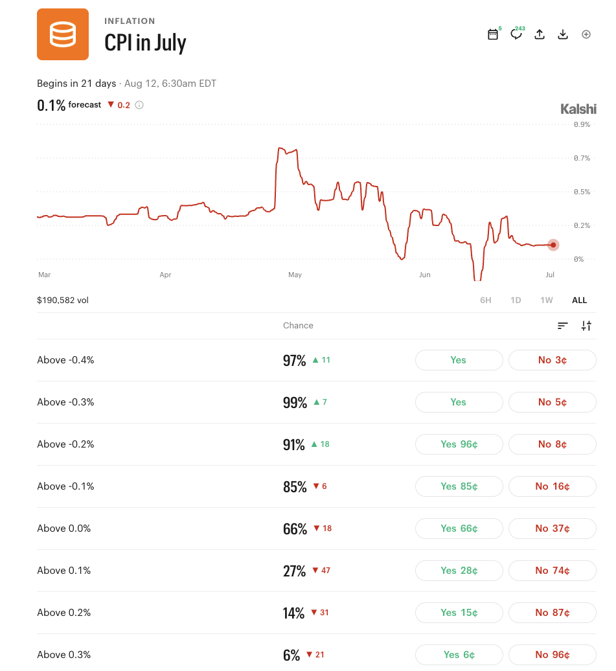
The market: monthly CPI threshold contracts on Kalshi
Example: prices → probability distribution
Contract | Price = P(above) | ⇒ Outcome | Prob.
CPI > 0.0% | 95¢ | ≤ 0.0% | 5%
CPI > 0.1% | 78¢ | = 0.1% | 17%
CPI > 0.2% | 35¢ | = 0.2% | 43%
CPI > 0.3% | 8¢ | = 0.3% | 27%
 |  | > 0.3% | 8%
Implied mean — the market’s point forecast
Σ probability × outcome: .05×0.0 + .17×0.1 + .43×0.2 + .27×0.3 + .08×0.4 = 0.216%
Notes:
60-75s. Explain threshold contracts with the example table. Key sentence: differencing adjacent threshold prices turns a set of binary contracts into a full probability distribution over the CPI print, and its weighted average is the market's point forecast.

Slide 16
Rule 1 — Price = bid/ask midpoint, not last trade
Real day: KXCPI-25JAN-T0.4 on Jan 3, 2025 — "Will Jan 2025 CPI rise more than 0.4%?"
The problem On 53% of contract-days with live quotes, nothing traded — no trade price exists, and stale prints can be days old.
The rule Use the midpoint of the closing bid and ask. Quotes are enforceable orders, so they are current even on zero-trade days — and the truth is bracketed between them.
Trades that day (volume) | 0 — nothing traded
Last trade price | (none)
Best bid (sell now) | $0.25
Best ask (buy now) | $0.35
Midpoint → P(CPI > 0.4%) | (0.25+0.35)/2 = 30%
A last-trade rule would have no price here; the midpoint gives a live 30% forecast. (January CPI printed 0.5% — the contract settled YES.)

Slide 17
Rule 2 — Probabilities sum to 1 by construction
Real day: CPI-23AUG on Sep 11, 2023 (2 days pre-release) — all four informative thresholds
Outcome slice | Formula | Value
CPI ≤ 0.4% | 1 − S(0.4) | 1 − 0.985 = 0.015
CPI = 0.5% | S(0.4) − S(0.5) | 0.985 − 0.820 = 0.165
CPI = 0.6% | S(0.5) − S(0.6) | 0.820 − 0.515 = 0.305
CPI = 0.7% | S(0.6) − S(0.7) | 0.515 − 0.100 = 0.415
CPI > 0.7% | S(0.7) | 0.100
Total | everything cancels | = 1.000 exactly
(1−S₁) + (S₁−S₂) + (S₂−S₃) + (S₃−S₄) + S₄ = 1
A telescoping sum — every price cancels, only the 1 survives, for any prices on any day. Verified at exactly 1.0 on all 3,484 event-days, so incoherence must show up as Rule 3.
Two days later the BLS printed 0.6% — the bolded slice.

Slide 18
Rule 3 — Out-of-order prices: measure, fix, report
Real day: CPI-24JAN on Feb 1, 2024 (12 days pre-release) — two prices sit above the one below
Threshold | Quoted P(above) | After fix | Slice
> −0.2% | 0.900 | 0.900 | 0.000
> −0.1% | 0.970 ✗ | 0.900 | 0.000
> 0.0% | 0.905 ✗ | 0.900 | 0.380
> 0.1% | 0.520 | 0.520 | 0.455
> 0.2% | 0.065 | 0.065 | 0.065
The problem P(>−0.1%) can't exceed P(>−0.2%) — but they trade independently and stale quotes invert them. Differencing would give a negative probability.
The fix Running minimum — cap each price at the one below it. Both offenders drop to 0.900; the recorded mono_violation = 0.07.
The accounting Violation size is logged every day: nonzero on 12%, median < 1¢, max 41¢, correlated 0.34 with spreads — a thin-market symptom, reported not hidden.

Slide 19
