Slide 1
Do Markets Know Inflation First?
Evaluating Kalshi's CPI prediction markets (KXCPI) as inflation forecasts
Week 2 progress report · July 2026
Notes:
30s. One-liner: we test whether a real-money prediction market forecasts US CPI well, using its full price history. Status: data pipeline done, first results in hand.

Slide 2
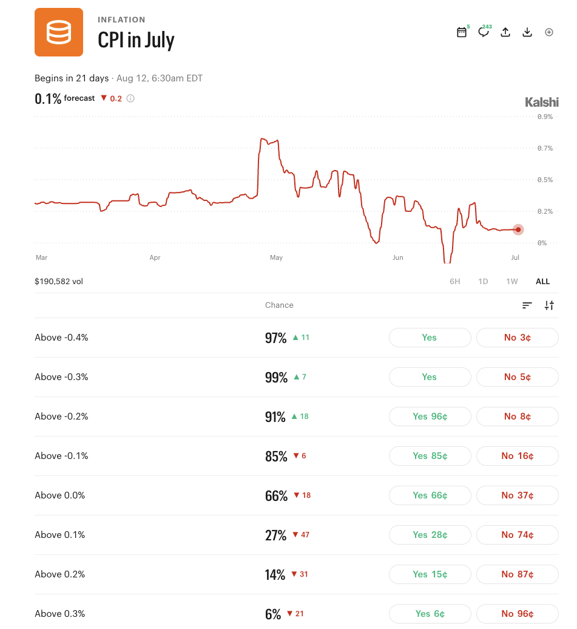
The market: monthly CPI threshold contracts on Kalshi
Example: prices → probability distribution
Contract | Price = P(above) | ⇒ Outcome | Prob.
CPI > 0.0% | 95¢ | ≤ 0.0% | 5%
CPI > 0.1% | 78¢ | = 0.1% | 17%
CPI > 0.2% | 35¢ | = 0.2% | 43%
CPI > 0.3% | 8¢ | = 0.3% | 27%
 |  | > 0.3% | 8%
Implied mean — the market’s point forecast
Σ probability × outcome: .05×0.0 + .17×0.1 + .43×0.2 + .27×0.3 + .08×0.4 = 0.216%
Notes:
60-75s. Explain threshold contracts with the example table. Key sentence: differencing adjacent threshold prices turns a set of binary contracts into a full probability distribution over the CPI print, and its weighted average is the market's point forecast.

