Slide 1
Data Science Seminars
Seminar 1
Nick Kuang
10 February, 2025
Template: Rui Song in OverLeaf

Slide 2

Course Information
Timings
- Five 2-hour seminars
- 14th and 21st November
Lecturers
- Nick Kuang, Jingyao Zheng, Dr Lik-hang Lee
Prerequisites
- Basic Programming Skill, preferably Python language
- Mathematics (especially Linear Algebra) and Statistics(especially Probability Theory)

Slide 3
Course Information(cont.)
Aims
- Understand the fundamentals of data science and its significance today
- Familiarize with the data science workflow and key concepts
- Gain proficiency in essential data science software tools
- Understand and apply statistical models for
Regression, Classification, Clustering, and Dimensionality Reduction
- Learn techniques for Time Series modeling
- Acquire skills in Textual Data Processing and effectively use ChatGPT
Course Materials
- Seminar Slides and Comprehensive Handouts featuring cell-level code will be provided after each seminar for in-depth revision.
Notes:
What is data science
Workflow
Why Pandas over Microsoft Excel (software tools)?
free,
Efficiency with Large Datasets: Pandas handles large datasets more efficiently than Excel, Excel can struggle with millions of rows.
Reproducibility: With Pandas, you can write scripts that can be reused, allowing you to reproduce the same analysis on different datasets. In Excel, you'd have to repeat steps manually, which can be error-prone and time-consuming.
Integration with Other Libraries: Pandas works well with other Python libraries, such as NumPy for mathematical operations, Matplotlib for visualization, and Scikit-Learn for machine learning, creating a powerful ecosystem for data analysis that Excel cannot match.

Slide 4
Course Information(cont.)
Resources
Books:
- 《Python for Data Analysis》 2e by Wes McKinney
- 《Data Science from Scratch First Principle with Python》 by Joel Grus
- 《Dive into Deep Learning》 by Aston Zhang,Zack C. Lipton, Mu Li and Alex J. Smola
- 《Python大数据分析与应用实战》 by 余本国
Libraries and Tools:
- NumPy
- Pandas
- Matplotlib etc
Datasets and Projects:
- Hong Kong Dataset from 資料一線通 and 政府統計處
- Kaggle and Google
- IB-Data-Science project from Cambridge

Slide 5
Why take this course?

Slide 6
The importance of Data Science Today
High Demand for Data Science Skills:
Mastering data science skills will make you more competitive in the job market.
We Live in an Era of Exploding Data
In just the last two years, the volume of data has been created than in all previous human history combined.[1]
Transferable and Broadly Applicable Skill
Every industry, beyond tech industry, is integrating data science into their businesses, example includes finance, healthcare, retail etc.
Future Trend of Technology
Proficiency in data science positions you at the forefront of technological revolutions driven by AI and Big Data.
[1]big-data-25-facts
Notes:
https://www.slideshare.net/slideshow/big-data-25-facts/39489862#26

Slide 7
Applications of Data Science
Manufacturing
Process Optimization
Quality Control
Transportation
Route Optimization
Traffic Forecasting
Retail
Customer Segmentation
Inventory Management
Recommender System
Finance
Market Prediction
Fraud Detection
Healthcare
Personalized Medicine
Notes:
Manufacturing
Process Optimization: Enhance efficiency in distribution.
Quality Control: Implement predictive maintenance and defect detection.
Transportation
Route Optimization: Determine the most efficient travel paths to reduce time and cost.
Traffic Forecasting: Predict traffic patterns to improve traffic management and reduce congestion.
Retail
Customer Segmentation: Group customers based on behaviors and preferences for targeted marketing.
Inventory Management: Optimize stock levels to reduce waste and meet demand.
Recommender Systems: Personalize product recommendations to increase sales and customer satisfaction.
Finance
Market Prediction: Forecast stock prices and market trends for informed investment decisions.
Fraud Detection: Identify fraudulent activities in real-time to protect assets.
Healthcare
Personalized Medicine: Tailor treatments to individual patients based on genetic and other data.
Housing
House Price Prediction: Estimate property values using data on location, trends, and market conditions.

Slide 8
What you will be able to do after
Find your answer to your questions from data
Verify your hypothesis, and validate assumptions
Communicate findings in a clear way
to the stakeholders using data visualization tools
Solve Real-World Data Science Problems

Slide 9
What is Data?

Slide 10
Data
How did humans make decisions in the days
before computers?
Experience
From Google Dictionaries
Facts and statistics collected together for reference or analysis.
From Wikipedia
a collection of discrete or continuous values that convey information, describing the quantity, quality, fact, statistics, other basic units of meaning, or simply sequences of symbols that may be further interpreted formally
Notes:
In this world, every single move leaves a trace

Slide 11
Data
What is Data?
Experience
Facts and Statistics
Information
Real-life representations of things
What data can be?
Structured and unstructured
Qualitive and quantitative variables
Discrete or continuous values
Common Data Storage Formats:
XLSX (Microsoft Excel Spreadsheets)
CSV (Comma-Separated Values) files
JSON (JavaScript Object Notation)
Notes:
JSON: lightweight
XML: tags, widely used in web services

Slide 12
What is Big Data?

Slide 13
Big Data
Definition:
Massive and complex datasets that cannot be handled by traditional data management tools due to the inability to scale effectively for data collection, storage, and processing.
Key Characteristics:
Volume: Scale of data, typically in the order of TeraBytes or larger
Variety: Different types of data; Diversity of data; Different Sources
Velocity: The speed the data is generated and accumulated and a never- stop process often in real-time
Veracity: Quality and accuracy of data such as Consistency, Completeness, Integrity and ambiguity
Value: The huge potential insights and benefits contained in the data
Notes:
Venn diagram from Meidum.com!!

Slide 14
Does data have value now?

Slide 15
"Data does not have value
until combined with science”
This emphasizes that data on its own is just raw information, and its true value is unlocked only when
it is analyzed and interpreted scientifically.

Slide 16
Content Today

Slide 17
What is Data Science?

Slide 18
Introduction to Data Science
Definition:
An interdisciplinary study that applies
Domain-Specific Knowledge
Programming
Math and Statistics
to extract valuable and meaningful insights from data
used for supporting decision-making.
Machine Learning
Math &
Statistics
Programming
Data Science
Traditional
Software
Traditional
Research
Domain Expertise
Notes:
Use data science to answer questions
Domain :Understand the context, what this data relly mean and how it may help
Undergo preprocessing into a structured data

Slide 19
Why Data Science Advances Rapidly?
Increased Demand Across Industries:
Businesses and organizations recognize the competitive advantage gained through data-driven decision-making
Breakthroughs in AI
Explosion of Data Generation
Proliferation of data from sources like social media, Internet of Things (IoT), and e-commerce transactions
Increased Computing Power:
Affordable and powerful hardware (CPUs, GPUs, cloud computing)
Improved Data Storage:
Efficient and scalable solutions (cloud storage)
Open-Source Tools and Libraries:
Accessibility of tools like Python, R, TensorFlow, and extensive libraries

Slide 20
Ethics of Data Science
Legal Compliance:
Ensure data is sourced from legal, trustworthy origins and adhere to with law and regulations during data usage.
Privacy:
Safeguard the privacy and confidentiality of individuals' data.
Bias and Fairness:
Identify and mitigate biases in data such as gender, race and ensure model does not discriminate against any group.
Transparency:
Maintain transparent about data sources, methodologies, and algorithms used in data analysis.
Security:
Protect data from unauthorized access and breaches
Notes:
Implement robust security measures to prevent data from falling into the wrong hands.

Slide 21
Data Science Workflow
Problem Specification:
Clearly define the problem and set the specific and measurable objectives.
Data Collection:
Gather relevant data from reliable sources, such as web scraping, databases and APIs.
Data Exploration:
Perform exploratory data analysis to understand data characteristics.
Identify issues like missing values and outliers.
Data Preprocessing:
Clean and prepare data for analysis.
Handle missing values, normalize data, encode categorical variables.
Modeling:
Select the appropriate statistical model.
Train the model and evaluate the model
Insights, Visualization and Communication:
Interpret the results
Present findings using visualizations.

Slide 22
Data Science Workflow
Problem Definition
1961
2009
Set clear, measurable objectives.
河南省博物馆
由开封迁至省会郑州
被国家确定为“中央与地方共建国家级博物馆”
1978
2022
1949
河南省博物馆渐入佳境，进入了一个新的历史发展时期
河南将推进河南博物院新院建设，面积19万平方米，投资约30亿
河南省政府任命省教育厅厅长曲乃生兼任馆长

Slide 23
Data Science Workflow
Problem Specification: Clearly define the problem you aim to solve and establish the specific and measurable objectives.
Data Collection: Gather relevant data from reliable, legal sources and select data that aligns with the problems.
Data Exploration: Conduct exploratory analysis to understand the characteristics of data. For example, get a high level understanding of data by summary statistics; Use visual tools (like box plot, histogram, line chart) to explore the distribution, patterns and trends within the data; Identify potential issues such as missing values, duplicates, outliers and inconsistent data types.
Data Preprocessing: Preprocess the data to ensure its quality and consistency. For example, address issues identified during exploration; normalize and standardize data, transform categorical variables into numerical formats, reduce the number of attributes with a acceptable loss in information(explained in detail later).
Modeling: Select the appropriate statistical model. Split data into train and test sets. Train the model on the training data. Evaluate the model performance on test data.
Insights, Visualisation and Communication: Interpret the model to derive actionable insights. Prepare clear, concise reports and visualizations. Think about how to communicate your results with your audience.

Slide 24
Data Science Workflow
Problem Specification: The objective is to predict house prices in Hong Kong based on various factors, including area, number of bedrooms, age of the property, furnishing status, and other relevant factors.
Data Collection: Gather housing-related data in Hong Kong, including details such as property area, number of bedrooms, location, age of the building, sale prices, and additional relevant features that could influence property values.
Data Exploration: Perform exploratory data analysis to gain insights into the dataset. This includes looking at summary statistics (such as mean, median, and standard deviation) for numerical variables, and using box plots and histograms to detect outliers and identify missing values.
Data Preprocessing: Address any data quality issues identified during exploration: Decide how to handle missing values—whether to remove or impute them; Identify and manage outliers appropriately.; Standardize the price and other numerical variables to ensure consistency.; Convert categorical variables, such as furnishing status (“yes” or “no”), into numerical format; Evaluate the potential for dimensionality reduction to simplify the model while preserving key information.
Modeling: Select the Linear Regression Model. Randomly choose 80% data as training data and the rest as test data. Evaluate the performance using Root Mean Square Error metrics.
Insights, Visualisation and Communication: Create visualizations to compare predicted house prices with actual values, such as a scatter plot. Additionally, develop a user interface that allows users to input relevant information (like area, number of bedrooms, etc.)

Slide 25
Python and Jupyter Notebook
Why Python?
Ease of learning and understanding
Rich Ecosystem of libraries
Strong Community and Support
Notes:
Ease of Learning and Understanding:
Python's simple syntax and readability make it ideal for both beginners and experienced programmers.
Rich Ecosystem of Libraries:
Extensive libraries such as NumPy, Pandas, and Matplotlib support a wide range of data science tasks.
Strong Community and Support:
A large, active community contributes to continuous development and provides abundant resources and support.

Slide 26
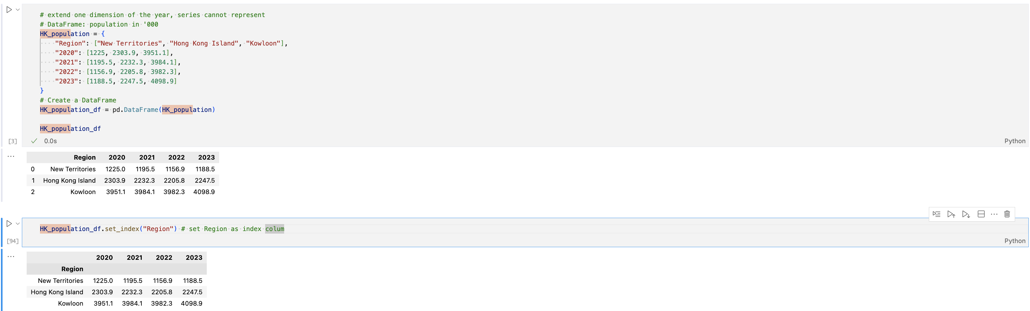
Jupyter Notebook
Why Jupyter Notebook?
Interactive Coding Environment:
Organize code, output, and visualizations in cells for better readability and experimentation.

Slide 27
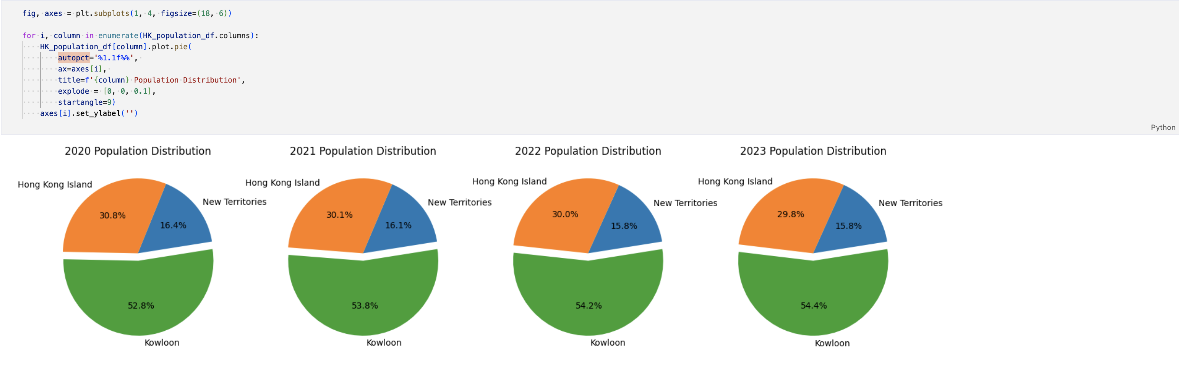
Jupyter Notebook
Why Jupyter Notebook?
Ideal for Data Exploration:
Execute code in small chunks with inline plots, making data exploration interactive and intuitive.
Notes:
Ease of Learning and Understanding:
Python's simple syntax and readability make it ideal for both beginners and experienced programmers.
Rich Ecosystem of Libraries:
Extensive libraries such as NumPy, Pandas, and Matplotlib support a wide range of data science tasks.
Strong Community and Support:
A large, active community contributes to continuous development and provides abundant resources and support.

Slide 28
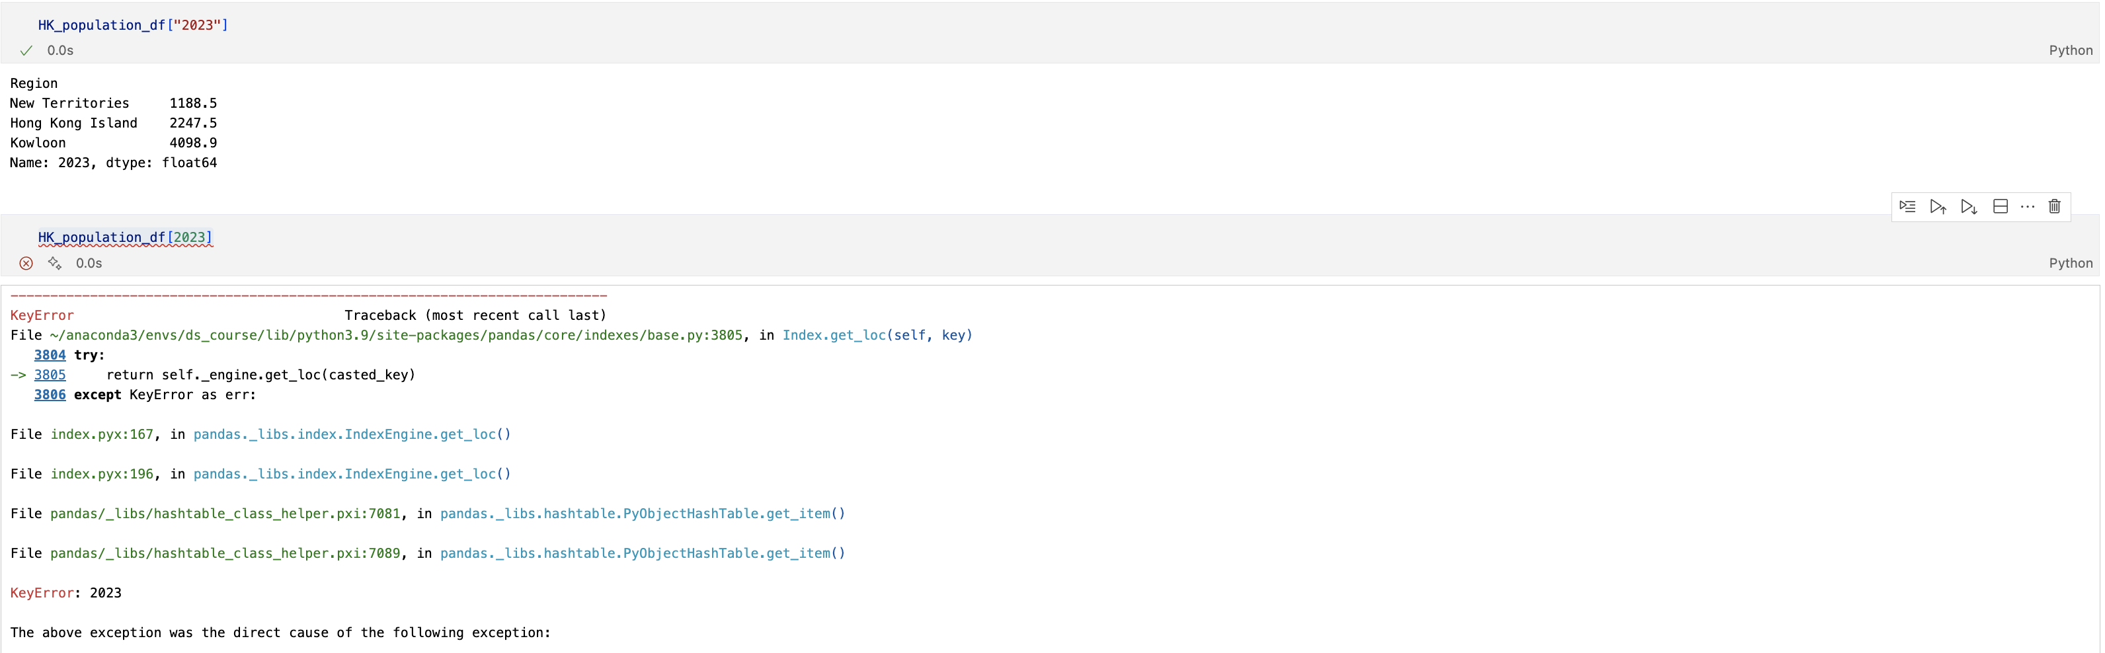
Jupyter Notebook
Why Jupyter Notebook?
Facilitates Testing and Debugging:
Run code incrementally to see outputs immediately and debug errors in specific cells.
Notes:
Ease of Learning and Understanding:
Python's simple syntax and readability make it ideal for both beginners and experienced programmers.
Rich Ecosystem of Libraries:
Extensive libraries such as NumPy, Pandas, and Matplotlib support a wide range of data science tasks.
Strong Community and Support:
A large, active community contributes to continuous development and provides abundant resources and support.

Slide 29
Getting Started
Download Python:
Download the latest version from the official Python website.
Recommended: Anaconda Distribution
Why Anaconda?
Comes bundled with Python and over 1,500 data science packages.
Includes Jupyter Notebook for easy setup.
Installation:
Download from the Anaconda website.
Installation is straightforward, and Jupyter Notebook can be launched from the Anaconda Navigator.

Slide 30
Virtual Environment
It is highly recommended to create a virtual environment for each project.
Key Features
Isolation: Different projects may require distinct versions of same package. Each virtual environment has its own independent set of installed packages. This isolation prevents conflicts between packages that might require different versions.
Reproducibility: By using a virtual environment, you can create a consistent development environment across different machines, making it easier to share projects with others or learning from others.
Dependency Management: You can install specific versions of packages for a project, ensuring that your project works as expected without being affected by updates to those packages elsewhere on your system.

Slide 31
Quick intro to NumPy
A powerful library for numerical computing in Python, providing robust support for large, multi-dimensional arrays and matrices, along with a comprehensive suite of mathematical functions for efficient operations.
Fast Mathematical Operations:
- Perform basic arithmetic, trigonometric, statistical operations and more
- Designed for fast computations and optimized storage
Array Creation and Manipulation:
- Create, reshape, and manipulate arrays and matrices.
- Generate linearly/ logarithmically spaced sequences of numbers
- Access and modify elements based on specified conditions
Random Sampling
- Generate random samples from various probability distributions.
- Perform random selection, shuffling, and other stochastic operations.
Linear Algebra
- Compute Inverse, Determinant
- Calculate Eigenvalues and Eigenvectors, Singular Vector Decomposition(SVD) and more
Fourier Transform
- Efficiently compute Fast Fourier Transforms and inverse

Slide 32
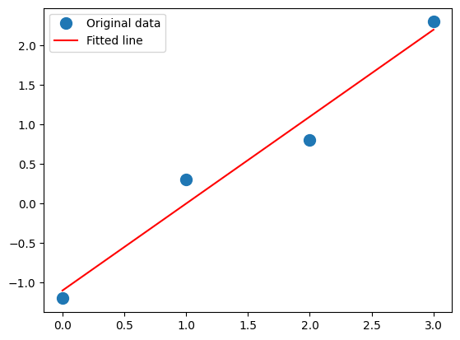
NumPy

Slide 33
Implementation
Let's walk through the entire process:
Download Anaconda
Set Up a Virtual Environment
Activate the Virtual Environment
Test Python Installation
Install NumPy Libraries
Import Libraries
Walk thorough the Jupyter Notebook

Slide 34
Code for VE
You may type the following commands in the Terminal(Mac, Linux) and Command Prompt.(Windows)
Python Built-in Venv
# > python3.9 -m venv ds_course
Windows:
# > ds_course\Scripts\activate
Mac/Linux
# > source ds_course/bin/activate
# > pip install notebook
# > deactivate
Conda (more recommended)
# > conda create -n ds_course python=3.9
# > conda activate ds_course
# > conda install ipykernel
# > python -m ipykernel install --user --name ds_course --display-name "Python3.9 (ds_course)"
Notes:
# > conda install jupyter

