Slide 1
Data Science Seminars
Seminar 5 Prompt Engineering
Nick Kuang
11 June, 2025

Slide 2
What We’ve Covered So Far
Introduction to Data, Big Data and Data Science
Numpy Essentials
Data Science Workflow with Pandas
Statistical Modelling and Inference
Data Collection via Experiments and Data Analysis
Until now our datasets were mostly numeric, but language is the richest data humans create—fueling today’s Large Language Models and unlocking entirely new insights. Let’s dive into how we make text computable.

Slide 3
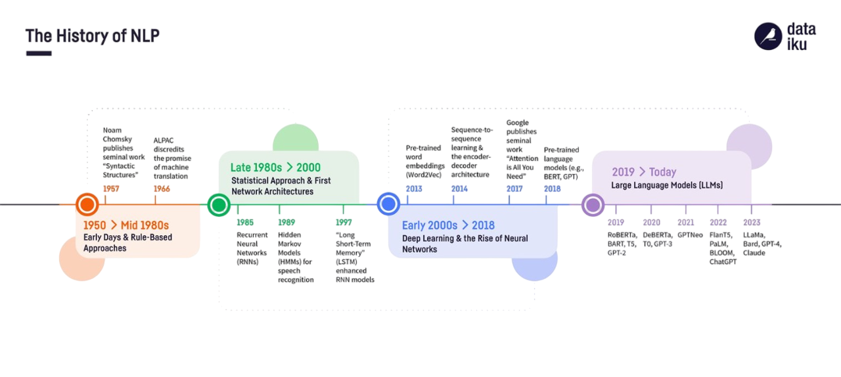
Evolution of Natural Language Processing
Rule-Based
Statistical
Neural Network
Transformer/LLMs

Slide 4
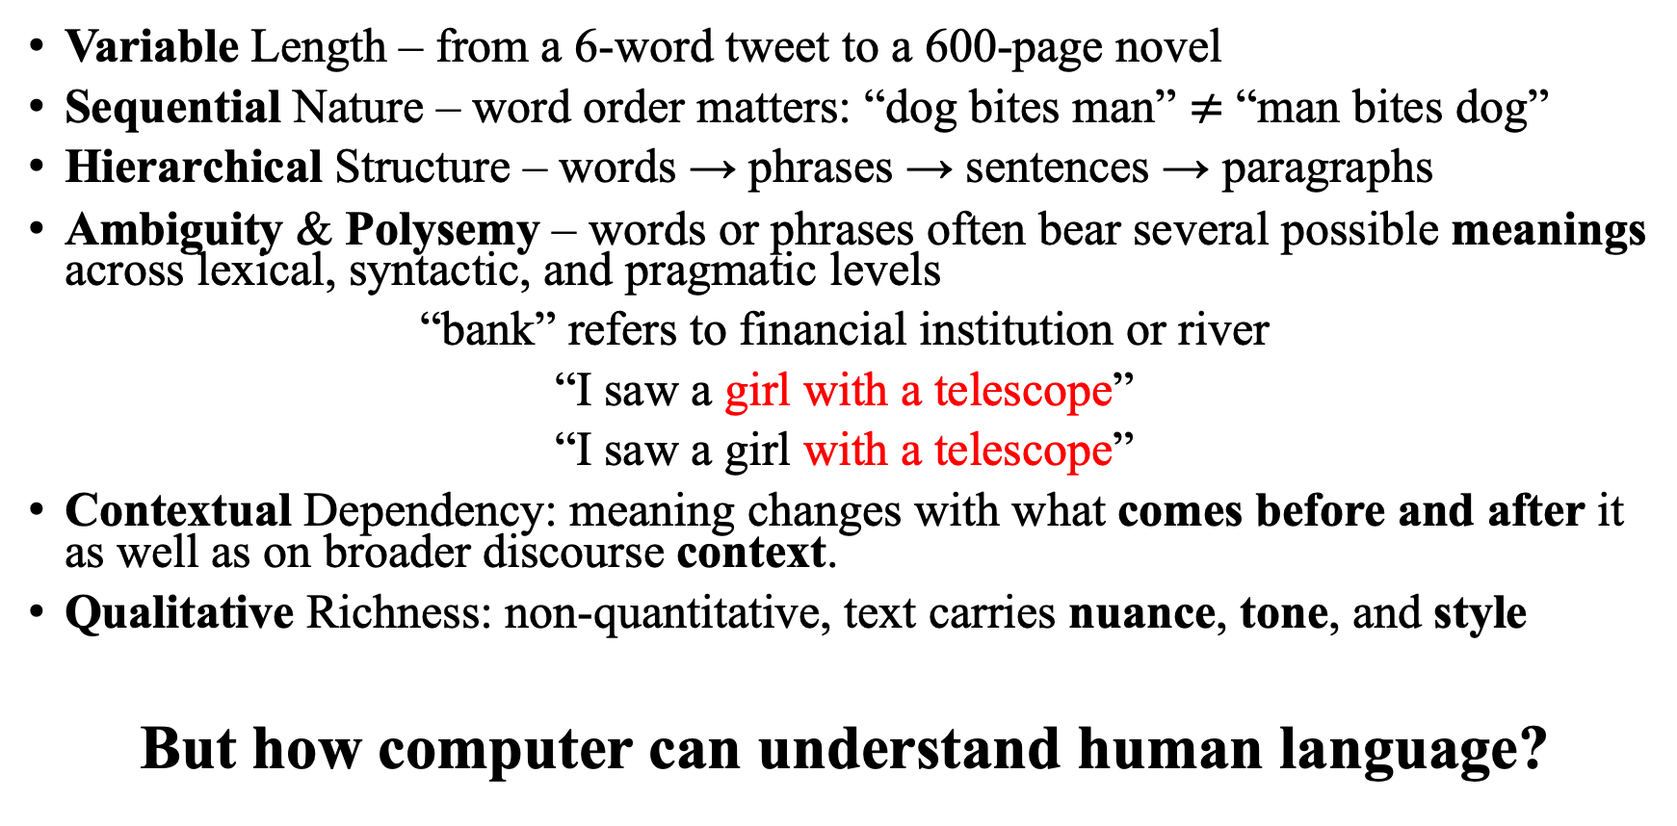
The Characteristics of Text
Variable Length – from a 6-word tweet to a 600-page novel
Sequential Nature – word order matters: “dog bites man” $≠$ “man bites dog”
Hierarchical Structure – words → phrases → sentences → paragraphs
Ambiguity & Polysemy – words or phrases often bear several possible meanings across lexical, syntactic, and pragmatic levels
“bank” refers to financial institution or river
“I saw a girl with a telescope”
“I saw a girl with a telescope”
Contextual Dependency: meaning changes with what comes before and after it as well as on broader discourse context.
Qualitative Richness: non-quantitative, text carries nuance, tone, and style
But how computer can understand human language?

Slide 5
From Words→Numbers: Computers Read Language
Computers think in numbers, so text must be encoded before a model can use it.
Building a Vocabulary – a lookup table is crucial,
it defines the mapping between words and numbers.

Slide 6
Steps to Process Text into Numbers
Reading Text Data: Load and clean raw text data (e.g., removing punctuation, converting to lowercase).
Tokenization: Break text into smaller units called tokens. These tokens can be words, subwords, or characters. For example, "Hello, world!" becomes ```["Hello", "world"]```.
For example:
“Hello, world!” → [“hello”, “world”]
Building Vocabulary: Assign a unique identifier to each token to build a vocabulary
“hello” → 21, “world” → 7592
Convert the text into sequences of numerical indices
“hello world” → [21, 7592]

Slide 7
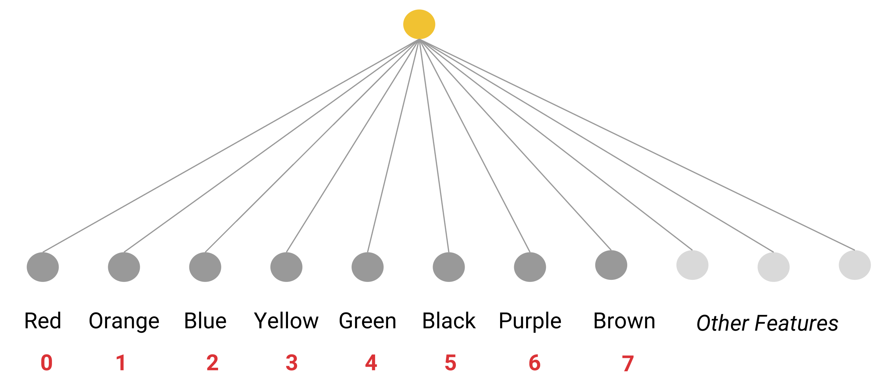
Words into Index

Slide 8
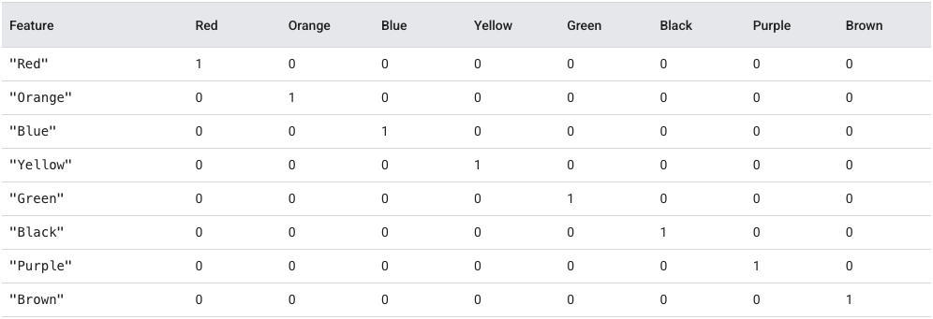
One-Hot (Bag-of-Words) Representation
Each row is a one-hot vector for a single word: 1 = word present, 0 = absent.
Notes:
Problems

Slide 9
Text Preprocessing
Tokenization
Sentence Segmentation
Morphological Analysis
Syntactic Analysis

Slide 10
From One-Hot to Meaningful Representations
One-Hot Representation is simple to construct, but it has significant limitations:
The vocabulary size can be extremely large — for example, the Oxford English Dictionary includes over 600,000 words. Sparse Vector
It fails to capture any semantic similarity between words — each word is treated as completely independent of the others.
Therefore, embedding was introduced as a game-changer to address the limitations.
word2vec, GloVe, FastText map every word to a 50-300-D point
Similar words cluster(walk ↔ run < walk ↔ apple)
Directions capture relations: king − man + woman ≈ queen

Slide 11
From Word Embeddings to Language Models
Static embeddings (Word2Vec) were a milestone, but they fall short:
One vector per word, regardless of context
→ e.g., “bank(river)” = “bank(finance)” gets the same vector
Shallow window-based context
→ Captures local relationships, not deeper sentence-level understanding
What we want instead:
Vectors that change with sentence or paragraph context
Models that read the whole sequence
Built-in ability for downstream tasks (translation, Q&A, summarization)
Solution:
Contextual Language Models

Slide 12

Large Language Models
Large Language Models (LLMs) like BERT, GPT, and T5 represent a major leap:
Model language globally with Transformer self-attention
Train on massive corpora
Can be fine-tuned for a wide range of downstream tasks
These models go beyond static embeddings — they generate contextualized, dynamic representations of text.
Language models treat content generation as a probabilistic process. GPT models predict the next word/token.

Slide 13
How Large Language Models
GPT: Next-Word Prediction(Causal Language Modelling)
Content generation is probabilistic process, and it predicts next-word token

Slide 14
Large Language Models: Applications
You may build an application by deploying the open-sourced models locally or calling paid API services if close-sourced.
Embedding
Why prompts are "additional context" not "training"
LLMs are trained to get stronger, but can trained in a different objective
At the heart of every LLM-powered application is one key design ingredient — the prompt.

Slide 15
Large Language Models: Applications
LLMs power diverse applications:
🧠 Text Understanding
Sentiment Analysis, Summarization, TopicClassification
🗨️ Conversational Agents
Customer Service Bots, Virtual Tutor
📄 Text Transformation
Translation, Paraphrasing
🧑‍💻 Coding Assistants
Copilot, Auto Completion, Bug Explanation & Refactoring
At the heart of every LLM application is one key design ingredient —prompt

Slide 16
Why Prompt Engineering Matters?
Quality lever – LLM answers can swing from brilliant to wrong with a single wording change
Fast / low-cost iteration – editing a prompt takes seconds; fine-tuning a model burns GPUs and budget
Measured gains – smart prompts often lift accuracy by 20 – 50 percentage points
Capability unlock – step-by-step or tool-calling prompts elicit reasoning and planning skills
Undesired behaviors – precise instructions trim hallucinations and policy violations
A well-crafted prompt is the quickest, cheapest way to turn a general LLM into a task-specific expert.
Notes:
LLM output quality is highly prompt-dependent
Iterating on prompts is much faster (and cheaper) than model fine‑tuning.
Well‑crafted prompts can:
Improve task accuracy by ↑20‑50%
Unlock the capabilities of LLM such as reasoning
Reduce the likelihood of hallucinations

Slide 17
Prompt Engineering 101
Prompt = a natural language instruction sent to LLM
A prompt contains any of the following elements:
Role / Persona Assignment: Set the voice & expertise:
“You are an financial analyst.”
Context / Knowledge Grounding: Supply facts or reference text
“Using the article below…”
Instruction / Task Definition: Define the action
“Summarise the article in sentence ...”
Format Specification: Specify the response shape
“Please reply in JSON format with following entries…”
Examples:Show the model what “good” looks like
Guidance: “Input: X ⇒ Output: Y”
Notes:
PurposeMicro-example
1Role / PersonaSet the voice & expertise“You are a financial analyst.”
2Context / GroundingSupply facts or reference text“Using the article below …”
3Task InstructionDefine the action“Summarize the article in one sentence.”
4Output FormatSpecify the response shape“Reply in JSON with keys title, summary.”
5Examples (Few-shot)Show the model what “good” looks likeInput: X ⇒ Output: Y

Slide 18
Prompt Engineering Principles
Principle 1- Be clear, concise, specific
Removes ambiguity; the model can aim straight at the target.
Example:
“Summarize the article in exactly 2 bullet points.
Output JSON with keys headline, bullets.”
Principle 2 - Give the model time to “think”
Asking for intermediate reasoning improves accuracy and reduces hallucinations
Example:
“Show your step-by-step analysis first,
then give the final answer on a new line prefixed with ANSWER:.”

Slide 19
Anatomy of Effective Prompts
Specific & Clear – eliminate ambiguity; state the desired outcome
Structured I/O – guide the model with JSON, CSV, or numbered lists
Delimiters – triple‑backticks or XML tags to separate sections
Task Decomposition – break complex goals into ordered subtasks
Notes:
Key Considerations for Prompt Design
Specificity and Clarity: Just like giving instructions to a human, prompts should clearly articulate the desired outcome. Ambiguity can lead to unexpected or irrelevant outputs.
Structured Inputs and Outputs: Structuring inputs using formats like JSON or XML can significantly enhance an LLM's ability to understand and process information. Similarly, specifying the desired output format (e.g., a list, paragraph, or code snippet) improves response relevance.
Delimiters for Enhanced Structure: Utilizing special characters as delimiters within prompts can further clarify the structure and segregate different elements, improving the model's understanding.
Task Decomposition for Complex Operations: Instead of presenting LLMs with a monolithic prompt encompassing multiple tasks, breaking down complex processes into simpler subtasks significantly improves clarity and performance. This allows the model to focus on each subtask individually, ultimately leading to a more accurate overall outcome.

Slide 20
Prompt Engineering
Key Considerations for Prompt Design
Specificity and Clarity: Just like giving instructions to a human, prompts should clearly articulate the desired outcome. Ambiguity can lead to unexpected or irrelevant outputs.
Structured Inputs and Outputs: Structuring inputs using formats like JSON or XML can significantly enhance an LLM's ability to understand and process information. Similarly, specifying the desired output format (e.g., a list, paragraph, or code snippet) improves response relevance.
Delimiters for Enhanced Structure: Utilizing special characters as delimiters within prompts can further clarify the structure and segregate different elements, improving the model's understanding.
Task Decomposition for Complex Operations: Instead of presenting LLMs with a monolithic prompt encompassing multiple tasks, breaking down complex processes into simpler subtasks significantly improves clarity and performance. This allows the model to focus on each subtask individually, ultimately leading to a more accurate overall outcome.

Slide 21
Prompt Engineering: Talking to LLM effectively
After the model receives a prompt, depending on the type of model being used, it can generate text, embeddings, code, images, videos, music, and more.
Prompt engineering is the process of writing effective instructions for a model, such that it consistently generates content that meets your requirements(OpenAI), in other words the strategies and tactics for getting better results from LLMs.
Because the content generated from a model is non-deterministic, it is a combination of art and science to build a prompt that will generate content in the format you want, it involves Trial and Errors.
However, there are a number of techniques and best practices you can apply to consistently get good results from a model.

Slide 22
Structured Formatting
Mark clear boundaries – fence each section of your prompt (role, instructions, context, examples) so the model never confuses them.
Prefer machine-readable wrappers – use triple back-ticks …, angle-tag pairs <context> … </context>, or JSON / XML envelopes.
Keep I/O consistent – if you ask for code, forbid Markdown; if you ask for JSON, supply a sample schema.
Think “compiler” – the stricter the syntax, the less room for hallucination.

Slide 23
Template Example
# Role
You are a coding assistant that enforces **snake_case** variables in JavaScript targeting Internet Explorer 6.
# Instructions
Declare all variables with `var`, not `let` / `const`.
To support old browsers, declare variables using the older "var" keyword.
Output **plain code only** – no Markdown, no commentary.
# Examples I/O
<user_query>
How do I declare a string variable for a first name?
</user_query>
<assistant_response>
var first_name = "Anna";
</assistant_response>

Slide 24
Few-Shot Learning
# Identity
You are a helpful assistant that labels short product reviews as Positive, Negative, or Neutral.
# Instructions
* Only output a single word in your response with no additional formatting or commentary.
* Your response should only be one of the words "Positive", "Negative", or "Neutral" depending on the sentiment of the product review you are given.
# Examples
<product_review id="example-2"> Battery life is okay, but the ear pads feel cheap.</product_review>
<assistant_response id="example-2">Neutral</assistant_response>
<product_review id="example-3">Terrible customer service, I'll never buy from them again. </product_review>
<assistant_response id="example-3">Negative</assistant_response>

Slide 25
Chain‑of‑Thought & Self‑Consistency
Instructing the model to reason
Zero Shot CoT: “Let's think step by step”
Break Down Complex Task
Step 1 –
Step 2 –
Step 3 -
Self-Consistency Decoding
Sample many reasoning paths instead of taking the first (greedy) draft.
Compare answers and select the one that appears most often or is most coherent.
Yields strong gains on arithmetic and commonsense tasks.

Slide 26
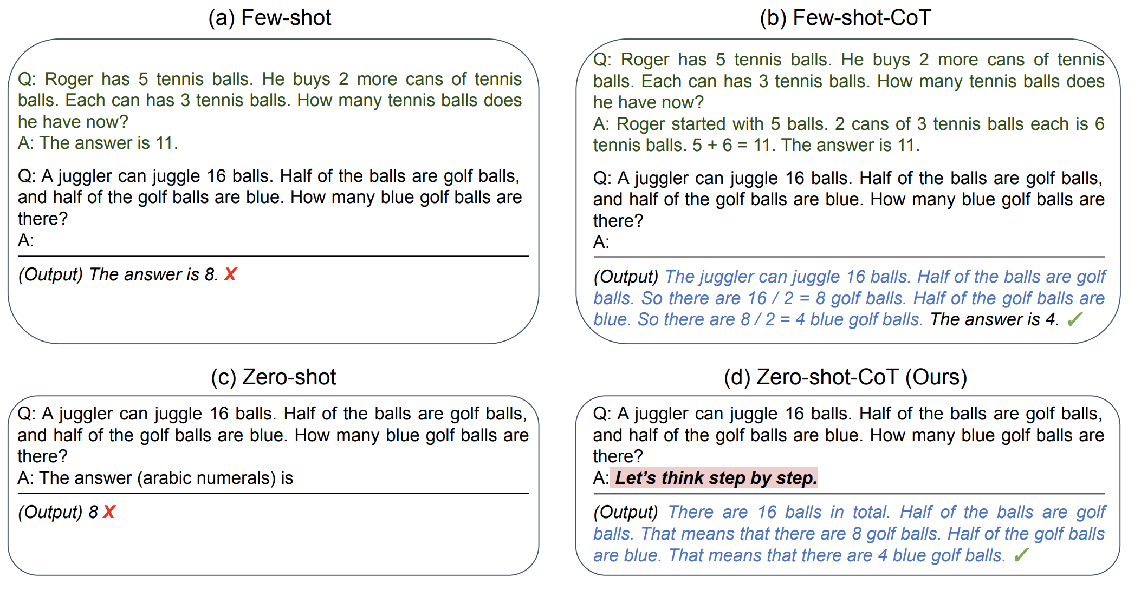
Few-Shot Chain-of-Thought

Slide 27
Contextual Information Included
LLM store their knowledge in parametric memory during training, and the knowledge is static and fixed once training finishes.
It is often useful to include additional context information the model can use to generate a response within the prompt you give the model. There are a few common reasons why you might do this:
Expose private or up-to-date knowledge
Proprietary manuals, internal FAQs, time-sensitive data.
Constrain the answer space
“Respond using only the documents supplied below.”
Improve correctness & depth
Fresh context reduces hallucinations and lets the model cite sources.
The technique of adding additional relevant context to the model generation request is sometimes called retrieval-augmented generation (RAG).

Slide 28
AI combined with external resources
Keeping an LLM’s brain up-to-date
User prompt
Retriever – vector / hybrid search finds the k best text chunks
Context – retrieved passages are appended to the prompt
Generator – the LLM produces an answer grounded in that evidence
Key benefits:
Fresh knowledge without re-training
Domain specificity – inject proprietary or restricted data
Fewer hallucinations – answers trace back to retrieved text

Slide 29
ReAct(Reason + Act Prompting)
Think → Act loop – the model alternates between internal Thought steps and explicit Action calls
Thought: “Need today’s stock price.” → Action: lookup("AAPL")
On-the-fly planning – reasoning traces let the model create, track, and revise its action plan (and handle exceptions)
Tool interop – Action steps query external sources (knowledge bases, APIs, simulators), injecting fresh facts into the conversation
Higher fidelity answers – external evidence + self-checked reasoning ⇒ more reliable, up-to-date, and factual outputs
combine chain-of-thought with tool calls,
the LLM can think, gather, and answer
—all in one prompt.

Slide 30
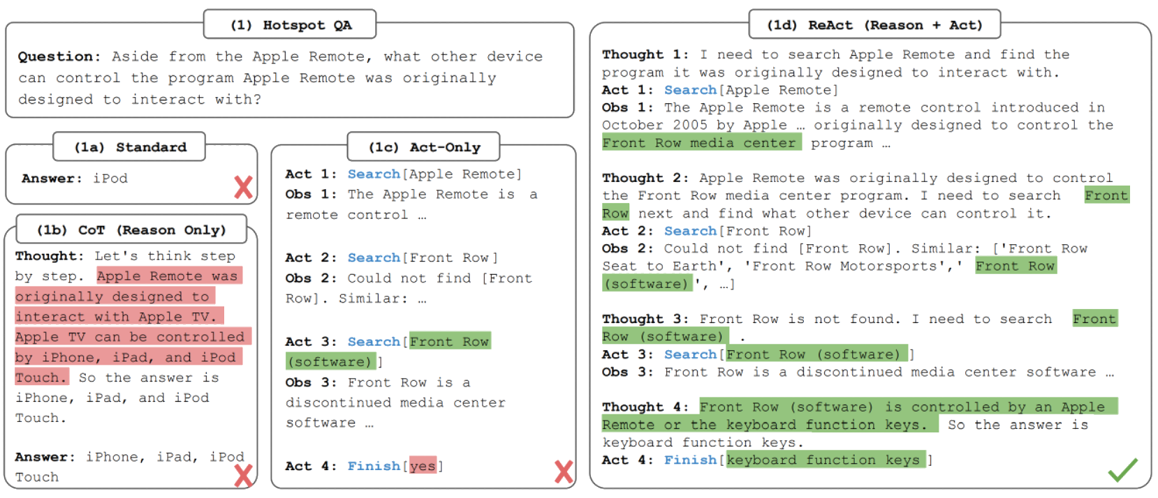
ReAct

Slide 31
Evaluation & Iteration Loop
Draft prompt
Test with eval set
Measure (accuracy, latency, cost, safety)
Refine & repeat

Slide 32
Exercise
Text Summarization
Information Extraction
…

Slide 33
Tools for Prompt Engineering
- OpenAI Playground

