Slide 1


Gendered Pronoun Resolution
Yuanjie Shi: 10430581
Jiawei Wang: 10431455
Bowen Li: 10433921
Notes:
Hi guys, my name is Jiawei Wang, She is Yuanjie Shi, her name is Bowen Li. Our project is talking about gendered pronoun resolution, which is based on NLP(Nature Language Processing), Random forest and K_fold validation. As a Kaggle competition, the rank of our project is TOP 24%

Slide 2
Contents
Background
Dataset
Feature Engineering
Model training and validation
Future Work
Notes:
This lecture contains 5 parts.

Slide 3
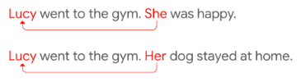
1. Background
Task
Pairing an expression to its referring entity.
An important task for natural language understanding.
Resolution of ambiguous pronouns is a longstanding challenge.
Our Job
Figure out meaning of every dataset variables.
Apply feature engineering among these variables.
Use Random Forest to train the model and make a prediciton
Notes:
Firstly, the background.our project is based on knowledge of Nature language processing to recognize the pronoun. What we do is to write an algorithm to distinguish the pronoun in a sentence since there are two name in the sentence.
At the beginning of the project, we have to specific plan which could guide us to finish this project as plan. The Gantt Chart shows that we began our project on March 31, after preparing, scheduling, requirement analyzing, test, and finally we finish the report.

Slide 4
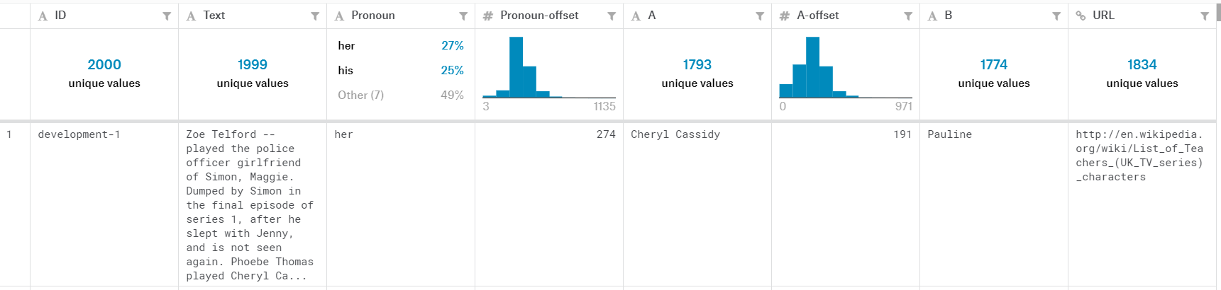
2. Dataset
Column | Header | Description
1 | ID | Unique identifer for an example (two pairs)
2 | Text | Text containing the ambiguous pronoun and two candidate names. About a paragraph in length
3 | Pronoun | The pronoun, text
4 | Pronoun-offset | Character offset of Pronoun in Column 2 (Text)
5 | A | The first name, text
6 | A-offset | Character offset of A in Column 2 (Text)
7 | A-coref | Whether A corefers with the pronoun, TRUE or FALSE
8 | B | The second name, text
9 | B-offset | Character offset of B in Column 2 (Text)
10 | B-coref | Whether B corefers with the pronoun, TRUE or FALSE
11 | URL | The URL of the source Wikipedia page
Notes:
The Data set contains eleven parts. One of the most important content is the offset, that means from the name to the pronoun, how many characters It contains. And the A-coref means the accuracy of the estimation. Now let my teammate Bowen show the feature that we analyzed

Slide 5
3. Feature Engineering
Get Features
Find out the minimum value among ‘Pronoun-offset’, ‘A-offset’ and ‘B-offset’.
Add the length of pronoun to 'Pronoun-offset', ‘A-offset’ and ‘B-offset’.
Find out the maximum value among new ‘Pronoun-offset’, ‘A-offset’ and ‘B-offset’.
Replace ‘A-pronoun’ and ‘B-pronoun’ with ‘subjecton’ and ‘subjecttwo’.
Define the difference between ‘Pronoun-offset’ with ‘A-offset’ and ‘B-offset’ as ‘A-distance’ and ‘B-distance’.
Add these new features to the tail of the data
Apply the steps above to all train and test data.

Slide 6
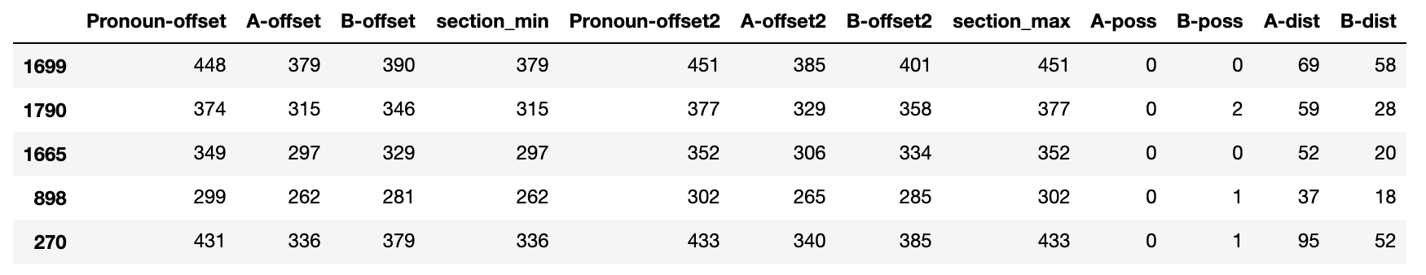
3. Feature Engineering
NLP features
Use function nlp() to separate text into strings.
Apply function token.dep_ to judge whether strings have poss attribute.
Return to the length of the subject who has a poss attribute.
Apply the steps above to all train and test subject values.
Create new dataset with these features

Slide 7
4. Model training
Random Forest
What is random forest?
Why do we use random forest?
How does it work?
Notes:
In machine learning, a random forest is a classifier that contains multiple decision trees, and the category of its output is determined by the mode of the category of the individual tree output. Specifically, a forest is built in a random way. There are many decision trees in the forest. There is no correlation between each decision tree in the random forest. After getting the forest, when a new input sample enters, let each decision tree in the forest make a separate judgment to see which class the sample should belong to (for the classification algorithm), and then see which One type is selected the most, and the sample is predicted to be that type.
When we need to separate all the green dots without errors in the training (that is, the parameter selection is not very reasonable), the decision tree will produce an over-fitting phenomenon, which will weaken the generalization ability.
It uses the bootstrap resampling technique to randomly extract k samples from the original training sample set N to generate a new training sample set, and then generate k classification trees according to the self-service sample set to form a random forest. The classification result of the data is determined by the score formed by the number of votes in the classification tree. Its essence is an improvement of the decision tree algorithm, which combines multiple decision trees. The establishment of each tree depends on an independently extracted sample. Each tree in the forest has the same distribution, and the classification error depends on each The ability of a tree to classify and the correlation between them. Feature selection uses a random approach to split each node and then compare the errors produced in different situations. The inherent estimation errors, classification capabilities, and correlations that can be detected determine the number of selected features. The classification ability of a single tree may be small, but after randomly generating a large number of decision trees, a test sample can be selected by the classification result of each tree to select the most likely classification.

Slide 8
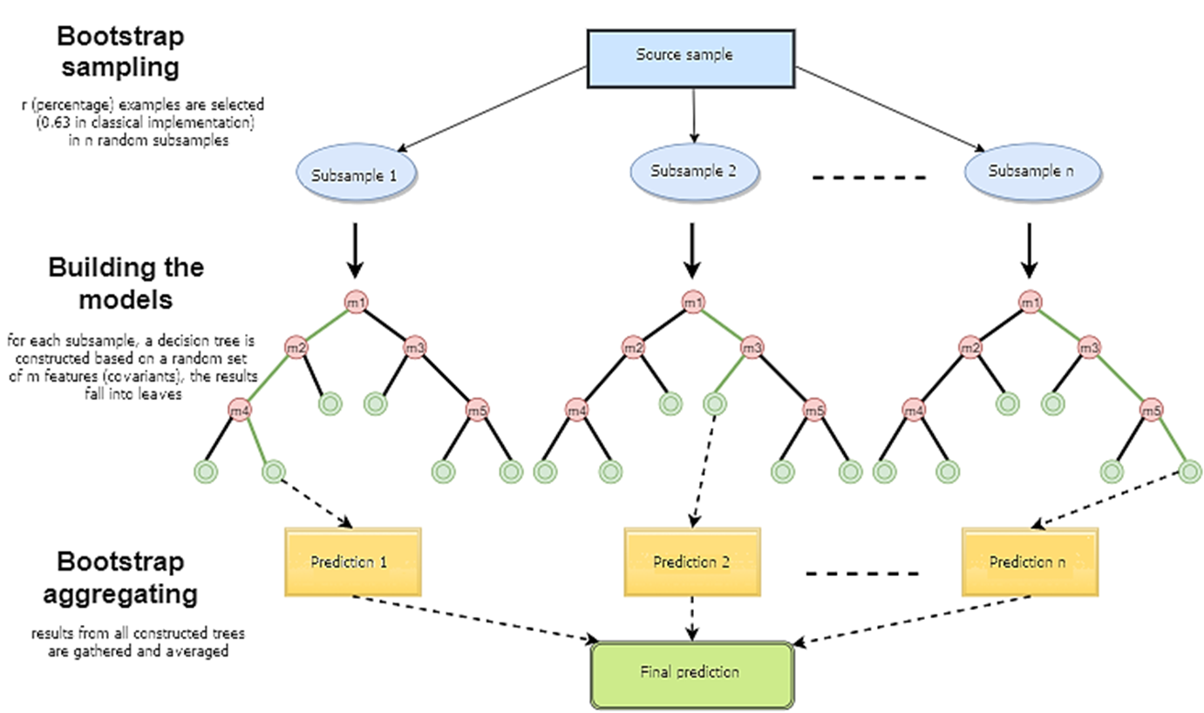
4. Model training
Random Forest
Notes:
1) N is used to indicate the number of training cases (samples), and M is the number of features.
2) Enter the number of features m to determine the decision result of a node on the decision tree; where m should be much smaller than M.
3) From the N training cases (samples), the samples are sampled N times to form a training set (ie, bootstrap sampling), and the unused use cases (samples) are used for prediction to evaluate the error.
4) For each node, m features are randomly selected, and the decision of each node on the decision tree is determined based on these features. According to these m features, calculate the best split mode.
Every tree grows intact without pruning (Pruning, which may be used after building a normal tree classifier).
The random forest classification effect (error rate) is related to two factors:
Correlation of any two trees in the forest: the greater the correlation, the greater the error rate;
The ability to classify each tree in the forest: The stronger the classification ability of each tree, the lower the error rate of the entire forest.

Slide 9

4. Model training
Random Forest
$$model=multiclass.OneVsRestClassifier(ensemble.RandomForestClassifier(max_depth=7,n_estimators=1000, random_state=33))$$
Notes:
 Max_depth: The maximum depth of the decision tree. If not entered, the decision tree does not limit the depth of the subtree when building the subtree. In the case of a large sample size and many features, the maximum depth needs to be limited. The specific value depends on the distribution of the data.
 N_estimators: The maximum number of iterations of the weak learner, or the maximum number of weak learners. In general, n_estimators are too small, easy to fit, n_estimators is too large, the amount of calculation will be too large, and after n_estimators reaches a certain number, the model increase obtained by increasing n_estimators will be small.
 Random_state: This parameter makes the result easy to reproduce. A certain random value will produce the same result, with the parameters and training data unchanged.

Slide 10
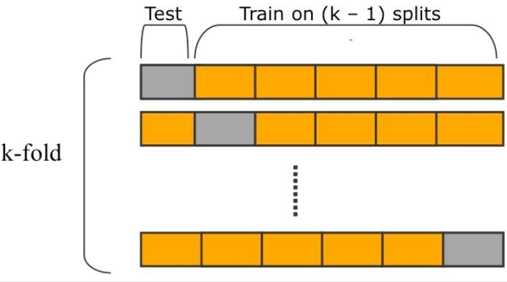

4. Model Validation
K-Fold
$$CV\left(k\right)=\frac{1}{k}\sum_{i=1}^{k}{{MSE}_{i}}$$
Notes:
K-fold cross-validation, the initial sampling is divided into K sub-samples, a single sub-sample is retained as the data of the verification model, and the other K-1 samples are used for training. Cross-validation is repeated K times, each sub-sample is verified once, and the average K-time results or other combinations are used to finally obtain a single estimate. The advantage of this method is that it repeatedly uses randomly generated subsamples for training and verification. Each time the results are verified once, 10-fold cross-validation is the most commonly used.
The steps are:
Divide all training sets S into k disjoint subsets. Assuming that the number of training examples in S is m, then each subset has m/k training examples, and the corresponding subset is called {S_1,S_2,…,S_k} .
Take M_i out of the model set M each time, and then select k-1 datasets {S_1,S_2,…,S_(j-1),S_(j+1),…,S_k} in the training subset. (That is, only S_j is left at a time), after training M_i with these k-1 subsets, the hypothesis function h_ij is obtained. Finally, use the remaining S_j for testing and get an empirical error ε ̂_( S_j ) (h_ij ).
Since we leave S_j (j is from 1 to k) each time, we get k empirical errors, then for M_i, its empirical error is the average of these k empirical errors.
Select the lowest average error rate of M_i, and then use all the S to do another training to get the final h_i.

Slide 11
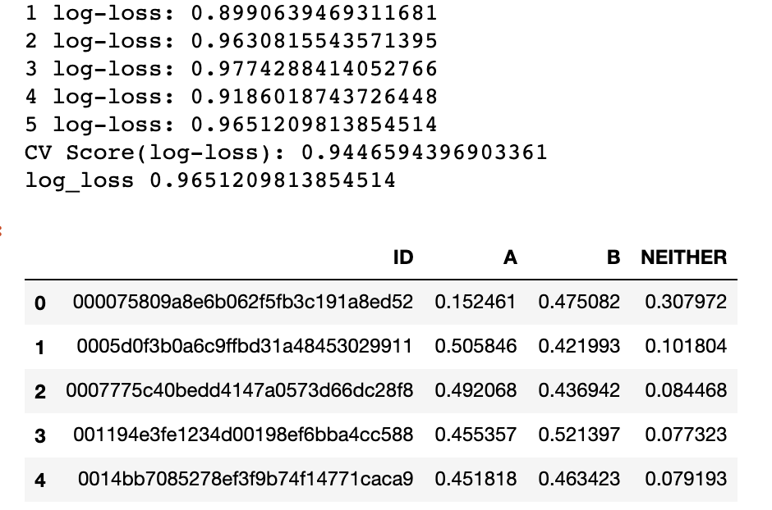
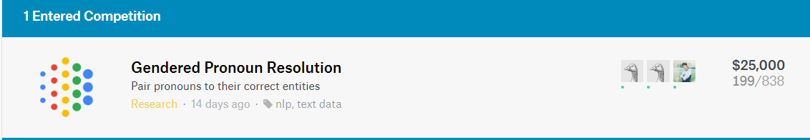
5. Final Output
Define a output data frame.
‘A’ is the conference value of A, ‘B’ is the conference value of B. ‘Neither’ is 1 minus these two variables.
Use test data to do the prediction.

Slide 12
6. Future Work
Accuracy is not a good way to evaluate models when dealing with unbalanced categories. We can use AUC and f1-score.
Unsurprisingly, ensemble models are superior to other learning algorithms in most cases.
We can improve the features and models by using some other algorithms like XGBoost and BERT.
Try some neural network methods to increase accuracy of outcome.

