Slide 1
LevelDB & bLSM
Introduction on Compaction & BloomFilter in LevelDB

Slide 2
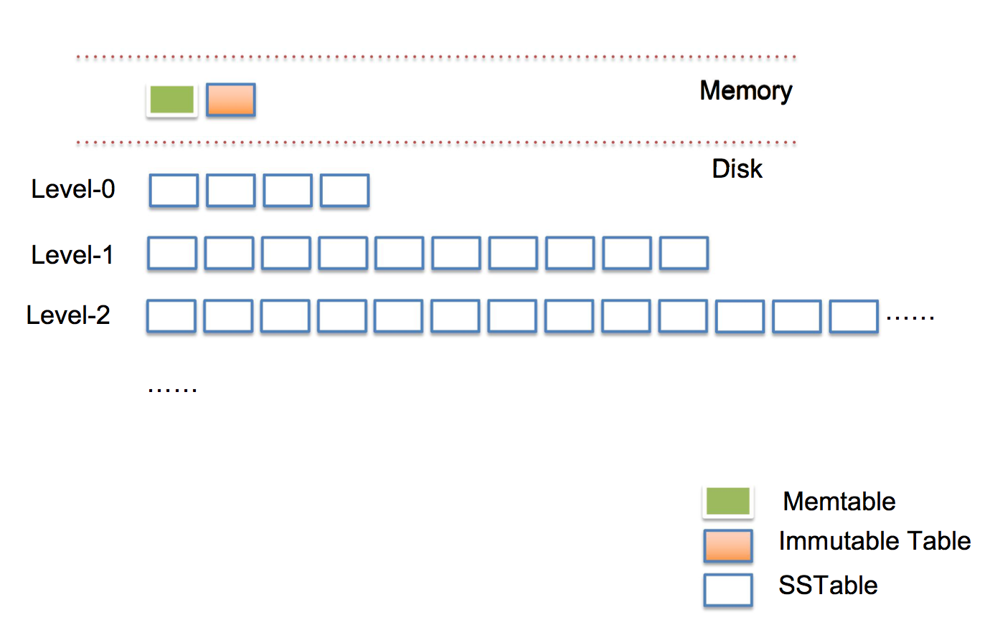

Slide 3
Why Compact?
Limited Size on each level
Overlapping between SSTs
Memory Table is full

Slide 4
When to Compact
1. DB::Open -> main Thread
2. memTable is full -> compact!
3. DB::Get -> Frequented SSTs with useless returns
Outnumbered SSTs on one level
4. Manual Compaction -> DBImpl::CompactRange
5. Memory Occupation of level n

Slide 5
How to Compact
Major Compaction
level n -> level n + 1 until no overlapping
BackgroundCall() -> MaybeScheduleCompaction()
BackgroundCompaction() ->
Manual Compaction -> CompactRange()
Auto Compaction -> PickCompaction()
Minor Compaction
Memory Table -> Immutable MemTable-> SST
WriteLevel0Table() -> PickLevelForMemTableOutput()

Slide 6
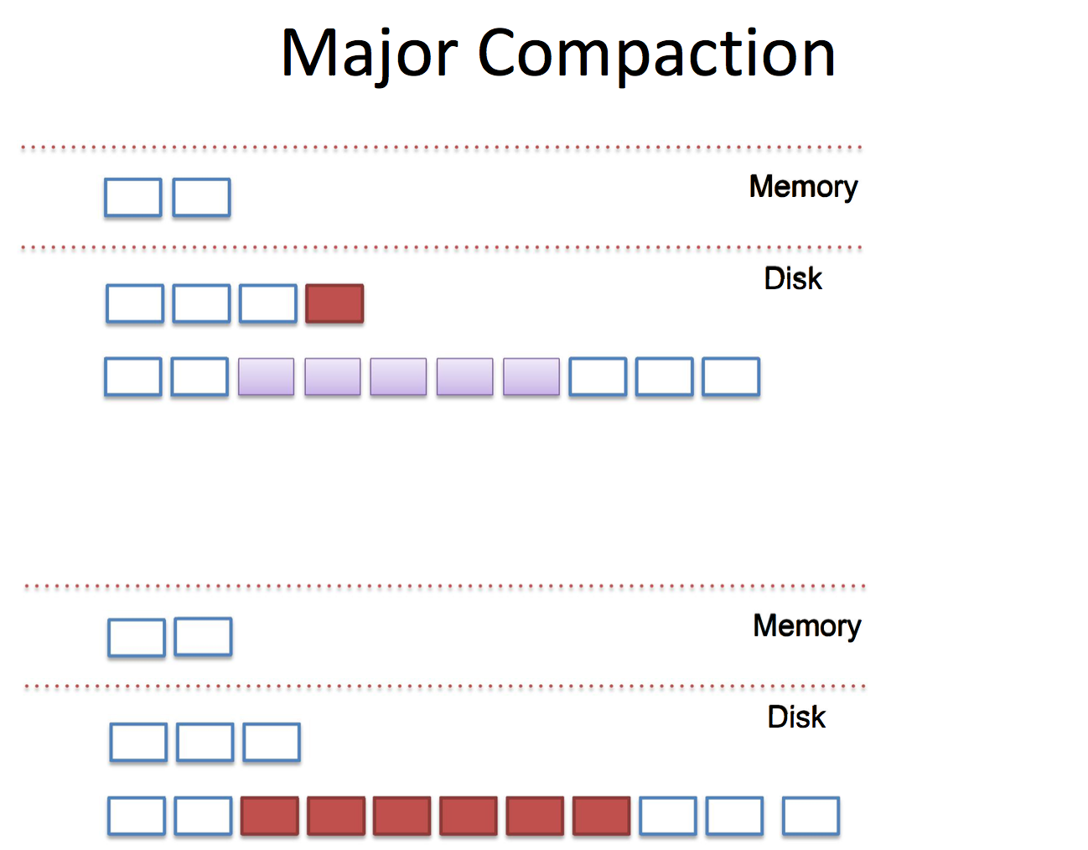

Slide 7
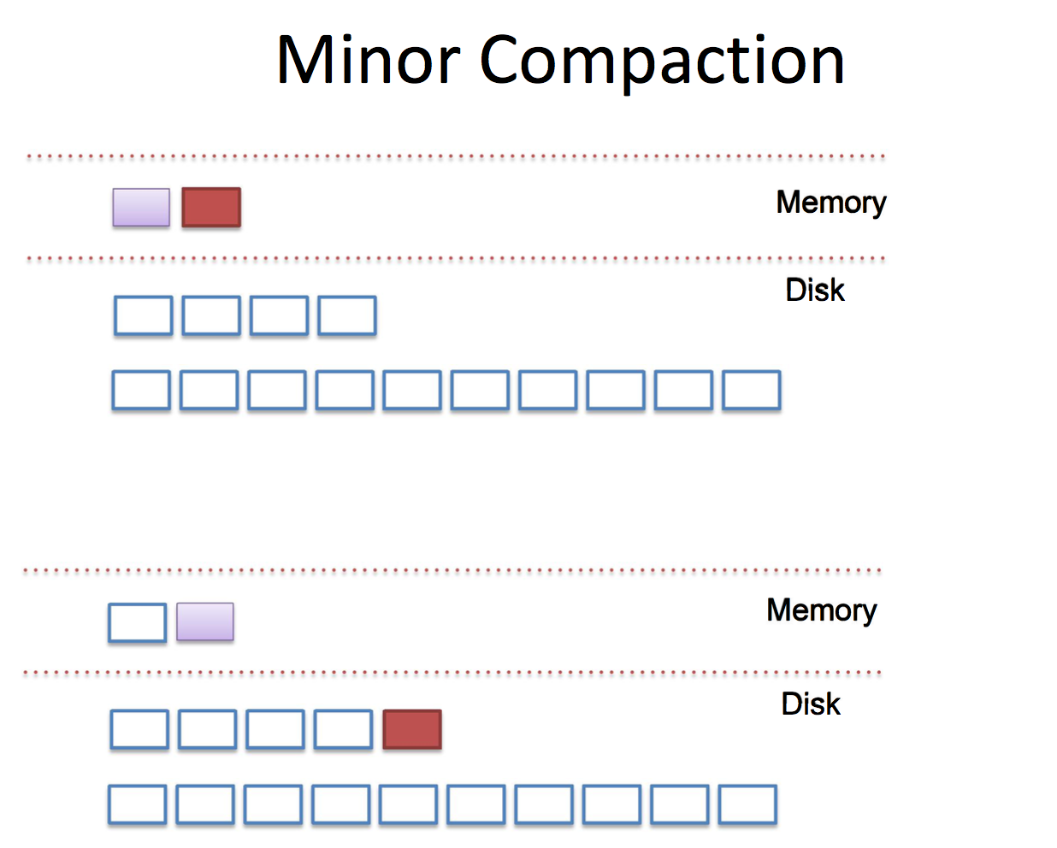

Slide 8
Limitations on Log Structured Indexes
Trade-off between “write” & “read” performances
-> Excessive read amplification
-> Exhaustive Lookups & Seeks during Inserts
-> Write Pauses
So bLSM Tree it is !

Slide 9
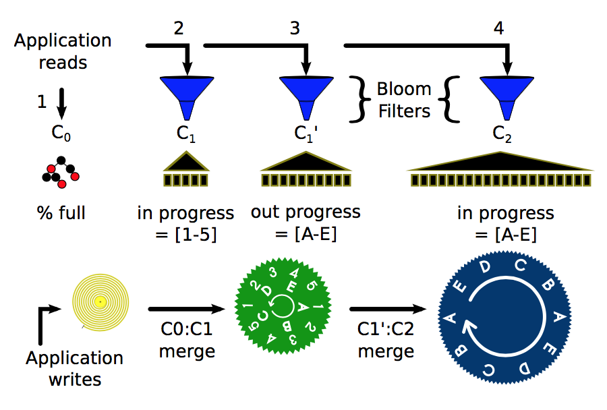
What is bLSM Tree?
BloomFilter
Gear Scheduler
(Not relevant to Compaction)

Slide 10
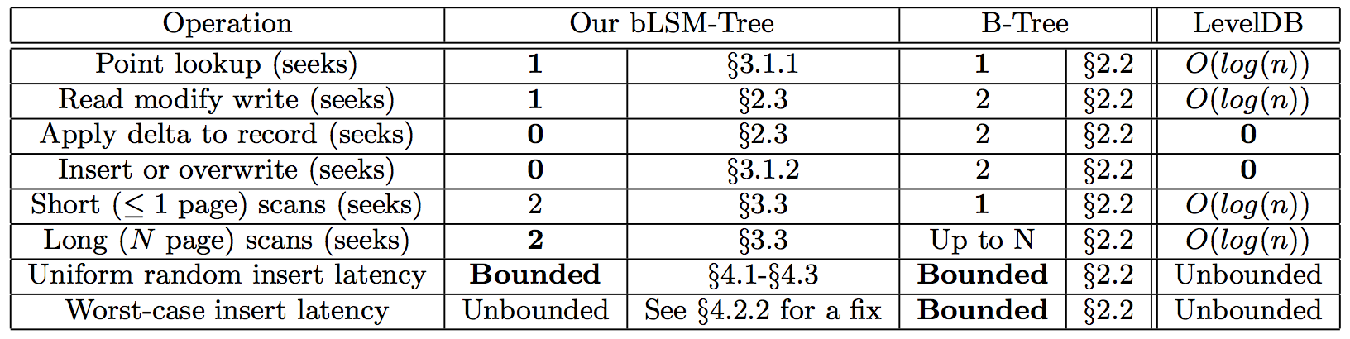
How is bLSM Tree?

Slide 11
Deal with Read Amplification
Base LSM-Tree algorithm
-> Unacceptable high read amplification
-> Lookups and scans perform N -1 times
With BloomFilter
-> Lookups from N to 1 + N/100 !
-> 10 bits per item → a 1% false positive rate
-> Not good with redundant copies of data

Slide 12
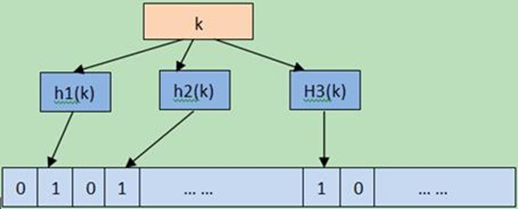
BloomFilter Implementation
table/filter.h, filter_block.cc
FilterBlockReader & FilterBlockBuilder
util/bloom.c
leveldb.BuiltinBloomFilter

