Slide 1
Previous & SST-trie
Clarifications on last slides & Intro to LSM-trie

Slide 2
Why LSM trie
Large Write Amplification Ratio
Worst case: 10 SSTs needed to be merged for one higher level SST
Hence there are totally 11 SSTs involved
Write Amplification Ratio -> 11!
11 = 1 + 10 in which 10 is the default amplification factor(AF)
For one simple KV to reach the level n
The ratio could reach to (1 + AF) * n

Slide 3
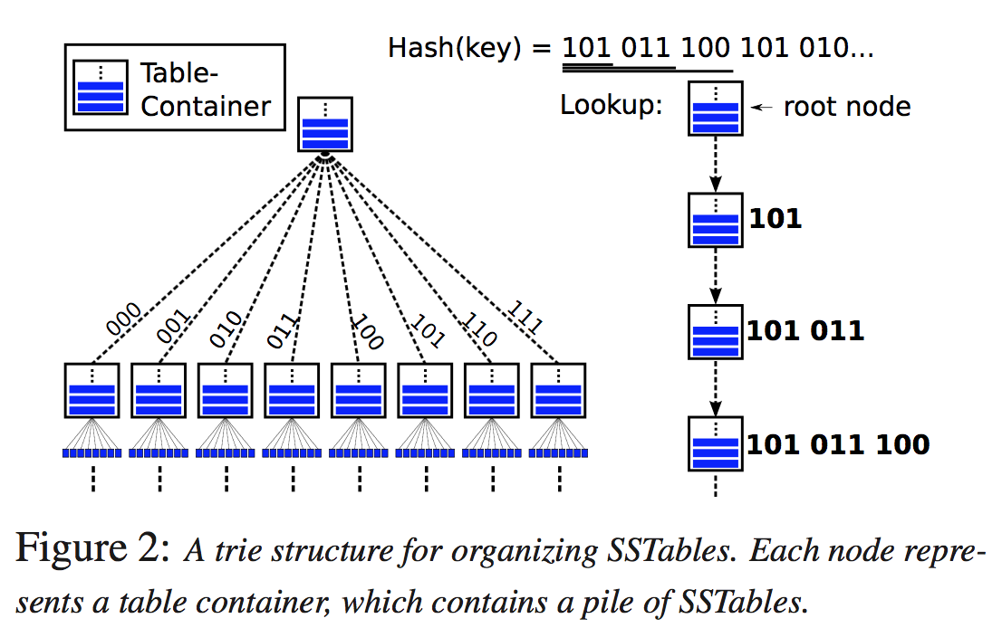
What is SST-trie?

Slide 4
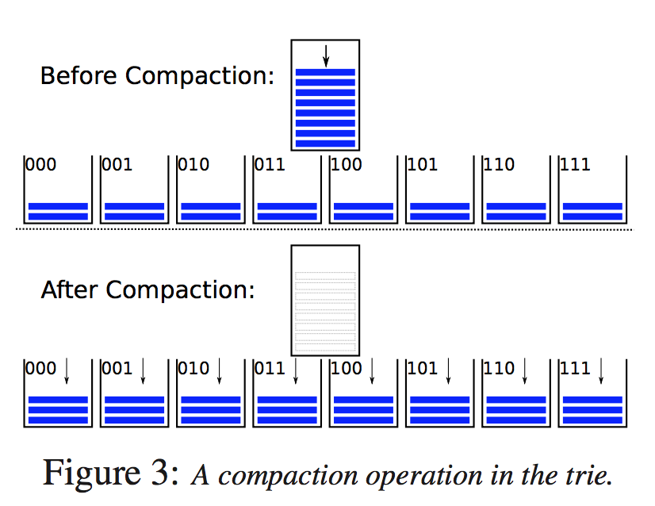
How SST-trie compacts?

Slide 5
Is bLSM perfect?
For a 10 TB store holding 200 B-KV-items would require about 125 GB space for 10-bit-per-key Bloom- filters and 30 GB for indices.
Each Bloom filter has a false positive rate (about 0.82% for a setting of 10 bits per item)
Which leads to 5.7% for a 7-level structure to 46% for a 56-level one

Slide 6
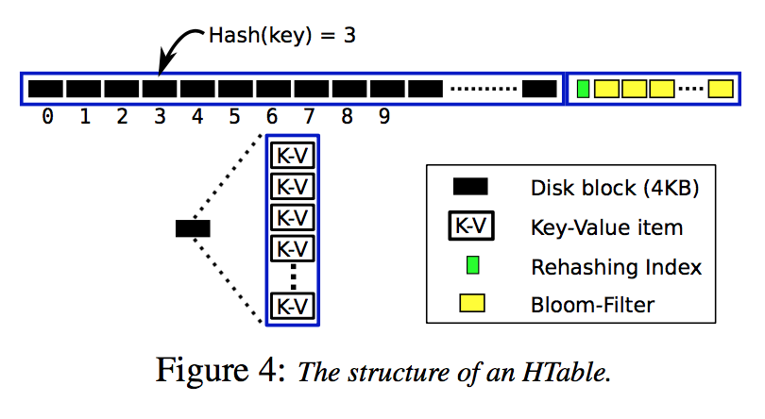
LSM-trie
SST-trie with better metadata management!
Use Hash Table(HTable) instead of Sorted String Table(SST)

Slide 7
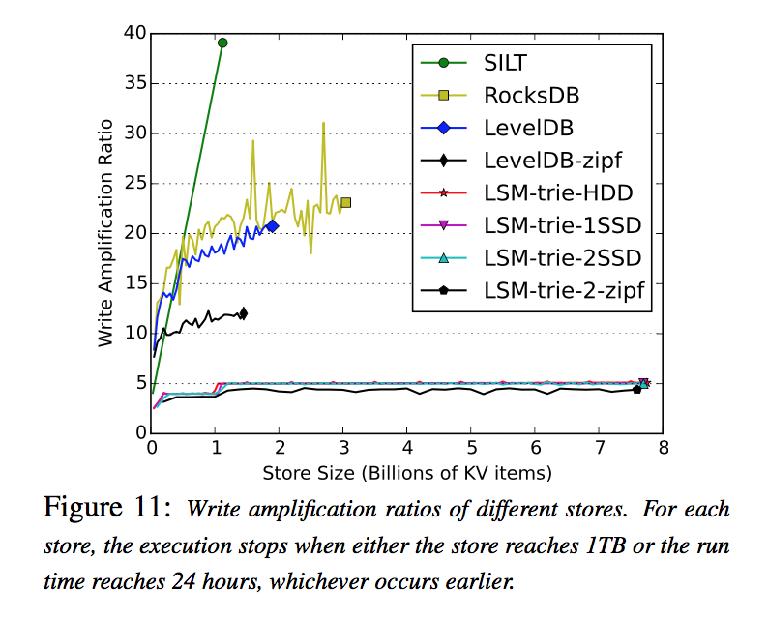
How is LSM-trie?

