Slide 1
Design of eMMC Controller with Multiple Channels
Chulhoon Kim, Chanho Lee, Soongsil University, Seoul, Korea – ISOOC 2016

Slide 2
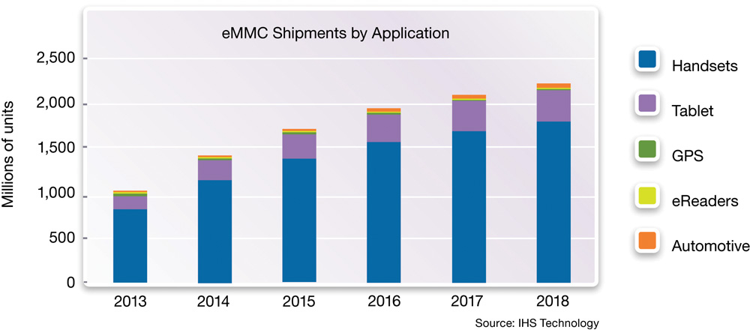
EMMC – de facto Standard

Slide 3
What is eMMC
High Performance Non-Volatile Memory
Includes
  NAND flash memory devices
  Controller

Slide 4
Mutli-Channel for eMMC
EMMC data bandwidth → 8 bits
Multi-channel → larger data bandwidth
EMMC controller:
  Application Adaptor
  EMMC adaptor

Slide 5
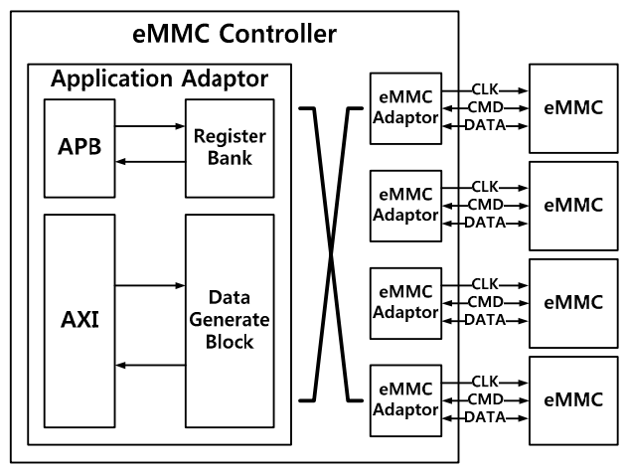
Overview of multi-channel eMMC

Slide 6
Application Adaptor
AMBA APB slave interface
  Configuring controller
  Writing eMMC command
  Reading eMMC response
AMBA AXI master interface
  Direct Memory Access Controller

Slide 7
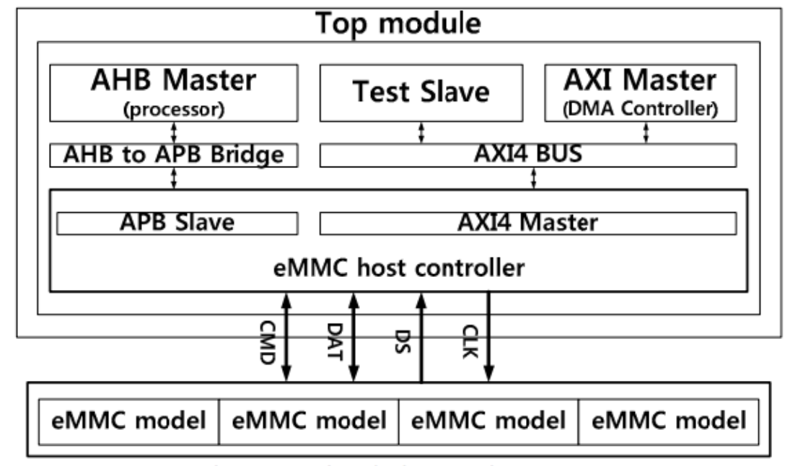
EMMC Adaptor
One channel controller → one eMMC device
Controlled by APB interface

Slide 8
Recall from a previous paper
An Efficient Design and Implementation of LSM-Tree based Key-Value Store on Open-Channel SSD

Slide 9
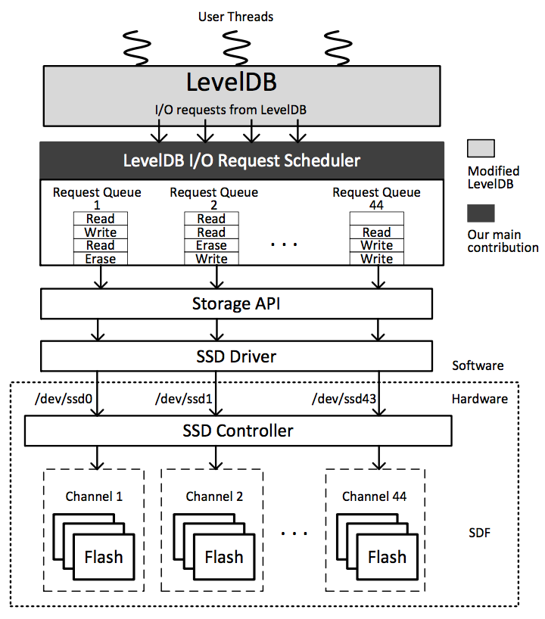

Slide 10
Potential Benefit from Multi-channel eMMC
Larger data bandwidth
Process multi-requests
Combination with Key-Value store
Make the most of its parallelism

