Slide 1

Key-Value Store
THE HONG KONG
POLYTECHNIC UNIVERSITY
Department of Electronic and Information Engineering
Zhaoyan Shen
15 July

Slide 2
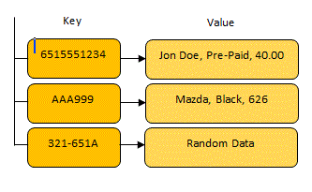
Key-Value Store
Key-Value Store
Key-value store is a computer program designed for storing, retrieving and managing objectives or records (value), which in turn have many different fields.
Records or objectives are stored and retrieved using a key that uniquely identifies and finds the record。
Clients
Key-Value Store
Cluster
PUT(key, value)
value = GET(key)
DELETE(key)

Slide 3
NoSQL DB and KV Store
A NoSQL or Not Only SQL database stores and organizes data differently from the tabular relations used in relational databases.
Why NoSQL?
  Simplicity of design, horizontal scaling, and finer control over availability.
It can be classified as column, document, key-value, and graph store based on their data models.
The key-value model is one of the simplest non-trivial data models, and richer data models are often implemented on top of it.
  Applications store their data in a schema-less way.
Array, linked list, binary search trees, B+ tree, or hash table …?

Slide 4
RD vs KV
Relational Database vs Key-Value Database
Database Definition
Relational Database | Key-Value Database
Database contains tables, tables contain columns and rows, and rows are made up of column values. Rows within a table all have the same schema. The data model is well defined in advance. A schema is strongly typed and it has constraints and relationships that enforce data integrity. The data model is based on a “natural” representation of the data it contains not on an application’s functionality. The data model is normalized to remove data duplication. Normalization establishes table relationships. Relationships associate data between tables. | Domains can initially be thought of like a table, but unlike a table you don’t define any schema for a domain. A domain is basically a bucket that you put items into. Items within a single domain can have different schemas. Items are identified by keys, and a given item can have dynamic set of attributes attached to it. In some implementations, attributes are all of a string type. In other implementations, attributes have simple types that reflect code types, such as ints, string arrays, and lists. No relationships are explicitly defined between domains or within a given domain.

Slide 5
RD vs KV
Relational Database vs Key-Value Database
Database Access
Relational Database | Key-Value Database
Data is created, updated, deleted, and retrieved using SQL. SQL queries can access data from a single table or multiple tables through table joins. SQL queries include functions for aggregation and complex filtering. Usually contain means of embedding logic close to data storage, such as triggers, stored procedures, and functions. | Data is created, updated, deleted, and retrieved using API method calls. Some implementations provide basic SQL-like syntax for defining filter criteria. Basic filter predicates (such as =, !=, <, >, <=, and >=) can often only be applied. All application and data integrity logic is contained in the application code.

Slide 6
RD vs KV
Relational Database vs Key-Value Database
Application Interface
Relational Database | Key-Value Database
Tend to have their own specific API, or make use of a generic API such as OLE-DB or ODBC. Data is stored in a format that represents it natural structure, so must be mapped between application code structure and relation structure. | Tend to provide SOAP and/or REST APIs (Standards used in web services) over which data access calls can be made. Data can be more effectively stored in application code that is compatible with its structure, requiring only relational “plumbing” code for the object.

Slide 7
Why Key-Value Store
cons of Relational Database
  Scalability: When it comes to big data, RD have scaling issues. It has some constraints to offer distributed storage.
  Efficiency: Relational data models and Application Code Object Models are typically built differently, which leads to incompatibilities. Developers overcome these incompatibilities with code that maps relational models to their object models, increase development time.
  With big data background, parsing SQL has significant overhead.

Slide 8
Why Key-Value Store
pros of Key-Value Database
  Scalability: It is simple, do not need to normalized to any relational models. Thus, it scales much better and suitable for distributed storage.
  More natural fit with code: key/value databases retain data in a structure that maps more directly to object classes used in the underlying application code, which can significantly reduce development time.

Slide 9
Evaluate KV Store
Three Metrics (Specifically for flash-base storage)
Memory overhead
= Index size per entry
Ideally 0 (no memory overhead)
Read amplification
= Flash reads per query
Limits query throughput
Ideally 1 (no wasted flash reads)
Write amplification
= Flash writes per entry
Limits insert throughput
Also reduces flash life expectancy
  Must be small enough for flash to last a few years

Slide 10
Key-Value Store Design
A common approach to building high-performance KV store on flash uses three components:
  An in-memory filter to efficiently test whether a given key is stored in this store before accessing flash.
  An in-memory index to locate the data on flash for a given key
  An on-flash data layout to store all key-value pairs persistently

Slide 11
Key-Value Store Design
Conventional Single-Store Approach
Contain only the basic components (no hierarchy)
E.g., FAWN, FlashStore, SkimpyStash
Multi-Store Approach
Combine a series of basic key-value stores (Multi-level)
E.g., LevelDB, SILT, LSM-trie

Slide 12
Design: FAWN for Fast Read and Fast Write
FAWN (Fast Array of Wimpy Nodes)
  A Key-Value Storage System
    I/O intensive, not computation
    Massive, concurrent, random , small-sized data access
  A new low-power cluster architecture
    Nodes equipped with embedded CPUs + FLASH
    A tenth of the power compared to conventional architecture
  Hash Index to map 160-bit keys to a value stored in the data log
  It stores only a fragment of the actual key in memory to find a location in the log => reduce memory use.
David G. Andersen, et al, FAWN: a Fast Array of Wimpy Nodes, on SOPS’09

Slide 13
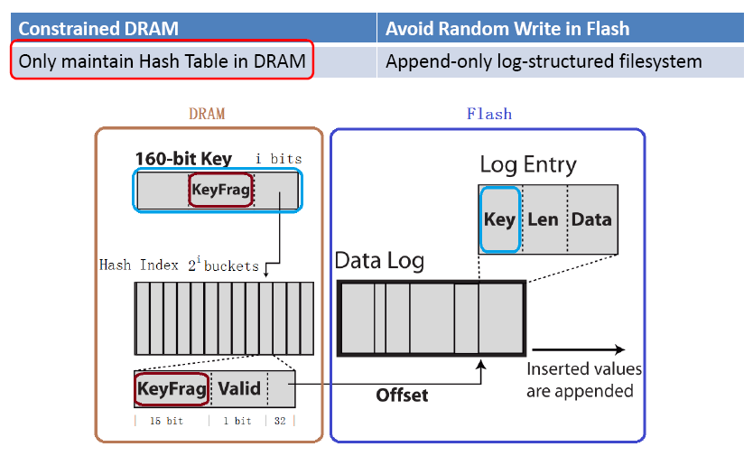
FAWN DataStore
Chained hash entries in each bucket

Slide 14
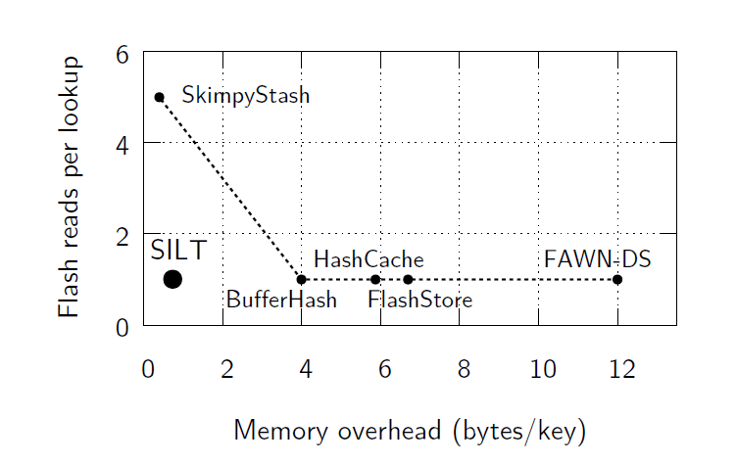
Design: SILT with Levels of Dramatically-different Sizes
Hyeontaek Lim et al, SILT: A Memory-Efficient, High-Performance Key-Value Store, in SOSP’11.

Slide 15
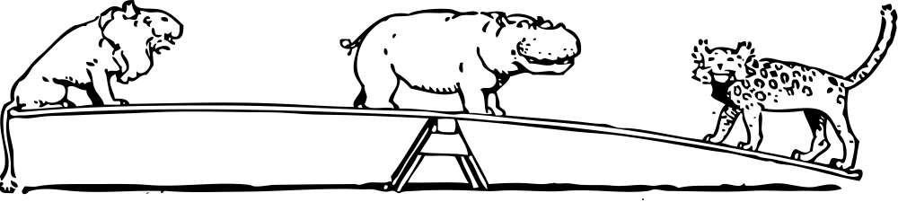
Seesaw Game?
FAWN-DS
How can we improve?
BufferHash
SkimpyStash
Memory efficiency
High performance

Slide 16
Design Goals
Low read amplification
Controllable write amplification and favoring sequential writes
Memory-efficient indexing
Computation-efficient indexing
Effective use of flash space

Slide 17
Solution Preview: (1) Three Stores with (2) New Index Data Structures
Queries look up stores in sequence (from new to old)
Inserts only go to Log
Data are moved in background
SILT Sorted Index
(Memory efficient)
SILT Filter
SILT Log Index
(Write friendly)
Memory
Flash

Slide 18
LogStore: No Control over Data Layout
SILT Log Index (6.5+ B/entry)
Still need pointers:
size ≥ log N bits/entry
Memory
Flash
Inserted entries are appended
(Older)
On-flash log
(Newer)
Memory overhead
Write amplification
6.5+ bytes/entry
1

Slide 19
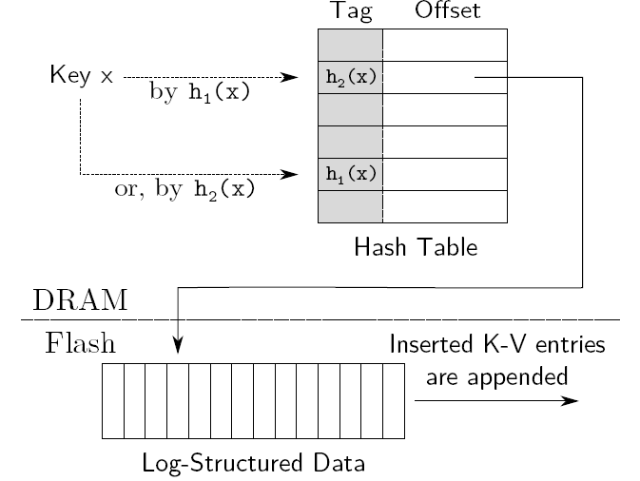
LogStore: Using Cuckoo Hash to Embed Buckets into HT Directory
How to find the alternative slot for displacement by storing hash index in the tag?

Slide 20
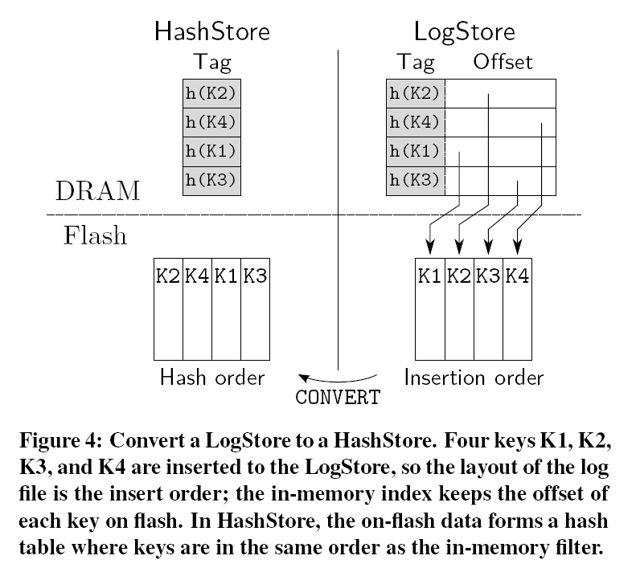
HashStore: Remove in-memory HT (or the index)
HashStore saves memory over LogStore by eliminating the index and reordering the on-flash (key,value) pairs from insertion
order to hash order.

Slide 21
SortedStore: Space-Optimized Layout
SILT Sorted Index (0.4 B/entry)
Memory
Flash
Need to perform bulk-insert to amortize cost
On-flash sorted array
To merge HashStore entries into the SortedStore, SILT must generate a new SortedStore

Slide 22
SILT’s Design (Recap)
<SortedStore>
<HashStore>
<LogStore>
SILT Sorted Index
SILT Filter
SILT Log Index
Merge
Conversion
On-flash sorted array
On-flash hashtables
On-flash log
Read amplification
Write amplification
Memory overhead
0.7 bytes/entry
1.01
5.4

Slide 23
Any Issue with SILT?
SILT provides both memory-efficient and high-performance key-value store
  Multi-store approach
  Entropy-coded tries
  Partial-key cuckoo hashing
The weakness: Write amplification is way too high!

Slide 24
Design V: Google’s LevelDB
LevelDB: A multi-layered LSM-tree structure
Requirements:
New data must be quickly admitted into the store to support high-throughput write
KV items in the store are sorted to support fast data location
Chang, et al., Bigtable: A Distributed Storage System for Structured Data in OSDI’06.

Slide 25
Design V: Google’s BigTable and LevelDB to Scale Data Store
High-throughput write:
MemTable
An in-memory buffer;
To receive incoming KV items;
Items ordered by insert sequence
SSTable
On-flash immutable data;
Stored as file, items placed in blocks;
Items ordered by their keys
Full
Notes:
Billions of URLs, many version.pages (~20k/version)
100TB+ of satellite image data

Slide 26
Design V: Google’s BigTable and LevelDB to Scale Data Store
SSTable
64K block
64K block
64K block
SSTable
64K block
64K block
64K block
SSTable
Index
Index
Lookup in SSTable:
LevelDB place an index in SSTable recording the key of first KV item in each block. Use binary search find the possible block;
Use Bloom filter for each block to indicate whether an item is in it

Slide 27
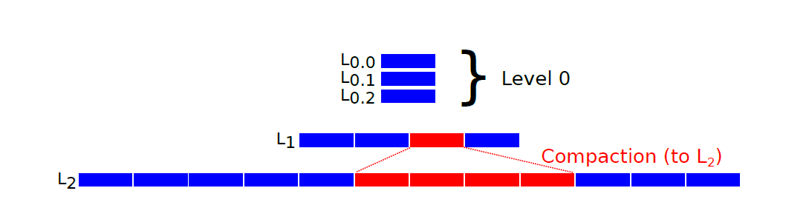
Design V: Google’s BigTable and LevelDB to Scale Data Store
Fast data location:
Multilevel tree-like structure
Compaction process
Compaction process
Notes:
Billions of URLs, many version.pages (~20k/version)
100TB+ of satellite image data

Slide 28
Management of SSTable -- LSM-tree
Log-Structured Merge-Tree (LSM-tree)
  Optimized for fast random updates, inserts and deletes with moderate read performance.
  Convert the random writes to sequential writes
    Accumulate recent updates in memory
    Flush the changes to disks sequentially in batches
    Merge on-disk components periodically
  At the expense of read performance

Slide 29
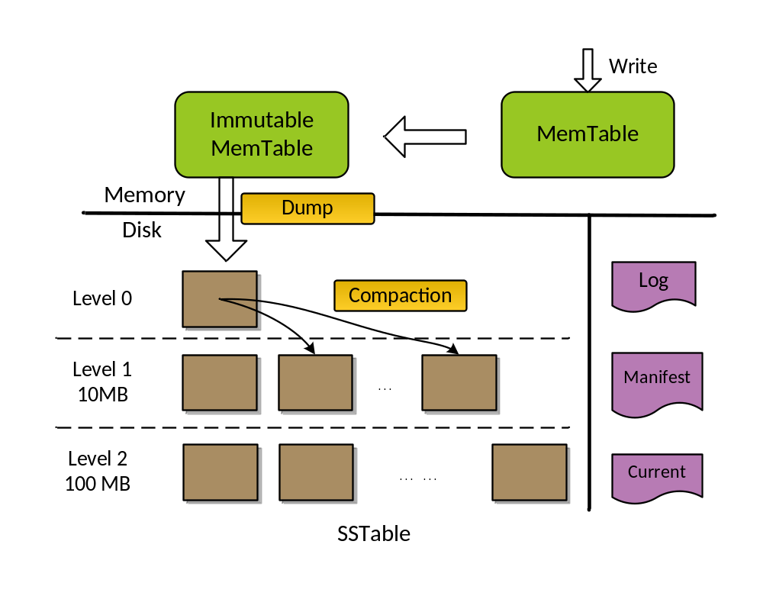
Google’s LevelDB: Progressively Increasing Level Size
K1 V1
K2 V2
K3 V3
MemTable
SSTable
SSTable
Immutable MemTable
SSTable
SSTable
SSTable

Slide 30
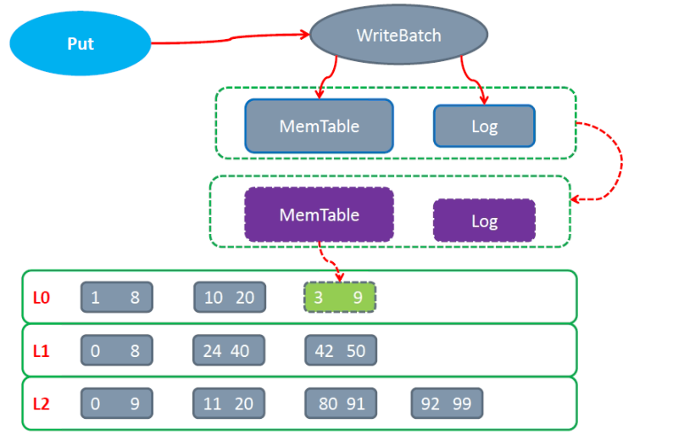
LevelDB Write Flow

Slide 31
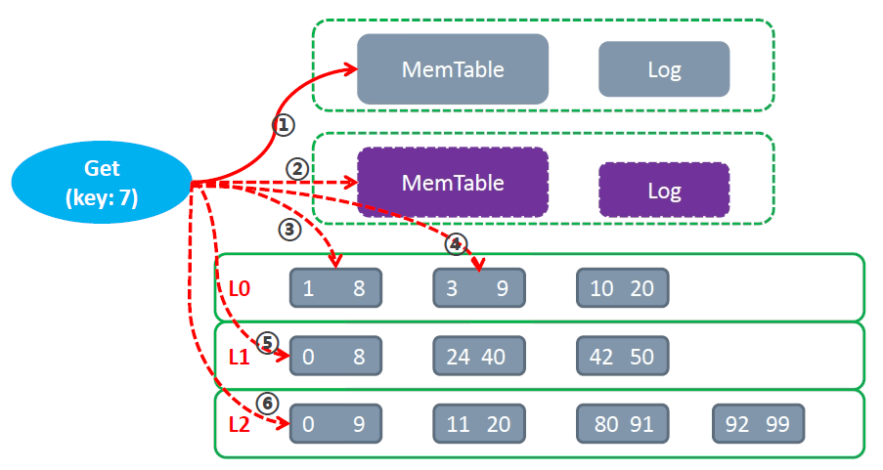
LevelDB Read Flow
Bloom Filter

Slide 32
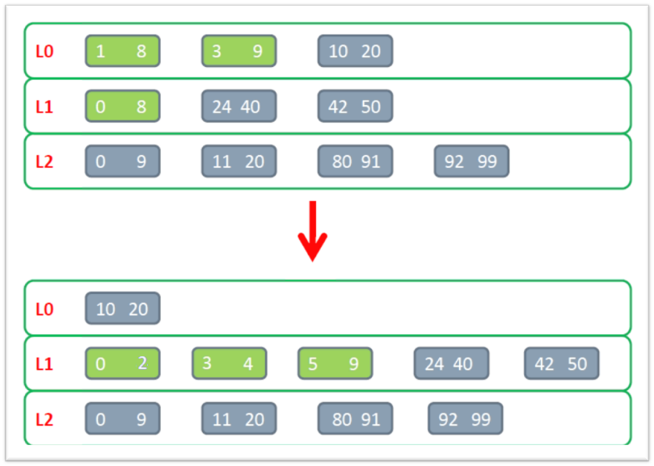
LevelDB Compact (L0/L1)

Slide 33
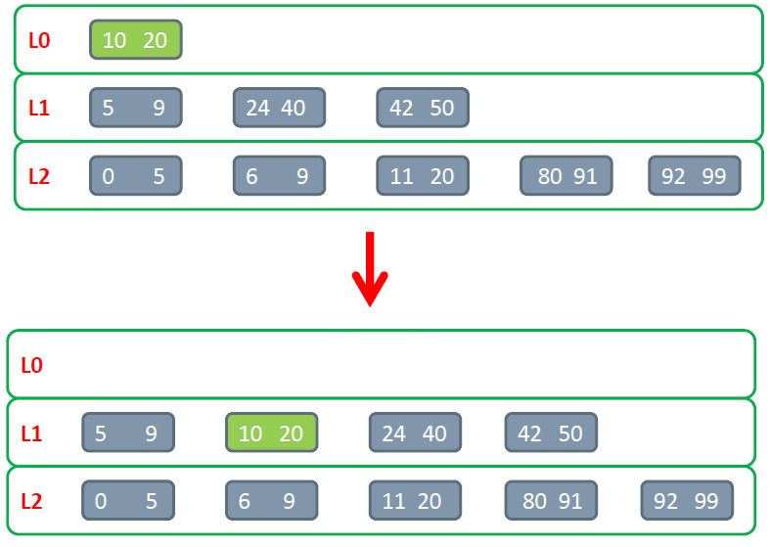
LevelDB Compact (L0/L1 Move)

