Slide 1


龙星计划课程: 大数据在互联网数据中心的管理和计算
Management of Big Data in Datacenters to Support Internet-scale Applications
Lecture 1: Introduction to Distributed Systems

Slide 2
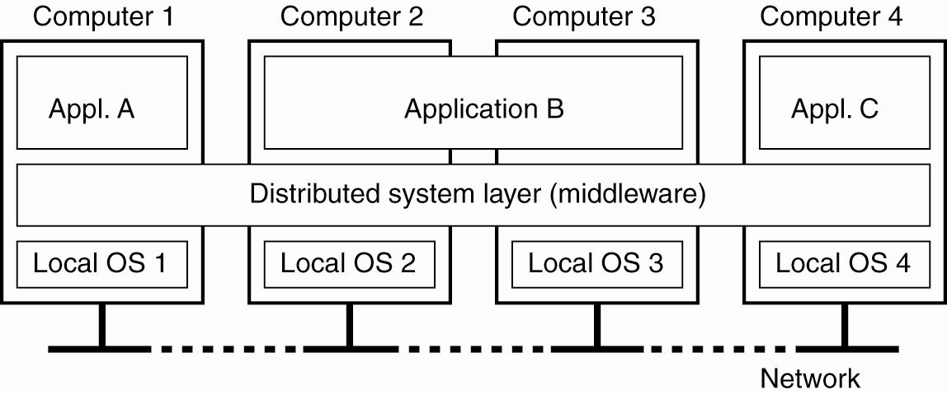
What’s distributed system ?
A distributed system is a collection of independent computers that appears to its users as a single coherent system.
... or as a single system.

Slide 3
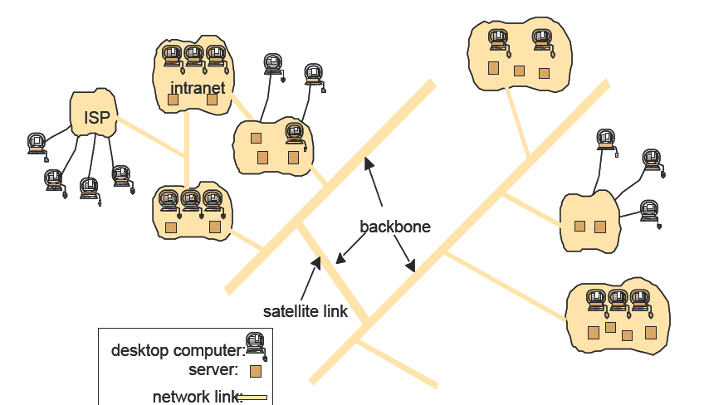
Example Distributed System: the Internet
The Internet: net of nets
global access to “everybody”
(data, service, other
actor; open ended)
enormous size (open ended)
no single authority
communication types

Slide 4
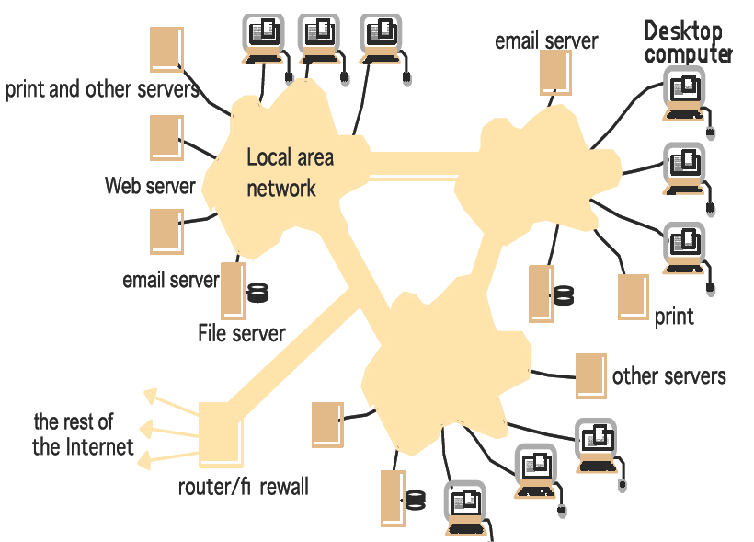
Example Distributed System: Intranet
a single authority
protected access
  a firewall
  total isolation
may be worldwide
typical services:
  infrastructure services:
  file service
  application services

Slide 5
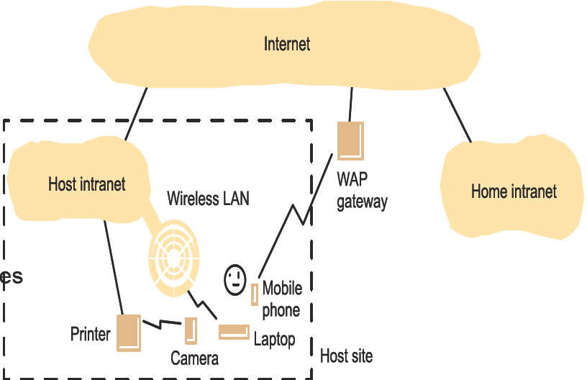
Example Distributed System: Mobile and ubiquitous computing
Portable devices
  laptops
  handheld devices
  wearable devices
  devices embedded in appliances
Mobile computing
Location-aware computing
Ubiquitous computing, pervasive computing

Slide 6
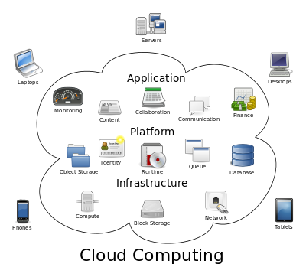
Resource Sharing and Cloud Computing
Infrastructure as a service (IaaS)
Platform as a service (PaaS)
Software as a service (SaaS)
When more resources and services are consolidated into data centers, the infrastructure, including system software, becomes increasingly critical.

Slide 7
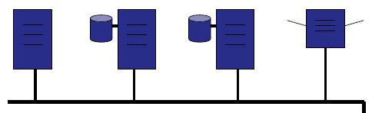
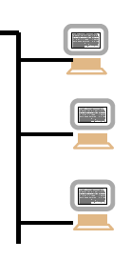
Why Distributed Systems?
… because we cannot build a single computer as powerful as we need.
…. even if we could, we cannot afford it.
… so we use a large number of computers and connect them.
…. and mostly use off-the-shelf parts.
Benefits: scale the system as large as demanded on performance, capacity, and capability.
Issues: coordination, reliability, fault tolerance, and availabilitiy.

Slide 8
Required Properties of a Distributed System: Reliability
Reliability denotes the ability of a distributed system to deliver its services even when one or several of its software of hardware components fail.
Fail modes: fail stop, omission (send, channel, and receive), and arbitrary(Byzantine).
More components => increased fault rate
  Failure is a norm, rather than exception, in large-scale data centers.
  Redundancy => more possibilities for recovery
  No centralized control/no single point of failure. => no fatal failure

Slide 9
Required Properties of a Distributed System: Reliability (cont’d)
Issues:
  Detecting failures (heartbeating)
  Tolerating failures (no loss of service)
  Recovery from failures (how much effort to bring the system back to its normal status?)
  Minimizing the impact of failure (confined within a device, exposed to the system software, user programs, or end users at the clients?)

Slide 10
Required Properties of a Distributed System: Scalability
Scalability refers to the ability of a system to continuously evolve in order to support a growing amount of tasks. Ideally system capability increases in proportion to the added resources.
Horizontal scalability and vertical scalability
100 servers, each holding 1/100 data and serving 1/100 queries. How to scale the system if we have 20% more data and accordingly 20% more queries. (how to distributed data/queries).
Adding extra memory/disks and upgrading processors (vertical scalability) ➔ challenge?
Adding 20 new servers (Horizontal scalability) ➔ challenge?

Slide 11
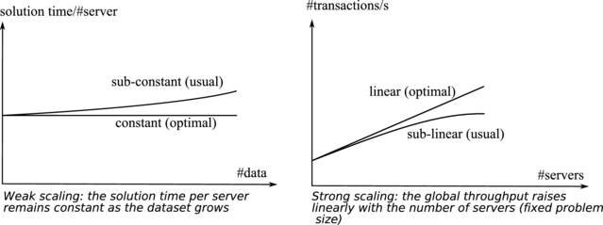
Required Properties of a Distributed System: Scalability (cont’d)
weak scalability and strong scalability
Improving the scalability in a one-master-many-servers architecture?
  The master handles a few specific tasks (e.g., adding a new server to the cluster or connecting a client) and manages metadata.
  The servers hold the data set usually via “sharding”.
  Data service can be well load-balanced across the servers.
  The master can be the bottleneck. How to break it?

Slide 12
Required Properties of a Distributed System: Availability
Availability is the capacity of a system to limit as much as possible this latency.
  The failure must be detected as soon as possible, and a quick recovery procedure must be initiated. (quick failover)
  Service availability is critical to the success of on-line businesses.
  The master periodically check the status of each serve (heartbeating).
  Replication and redundancy for recovery.

Slide 13
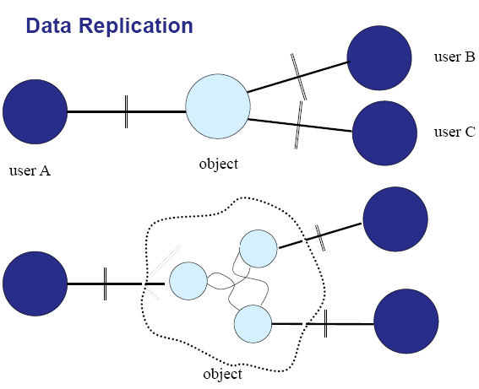
Required Properties of a Distributed System: Consistency
Why replication? Example replication scenarios?
We run the risk of having multiple values for one data object (inconsistency). [why no such issue on one machine (buffer cache +disk)?]
  What are the implications to programs accessing the data?
  What are the rules to maintain consistency?
  <Will be explained in the afternoon’s lecture by Dr. 白 童 心>

Slide 14
Required Properties of a Distributed System: Performance
Basic metrics: latency and throughput of requests/queries.
How to estimate the cost of serving a request?
  Serving a quest can involve a large number of operations in the foreground and/or background.
    Serving A page request to one of the Amazon’s e-commerce sites typically requires the rendering engine to construct its response by sending requests to over 150 services.
    Write a data item into a data store can incur tens of data orgization operations.
    Each a single file write operation in a VM can incur many data/metadata/journaling operations in the guest/host servers.
  Using average, median and expected variance on the metrics might not be sufficient.
  At Amazon, service quality is expressed and measured at the 99.9th percentile of the distribution

Slide 15
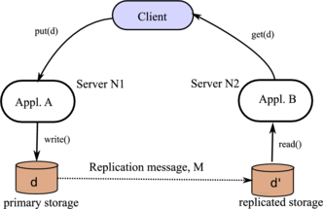
Putting Everything Together: the CAP Theorem
No distributed system can simultaneously provide all three of the following properties: Consistency (all nodes see the same data at the same time), Availability (node failures do not prevent survivors from continuing to operate), and Partition tolerance (the system continues to operate despite arbitrary message loss).

Slide 16
Putting Everything Together: the CAP Theorem
Scenario 1: In a the e-commerce site after you remove an item from your basket, it possibly re-appears later in the transaction.
Scenario 2: The website exposes a high response time to users until the inconsistency is resolved.
➔ Which is preferred, CP (consistent and partition tolerant) and AP (available and partition tolerant)?

Slide 17
A Case study: Evolution of Distributed File System
The environment:
  A cluster of thousands of servers connected a high speed local network.
  The servers have high failure probability
The workloads
  A very large collections of unstructured to semi-structured documents,
  Data collections are written once and read many times

Slide 18
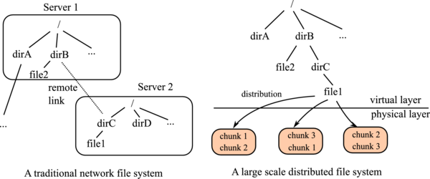
A Case study: Evolution of Distributed File System (cont’d)
Example: NFS (Network File System)
File is allocation unit. Files are not evenly distributed and load may be balanced.
The control path (data location service) is coupled with the data path, limiting the throughout
Separate metadata server and data (chunk) servers.
Decouple the two paths
Chunk is the unit. Replication is used to tolerate fault.
Could be the metadata server the bottleneck?

Slide 19
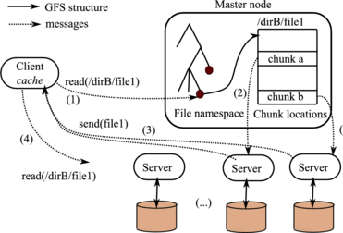
A Case study: Evolution of Distributed File System (cont’d)
Typical files of several hundreds of MBs each, and sets accordingly the chunk size to 64 MBs limiting memory demand (why is this important?)
Client cache metadata to reduce the master’s load
Three-copy-replication of each chunk
the Master is in charge of detecting and repairing failed chunk servers.
Know your customers (workloads) before you design and implement.

