Slide 1


龙星计划课程: 大数据在互联网数据中心的管理和计算
Management of Big Data in Datacenters to Support Internet-scale Applications
Lecture 4: Distributed Execution Engines

Slide 2
MapReduce: Simplified Data Processing on Large Clusters
Motivation
Large-Scale Data Processing
  Want to use 1000s of CPUs
    But don’t want hassle of managing things
MapReduce provides
  Automatic parallelization & distribution
  Fault tolerance
  I/O scheduling
  Monitoring & status updates
Jeffrey Dean, et al., MapReduce: Simplified Data Processing on Large Clusters in OSDI’04

Slide 3
Map/Reduce
Map/Reduce
  Programming model from Lisp
  (and other functional languages)
Many problems can be expressed this way
Easy to distribute across nodes
Nice retry/failure semantics

Slide 4
Map in Lisp (Scheme)
(map f list [list₂ list₃ …])
(map square ‘(1 2 3 4))
  (1 4 9 16)
(reduce + ‘(1 4 9 16))
  (+ 16 (+ 9 (+ 4 1) ) )
  30
(reduce + (map square (map – l₁ l₂))))
Unary operator
Binary operator

Slide 5
Map/Reduce ala Google
map(key, val) is run on each item in set
  emits new-key / new-val pairs
reduce(key, vals) is run for each unique key emitted by map()
  emits final output

Slide 6
count words in docs
  Input consists of (url, contents) pairs
  map(key=url, val=contents):
    For each word w in contents, emit (w, “1”)
  reduce(key=word, values=uniq_counts):
    Sum all “1”s in values list
    Emit result “(word, sum)”

Slide 7
Count,
Illustrated
  map(key=url, val=contents):
    For each word w in contents, emit (w, “1”)
  reduce(key=word, values=uniq_counts):
    Sum all “1”s in values list
    Emit result “(word, sum)”
  see 1
  bob 1
  run 1
  see 1
  spot 1
  throw 1
  bob 1
  run 1
  see 2
  spot 1
  throw 1
  see bob throw
  see spot run

Slide 8
Pseudo-code of WordCount
Map(String input_key, String input_value):
//input_key: document name
//input_value: document contents
for each word w in input_values:
EmitIntermediate(w, "1");
Reduce(String key, Iterator intermediate_values):
//key: a word, same for input and output
//intermediate_values: a list of counts
int result = 0;
for each v in inermediate_values:
result += ParseInt(v);
Emit(AsString(result))

Slide 9
Grep
  Input consists of (url+offset, single line)
  map(key=url+offset, val=line):
    If contents matches regexp, emit (line, “1”)
  reduce(key=line, values=uniq_counts):
    Don’t do anything; just emit line

Slide 10
Reverse Web-Link Graph
Map
  For each URL linking to target (the link) in a source page …
  Output <target, source> pairs
Reduce
  Concatenate list of all source URLs
  Outputs: <target, list (source)> pairs

Slide 11
More examples
Inverted index
Distributed sort

Slide 12
Implementation Overview
Typical cluster:
      100s/1000s of 2-CPU x86 machines, 2-4 GB of memory
      Limited bisection bandwidth
      Storage is on local IDE disks
      GFS: distributed file system manages data (SOSP'03)
      Job scheduling system: jobs made up of tasks, scheduler assigns tasks to machines
Implementation is a C++ library linked into user programs

Slide 13
Execution
How is this distributed?
  Partition input key/value pairs into chunks, run map() tasks in parallel
  After all map()s are complete, consolidate all emitted values for each unique emitted key
  Now partition space of output map keys, and run reduce() in parallel
If map() or reduce() fails, reexecute!

Slide 14
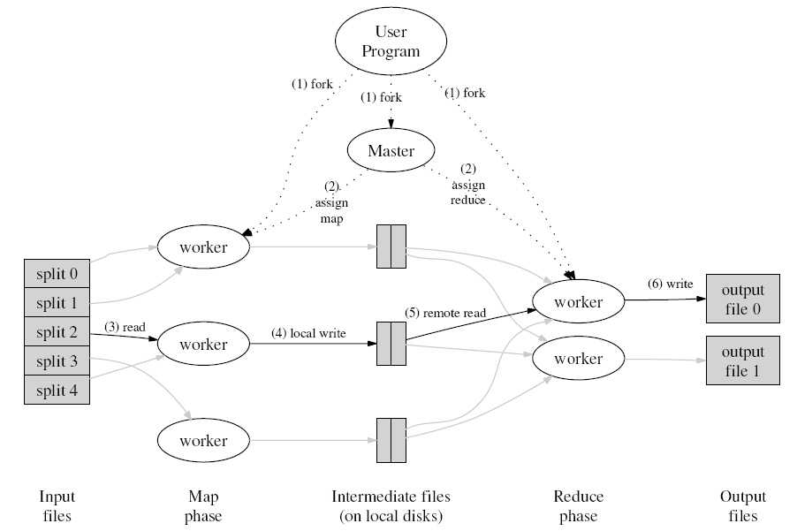
MapReduce Overall Architecture

Slide 15
MapReduce: A Bird’s-Eye View
In MapReduce, chunks are processed in
isolation by tasks called Mappers
The outputs from the mappers are denoted as
intermediate outputs (IOs) and are brought
into a second set of tasks called Reducers
The process of bringing together IOs into a set
of Reducers is known as shuffling process
The Reducers produce the final outputs (FOs)
Overall, MapReduce breaks the data flow into two phases,
map phase and reduce phase
chunks
C0
C1
C2
C3
Map Phase
M0
M1
M2
M3
mappers
IO0
IO1
IO2
IO3
Shuffling Data
Reduce Phase
Reducers
R0
R1
FO0
FO1

Slide 16
Keys and Values
  The programmer in MapReduce has to specify two functions, the map function and the reduce function that implement the Mapper and the Reducer in a MapReduce program
  In MapReduce data elements are always structured as
  key-value (i.e., (K, V)) pairs
  The map and reduce functions receive and emit (K, V) pairs
Input Splits
Intermediate Outputs
Final Outputs
(K, V) Pairs
(K’, V’) Pairs
(K’’, V’’) Pairs
Map Function
Reduce Function
Notes:
Every value is identified by an associated key

Slide 17
Partitions
  In MapReduce, intermediate output values are not usually
  reduced together
  All values with the same key are presented to a single
  Reducer together
  More specifically, a different subset of intermediate key space is assigned to each Reducer
  These subsets are known as partitions using a partitioning function such as hash(key) mod R.
Different colors represent
different keys (potentially)
from different Mappers
Partitions are the input to Reducers

Slide 18
Task Scheduling in MapReduce
  MapReduce adopts a master-slave architecture
  The master node in MapReduce is referred
  to as Job Tracker (JT)
  Each slave node in MapReduce is referred
  to as Task Tracker (TT)
  MapReduce adopts a pull scheduling strategy rather than
  a push one
    I.e., JT does not push map and reduce tasks to TTs but rather TTs pull them by making pertaining requests
TT
Task Slots
JT
Request
Reply
Tasks Queue
T0
T1
Reply
T0
T1
T2
Request
TT
Task Slots

Slide 19
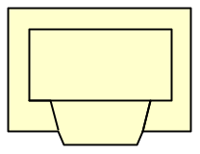
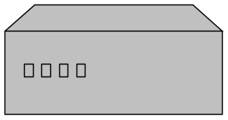

Job Processing
TaskTracker 0
TaskTracker 1
TaskTracker 2
JobTracker
TaskTracker 3
TaskTracker 4
TaskTracker 5
“grep”
Client submits “grep” job, indicating code and input files
JobTracker breaks input file into k chunks, (in this case 6). Assigns work to ttrackers.
After map(), tasktrackers exchange map-output to build reduce() keyspace
JobTracker breaks reduce() keyspace into m chunks (in this case 6). Assigns work.
reduce() output may go to GFS/HDFS

Slide 20
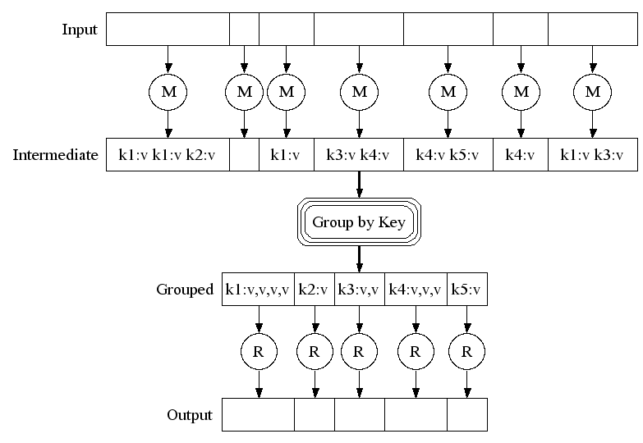
Execution

Slide 21
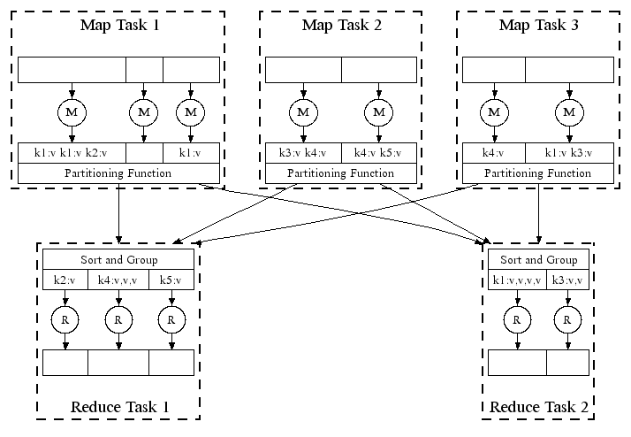
Parallel Execution

Slide 22
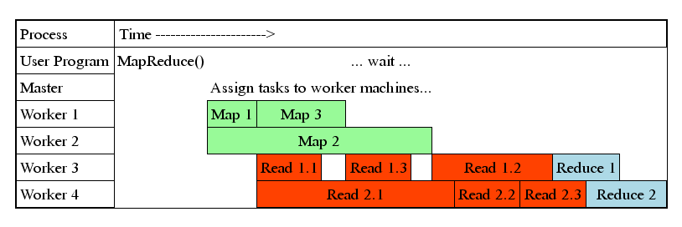
Task Granularity & Pipelining
Fine granularity tasks: map tasks >> machines
  Minimizes time for fault recovery
  Can pipeline shuffling with map execution
  Better dynamic load balancing
Often use 200,000 map & 5000 reduce tasks
Running on 2000 machines

Slide 23
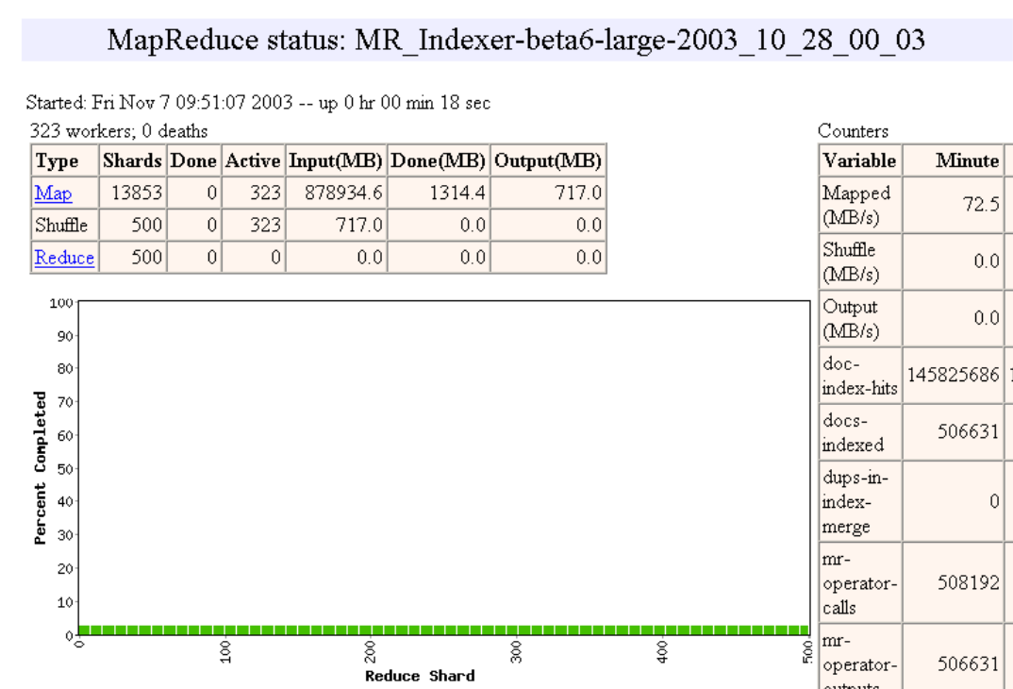

Slide 24
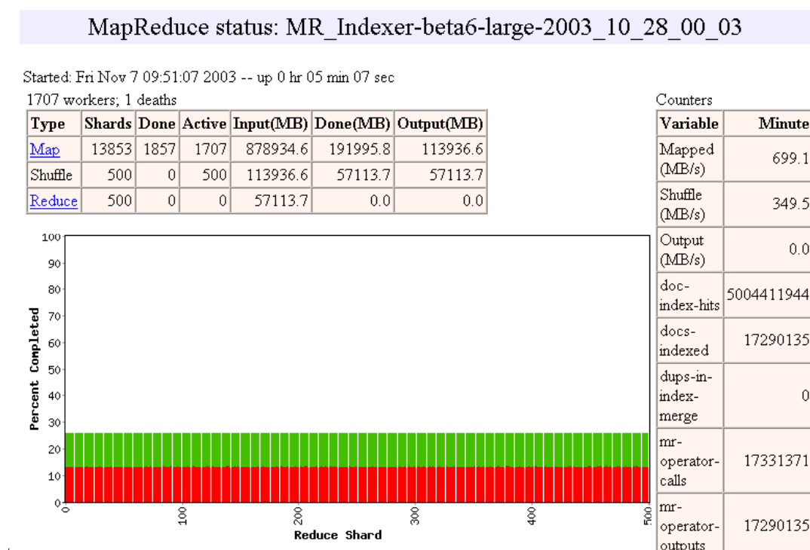

Slide 25
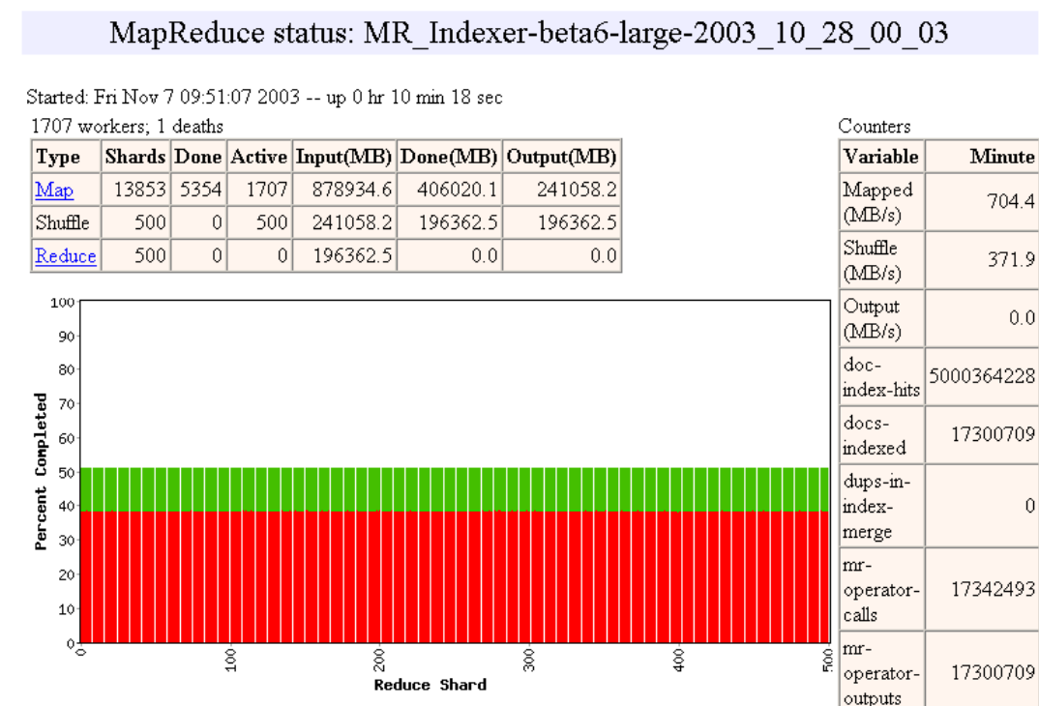

Slide 26
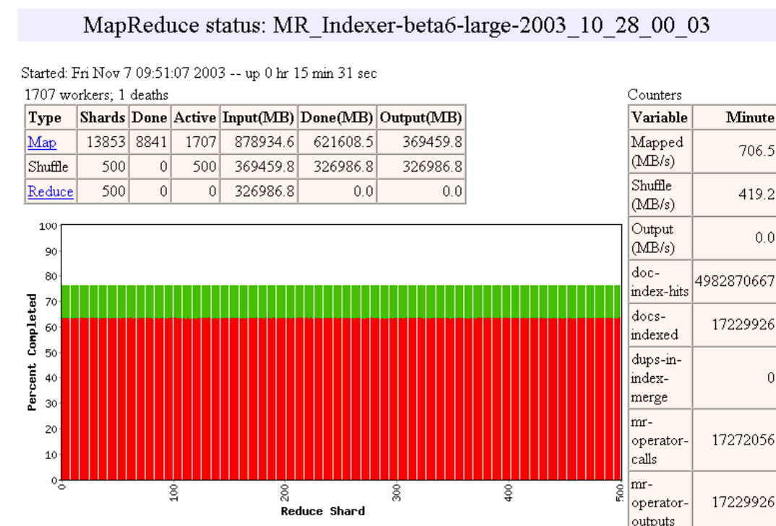

Slide 27
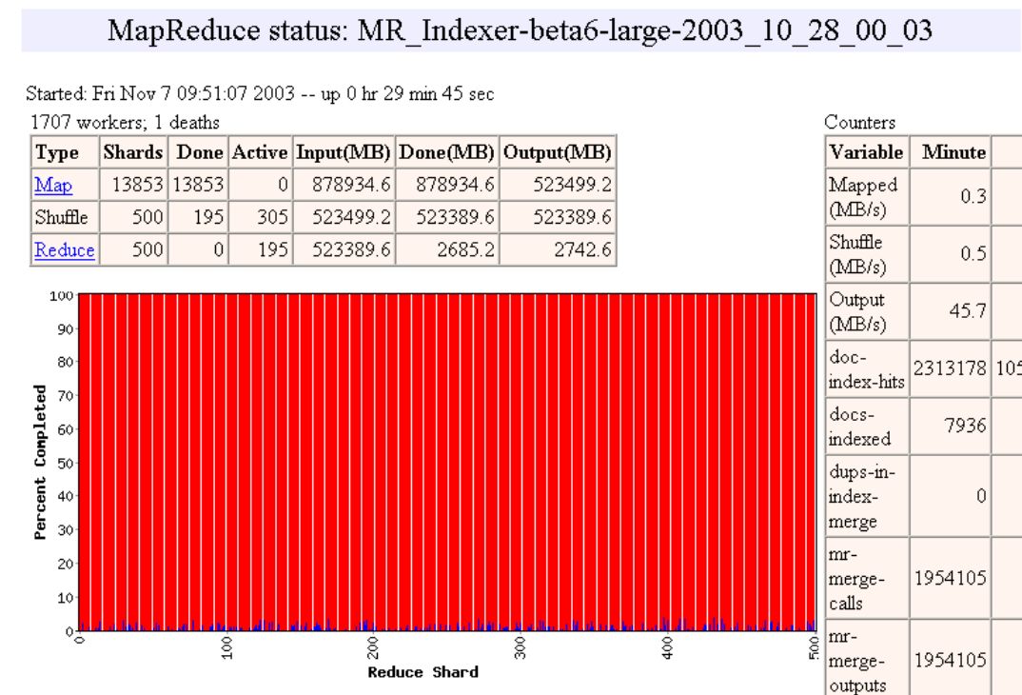

Slide 28
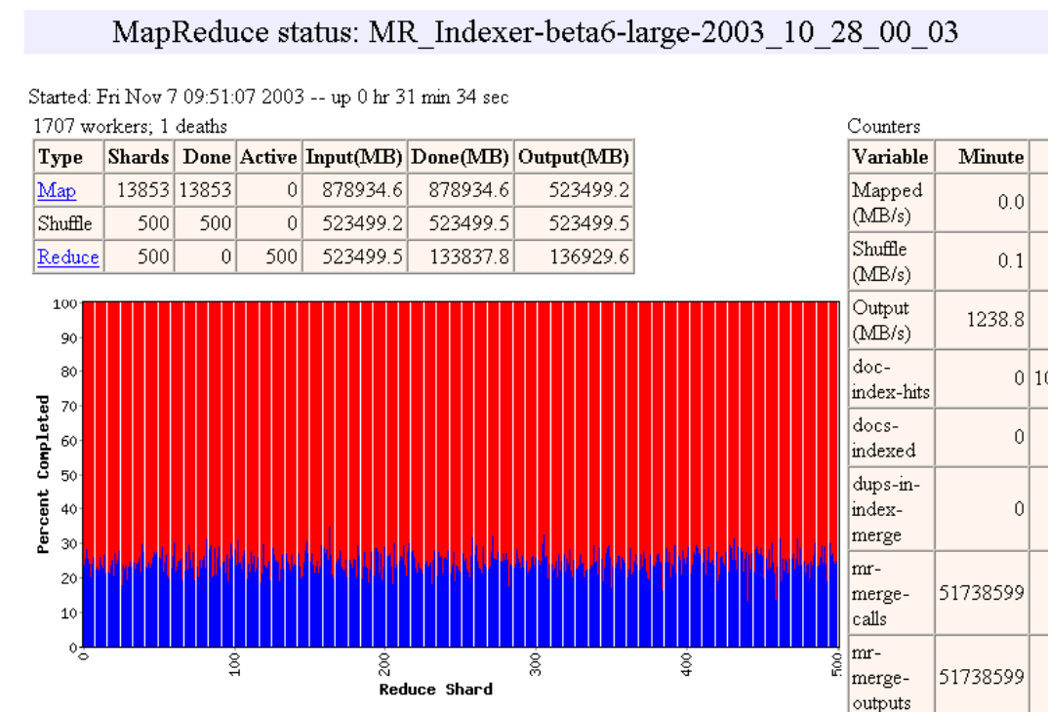

Slide 29
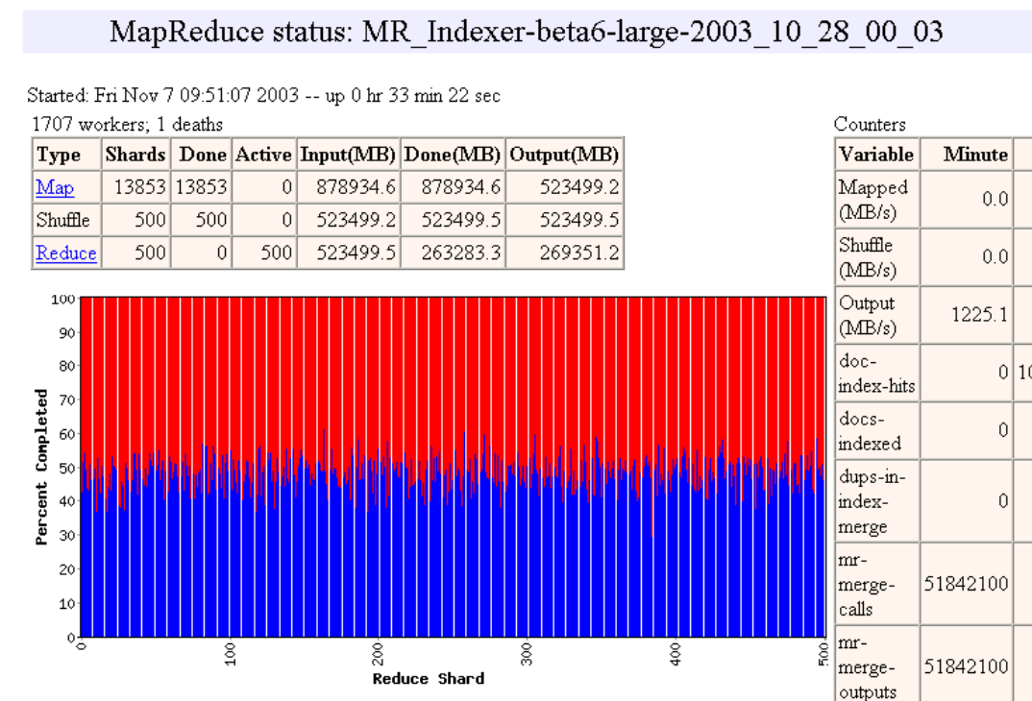

Slide 30
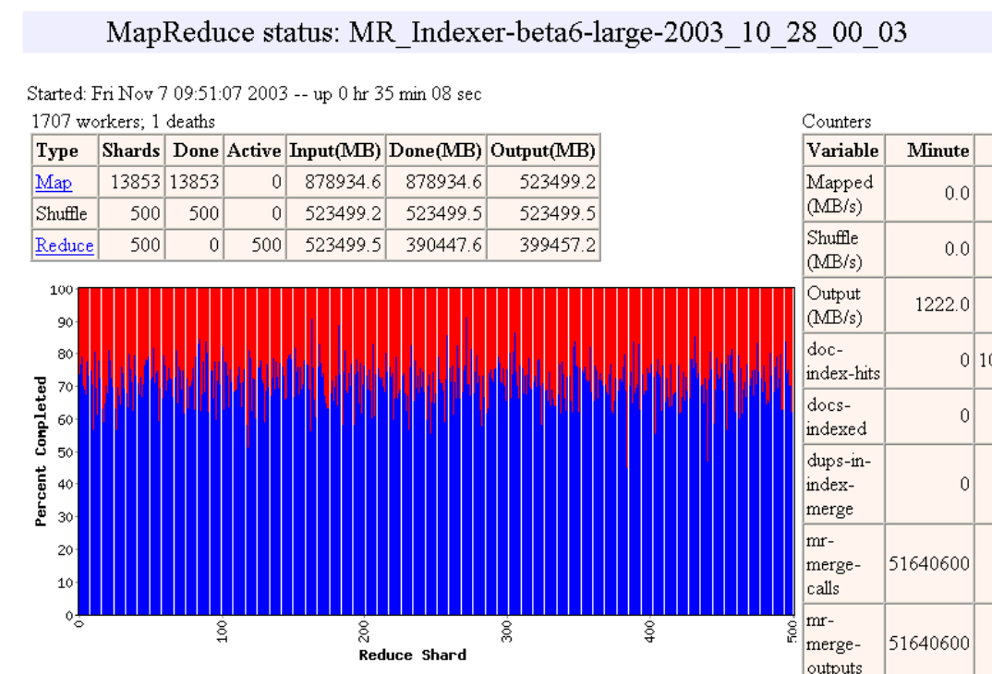

Slide 31
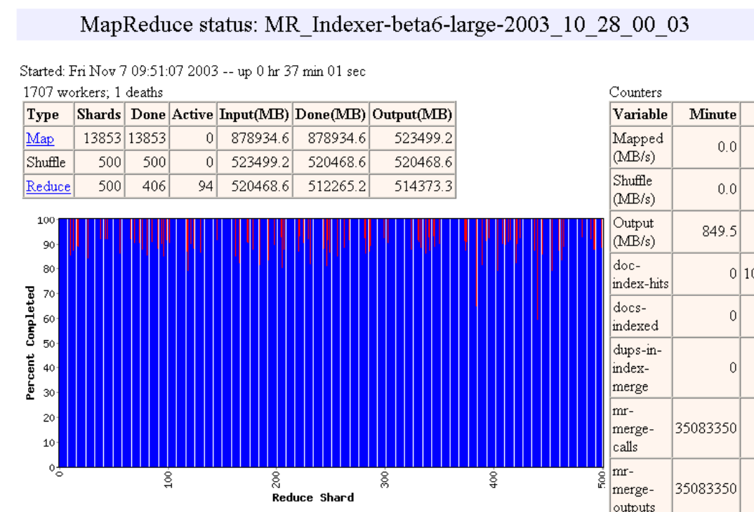

Slide 32


Slide 33


Slide 34
Fault Tolerance / Workers
Handled via re-execution
  Detect failure via periodic heartbeats
  Re-execute completed + in-progress map tasks
    The map outputs are on the local disks.
  Re-execute in progress reduce tasks
  Task completion committed through master
Robust: lost 1600/1800 machines once → finished ok

Slide 35
Master Failure
Could handle, … ?
But don't yet
  (master failure unlikely)

Slide 36
Refinement:
Redundant Execution
Slow workers significantly delay completion time
  Other jobs consuming resources on machine
  Bad disks w/ soft errors transfer data slowly
  Weird things: processor caches disabled (!!)
Solution: Near end of phase, spawn backup tasks
  Whichever one finishes first "wins"
Dramatically shortens job completion time

Slide 37
Refinement:
Locality Optimization
Master scheduling policy:
  Asks GFS for locations of replicas of input file blocks
  Map tasks typically split into 64MB (GFS block size)
  Map tasks scheduled so GFS input block replica are on same machine or same rack
Effect
  Thousands of machines read input at local disk speed
    Without this, rack switches limit read rate

Slide 38
Refinement
Skipping Bad Records
Map/Reduce functions sometimes fail for particular inputs
  Best solution is to debug & fix
    Not always possible ~ third-party source libraries
  On segmentation fault:
    Send UDP packet to master from signal handler
    Include sequence number of record being processed
  If master sees two failures for same record:
    Next worker is told to skip the record

Slide 39
Other Refinements
Sorting guarantees
  within each reduce partition
Combiner
  Useful for saving network bandwidth
Local execution for debugging/testing
User-defined counters

Slide 40
What Makes MapReduce Unique?
MapReduce is characterized by:
  Its simplified programming model which allows the user to quickly write and test distributed systems
  Its efficient and automatic distribution of data and workload across machines
  Its flat scalability curve. Specifically, after a Mapreduce program is written and functioning on 10 nodes, very little-if any- work is required for making that same program run on 1000 nodes

Slide 41
Comparison With Traditional Models
Aspect | Shared Memory | Message Passing | MapReduce
Communication | Implicit (via loads/stores) | Explicit Messages | Limited and Implicit
Synchronization | Explicit | Implicit (via messages) | Immutable (K, V) Pairs
Hardware Support | Typically Required | None | None
Development Effort | Lower | Higher | Lowest
Tuning Effort | Higher | Lower | Lowest

Slide 42
Summary of MapReduce
MapReduce proven to be useful abstraction
Greatly simplifies large-scale computations
Fun to use:
  focus on problem,
  let library deal w/ messy details

Slide 43

Pregel: A System for Large-Scale Graph Processing
Google was interested in applications that could perform internet-related graph algorithms, such as PageRank, so they designed Pregel to perform these tasks efficiently.
It is a scalable, general-purpose system for implementing graph algorithms in a distributed environment.
Focus on “Thinking Like a Vertex” and parallelism
Grzegorz Greg Malewicz, et al., Pregel: A System for Large-Scale Graph Processing, in SIGMOD’10

Slide 44
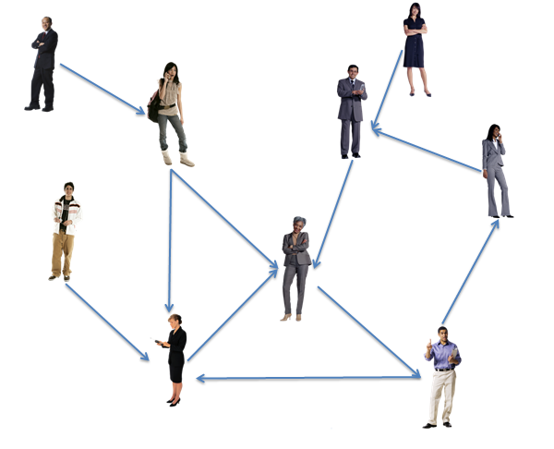

What is a Graph?
A graph is a representation of a set of objects (vertices) where some pairs of objects are connected by links (edges).
Notes:
Pagerank can be expressed as an iterative algorithm, where each vertex updates its rank as a discounted weighted average of its neighbors.
For example, in this graph, vertex 5 updates its rank

Slide 45

Introduction
Many practical applications concern large graphs
Large graph data
Graph Applications
  Web graph
  Transportation routes
  Citation relationships
  Social networks
  PageRank
  Shortest path
  Connected components
  Clustering techniques

Slide 46













PageRank
Depends on rank
of who follows them…
Depends on rank
of who follows her
What’s the rank
of this user?
Rank?
Loops in graph ➔ Iterations!
Notes:
Pagerank can be expressed as an iterative algorithm, where each vertex updates its rank as a discounted weighted average of its neighbors.
For example, in this graph, vertex 5 updates its rank

Slide 47
Introduction
Graph Processing
  Computation is vertex-centric
  Many iterations
Real world graphs are really large!
  the World Wide Web has billions of pages with billions of links
  Facebook’s social graph had more than 700 million users and more than 68 billion friendships in 2011
  Twitter’s social graph has billions of follower relationships

Slide 48
Why not MapReduce?
Map Reduce is ill-suited for graph processing
  Program Model is not intuitive: hard to implement
  Not design for iterations
  Unnecessarily slow: Each iteration is scheduled as separate MapReduce job with lots of overhead

Slide 49
Example: SSSP – Parallel BFS in MapReduce
Example: SSSP – Parallel BFS in MapReduce
B
C
Adjacency matrix
Adjacency List
A: (B, 10), (D, 5)
B: (C, 1), (D, 2)
C: (E, 4)
D: (B, 3), (C, 9), (E, 2)
E: (A, 7), (C, 6)
 | A | B | C | D | E
A |  | 10 |  | 5
B |  |  | 1 | 2
C |  |  |  |  | 4
D |  | 3 | 9 |  | 2
E | 7 |  | 6
∞
∞
1
10
A
0
2
3
9
4
6
5
7
∞
∞
2
D
E

Slide 50
Example: SSSP – Parallel BFS in MapReduce
Map input: <node ID, <dist, adj list>>
<A, <0, <(B, 10), (D, 5)>>>
<B, <inf, <(C, 1), (D, 2)>>>
<C, <inf, <(E, 4)>>>
<D, <inf, <(B, 3), (C, 9), (E, 2)>>>
<E, <inf, <(A, 7), (C, 6)>>>
Map output: <dest node ID, dist>
<B, 10> <D, 5>
<C, inf> <D, inf>
<E, inf>
<B, inf> <C, inf> <E, inf>
<A, inf> <C, inf>
B
C
∞
∞
1
10
A
0
2
3
9
4
6
5
7
∞
∞
2
D
E
<A, <0, <(B, 10), (D, 5)>>>
<B, <inf, <(C, 1), (D, 2)>>>
<C, <inf, <(E, 4)>>>
<D, <inf, <(B, 3), (C, 9), (E, 2)>>>
<E, <inf, <(A, 7), (C, 6)>>>
Flushed to local disk!!

Slide 51
Example: SSSP – Parallel BFS in MapReduce
Reduce input: <node ID, dist>
<A, <0, <(B, 10), (D, 5)>>>
<A, inf>
<B, <inf, <(C, 1), (D, 2)>>>
<B, 10> <B, inf>
<C, <inf, <(E, 4)>>>
<C, inf> <C, inf> <C, inf>
<D, <inf, <(B, 3), (C, 9), (E, 2)>>>
<D, 5> <D, inf>
<E, <inf, <(A, 7), (C, 6)>>>
<E, inf> <E, inf>
B
C
∞
∞
1
10
A
0
2
3
9
4
6
5
7
∞
∞
2
D
E

Slide 52

Example: SSSP – Parallel BFS in MapReduce
B
C
∞
∞
1
10
A
0
2
3
9
4
6
5
7
∞
∞
2
D
E

Slide 53
Example: SSSP – Parallel BFS in MapReduce
Reduce output: <node ID, <dist, adj list>>
= Map input for next iteration
<A, <0, <(B, 10), (D, 5)>>>
<B, <10, <(C, 1), (D, 2)>>>
<C, <inf, <(E, 4)>>>
<D, <5, <(B, 3), (C, 9), (E, 2)>>>
<E, <inf, <(A, 7), (C, 6)>>>
Map output: <dest node ID, dist>
<B, 10> <D, 5>
<C, 11> <D, 12>
<E, inf>
<B, 8> <C, 14> <E, 7>
<A, inf> <C, inf>
B
C
10
∞
1
Flushed to DFS!!
10
A
0
2
3
9
4
6
5
7
5
∞
<A, <0, <(B, 10), (D, 5)>>>
<B, <10, <(C, 1), (D, 2)>>>
<C, <inf, <(E, 4)>>>
<D, <5, <(B, 3), (C, 9), (E, 2)>>>
<E, <inf, <(A, 7), (C, 6)>>>
2
D
E
Flushed to local disk!!

Slide 54
Example: SSSP – Parallel BFS in MapReduce
Reduce input: <node ID, dist>
<A, <0, <(B, 10), (D, 5)>>>
<A, inf>
<B, <10, <(C, 1), (D, 2)>>>
<B, 10> <B, 8>
<C, <inf, <(E, 4)>>>
<C, 11> <C, 14> <C, inf>
<D, <5, <(B, 3), (C, 9), (E, 2)>>>
<D, 5> <D, 12>
<E, <inf, <(A, 7), (C, 6)>>>
<E, inf> <E, 7>
B
C
10
∞
1
10
A
0
2
3
9
4
6
5
7
5
∞
2
D
E

Slide 55

Example: SSSP – Parallel BFS in MapReduce
B
C
10
∞
1
10
A
0
2
3
9
4
6
5
7
5
∞
2
D
E

Slide 56
Example: SSSP – Parallel BFS in MapReduce
Reduce output: <node ID, <dist, adj list>>
= Map input for next iteration
<A, <0, <(B, 10), (D, 5)>>>
<B, <8, <(C, 1), (D, 2)>>>
<C, <11, <(E, 4)>>>
<D, <5, <(B, 3), (C, 9), (E, 2)>>>
<E, <7, <(A, 7), (C, 6)>>>
… the rest omitted …
B
C
8
11
1
Flushed to DFS!!
10
A
0
2
3
9
4
6
5
7
5
7
2
D
E

Slide 57
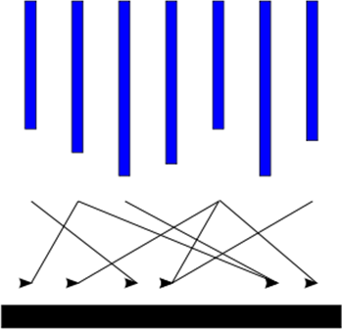
Computation Model (1/3)
Input
Supersteps
(a sequence of iterations)
Output

Slide 58
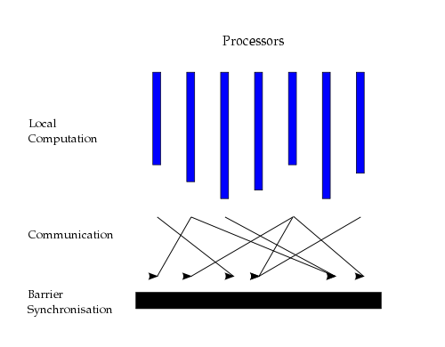
Computation Model (2/3)
“Think like a vertex”
Inspired by Valiant’s Bulk Synchronous Parallel model (1990)
Source: http://en.wikipedia.org/wiki/Bulk_synchronous_parallel

Slide 59
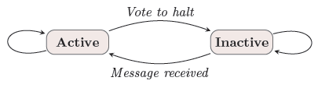
Computation Model (3/3)
Superstep: the vertices compute in parallel
  Each vertex
    Receives messages sent in the previous superstep
    Executes the same user-defined function
    Modifies its value or its outgoing edges
    Sends messages to other vertices (to be received in the next superstep)
    Mutates the topology of the graph
    Votes to halt if it has no further work to do
  Termination condition
    All vertices are simultaneously inactive
    There are no messages in transit

Slide 60
Example: SSSP – Parallel BFS in Pregel
∞
∞
1
10
0
2
3
9
4
6
5
7
∞
∞
2

Slide 61
Example: SSSP – Parallel BFS in Pregel
∞
∞
∞
1
10
10
∞
∞
∞
0
∞
2
3
9
4
6
5
∞
7
∞
5
∞
∞
2
∞

Slide 62
Example: SSSP – Parallel BFS in Pregel
10
∞
1
10
0
2
3
9
4
6
5
7
5
∞
2

Slide 63
Example: SSSP – Parallel BFS in Pregel
10
11
∞
1
14
10
8
0
2
3
9
4
6
5
12
7
5
∞
2
7

Slide 64
Example: SSSP – Parallel BFS in Pregel
8
11
1
10
0
2
3
9
4
6
5
7
5
7
2

Slide 65
Example: SSSP – Parallel BFS in Pregel
8
9
11
1
10
13
0
14
2
3
9
4
6
5
7
15
5
7
2

Slide 66
Example: SSSP – Parallel BFS in Pregel
8
9
1
10
0
2
3
9
4
6
5
7
5
7
2

Slide 67
Example: SSSP – Parallel BFS in Pregel
8
9
1
10
0
2
3
9
4
6
5
7
13
5
7
2

Slide 68
Example: SSSP – Parallel BFS in Pregel
8
9
1
10
0
2
3
9
4
6
5
7
5
7
2

Slide 69
Differences from MapReduce
Graph algorithms can be written as a series of chained MapReduce invocation
Pregel
  Keeps vertices & edges on the machine that performs computation
  Uses network transfers only for messages
MapReduce
  Passes the entire state of the graph from one stage to the next
  Needs to coordinate the steps of a chained MapReduce

Slide 70
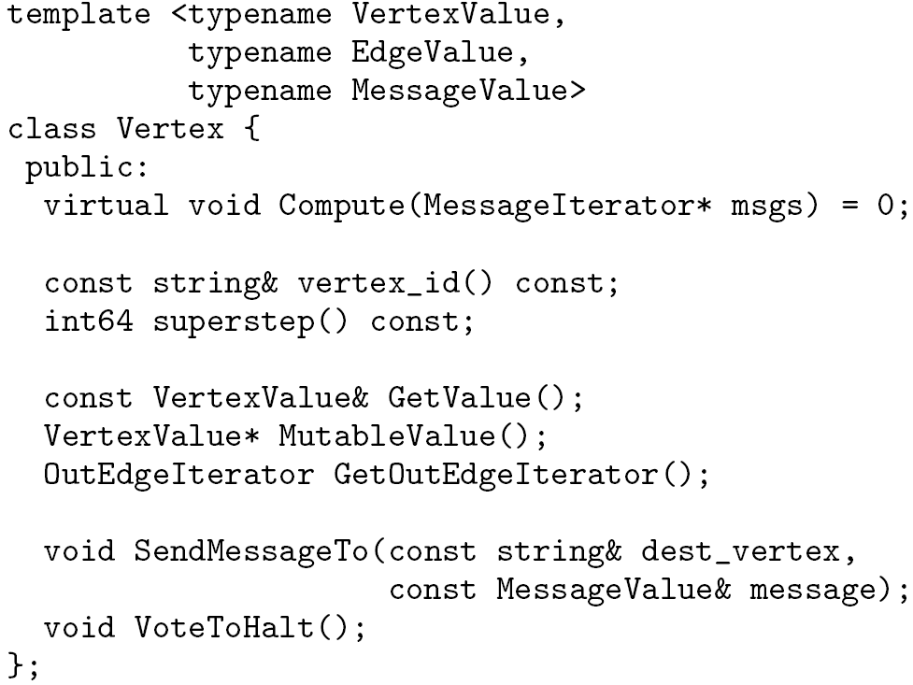
C++ API
Writing a Pregel program
  Subclassing the predefined Vertex class
Override this!
in msgs
out msg

Slide 71
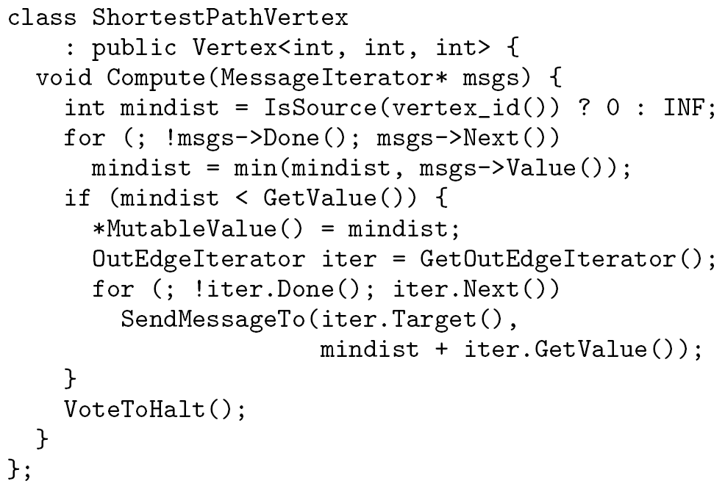
Example: Vertex Class for SSSP

Slide 72
System Architecture
Pregel system also uses the master/worker model
  Master
    Maintains worker
    Recovers faults of workers
    Provides Web-UI monitoring tool of job progress
  Worker
    Processes its task
    Communicates with the other workers
Persistent data is stored as files on a distributed storage system (such as GFS or BigTable)
Temporary data is stored on local disk

Slide 73
Execution of a Pregel Program
Many copies of the program begin executing on a cluster of machines
The master assigns a partition of the input to each worker
  Each worker loads the vertices and marks them as active
The master instructs each worker to perform a superstep
  Each worker loops through its active vertices & computes for each vertex
  Messages are sent asynchronously, but are delivered before the end of the superstep
  This step is repeated as long as any vertices are active, or any messages are in transit
After the computation halts, the master may instruct each worker to save its portion of the graph

Slide 74
Fault Tolerance
Checkpointing
  The master periodically instructs the workers to save the state of their partitions to persistent storage
    e.g., Vertex values, edge values, incoming messages
Failure detection
  Using regular “ping” messages
Recovery
  The master reassigns graph partitions to the currently available workers
  The workers all reload their partition state from most recent available checkpoint

