Slide 1
Previous & SST-trie
Clarifications on last slides & Intro to LSM-trie

Slide 2
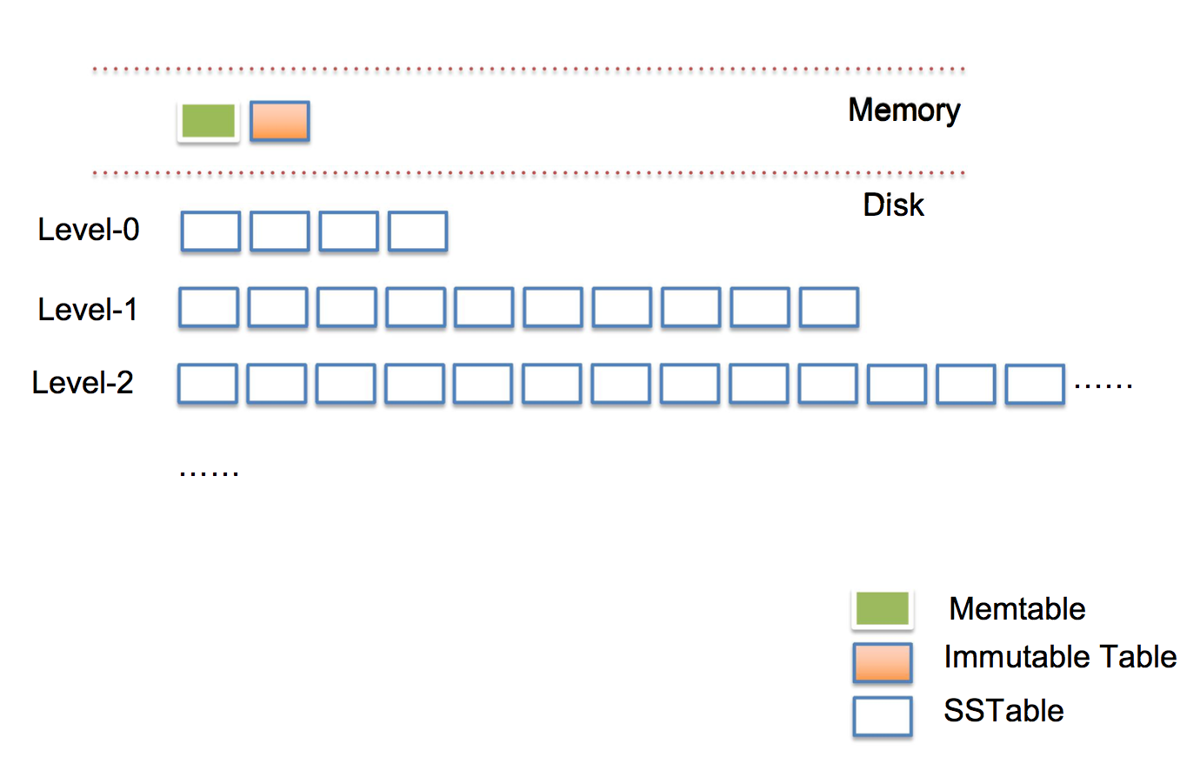
Max space limited to be 10^n MB at level n!

Slide 3
Why and When to Compact?
Major Compaction
Limited Size on each level
Some SSTs are frequented with meaningless return value
Minor Compaction
Memory Table is full

Slide 4
Limitations on Log Structured Indexes
Trade-off between “write” & “read” performances
-> Excessive read amplification
-> Exhaustive Lookups & Seeks during Inserts
-> Write Pauses
So bLSM Tree it is !

Slide 5
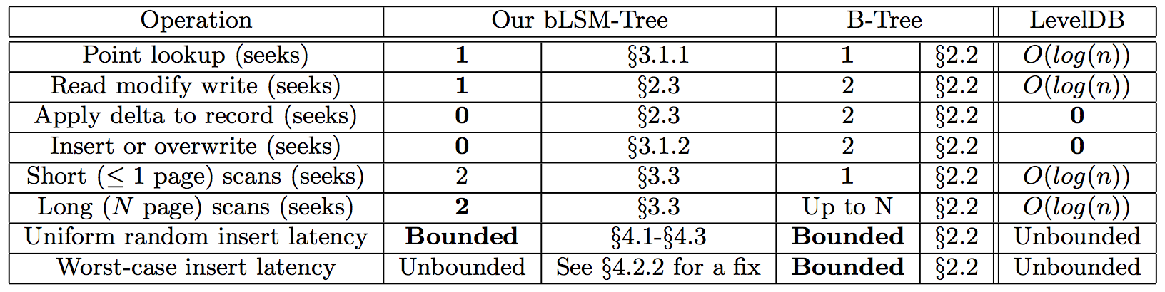
How is bLSM Tree?
N means the level of LSM tree and n means the size of each SST!

Slide 6
Key-Value Store
Small KV items -> Widespread
Capacity on single KV server -> Increasing
Performance on write and read -> High

Slide 7
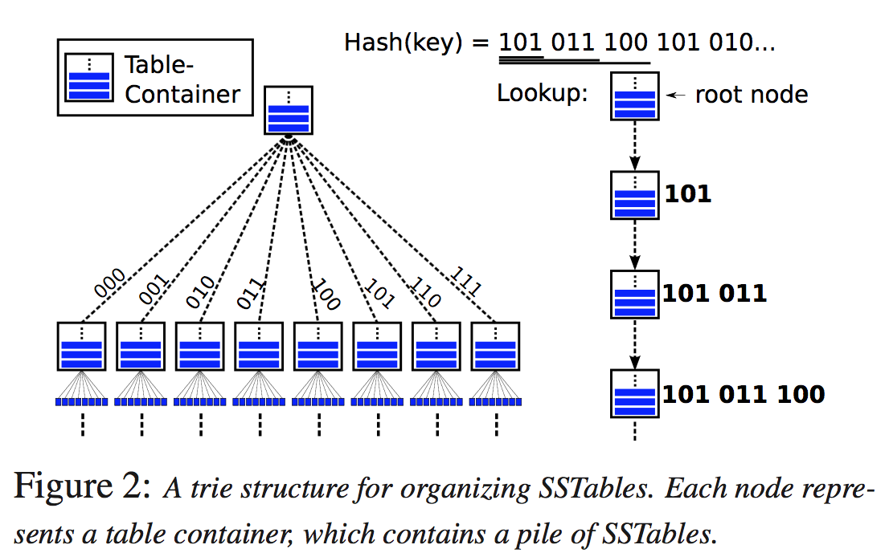
What is SST-trie?

Slide 8
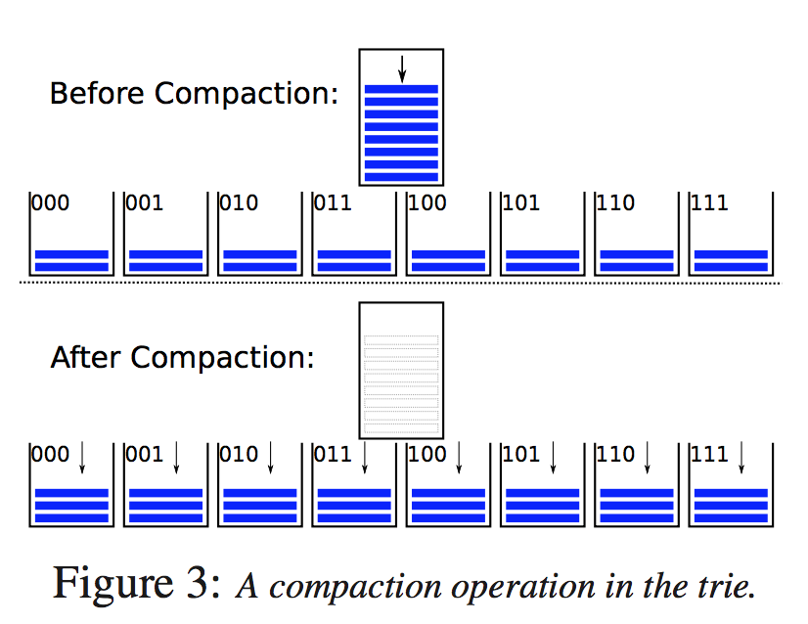
How SST-trie compacts?

Slide 9
Is bLSM perfect?
For a 10 TB store holding 200 B-KV-items would require about 125 GB space for 10-bit-per-key Bloom- filters and 30 GB for indices.
Each Bloom filter has a false positive rate (about 0.82% for a setting of 10 bits per item)
Which leads to 5.7% for a 7-level structure to 46% for a 56-level one

Slide 10
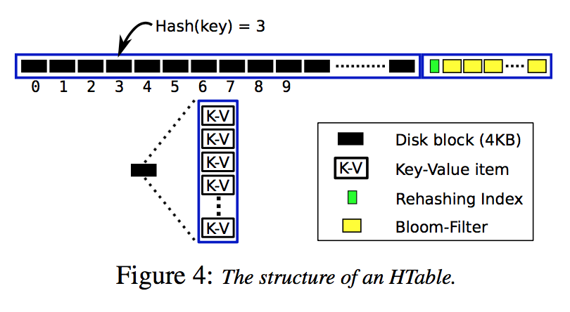
LSM-trie
SST-trie with better metadata management!
Use Hash Table(HTable) instead of Sorted String Table(SST)

Slide 11
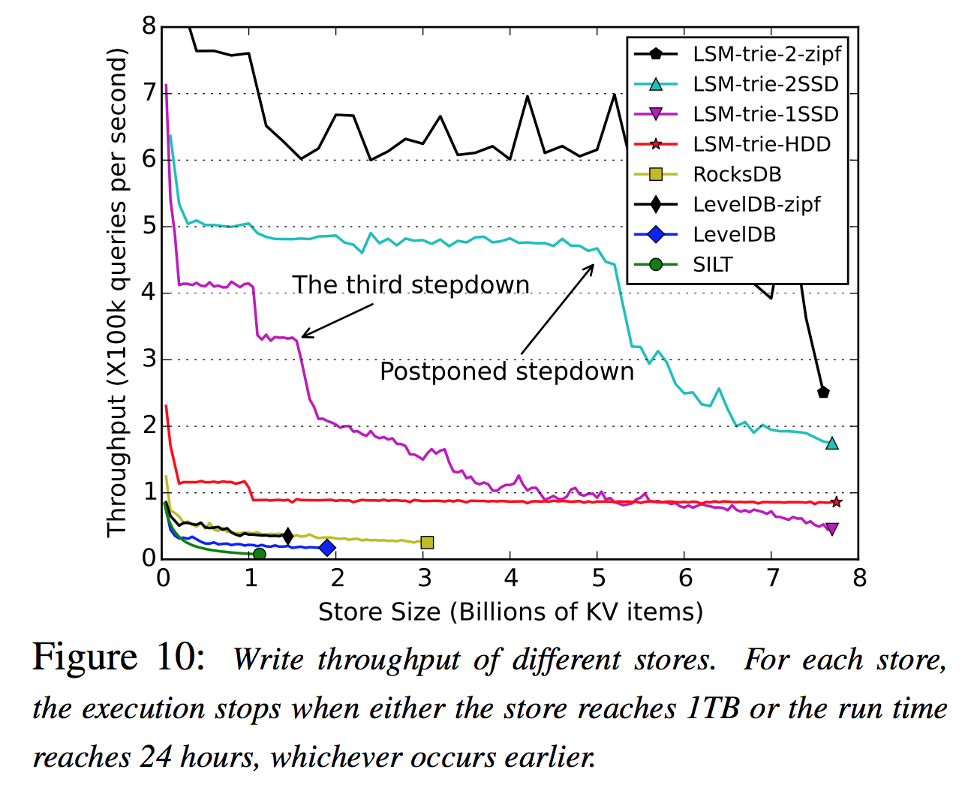
How is LSM-trie?

