Slide 1
Optimal Order Placement
Optimize order execution problem using reinforcement learning
State:
private variable: outstanding inventory, time remaining
Market variable: order book shape, order flow
Action:
Price level and volume to place the order at each timestamp
Reward:
Implementation shortfall

Slide 2
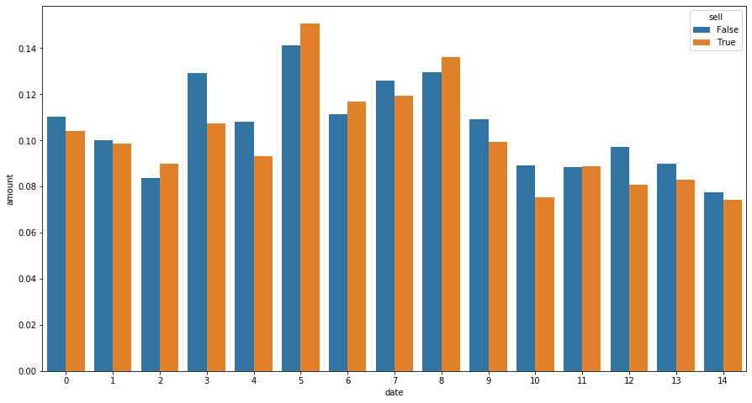
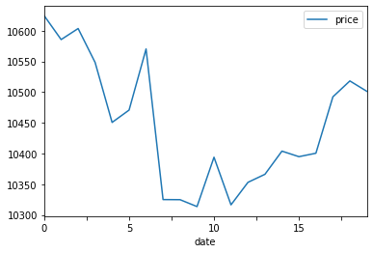
Data
Coinapi: Level II Full Order Book, trade, snapshot

