Slide 1
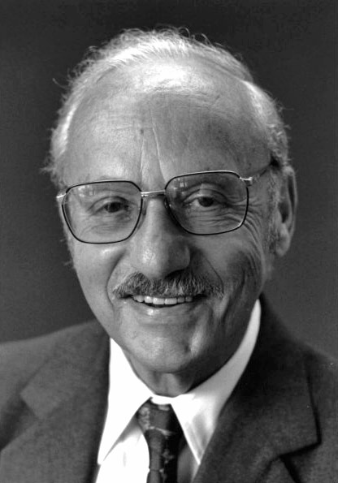
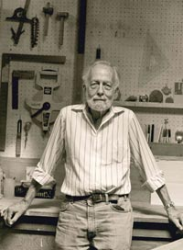
George Dantzig
1914~2005
Philip Wolfe
1927~2016

