Slide 1
React native
Description

Slide 2
2017.8.31
1
Rn必须理解的概念
React Native
Learn once, write anywhere
2
官方 访问
一起开发一个页面
https://facebook.github.io/react-native/
3
遇到的坑

Slide 3
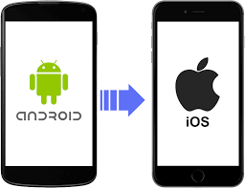
What is RN
58
商家通
Learn once, write anywhere: Build mobile apps with React
85%
Learn once , write anywhere
write once, run anywhere

Slide 4
Conception
58
商家通
Learn once, write anywhere: Build mobile apps with React
状态机变量
状态机变量的改变将导致UI的重新渲染
生命周期
和我们Native的生命周期回调一样
FlexBox
强大的布局样式处理模式
调试
向前端一样方便快捷，告别Android 2分钟的编译等待

Slide 5
状态机变量
58
商家通
Learn once, write anywhere: Build mobile apps with React
DataBiding

Slide 6
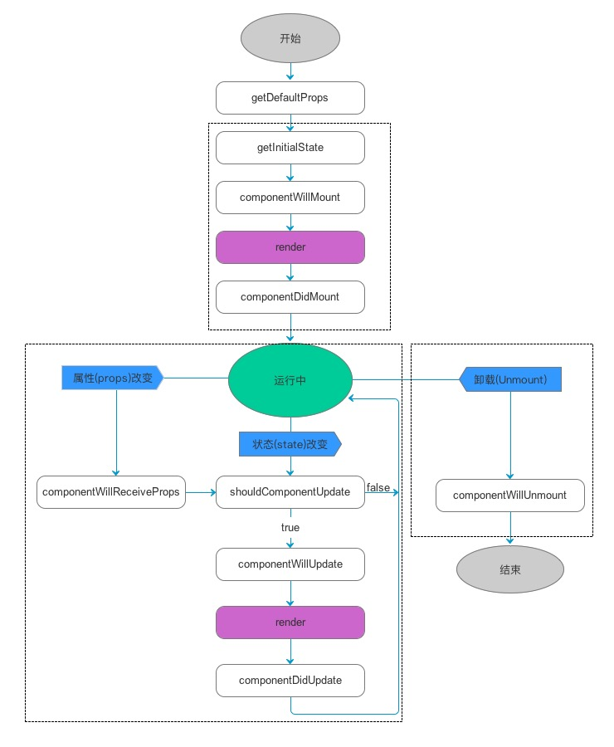
生命周期
58
商家通
Learn once, write anywhere: Build mobile apps with React

Slide 7
FlexBox
58
商家通
Learn once, write anywhere: Build mobile apps with React
flex number
flexDirection enum(‘row’, ‘column’)
flexWrap enum(‘wrap’, ‘nowrap’)
alignItems enum(‘flex-start’, ‘flex-end’, ‘center’, ‘stretch’)
alignSelf enum(‘auto’, ‘flex-start’, ‘flex-end’, ‘center’, ‘stretch’)
justifyContent enum('flex-start', 'flex-end', 'center', 'space-between', 'space-around')
http://www.ruanyifeng.com/blog/2015/07/flex-grammar.html
http://blog.csdn.net/sbsujjbcy/article/details/50017029
http://reactnative.cn/docs/0.47/layout-props.html#content

Slide 8
Let’s
fuck code
一起开发一个列表页

Slide 9
实战
58
商家通
Learn once, write anywhere: Build mobile apps with React
事件响应
父子组件间通讯
网络请求
android rn间通讯
导航与路由跳转
调试
打包问题
创建Activity 布局 rn容器
java一系列代码 配置
js端Item组装，布局处理
加入List 组件间通讯
加入网络请求
加入路由协议

Slide 10
坑
The problem we meet
One
Warning: Failed to create the file android/app/assets/index.android.bundle
Three
java.lang.UnsatisfiedLinkError: could find DSO to load: libreactnativejni.so
Two
Caused by: java.lang.IllegalAccessError: Method ‘void android.support.v4.net.ConnectivityManagerComp

Slide 11

Thanks
My简书
http://www.jianshu.com/u/ebb100922304

