Slide 1
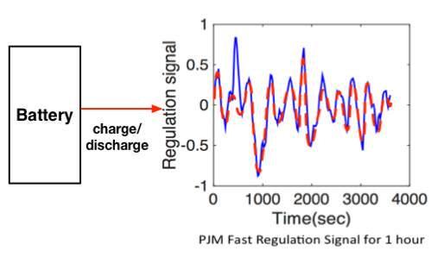

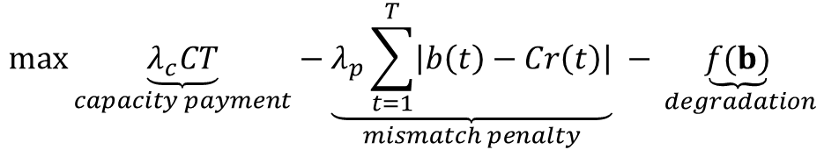


$$\max{\underset{capacity payment}{\underbrace{λ_{c}CT}}}−\underset{mismatch penalty}{\underbrace{λ_{p}\sum_{t=1}^{T}{\left|b\left(t\right)−Cr\left(t\right)\right|}}} −\underset{ degradation}{\underbrace{f(b)}}$$
$$s.t. C≥0$$
$$0≤b\left(t\right)≤P, t=1,2,…,T$$
$$s^{min}≤s^{0}+\frac{\sum_{τ=1}^{t}{b\left(τ\right)t_{s}}}{E}≤s^{max}, t=1,2,…,T$$
Batteries charge/discharge to follow the signal
Receive payments: capacity payment, performance payment (in terms of mismatch penalty)

Slide 2
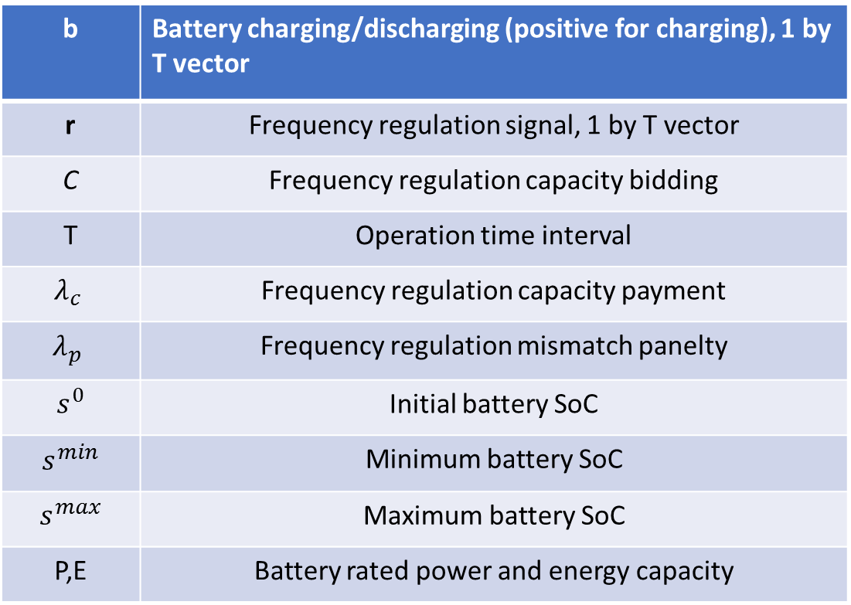
b | Battery charging/discharging (positive for charging), 1 by T vector
r | Frequency regulation signal, 1 by T vector
C | Frequency regulation capacity bidding
T | Operation time interval
$$λ_{c}$$ | Frequency regulation capacity payment
$$λ_{p}$$ | Frequency regulation mismatch panelty
$s^{0}$ | Initial battery SoC
$s^{min}$ | Minimum battery SoC
$s^{max}$ | Maximum battery SoC
P,E | Battery rated power and energy capacity

