Slide 1

Transform Valuable Readership into Value
Natural Language Processing on TechCrunch Blogs and Bloggers

Slide 2

Table of Content 1. Business Objective and Initiative 2. Measurement 3. Execution 4. Implementation

Slide 3
Business Background
What is TechCrunch?
A Leading Technology Media Property With Valuable Readership
13 million followers
26 million monthly page views
19% considering themselves influential
44% earn an annual household income of $110K+

Slide 4
Business Objective
What Do We Offer?
Transform Valuable Readership into Value
Where is the Value?
Advertisement
Sponsored Content

Slide 5

Business Initiative
Attract more Advertiser and Content Sponsor by
The influence of the blog
The reader’s reaction of the blog
Identify what contributes to influence and reader’s reaction by
Writing Styles Modeling
Topic Modeling
Sentiment Analysis

Slide 6
Business Measurement
Direct Measurement
Revenue
Indirect Measurement
Influence (Pageviews, Shares, Comments per Blog)
Reader’s Reaction (Sentiment)
Additional Measurement
User Acquisition (Registration and Subscription)
User Engagement (Pageviews, Shares, Comments per User)

Slide 7
Analysis – Data Characteristics
Post Dataset
19464 Posts
Comment Dataset
746561 Posts
Author Dataset
107 Bloggers
Styles Modeling
Topic Modeling
Sentiment Analysis
Regression
Notes:
techcrunch
107
19thousand
Sentiment->comments->avg post

Slide 8
Analysis – Sentiment Analysis
Score
Negative
Positive
Neutral
--1 0 1
Notes:
Sentiment comment
Average post
(-1,1)
The more close 1, positive, -1, negative, 0 neutral
Sentiment of readers
indep

Slide 9
Analysis – Writing Styles Modeling
Diversity
Readability
Structure
Structure
The Structure Complexity
Diversity
The Vocabulary Richness
Readability
The Understandability
Notes:
20 columns -> indicators 3 parts
Structure Complexity: Average Word Length, Average Sentence Length By Word, Punctuation Count
Vocabulary Richness Features
Understandability
Gave different scores for diff indicators -> representing diff writing styles
dep

Slide 10
Analysis – Topic Modeling
Extract Topics from Posts
Posts are composed by Topics
Topics are composed by Keywords
Example
Topic 16: Event + Startup + Launch + Conference
Keywords
Topics
Posts
Notes:
Clustered 20 topics topic 16
Before regression, transformed topic indicators as 20 categorical variables
Each post only before to one category, which is its main topics
Scatter plot topics, influence of posts
dep

Slide 11

Analysis – EDA and Regression
For Influence
Identify most influential variables
Correlation
Visualization
For Reader’s Reaction
Identify what contributes to reader’s reaction
Linear Regression
Regression Tree
Gradient Boost Regression Tree
Notes:
Deleted duplicated variables
Writing styles
Structure Complexity: Average Word Length, Average Sentence Length By Word, Punctuation Count
Understandability
high-related with each other
Regression
Mean absolute error
Linear

Slide 12
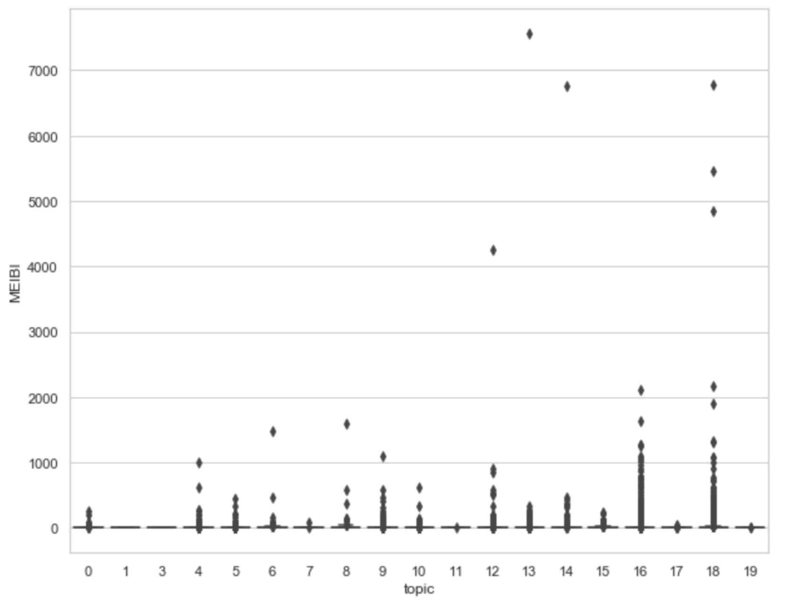
Conclusion – For Influence
Most Influential Topics
Topic 16: Event + Startup + Launch + Conference
Topic 18: Social + Network + Friend + Share
Recommendation
Partner with advertiser and content sponsor to promote Devices and Social Network products

Slide 13
Conclusion – For Reader Reaction
Most Preferable Features
Longer Words & Shorter Sentence
Higher Vocabulary Richness
Better Readability
Recommendation
Train its blogger to focus on these features to write more attractive blogs
Feature | Importance
Number of comments | 0.11065
Number of retrieved inlinks | 0.08365
MEIBI score | 0.08333
topic_0 | 0.07735
Post Length (#words) | 0.07583
dihapax ( Hapax DisLegemena(Sichel’s Measure)) | 0.06864
meanwl (Average Word Length) | 0.06770
meansl (Average Sentence Length By Character) | 0.06214
D (Dale Chall Readability) | 0.06178
S (Simpson's Index) | 0.05941
p (Punctuation Count) | 0.05757
TTratio (Hapax Legomenon) | 0.05397

Slide 14
Challenges and Future Plans
Comments
Like/Unlike
Title

Slide 15

Q & A

