Slide 1


$$Spectral entropy S=−\sum_{p}{I_{p}\ln{I_{p}}}$$
$$Entropy distance=\left(S_{AB}−S_{B}\right)+\left(S_{AB}−S_{B}\right)$$
$$Entropy similarity=1−\frac{Entropy distance}{\ln{4}}$$

Slide 2
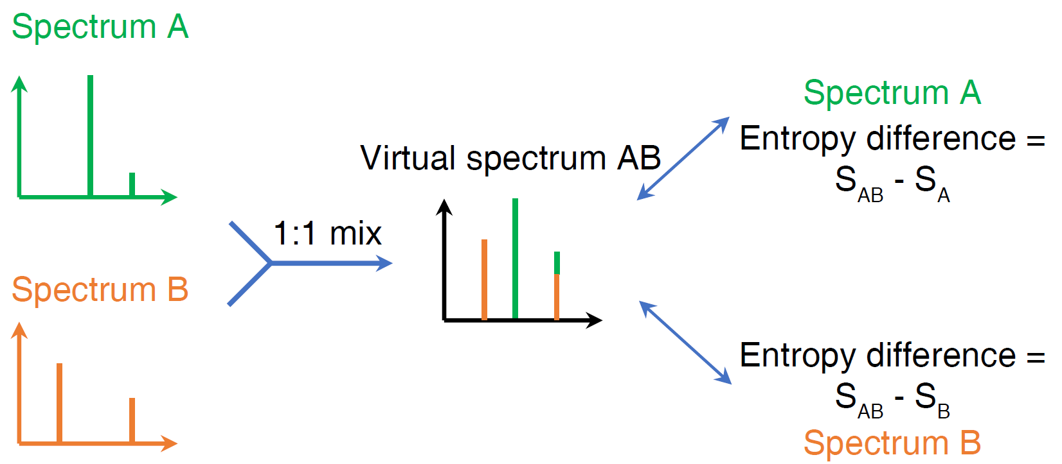
$$Entropy distance=\left(S_{AB}−S_{B}\right)+\left(S_{AB}−S_{B}\right)$$
$$Entropy similarity=1−\frac{Entropy distance}{\ln{4}}$$

