Slide 1
Fast and Accurate Analysis of MS/MS Spectra using Spectral Entropy
Yuanyue Li
李渊越
https://yuanyue.li
2023.08.28

Slide 2

The MS/MS spectrum
Precursor ions
Product ions
MS/MS spectrum
3
Intensity
2
Fragmentation
Detection
A
B
m/z

Slide 3
The traditional view of MS/MS spectra similarity
3
Spectrum A
Intensity
2
(2,3)
A
B
m/z
Spectral similarity = cos(θ)
(3,2)
θ
3
Intensity
2
Spectrum B
A
B
m/z
Steve Sokolow, et, al. Finnigan Application Report, 1978

Slide 4
MS/MS spectrum is a probability distribution

Slide 5
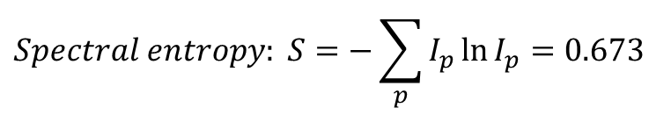
The idea of spectral entropy
Precursor ions
Product ions
MS/MS spectrum
3
Intensity
2
Fragmentation
Detection
A
B
m/z
0.6
: 60%
Probability
0.4
: 40%
A
B
m/z
$$Spectral entropy: S=−\sum_{p}{I_{p}\ln{I_{p}}}=0.673$$
Yuanyue Li, et, al. Nature Methods, 2021

Slide 6







The idea of entropy similarity
0.6
Probability
0.4
Spectral distance = Sum of entropy gain
Spectrum A
Spectral entropy $S_{A}$
A
B
m/z
Entropy gain: $S_{mix}−S_{A}$
0.5
0.5
Entropy distance=$\left(S_{mix}−S_{A}\right)+\left(S_{mix}−S_{B}\right)$
Spectrum Mix
Probability
Spectral entropy $S_{mix}$
Unweighted entropy similarity=$1−\frac{Entropy distance}{\ln{4}}$
Entropy similarity: Based on unweighted entropy similarity and adding extra weight for low abundance peak.
A
B
m/z
Entropy gain: $S_{mix}−S_{B}$
0.6
Spectrum B
Probability
0.4
Spectral entropy $S_{B}$
A
B
m/z

Slide 7
From the view of probability distribution
0.6
Spectral distance = probability distribution distance
Spectrum A
Probability distribution A
Probability
0.4
A
B
m/z
One of the widely used probability distribution distance is Jensen–Shannon divergence.
0.6
Spectrum B
Probability distribution B
0.4
If scaled into [0,1], Entropy distance is mathematically equivalent to Jensen–Shannon divergence.
Probability
A
B
m/z

Slide 8
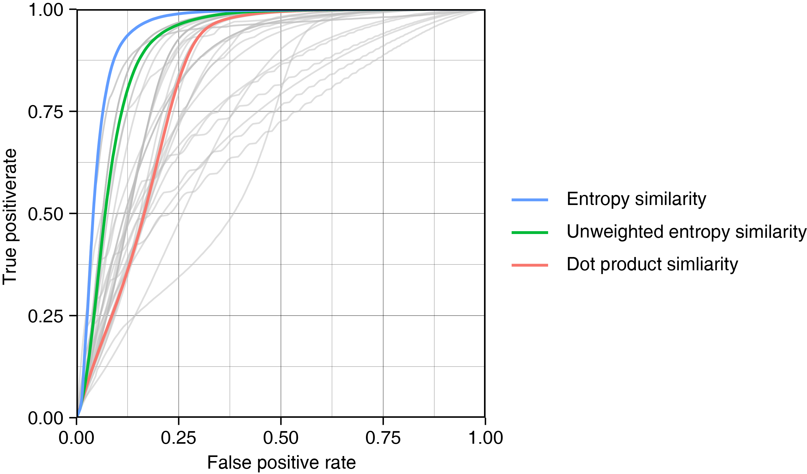
Entropy similarity outperforms dot product similarity
Tested on LC-MS, for metabolite identification
Yuanyue Li, et, al. Nature Methods, 2021

Slide 9
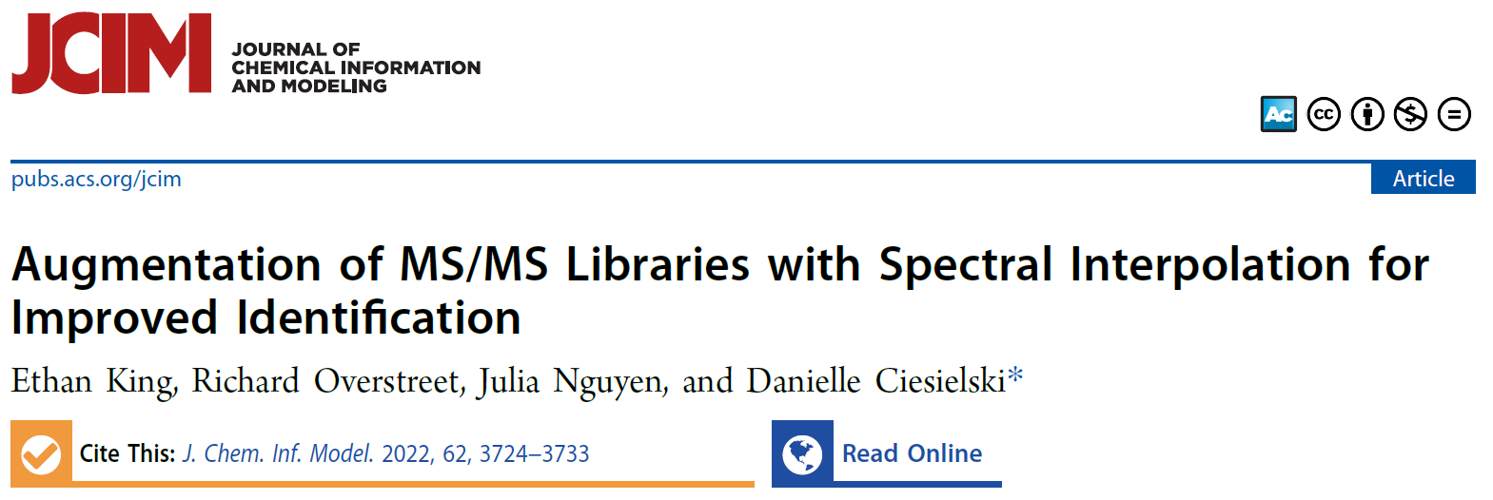
Entropy similarity has good performance in many scenarios
Tested on GC-MS, for metabolite identification
“
… use of the entropy similarity metric and interpolation results in a 20% increase in identification accuracy over cosine similarity …
”

Slide 10
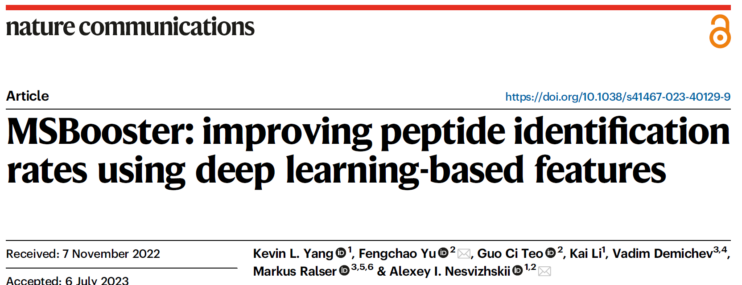
Entropy similarity has good performance in many scenarios
Tested on LC-MS, for peptide identification
“
… For spectral similarity features, the greatest boosts were consistently obtained with “unweighted spectral entropy”…
”

Slide 11
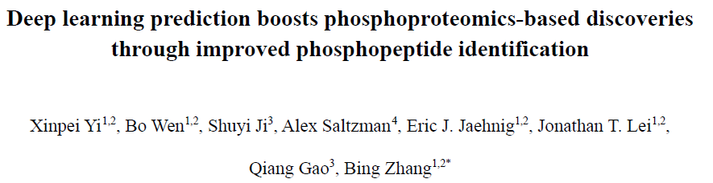
Entropy similarity has good performance in many scenarios
Tested on LC-MS, for phosphopeptide identification
“
… entropy distance (Entropy), which outperformed the other five spectrum similarity computation methods including dot product (DP), square root dot product (srDP), spectral contrast angle (SA), Pearson correlation coefficient (PCC), and unweighted entropy distance (unwEntropy) in our comparative analysis .…
”

Slide 12
Types of spectral comparison

Slide 13
The identity search
Only compare spectra with the same precursor m/z.
Can only be used to identify compounds with exact same structure.
+
+
+
+
Probability / Intensity
m/z
+
+
+
+

Slide 14




The limitation of identity search
Unknown molecule
Library molecule
Identity search

Slide 15
The open search
Compare spectra with different precursor m/z.
Widely used in proteomics.
+
+
+
+
Probability / Intensity
m/z
+
+
+
+

Slide 16
The neutral loss search
Similar to open search but compare neutral loss fragments.
Used in METLIN database.
+
+
+
+
Probability / Intensity
m/z
+
+
+
+

Slide 17
The hybrid search
Compare both fragment ions and neutral loss fragments matches.
Also called "modified (cosine)" in GNPS network.
Widely used in metabolomics.
+
+
+
+
Probability / Intensity
m/z
+
+
+
+

Slide 18
Types of spectral comparison
Identity search
Open search
Neutral loss search
Hybrid search
Intensity
Intensity
Intensity
Intensity
m/z
m/z
m/z
m/z
Intensity
Intensity
Intensity
Intensity
m/z
m/z
m/z
m/z
Need to compare with all molecules: large searching space

Slide 19
How to increase searching speed?

Slide 20
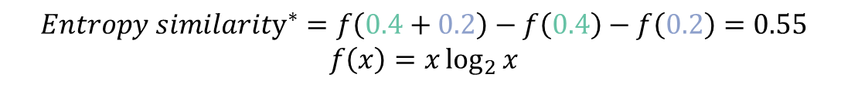

Simplify the calculation of entropy similarity
New formula to calculate entropy similarity.
No need to merge spectra.
$${Entropy similarity}^{∗}=\sum_{i,j}{\left\{\begin{matrix}0 & if m/z_{A,i}≠m/z_{B,j} \\ f\left(I_{A,i}+I_{B,j}\right)−f\left(I_{A,i}\right)−f\left(I_{B,j}\right) & if m{/z}_{A,i}=m/z_{B,j}\end{matrix}\right.},with f\left(x\right)=x\log_{2}{x}$$
0.4
Intensity
$${Entropy similarity}^{∗}=f\left(0.4+0.2\right)−f\left(0.4\right)−f\left(0.2\right)=0.55$$
$$f\left(x\right)=x\log_{2}{x}$$
0.1
m/z
0.2
0.3
$∗$The spectra need to be normalized into sum equals 0.5, and the entropy-based weight needs to be applied before calculation.

Slide 21
Skip the comparison of non-overlapping peaks
Intensity
More than 90% spectra do not have overlapped peaks.
m/z
Intensity
Only needs to calculate entropy similarity in this situation.
m/z

Slide 22
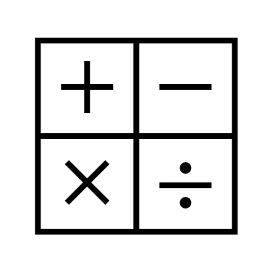
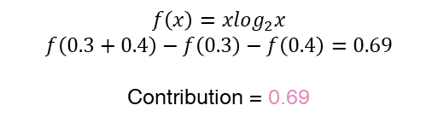
The Flash Entropy Search algorithm
Library spectra
1. Sort by ion’s m/z
ID
m/z
Intensity
……
Sorted library spectra
4
256.356
0.2
Query spectrum
5
121.251
0.3
ID
m/z
Intensity
……
m/z
Intensity
5
256.349
0.2
1
121.213
0.1
2. Search
……
6
115.373
0.1
5
121.251
0.3
121.251
0.4
6
361.967
0.3
3
121.269
0.2
……
6
639.032
0.1
……
7
573.773
0.4
……
3. Calculate similarity contribution
$$f\left(x\right)=xlog_{2}x$$
$$f\left(0.3+0.4\right)−f\left(0.3\right)−f\left(0.4\right)=0.69$$
Contribution = 0.69
Old similarity table
Spectral ID
…
4
5
6
…
Similarity
…
0
0
0
…
4. Add to similarity
New similarity table
Spectral ID
…
4
5
6
…
Similarity
…
0
0.69
0
…
Yuanyue Li & Oliver Fiehn, Nature methods, in press

Slide 23
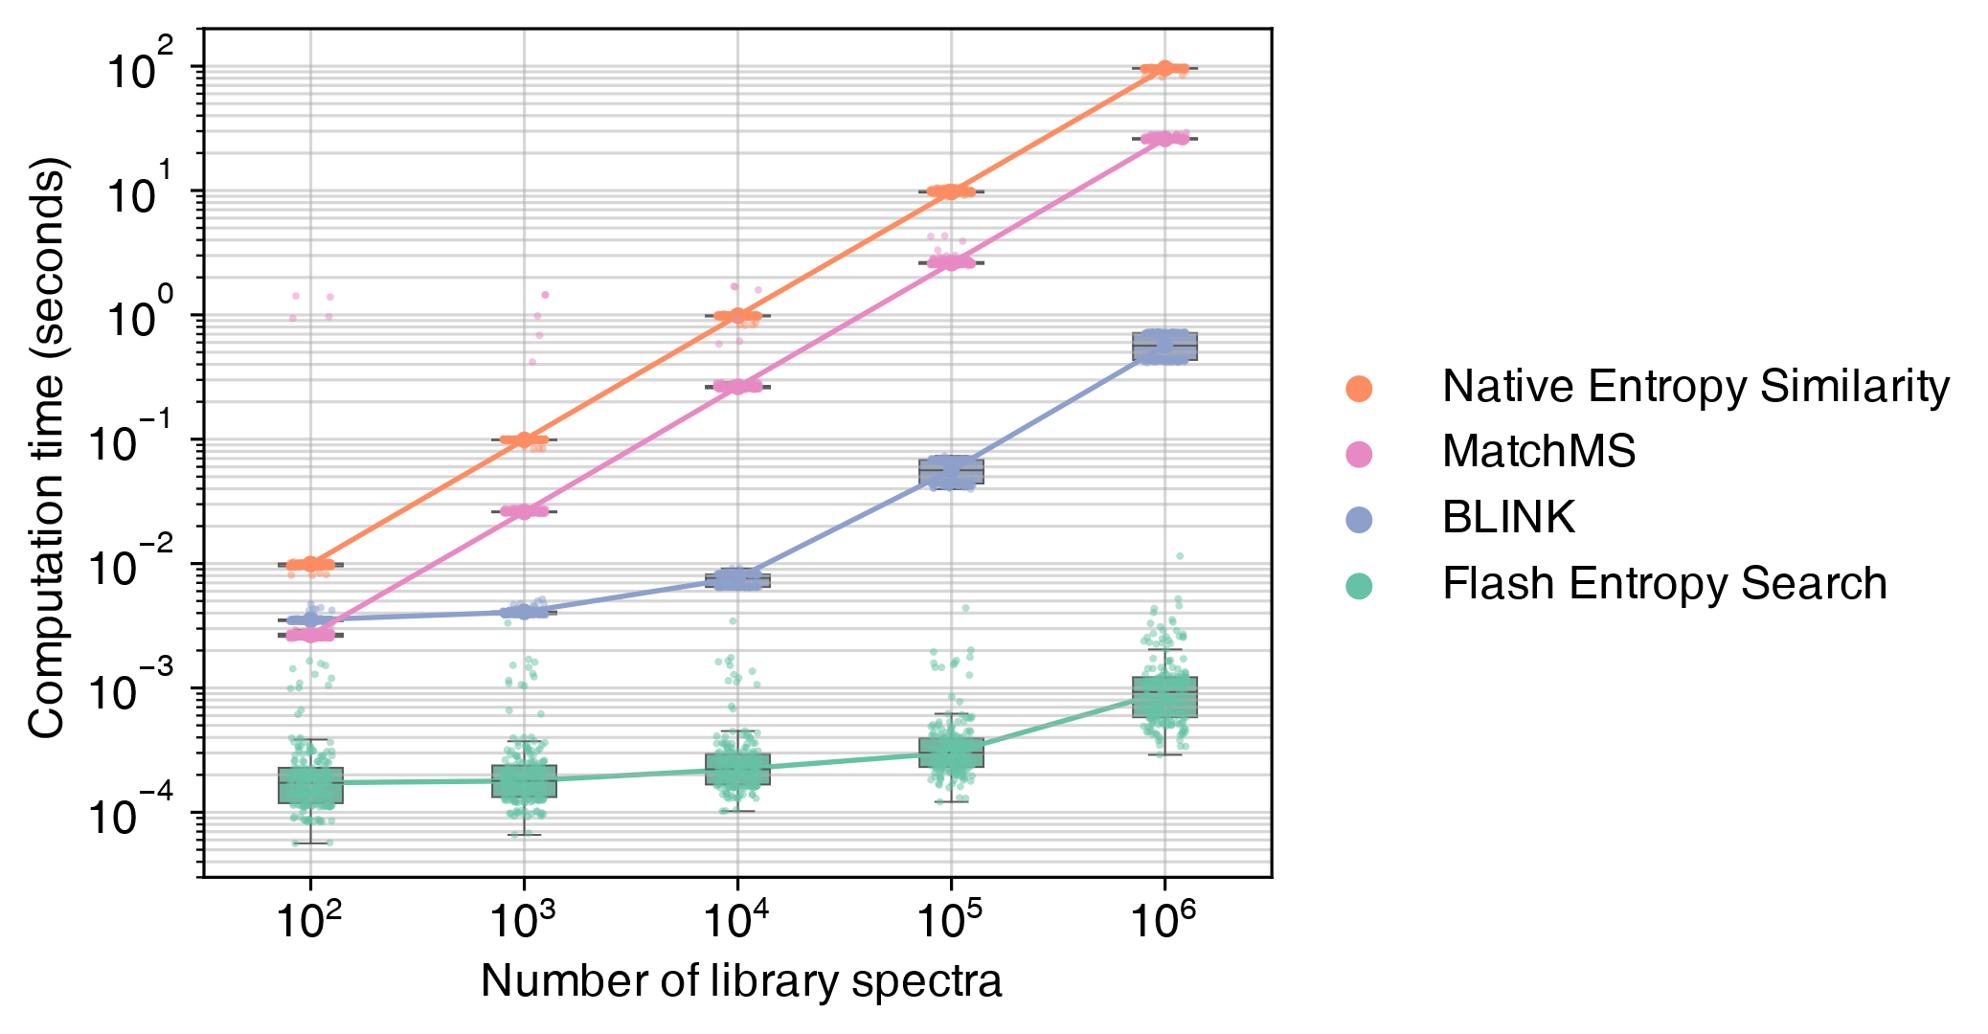
The performance of Flash Entropy Search
Open search

Slide 24
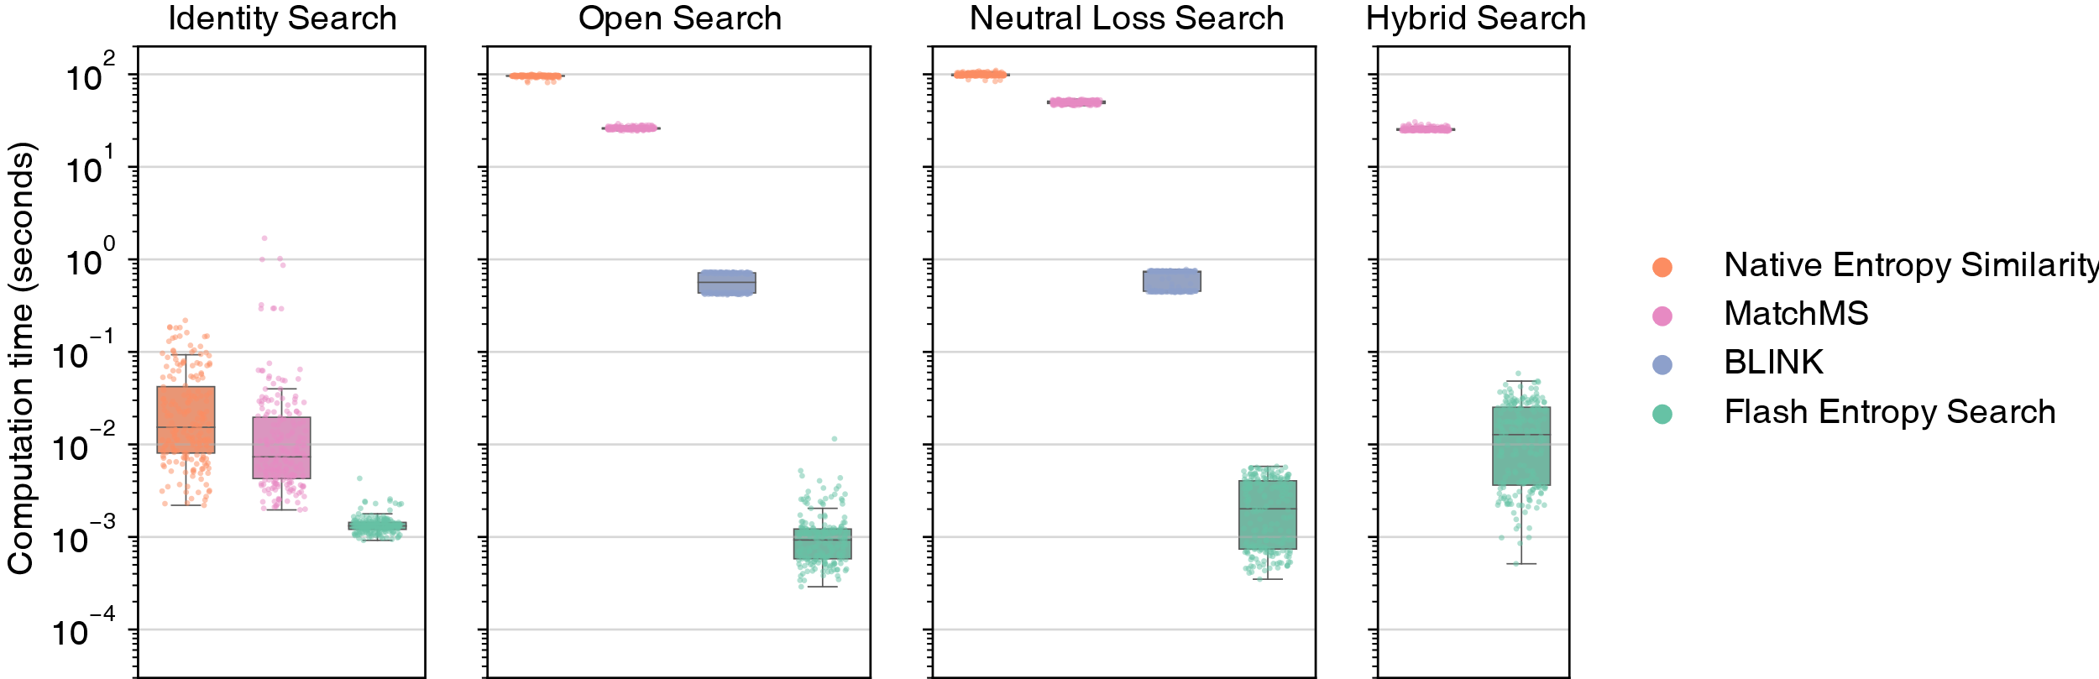
The performance of Flash Entropy Search
Number of library spectra: 1,000,000

Slide 25
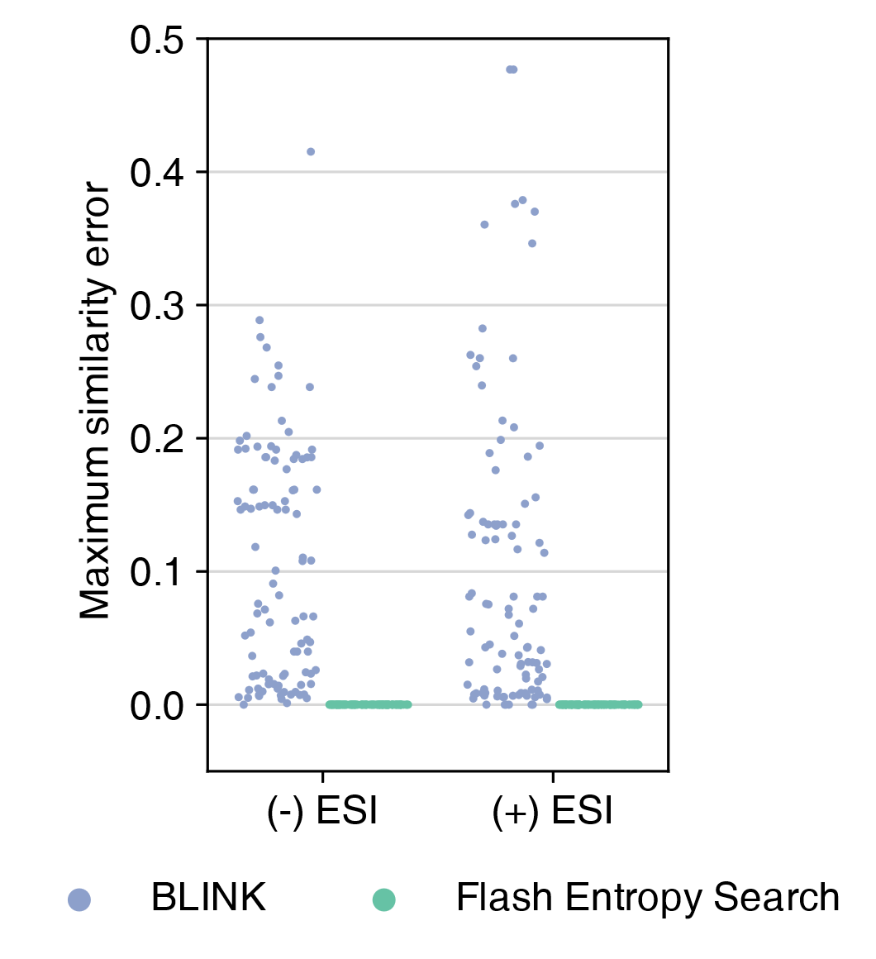
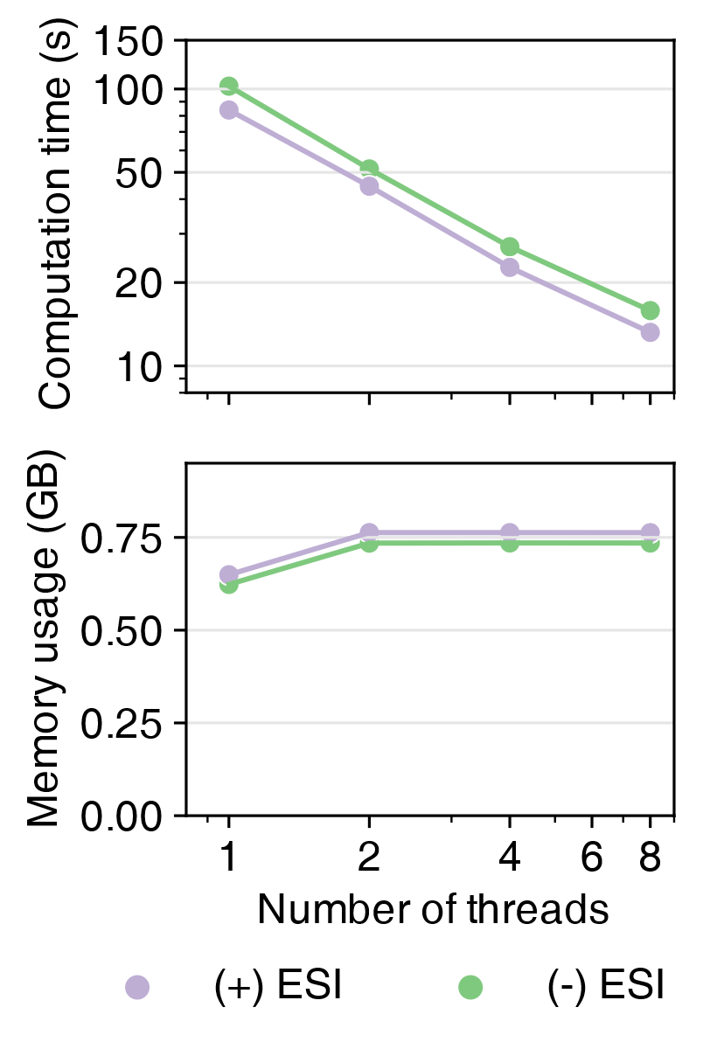
The accuracy and multiple threads performance
Open search
Open search
Number of library spectra: 1,000,000
Number of query spectra: 100,000
Number of library spectra: 1,000,000

Slide 26
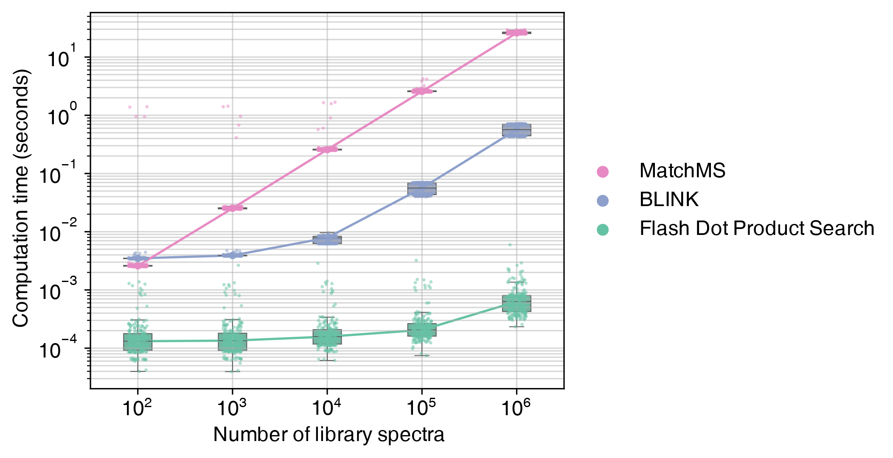
Can also be used to calculate dot product (cosine) similarity
Open search

Slide 27
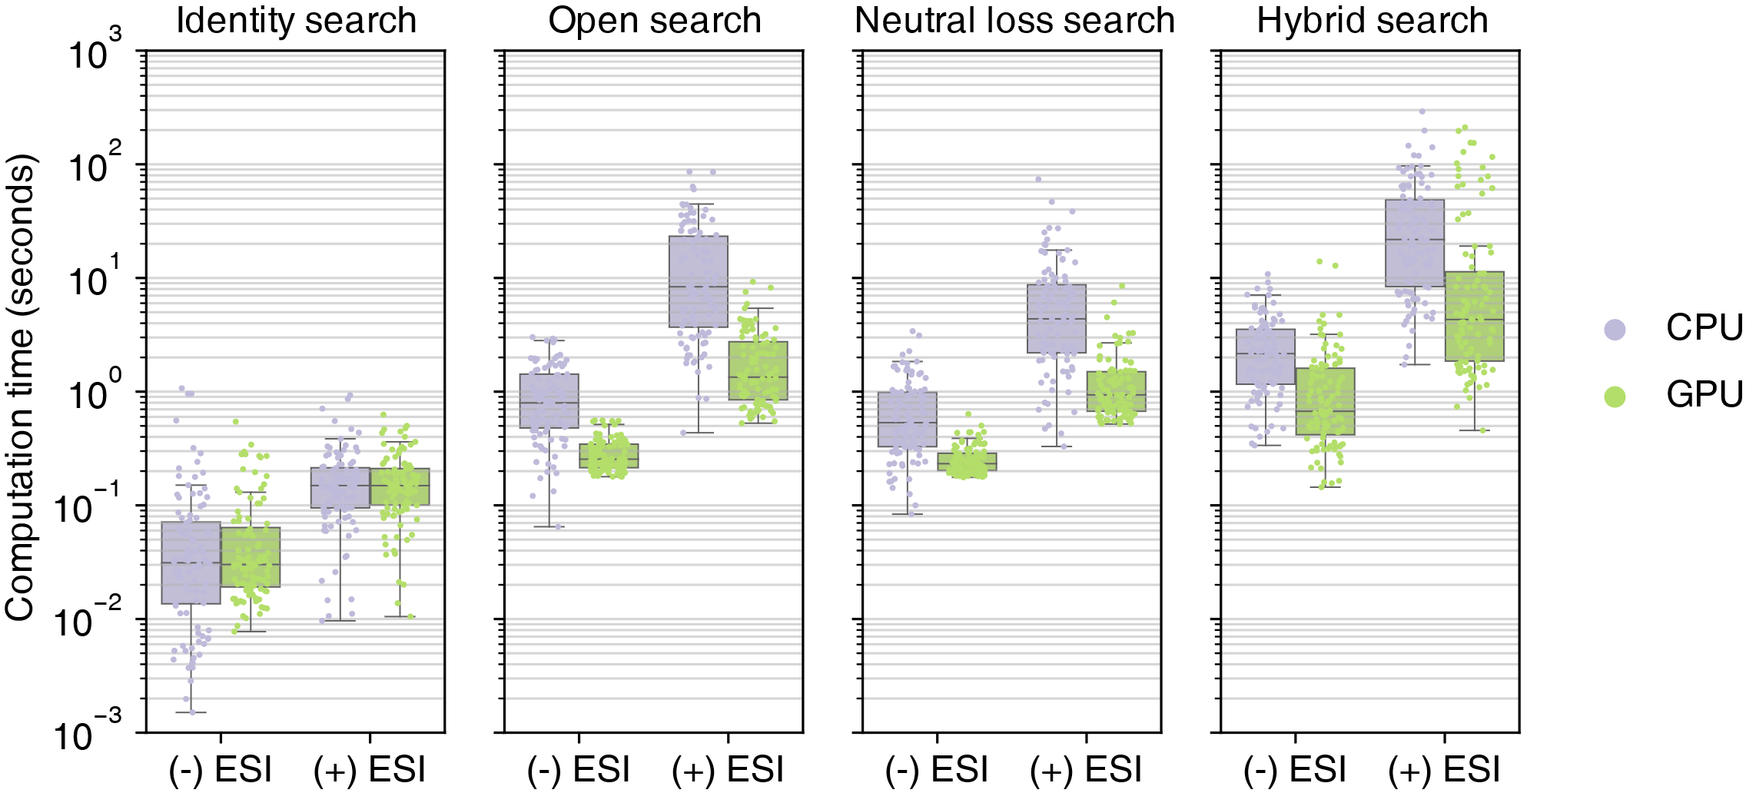
Flash Entropy Search’s performance in large-scale data
Flash Entropy Search can be boosted by GPU.
Number of library spectra: near 1 billion.
Memory: 64 GB, single CPU core / RTX 2060 GPU.

Slide 28
Tools to calculate entropy similarity?

Slide 29


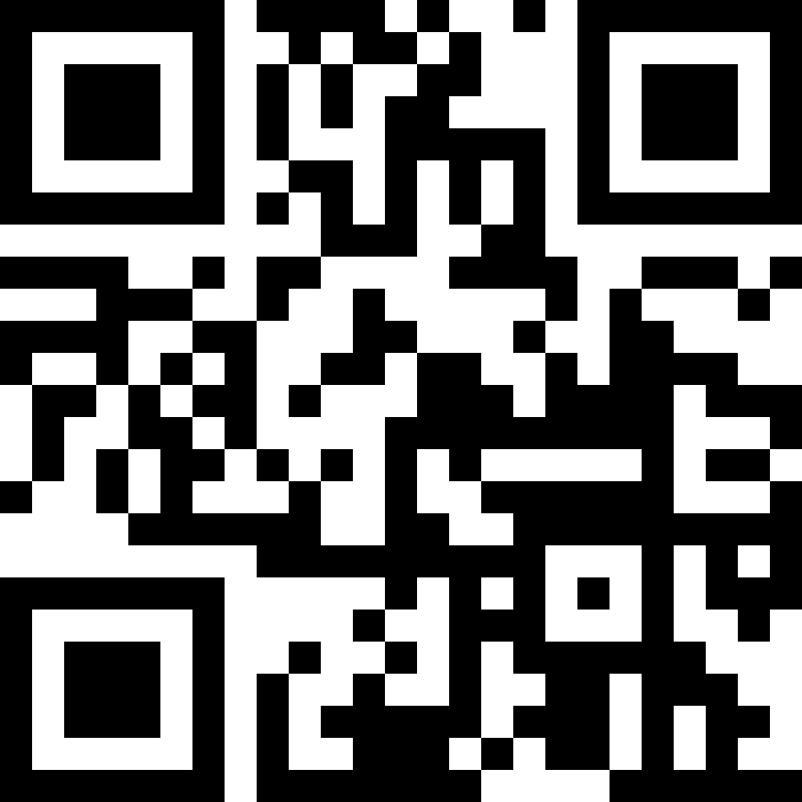
Multiple ways to calculate entropy similarity
MS Entropy
By programming:
MS Entropy (https://yuanyue.li/msentropy)
Python (PyPI): ms_entropy
Supporting Flash Entropy Search algorithm
R (CRAN): msentropy
C/C++
JavaScript
By graphical user interface (GUI):
MSViewer (https://yuanyue.li/msviewer)
Entropy Search (https://yuanyue.li/entropysearch)
MS Viewer
Entropy Search

Slide 30
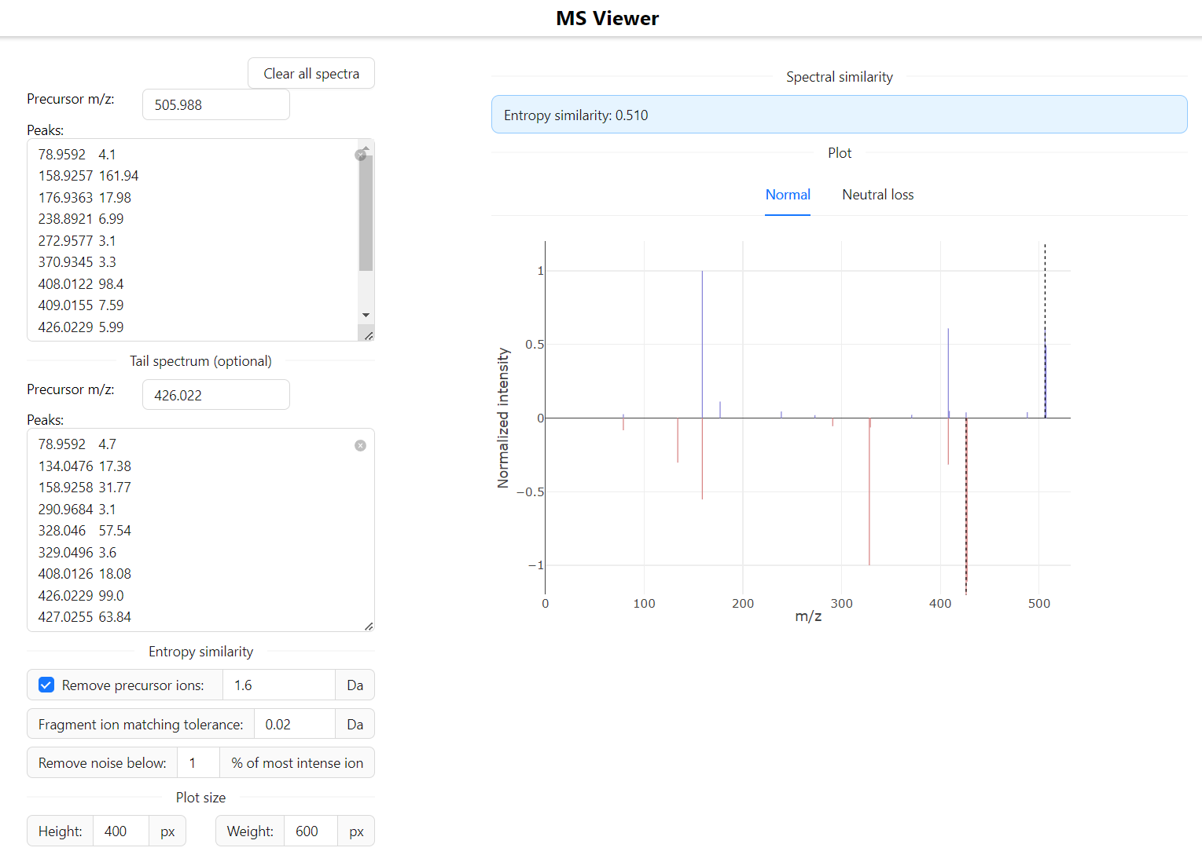
MSViewer
MS Viewer
https://yuanyue.li/msviewer
A web-based MS/MS spectrum viewer and comparison tool.
Draw head-to-tail MS/MS spectrum.
Calculate entropy similarity in real-time.

Slide 31
Entropy Search
Entropy Search
https://yuanyue.li/entropysearch
A GUI which can search one MS/MS spectral file against another spectral library / spectral file.
Using Flash Entropy Search algorithm.
Perform identity-, open-, neutral loss-, and hybrid search at the same time.
Works in Windows, Linux, and Mac OS.

Slide 32
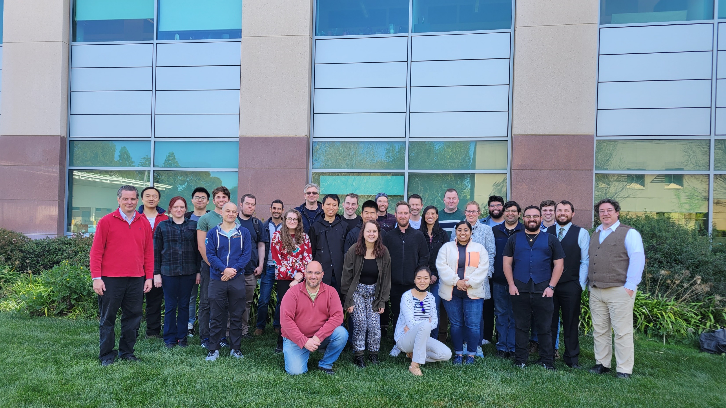
Thank you
Thanks:
Prof. Oliver Fiehn
People in the Fiehn’s lab

