Slide 1
Flash entropy search to query all mass spectral libraries in real time
Yuanyue Li
University of California, Davis
2023.10.10

Slide 2

The MS/MS spectrum
Precursor ions
Product ions
MS/MS spectrum
3
Intensity
2
Fragmentation
Detection
A
B
m/z

Slide 3
How to compare MS/MS spectra?

Slide 4
MS/MS spectrum is a probability distribution

Slide 5
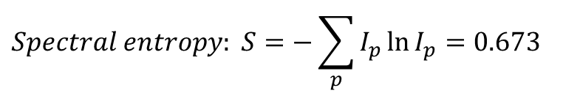
The idea of spectral entropy
Precursor ions
Product ions
MS/MS spectrum
3
Intensity
2
Fragmentation
Detection
A
B
m/z
0.6
: 60%
Probability
0.4
: 40%
A
B
m/z
$$Spectral entropy: S=−\sum_{p}{I_{p}\ln{I_{p}}}=0.673$$
Yuanyue Li, et, al. Nature Methods, 2021

Slide 6







The idea of entropy similarity
0.6
Probability
0.4
Spectral distance = Sum of entropy gain
Spectrum A
Spectral entropy $S_{A}$
A
B
m/z
Entropy gain: $S_{mix}−S_{A}$
0.5
0.5
Entropy distance=$\left(S_{mix}−S_{A}\right)+\left(S_{mix}−S_{B}\right)$
Spectrum Mix
Probability
Spectral entropy $S_{mix}$
Unweighted entropy similarity=$1−\frac{Entropy distance}{\ln{4}}$
Entropy similarity: Based on unweighted entropy similarity and adding extra weight for low abundance peak.
A
B
m/z
Entropy gain: $S_{mix}−S_{B}$
0.6
Spectrum B
Probability
0.4
Spectral entropy $S_{B}$
A
B
m/z

Slide 7
From the view of probability distribution
0.6
Spectral distance = probability distribution distance
Spectrum A
Probability distribution A
Probability
0.4
A
B
m/z
One of the widely used probability distribution distance is Jensen–Shannon divergence.
0.6
Spectrum B
Probability distribution B
0.4
If scaled into [0,1], Entropy distance is mathematically equivalent to Jensen–Shannon divergence.
Probability
A
B
m/z

Slide 8
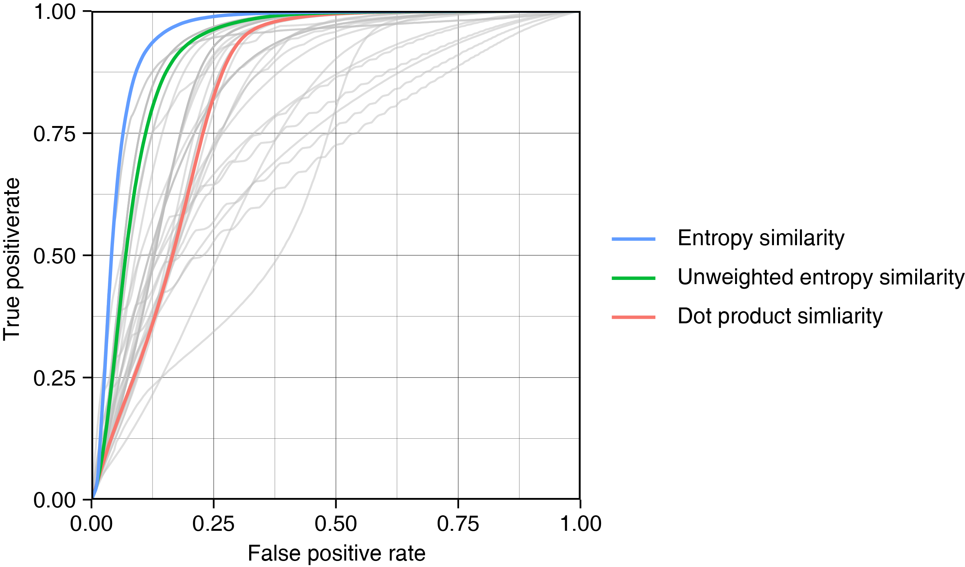
Entropy similarity outperforms dot product similarity
LC-MS

Slide 9
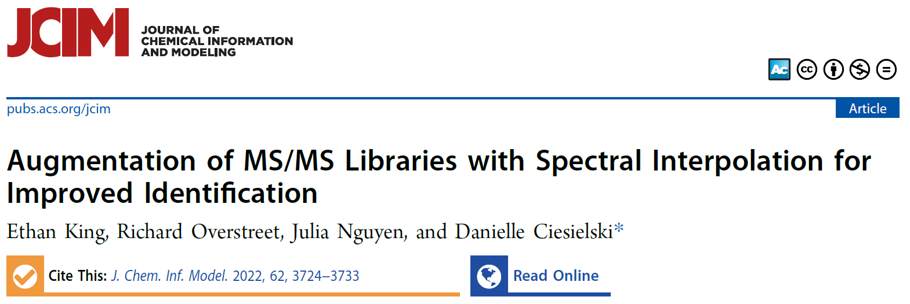
Entropy similarity has good performance in many scenarios
“
… use of the entropy similarity metric and interpolation results in a 20% increase in identification accuracy over cosine similarity …
LC-MS
”
GC-MS

Slide 10
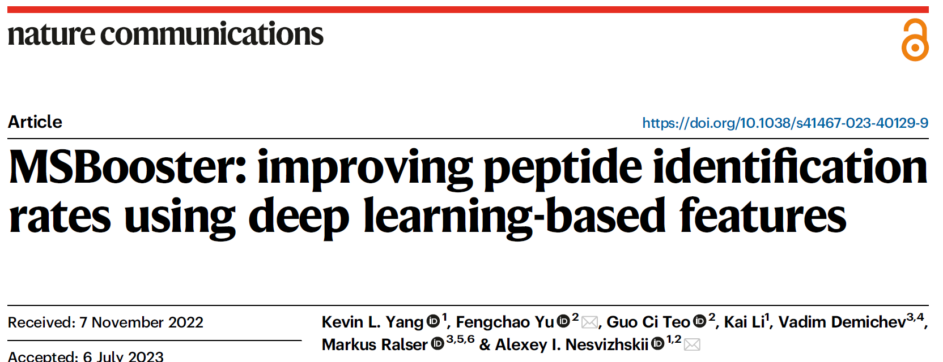
Entropy similarity has good performance in many scenarios
“
… For spectral similarity features, the greatest boosts were consistently obtained with “unweighted spectral entropy”…
LC-MS
”
GC-MS
Proteomics

Slide 11
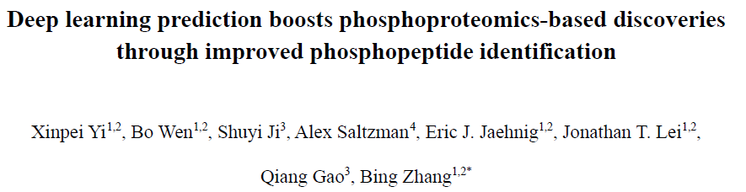
Entropy similarity has good performance in many scenarios
“
… entropy distance (Entropy), which outperformed the other five spectrum similarity computation methods including dot product (DP), square root dot product (srDP), spectral contrast angle (SA), Pearson correlation coefficient (PCC), and unweighted entropy distance (unwEntropy) in our comparative analysis .…
LC-MS
”
GC-MS
Proteomics
Phosphoproteomics

Slide 12
Types of spectra comparison

Slide 13
The identity search
Only compare spectra with the same precursor m/z.
Can only be used to identify compounds with same structure.
Identity search
Intensity
m/z
Intensity
m/z

Slide 14




The limitation of identity search
Unknown molecule
Library molecule
Identity search

Slide 15
The open search
Compare spectra with different precursor m/z.
Widely used in proteomics.
Open search
Intensity
m/z
Intensity
m/z

Slide 16
The neutral loss search
Similar to open search but compare neutral loss fragments.
Used in METLIN database.
Neutral loss search
Intensity
m/z
Intensity
m/z

Slide 17
The hybrid search
Compare both fragment ions and neutral loss fragments matches.
Also called "modified (cosine)" in GNPS network.
Used in NIST MS Search and GNPS.
Hybrid search
Intensity
m/z
Intensity
m/z

Slide 18
Types of spectra comparison
Identity search
Open search
Neutral loss search
Hybrid search
Intensity
Intensity
Intensity
Intensity
m/z
m/z
m/z
m/z
Intensity
Intensity
Intensity
Intensity
m/z
m/z
m/z
m/z
Need to compare with all spectra: large searching space

Slide 19
How to increase spectra comparison speed?

Slide 20
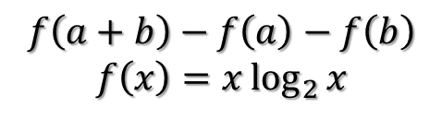
How to increase spectra comparison speed?
Simplify entropy similarity calculation formula
$$f\left(a+b\right)−f\left(a\right)−f\left(b\right)$$
$$f\left(x\right)=x\log_{2}{x}$$

Slide 21
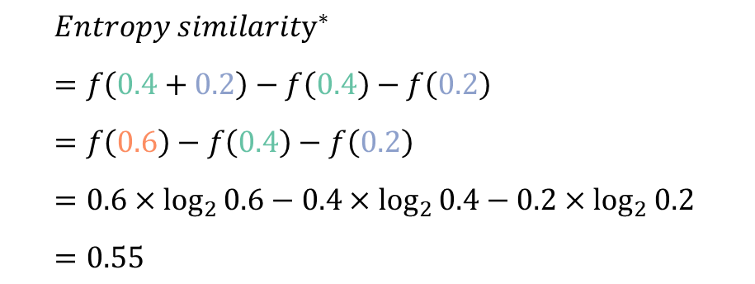

Simplify the calculation of entropy similarity
No need to merge spectra.
$${Entropy similarity}^{∗}=\sum{f\left(I_{A}+I_{B}\right)−f\left(I_{A}\right)−f\left(I_{B}\right)},with f\left(x\right)=x\log_{2}{x}$$
0.4
$${Entropy similarity}^{∗} \\ =f\left(0.4+0.2\right)−f\left(0.4\right)−f\left(0.2\right) \\ =f\left(0.6\right)−f\left(0.4\right)−f\left(0.2\right) \\ =0.6×\log_{2}{0.6}−0.4×\log_{2}{0.4}−0.2×\log_{2}{0.2} \\ =0.55$$
Intensity
0.1
m/z
0.2
0.3
$∗$The spectra need to be normalized into sum equals 0.5, and the entropy-based weight needs to be applied before calculation.

Slide 22
How to increase spectra comparison speed?
Simplify entropy similarity calculation formula
New spectra comparison algorithm
$$f\left(a+b\right)−f\left(a\right)−f\left(b\right)$$
$$f\left(x\right)=x\log_{2}{x}$$

Slide 23
Skip the comparison of non-overlapping peaks
Intensity
More than 90% spectra do not have overlapped peaks.
m/z
Intensity
Only needs to calculate entropy similarity in this situation.
m/z

Slide 24
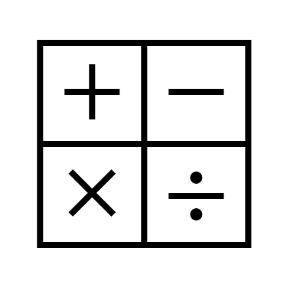
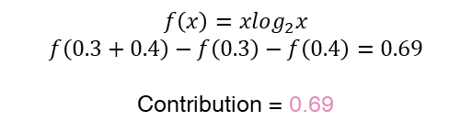
The Flash Entropy Search algorithm
Library spectra
1. Sort by ion’s m/z
ID
m/z
Intensity
……
Sorted library spectra
Index the spectral library
4
256.356
0.2
Query spectrum
5
121.251
0.3
ID
m/z
Intensity
……
m/z
Intensity
5
256.349
0.2
1
121.213
0.1
2. Search
……
6
115.373
0.1
5
121.251
0.3
121.251
0.4
6
361.967
0.3
3
121.269
0.2
……
Find matching ion pairs
6
639.032
0.1
……
7
573.773
0.4
……
3. Calculate similarity contribution
Calculate similarity contribution
$$f\left(x\right)=xlog_{2}x$$
$$f\left(0.3+0.4\right)−f\left(0.3\right)−f\left(0.4\right)=0.69$$
Contribution = 0.69
Old similarity table
Spectral ID
…
4
5
6
…
Similarity
…
0
0
0
…
Update similarity table
4. Add to similarity
New similarity table
Spectral ID
…
4
5
6
…
Similarity
…
0
0.69
0
…
Yuanyue Li & Oliver Fiehn, Nature methods, 2023

Slide 25
The Flash Entropy Search algorithm – hybrid search
Index the spectral library
by fragment ions’ m/z
Index the spectral library
by neutral loss’ mass
Find matching ion pairs
by fragment ions’ m/z
Find matching ion pairs
by neutral loss’ mass
Merge matched ions
Remove duplicates
Calculate similarity contribution
Update similarity table

Slide 26
The Flash Entropy Search algorithm
Fast
>10,000 X faster
1 million spectra:
1 millisecond
1 billion spectra:
2 seconds

Slide 27
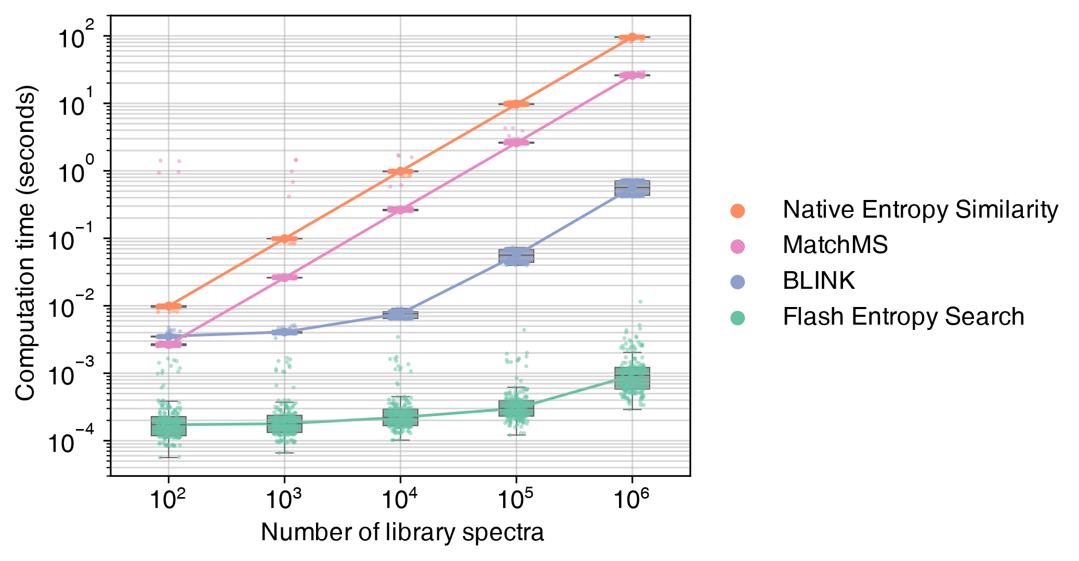
The performance of Flash Entropy Search
Open search

Slide 28
The Flash Entropy Search algorithm
Fast
Powerful
>10,000 X faster
1 million spectra:
1 millisecond
1 billion spectra:
2 seconds
Identity search
Open search
Neutral loss search
Hybrid search

Slide 29
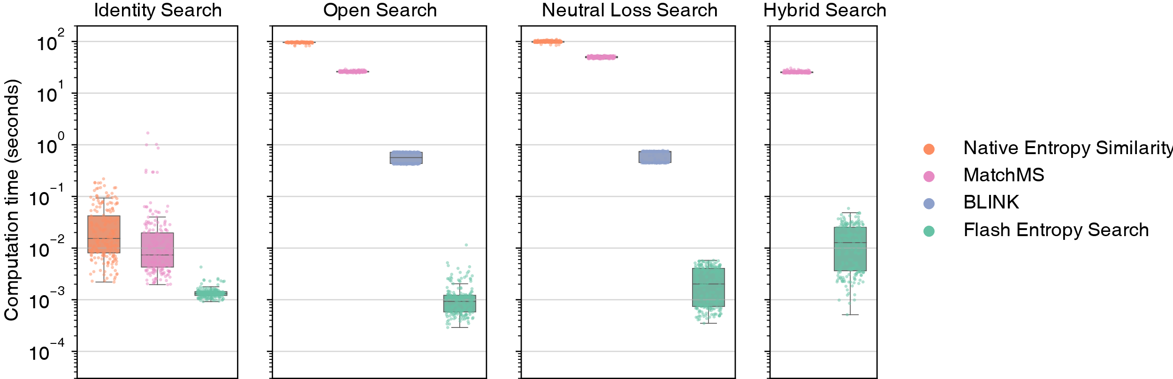
The performance of Flash Entropy Search
Number of library spectra: 1,000,000

Slide 30
The Flash Entropy Search algorithm
Fast
Powerful
Accurate
Zero error
>10,000 X faster
1 million spectra:
1 millisecond
1 billion spectra:
2 seconds
Identity search
Open search
Neutral loss search
Hybrid search

Slide 31
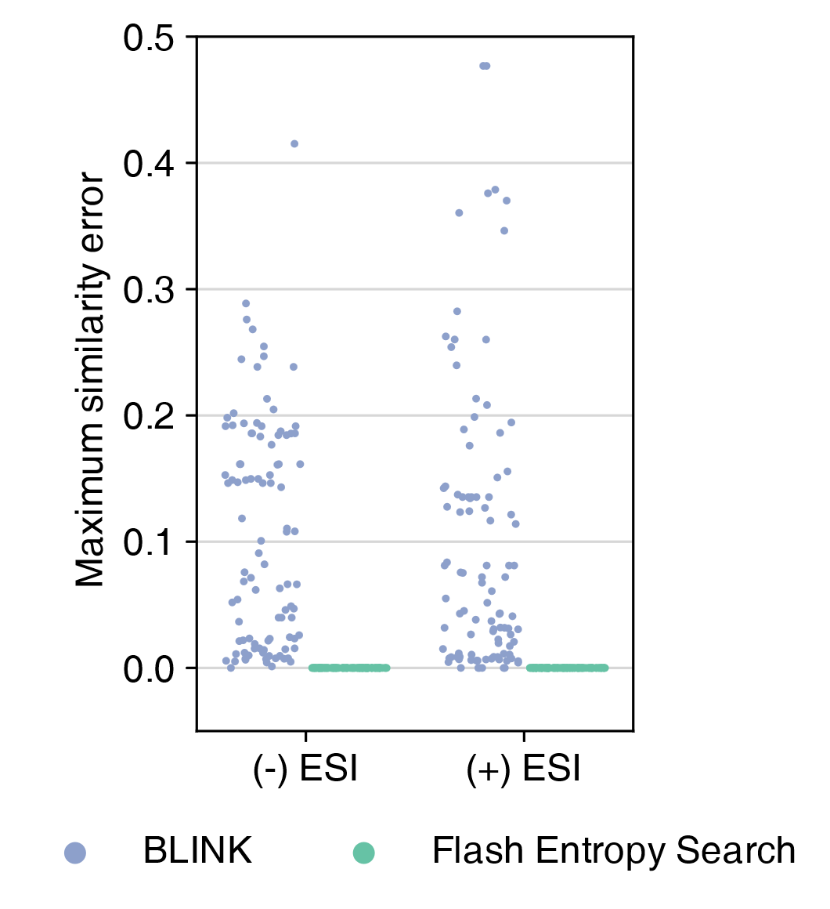
Flash Entropy Search is accurate
Open search
Number of library spectra: 1,000,000

Slide 32
The Flash Entropy Search algorithm
Fast
Powerful
Accurate
Zero error
>10,000 X faster
1 million spectra:
1 millisecond
1 billion spectra:
2 seconds
Identity search
Open search
Neutral loss search
Hybrid search
Flexible
Also works on cosine similarity

Slide 33
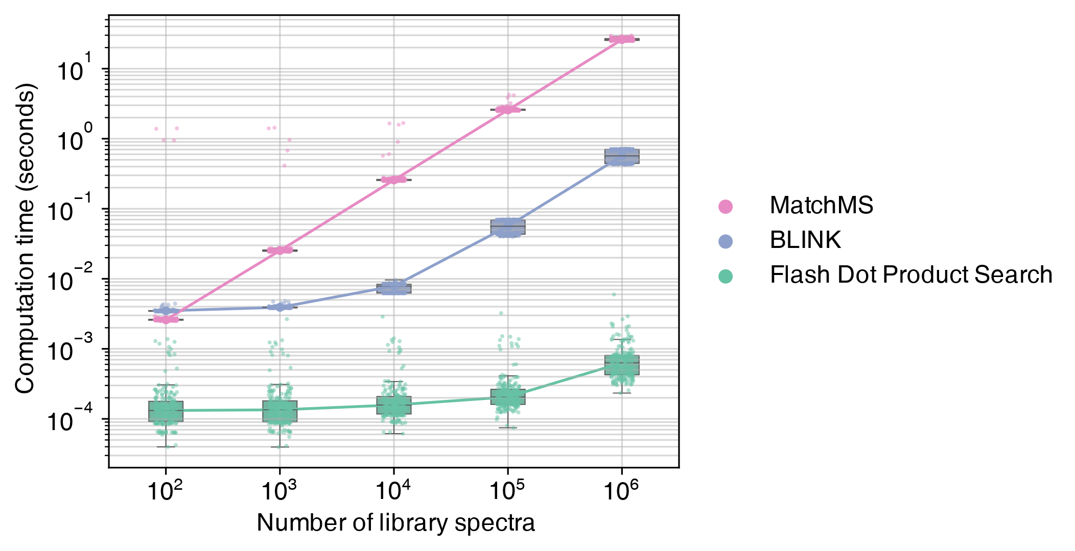
Can also be used to calculate dot product (cosine) similarity
Open search

Slide 34

The Flash Entropy Search algorithm
Fast
Powerful
Accurate
Excellent multi-threads performance
Zero error
>10,000 X faster
1 million spectra:
1 millisecond
1 billion spectra:
2 seconds
Identity search
Open search
Neutral loss search
Hybrid search
Flexible
Also works on cosine similarity

Slide 35
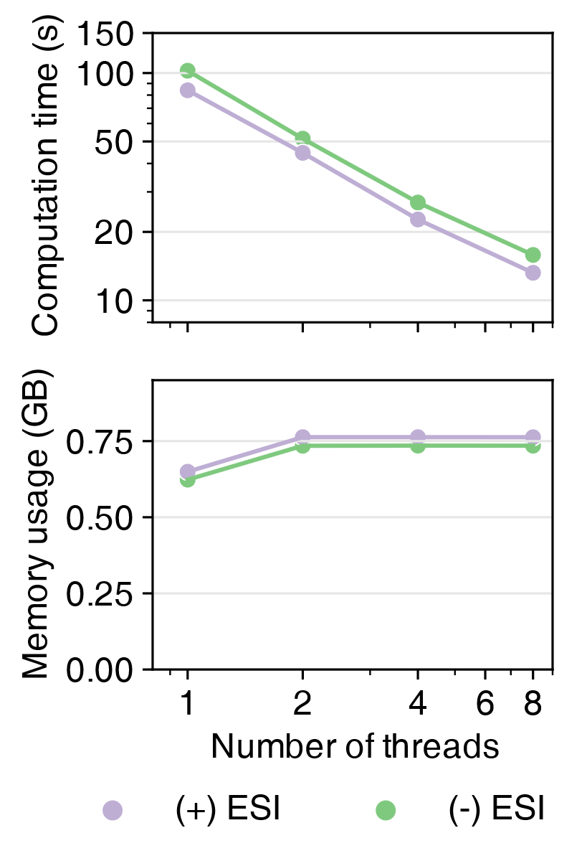
The multiple threads performance
Open search
Number of query spectra: 100,000
Number of library spectra: 1,000,000

Slide 36


The Flash Entropy Search algorithm
Fast
Powerful
Accurate
Excellent multi-threads performance
Zero error
>10,000 X faster
1 million spectra:
1 millisecond
1 billion spectra:
2 seconds
Identity search
Open search
Neutral loss search
Hybrid search
Low memory usage
Flexible
Also works on cosine similarity
Boost by GPU

Slide 37
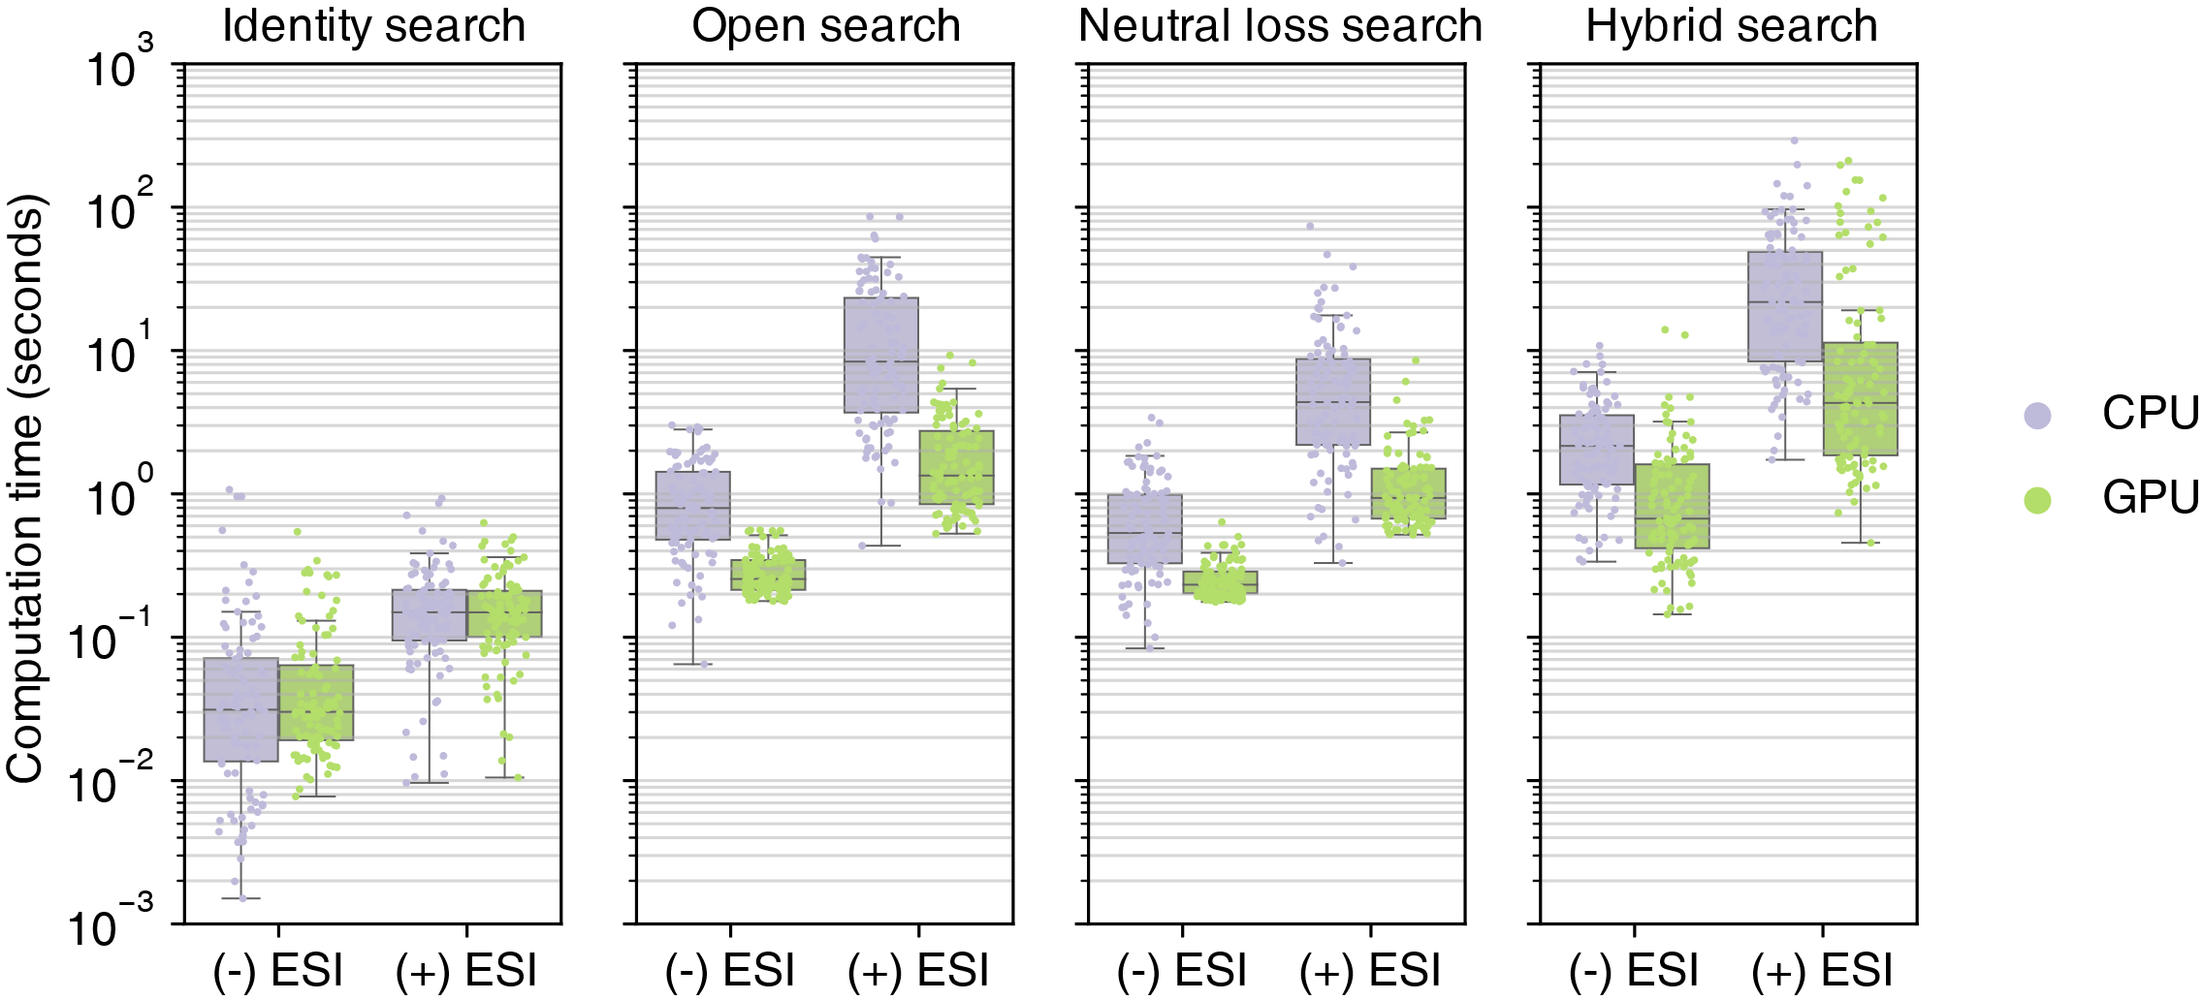
Flash Entropy Search’s performance in large-scale data
Flash Entropy Search can be boosted by GPU.
Number of library spectra: near 1 billion.
Memory: 64 GB, single CPU core / RTX 2060 GPU.

Slide 38
The Flash Entropy Search algorithm
Fast
Powerful
Accurate
Excellent multi-threads performance
Zero error
>10,000 X faster
1 million spectra:
1 millisecond
1 billion spectra:
2 seconds
Identity search
Open search
Neutral loss search
Hybrid search
Low memory usage
Flexible
Also works on cosine similarity
Boost by GPU

Slide 39
Tools to calculate entropy similarity

Slide 40

By programming
MS Entropy
https://github.com/YuanyueLi/MSEntropy
Python (PyPI): ms_entropy
Supporting Flash Entropy Search algorithm
R (CRAN): msentropy
C/C++
JavaScript
MS Entropy

Slide 41

By graphical user interface (GUI)
Entropy Search
https://github.com/YuanyueLi/EntropySearch/releases
Using Flash Entropy Search algorithm.
Perform identity-, open-, neutral loss-, and hybrid search at the same time.
Works in Windows, Linux, and Mac OS.
Entropy Search

Slide 42
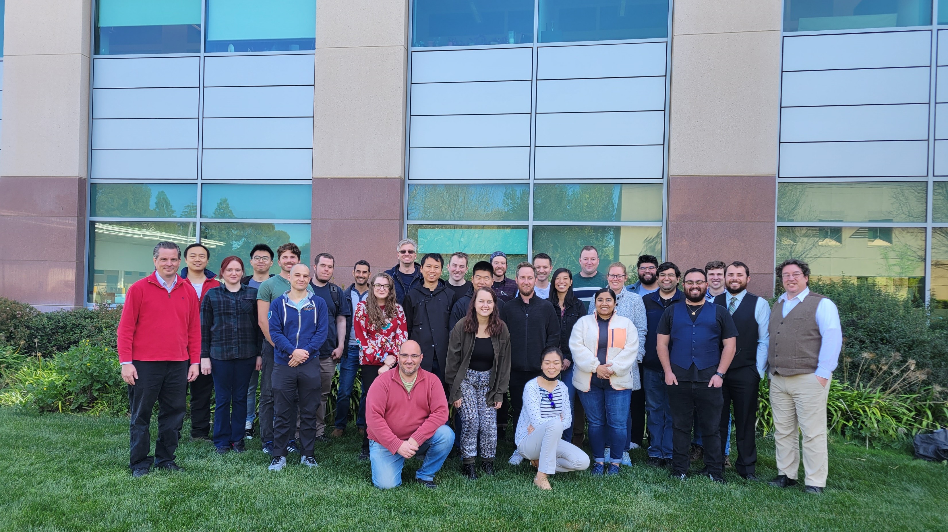
Thank you
Thanks:
Prof. Oliver Fiehn
People in the Fiehn’s lab

