Slide 1
Randomisation & python lists
Notes:
Hello Everyone, My name is Ali, and today I wanna give you a brief introduction to python programming.

Slide 2
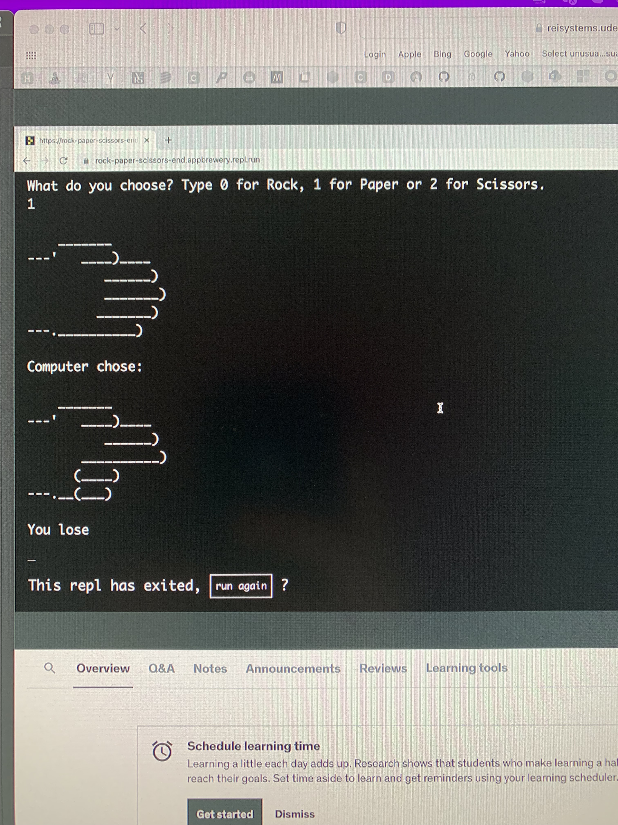
Rock paper, scissors

