Slide 1
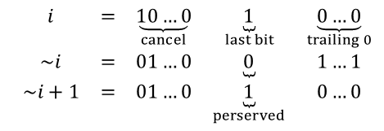

















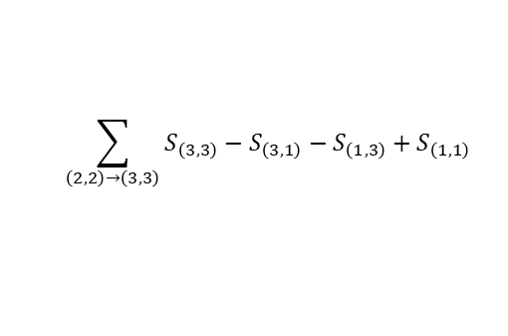
$$n$$
$$n/2$$
$$n/2$$
$$\log_{2}{n}$$
$$n/4$$
$$n/4$$
$$n/4$$
$$n/4$$
…
$$\begin{matrix}i & = & \underset{cancel}{\underbrace{10…0}} & \underset{last bit}{\underbrace{1}} & \underset{trailing 0}{\underbrace{0…0}} \\ \sim i & = & 01…0 & \underbrace{0} & 1…1 \\ \sim i+1 & = & 01…0 & \underset{perserved}{\underbrace{1}} & 0…0\end{matrix}$$
$$S_{1,3}$$
$$(1,1)$$
$$b_{x_{1},y_{1}}+c$$
$$S_{3,1}$$
$$(2,2)$$
$$(x_{1},y_{1})$$
$$(3,3)$$
$$(x_{2},y_{2})$$
$$b_{x_{2}+1,y_{1}}−c$$
$$\sum_{\left(2,2\right)→\left(3,3\right)}{S_{\left(3,3\right)}−S_{\left(3,1\right)}−S_{\left(1,3\right)}+S_{\left(1,1\right)}}$$
$$b_{x_{1},y_{2}+1 }−c$$
$$b_{x_{2}+1,y_{2}+1}+c$$

Slide 2











$$head$$
$$…$$
$$null$$
$$i−1$$
$$i$$
$$j$$
$$j+1$$
$$0$$
$$j$$
$$i−j$$
$$i−1$$

