Slide 1
Student Exam Performance Prediction System
Analyzing data to forecast academic success outcomes
ML Project Presentation · March 2026
Presented by Yubaraj Mahato
Domain: Data Science
Internship ID: UMID25122576211
Notes:
AI-generated content may be incorrect. ---

Slide 2
Project Context and Purpose
Notes:
Student Exam Performance Prediction System Overview

Slide 3

Student Exam Performance Prediction System Overview
End-to-End ML Lifecycle
The system demonstrates a complete ML lifecycle from problem definition to cloud deployment, showcasing practical engineering.
Predicting Student Scores
Predicts mathematics scores using demographic, socio-economic, and academic indicators for early risk detection.
Modular System Architecture
Features training and inference pipelines with model evaluation and serving through a Flask web app.
Educational Impact
Enables early academic risk identification allowing timely intervention and improved student outcomes.
Notes:
The Student Exam Performance Prediction System is a portfolio-grade machine learning project designed to demonstrate a complete, well-structured ML lifecycle, from problem definition to cloud deployment. The core purpose of this system is to predict a student’s mathematics score based on a combination of demographic, socio-economic, and academic performance indicators. By framing the project as an end-to-end system rather than a standalone model, it highlights practical engineering considerations such as data ingestion, preprocessing, model selection, artifact management, and real-time inference. The project is particularly relevant for educational institutions seeking early indicators of academic risk, allowing timely intervention before final assessments. From a technical perspective, the system integrates multiple components: a training pipeline that processes raw CSV data, evaluates several regression models, and persists the best-performing model, and an inference pipeline that serves predictions through a Flask-based web application. The presentation positions this project as both a learning exercise and a realistic prototype, suitable for extension into production. It emphasizes clarity, modularity, and reproducibility, which are essential qualities of a “well-mannered” and professional ML presentation. By clearly communicating the motivation, scope, and outcomes, this slide sets the tone for the rest of the presentation and helps the audience quickly understand why the project exists, what problem it solves, and how it delivers value using machine learning and software engineering best practices.

Slide 4
Problem Definition
Notes:
Business Problem in Educational Analytics

Slide 5

Business Problem in Educational Analytics
Challenges in Identifying Underperformance
Institutions face delays and inconsistencies in spotting students at risk using manual, subjective methods.
Need for Data-Driven Tools
A scalable, automated system is needed to provide early indicators of student math performance.
Machine Learning Application
Using supervised regression, math scores are predicted to enable proactive decision-making and targeted support.
Business Impact
Predictive insights help allocate resources efficiently and improve academic outcomes through timely interventions.
Notes:
Educational institutions often struggle to identify students who may underperform in key subjects such as mathematics until it is too late for effective intervention. Traditional methods rely heavily on manual analysis by teachers or administrators, which can be time-consuming, subjective, and inconsistent across departments. This creates a clear business and operational problem: the lack of scalable, data-driven tools to provide early performance signals. The Student Exam Performance Prediction System addresses this gap by using historical and contextual student data to estimate math scores before final evaluations. The problem is framed in practical terms, focusing on the need for faster insights, consistency in analysis, and the ability to support decision-making with quantitative evidence. By predicting performance, institutions can allocate resources more efficiently, design targeted support programs, and improve overall academic outcomes. From an ML standpoint, the problem is defined as a supervised regression task, where the target variable is a continuous math score. Clearly articulating this business problem ensures that the technical solution remains aligned with real-world needs. This slide demonstrates a disciplined approach to problem definition, which is essential for a well-structured and professional presentation, and helps bridge the gap between educational challenges and machine learning solutions.

Slide 6
Project Goals
Notes:
Objectives and Success Criteria

Slide 7
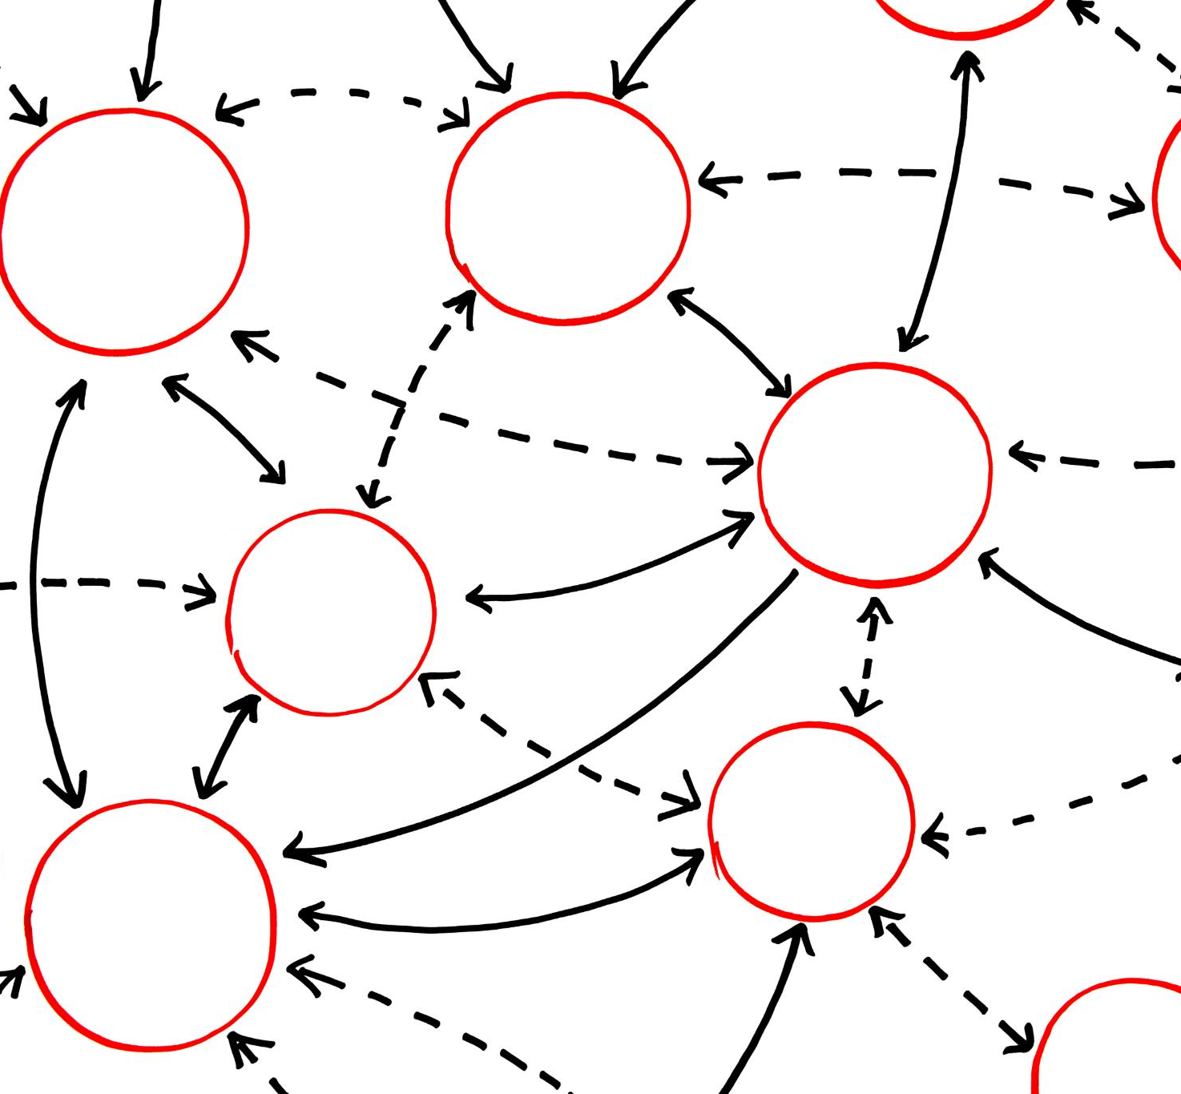
Objectives and Success Criteria
Comprehensive Project Goals
Project aims for reproducible ML pipelines predicting student scores with focus on accuracy and modularity.
Model Training and Evaluation
Train multiple regression models and select the best based on test-set R² with quality thresholds.
Engineering Best Practices
Separate training and inference logic, persist artifacts, and log executions to ensure maintainability.
User-Friendly Interface
Provide intuitive web interface exposing ML predictions to non-technical users effectively.
Notes:
The primary objective of this project is to build a reproducible and maintainable machine learning pipeline capable of predicting student math scores with reasonable accuracy. Rather than focusing solely on achieving the highest possible metric, the project defines success through multiple criteria: code modularity, clarity of workflow, and the ability to deploy and serve predictions in real time. Specific goals include training and evaluating multiple regression models, selecting the best model based on test-set R² performance, and enforcing a minimum quality threshold to avoid deploying weak models. Another key objective is to demonstrate good ML engineering practices, such as separating training and inference logic, persisting artifacts like preprocessors and models, and logging pipeline execution. Additionally, the project aims to provide a simple and intuitive web interface for users, showing how ML outputs can be exposed to non-technical stakeholders. These objectives reflect a balanced view of success that combines model performance, engineering quality, and usability. Presenting clear objectives helps the audience understand what the project is trying to achieve and provides a framework for evaluating its outcomes in later slides.

Slide 8
Data Understanding
Notes:
Dataset Source and Feature Description

Slide 9
System Workflow
Notes:
End-to-End Machine Learning Pipeline

Slide 10
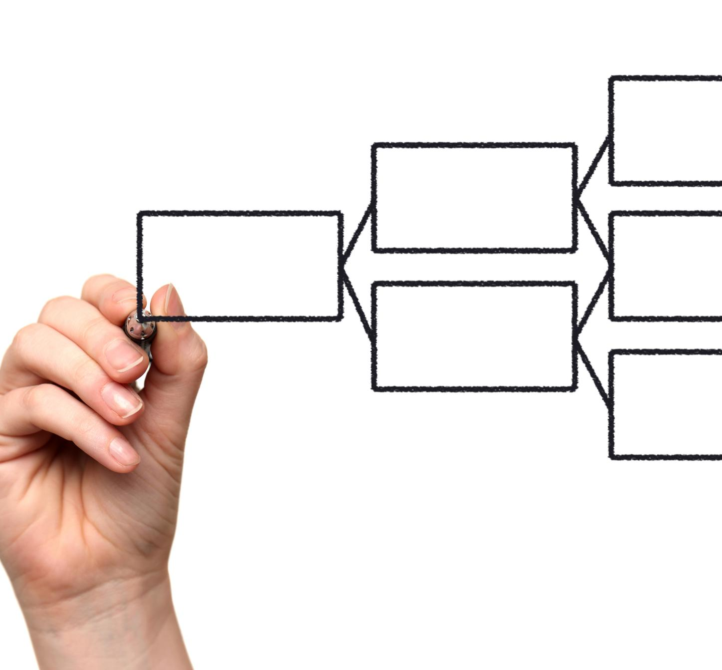
End-to-End Machine Learning Pipeline
Data Ingestion and Preparation
Raw CSV data is ingested, validated and split into training and test sets for unbiased model evaluation.
Preprocessing Pipeline
Preprocessing handles missing values, scales numerical data, and encodes categorical features efficiently.
Model Training and Selection
Multiple regression models are trained, tuned, and evaluated to select the best based on R² score.
Model Deployment and Inference
The selected model and preprocessor are saved and deployed via a Flask web app for predictions.
Notes:
The end-to-end workflow of the Student Exam Performance Prediction System is designed to be logical, modular, and easy to follow. It begins with data ingestion, where raw CSV data is read and validated, followed by a train-test split to ensure unbiased model evaluation. Next, a preprocessing pipeline is constructed to handle missing values, scale numerical features, and encode categorical variables. Multiple regression models are then trained and tuned using systematic hyperparameter search techniques. Each trained model is evaluated on the test dataset, and the best-performing model is selected based on R² score. A quality gate is applied to prevent weak models from being saved. Once selected, the model and preprocessor are persisted as artifacts. Finally, the inference workflow loads these artifacts and serves predictions through a Flask web application. This clear, step-by-step workflow demonstrates disciplined ML engineering and makes the system easier to debug, extend, and explain, which is essential for a professional presentation.

Slide 11
Data Preprocessing
Notes:
Numerical and Categorical Feature Processing

Slide 12
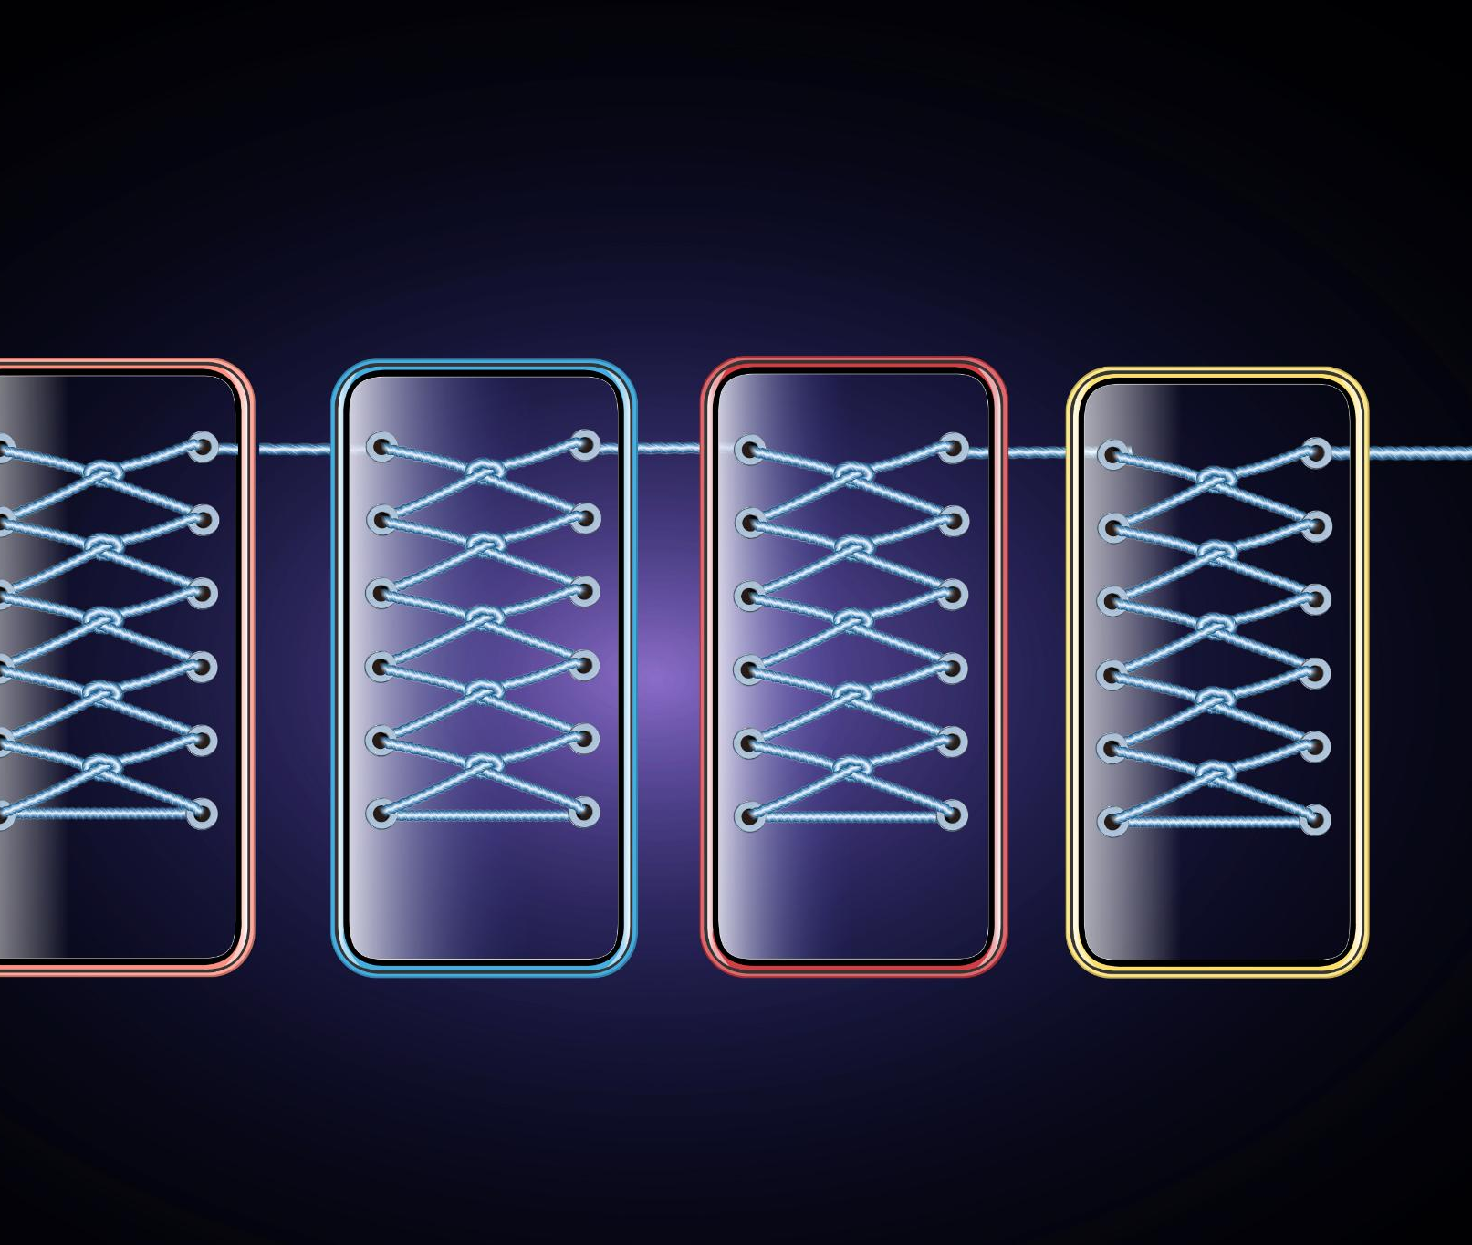
Numerical and Categorical Feature Processing
Numerical Feature Processing
Median imputation fills missing numerical data. Standard scaling normalizes ranges for better model convergence.
Categorical Feature Processing
Most-frequent imputation handles missing categories. One-hot encoding converts categories to numerical form efficiently.
Combined Pipeline Strategy
ColumnTransformer integrates separate pipelines for feature types, reducing data leakage and ensuring consistent preprocessing.
Notes:
Data preprocessing is a critical component of the system, ensuring that raw input data is transformed into a format suitable for machine learning models. Numerical features undergo median imputation to handle missing values, followed by standard scaling to normalize feature ranges and improve model convergence. Categorical features are processed using most-frequent imputation to address missing categories, then transformed using one-hot encoding to convert them into numerical representations. Scaling is applied in a sparse-safe manner to maintain efficiency. These separate pipelines are combined using a ColumnTransformer, allowing different preprocessing strategies to be applied to different feature types in a clean and maintainable way. This approach reduces data leakage risks and ensures consistent transformations during both training and inference. Presenting preprocessing in a structured manner highlights attention to detail and reinforces the importance of data quality in achieving reliable model performance.

Slide 13
Model Development
Notes:
Regression Models and Training Strategy

Slide 14
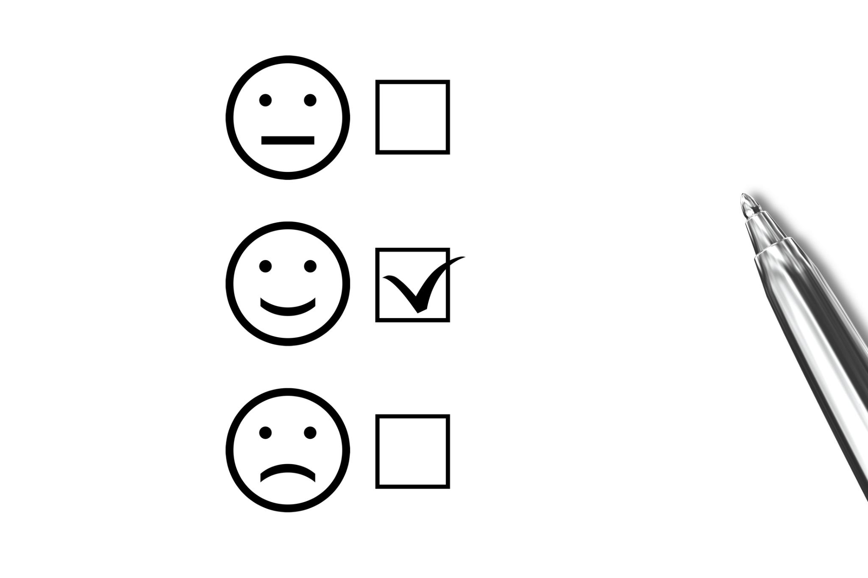
Regression Models and Training Strategy
Comparative Modeling Approach
Multiple regression algorithms are trained and evaluated under a consistent framework for objective comparison.
Diverse Regression Models
Models include Linear Regression, tree-based models, ensemble methods, and instance-based learning for varied data relationships.
Advanced Model Flexibility
Optional advanced models like XGBoost and CatBoost can be enabled via configuration to enhance accuracy.
Hyperparameter Tuning
GridSearchCV is used for systematic hyperparameter tuning to find optimal model settings.
Notes:
The project adopts a comparative modeling strategy by training multiple regression algorithms and evaluating them under a consistent framework. Candidate models include Linear Regression for baseline performance, tree-based models such as Decision Trees and Random Forests for non-linear relationships, ensemble methods like Gradient Boosting and AdaBoost for improved accuracy, and K-Nearest Neighbors for instance-based learning. Optional advanced models such as XGBoost and CatBoost can be enabled through configuration flags, demonstrating extensibility. Hyperparameter tuning is performed using GridSearchCV, ensuring systematic exploration of model configurations. This strategy reflects real-world ML practice, where multiple models are tested rather than relying on a single approach. Clearly explaining this strategy shows methodological rigor and helps the audience appreciate why the selected model can be trusted.

Slide 15
Model Evaluation
Notes:
Model Selection and Quality Gates

Slide 16

Model Selection and Quality Gates
Model Evaluation with R²
The R² metric on test data measures how well the model explains variance in math scores.
Quality Gate Enforcement
Training stops if no model meets minimum performance to prevent deploying poor models.
Model Selection and Storage
The best model is selected and saved with preprocessing pipeline to ensure inference consistency.
Transparent ML Practices
Clear documentation of evaluation and selection builds stakeholder trust through responsible ML.
Notes:
Model evaluation is conducted using the R² metric on a held-out test dataset, providing an interpretable measure of how well predictions explain variance in math scores. After evaluating all tuned models, the system selects the model with the highest test R². To maintain quality, a minimum performance threshold is enforced, and training fails if no model meets this criterion. This quality gate prevents accidental deployment of underperforming models and reflects production-minded thinking. The selected model is saved as a serialized artifact, along with the preprocessing pipeline, ensuring consistency during inference. By clearly documenting evaluation and selection logic, the presentation demonstrates transparency and responsible ML practices, which are essential for stakeholder trust.

Slide 17
Deployment
Notes:
Flask Application and Cloud Hosting

Slide 18

Flask Application and Cloud Hosting
User Interface with Flask
A Flask web app provides a simple form for users to input student features and request predictions easily.
Real-Time Prediction Endpoint
The application routes inputs to a prediction endpoint that loads models and preprocessors to generate predictions in real time.
Cloud Deployment with Gunicorn
The Flask app is deployed on a cloud platform using Gunicorn as the production server, demonstrating modern deployment practices.
End-to-End ML Integration
This deployment highlights integrating ML models into real user-facing applications beyond just model training environments.
Notes:
The deployment layer of the system uses a Flask web application to provide a simple and accessible interface for generating predictions. Users input student-related features through a form, and the application routes the request to a prediction endpoint that loads the saved model and preprocessor artifacts. Predictions are generated in real time and displayed back to the user. The application is deployed on the Render cloud platform using Gunicorn as the production server, demonstrating familiarity with modern deployment practices. This setup shows how ML models can be integrated into user-facing systems rather than remaining isolated in notebooks. Including deployment details reinforces the project’s end-to-end nature and highlights practical skills beyond model training.

Slide 19
Project Outputs
Notes:
Artifacts and Deliverables

Slide 20
Evaluation of the System
Notes:
Strengths and Current Limitations

Slide 21

Strengths and Current Limitations
System Strengths
The system features a modular codebase, clear separation of concerns, and a reproducible artifact-driven workflow.
Engineering Judgment
A quality threshold for model selection reflects practical and thoughtful engineering decision-making.
Acknowledged Limitations
Current gaps include lack of automated testing, data validation, experiment tracking, and continuous integration.
Balanced Evaluation
Presenting both strengths and limitations shows maturity and readiness for production deployment.
Notes:
The system has several notable strengths, including a modular codebase, clear separation of concerns, and a reproducible artifact-driven workflow. The use of a quality threshold for model selection reflects practical engineering judgment. However, the project also acknowledges current gaps, such as the absence of automated testing, formal data validation, experiment tracking, and continuous integration pipelines. Presenting both strengths and limitations demonstrates honesty and maturity, showing that the creator understands what is required for production readiness. This balanced evaluation is a hallmark of a well-mannered and credible technical presentation.

Slide 22
Future Enhancements
Notes:
Planned Improvements and Extensions

Slide 23

Planned Improvements and Extensions
Enhancing Robustness
Adding unit and integration tests improves system reliability and robustness for future development.
Input Validation
Implementing schema and range validation ensures data integrity and reduces input errors.
Containerization and Tracking
Using Docker for containerization and experiment tracking tools streamlines deployment and monitoring.
Production Readiness
Health-check endpoints, API versioning, and automated CI/CD pipelines align the system with production standards.
Notes:
Future improvements for the system focus on increasing robustness, maintainability, and scalability. Planned enhancements include adding unit and integration tests, implementing schema and range validation for input data, introducing experiment tracking tools, and containerizing the application using Docker. Additional improvements such as health-check endpoints, API versioning, and automated CI/CD pipelines would further align the system with production standards. Discussing these next steps shows forward thinking and signals readiness to evolve the project beyond its current state, which is valuable in both academic and professional contexts.

Slide 24
Overall Impact
Notes:
Practical and Educational Value

Slide 25

Practical and Educational Value
Integration of Theory and Practice
Combining theoretical machine learning with practical engineering creates effective real-world solutions.
Reinforcing Best Practices
The project emphasizes reproducibility, evaluation discipline, and deployment awareness for learners.
Showcasing Complete Systems
Demonstrates the ability to deliver a fully functional and usable machine learning system to stakeholders.
Broader Impact and Significance
Highlights the project's wider significance beyond technical components to engage the audience.
Notes:
This project demonstrates strong practical and educational value by combining theoretical ML concepts with real-world engineering implementation. It serves as a concrete example of how data science, machine learning, and software development intersect to solve applied problems. For learners, it reinforces best practices such as reproducibility, evaluation discipline, and deployment awareness. For institutions or reviewers, it showcases the ability to deliver a complete, usable system. Emphasizing impact helps the audience appreciate the broader significance of the work beyond individual technical components.

Slide 26
Conclusion
Notes:
Summary and Key Takeaways

Slide 27
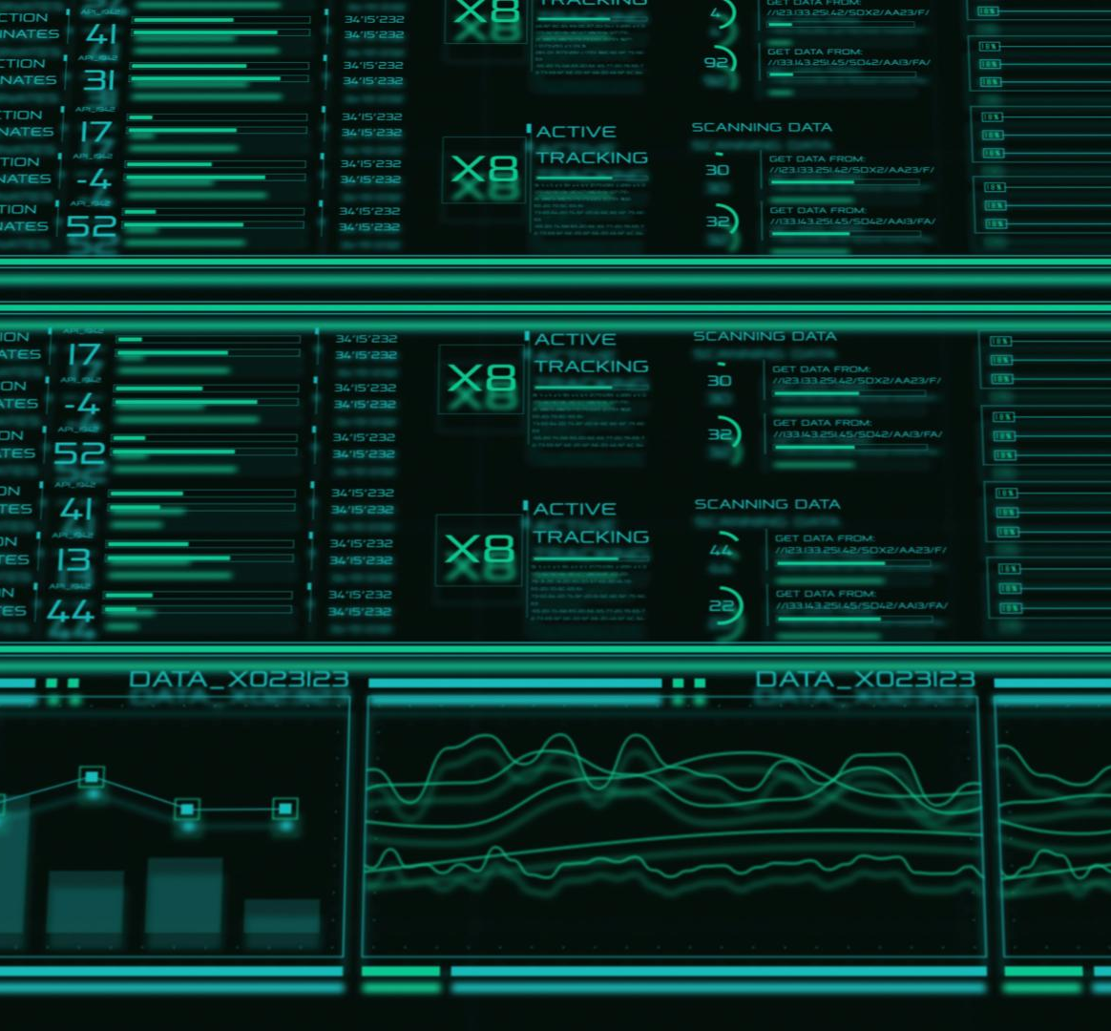
Summary and Key Takeaways
Comprehensive ML Project
The project addresses a real-world problem with structured data preprocessing and modeling techniques.
Deployment and Usability
Predictions are delivered via a deployed web application focusing on usability and engineering quality.
Project Maturity
Acknowledges limitations and future improvements showing readiness for further development.
Academic and Professional Value
The presentation effectively summarizes the full ML lifecycle for academic, interview, or portfolio purposes.
Notes:
In conclusion, the Student Exam Performance Prediction System represents a well-mannered and professionally structured machine learning project. It clearly defines a real-world problem, applies appropriate data preprocessing and modeling techniques, and delivers predictions through a deployed web application. The project emphasizes not only model performance but also engineering quality, reproducibility, and usability. By acknowledging limitations and outlining future improvements, it demonstrates maturity and readiness for further development. Overall, this presentation highlights the full ML lifecycle in a clear, organized, and impactful way, making it suitable for academic evaluation, interviews, or portfolio presentation.

Slide 28
Project Link & Render Deployment
Working Project Link: https://ml-project-g7m8.onrender.com/
Deployment Details:
- Hosted on Render
- Gunicorn used as production server
- Flask app serves /predictdata route for inference

Slide 29
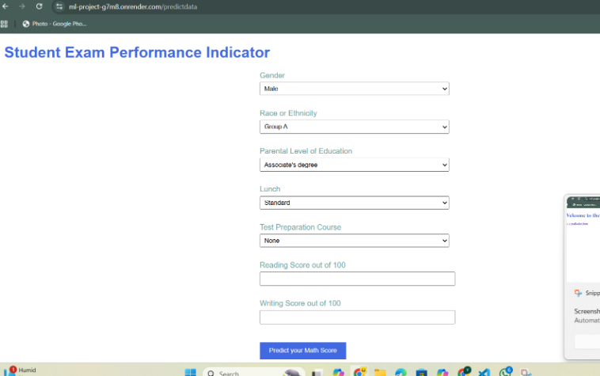

Project Interface Screenshots

