Slide 1
ANDB前期预研

Slide 2
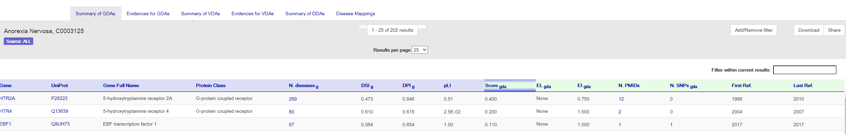
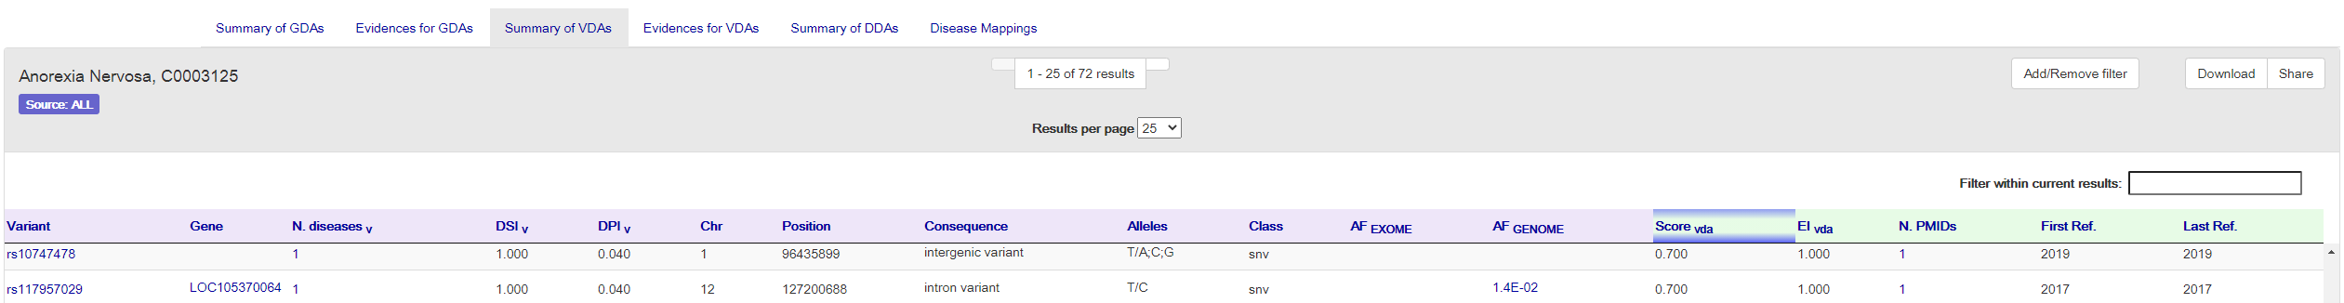
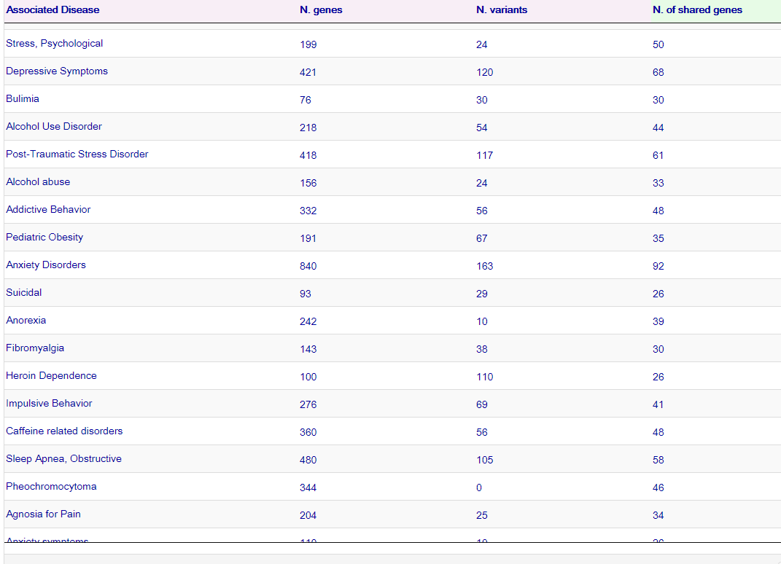
Anorexia Nervosa
GDA、VDA、DDA
 | 关联基因个数 | 关联突变个数
Anorexia | 242 | 10
Anorexia Nervosa | 202 | 72
Anorexia and bulimia syndrome | 7 | 1
Bulimia | 76 | 30
Bulimia Nervosa | 71 | 24
Binge Drinking | 3 | 0
Binge eating disorder | 4 | 0

Slide 3
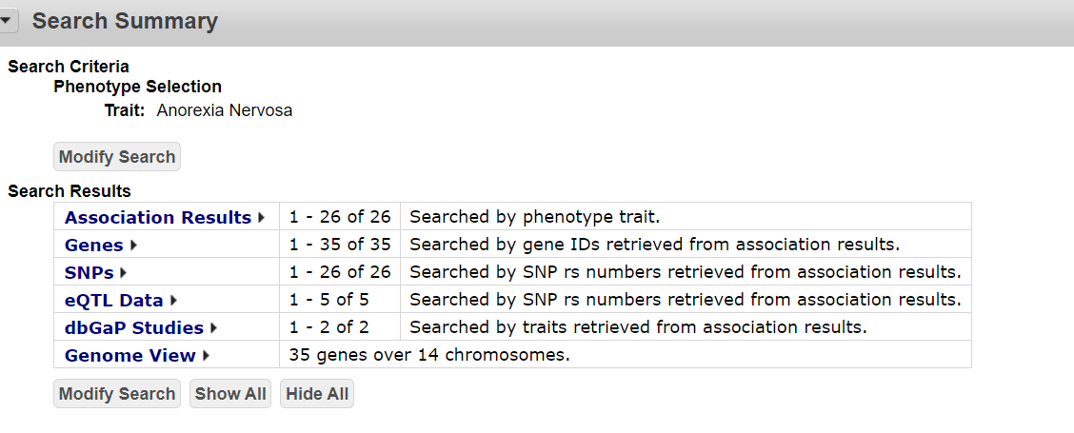
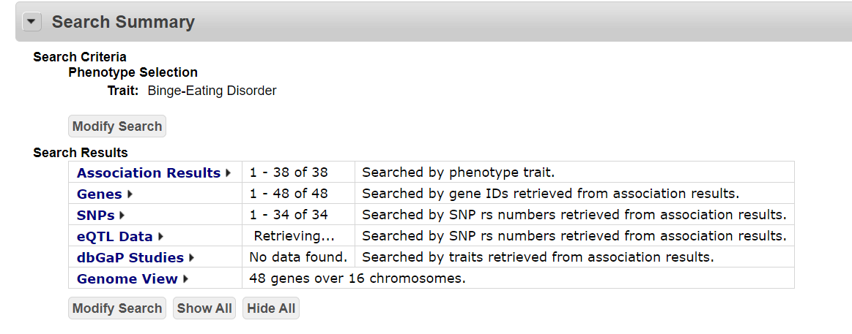
PheGenI

