Slide 1
UNIX
System Programming

Slide 2
Professor: Steve Haga
Office: F9037
Office Hours: Monday 12:30-2:30
Friday 10:00-12:00
Email: stevewhaga@cse.nsysu.edu.tw
(Please write the subject heading in English.)
TA: Sophie Office hour: Tuesday 1:00-3:00
Email:M033040025@student.nsysu.edu.tw
TA: Blake Office hour: Wednesday 1:00-3:00
Email:gymprotector1@gmail.com

Slide 3
Course Requirements
Midterm
Final
Class Attendance Participation and Quizzes
Programming Assignments

Slide 4
Course Outline
Basic UNIX Commands
  cd, ls, mkdir, rmdir, cp, mv, cat, more, echo, diff, history
Redirection and Pipes
UNIX Prompt Patterns
  *, ?, [ ], ', ", and Environment Variables
Regular Expression Patterns (grep)
Extended Regular Expression Patterns (egrep)
C Shell Programming
The tr Command
The sed Command
The awk Command
Makefiles
The lex and yacc Commands
Bash Shell Programming

Slide 5
There are many reasons to learn UNIX/Linux
Quicker to perform tasks than in Windows
  But harder to learn
Fewer viruses
  Mostly because less popular
More research software
  But less consumer software
Used a lot in
  Servers, laboratories, embedded systems, low budget systems (its free)

Slide 6
The Unix Philosophy
Provide many tools that each do one thing well
Use these tools together to form more powerful Unix commands
Let these tools communicate through files
In Unix, everything is treated as a file that can be read from and written to
In reality, files are treated as a stream of bytes

Slide 7
Using the Command Line
GUIs (Graphical User Interfaces) are available and often used on Linux systems
But you must know the command line utilities, pipes, and I/O redirection in order to create UNIX script programs
Once you learn the UNIX command line, you often prefer it to the GUI, because it is so flexible and powerful

Slide 8
Introducing Unix Commands
Issue commands from a command prompt
Commands have
  A name
  Optional flags
  Arguments
Commands are typed in lowercase:
cat (concatenate) is different than Cat or CAT
cat filename displays the file

Slide 9
Introducing Unix Commands
Issue commands from a command prompt
Commands have
  A name
  Optional flags
  Arguments
Commands are typed in lowercase:
cat (concatenate) is different than Cat or CAT
cat filename <-- displays the file

Slide 10
Introducing Unix Commands
Issue commands from a command prompt
Commands have
  A name
  Optional flags
  Arguments
Commands are typed in lowercase:
cat (concatenate) is different than Cat or CAT
cat filename <-- displays the file

Slide 11
Viewing Files
cat <filename> - display a file on screen
cat –n <filename> - display with line numbers
more <filename> - to see a screenful at a time
less <filename> - a better version of more
(Because, in life, less is often better than more.)
head <filename> - display the first 10 lines of a file.
head –n <filename> - displays the first n lines.
tail <filename> - display the last 10 lines of a file.
tail –n <filename> - displays the last n lines.

Slide 12
File Names
CaSe sEnSiTiVe
It is unwise to make file names that use:
  spaces ( )
  commas (,)
  question marks (?)
  stars (*)
  dollars ($)
  forward slashes (/)
  backwards slashes (\)

Slide 13
A Simple Unix
Directory Structure
/
usr
etc
home
bin
var
...
local
bin
...
bill
steve
alice
...
subdir1
subdir2
...
Notes:
Hierarchy - parent/child relationship
Pwd
Cd allows us to move within this hierarchy

Slide 14
Special Directories
The Root Directory
/
The Home Directory (These are all equivalent) :
  /home/steve
  ~steve
  ~
A user generally has permission to access files within the home directory and its children.
Users start with their home directory as their current directory when they login.

Slide 15
Absolute & Relative Paths
Absolute:
every file has 1 -- and only 1 -- absolute path
starts with a “/” as the first character
  “/” is the root
  Comparable addressing exists in Windows
can use “~” to start the path at the user level
Relative:
describe path from current working directory
  Single dot (.) is the current directory
  Double dot (..) is the parent directory
  Comparable addressing exists in Windows

Slide 16
Navigating Unix
To move from a child to a parent directory:
cd ..
PARENT
CHILD

Slide 17
Navigating Unix
To move from a grandchild to a parent directory:
cd ../..
PARENT
CHILD
GRANDCHILD

Slide 18
Navigating Unix
To move from one child to a sibling directory:
cd ../child2
PARENT
CHILD1
CHILD2

Slide 19
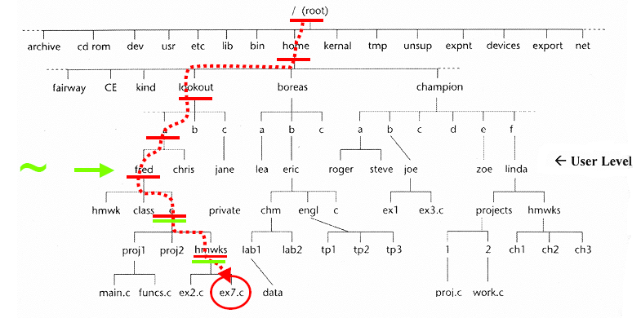
Absolute addressing
Absolute address of file ex7.c: /home/lookout/a/fred/c/hmwrks/ex7.c
With the ~ shortcut: ~/c/hmwrks/ex7.c

Slide 20
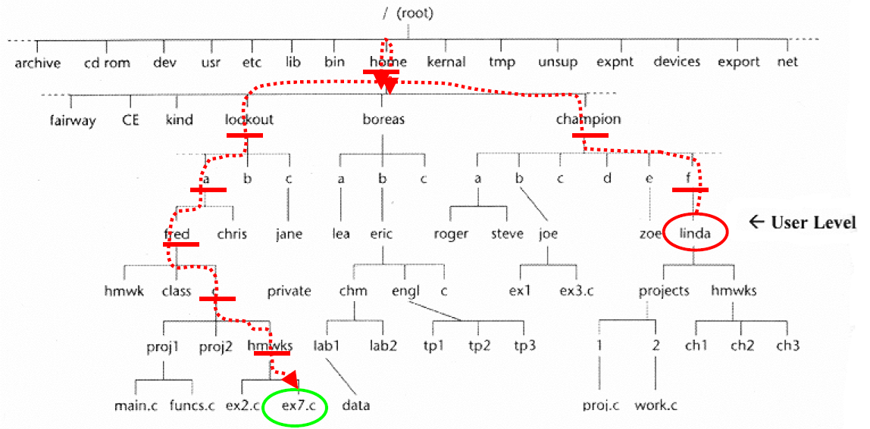
Relative addressing
Relative address, if your working directory is “linda”:
../../../../home/lookout/a/fred/c/hmwrks/ex7.c
or better would be: ../../../lookout/a/fred/c/hmwrks/ex7.c

Slide 21
Changing Directories
cd(Change Directory) is used to change directories
Paths can be relative or absolute
  % cd /home/steve/subdir1 ← an absolute path
  % cd ← equivalent to “cd ~”
  % cd - ← change back to previous
  % cd ~/subdir1 ← a path relative to your home
  % cd ../subdir2 ← a relative path
(.. Is the parent directory.)
pwd (Present Working Directory) shows the current directory
  % pwd
  /home/steve/subdir2
Notes:
Example of relative and absolute paths
Pwd
Cd
.
..

Slide 22
Other Basic Commands
ls (-alrt) | Lists all files in a directory
cp (-p) | Copies files
mv | Moves files
rm (-iIf) | Deletes files
mkdir | Makes a directory
rmdir rm -r | Removes a directory (must be empty) Removes directory and everything below it

Slide 23
Other Basic Commands
ls (-alrt) | Lists all files in a directory
cp (-p) | Copies files
mv | Moves files
rm (-iIf) | Deletes files
mkdir | Makes a directory
rmdir rm -r | Removes a directory (must be empty) Removes directory and everything below it

Slide 24
The List Command
The list command (ls) shows the contents of a directory
We can add flags to the list command to modify what the command can does
To use more than one flag, concatenate them:
ls -lt

Slide 25
List Command Flags
ls –l shows files in long format, including permissions
ls –a shows hidden files
ls –c shows file listings in a column format
ls –t sorts file listings by last modified date
ls –r reverses the listing order
I often use “ls –lrt”
  It puts the most recently modified files at the bottom, where they are easy to see

Slide 26
Other Basic Commands
ls (-alrt) | Lists all files in a directory
cp (-p) | Copies files
mv | Moves files
rm (-iIf) | Deletes files
mkdir | Makes a directory
rmdir rm -r | Removes a directory (must be empty) Removes directory and everything below it
This flag preserves the original file’s date

Slide 27
The Unix Copy Command
cp can be used to make a copy of a file, leaving the original file untouched
Syntax:
cp [path/]oldfile [path/]newfile

Slide 28
The Unix Copy Command
To make a copy of a file while both the original and copy are in the same directory:
cp index.html home.html

Slide 29
The Unix Copy Command
To make a copy of a file that results in the copy retaining the original’s name, but being placed in a different directory:
cp index.html ../academic/

Slide 30
The Unix Copy Command
To make a copy of a file that results in the copy having a new name and being placed in a different directory:
cp index.html ../academic/home.html

Slide 31
The Unix Copy Command
To copy multiple files at once, the final argument must be a directory (otherwise it would not make sense):
cp f1 f2 otherfile ../academic/

Slide 32
Specifying filenames with Wildcards
Wildcards are special symbols that can substitute for multiple things
The term comes from poker terminology
  eg, “aces are wild” means that an ace can be substituted for any card you want – it is a wildcard.

Slide 33
The * and ? Wildcards
ls a* All files starting with 'a'
ls *a* All filenames with 'a' in them
ls *a*html All filenames with 'a' in them and ending with html
ls ????? - All 5 character filenames

Slide 34
The […] and [^…] Wildcards
ls [abc]* - All filenames starting with a, b, or c
ls [a-c]* - Same as above but done as a range
ls [^a-c]* - All filenames not starting with a, b, or c

Slide 35
Understanding Wildcards
Suppose we type:
ls f*
and get:
file1 file2 funfile
This tells us that three files in our current directory begin with an “f”
Now, suppose we type:
cp f* f*
then we get:
cp: target `funfile’ is not a directory
We want to understand what just happened. The UNIX operating system has replaced each f* with what it really is

Slide 36
Understanding Wildcards
Suppose we type:
ls f*
and get:
file1 file2 funfile
This tells us that three files in our current directory begin with an “f”
Now, suppose we type:
cp f* f*
then we get:
cp: target `funfile’ is not a directory
We want to understand what just happened. The UNIX operating system has replaced each f* with what it really is

Slide 37
Understanding Wildcards
Suppose we type:
ls f*
and get:
file1 file2 funfile
This tells us that three files in our current directory begin with an “f”
Now, suppose we type:
cp f* f*
then we get:
cp: target `funfile’ is not a directory
We want to understand what just happened. The UNIX operating system has replaced each f* with what it really is

Slide 38
Understanding Wildcards
Suppose we type:
ls f*
and get:
file1 file2 funfile
This tells us that three files in our current directory begin with an “f”
Now, suppose we type:
cp f* f*
then we get:
cp: target `funfile’ is not a directory
We want to understand what just happened. The UNIX operating system has replaced each f* with what it really is

Slide 39
Understanding Wildcards
Suppose we type:
ls f*
and get:
file1 file2 funfile
This tells us that three files in our current directory begin with an “f”
Now, suppose we type:
cp f* f*
then we get:
cp: target `funfile’ is not a directory
We want to understand what just happened.
The UNIX operating system has replaced each f*
with what it really is

Slide 40
Understanding Wildcards
Suppose we type:
ls f*
and get:
file1 file2 funfile
This tells us that three files in our current directory begin with an “f”
Now, suppose we type:
cp f* f*
then we get:
cp: target `funfile’ is not a directory
We want to understand what just happened.
The UNIX operating system has replaced each f*
with what it really is
file1 file2 funfile
f*
f*

Slide 41
Understanding Wildcards
Suppose we type:
ls f*
and get:
file1 file2 funfile
This tells us that three files in our current directory begin with an “f”
Now, suppose we type:
cp f* f*
then we get:
cp: target `funfile’ is not a directory
We want to understand what just happened.
The UNIX operating system has replaced each f*
with what it really is
file1 file2 funfile
file1 file2 funfile
f*
f*

Slide 42
Understanding Wildcards
Suppose we type:
ls a*
and get:
aa ab adirectory
This tells us that three “things” in our current directory begin with an “a”. The third among them is not a file.
Now, suppose we type:
cp a* a*f*
then we get:
cp: omitting directory `a3’
cp: warning: source file `a1’ specified more than once
cp: warning: source file `a2’ specified more than once
Why?

Slide 43
Understanding Wildcards
Suppose we type:
ls a*
and get:
aa ab adirectory
This tells us that 3 “things” in our current directory begin with “a”. The third among them is probably not a file.
Now, suppose we type:
cp a* a*f*
then we get:
cp: omitting directory `a3’
cp: warning: source file `a1’ specified more than once
cp: warning: source file `a2’ specified more than once
Why?

Slide 44
Understanding Wildcards
Suppose we type:
ls a*
and get:
aa ab adirectory
This tells us that 3 “things” in our current directory begin with “a”. The third among them is probably not a file.
Now, suppose we type:
cp a* a*
then we get:
cp: omitting directory `adirectory’
cp: warning: source file `aa’ specified more than once
cp: warning: source file `ab’ specified more than once
Why?

Slide 45
Understanding Wildcards
Suppose we type:
ls a*
and get:
aa ab adirectory
This tells us that 3 “things” in our current directory begin with “a”. The third among them is probably not a file.
Now, suppose we type:
cp a* a*
then we get:
cp: omitting directory `adirectory’
cp: warning: source file `aa’ specified more than once
cp: warning: source file `ab’ specified more than once
Why?

Slide 46
Understanding Wildcards
Suppose we type:
ls a*
and get:
aa ab adirectory
This tells us that 3 “things” in our current directory begin with “a”. The third among them is probably not a file.
Now, suppose we type:
cp a* a*
then we get:
cp: omitting directory `adirectory’
cp: warning: source file `aa’ specified more than once
cp: warning: source file `ab’ specified more than once
Why?

Slide 47
Understanding Wildcards
Suppose we type:
ls a*
and get:
aa ab adirectory
This tells us that 3 “things” in our current directory begin with “a”. The third among them is probably not a file.
Now, suppose we type:
cp aa ab adirectory aa ab adirectory
then we get:
cp: omitting directory `adirectory’
cp: warning: source file `aa’ specified more than once
cp: warning: source file `ab’ specified more than once
Why?

Slide 48
Understanding Wildcards
Suppose we type:
ls a*
and get:
aa ab adirectory
This tells us that 3 “things” in our current directory begin with “a”. The third among them is probably not a file.
Now, suppose we type:
cp aa ab adirectory aa ab adirectory
then we get:
cp: omitting directory `adirectory’
cp: warning: source file `aa’ specified more than once
cp: warning: source file `ab’ specified more than once
Why?

Slide 49
Understanding Wildcards
Suppose we type:
ls a*
and get:
aa ab adirectory
This tells us that 3 “things” in our current directory begin with “a”. The third among them is probably not a file.
Now, suppose we type:
cp aa ab adirectory aa ab adirectory
then we get:
cp: omitting directory `adirectory’
cp: warning: source file `aa’ specified more than once
cp: warning: source file `ab’ specified more than once
Why?

Slide 50

Understanding Wildcards
Suppose we type:
ls a*
and get:
aa ab adirectory
This tells us that 3 “things” in our current directory begin with “a”. The third among them is probably not a file.
Now, suppose we type:
cp aa ab adirectory aa ab adirectory
then we get:
cp: omitting directory `adirectory’
cp: warning: source file `aa’ specified more than once
cp: warning: source file `ab’ specified more than once
Why?
Because it does not make sense to copy a directory (cp only works on files). So cp will ignore this.

Slide 51

Understanding Wildcards
Suppose we type:
ls a*
and get:
aa ab adirectory
This tells us that 3 “things” in our current directory begin with “a”. The third among them is probably not a file.
Now, suppose we type:
cp aa ab adirectory aa ab adirectory
then we get:
cp: omitting directory `adirectory’
cp: warning: source file `aa’ specified more than once
cp: warning: source file `ab’ specified more than once
Why?
Because it does not make sense to copy a directory (cp only works on files). So cp will ignore this.
adirectory

Slide 52
Understanding Wildcards
Suppose we type:
ls a*
and get:
aa ab adirectory
This tells us that 3 “things” in our current directory begin with “a”. The third among them is probably not a file.
Now, suppose we type:
cp aa ab adirectory aa ab adirectory
then we get:
cp: omitting directory `adirectory’
cp: warning: source file `aa’ specified more than once
cp: warning: source file `ab’ specified more than once
Why?

Slide 53

Understanding Wildcards
Suppose we type:
ls a*
and get:
aa ab adirectory
This tells us that 3 “things” in our current directory begin with “a”. The third among them is probably not a file.
Now, suppose we type:
cp aa ab adirectory aa ab adirectory
then we get:
cp: omitting directory `adirectory’
cp: warning: source file `aa’ specified more than once
cp: warning: source file `ab’ specified more than once
Why?
Because you can copy a file twice, if you want, but it has no benefit. The 2nd one is dropped
aa

Slide 54
Understanding Wildcards
Suppose we type:
ls a*
and get:
aa ab adirectory
This tells us that 3 “things” in our current directory begin with “a”. The third among them is probably not a file.
Now, suppose we type:
cp aa ab adirectory aa ab adirectory
then we get:
cp: omitting directory `adirectory’
cp: warning: source file `aa’ specified more than once
cp: warning: source file `ab’ specified more than once
Why?
ab
Same thing.

Slide 55
Understanding Wildcards
Suppose we type:
ls a*
and get:
aa ab adirectory
This tells us that 3 “things” in our current directory begin with “a”. The third among them is probably not a file.
Now, suppose we type:
cp aa ab adirectory aa ab
then we get:
cp: omitting directory `adirectory’
cp: warning: source file `aa’ specified more than once
cp: warning: source file `ab’ specified more than once
So, what is the effect of this command?
adirectory
Well, lets suppose that we then type:
cd adirectory
ls a*
Then we would get:
aa ab

Slide 56
Other Basic Commands
ls (-alrt) | Lists all files in a directory
cp (-p) | Copies files
mv | Moves files
rm (-iIf) | Deletes files
mkdir | Makes a directory
rmdir rm -r | Removes a directory (must be empty) Removes directory and everything below it

Slide 57
mv
To move a file from one directory to another:
mv index.html ../friends/
To rename a file (stays in the same directory):
mv index.html home.html
To move a file and rename it at the same time:
mv index.html ../friends/home.html

Slide 58
Other Basic Commands
ls (-alrt) | Lists all files in a directory
cp (-p) | Copies files
mv | Moves files
rm (-iIf) | Deletes files
mkdir | Makes a directory
rmdir rm -r | Removes a directory (must be empty) Removes directory and everything below it

Slide 59
rm
To delete a directory and all its subdirectories:
rm –r directoryName
Please note that UNIX gives you great power. But Spiderman reminds us that with great power comes great responsibility.
  DO NOT TYPE THIS: rm –r ~
Just 7 characters and now everything is gone (if your system’s rm defaults to -f).
  (Things like this don’t happen in Windows, because Microsoft doesn’t trust you with power.)

Slide 60
rm
Q:How can we change the default settings?
A: Aliases run at startup…
To delete a single file:
rm index.html
(answer Y to confirm delete, if it asks)
(whether it asks depends on your settings)
To guarantee there will be no such asking:
rm –f index.html
To guarantee that you get asked:
rm –i *.html
rm -I *.html
Prompts before every removal
Prompts only once and only when removing 3 or more

Slide 61
Other Basic Commands
ls (-alrt) | Lists all files in a directory
cp (-p) | Copies files
mv | Moves files
rm (-iIf) | Deletes files
mkdir | Makes a directory
rmdir rm -r | Removes a directory (must be empty) Removes directory and everything below it

Slide 62
Miscellaneous Commands
alias | Create a command shortcut
wc (-lwc) | Word count. (Also counts lines and bytes.)
echo (-n) | Print text back to the screen (-n suppresses \n )
history | Display previous commands you have typed
man | Display help pages for a command

Slide 63
Miscellaneous Commands
alias | Create a command shortcut
wc (-lwc) | Word count. (Also counts lines and bytes.)
echo (-n) | Print text back to the screen (-n suppresses \n )
history | Display previous commands you have typed
man | Display help pages for a command
woman | ?
No, not that kind of man. It stands for manual.

Slide 64
Miscellaneous Commands
alias | Create a command shortcut
wc (-lwc) | Word count. (Also counts lines and bytes.)
echo (-n) | Print text back to the screen (-n suppresses \n )
history | Display previous commands you have typed
man | Display help pages for a command

Slide 65
alias
You can define default flags with alias:
alias rm='rm –I'
  Now, when the user types “rm” the UNIX operating system automatically adds the “-I”
You can also do more than just set flags:
alias cdNshow='cd; ls'
  Now both things happen if you type “cdNshow”
But how to make it the automatic default whenever you turn on the computer?
  Add it into the startup file: ~/.bashrc
    Remember: it starts with “.”, so it is “hidden”
The “;” indicates a separator between independent commands (just like it would in C.)
All of these single-quote symbols are necessary. (Note that the single-quote is found near the “enter” key on your keyboard. It is not near the “esc” key.)

Slide 66
Miscellaneous Commands
alias | Create a command shortcut
wc (-lwc) | Word count. (Also counts lines and bytes.)
echo (-n) | Print text back to the screen (-n suppresses \n )
history | Display previous commands you have typed
man | Display help pages for a command

Slide 67
Miscellaneous Commands
alias | Create a command shortcut
wc (-lwc) | Word count. (Also counts lines and bytes.)
echo (-n) | Print text back to the screen (-n suppresses \n )
history | Display previous commands you have typed
man | Display help pages for a command

Slide 68
Miscellaneous Commands
alias | Create a command shortcut
wc (-lwc) | Word count. (Also counts lines and bytes.)
echo (-n) | Print text back to the screen (-n suppresses \n )
history | Display previous commands you have typed
man | Display help pages for a command

Slide 69
Miscellaneous Commands
alias | Create a command shortcut
wc (-lwc) | Word count. (Also counts lines and bytes.)
echo (-n) | Print text back to the screen (-n suppresses \n )
history | Display previous commands you have typed
man | Display help pages for a command

Slide 70
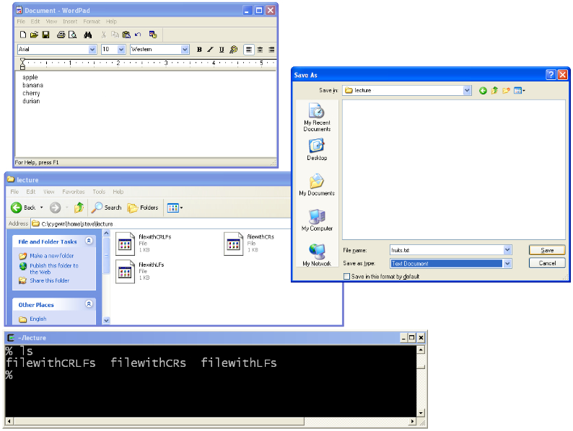
Let’s try it. Create a file with Wordpad.
I have to select Text Document. (When I did so it immediately put a .txt on my file whether I want it or not.)
So, let’s click the save button and then refresh the directory views...
I had to click around to get the desired folder, underneath C:\Cygwin\home\...
I haven’t saved it yet. That is why the file is not showing up in the directory.

Slide 71
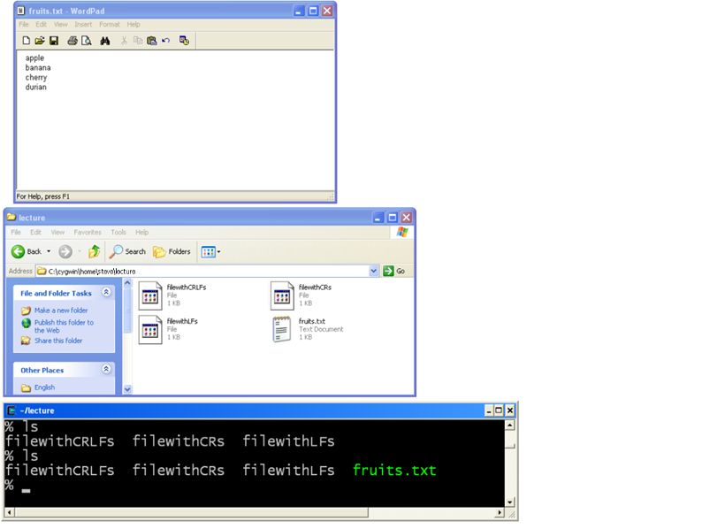
Let’s try it. Create a file with Wordpad.
So it is in the directory now. But it is DOS format and it has the “.txt” in it.

Slide 72
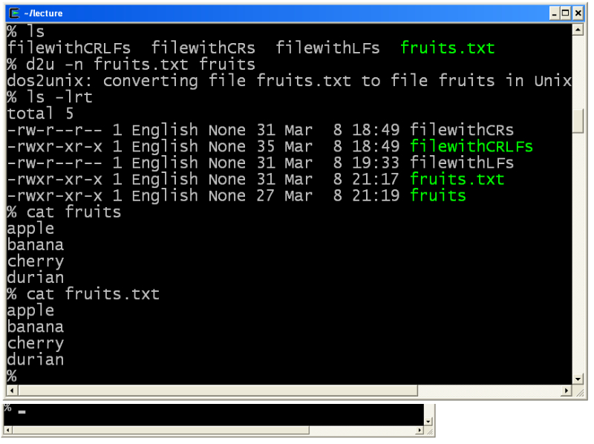
Fixing the format with d2u
But wait! Why does the old one also display correctly? It is because the cat program isn’t affected by the different format (but some other commands will be affected.)
If you installed Cygwin the you should’ve obeyed the instructions to select the dos2unix tool.
You have to remember the -n flag. The 1st argument is the old filename. The 2nd argument is the new (unix formatted) filename.
So it worked. See how the new file is 4 bytes smaller.
Yep, it worked. The file displays correctly.

Slide 73
Homework
1. Set up linux on whatever computer you want
  It can be an ssh into a UNIX system
  It can be a boot partition on your computer
  It can be on a bootable USB memory stick
  It can be a Cygwin terminal
    When installing, make sure that you select the options to:
      Under “Shells,” select to install tcsh
      Under “Utils,” select to install ncurses & dos2unix
      Under “Editors,” select to install emacs & nano
      Under “Devel,” select to install gcc-core, gcc-g++, make, & python
2. Practice each of the commands in these lecture notes. Try “ls” with different flags and the wildcards. Try creating files and directories.
3. Do the assignment that begins on the next page.

Slide 74
Homework the concept of pasting an alias from a file
In this assignment, you will create a directory structure. But you will do so in an unusual way.
We have not yet learned much about UNIX. But we have learned the “alias” command. So we will use an alias to complete the assignment.
Now, you can just type aliases at the command prompt. But we need to instead save ours to a file, so that it can be submitted.
So, instead, you run your alias by copying it out of the file that you create, and then pasting it into the UNIX window. For example, consider the following 5 slides…

Slide 75
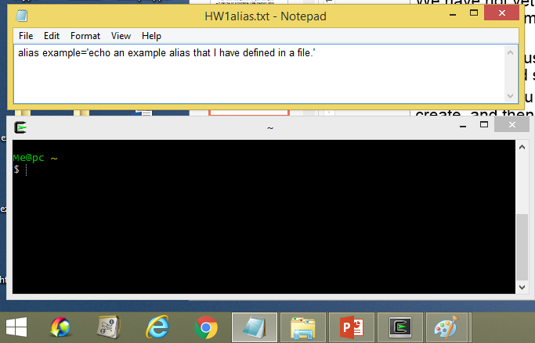
Homework the concept of pasting an alias from a file
Here we have a file “HW1alias.txt” that contains an alias…

Slide 76
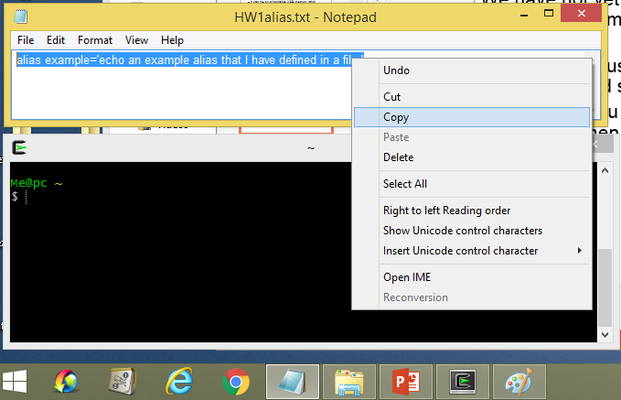
Homework the concept of pasting an alias from a file
So we select the alias and click to copy it…

Slide 77
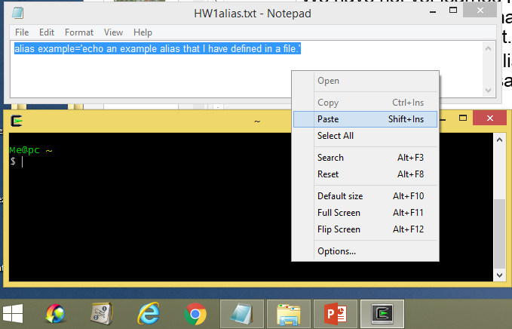
Homework the concept of pasting an alias from a file
Then we click in the UNIX window and prepare to paste it…

Slide 78
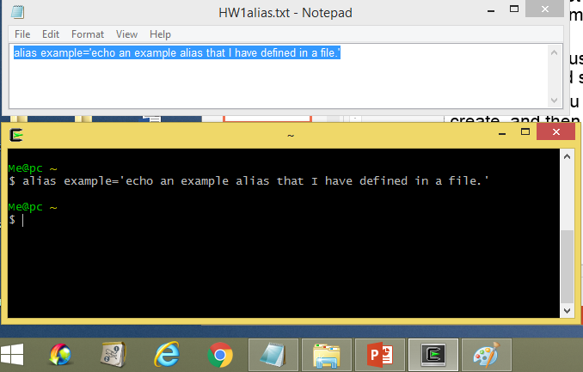
Homework the concept of pasting an alias from a file
We paste it and hit <Enter>. But nothing happens yet. Because we have not yet run the now-defined example command – we have only defined it.

Slide 79
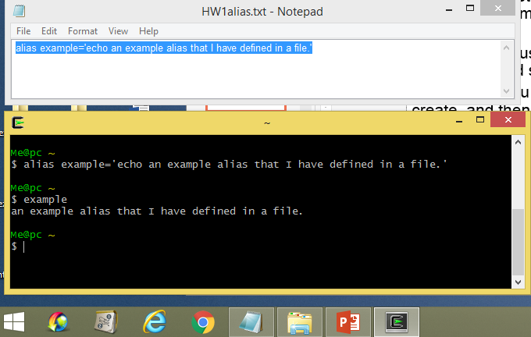
Homework the concept of pasting an alias from a file
So finally, now that it is defined, we run it. And it works.
So that’s it. That is the concept of pasting an alias from a file.
The reverse is also true: you can create your alias on the command line, and then paste it into the file when you get it working correctly.

Slide 80
Homework
What you actually need to do
In the next few homework assignments, you will reproduce a part of a text adventure game.
In this present assignment, you will create a directory structure that represents the allowed movements within the actual game.
You will create this directory structure by using two alias commands that you will together copy-and-paste from a file. The first alias simply defines “m” to be mkdir. The second alias defines “makedirs” to create the directory structure that we want. This second command is significantly shorter if you write it using m’s instead of mkdir’s. The next slide will give more details on the makedirs command…

Slide 81
Homework
The makedirs alias
The makedirs alias will actually be a series of commands separated by semicolons (;). The structure is:
alias makedirs='cd ~/hw1; ;m hw;cd hw;m e; ... ;cd ~/hw1'
Insert here a command to
remove the “hw” directory, and all subdirectories. It must not ask the user about whether the files should be removed, and it must not complain in the situation that that the hw subdirectory does not exist.
Insert here a series of commands create the rest of the directories.
The desired directory structure is given on the next slide…

Slide 82
1
This slide shows the structure of the 27 directories you are to create when you run your alias.
The next slide will describe how you can verify your answer…
hw
2
e
3
s
4
n
5
w
6
d
7
s
8
d
9
sw
10
e
12
sw
13
w
11
u
14
d
15
e
16
n
18
d
w
17
19
s
22
n
20
s
23
n
21
s
24
u
25
u
26
ne
27
ne

Slide 83
Homework verifying your answer
There is a command called “tar” that you have not learned yet.
Do not worry about what it is or does. Just follow the steps shown to the right, and you should get the output shown. If not, then your makedirs alias is broken.
(It also creates a file called ~/dir.tar – but you can ignore that.)
$ cd ~/hw1
$ makedirs
$ ls
hw1
$ tar -cvf ~/dir.tar hw
hw/
hw/e/
hw/e/n/
hw/e/n/d/
hw/e/n/d/d/
hw/e/n/d/d/sw/
hw/e/n/d/d/sw/e/
hw/e/n/d/d/sw/e/u/
hw/e/n/d/d/sw/sw/
hw/e/n/d/d/sw/w/
hw/e/n/d/d/sw/w/d/
hw/e/n/d/d/sw/w/d/d/
hw/e/n/d/d/sw/w/d/d/n/
hw/e/n/d/d/sw/w/d/d/n/n/
hw/e/n/d/d/sw/w/d/d/n/n/u/
hw/e/n/d/d/sw/w/d/d/n/n/u/u/
hw/e/n/d/d/sw/w/d/d/n/n/u/u/ne/
hw/e/n/d/d/sw/w/d/d/n/n/u/u/ne/ne/
hw/e/n/d/d/sw/w/d/d/s/
hw/e/n/d/d/sw/w/d/d/s/s/
hw/e/n/d/d/sw/w/d/d/s/s/s/
hw/e/n/d/d/sw/w/d/e/
hw/e/n/d/d/sw/w/d/e/n/
hw/e/n/d/d/sw/w/d/e/w/
hw/e/n/d/s/
hw/e/n/w/
hw/e/s/
$

Slide 84
Homework making your submission
Rename your alias file as your student ID number (eg, B000000000).
Note: I did not say to rename your alias; I said to rename your alias file.
Submit by 9:00am on Monday, March 6.
Next, follow the instructions below to upload your homework:
1. Remember to name your homework according to the instructions.
2. Log on (http://cu.nsysu.edu.tw) and choose this course from the dropdown list on the left side <1052_UNIX SYSYTEM PROGRAMMING>
∙ Click on it, and the system will generate a list of assignments.
∙ Select the assignment you are submitting
∙ Click on “do assignment” → “start” and then hit “browse.”
∙ Select the file and hit submit.
3. Remember to verify the correctness of the file that you upload.
4. If you have any problems in submitting your homework, please raise it before the submission time. Problems raised after submission deadline will be ignored. (And, if there is a problem, email the professor with the solution as an attachment, PRIOR to the deadline.)
Please note that homework solutions must be uploaded by time they are due. Submissions cannot be made later; the website will not even accept them.

Slide 85
Homework
making your submission
用你的學號來命名你的別名檔案(alias file)，例如: B000000000。
注意: 不是修改檔案裡的別名(alias)，是把整個檔案的名字改掉。
上傳期限: 3/6 星期一 早上9:00
再來，跟著下面的步驟來完成你的作業:
1 作業的命名請依照作業繳交格式來做。
2 登入網路大學((http://cu.nsysu.edu.tw)，於網頁左邊選擇本課程<1052_UNIX系統程式>。
∙ 於網頁上方選擇<作業評量區>
∙ 於列表中選取要上傳的作業名稱,點選<進行作業>
∙ 於該作業頁面點選<開始作答>
∙ 於繳交頁面點選<選擇檔案>並選擇要上傳的檔案
∙ 選擇完作業後點選<確定繳交>
3. 上傳做業前，請確認上傳的版本是你目前做出來最完整最正確的版本。
4.針對作業有任何的問題請在繳交期限之前跟助教提出,過了繳交期限恕不受理. 問題若再期限過後提出都會被忽略。(如果作業有問題，請在期限內寄信給教授，且寄信時請附上正確的版本給教授。)
作業繳交的方法請各位同學在"繳交期限"之前上傳檔案到網路大學,不接受遲交

