Slide 1


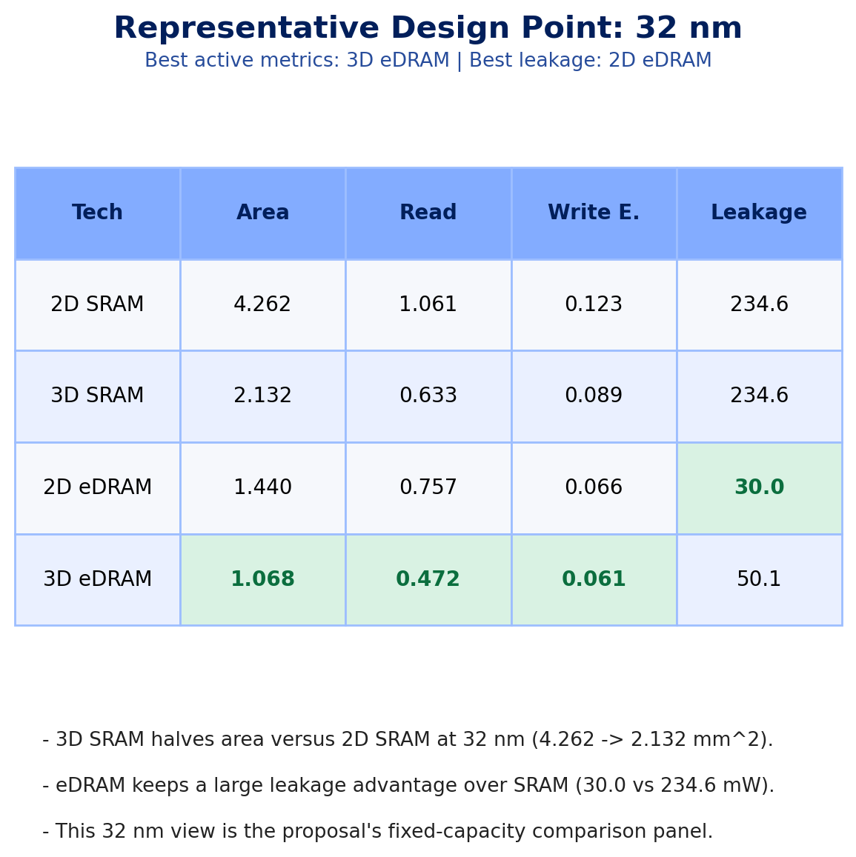

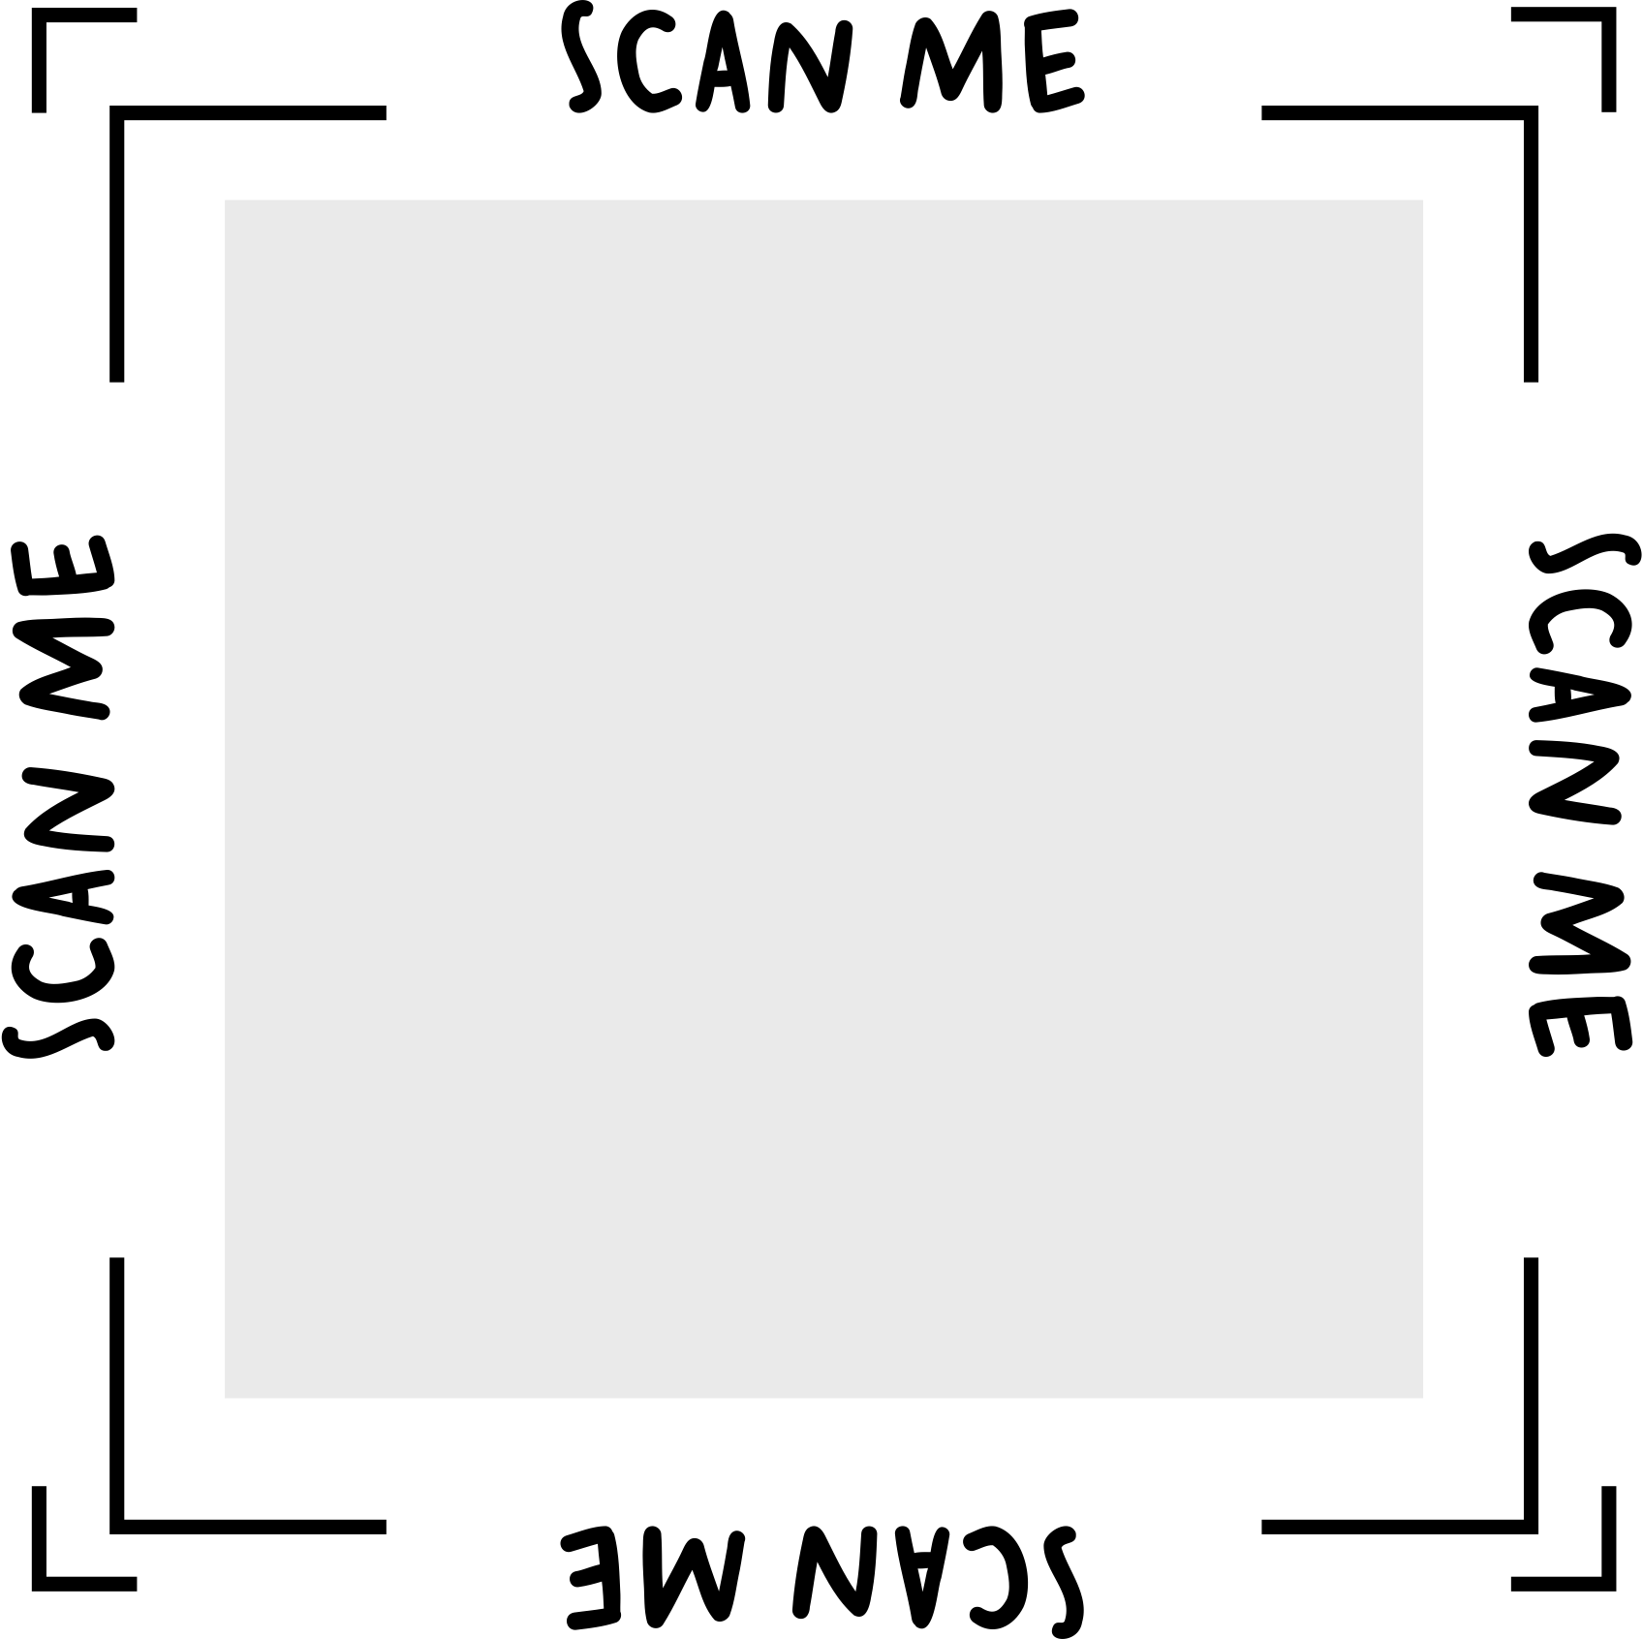

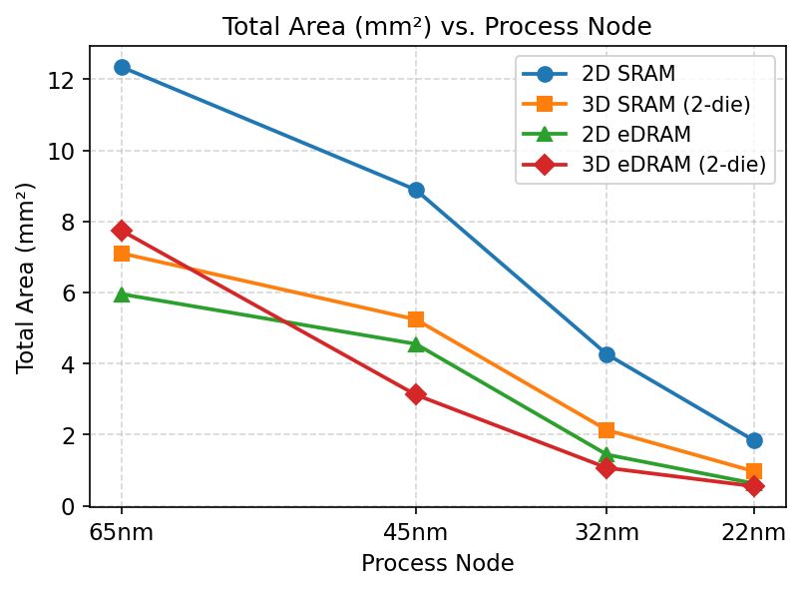
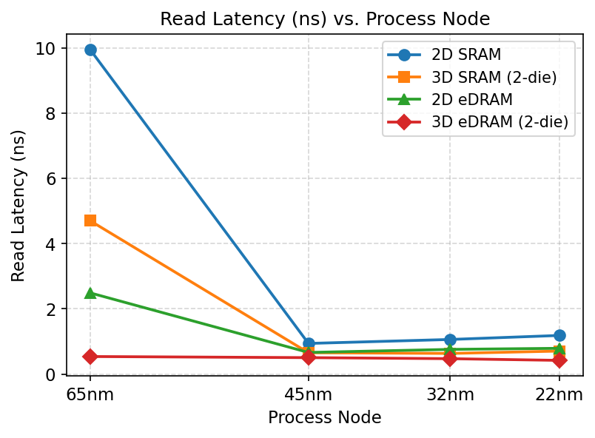
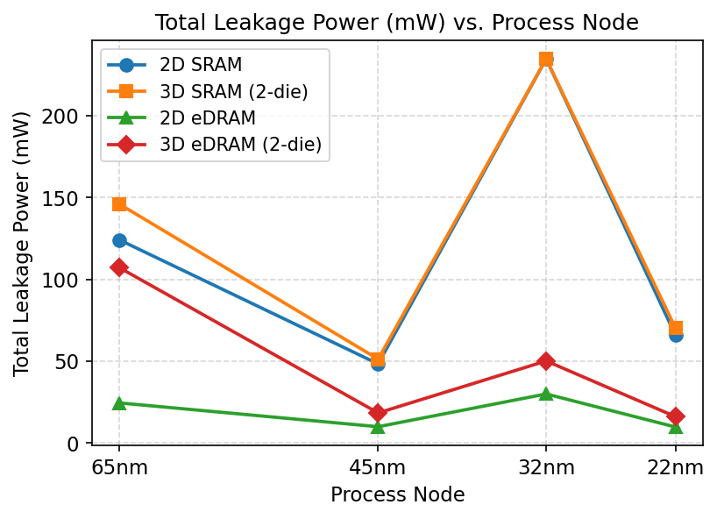
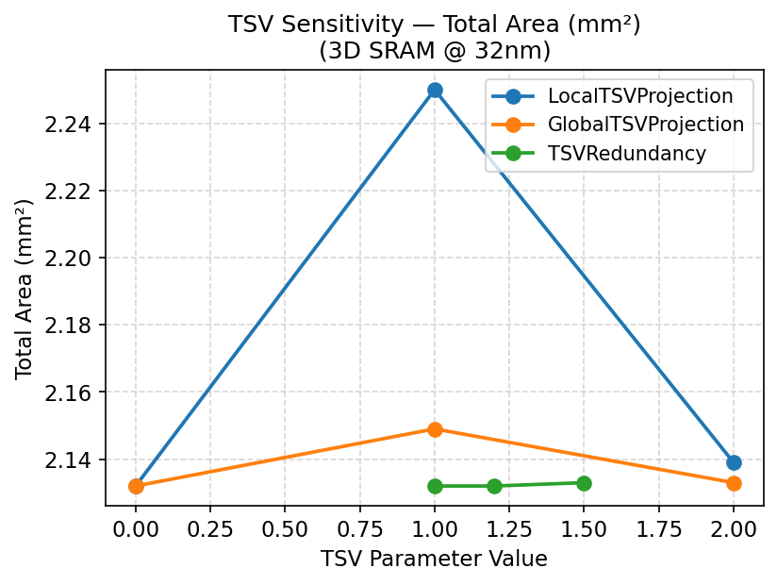



Main Takeaways
Proposal-guided takeaway:
3D eDRAM is the strongest active design at 32 nm, 2D eDRAM keeps the best leakage,
and TSV assumptions do not materially change the 2 MB cache conclusion.
• 3D eDRAM is best at 32 nm: 1.068 mm^2, 0.472 ns, 0.061 nJ/access.
• 2D eDRAM gives the lowest leakage: 30.0 mW at 32 nm.
• 3D SRAM cuts area by about 40-50% versus 2D SRAM across nodes.
• TSV sweeps change area by at most 5.5% and leave read latency unchanged.
Code +
data
Acknowledgements:
DESTINY simulator, ESE5760 course staff, and prior 3D-memory literature were used for
baseline validation, sanity checks, and interpretation of anomaly cases.
Introduction
Results
The proposal asked which technology trends remain stable when process node and 3D assumptions change in DESTINY.
This poster narrows the final scope to the configurations that were both reliable and interpretable in simulation: 2D SRAM, 3D SRAM, 2D eDRAM, and 3D eDRAM.
Our goal is not one perfect design point, but a robust comparison of what really changes with scaling, stacking, and TSV assumptions.
Poster scope follows the proposal:
fixed-capacity comparison, node scaling, and 2D/3D + TSV robustness.
We emphasize stable trends and call out optimizer-driven anomalies separately.
Comparative Analysis of
2D/3D SRAM and eDRAM
Using DESTINY
Tiebing Tang • Yishu Wang • Zhengyu Liu
Methods
Baseline: 2 MB cache, 256-bit word width, 1-way associativity, LOP roadmap, 350 K, and WriteEDP optimization.
Experiment 1 sweeps four technologies across 65 nm, 45 nm, 32 nm, and 22 nm (16 runs total).
Experiment 2 fixes 3D SRAM at 32 nm and sweeps LocalTSVProjection, GlobalTSVProjection, and TSVRedundancy.
Metrics: total area, read latency, write latency, write dynamic energy, and leakage power.
Project Links
GitHub repository
Full
analysis
Analysis + plots

