Slide 1

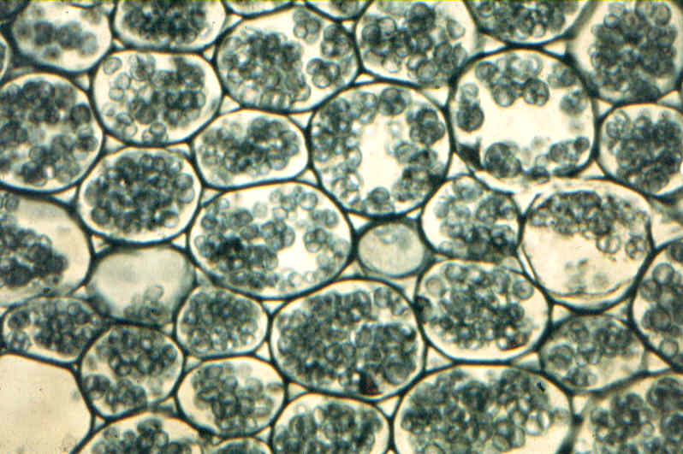
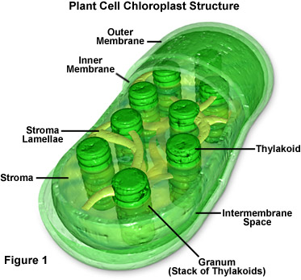
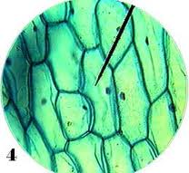
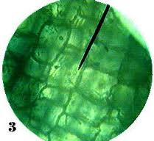
Title which simply addresses the nature of the research presented in the poster
Names of those who were involved with this body of work
Contact information provided here to reach the authors of this body of research
Things to Keep in Mind
Images
Fluorescent Colors
The poster is supposed to be a snapshot of months (or years) worth of research, data collection, analysis, etc. Don’t try to put every detail on one page!
Pull out the main components of research, including charts, images, slides, graphs or whatever it is you need to really get the main point(s) across to the reader.
Cramming the poster full of text does 2 things:
1- Makes people skip over your hard work
2- Slows down the ability for those engaged in
your work to access the main points, and
understand the research quickly
Try to use images with a resolution of 150 dpi
Do not use screen shot images (if possible) in the poster, they tend to be fuzzy when printed at poster size
When putting images into a poster, please don’t copy and paste!! Instead, go to
Insert>Photo>Picture From File
this will help you to manage this document easier without slowing it
down
Be aware that fluorescent colors will print darker than they seem in your document.
If you really need an image to stand out, avoid fluorescent colors (Dark Blue, Dark Purple on Black) because the details may not
show up as you need them to appear.
Logos
There are no logos in this template. If you want to add a Penn, CHOP, PennMedicine, PennVet, Upenn’s Shield, etc. logo please ask us to add it when you visit the Poster Printing Lab!
We want to ensure that your poster receives the right type of logo image file to produce a high resolution, high quality print.
Before Coming In
Schedule an appointment online with us at:
Make sure your appointment is scheduled with enough time ahead of your deadline!
Bring your method of payment; we accept VISA, Mastercard, PennCash, Departmental Copy Cards and Departmental Account Numbers.
***We DO NOT accept cash.***
Don’t forget your poster! Bring a backup method as well in case your file will not open (USB, CD, External Hard Drives, email to yourself, etc.)
Most Importantly!!!
Be aware that as this time, we do NOT offer any sort of
design services for your poster. Come prepared with
the document you wish to print, we are glad to help
with any minor details ☺
18 Font Tex for Captions of Images/Charts/Graphs/Etc.
http://www.library.upenn.edu/forms/biomed/posterprinting.html
Formatting
USING ONLY CAPITAL LETTERS MAKES READING DIFFICULT
High contrasting colors are better and easier to follow
Consistency in Font, text size for headings, body, captions, etc.
Stick with a non-serif based fonts (i.e. Arial)
Organize information moving from top to bottom, across the columns in your poster.
PowerPoint to PDF
To save this document as a PDF, go to
File>Print.
At the bottom left hand corner, there is a button,
“PDF”
— click on this button and scroll to:
“Save as PDF…”
Open your PDF after creating the file to make sure the poster is not cut off. If it is, go to:
File>Print,
and click the “Page Setup”
button above the “PDF” button. Check to see that
the size and orientation are the same as the poster
you have been working on.
Even if you have already have made your PDF document before coming to your appointment, it is always good to bring the PowerPoint file as a backup in case there are any issues.
Still having problems? We can help you out ☺
Basic Print Tips
Check, check, check! to make sure you have caught all errors, typos, formatting issues, stray lines/objects/text, etc. in your document BEFORE coming to your appointment. It will save you time (and a headache) !
Try to use colors, font and text sizes that allow the reader to easily move through the work. This, for example:
Using a caption to describe an image can be more productive than a paragraph.
DoEs nOt WoRk
DOES NOT WORK

