Slide 1

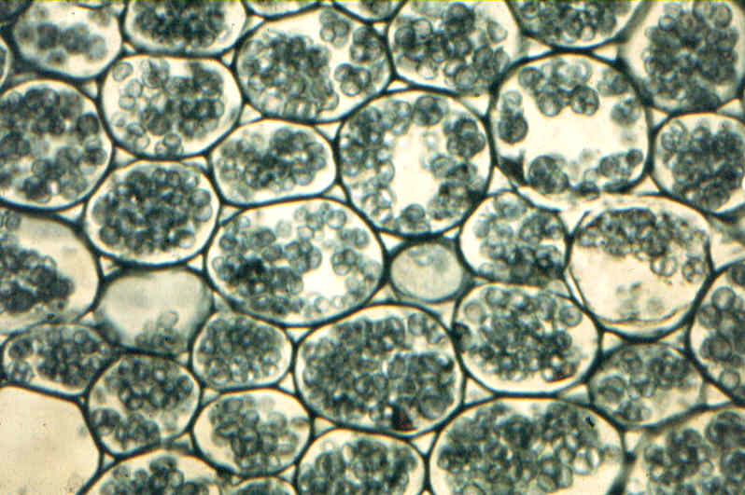
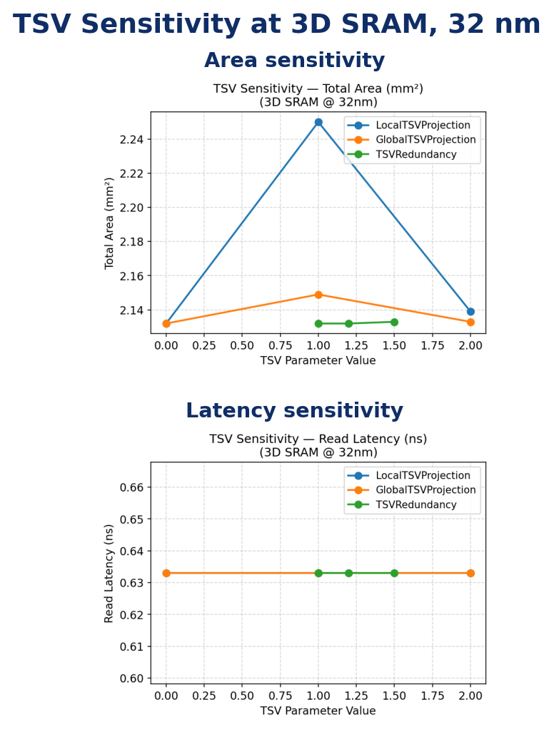

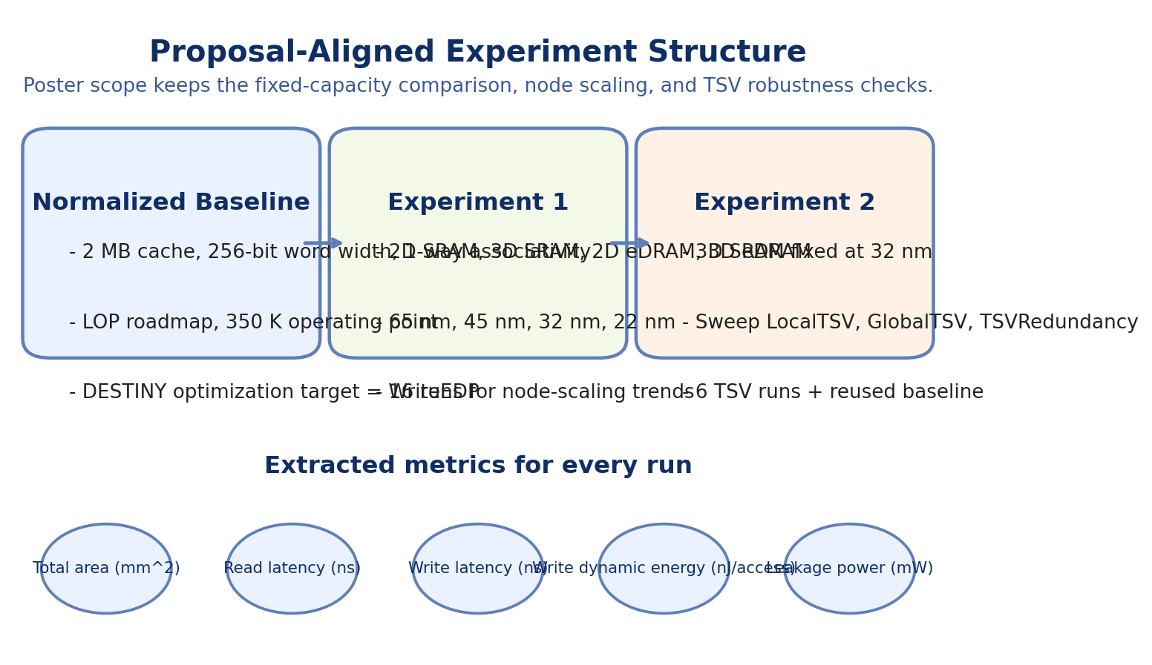
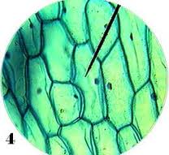
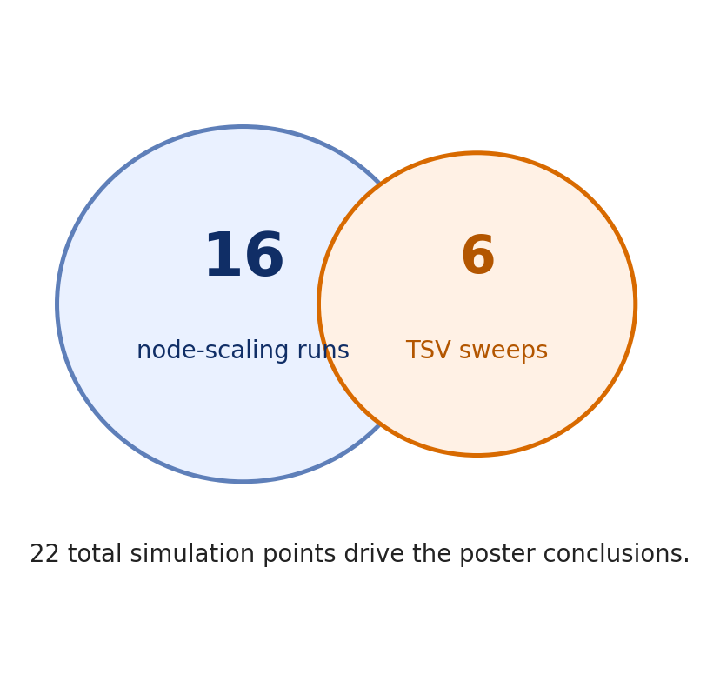
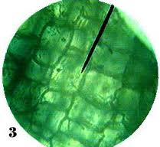
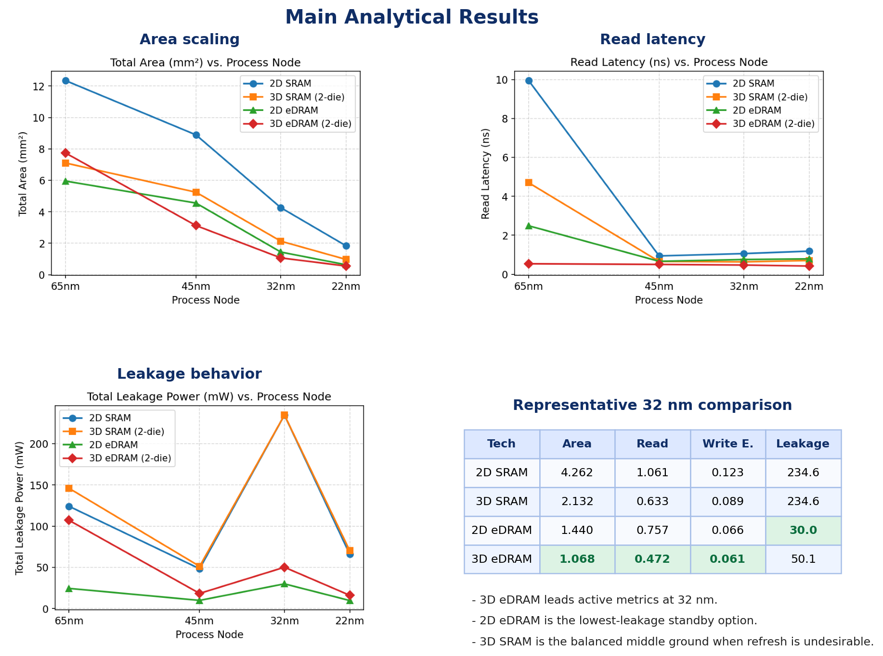
Comparative Analysis of 2D/3D SRAM and eDRAM Across Process Nodes Using DESTINY
Tiebing Tang • Yishu Wang • Zhengyu Liu
ESE5760 Final Project • Proposal-guided poster scope • Conclusions derived from Doc/Analysis_Full.md
Motivation & Scope
Cross-Technology Results
TSV Sensitivity & 3D Robustness
The proposal framed this project around one question: which memory trends are robust, and which are highly assumption-dependent in DESTINY?
We therefore narrowed the poster to the most stable and interpretable comparisons:
• fixed-capacity cross-technology comparison,
• node-scaling trends across 65/45/32/22 nm,
• 2D/3D benefit and TSV-sensitive robustness.
The poster intentionally favors a few strong analytical results over exhaustive coverage of every simulation output.
At the poster level, three trends are the most defensible:
1. eDRAM scales more aggressively than SRAM, and 3D eDRAM becomes the smallest design by 22 nm (0.550 mm^2).
2. 3D SRAM consistently saves roughly 42-50% area over 2D SRAM, so the stacking benefit is robust for SRAM.
3. At 32 nm, 3D eDRAM wins the active metrics (area, read latency, write energy), while 2D eDRAM remains the best leakage option.
The TSV experiment answers the proposal's third research question directly.
LocalTSVProjection is the only first-order area knob, and even there the maximum penalty is only +5.5%. GlobalTSVProjection and TSVRedundancy remain below 1% area impact.
Read latency is unchanged across all TSV sweeps, so the critical path at this 2 MB scale is not TSV-limited.
Practical implication: conservative TSV assumptions are acceptable for this class of cache without materially changing the system-level conclusion.
Why 32 nm Is the Best Comparison Point
32 nm is the cleanest fixed-capacity comparison node: it avoids the extreme 65 nm H-tree penalty while still preserving strong technology separation.
The 32 nm scorecard shows a useful split:
• 3D eDRAM is best when active performance matters.
• 2D eDRAM is best when standby leakage dominates.
• 3D SRAM is a balanced compromise if refresh complexity is undesirable.
Key Conclusions
1. Node scaling helps every technology, but eDRAM gains more from scaling than SRAM.
2. 3D stacking gives a clear and repeatable area benefit for SRAM; for eDRAM it becomes beneficial only after TSV overhead stops dominating.
3. At 32 nm, 3D eDRAM is the strongest active design point, while 2D eDRAM is the most attractive low-leakage option.
4. The main 3D conclusion is robust even when TSV assumptions are made more conservative.
22 runs total: enough for comparative trends, small enough to explain clearly.
Full writeup: Doc/Analysis_Full.md
Methodology & Experiment Matrix
All runs share a normalized baseline: 2 MB capacity, 256-bit word width, 1-way associativity, LOP roadmap, 350 K, and WriteEDP optimization.
Experiment 1 compares 2D SRAM, 3D SRAM, 2D eDRAM, and 3D eDRAM across four nodes (16 runs).
Experiment 2 fixes 3D SRAM at 32 nm and sweeps LocalTSVProjection, GlobalTSVProjection, and TSVRedundancy (6 runs).
Because DESTINY optimizes for WriteEDP, some anomalies are organizational effects rather than pure device limits.
Interpretation of the Anomalies
Two non-monotonic SRAM behaviors need interpretation rather than blind reporting.
The 65 nm SRAM latency spike is caused by large-array H-tree delay under a WriteEDP-selected organization; it is not a fundamental SRAM speed limit.
The 32 nm SRAM leakage spike (234.6 mW for both 2D and 3D SRAM) indicates that DESTINY converged to a high-parallelism organization that favors WriteEDP at the cost of standby power.
This distinction matters because the proposal explicitly asked for robust trends versus assumption-sensitive conclusions. The area ordering and eDRAM leakage advantage are robust. The exact SRAM anomaly magnitudes depend on the optimizer target.
Limits & Design Implications
DESTINY does not include eDRAM refresh energy, so the eDRAM advantage here is strongest on active metrics rather than full-system power.
22 nm should be interpreted as a model projection, not silicon validation.
All reported trends are under a single optimization target (WriteEDP). A ReadLatency objective would likely weaken the SRAM anomalies and strengthen some 3D latency gains.
Proposal filter: we keep the stable poster-ready experiments and defer broader sensitivity work to the full writeup.
ROBUST TRENDS
ASSUMPTION-SENSITIVE DETAILS

