Slide 1
Study Hypertension based on brfss2013
1. Find the influencing factors of hypertension
2. Develop mathematical models to predict whether an individual has high blood pressure or not
BY GROUP 8
田若瑶 宋雨辰 王学文 冯义浩 毛丰健

Slide 2
1. Background
2. Methodology
Content
3. EDA
4. Modelling
5. Conclusion

Slide 3
Background
/01

Slide 4
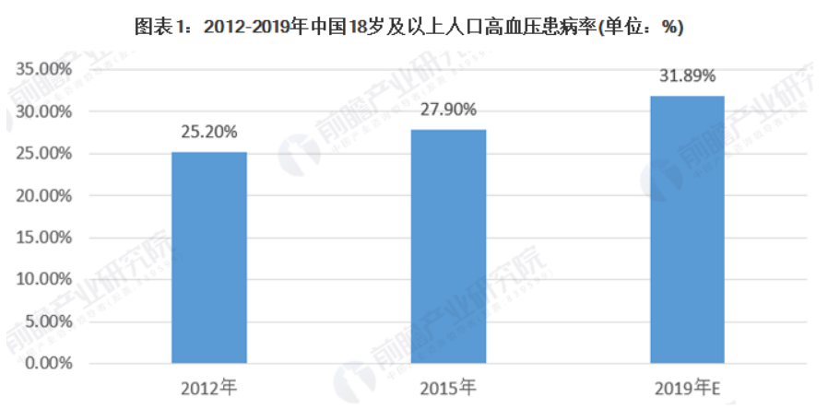
Background
Data Set
The data set we choose is the Behavioral Risk Factor Surveillance System(BRFSS), since this data set is authentic and rigorous.
Why we study hypertension?
Research shows that hypertension is harmful to people's health and has become a problem for more and more people.
What we would like to do?
1. Find out the influencing factors of hypertension, to help people better prevent hypertension
2. Develop mathematical models to predict whether an individual has hypertension or not

Slide 5
Methodology
/02

Slide 6
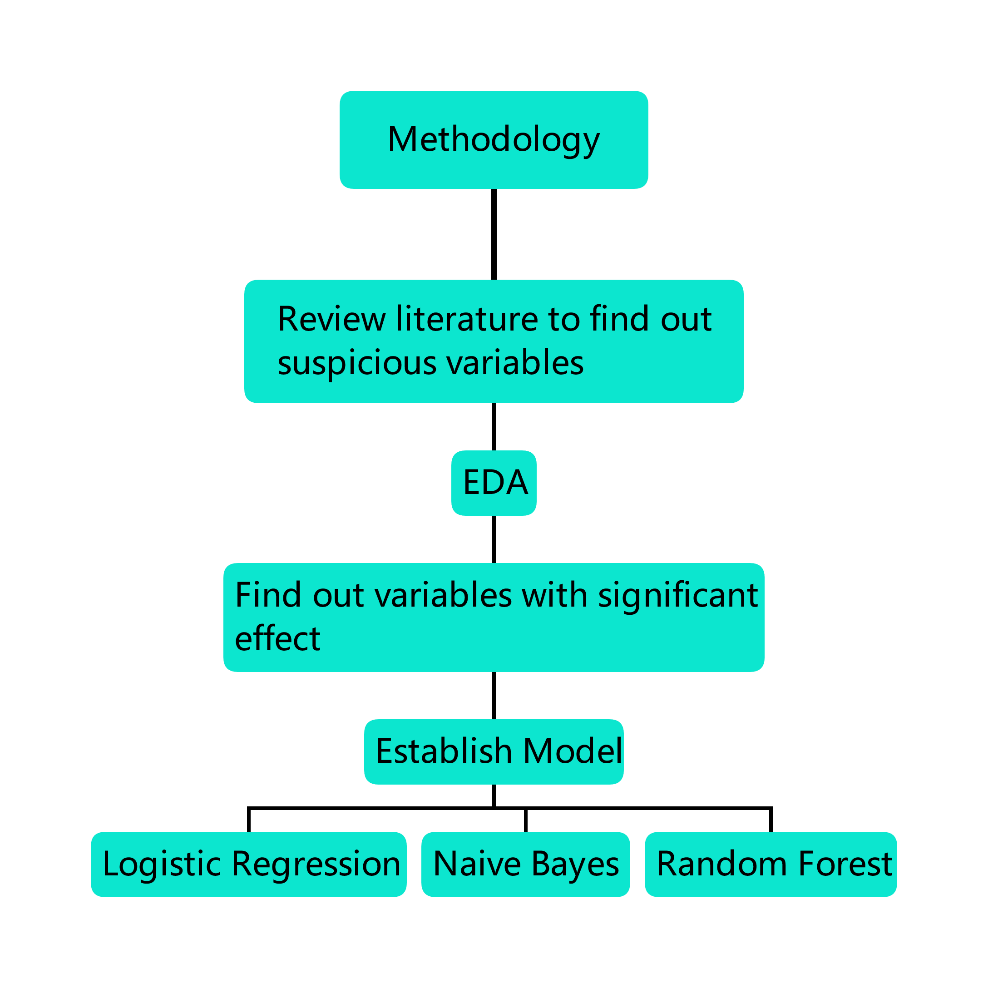
Methodology
that probably have effect on hypertension
Use many methods that have been taught in course and labs
Assemble these significant variables

Slide 7
EDA
/03

Slide 8
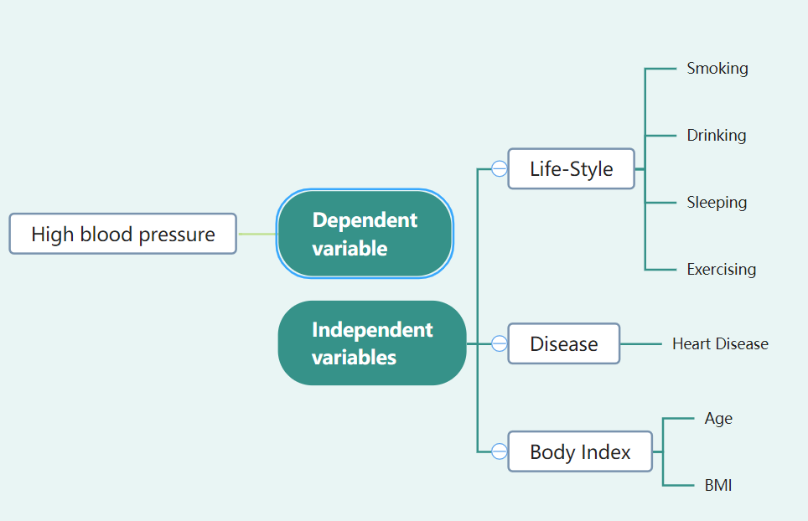
EDA
Question1: Which variables are worth studying?
Step1: Refer to other people's research reports to obtain the independent variables which we are interested in.
Dependent variable:
X_rfhype5
Independent variables:
Smoke100
Alcday5,
Cvdinfr4
X_bmi5,
Exerany2,
X_age_g,
Sleptim1.
References:
我国老年人高血压现状及其影响因素分析_陈娇

Slide 9
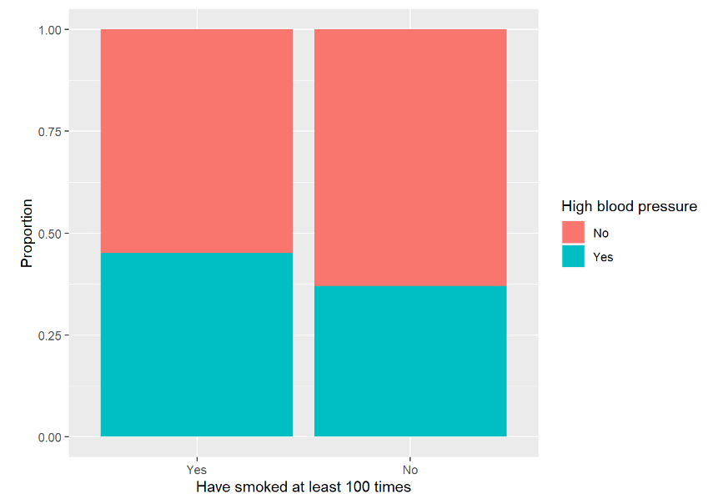
EDA
Question2: Are these variables really related to high blood pressure?
Step2: Test them one by one using the methods we have learnt in class!
Variable: Smoke100
Type: Categorical variable
1. Data preprocessing : Eliminate the individuals whose value of smoke100 or X_rfhype5 is NA in the data set.
2. Data Visualization:
The stack bar chart clearly shows that the proportion of hypertension is larger in the group of people who smoke more than 100 times in their lives.
Therefore, it is necessary to test the correlation between these two variables because it causes the difference.

Slide 10
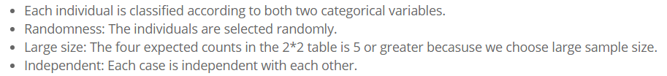
EDA
3. EDA Method Selection:
So we can use the Chi-square test to test the independence of smoking and hypertension.
4. Data sampling : 1/20 of the population was selected as the sample for Chi-square test.

Slide 11
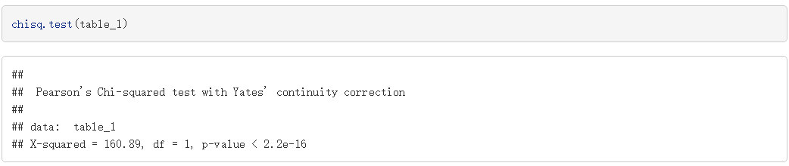
EDA
5. Make hypothesis :
H0: There is no difference in the distribution of hypertensive patients in the smoke more than 100 times and smoke less than 100 times populations.
Ha: There is difference in the distribution of hypertensive patients in the smoke more than 100 times and smoke less than 100 times populations.
6. Chi-square Test :
7. Conclusion :
The proportion of hypertension is different between the smoke more than 100 times group and the smoke less than 100 times group.
Smoke100 is an influencing factor!

Slide 12
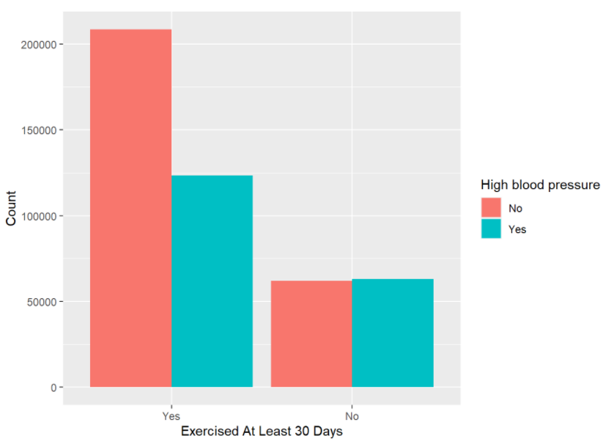
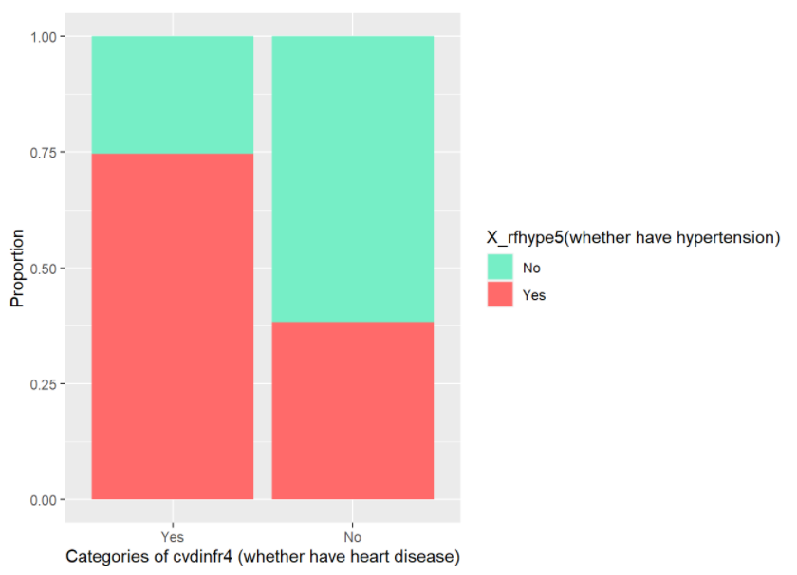
EDA
Chi-square Test
Exercising and heart disease are influencing factors.

Slide 13
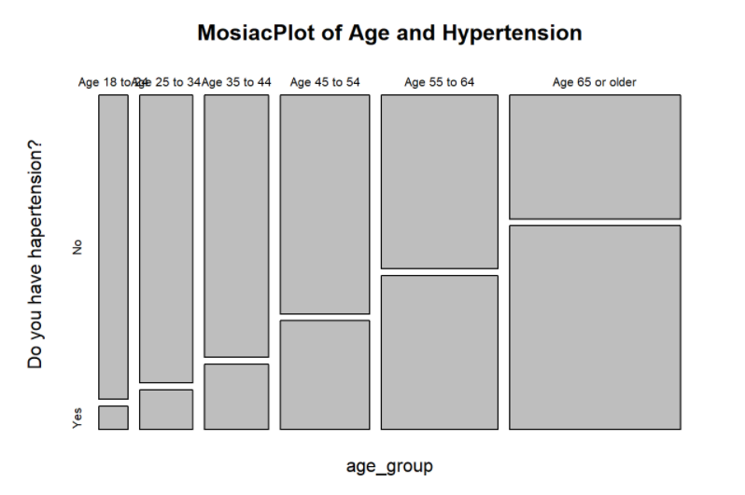
EDA
Chi-square Test
Age is an influencing factors, too!

Slide 14
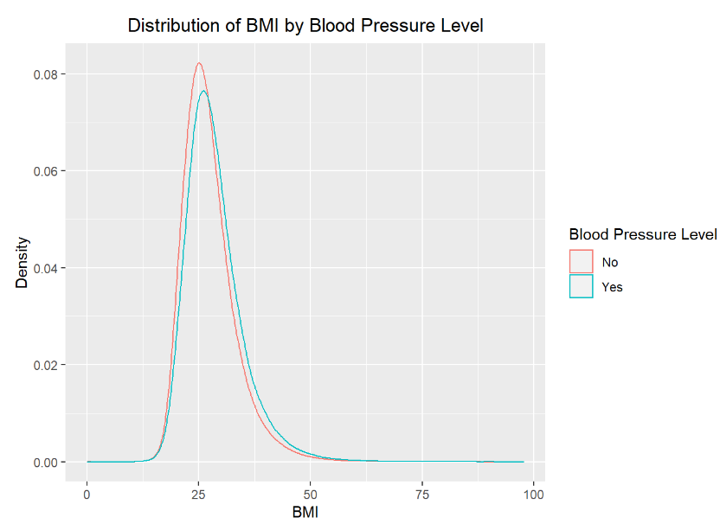
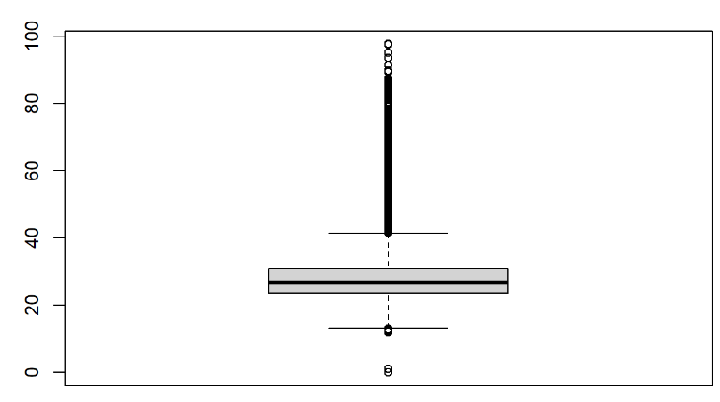
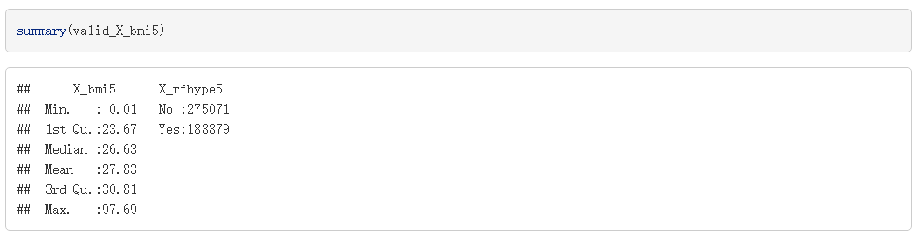
EDA
Variable: X_bmi5
Type: Numerical variable
1. Data Visualization
Outliers!
Outliers!
Boxplot
So strange!
Density map
To sum up, the outliers must be removed by using 1.5IQR Principle before the test is carried out.

Slide 15
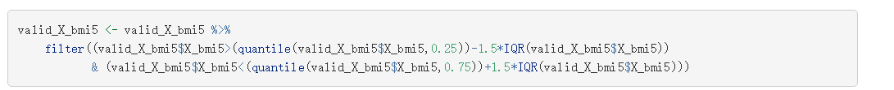
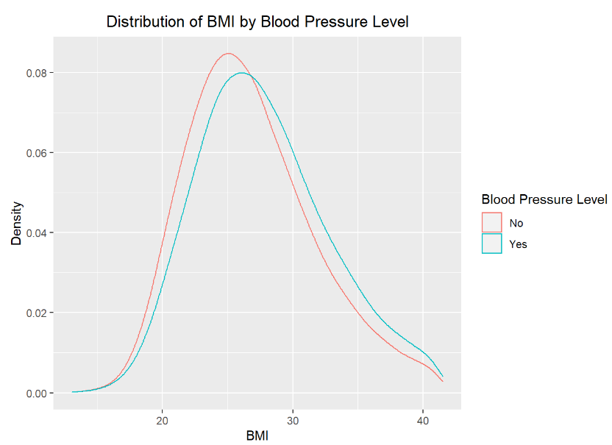
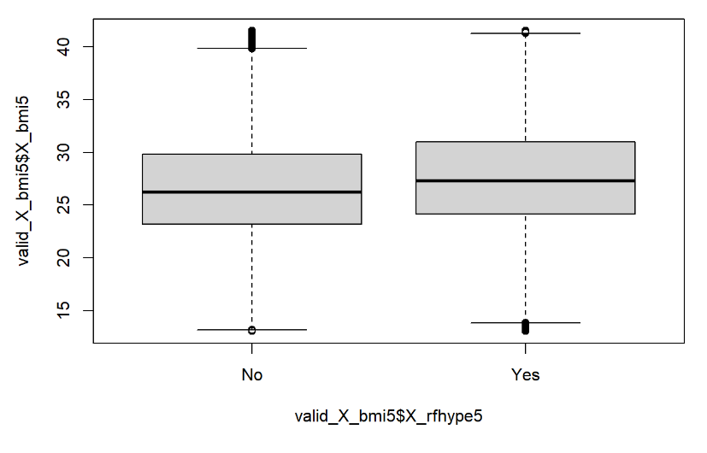
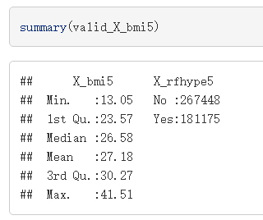
EDA
2. 1.5 IQR Principle to Remove Outliers :
After removing outliers:
new summary
Some differences!
new boxplot
new density map

Slide 16
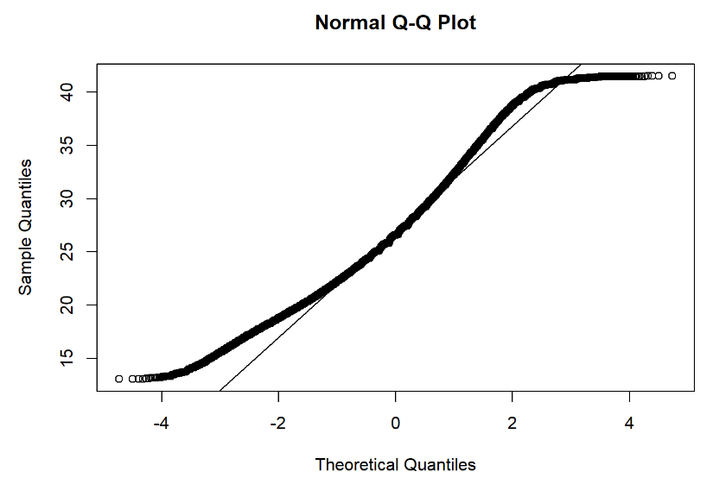
EDA
3. EDA Method Selection:
µ1 = the true mean bmi of hypertensive populations
µ2 = the true mean bmi of non-hypertensive populations.
Estimate the difference µ1 – µ2 at a 95% confidence level.
Although the distribution of BMI is not Normal, Choose the sample size which is larger than 30, we can still use large sample t test to compare two means.
4. Data sampling :
Sample from population, the sample size are both larger than 30.

Slide 17
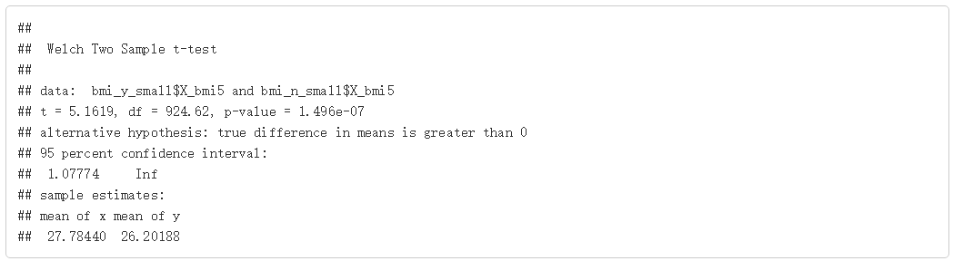
EDA
5. Large Sample T-test
In this test, we calculate the 95% confidence interval of the difference between mean value of bmi of hypertensive patients and none-hypertensive patients. The t-test in a single tail test.
6. Conclusion :
95% confidence interval is always larger than 0: the true mean of bmi of hypertensive patients in population is larger than than that of people who does not have hypertension.

Slide 18
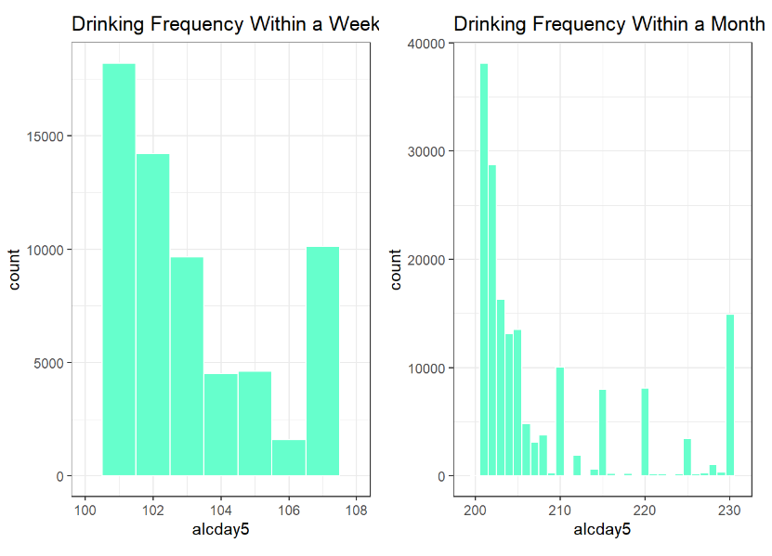
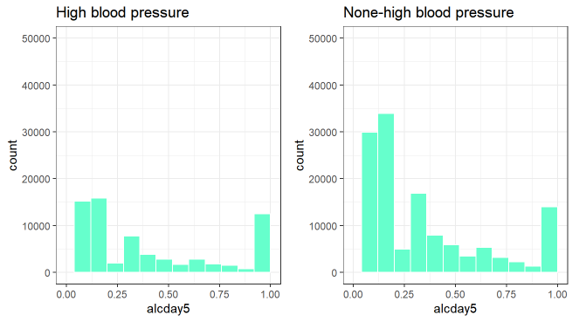
EDA
Something strange…
Variable: Alcday5
Type: Numerical variable
Two forms: (1-0X and 2-XX) and 0
Unusual distribution: double-modal and right-skewed.
There are a lot of people who drink less frequently and a lot of people who drink more frequently.
1. Can We Normalize them?
No significant difference!

Slide 19
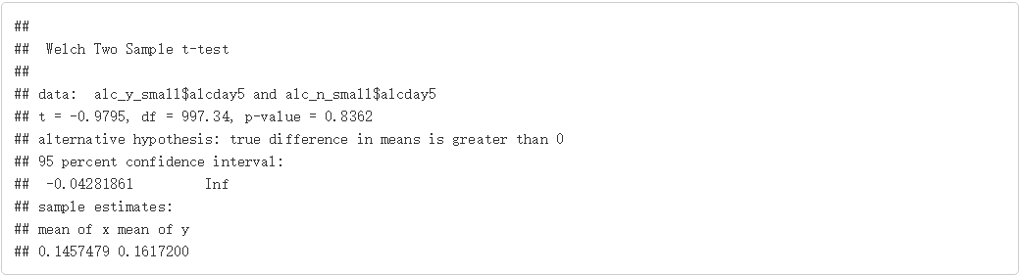
EDA
2. EDA Method Selection:
µ1 = the true mean alcday5 in hypertensive group
µ2 = the true mean alcday5 of in non-hypertensive group.
Estimate wether there is a difference between µ1 and µ2
Use the large sample t-test to estimate the difference.
3. Data sampling
4. Large Sample T-Test
Does not significant at all!

Slide 20
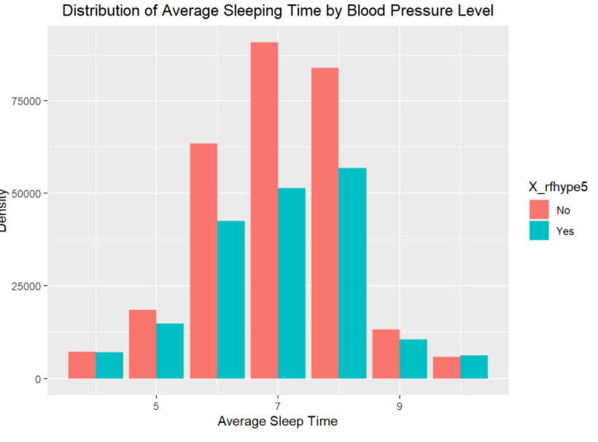
EDA
5. Conclusion :
The same as sleeping time.
Contrary to popular belief, there was no significant correlation between drinking frequency, sleeping time and hypertension.
It is necessary for us to find more data and verify the results of our test!
hypertension->more sleeping time? Or less sleeping time->hypertension?

Slide 21
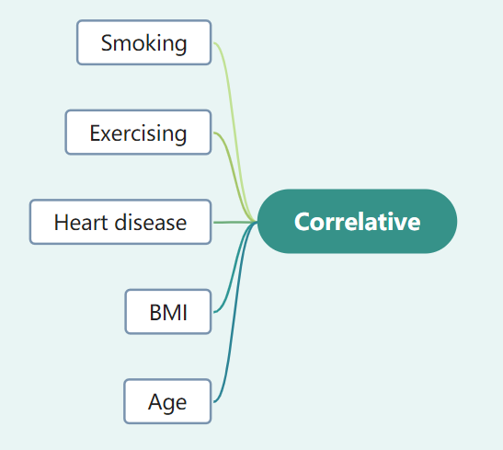
EDA
Positive
Negative
Positive
Positive
Positive

Slide 22
Modelling
/04

Slide 23
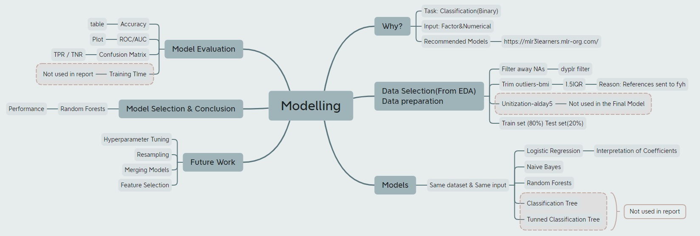
Model
Question3: What is the combined effect of these parameters?
Step3: Data Modelling!

Slide 24
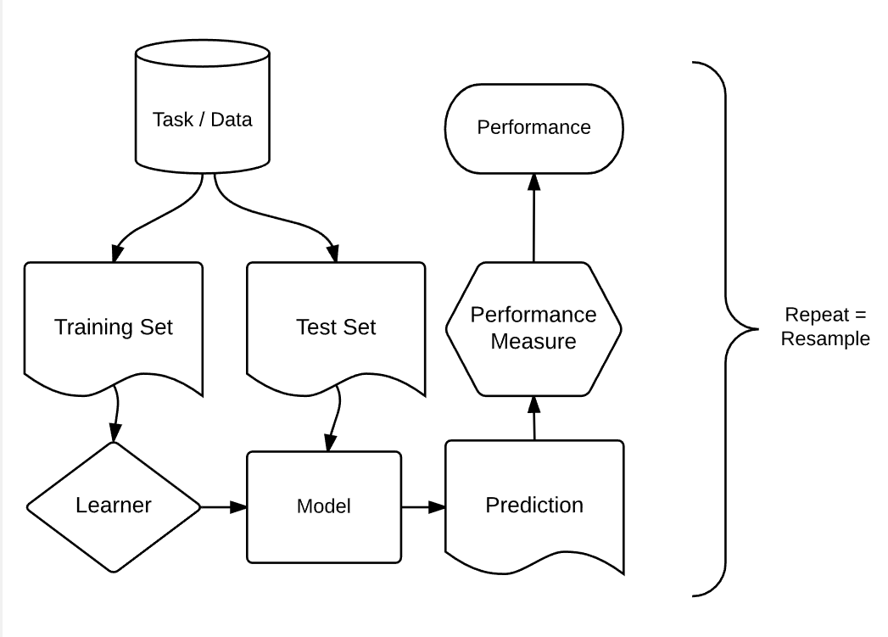
Model
Model Procedure:
Package: mlr3
https://mlr3book.mlr-org.com/introduction.html

Slide 25
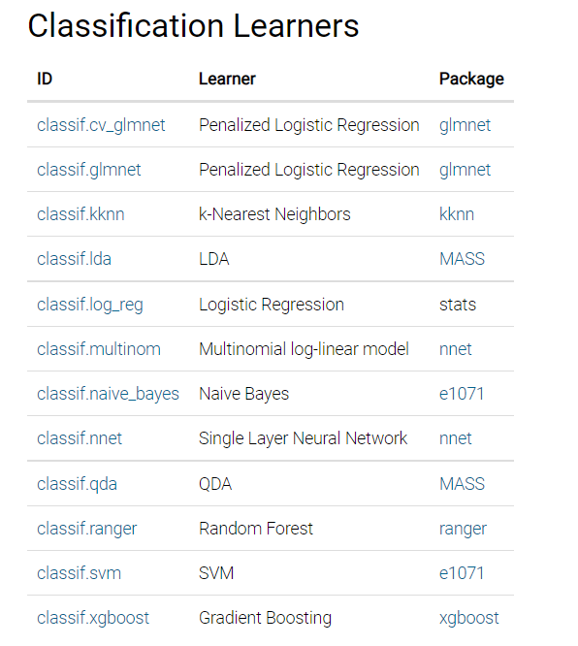
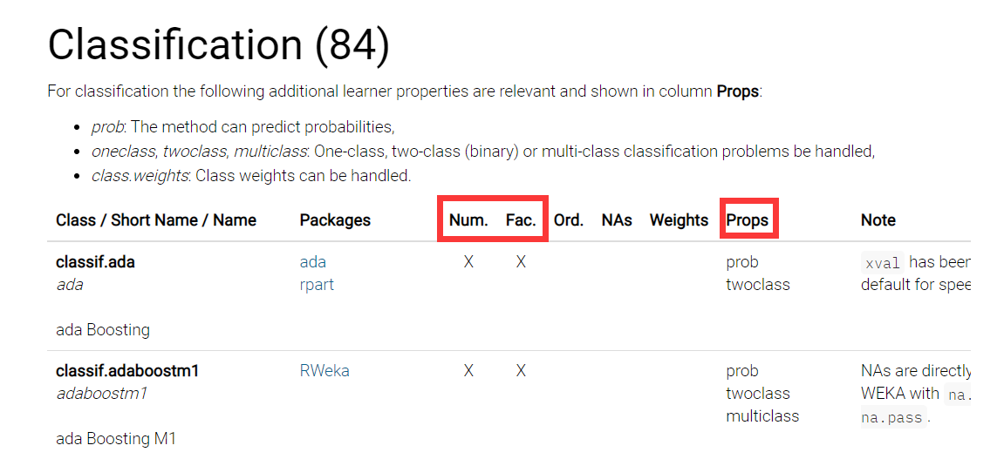
Model
Model Requiremet:
Task: Classification (Binary), also want output probability
Input: Factor + Numeric
Recommended Learners
https://mlr3learners.mlr-org.com/
https://mlr.mlr-org.com/articles/tutorial/integrated_learners.html#regression-59-

Slide 26
Model
Data Prepocessing:
Filter away NAs (dyplr Filter)
Trim outliers (1.5IQR -- X_bmi5)
Unitization (Calculate Frequency -- Alcday5)
Split Trainset(80%) and Testset(20%) (Random Rows)
https://mlr3learners.mlr-org.com/

Slide 27
Model
Models (learner)
Logistic Regression
Naive Bayes
Random Forests
https://mlr3learners.mlr-org.com/

Slide 28
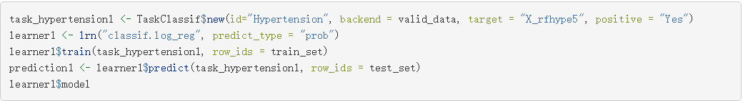
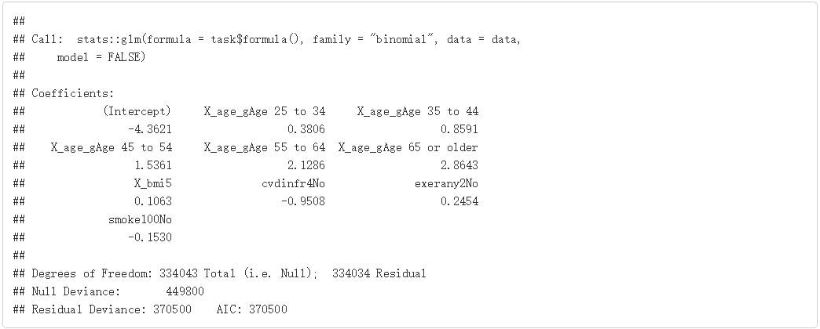
Model
Logistic Regression
Model One: Logistic Regression

Slide 29
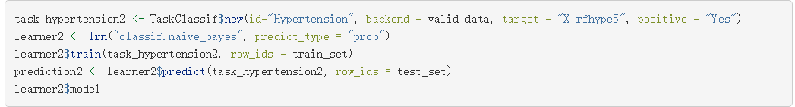
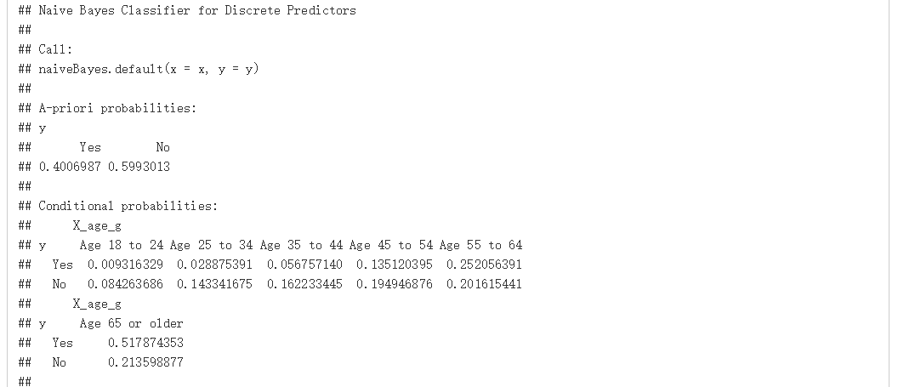
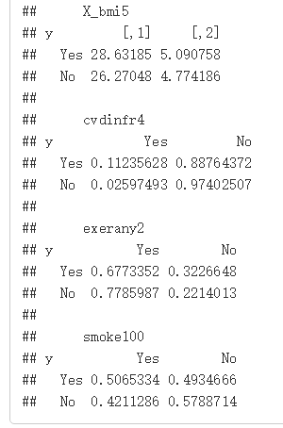
Model
Naive Bayes
Model Two: Naive Bayes

Slide 30
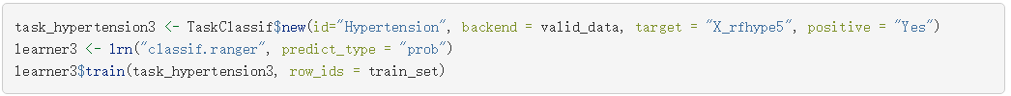
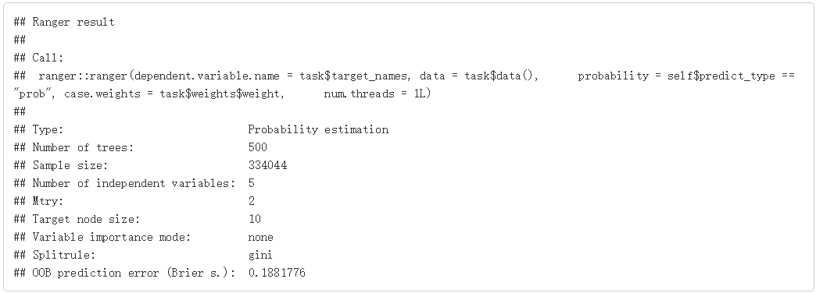
Model
Random Forest
Model Three: Random Forest

Slide 31
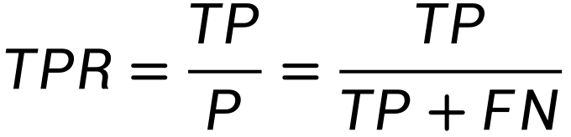
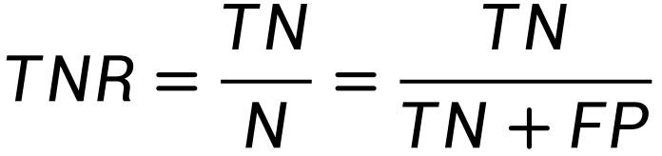
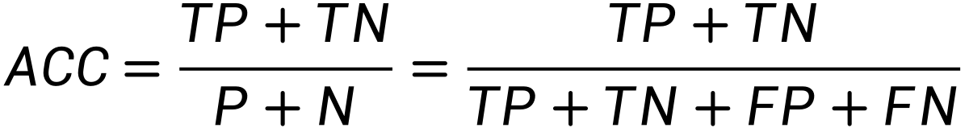
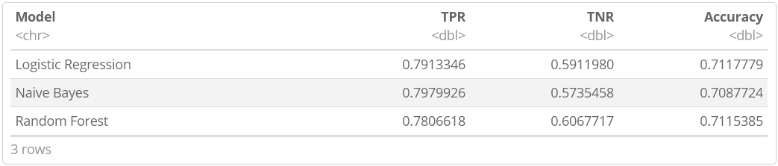
Model
Model Evaluation: Confusion Matrix
True Positive Rate: -- Hypertension group
True Negative Rate: -- Normal group
Accuracy: -- Overall Performance
https://en.wikipedia.org/wiki/Confusion_matrix
Notes:
Now, we compared the two models according to TPR, TNR and Accuracy. From the table above, we can see that:
1. The probability of correct prediction of positive classes, namely TPR, of Logistic Regression model and Naive Bayes model is approximately equal, 1% higher than that of Random Forest model. This means that the three model shows little difference in predicting patients with hypertension.
2. The probability of correct prediction of positive classes, namely TNR, of Random Forest model, is 2% higher than that of Logistic Regression model and 3% higher than that of Naive Bayes model. This means that Random Forest model predicts non-hypertensive patients with better outcomes. But the other two models did not do much worse in this aspect. And all three models does less well in predicting patients without hypertension than in predicting patients with hypertension.
3. The overall probability of correct prediction, namely Accuracy, of the Logistic Regression model and Naive Bayes model is approximately equal, 1% lower than that of Random Forest model. This means that, the Logistic Regression model performs worst and the first two models performs almost equally, but the Random Forest model predicts slightly better.

Slide 32
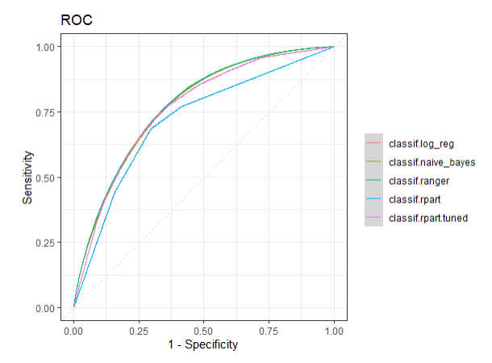



Model
Model Evaluation: ROC Curve & AUC
Logistic Regression
Naive Bayes
Random Forest
Notes:
By observing the ROC curves of the three models, we can find that, compared with the Logistic Regression model and Naive Bayes model, the ROC curves of the Random Forest model are more inclined to the upper left corner.

Slide 33
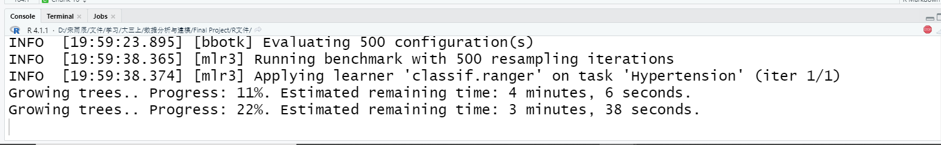
Model
Model Evaluation: Training Time

Slide 34
Model
Model Selection
Random Forests
Accuracy: 71%
AUC: 0.776
Training Time: Several Minutes

Slide 35
Model
Future Work
Hyperparameter Tuning
Resampling -- Robustness
Models Assemble
Feature Selection

Slide 36
Conclusion
/05

Slide 37
Conclusion
Response variable：
X_rfhype5(whether to have hypertension)
Methods and plots used in EDA :
Sampling, 1.5 IQR Principle, Normalization, Hypothesis test, Chi-squared test, Large sample T test, Density curve, Two-way table, Stacked-bar chart, Boxplot, Histogram, Mosaic plot, QQ plot, Bar plot, etc.
Results
1. Find out five variables with great impact to hypertension:
Smoke100 , Exerany2, X_bmi5, cvdinfr4, X_age_g.
2. We train three models, such as Logistic Regression, Naive Bayes and Random Forest. We could use these models to predict whether an individual have hypertension if given the data of those five exploratory variables

Slide 38
Thanks.
Group 8
2021/12/8

