Slide 1

Point Spread Function Estimation
Yuchen Wang

Slide 2
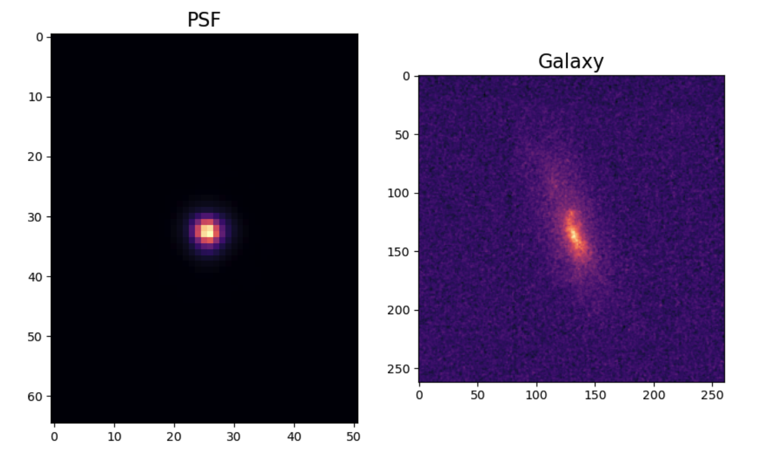
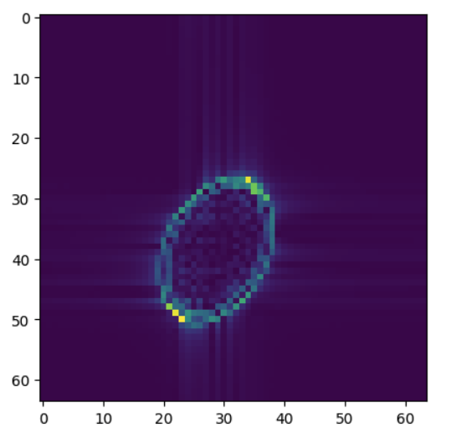
Point Spread Function
Galaxy Point Spread Function
Photoacoustic Computed Tomography (PACT) Point Spread Function
Gaussian psf
PACT psf
[https://github.com/Lukeli0425/LR-PSF/blob/main/tutorials/simulations_astro.ipynb]
Notes:
So here we experiment two Points Spread Function. The first one is the Galaxy Points Spread Function, and the second one is the Photo Acoustic Computed Tomography Points Spread Function. The first Point Spread Function is to de-blur the galaxy image.

Slide 3
My Work: PSF Fitting
EM algorithm
Neural Networks
Notes:
We first put the input into the E-step to estimate the parameters, and then we put the parameters in the M-step to maximize the accuracy. So here we are using the neural network. After the neural network improving the accuracy, we put the estimated PSF back into the E-step, and then we just do it to maximize the accuracy.

Slide 4
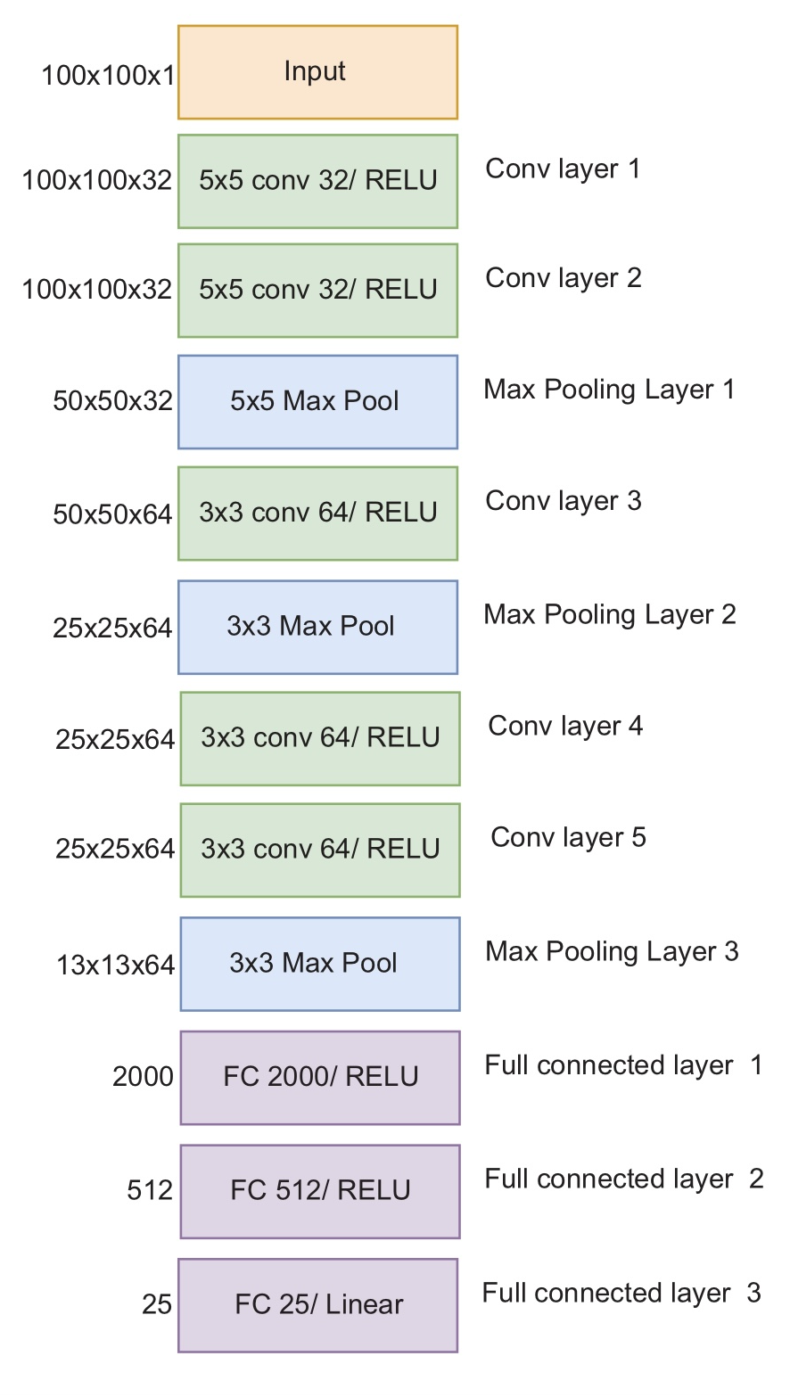
Neural Network
Cnn + mlp
Loss function: mean square(differentiable)
Normalised
input
Conv 32/RELU
Conv Layer 1
Max Pool
Max Pooling Layer 1
Conv 64/RELU
Conv Layer 2
FC 1600/RELU
Full connected layer 1
FC 128/RELU
Full connected layer 2
FC 64/RELU
Full connected layer 3
FC 3/RELU
Full connected layer 4
[Siddik A B, Sandoval S, Voelz D, et al. , 2023]
Notes:
So I implemented two neural networks as they are applied to different points-based functions. They are both CNN plus MLP and the loss functions are all mean squared and all the input data are normalized before it pulls into the neural networks. So the first one have only two convolution layers and three full connected layers. So this one is for the Gaussian Galaxy Poincare function. And the second one is found on a paper published in 2023. But this one is actually for the Nike Poincare function. But I used it for the photopacked Poincare function. And it works well except for the five parameters. The reason why I have two different neural networks is because they perform differently on these two Poincare functions. This neural network is faster because it has less layers. So for the first Poincare function, it only has three parameters. So it is very simple. So actually the two neural networks perform the same. But the first one is faster, so I use the first one to do the Gaussian Poincare function feeding. But for the second one, for the packed PSF, the first neural network performance is not that well. So that's why I use the second one to improve its performance.

Slide 5
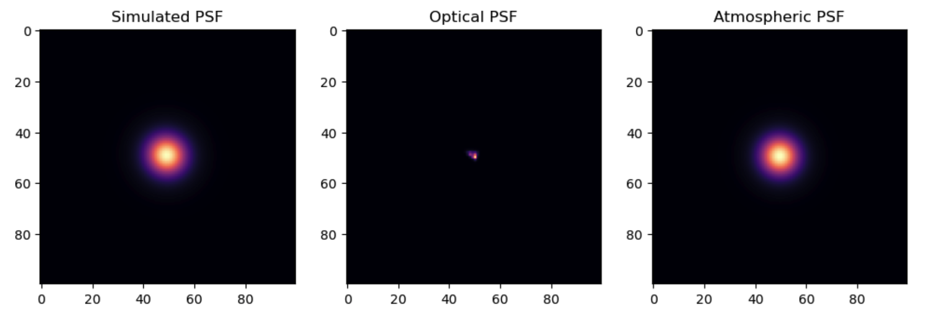
Galaxy Point Spread Function
Optical PSF: small effects(removed)
Atmospheric PSF
[https://github.com/Lukeli0425/LR-PSF/blob/main/tutorials/simulations_astro.ipynb]

Slide 6
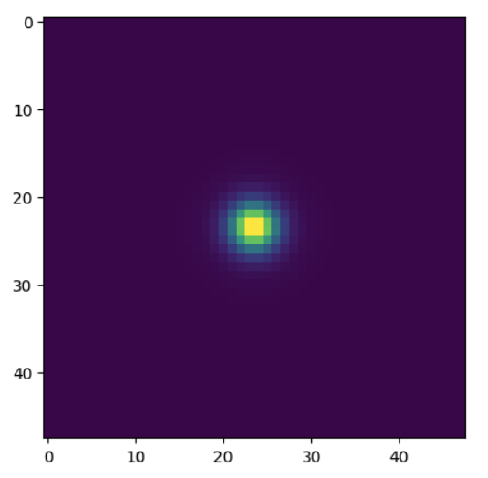
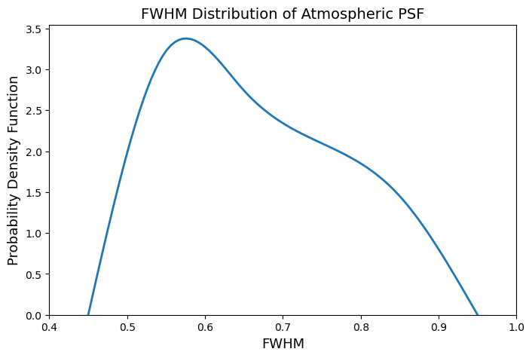
Atmospheric PSF
atomos_fwhm:0.45-0.95
atmos_e : 0.01-0.03
atmos_beta :0-2pi
Kolmogorov function
[Li T, Alexander E., 2022]
[https://github.com/Lukeli0425/LR-PSF/blob/main/tutorials/simulations_astro.ipynb]
Notes:
The atmospheric psf is mainly determined by three parameters: atomos_fwhm, atmos_e and atmos_beta and the implementation is based on Tianao’s previous work on galaxy image deconvolution. You could see there are three parameters, but actually it is a simplified version that we did not add the extra shearing parameters. So the shearing equals to 0. The image on the left is one example of the generated point spread function image. The Kolmogorov function is used to simulate the turbulence.
The full width at half maximum of the Kolmogorov function, it can represent the size of the psf. The distribution of atomos_fwhm is from GREAT3 Challenge by Mandelbaum
Atomos_e is the Ellipticity of the shear to apply to the atmospheric component.
Atmos_beta is the Position angle (in radians) of the shear

Slide 7
Data Generation:Galaxy psf
56030 samples
Random
Notes:
The data used are generated randomly within its range

Slide 8
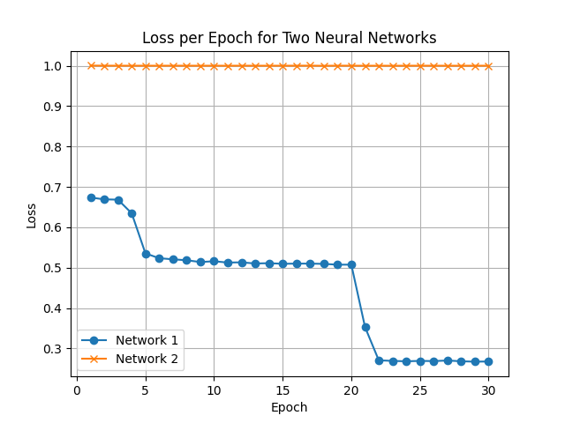
Neural Networks: Galaxy psf
Neural Network 1
Neural Network 2
input
Conv 32/RELU
Conv Layer 1
Max Pool
Max Pooling Layer 1
Conv 64/RELU
Conv Layer 2
FC 1600/RELU
Full connected layer 1
FC 128/RELU
Full connected layer 2
FC 64/RELU
Full connected layer 3
FC 3/RELU
Full connected layer 4
[Siddik A B, Sandoval S, Voelz D, et al. , 2023]

Slide 9
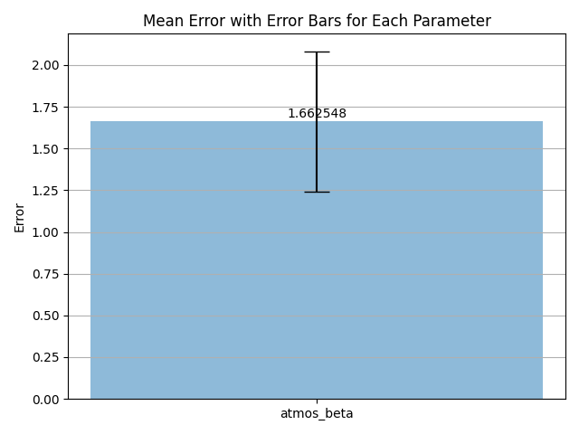
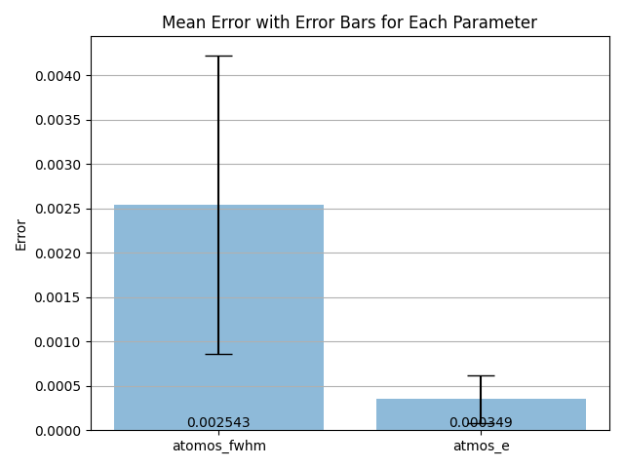
Results: Galaxy psf
atomos_fwhm:0.45-0.95
atmos_e : 0.01-0.03
atmos_beta :0-2pi
Notes:
0

Slide 10
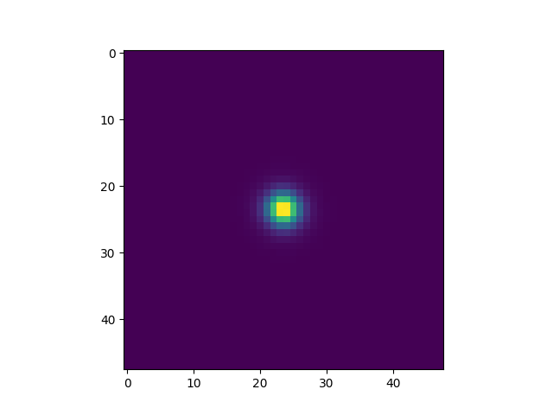
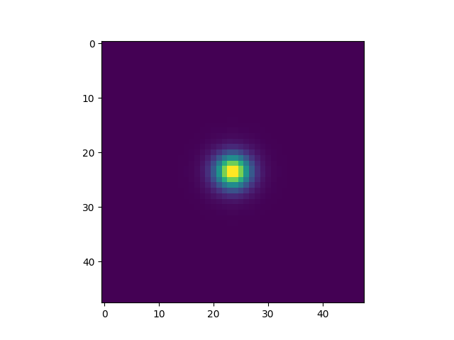
Results Visualisation
Parameter | Atmos_fwhm | Atmos_e | Atmos_beta
Ground Truth | 0.7564 | 0.0269 | 3.8587
Predicted | 0.9651 | 0.0490 | 3.1772
Ground Truth
Predicted psf

Slide 11
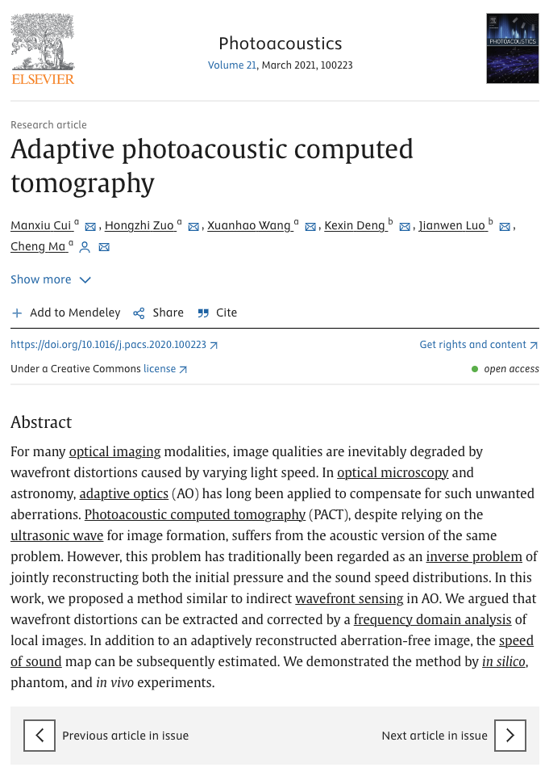
Photoacoustic Computed Tomography (PACT) Point Spread Function
Problem: varying light speed-> wavefront distortions-> image quality degraded
Based on previous work [Cui M, Zuo H, Wang X, et al., 2021]
Adaptive Optics(AO)
[Cui M, Zuo H, Wang X, et al., 2021]
Notes:
So photoacoustic computed tomography points-by-function is used to solve the problem that the image quality is degraded by the wavefront distortion by varying light speed. And the calculation of the points-by-function is based on previous work by Cui Manxiu of this paper.
The point spread function is calculated patch by patch

Slide 12
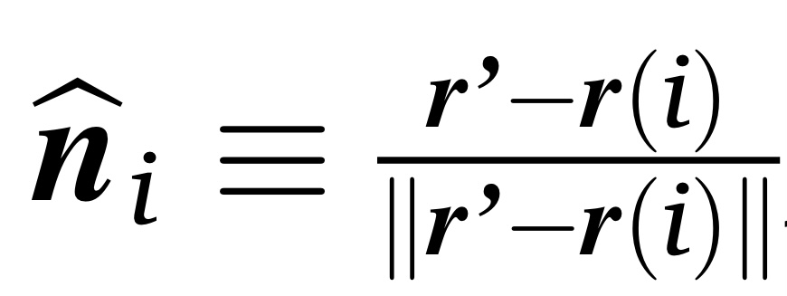
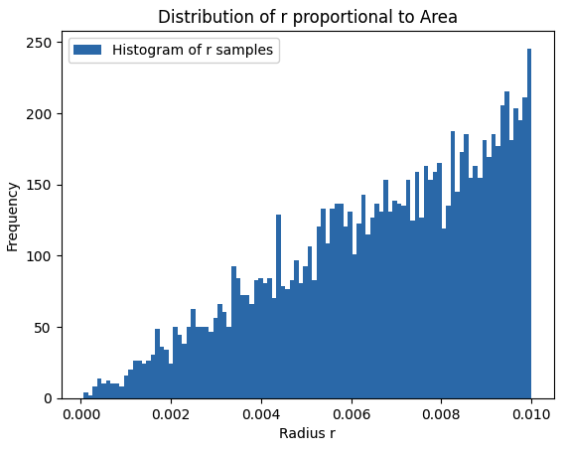
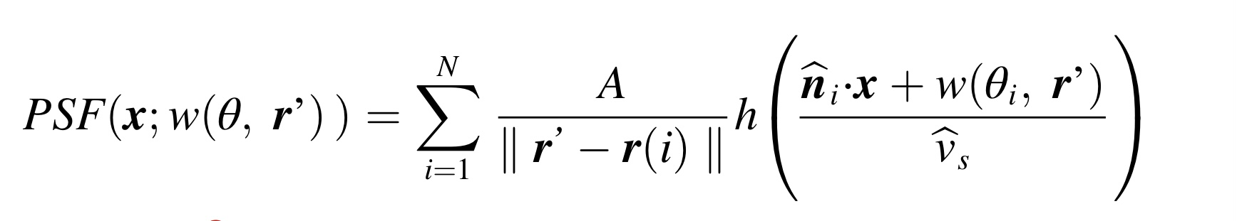
Psf functions
transducers
[Cui M, Zuo H, Wang X, et al., 2021]

Slide 13
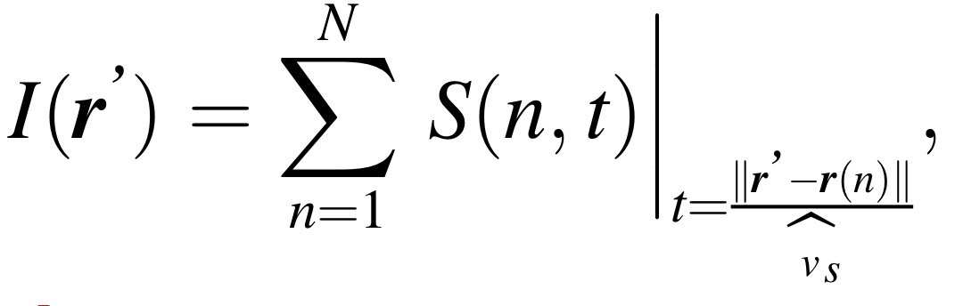
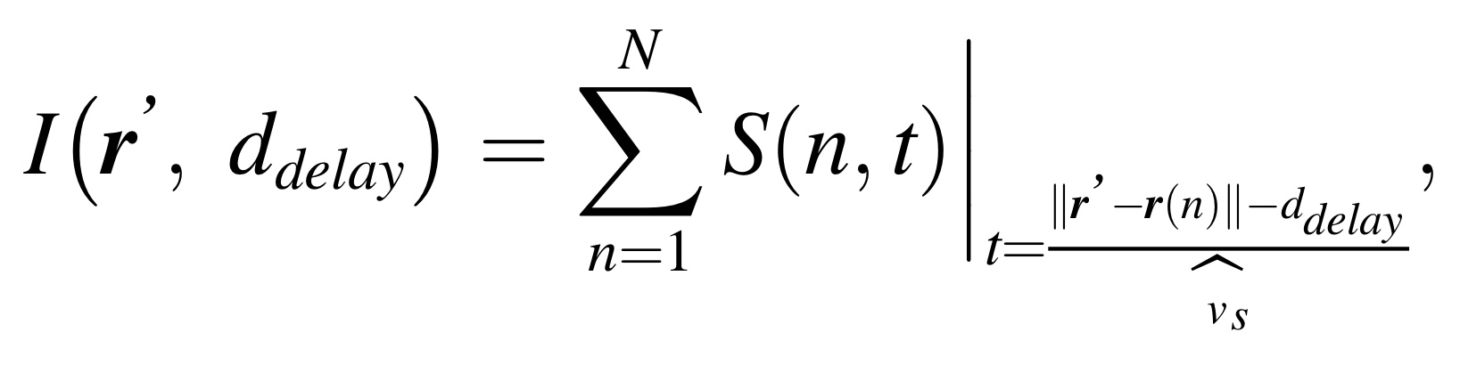
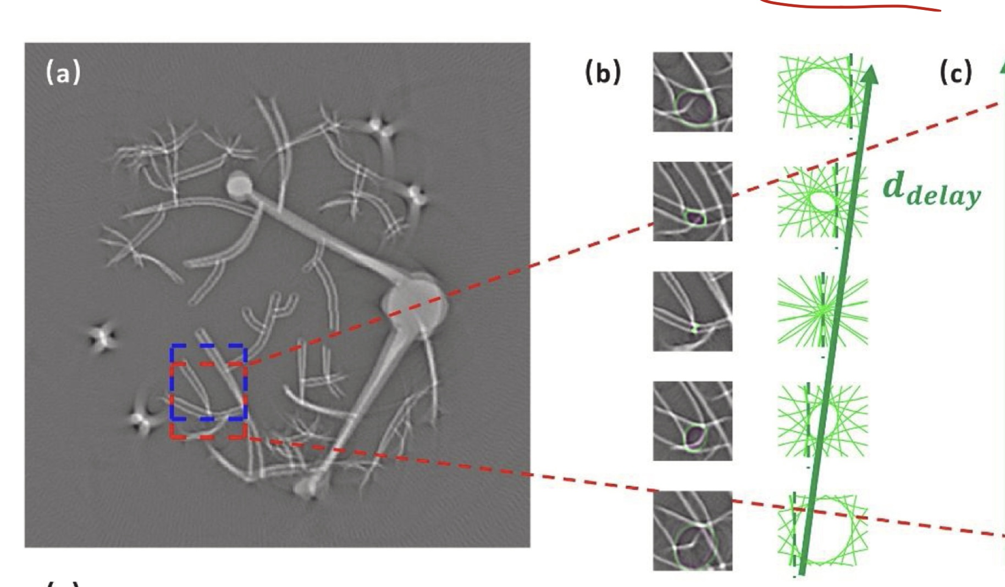
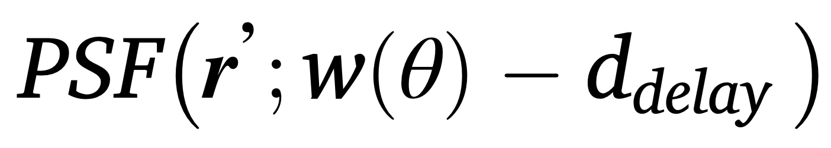
Photoacoustic Computed Tomography (PACT) Point Spread Function
Piecewise deconvolution
Patch by patch
W(theta), delay
Speed of Sound(SOS)
[Cui M, Zuo H, Wang X, et al., 2021]
Notes:
The local PSF, which has long been regarded as an unknown, can be
computationally found from a stack of local images reconstructed with
different delays.
They propose a method that can computationally found the PSF. The full image is reconstructed patch by patch. The red rectangle here is a patch and the blue rectangle here is the successive patch. And the full image can be reconstructed by piecewise deconvolution. And here is the image, the patch, reconstructed with increasing delay. The outline of the PSF is marked in green.
The image is reconstructed by the traditional delay and sum algorithm.
PSF shape is determined by the wavefront distortion and delay.
These local images are stitched together, with neighboring
patches partially overlapped and superimposed, to generate the full
image.
Within each patch, the wavefront distortion is almost identical in each patch

Slide 14
Photoacoustic Computed Tomography (PACT) Point Spread Function
Phi: 0-2pi
C0: 3.097 e-08 to 0.00062
C1: 4.999e-06 to 0.00062
C2: 2.225e-08 to 0.00015
Delay:-0.0003 to 0.0004
PACT psf
[Cui M, Zuo H, Wang X, et al., 2021]
Notes:
ddelay is the extra delay distance in the delay and sum (DAS) algorithm.
Below is the equation to calculate the wavefront function , we only use c0, c1 and c2. So here you could see we will estimate these three parameters here. The calculations of these three parameters will use the speed of sound in water and in the animal bodies, and the radius
Phi is the shifting angle

Slide 15
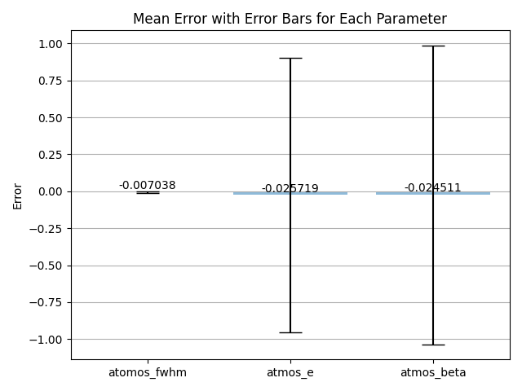
Results: Galaxy Point Spread Function

Slide 16
Data Generation:pact psf
5000 samples
Random
Notes:
The data used are generated randomly within its range

Slide 17
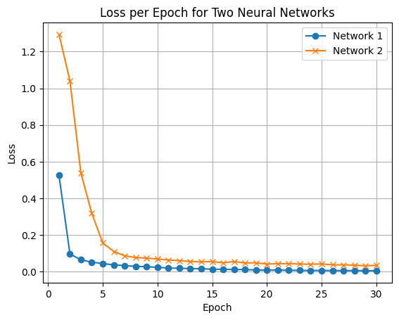
Neural Networks: PACT psf
Neural Network 1
Neural Network 2
input
Conv 32/RELU
Conv Layer 1
Max Pool
Max Pooling Layer 1
Conv 64/RELU
Conv Layer 2
FC 128/RELU
Full connected layer 1
FC 64/RELU
Full connected layer 2
FC 3/RELU
Full connected layer 3
[Siddik A B, Sandoval S, Voelz D, et al. , 2023]

Slide 18
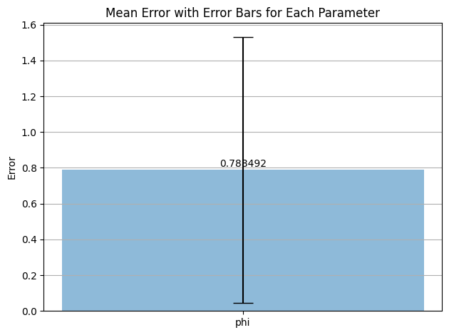
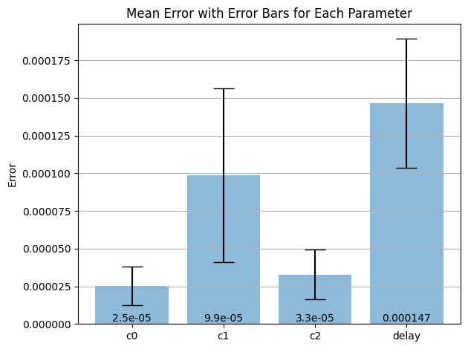

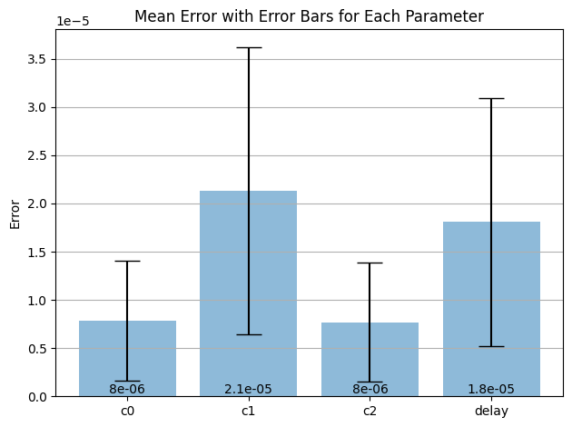
Results: PACT psf
First Neural Network
Phi: 0-2pi
C0: 3.097 e-08 to 0.00062
C1: 4.999e-06 to 0.00062
C2: 2.225e-08 to 0.00015
Delay:-0.0003 to 0.0004
Second Neural Network
nn1: 16 minutes ,nn2: 3 hours
Notes:
So here is the result of the packed PSF. The first diagram is for PHY, and the second diagram is for the rest of the features. You could see that the reason why I split these two parameters is because they are in different range. The result is kind of satisfactory right now.

Slide 19
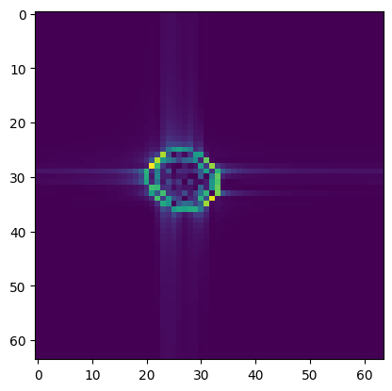
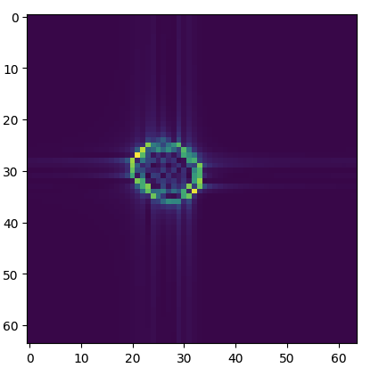
Results Visualisation
parameter | phi | C0 | C1 | C2 | delay
Ground truth | 1.825 | 5.964e-04 | 2.676e-04 | 2.864e-05 | 3.2029e-04
predicted | 1.906 | 5.940e-04 | 2.794e-04 | 3.138e-05 | 3.091e-04
Ground Truth
Predicted psf

Slide 20
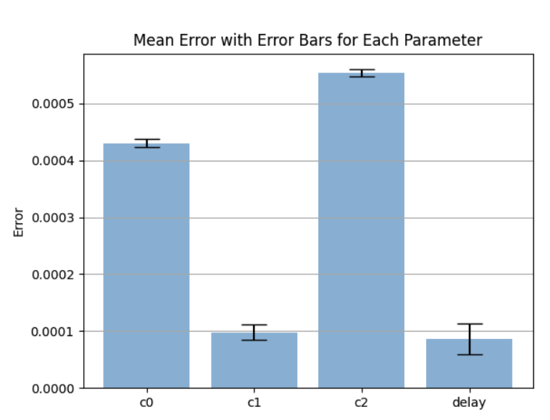
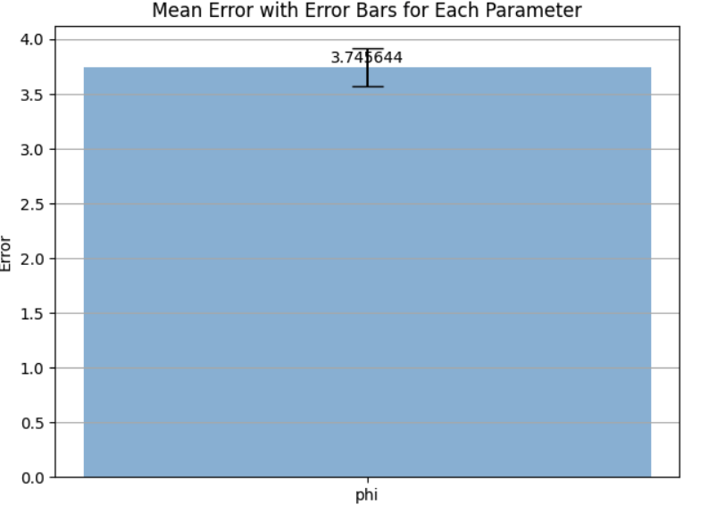
Results: PACT psf
0.00055
0.00043
0.000098
0.000086
Notes:
So here is the result of the packed PSF. The first diagram is for PHY, and the second diagram is for the rest of the features. You could see that the reason why I split these two parameters is because they are in different range.

Slide 21
Future Work
Improve the performance of neural networks predicting the galxy psf
Integrate the neural networks into the EM algorithm

Slide 22
Conclusion

Slide 23
References
Li T, Alexander E. Galaxy Image Deconvolution for Weak Gravitational Lensing with Physics-informed Deep Learning[J]. arXiv preprint arXiv:2211.01567, 2022.
Siddik A B, Sandoval S, Voelz D, et al. Deep learning estimation of modified Zernike coefficients and recovery of point spread functions in turbulence[J]. Optics Express, 2023, 31(14): 22903-22913.
Cui M, Zuo H, Wang X, et al. Adaptive photoacoustic computed tomography[J]. Photoacoustics, 2021, 21: 100223.

Slide 24

Thanks for listening

