Slide 1

F I T 5 1 9 2
Assignment 2
Liu Binchu
Lu Zhen

Slide 2
1. Introduction
Background:
we designed a website for CoCo Milk Tea Group where people can apply to join this Milk Tea Brand and open new store.
Functionality:
Home
Registration & login &user display
About us : History and FAQs
Site Map
Documentation
Calendar: highlight events and show detail
Email : send Email to users
Technical detail:
Access database
. Net Framework 4.0

Slide 3
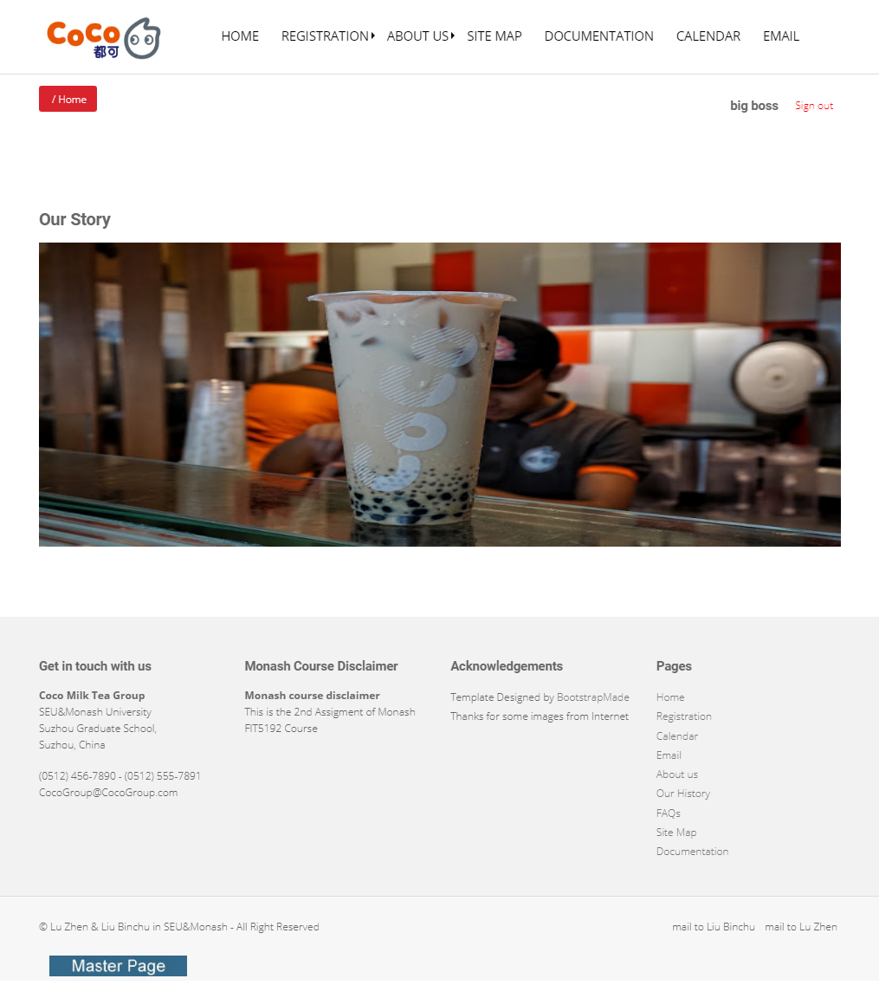
2. Website Presentation ：Home & Master Page
Menu
Breadcrumb
AdRotator
Monash Course disclaimer
Copy right notice& Email Links& Acknowledgements
Navigations
Image Button
Notes:
1. We use an menu to navigate the whole website
2. We use a breadcrumb to show the current web’s path in the whole website
3. An adRotator is used to show some pictures , 3 pictures, click the picture the html code of home page generated by server will be displayed
4.

Slide 4
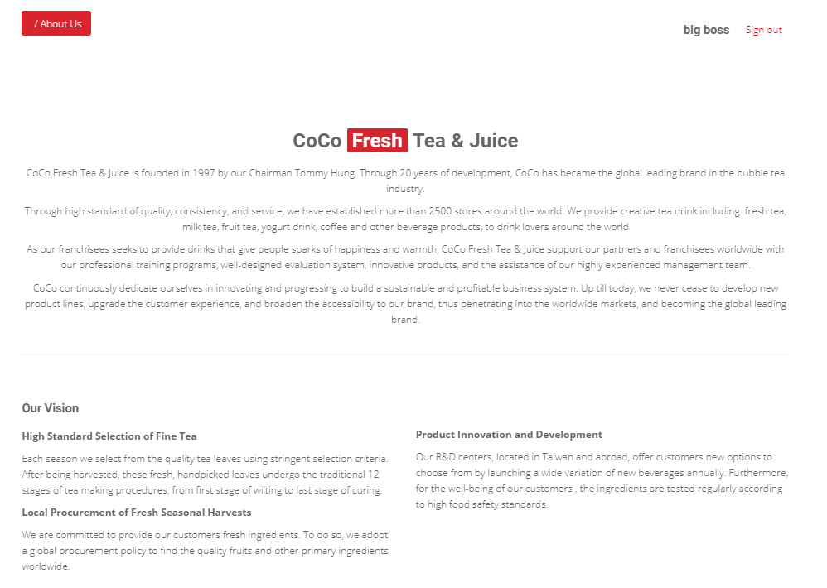
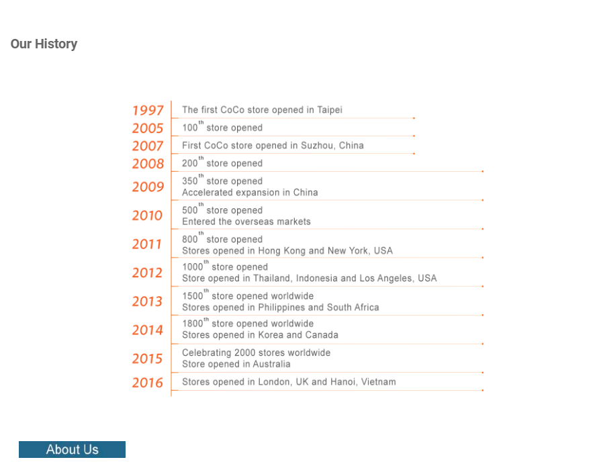
2. Website Presentation ：About us & Our history

Slide 5
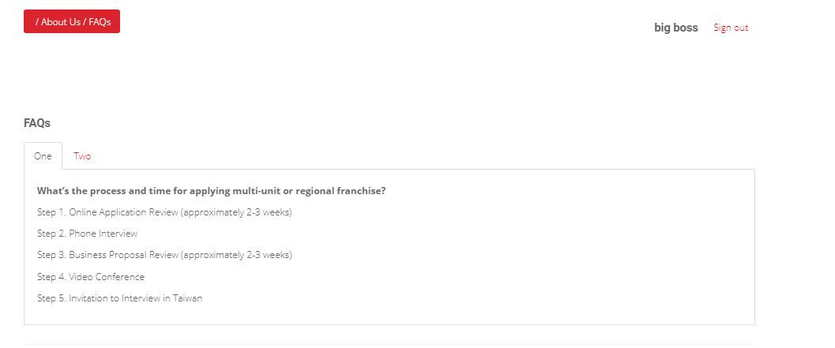
2. Website Presentation ：FAQs

Slide 6
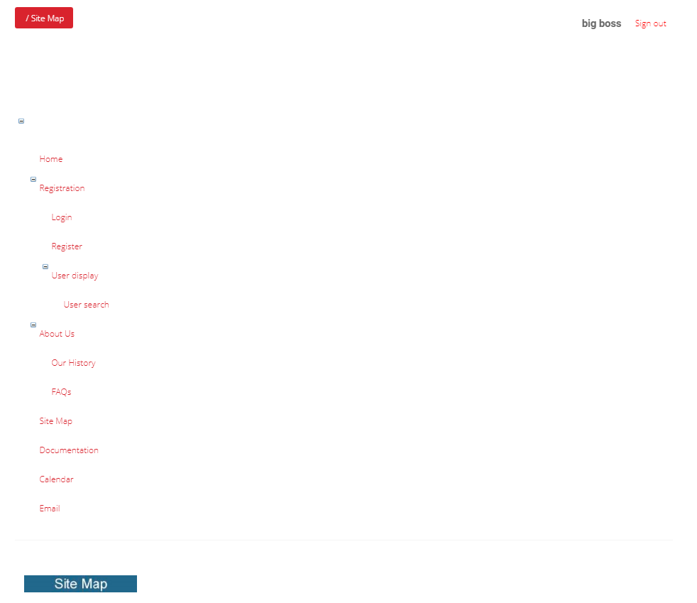
2. Website Presentation ：Site Map
Tree View Control
Show the structure of website

Slide 7
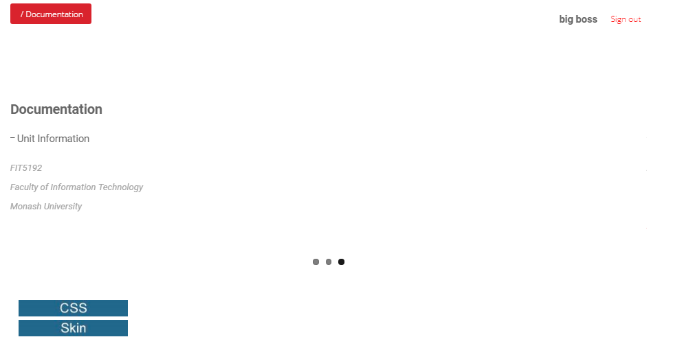
2. Website Presentation ：Documentation

Slide 8
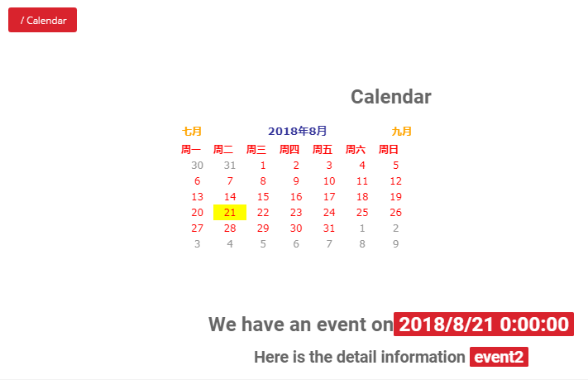
2. Website Presentation ：Documentation
Highlight Event Day
Display event detail
Notes:
When the page loads, it will check the database to determine if there any events scheduled for today. If so, today’s date should be highlighted in Yellow in the calendar and the event description and event time will be displayed beneath calendar
If there is no event today, the calendar will not highlight it and display no event today

Slide 9

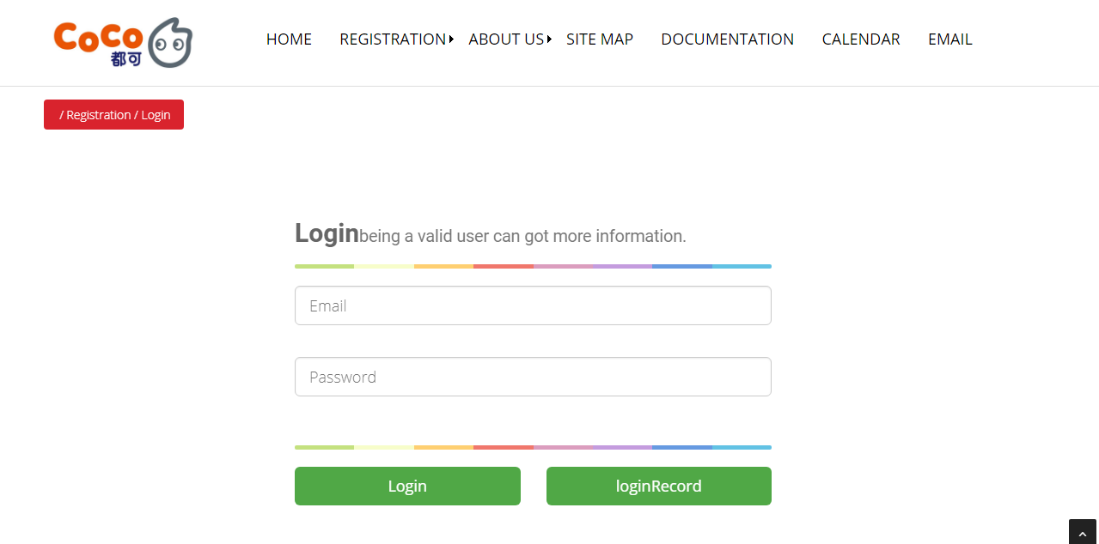
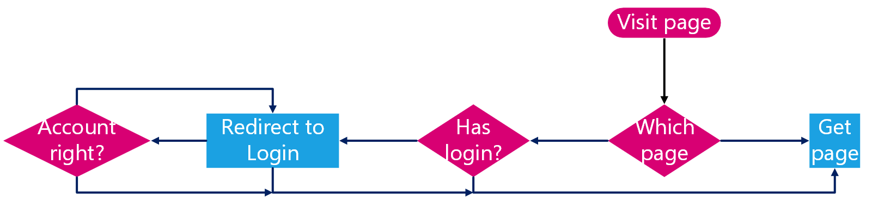
FormsAuthtication (set cookie)
FormsAuthentication.RedirectFromLoginPage(strResultsHolder, true);
Web.config -> Forms -> <deny users="?" />
2. Website Presentation ：Login
OleDbConnection Access Database
string strConnection = "Provider=Microsoft.ACE.OLEDB.12.0;DataSource=|datadirectory|/fit5192.accdb;Persist Security Info=False;";

Slide 10
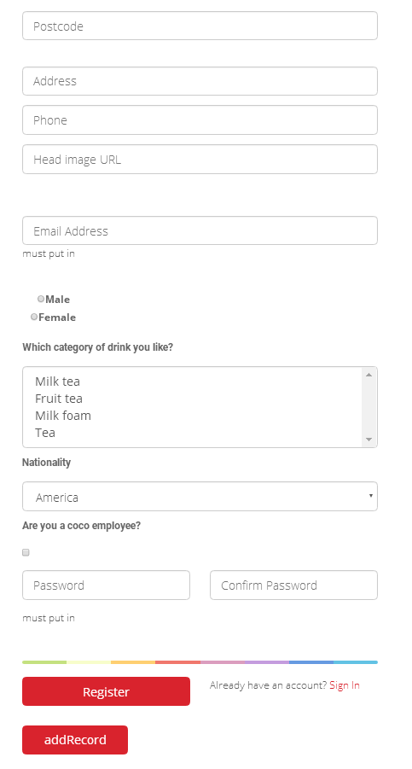
2. Website Presentation ：Registration
Including dropdown list, listbox, textbox, radio buttons list and checkbox.
Using RequiredFieldValidator(must have content), CompareValidator control(judge valid password and postcode), CustomValidatorcontrol(ensure email form and length), RangeValidator control (judge valid age)and RegularExpressionValidatorcontrol(ensure password form).
Insert Access Database C# code implement
Using OleDbConnection and write SQL sentence.
Html Code show
In registration script: Render()function -> StringWriter(); HtmlTextWriter(tw);

Slide 11
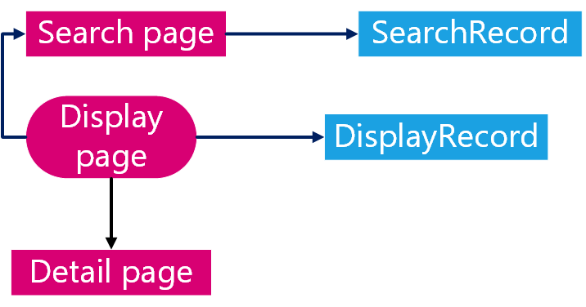
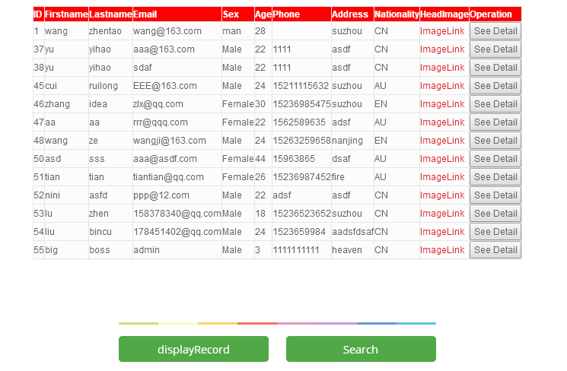
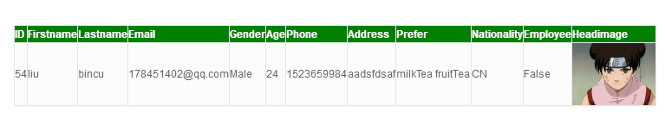
2. Website Presentation ：Display and Search
Using GridView, BoundFields, ImageField, ButtonField and HyperlinkField.
Using asp:AccessDataSource
Can search by ID, Name, Address

Slide 12


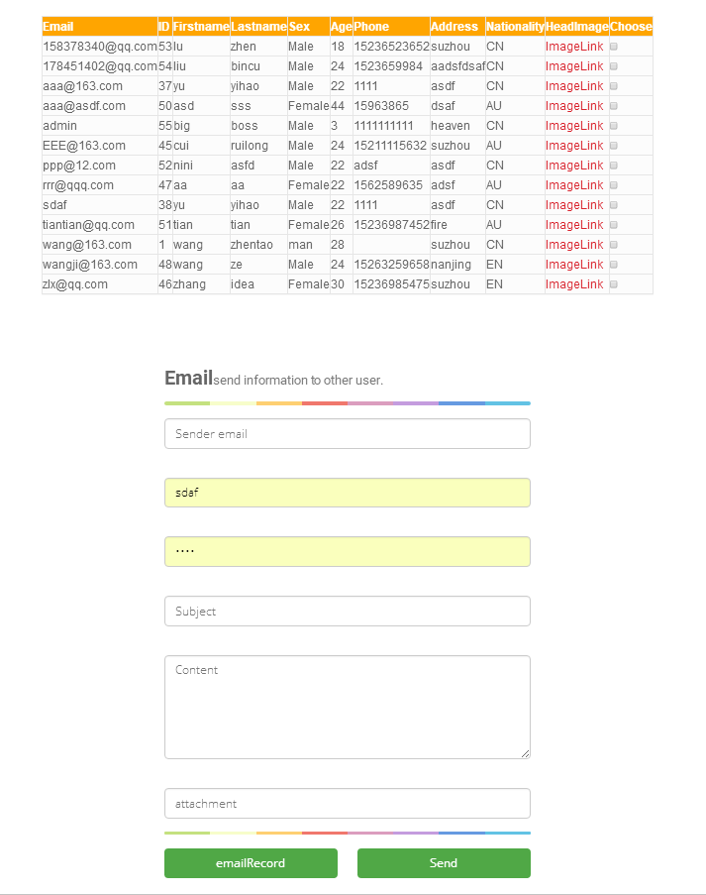
2. Website Presentation ：Registration
Using SmtpClient and MailMessage to build and send email.
Must put in your STMPHOST and AUTHENTICATION CODE (if need)
User can choose multiple other users’ emails to send email.
User can upload attachment in the email.

Slide 13
Thank You !
Questions ？

