Slide 1
尺寸(mm) | 尺寸链图 | 尺寸链分析 | 结果(mm) | 是否满足要求
7.2 | 直接加工 |  | 7.2 | 满足
10.4 |  |  | 10.4 | 满足
60 |  |  | 60 | 满足
9.6 |  |  | 9.6 | 满足

Slide 2
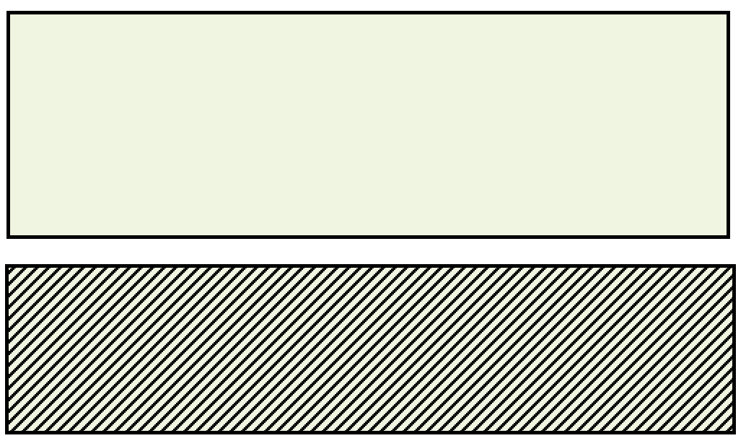
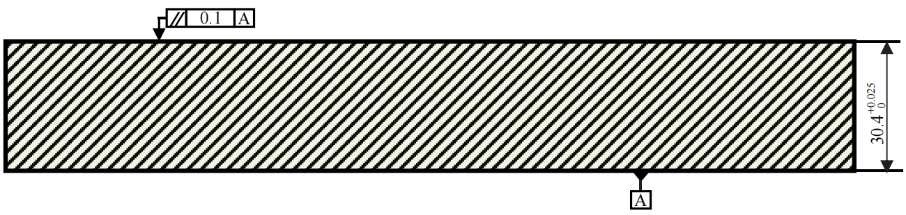
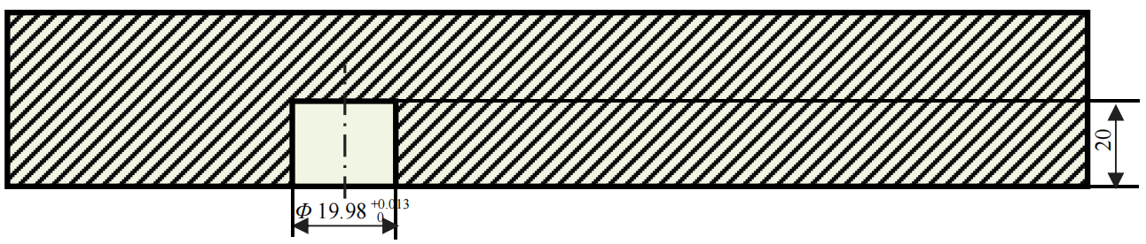
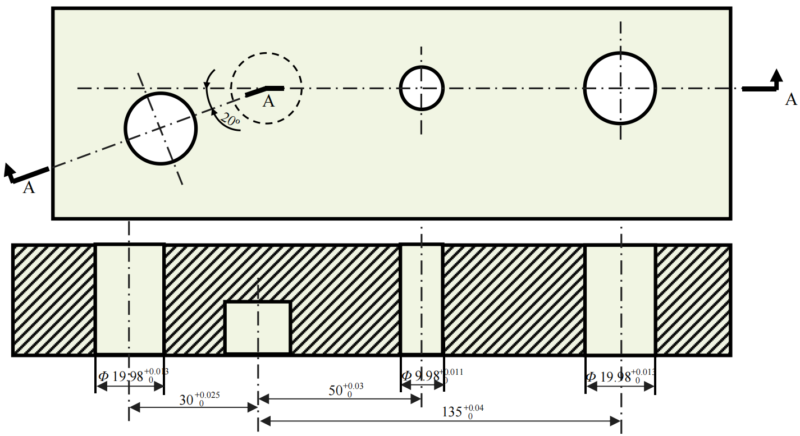
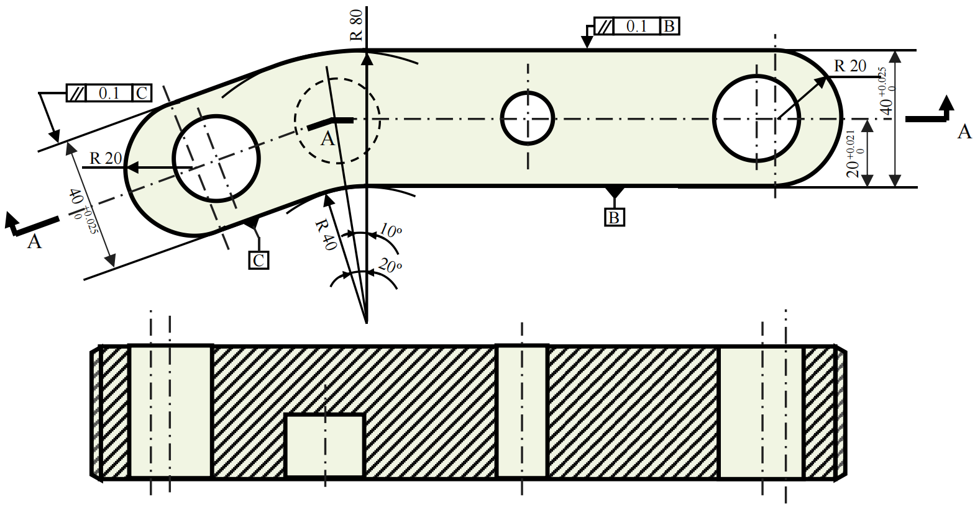
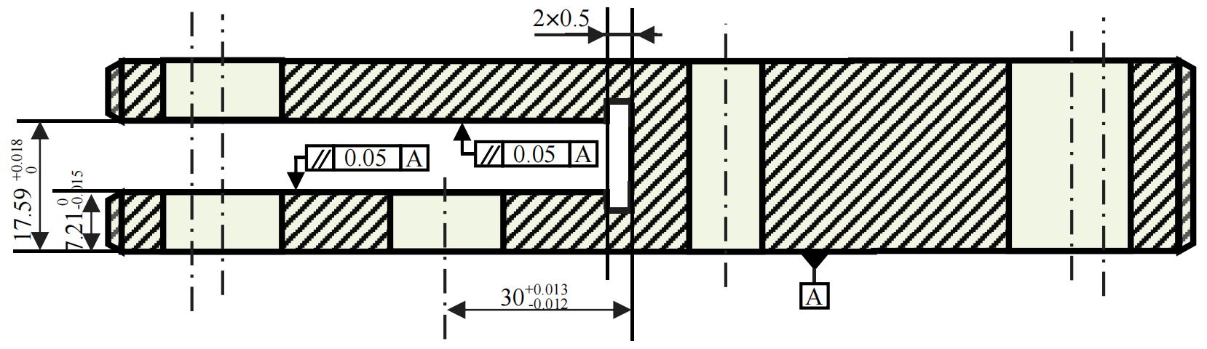
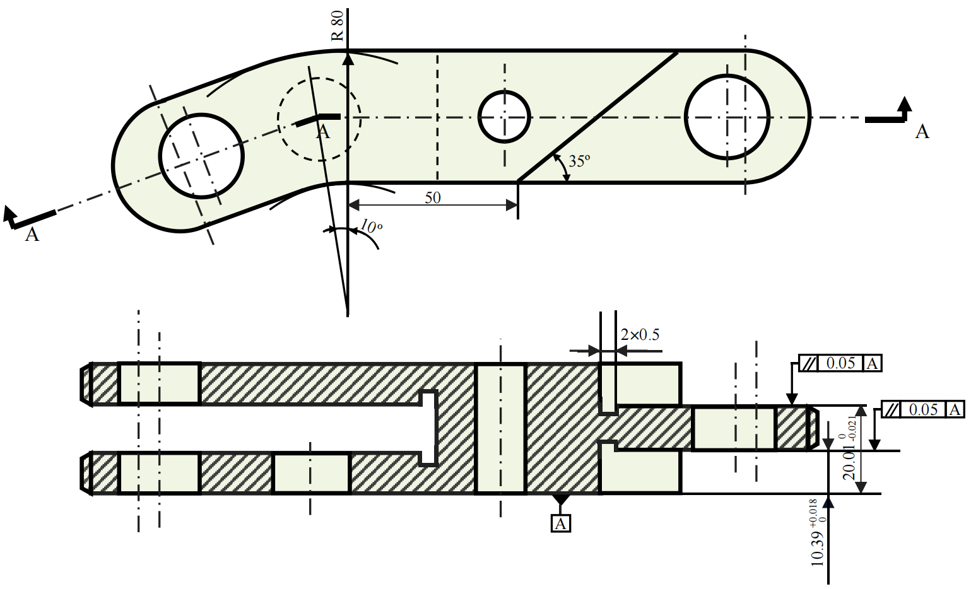
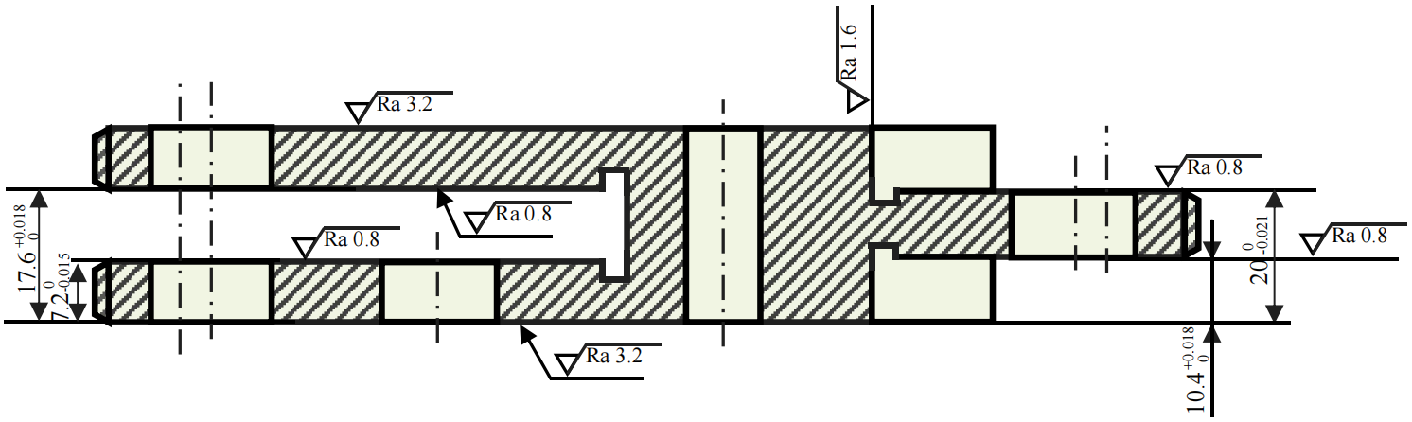
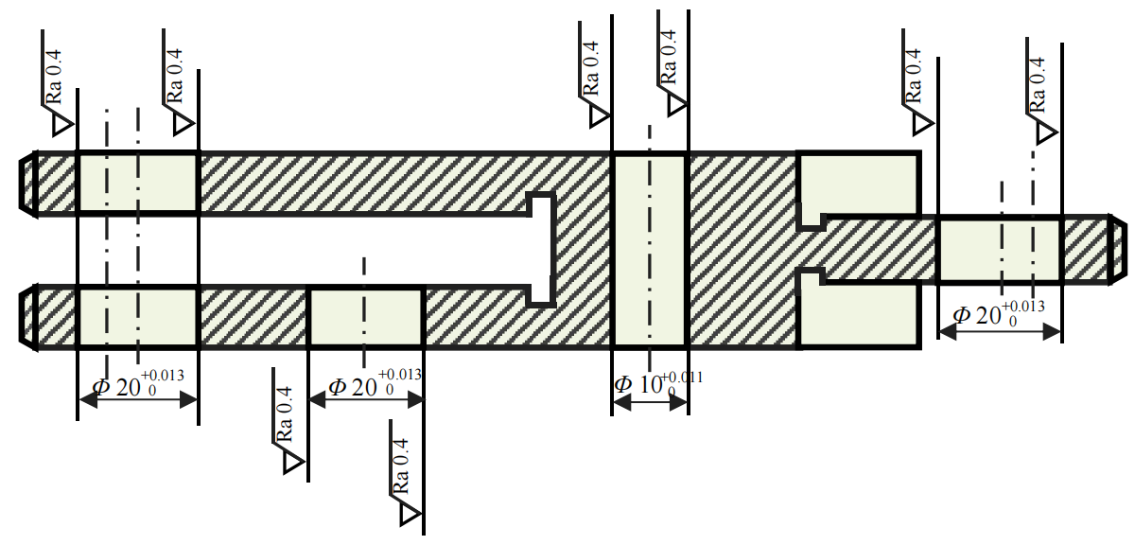
 | Operation | Process Content | Schematic Equipment | Equipment
1 | Cutting Material | 240mm · 90mm · 50mm
2 | Milling | Rough and finish milling base surface A; milling top surface with A as reference; |  | Milling Machine
3 | Boring | Rough boring, semi-finish boring, finish boring the datum hole, leave grinding allowance 0.01mm; |  | Boring Machine
4 | Boring | Rough boring, semi-finish boring, finish boring the rest of the holes (based on the datum hole), leave grinding allowance 0.01mm; |  | Boring Machine
5 | Milling | Numerical control (NC) milling of the entire side surface (each hole as reference) |  | CNC Milling Machine
6 | Milling | Rough and finish milling the left slot (with A surface, datum hole as reference) and clearance slot, leave grinding allowance 0.01mm |  | Milling Machine
7 | Milling | Rough and finish milling the right-hand surface (with A surface, datum hole as reference) and clearance slot, leave grinding allowance 0.01mm; |  | Milling Machine
8 | Grinding | Rough and finish grinding of all planes, ensure surface roughness and machining accuracy requirements; |  | Surface Grinding Machine
9 | Grinding | Rough and finish grinding of all internal holes, ensure surface roughness and machining accuracy requirements; |  | Internal Grinding Machine
10 | Inspection | Inspect according to drawing requirements

