Slide 1
BU Events Planner
Presented by: Jialong Ke, Yuchen Cao, Zihan Li

Slide 2
App Purpose
This app is designed for Boston University students to easily browse and register for various campus events.
The app aims to help students stay informed about campus happenings, providing an accessible way to enhance their university experience by participating in events.

Slide 3

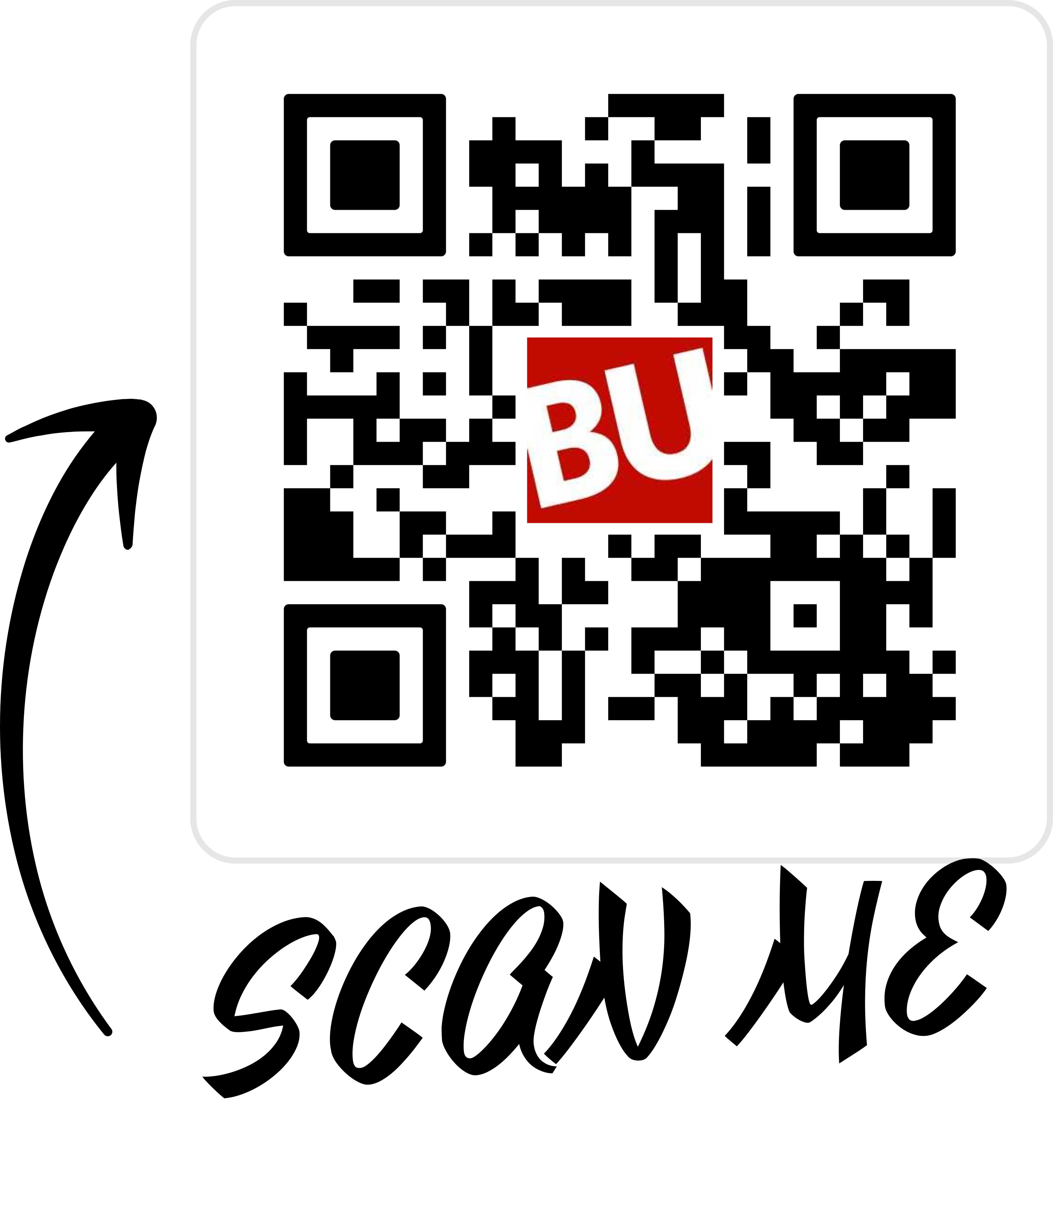
QR Code

Slide 4
App Showcase

Slide 5
APIs
Firebase APIs
Jetpack Compose APIs
Android APIs :ActivityResultContracts.GetContent, Uri
Coil : load images from url
HorizontalPager
Google Sign-In
Google Map
Room
Google Calendar
JUnit
Espresso

Slide 6
Device sensor
GPS

Slide 7
Database schema
data class Event(
val id: String = "",
val title: String = "",
val description: String = "",
val eventUrl: String = "",
val photo: String = "",
val location: String = "",
val startTime: String = "",
val endTime: String = "",
val savedUsers: List<String> = emptyList()
)
data class User(
val firstName: String = "",
val lastName: String = "",
val password: String = "",
val userEmail: String = "",
val userImage: String = "",
val userSavedEvents: List<Event> = emptyList()
)

Slide 8
Additional Features
1. File Upload and Media Handling
2. Location Services
3. Calendar
4. Local Cache (Room)

Slide 9
Omitted Features
1. Device Sensor: Camera 2. OpenEvent Source APIs

Slide 10
Accomplishments
Zihan -> onBoarding, Personal Profile
Yuchen and Jialong -> Login, Register and Event
Yuchen -> Local Cache (Room)
Zihan and Jialong -> Location
Zihan -> Calendar
Together -> FirebaseService, APK, Responsive design

Slide 11
Thank You!

