Slide 1
BU Events Planner
Presented by: Jialong Ke, Yuchen Cao, Zihan Li

Slide 2
App Purpose
This app is designed for Boston University students to easily browse and register for various campus events.
The app aims to help students stay informed about campus happenings, providing an accessible way to enhance their university experience by participating in events.

Slide 3
Additional Features
1. Location Services
2. Dark Mode
3. File Upload and Media Handling

Slide 4
Target User
Primarily designed for Boston University students and staff who want quick access to information about campus events.

Slide 5
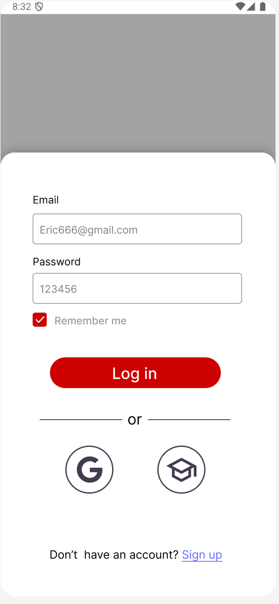
User’s Registration and Login
Users can register and log in using their email or through third-party platforms like Google.
Notes:
Mockups and UI Design
Design Tool: Figma

Slide 6
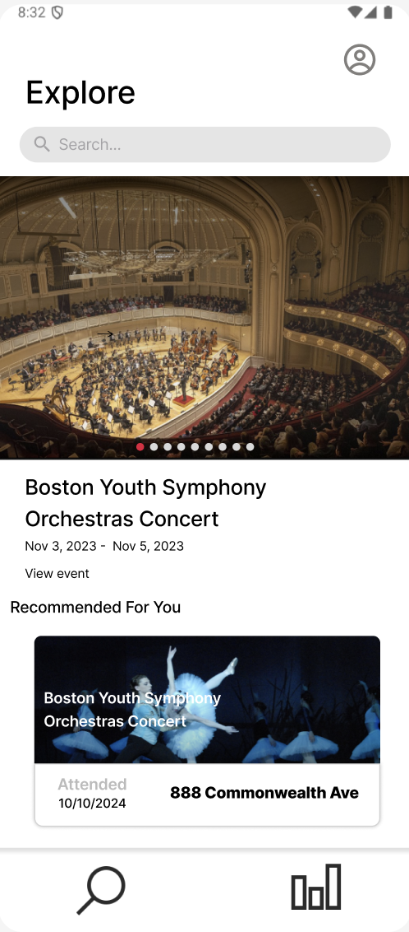
Event List Page
Users can view a list of upcoming events, with details such as date, time, and location.
Below are some recommended events for users.
Notes:
The recommendation method won’t be too complex; our initial idea is to recommend events with the highest attendance.

Slide 7
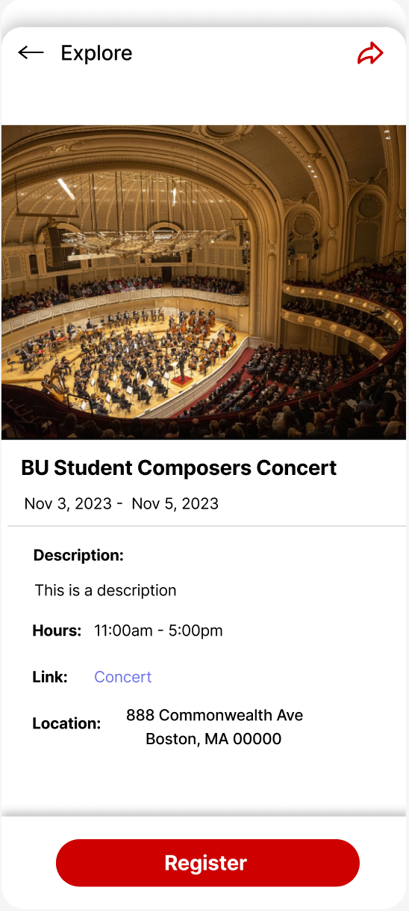
Event Details View
By selecting an event, users can see more detailed information, including descriptions, timings, link for the event, location, and an option to register for the event.

Slide 8
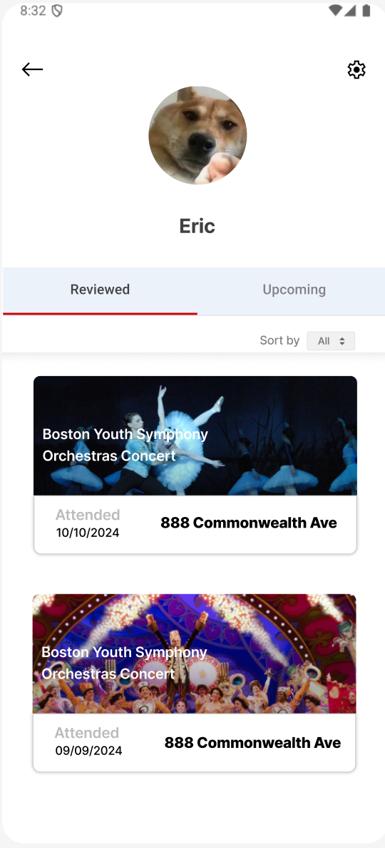
Personal Homepage with Event History
Users can view a personal profile page displaying past attended events and upcoming registered events.

Slide 9
APIs
Firebase Firestore: To store event details and user registration history.
Firebase Authentication: For user registration and login.
Google Maps Geolocation API
Camera API
MediaStore API

Slide 10
Device sensor
GPS
Camera

Slide 11
Database schema
Firestore
|
|-- events (Collection)
| |-- eventID (Document)
| |-- eventTitle: String
| |-- eventURL: String
| |-- eventPhoto: String
| |-- eventLocation: String
| |-- eventStartTime: Timestamp
| |-- eventEndTime: Timestamp
| |-- eventDescription: String
| |-- eventPoints: Integer
| |-- savedUsers: Array<String>
|-- users (Collection)
| |-- userUID (Document)
| |-- firstName: String
| |-- lastName: String
| |-- userProfileURL: String
| |-- userBUID: String
| |-- userEmail: String
| |-- userSchool: String
| |-- userYear: String
| |-- userPoints: Integer
| |-- userSavedEvents: Map<String, Boolean>

Slide 12
External Libraries and Tools
Firebase Crashlytics: For real-time error and crash monitoring.

Slide 13
Thank You!

