Slide 1
BU Events Planner
Presented by: Jialong Ke, Yuchen Cao, Zihan Li

Slide 2
App Purpose
This app is designed for Boston University students to easily browse and register for various campus events.
The app aims to help students stay informed about campus happenings, providing an accessible way to enhance their university experience by participating in events.

Slide 3
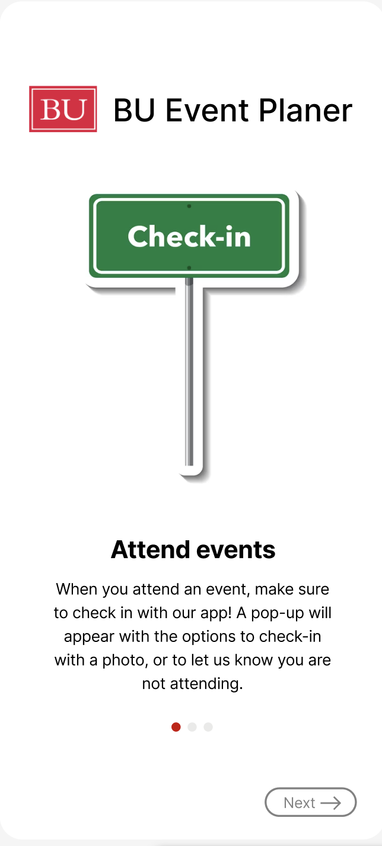
Onboarding Pages
This page introduces the check-in feature, allowing users to confirm attendance with a photo or indicate non-attendance, ensuring accurate tracking.
Notes:
This onboarding page introduces the event check-in feature, guiding users to confirm their attendance by either uploading a photo or marking themselves as not attending. It ensures accurate attendance tracking and enhances user engagement with clear instructions and a streamlined process

Slide 4
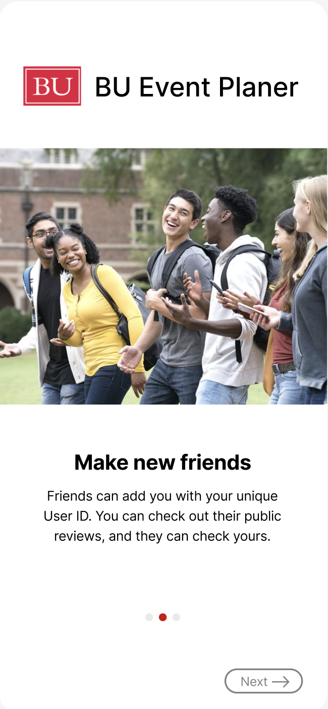
Onboarding Pages
This page highlights the social feature, allowing users to connect with friends through unique User IDs and share public reviews to enhance community interaction.
Notes:
This page introduces the social connection feature, encouraging users to make new friends by sharing their unique User ID. Users can explore public reviews of others while sharing their own, fostering interaction and community engagement.

Slide 5
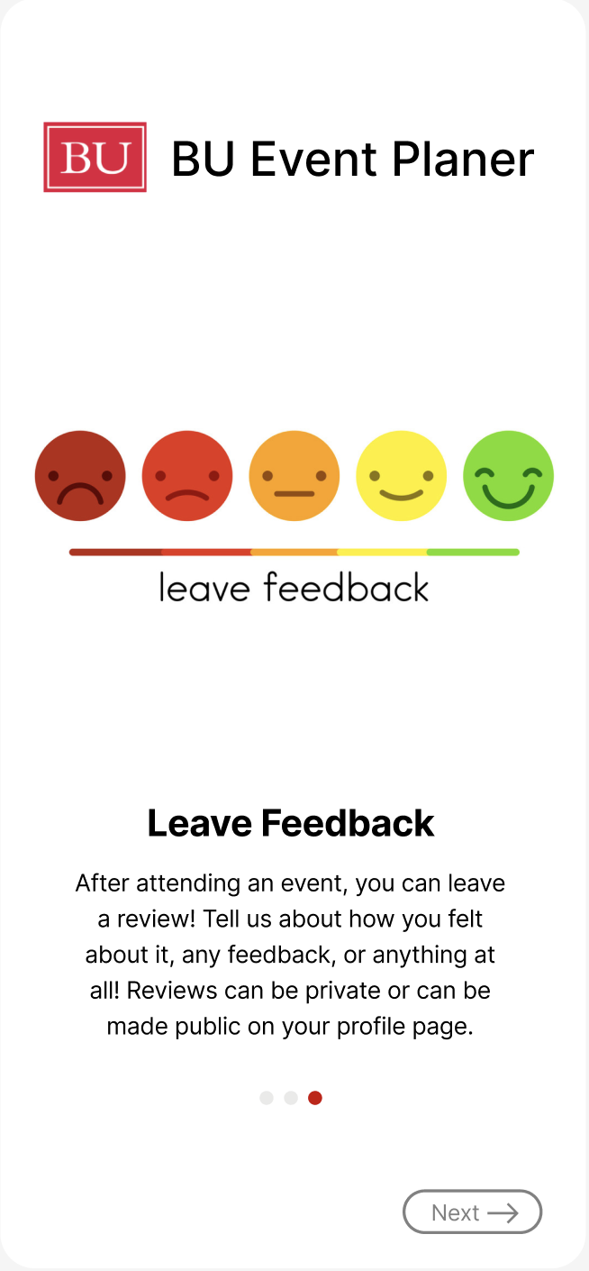
Onboarding Pages
This page explains the feedback feature, enabling users to share private or public reviews, improving event quality and enhancing user engagement.
Notes:
This page introduces the feedback feature, allowing users to share their experiences after attending an event. Feedback can be private or public, helping to improve future events and fostering community transparency.

Slide 6
APIs
Firebase Firestore: To store event details and user registration history.
Firebase Authentication: For user registration and login.
Google Maps Geolocation API
Camera API
MediaStore API

Slide 7
Device sensor
GPS
Camera

Slide 8
Database schema
Firestore
|
|-- events (Collection)
| |-- eventID (Document)
| |-- eventTitle: String
| |-- eventURL: String
| |-- eventPhoto: String
| |-- eventLocation: String
| |-- eventStartTime: Timestamp
| |-- eventEndTime: Timestamp
| |-- eventDescription: String
| |-- eventPoints: Integer
| |-- savedUsers: Array<String>
|-- users (Collection)
| |-- userUID (Document)
| |-- firstName: String
| |-- lastName: String
| |-- userProfileURL: String
| |-- userBUID: String
| |-- userEmail: String
| |-- userSchool: String
| |-- userYear: String
| |-- userPoints: Integer
| |-- userSavedEvents: Map<String, Boolean>

Slide 9
External Libraries and Tools
Firebase Crashlytics: For real-time error and crash monitoring.

Slide 10
Additional Features
1. Location Services
2. Dark Mode
3. File Upload and Media Handling

Slide 11
Demo Showcase

Slide 12
Accomplishments
1. Yuchen -> Demo and Firebase
2. Zihan -> Database Schema and APIs
3. Jialong -> Demo and Firebase
All -> Figma UI design

Slide 13
Thank You!

