Slide 1
Responsive Design in Android using Jetpack Compose
Presented by: Jialong Ke, Yuchen Cao, Zihan Li

Slide 2
Overview of Jetpack Compose
Jetpack Compose: A modern toolkit for building native Android UIs with declarative components.
Allows easy adaptation of layouts with minimal boilerplate code and dynamic flexibility.

Slide 3
Key Techniques in Responsive Design with Compose
Adaptive Layouts: Compose layouts (Column, Row, Box) adjust to varying screen sizes.
Screen Density: Modifier and Layout classes for scaling components.
Orientation Handling: Examples of Modifier.fillMaxSize() and other dynamic composables.

Slide 4
Tools and Techniques in Jetpack Compose for Responsive Design
Constraint Layout: Adapts components based on screen size and resolution.
WindowSizeClass API: Categorizes devices into different size classes.
Modifier.padding() and Spacer() for dynamic spacing.

Slide 5
Demonstrating a Mini Responsive App
Take Hangman app as a example
Here is the app not using the responsive design. When I open the app in landscape or in portrait mode, they all perform well.
However, you can see when I want to rotate the screen, the layout will be mess up. no matter rotate from landscape to portrait or from portrait to landscape.

Slide 6
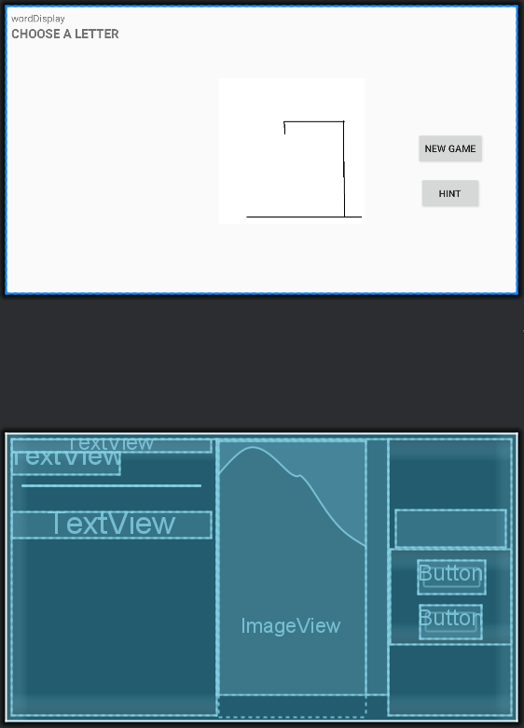
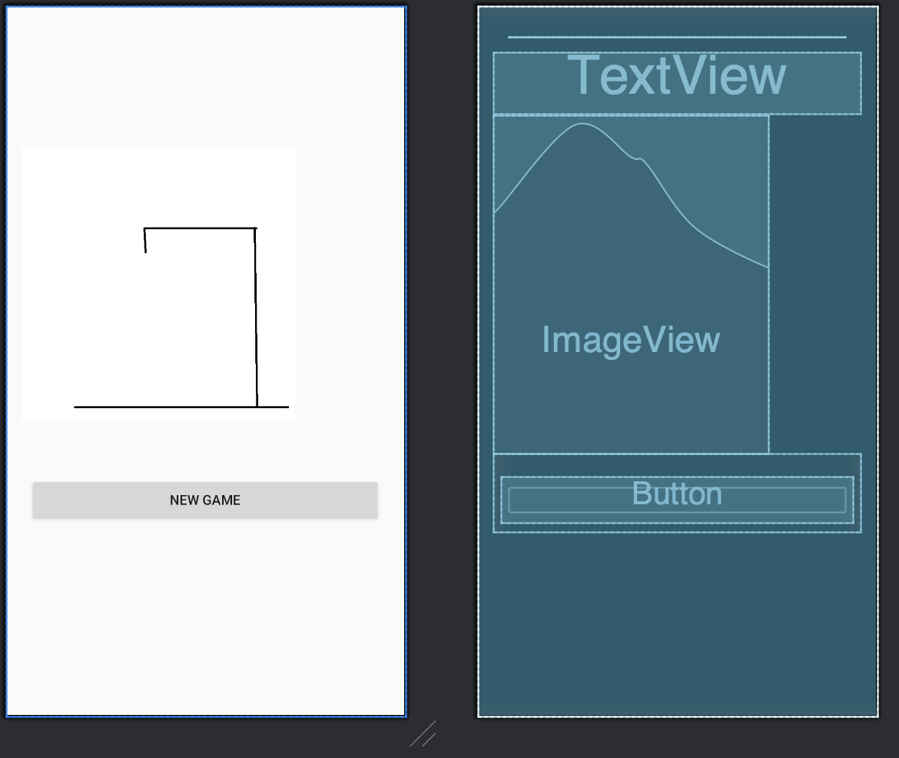
We created a landscape layout and a portrait layout.

Slide 7
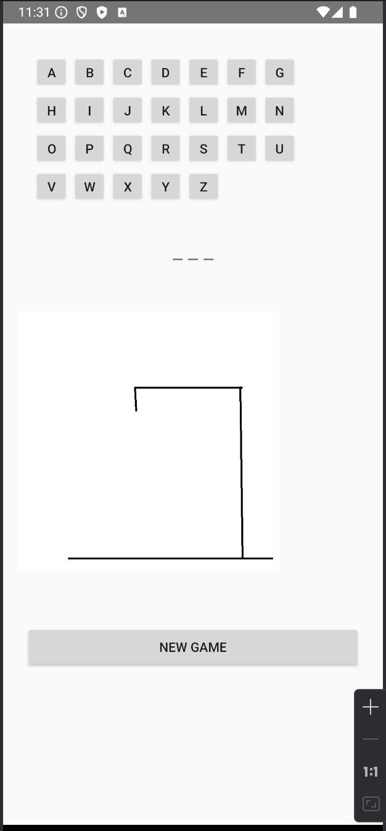
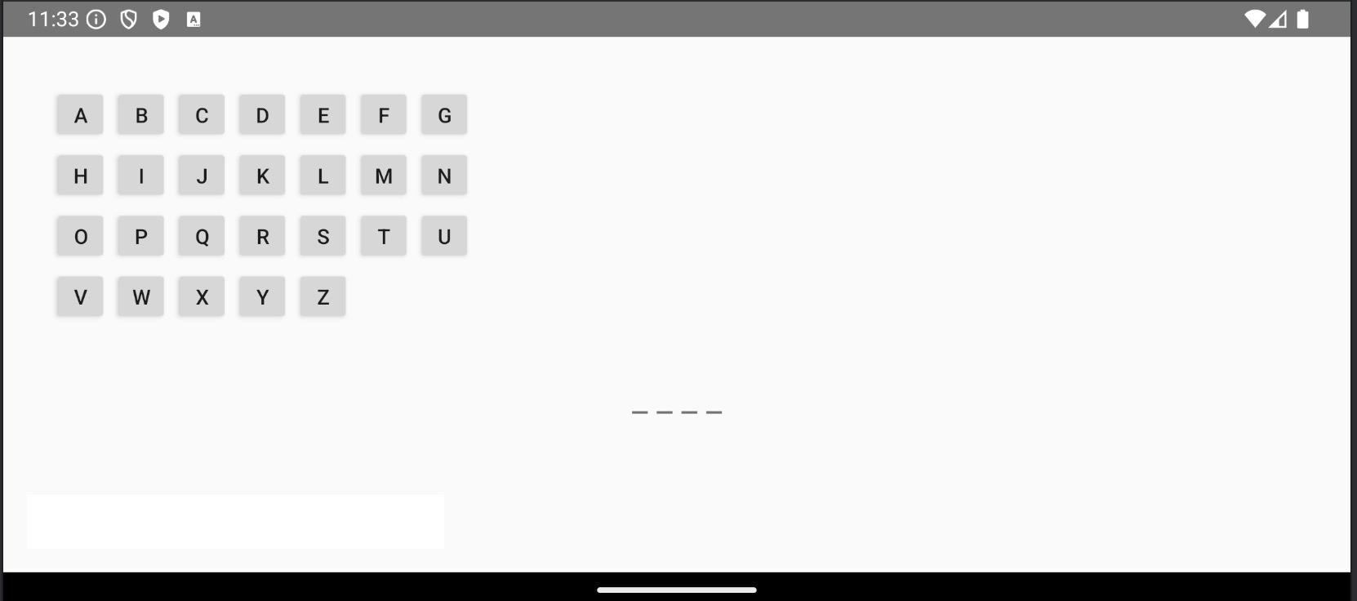

Slide 8
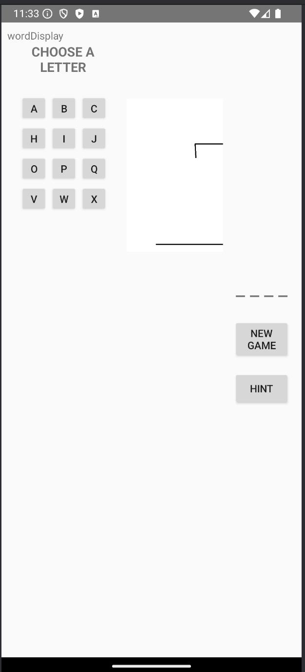
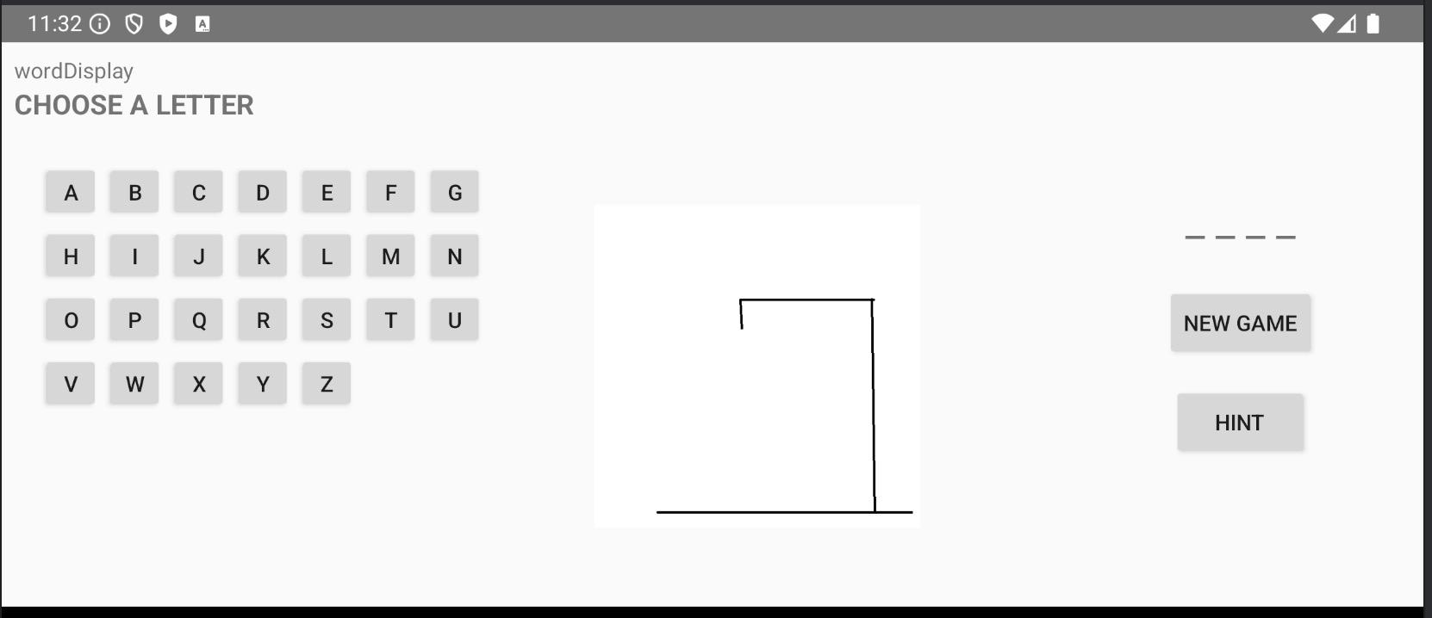
The app works fine when entering in both landscape and portrait modes.
But it cannot rotate!

Slide 9
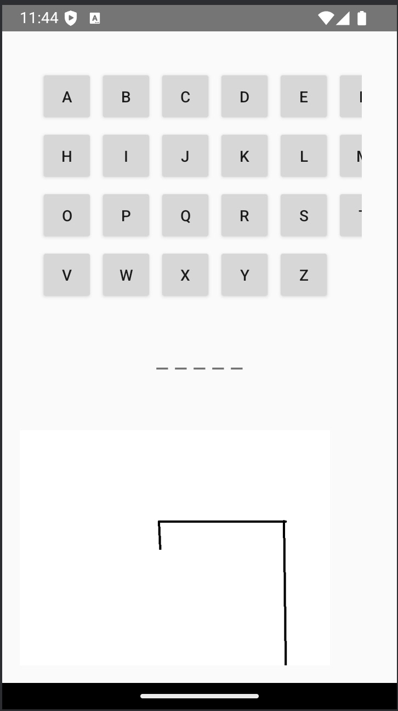
When the screen is very small, such as on a small phone, the fixed length of the components can cause layout issues due to insufficient space, leading to a disorganized layout.

Slide 10
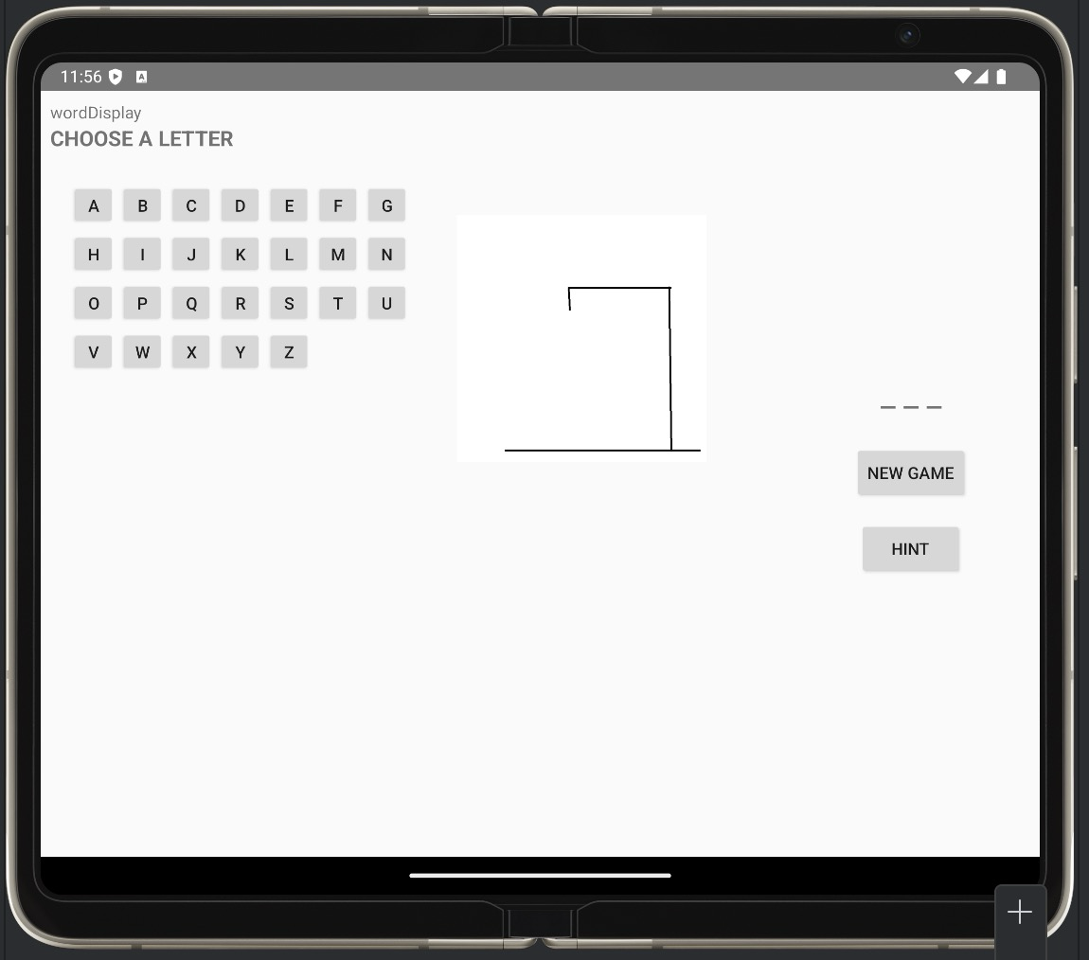
On the other hand, when the screen is too large, there will be a lot of empty space.

Slide 11
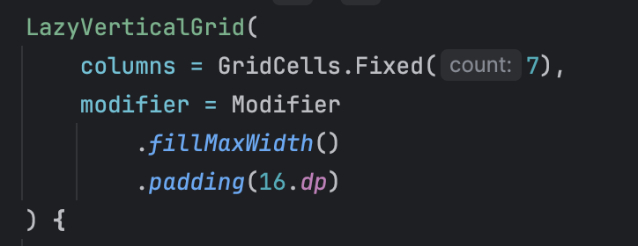
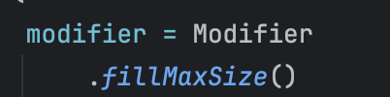
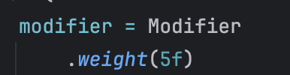
So in this app, we used separate layouts for portrait and landscape orientations, dynamically adjusting the UI based on the screen orientation.
For example, LocalConfiguration, LazyVerticalGrid, fillMaxSize(), and weight() help us dynamically design the layout of this app.

Slide 12
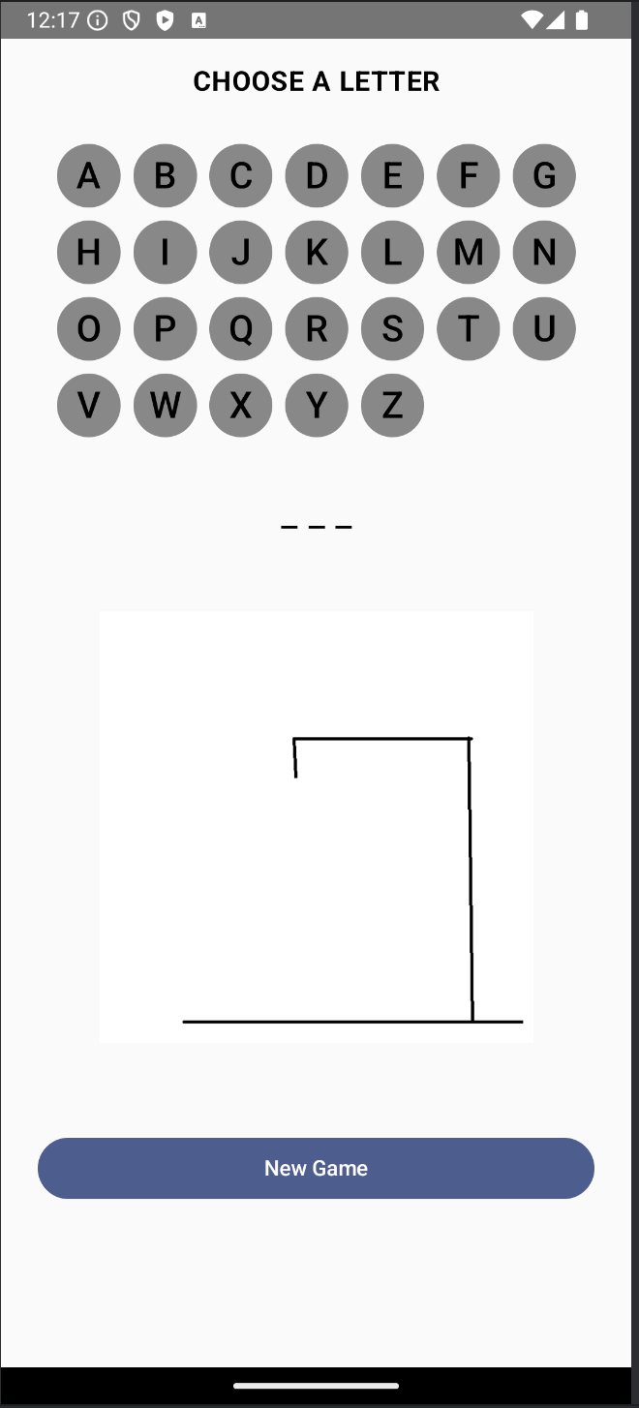
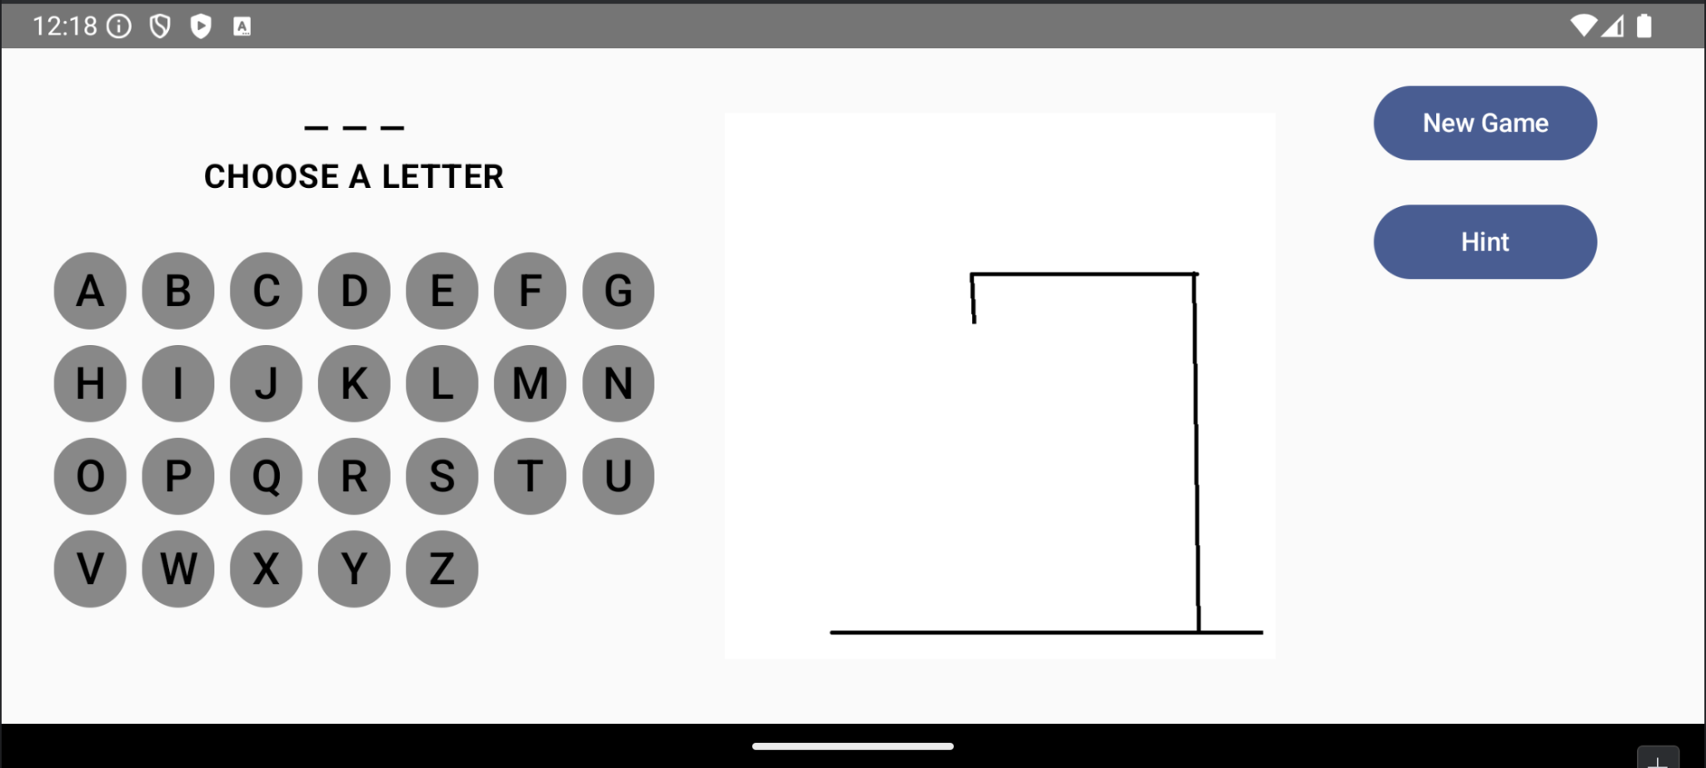

Slide 13
Real-world Example From
Google Play Store
After looking at our simple application, let's see how these apps switch screens and make full use of screen space in the real world.

Slide 14
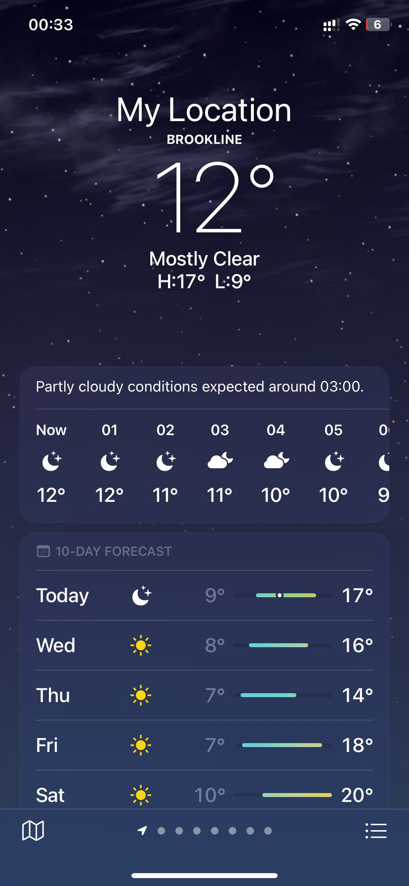
Take the Weather App as an example. It is a very mature app, so its interface design is also very well thought out. This is the layout when opening the app on a phone.

Slide 15
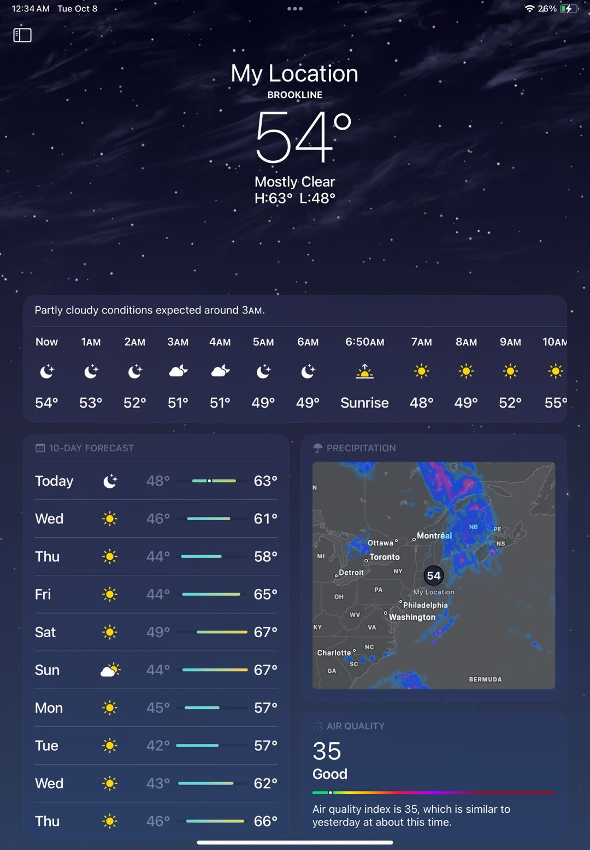
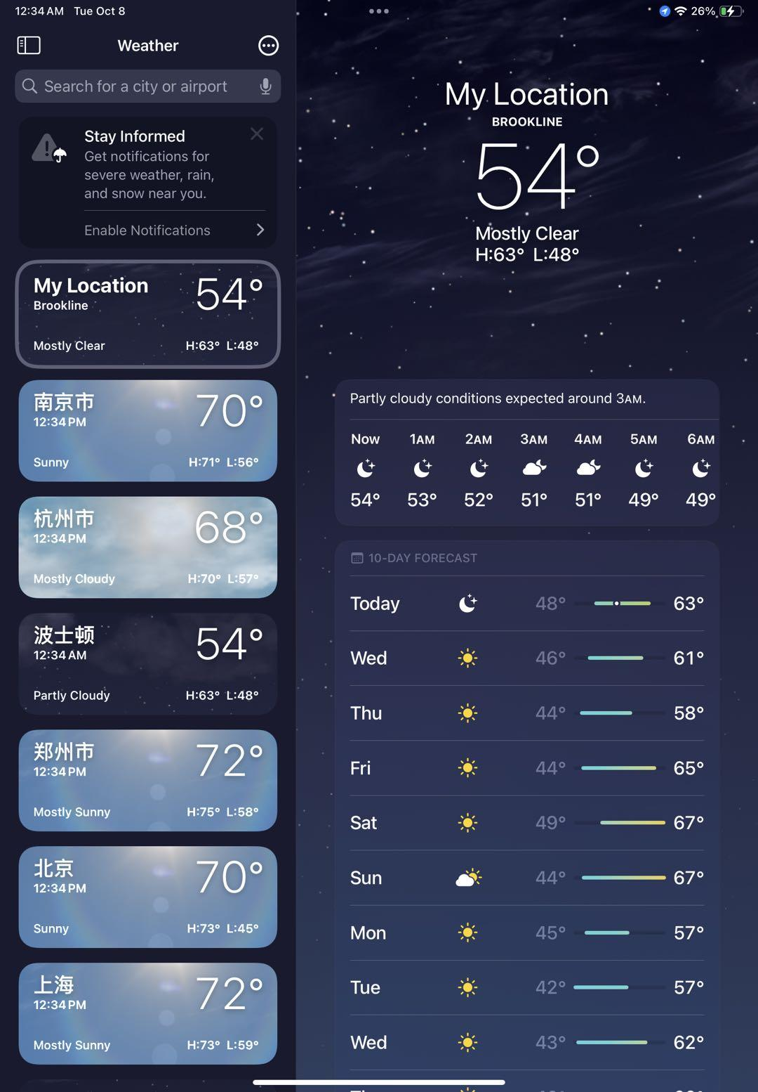
These are the layouts when opening the app on an ipad.
Notes:
We can see that the right side of this page is actually the same as on the phone, with just an added sidebar on the left.
When we click this button to hide the sidebar, the layout of the entire page changes accordingly to fit the screen: the weather forecast section becomes longer, and some new features are added.

Slide 16
Benefits of Responsive Design with Jetpack Compose
Efficiency: Single codebase adapts across devices.
Simplified Maintenance: Easier to manage UI changes compared to XML layouts.
Performance: Optimized for handling different device configurations.

Slide 17
Conclusion & Q&A
Summary: Responsive design is key for modern Android apps, and Jetpack Compose provides the necessary tools.

Slide 18
Thank You!

