Slide 1
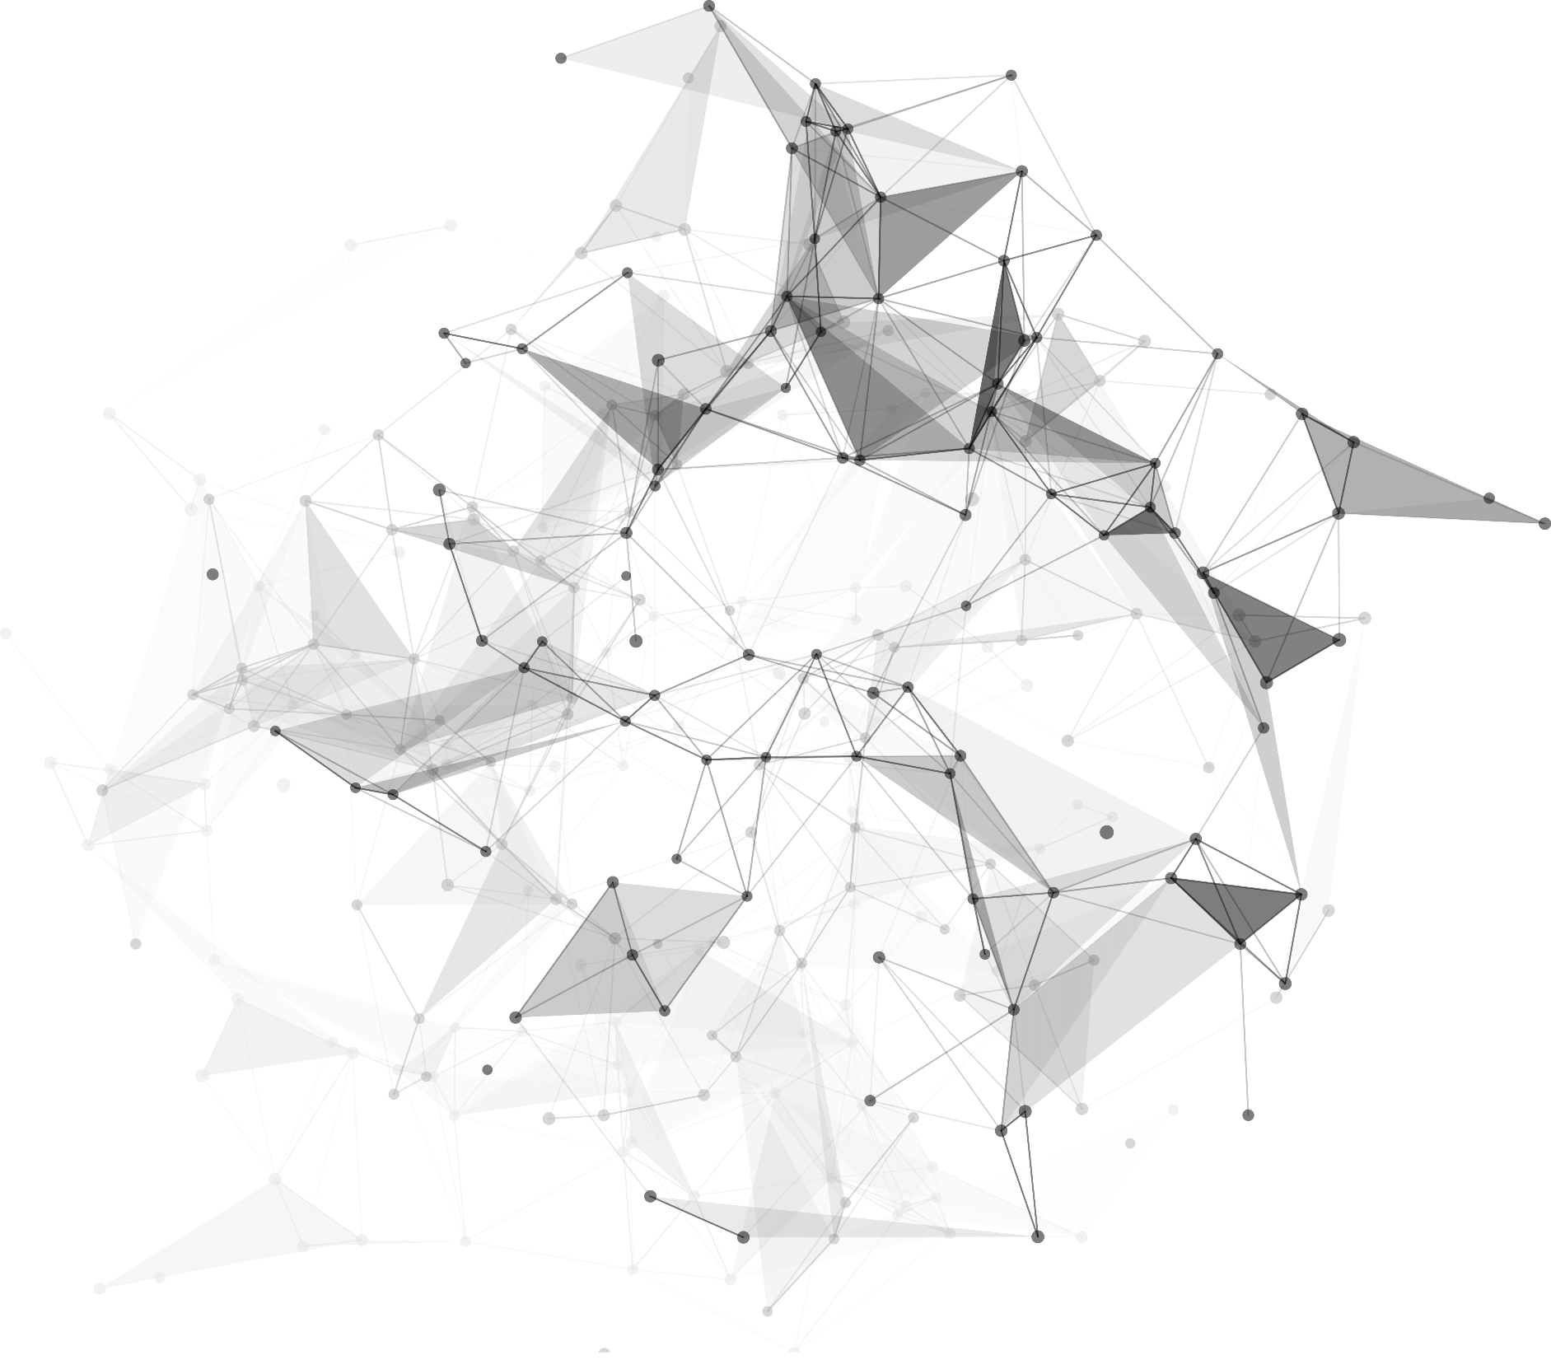
SUMMARY
Group 2
Qianyi Xue, Kejia Liu, Yuchen Ge, Longxin Wang
Breast cancer classification based on BreakHist dataset

Slide 2
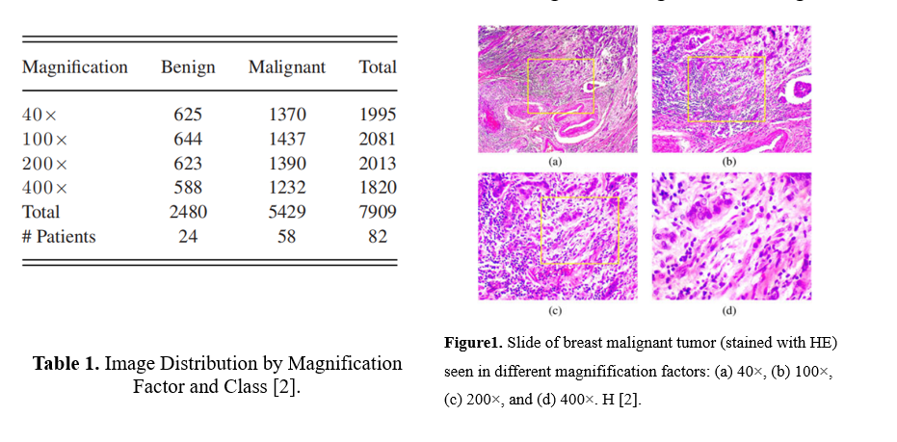
01
In women worldwide, breast cancer is the most common cancer and the second leading cause of cancer death (Boyle & Levin, 2008).
Data
Composed of 7909 microscopic images of breast tumor tissue with four magnification factors (40x, 100x, 200x, and 400x). Divided into two groups: benign and malignant.
Benign(4): adenosis, fibroadenoma, phyllodes tumor, and tubular adenoma.
Malignant(4): carcinoma, lobular carcinoma, mucinous carcinoma, and papillary carcinoma.
8 Classification issues

Slide 3
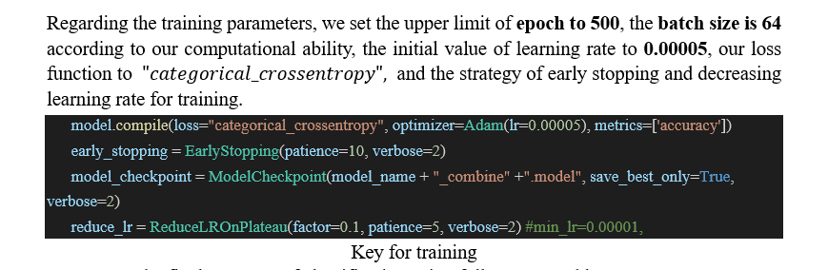
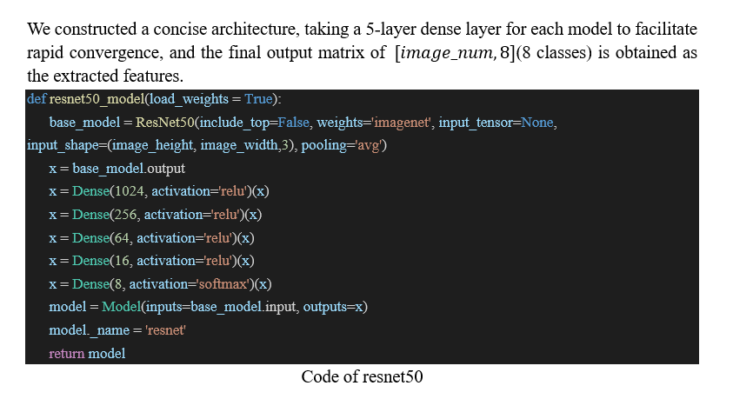
01
The overall approach is divided into 2 steps: extracting features from the images and building the classifier.
Model
Extracting Features : vgg16, vgg19, xception, resnet50, inception, inception_resnet
Classification: FC, LR, SVM,etc.

Slide 4
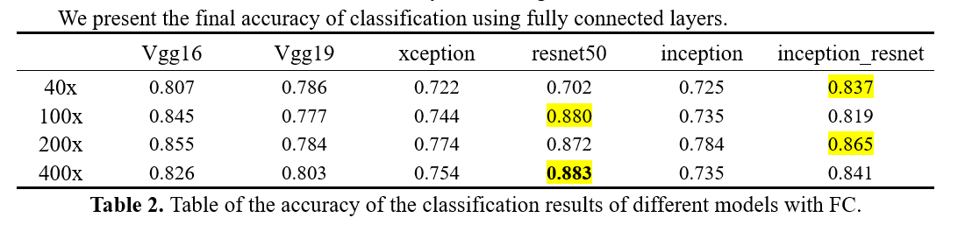
01
Result

Slide 5
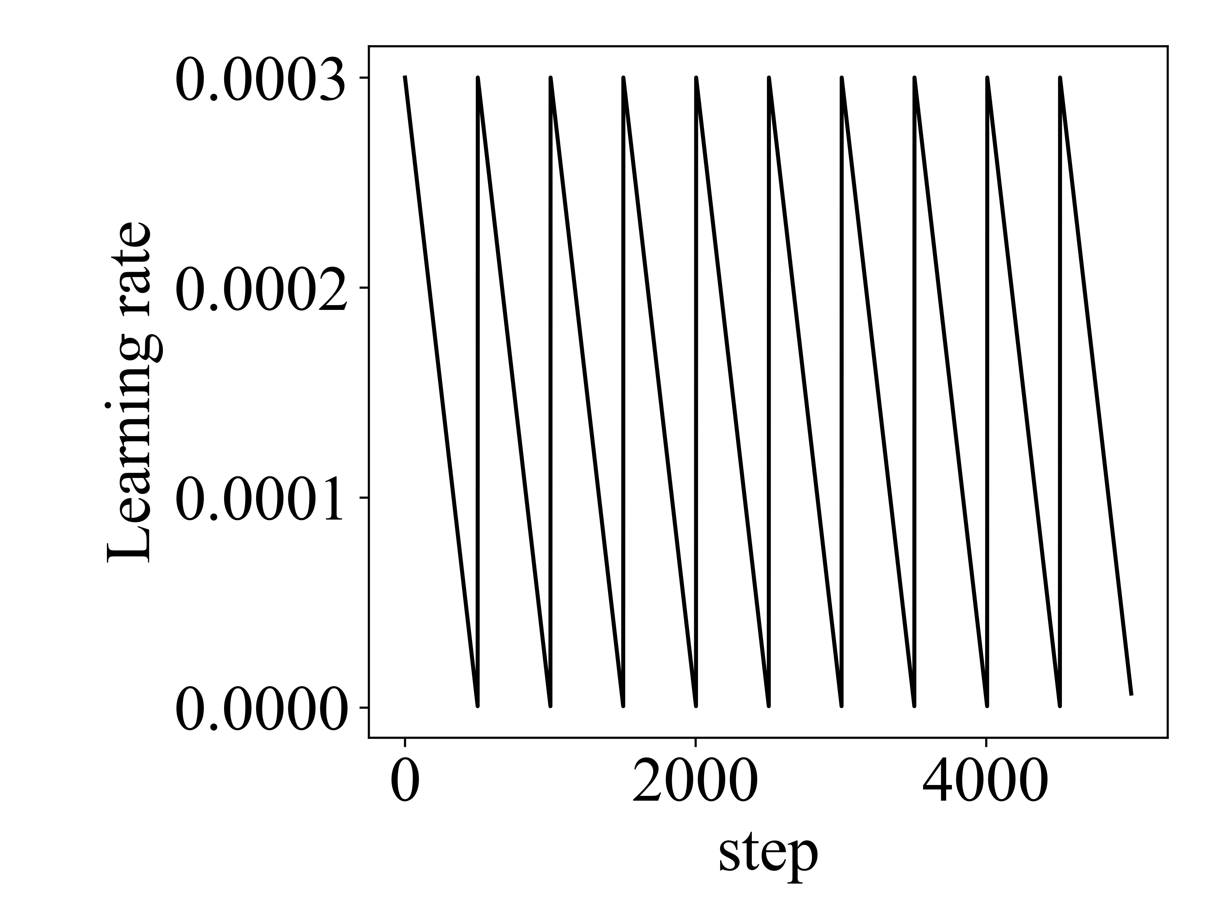
02
Tricks
Cyclic Learning Rate Decay
The learning rate is too large may cross the optimal value, and the learning rate is too small cannot converge for a long time. The basic idea of learning rate decay is that the learning rate decays gradually as the training progresses.
Adjusting the learning rate periodically may give better results.
Figure: Simulation training using CLR.

Slide 6
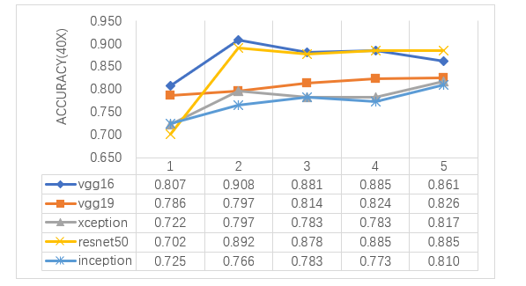
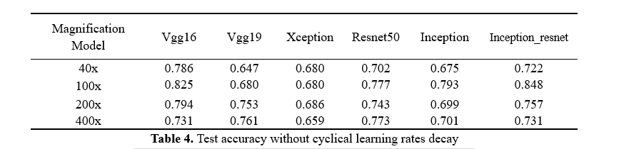
02
Cyclic Learning Rate Decay
Tricks
Comparison of cyclical learning rate decay and general learning rate decay
Figure: Results of 5 training sessions with different model cycles at 40x.
There is a slow increase.

Slide 7
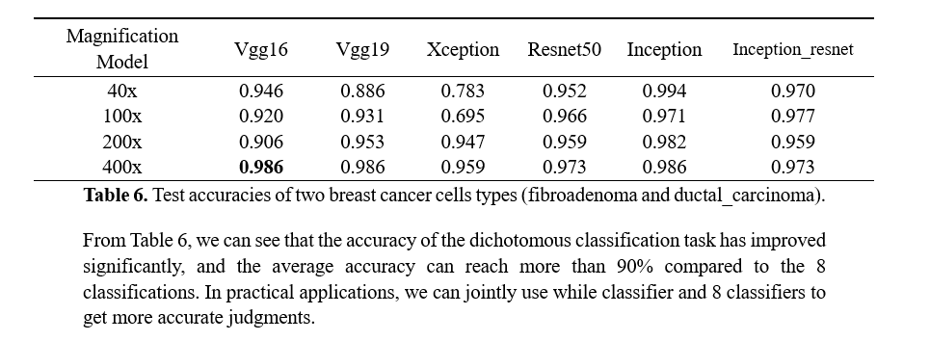
02
Tricks
Local optimal solutions for small data sets
We selected two of the eight types of breast cancer cells, benign selected for fibroadenoma and malignant selected for ductal_carcinoma.
These two breast cancers were selected because they represent a larger portion of the entire dataset and they are the representatives of the benign and malignant tumors correspondingly.

Slide 8
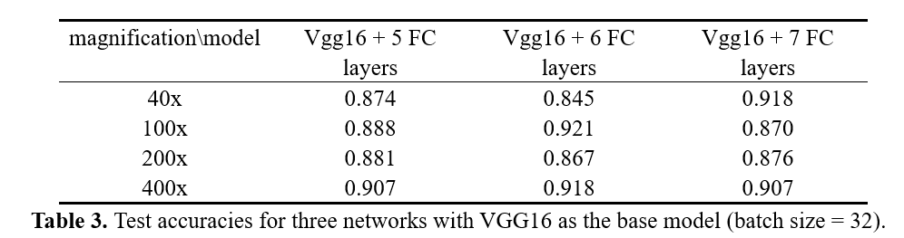
02
Tricks
Increasing the number of dense layers
Research by Krizhevsky et al. (2017) demonstrated that increasing the depth of the network is advantageous to extract more effective features and enhance the performance of the network.
More layers will help extract more features, which can be done up to a certain extent.
More layers = more parameters -> overfitting or need more data

Slide 9
02
Tricks
Replacing softmax with logistic regression
Since the softmax classifier is more suitable for datasets with more inter-class mutual exclusivity and less overlap, in the case of low similarity of features that cannot be model extracted, we guess that using LR classifier will give better results.

Slide 10
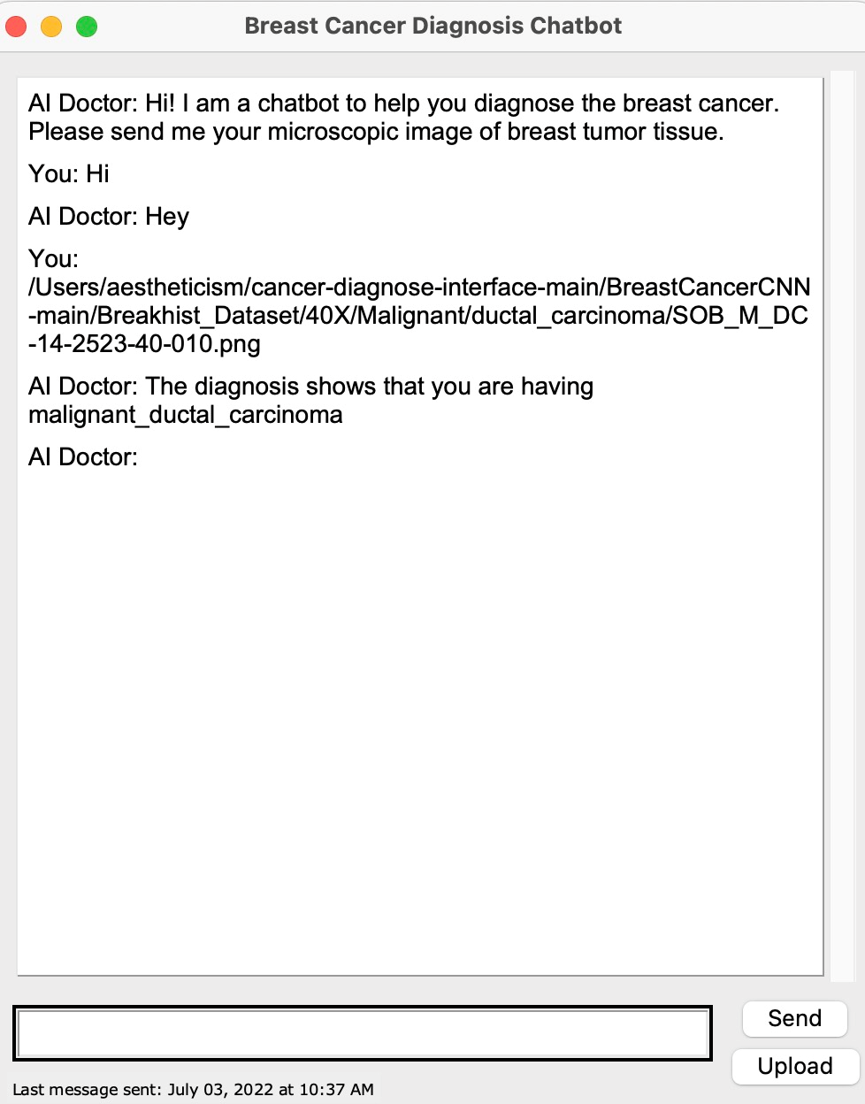
03
Generate the model.h5
Interface
Save the trained models’ architectures in trained.py
Transfer parameters into train.py through model.h5
Model works and predicts
Display

Slide 11
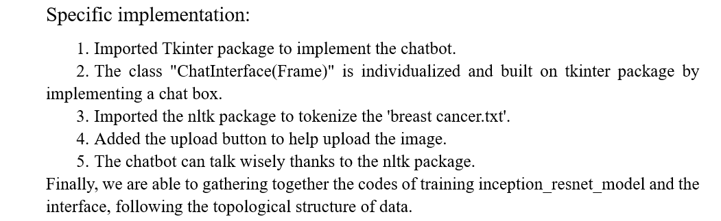
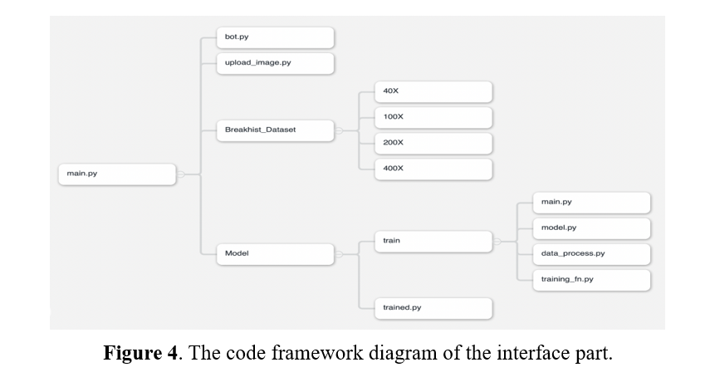
03
Interface

Slide 12
04
Discussion
The accuracy we obtained so far is between 80%-90%, and we still have a lot of room for improvement in training and model building for this dataset, and the previous methods and accuracy rates using this dataset are listed in the next page. In the future, we can build classification models using more powerful classifiers such as SVM, RF and XGBOOST. We can also make a deeper use of CLR in the tuning of learning rates. We should make greater use of models and datasets for more effective training.

Slide 13
04
Achievements in this dataset (Literature Review)
Author(s) | Methodology | Dataset | Accuracy (in %)
Spanhol et al.(2015) | • Feature Extraction: using LBP, CLBP, LPQ, GLCM, PFTAS and ORB. • Classification: 1-NN, QDA, SVM, and RF | BreaKHis | 80%-85%
Spanhol et al.(2016) | • Pre-trained CNN Models: LeNet and AlexNet CNN | BreaKHis | 80.8%-85.6%.
Bayramoglu et al.(2016) | • Proposed two CNN models: • Single task CNN: for predicting the malignancy. • Multi-task CNN: for predicting malignancy and image magnification levels | BreaKHis | 80.6%-83.3%.
Spanhol et al.(2017) | • Extracted deep features (DeCAF): using pretrained CaffeNet. | BreaKHis | 83.6%-84.8%.
Sudharshan et al(2019) | • Proposed MIL based approach: APR, KNN, DD, SVM, non-parametric algorithm and MIL-CNN | BreaKHis | 83.4%-92.1%.
Gour et al.(2020) | • Developed a deep residual convolutional neural network (ResHist) for breast cancer diagnosis. • Proposed a data augmentation technique. | BreaKHis | 84.34%-92.52%
Dabeer et al(2019) | • 7009 images from BreakHis database is used. Images captured are distributed into 4 magnification levels. | BreaKHis | 99.86%
Bardou et al.(2018) | • 25% of the training data is used for cross validation. • A 5 CNN layer topology with 3*3 filters and 2 fully connected layers is employed to classify the dataset. • RELU layer is also applied. | BreaKHis | 96.15% and 98.33% for the binary classification. 83.31% and 88.23% for multi-class classification.

Slide 14
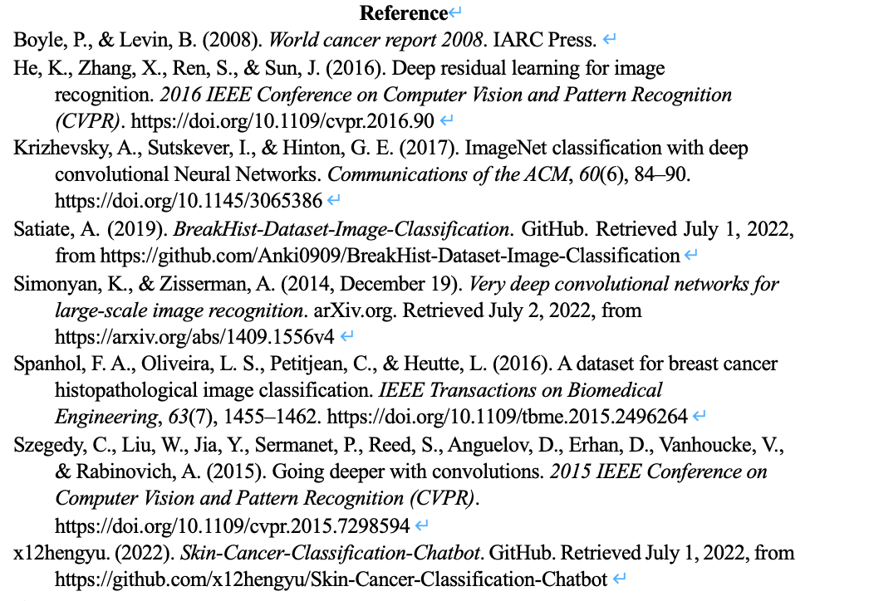
05

Slide 15
Thank You
.
.
.

