Slide 1
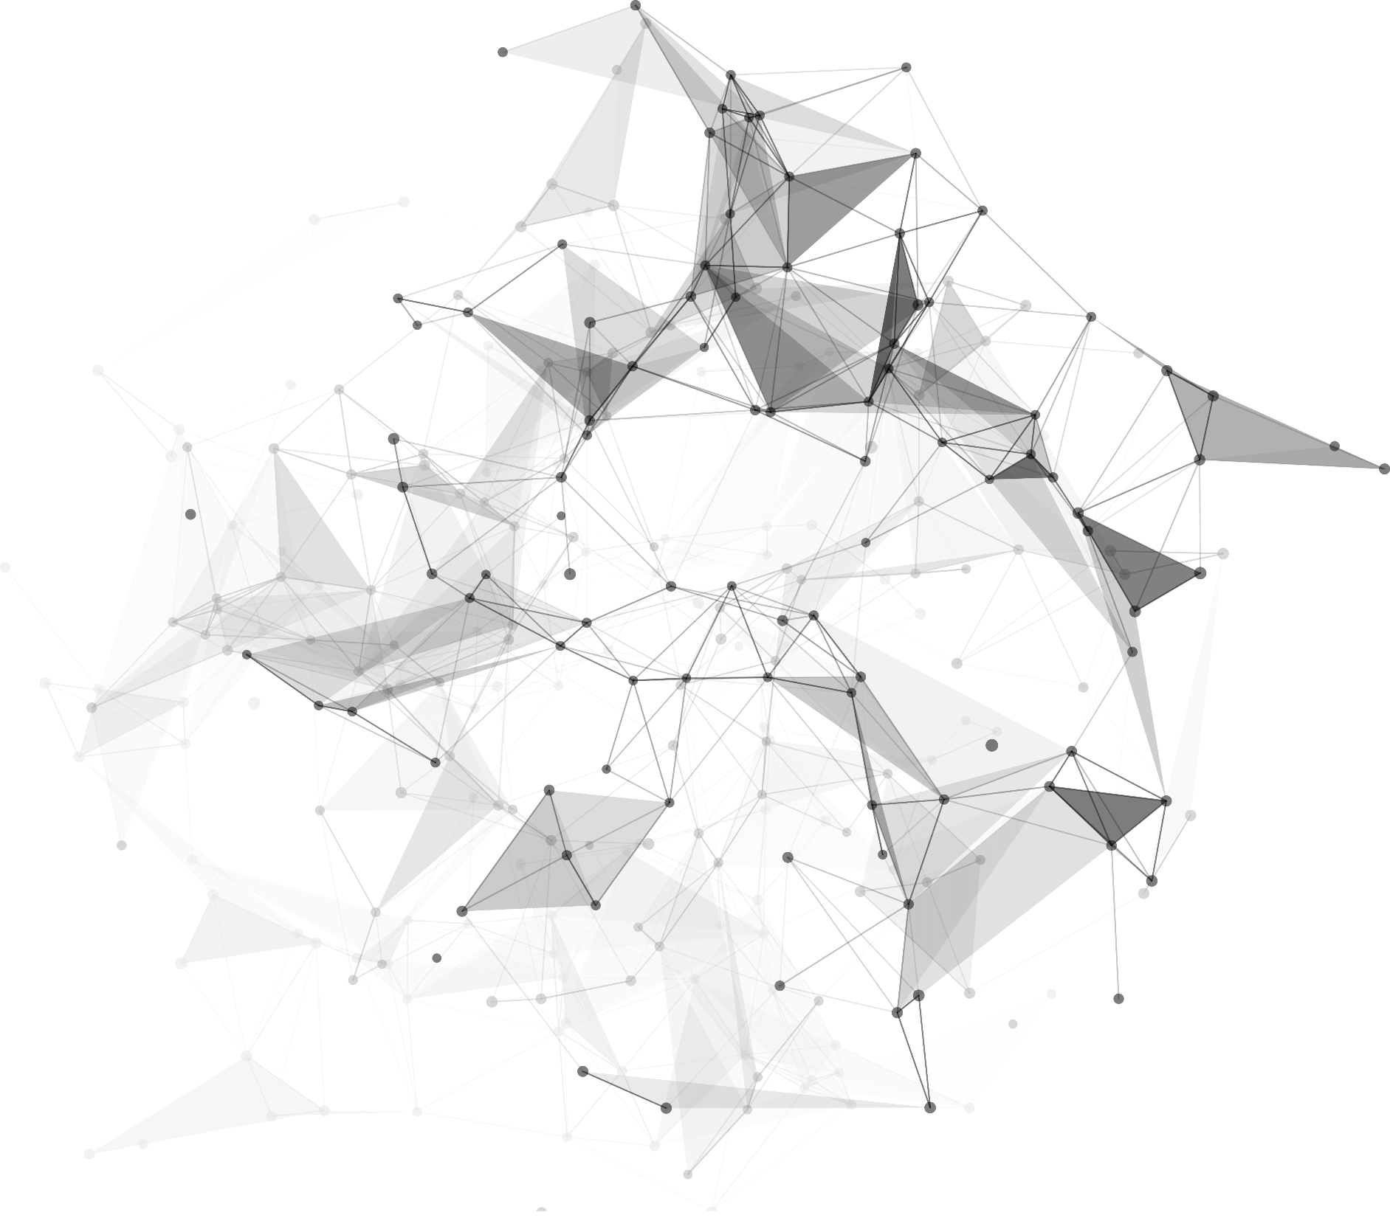
Implementation
Group 2
Qianyi Xue, Kejia Liu, Yuchen Ge, Longxin Wang

Slide 2
1
Code & Results

Slide 3
01
Goal
Image recognition was performed on the BreakHist[1] dataset(We got it by mail), classified as benign and malignant, and the results were compared using the following models:
CNN, vgg16, vgg19, xception, resnet50, inception, inception_resnet
Evaluation indicators:
Accuracy, F1-score, val_loss, test_loss
Finally, it is displayed in the chatbox interface.
[1] F. A. Spanhol, L. S. Oliveira, C. Petitjean and L. Heutte, "A Dataset for Breast Cancer Histopathological Image Classification," in IEEE Transactions on Biomedical Engineering, vol. 63, no. 7, pp. 1455-1462, July 2016, doi: 10.1109/TBME.2015.2496264.

Slide 4
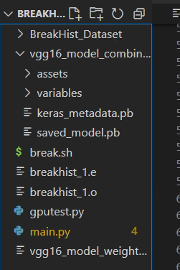
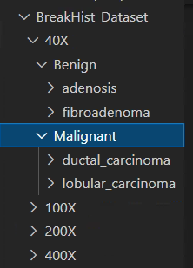
01
model
COMPANY
log
Main.py
Code Structure
Dataset

Slide 5
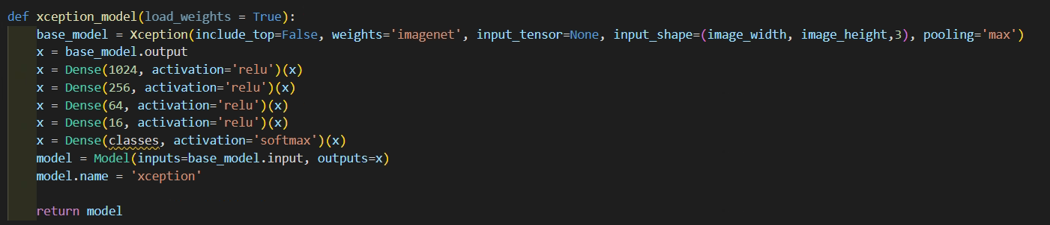
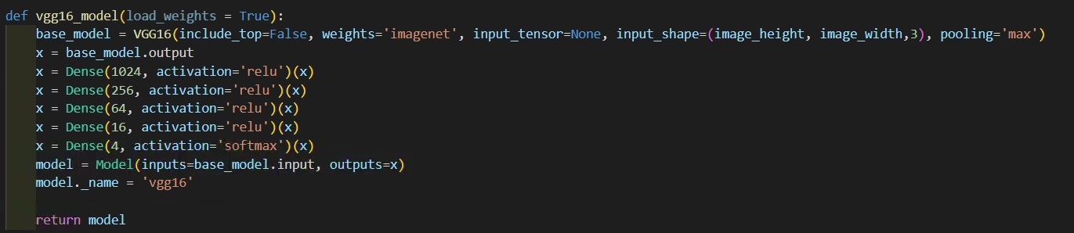
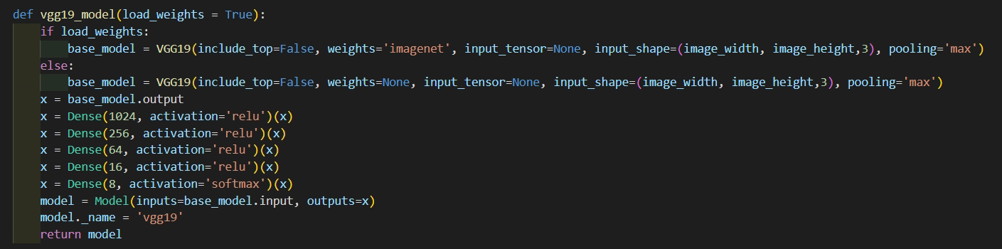
01

Slide 6
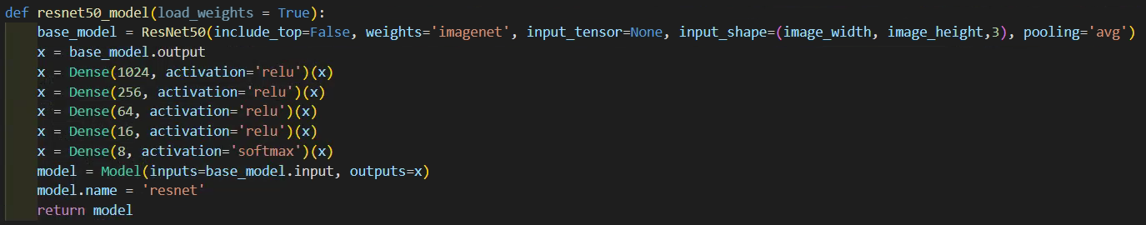
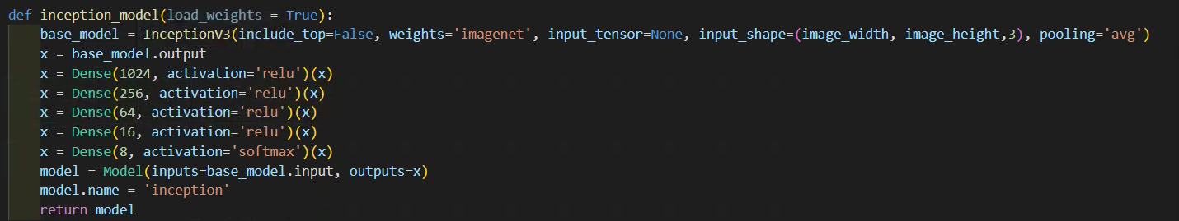
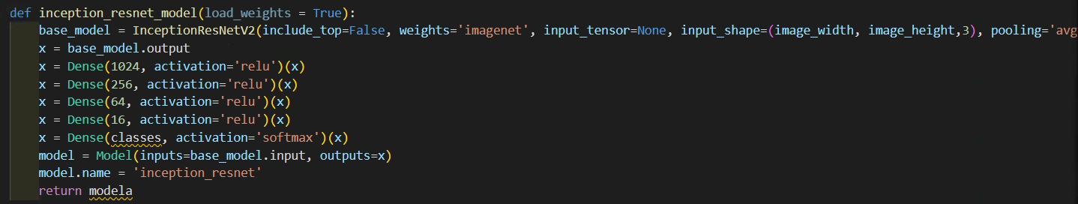
01

Slide 7
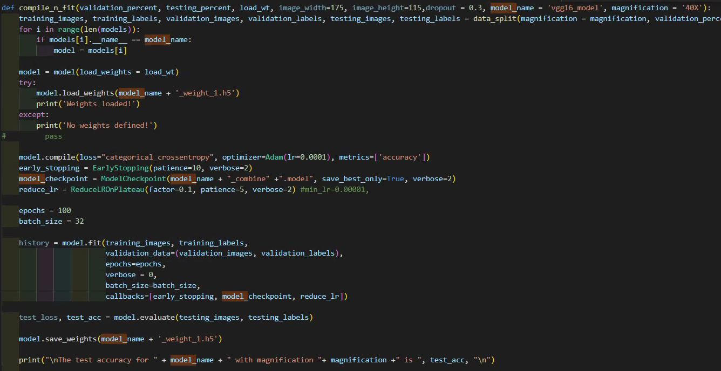
01

Slide 8
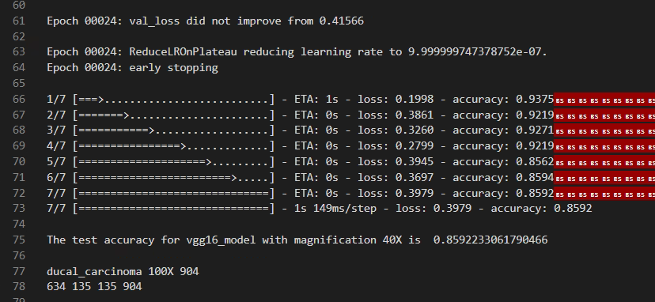
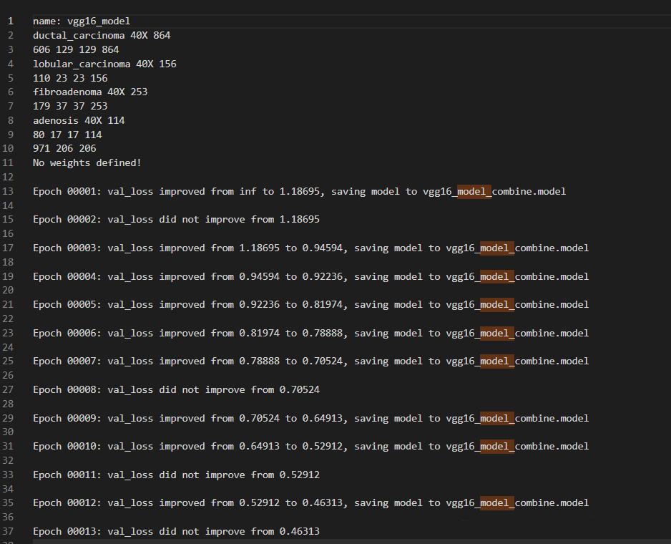
01
Training Log
Dataset Size
training set: validation set: test set = 7:1.5:1.5
Example: vgg16 40X
Due to time reasons, we have not run all the models and are still training them.

Slide 9
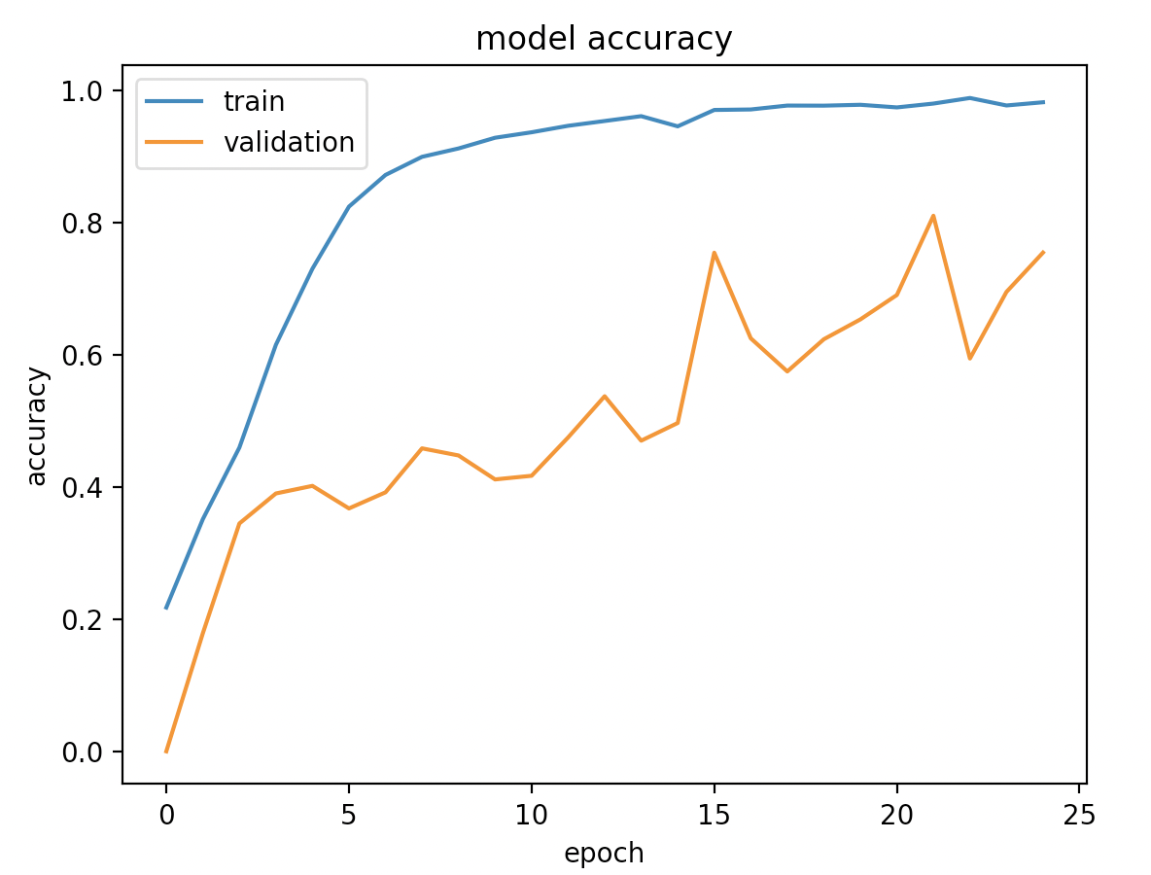
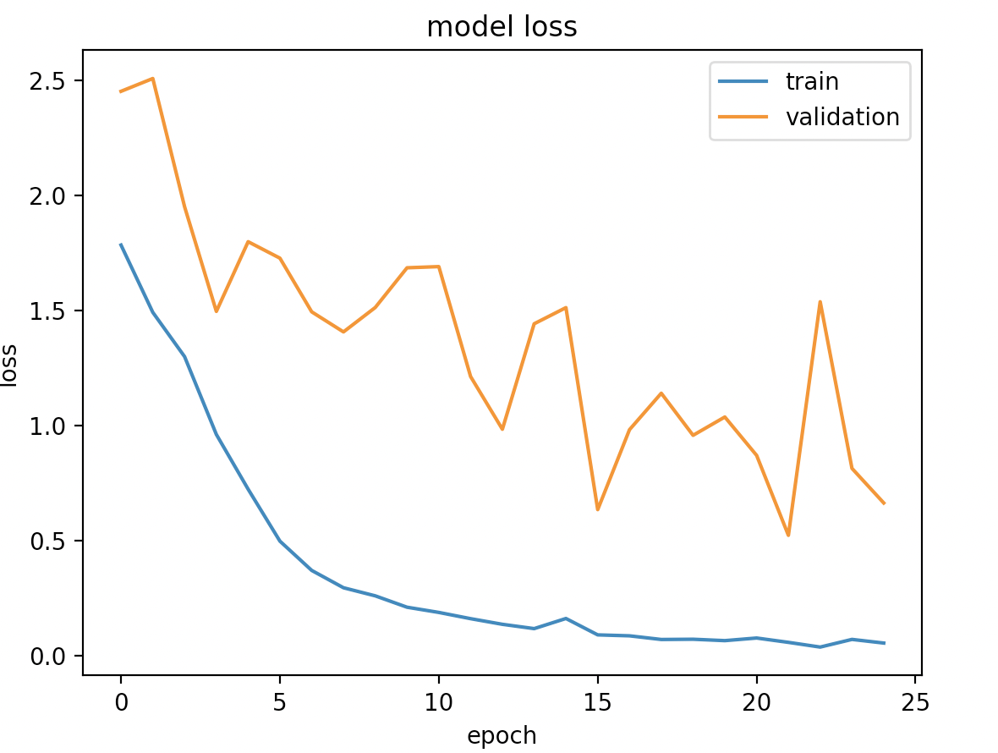
01
Vgg_19 Result

Slide 10
2
Part 02
Interface

Slide 11
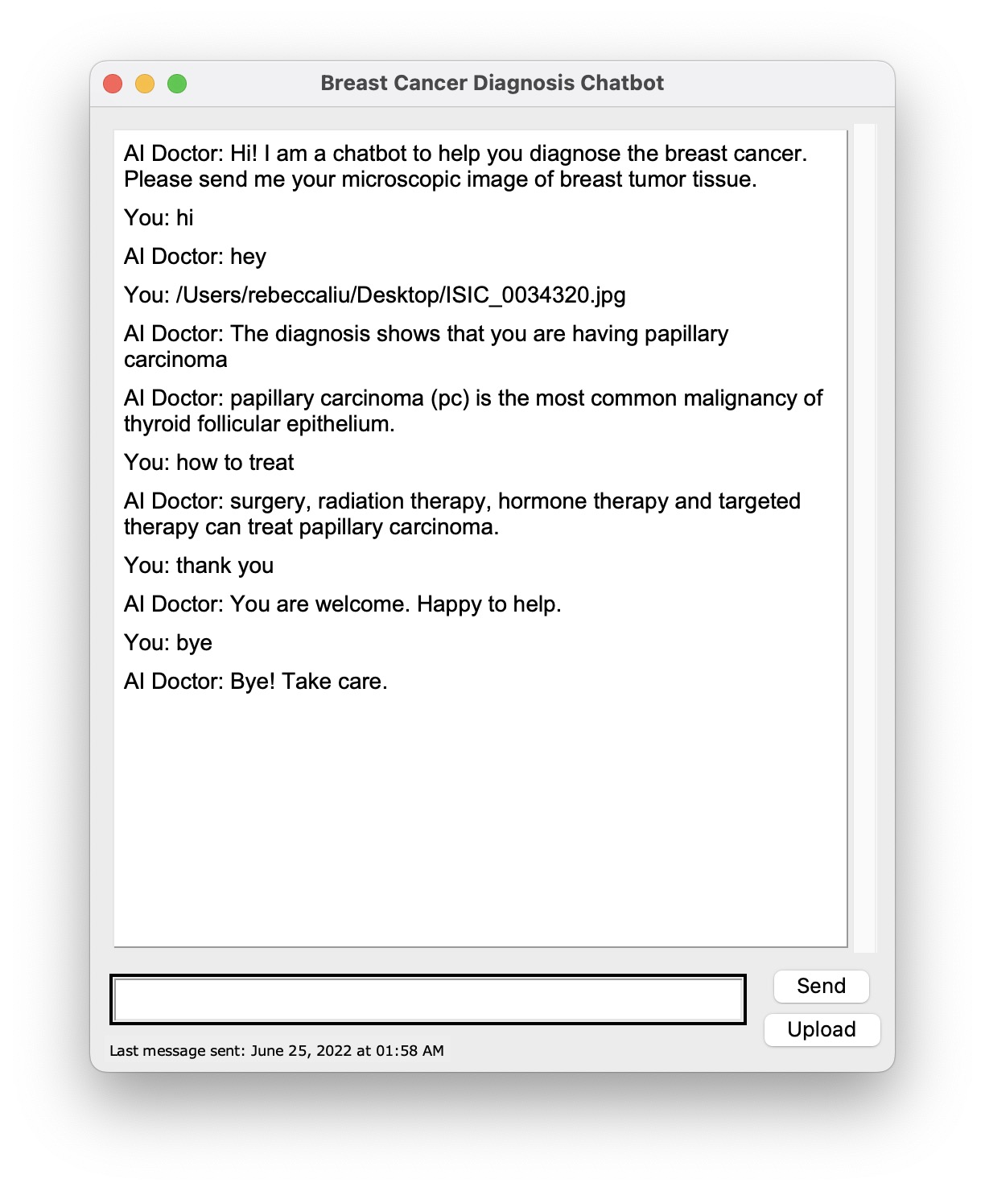
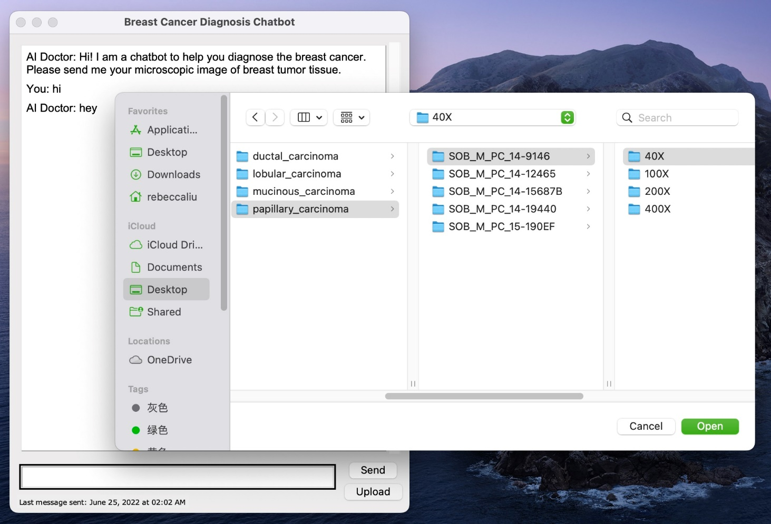
02
Auto-reply content:
Greet hello~
Ask about the type of breast cancer
How to treat it?
Upload Functionality

Slide 12
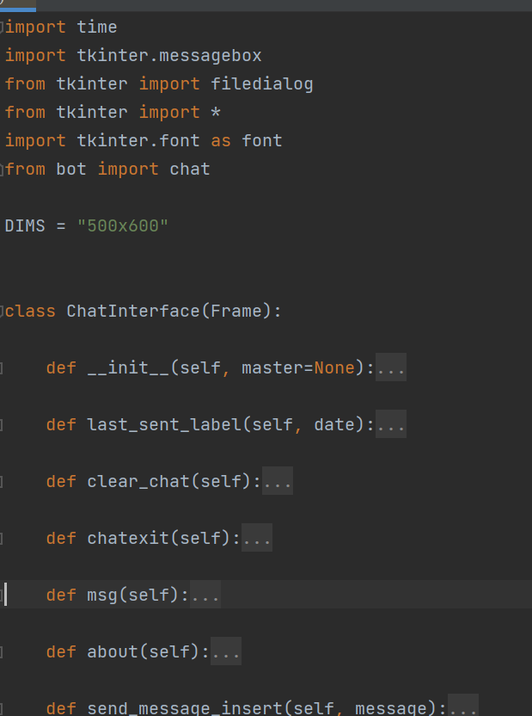
02
Building GUI interfaces with tkinter
Main.py
interface
Bot.py
breast cancer.txt
Main.py---Build the main interface

Slide 13
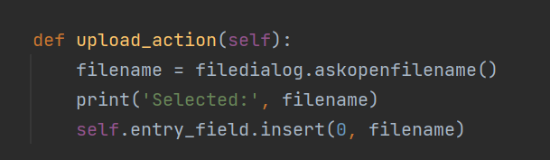
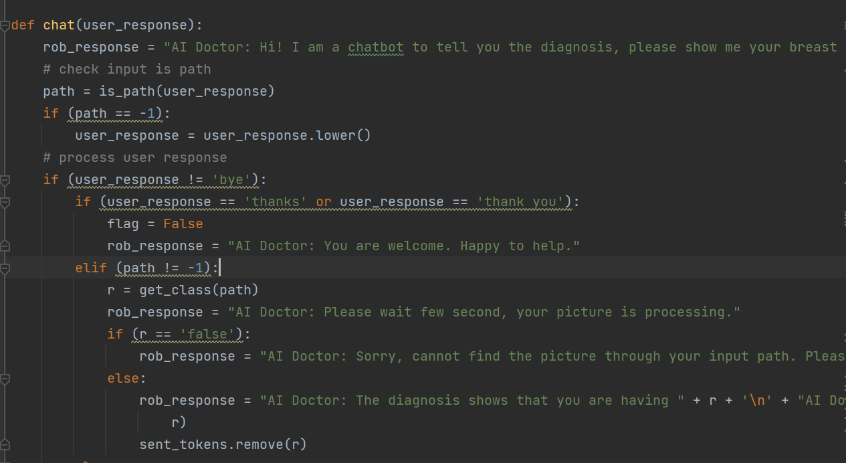
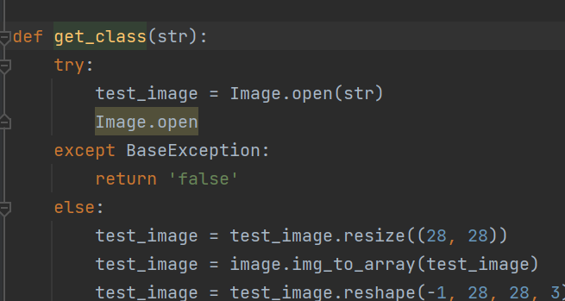
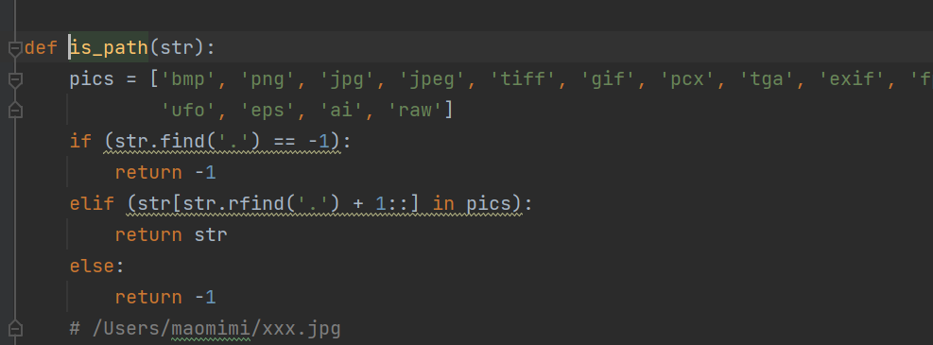
02
User input path
Determine whether it is a legal path
Exception Handling/Open Image

Slide 14
Thank You
.
.
.

