Slide 1



AutoLRS: Automatic Learning-Rate Schedule by Bayesian Optimization on the Fly
Yuchen Jin, Tianyi Zhou, Liangyu Zhao, Yibo Zhu, Chuanxiong Guo, Marco Canini, Arvind Krishnamurthy

Slide 2
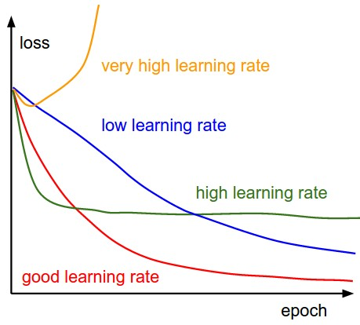
Learning rate (LR)
Learning rate is a parameter that determines the step size at each iteration of the optimization problem.
The success of training DNNs largely depends on the LR schedule.
[Stanford CS231n]

Slide 3
Tuning the learning rate (LR) schedule is non-trivial
Widely-used tuning strategies:
Pre-defined LR schedules
Limited number of choices, e.g., step decay & cosine decay
Optimization methods with adaptive LR (such as Adam and AdaDelta)
Still require a global learning rate schedule: Adam's default LR performs poorly in training BERT and Transformer
Both strategies introduce new hyper-parameters that have to be tuned separately for different tasks, datasets, and batch sizes.

Slide 4
Can we automatically tune the LR over the course of training without human involvement?

Slide 5
AutoLRS
“training stage”
Coarse-grained approach: determining a constant LR for every τ steps
LR
Which LR can minimize the validation loss for the next stage?
τ 2τ 3τ 4τ 5τ 6τ 7τ
Step

Slide 6
AutoLRS
Bayesian optimization (BO)
Treat the validation loss w.r.t. LR as a black-box function.
BO would require τ training steps to measure the validation loss associated with every LR η it explores. → Computationally expensive
Exponential forecasting model
For each LR η that BO explores, we only apply it for τ’ << τ steps and use the validation loss observed in the τ’ steps to train a time-series forecasting model.

Slide 7
Search for the LR at the beginning of each stage
LR to explore η
loss series y_{1:} _{τ’}
BO
Exponential model
DNN
train with η for τ’ steps
best LR η*
DNN
Predicted loss in τ steps
train with η* for τ steps
Each LR evaluation during BO starts at the same model parameter checkpoint
τ’ = τ/10; BO explores 10 LRs in each stage
→ steps spent to find the LR
= steps spent on training the model with the identified LR.

Slide 8
Experiments
Models: ResNet-50, Transformer, BERT Pre-training
Baselines:
LR schedule adopted in each model’s original paper
Highly hand-tuned Cyclical Learning Rate (CLR) ^{[1]}
Highly hand-tuned Stochastic Gradient Descent with Warm Restarts (SGDR) ^{[2]}
[1] Leslie N Smith. Cyclical learning rates for training neural networks. WACV’17.
[2] Ilya Loshchilov and Frank Hutter. SGDR: stochastic gradient descent with warm restarts. ICLR’17.

Slide 9
ResNet-50
1.22× faster convergence
LR schedules
Top-1 Accuracy

Slide 10
Transformer
1.43× faster convergence
LR schedules
BLEU

Slide 11
BERT
Training loss in Phase 1
1.5× faster convergence
LR schedules (Phase 1 + 2)
Training loss in Phase 2

Slide 12
AutoLRS Summary
➔ Aid ML practitioners with automatic and efficient LR schedule search for the DNNs
We perform LR search for each training stage and solve it by Bayesian optimization.
We train a light-weight exponential forecasting model from the training dynamics of BO exploration.
AutoLRS achieves a speedup of 1.22x, 1.43x, and 1.5x on training ResNet-50, Transformer, and BERT compared to their highly hand-tuned LR schedules.
Give it a try: https://github.com/YuchenJin/autolrs

